Slide 1
week coordination report 15/06/2018
Fulvio Tessarotto
INFN Trieste

Slide 2
no MD

Slide 3
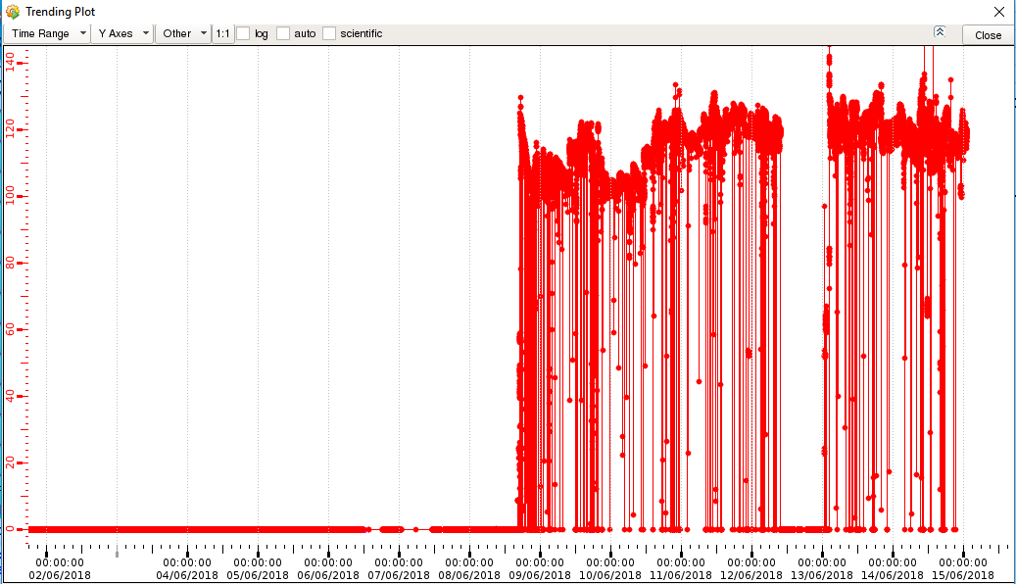
SPS beam intensity on T6
previous week
my week

Slide 4
Summary: reasonable week
No big safety problems
No major disasters
No epic failures
No general power cut
No polarization loss
No flood
…
Only few major problems
Mostly normal data taking

Slide 5
Main problems:
Low beam intensity and beam instability on weekend
Straw CATCH problem on Sunday
MP missing regions or reload failure
Jura Norma-bar power cut on Wednesday (Straw)
Several CAEN HV crate failures (SY527 failure on Wednesday)
MWPC PS01V1 F/E card intermittent
Pixel MM occupancy variations: inefficiency and noise
RICH WALL F/E card
Some GEM occupancy problems

Slide 6
Friday, June 8th
No beam until 16:30
11:30 Beam line magnets on, with new values:
B8 at 420 A (was 454 A), B9 at -291.5 A (was -250 A)
12:30 PT going to frozen spin mode (P: +78.10,-79.65)
12:50 SM1 and SM2 on; failure of QUAD27
15:50 LN2 buffer dewar in pump-room filled;
17:46 set 500 mm target, data taking started

Slide 7
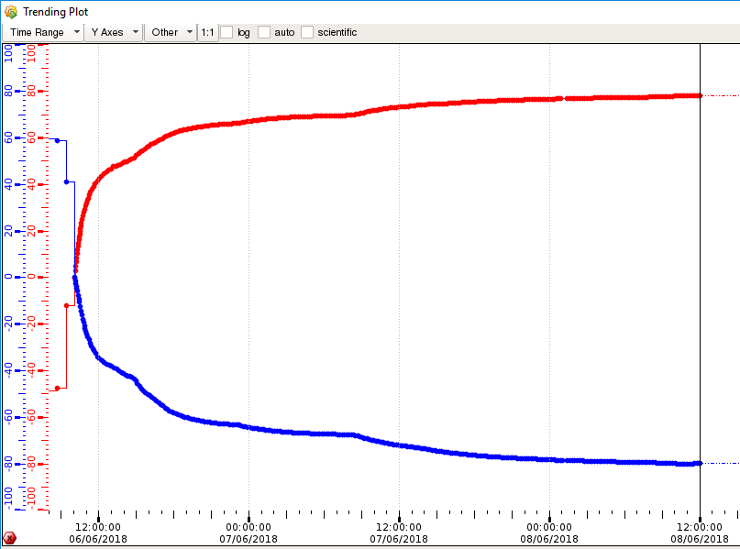
Good starting values for the target polarization
P+ = 78.10
P- = -79.65

Slide 8
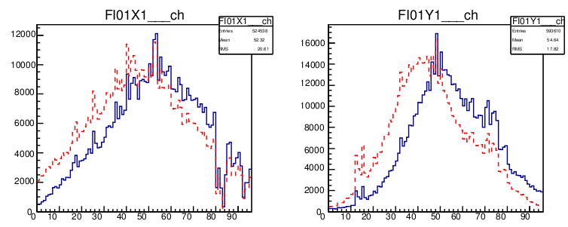
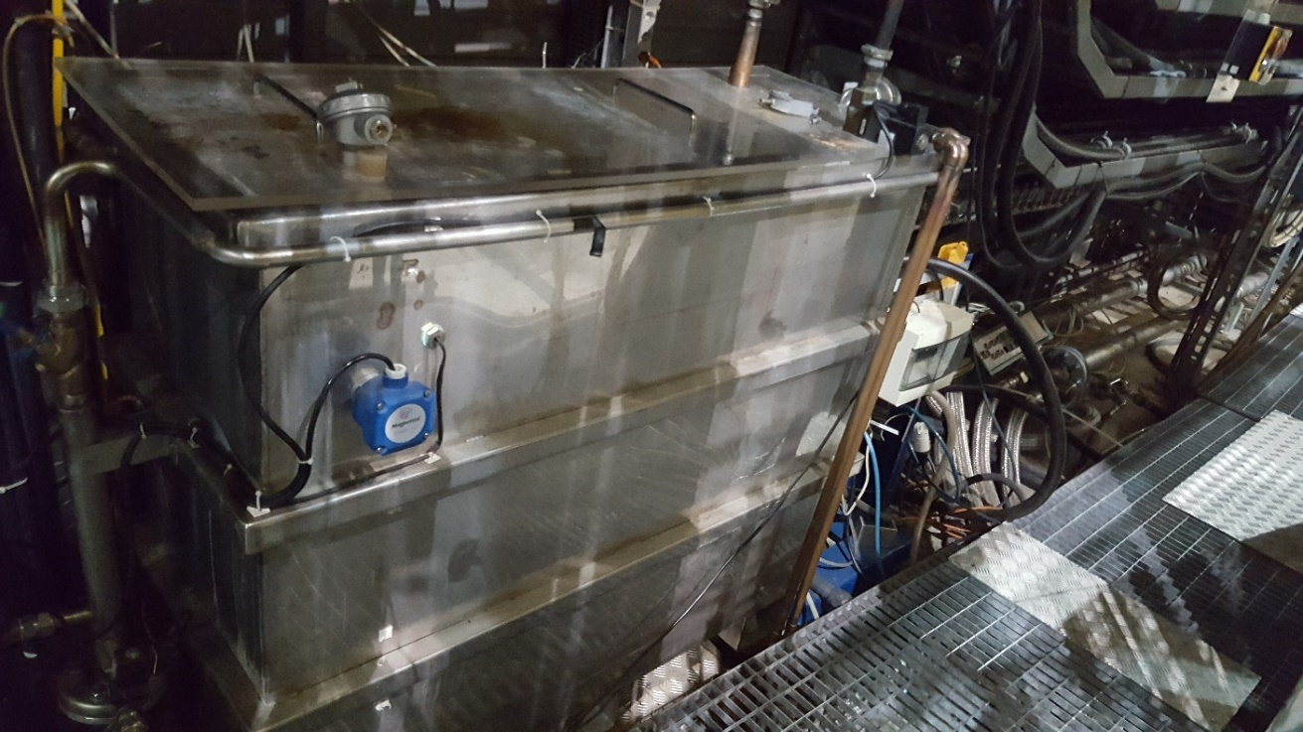
Change of beam position as seen by SciFi01
Straw, DC cooling
DC frame T increase,
due to water cooling system problem
20:06 → access for fixing it (Vincent)

Slide 9
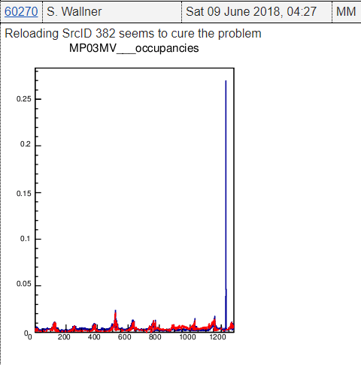
Saturday, June 9th
01:14 Straw HV trip 3Y1_DL07, related to beam spike (at end of spill)
04:30 Pixel MM: srcID LOAD –A 380 fails.

Slide 10
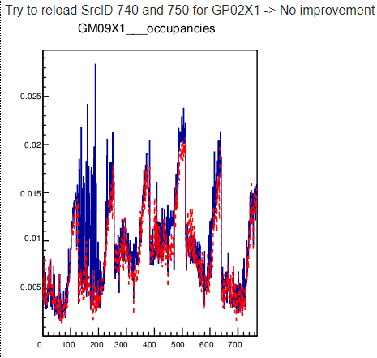
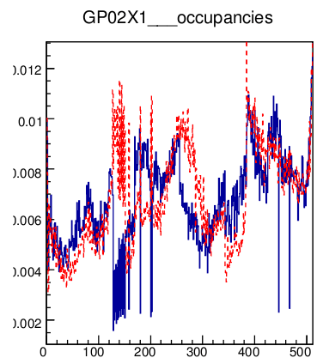
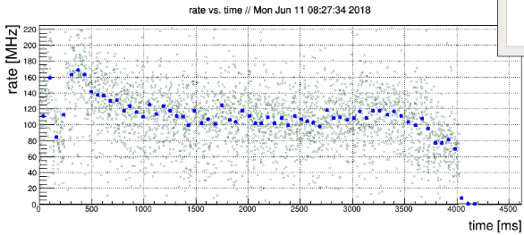
GEM
Spill profile problem

Slide 11
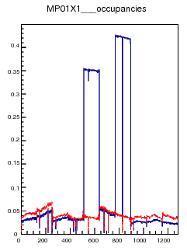
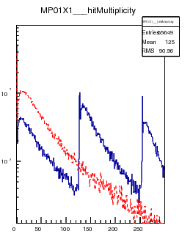
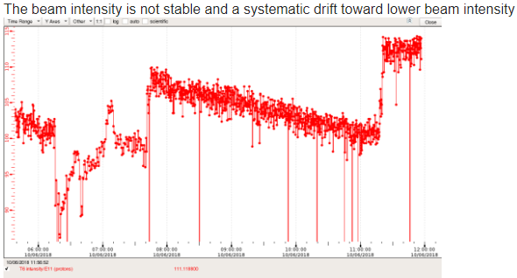
Sunday, June 10th
low beam intensity, smooth data taking
RICH WALL problem MP pathologies.

Slide 12
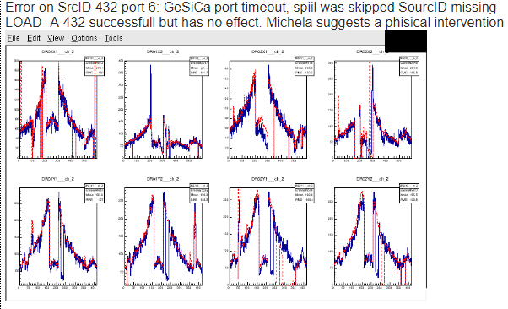

Slide 13
Monday, June 11th
Straws: CATCH problem → access and unplugging catch module
Straw trip, possibly related to beam spike (at end of spill)
HV crates turned off by themselves:
During run 283649 HV crate for H1 and RICH turned off → put back on
During run 283650 HV crate for DC01 and MM off → put back on
Bad spill shape (spikes at end of spill or at beginning of spill):
CCC called → extraction improved
DCS communication problem → crate restarted

Slide 14
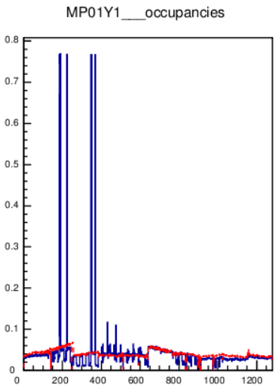
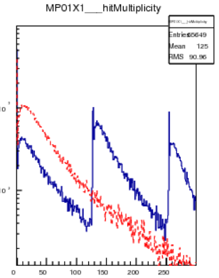
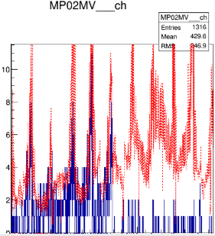
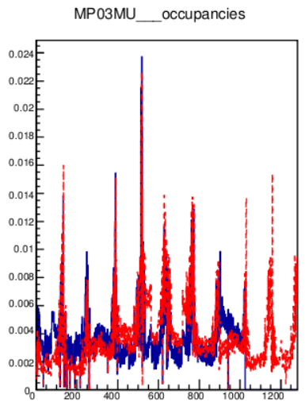
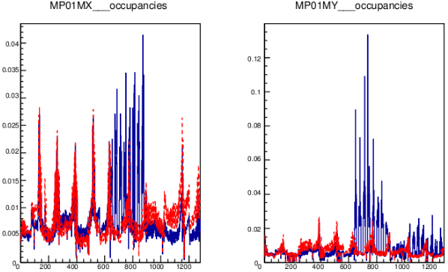
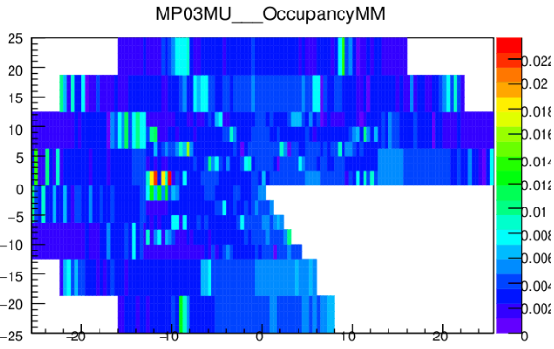

Slide 15
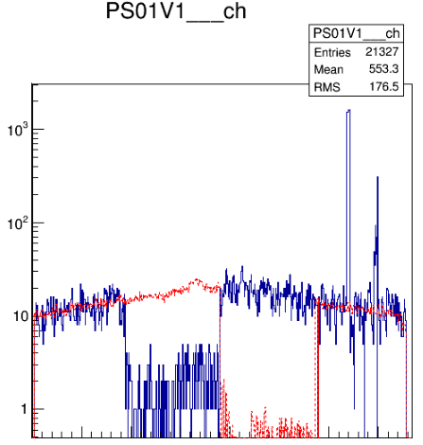
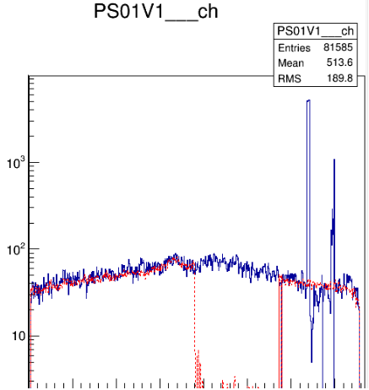

Slide 16
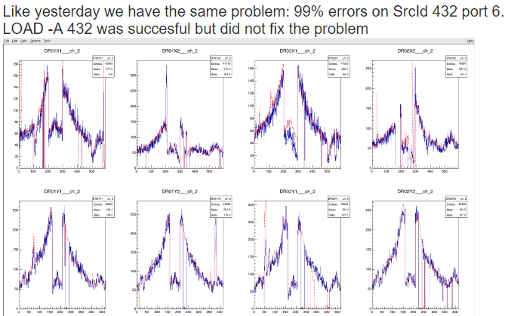

Slide 17
Tuesday, June 12th
Errors reported:
DAQ crash (03:00 -03:30)
PMM 382, 380
MWPC
DC 259
CAEN HV crate HOD_CCR1 stuck:
→ put back on by Christoph in 888

Slide 18
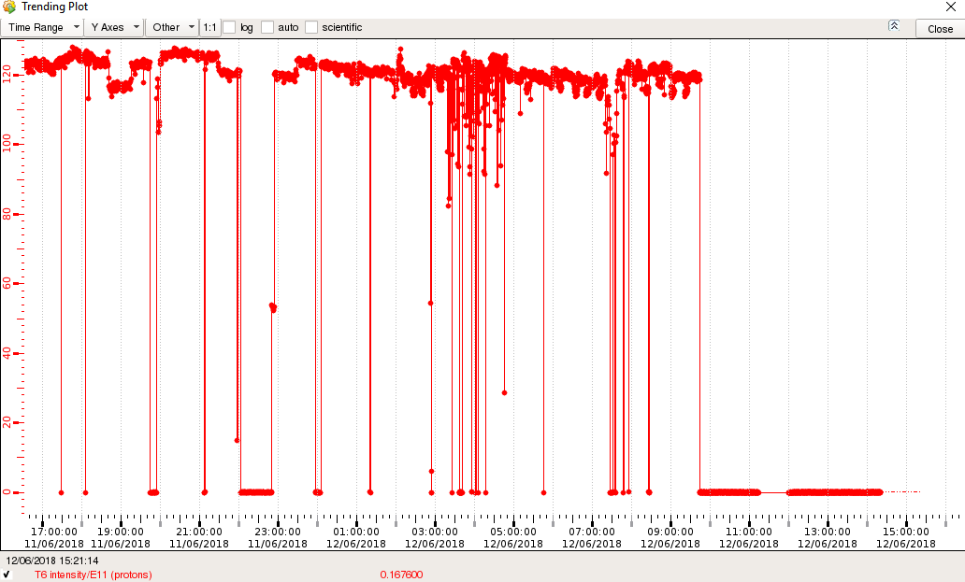
Reasonable beam intensity yesterday, no beam from 22:00 to 22:50.
~1.5 h unstable during the night, no beam from 09:40 today!

Slide 19
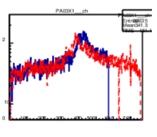
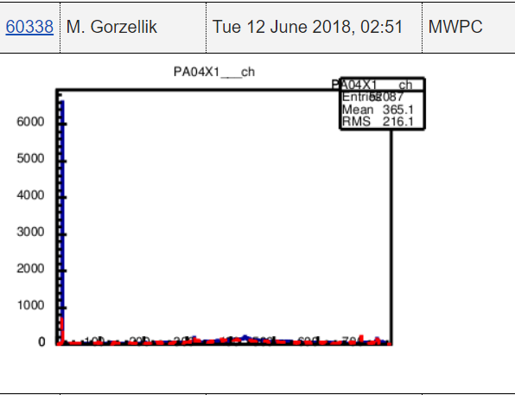
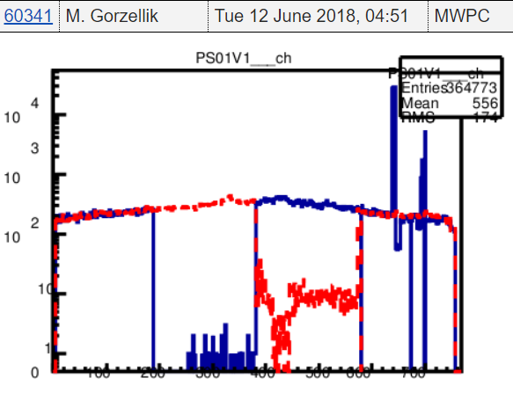
Access from ~10:00 to 11:00 for MWPC for checking the connenction on CATCH
PA03X1
PA04X1

Slide 20
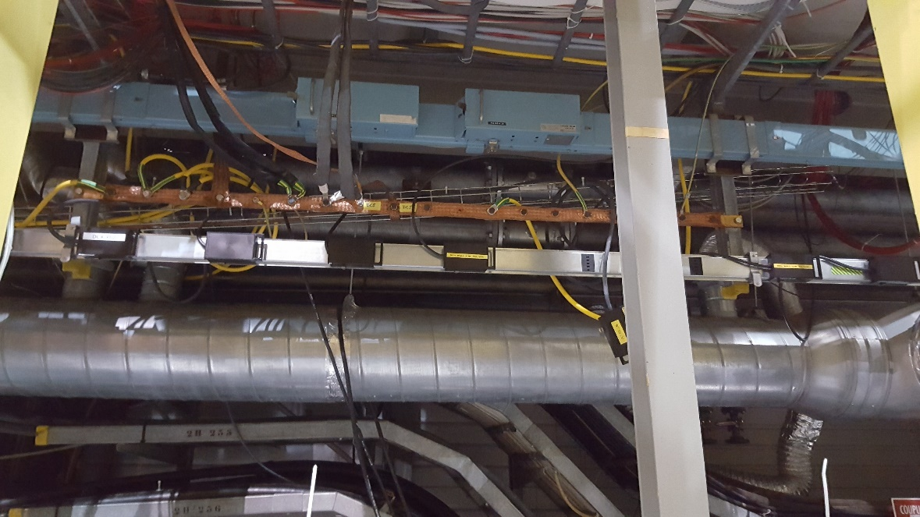
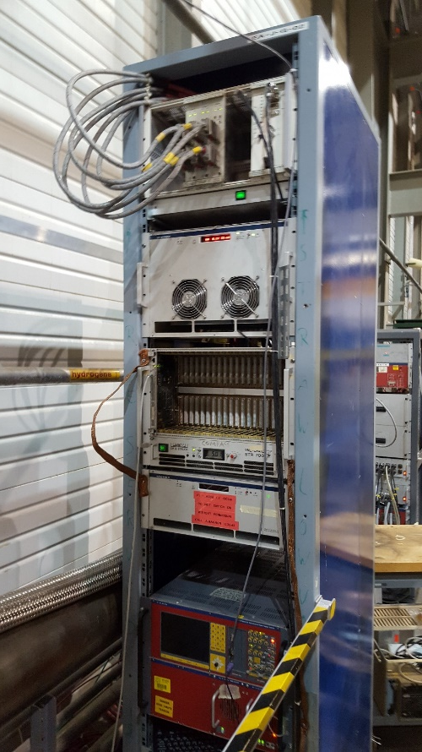
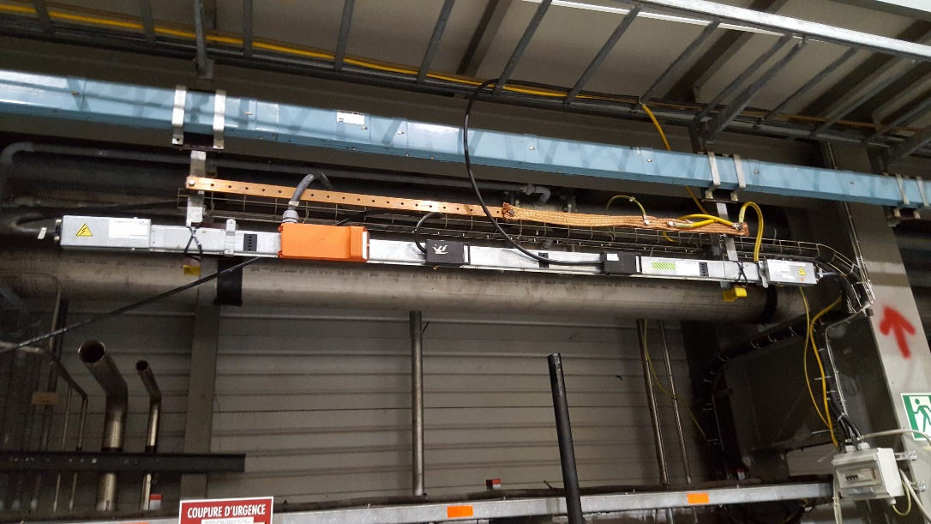
Wednesday, June 13th

Slide 21
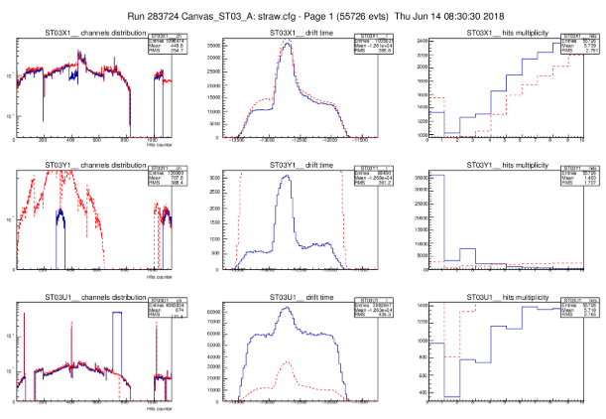
Straw status:

Slide 22
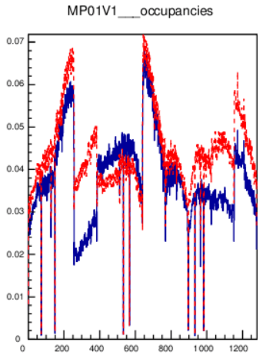
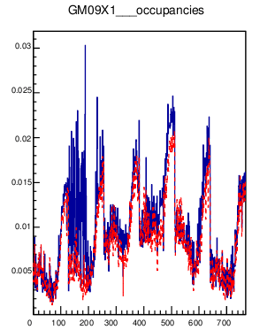
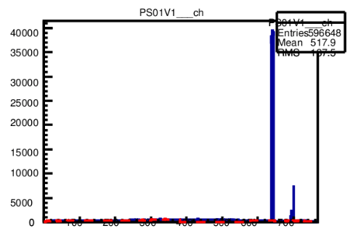
Other problems:

Slide 23
Failure of the HOD_CCR2 HV-Crate:
At ~ 17:00 DCS communication to CAEN HV-Crate CCR2 lost
Christoph + Moritz performed intervention
Burned electronic smell;
CAEN SY527 crate could not be restarted (dead);
Channels of HO03 and HO04 moved to neighboring CAEN SY1527 crate
(previously used for CAMERA)
Channels of Veto Outer 1 moved to CCR7 crate
Mapping in DCS changed and old references loaded
4 channels needed further (long) work to be restored to normal conditions
All channels fully working at ~21:00
Alignment runs taken during HV channels change

Slide 24
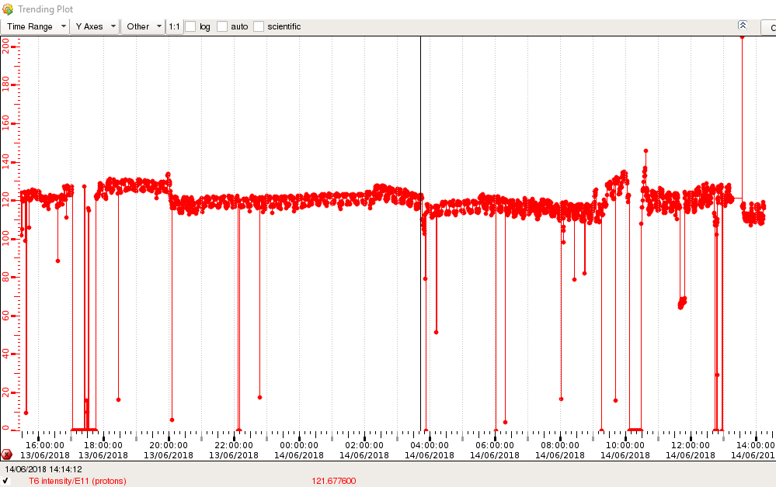
Thursday, June 14th
Reasonable average beam intensity,
Few short interruptions,
Strange substructure

Slide 25
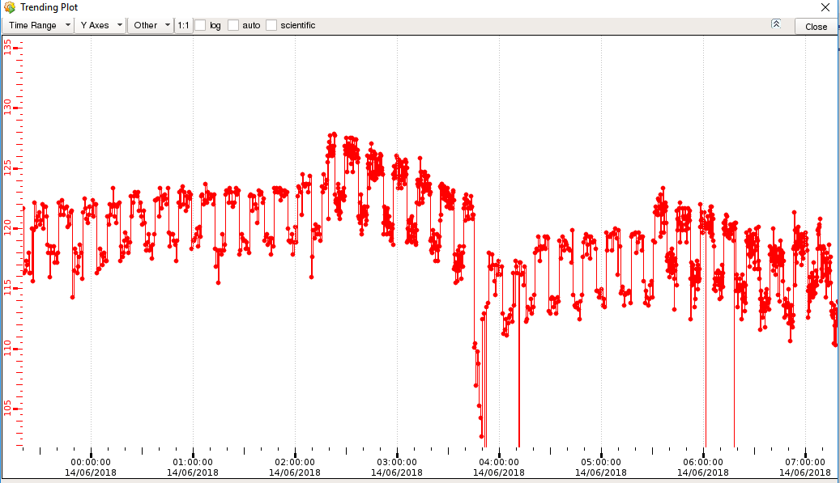
Periodic structure with:
~8 min higher intensity, ~5 min lower intensity (~5% less)
→ Related to LHC MD
~13 min period

Slide 26
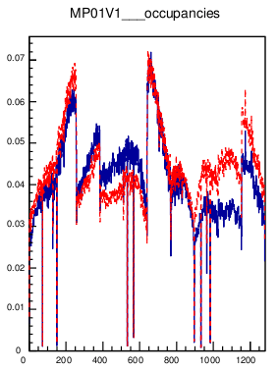
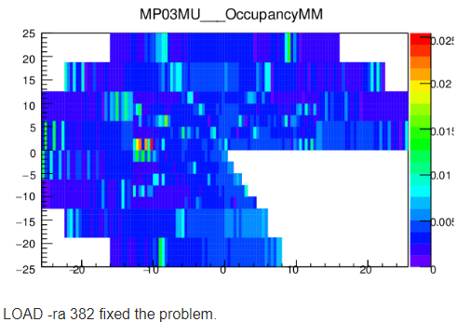
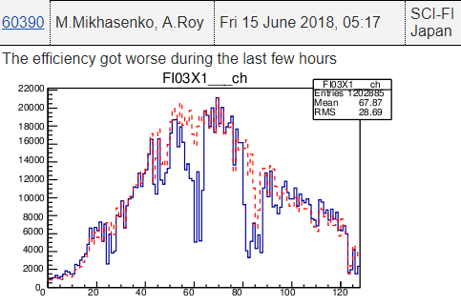
Friday, June 14th
Smooth data taking
Fi03X1 inefficient?
Usual MP problem, solved by LOAD –ra 382

Slide 27
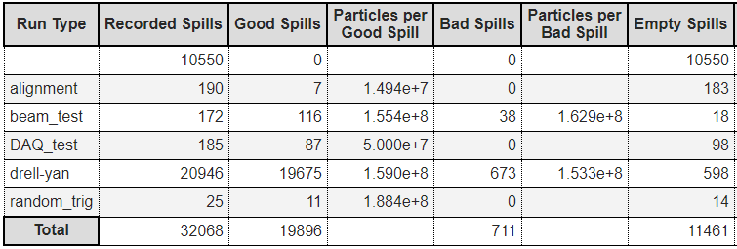
Almost 100 good DY runs collected during this week

Slide 28
Good luck, Antoine!

