Slide 1

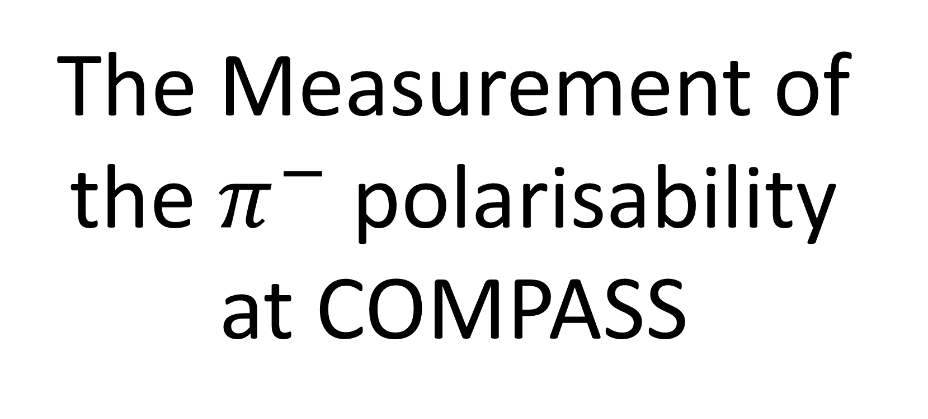
The Measurement of the $π^{−}$ polarisability at COMPASS

Slide 2
PRL on Feb 10

Slide 5
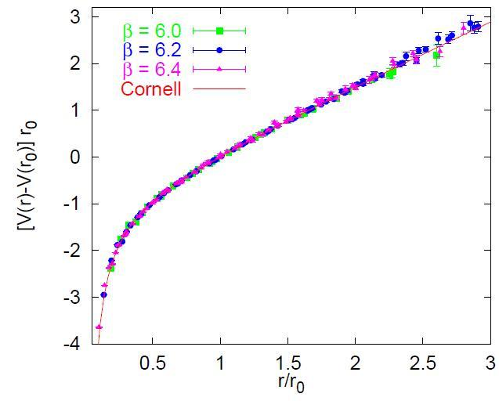
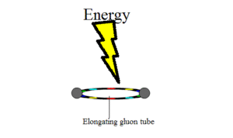


QCD and Strong-Interactions
Building blocks
  Quarks ($u,d,s$…, spin-$1/2$, $mq$ small, 3 colors)
  Gluons (spin-1, massless, 3² −1 colors)
Interactions
  $$ℒ=\overline{ψ}\left(iγ^{μ}D_{μ}−m_{q}\right)ψ−\frac{1}{4}G_{μν}^{a}G_{a}^{μν}$$
  In the low-energy region, it represents an extremely relativistic, strongly coupled, quantum many-body problem—one of the daunting challenges in theoretical physics
  Clay Mathematics Institute, Cambridge, MA
  $1M millennium prize to solve QCD! (E. Witten)
Above 1 fm the strong force stays constant independent of the distance,
about 160.000 N (quark confinement)
$$V\left(r\right)=−\frac{a}{r}+br$$
Bali, hep-ph/0001312
http://www.claymath.org/millenium-problems/yang%E2%80%93mills-and-mass-gap

Slide 6
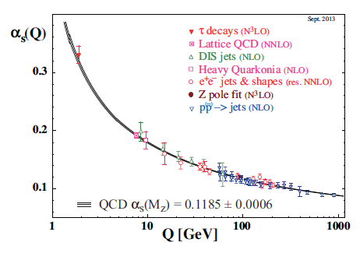
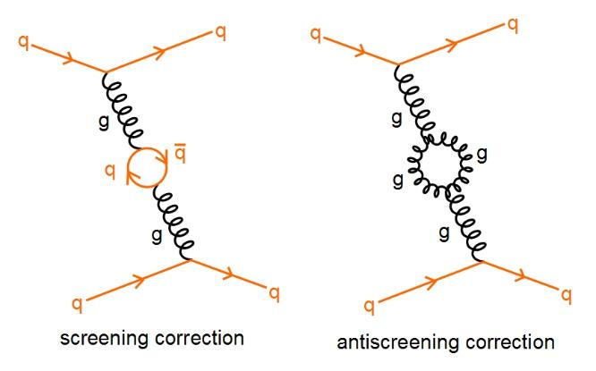

Asymptotic freedom: the role of glue
David Politzer
2004
David Gross
Frank Wilczek
The self-interaction (of color charged) gluons is fundamentally responsible for
the asymptotic freedom of quarks and gluons in Quantum Chromodynamics (QCD)

Slide 7
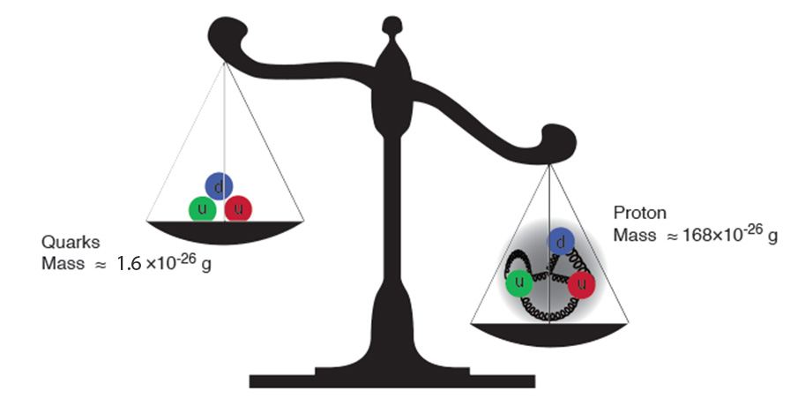
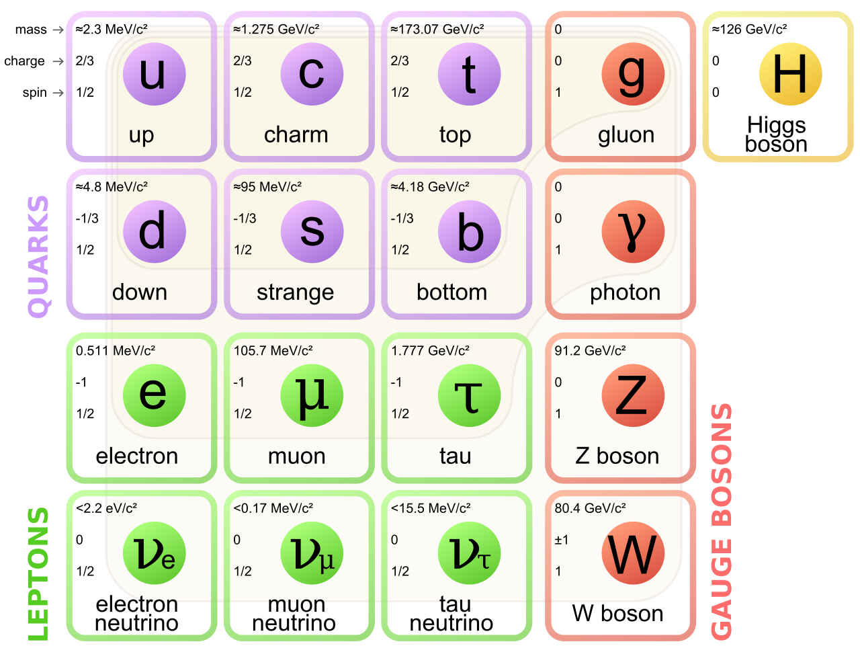
Proton mass
Gluons are massless…yet their dynamics is responsible for
(nearly all) the mass of visible matter

Slide 8
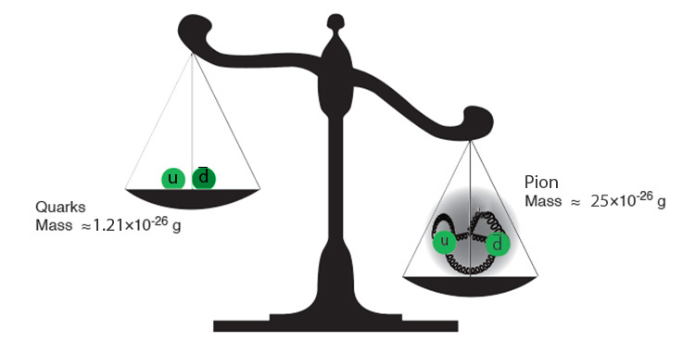
Pion mass

Slide 9
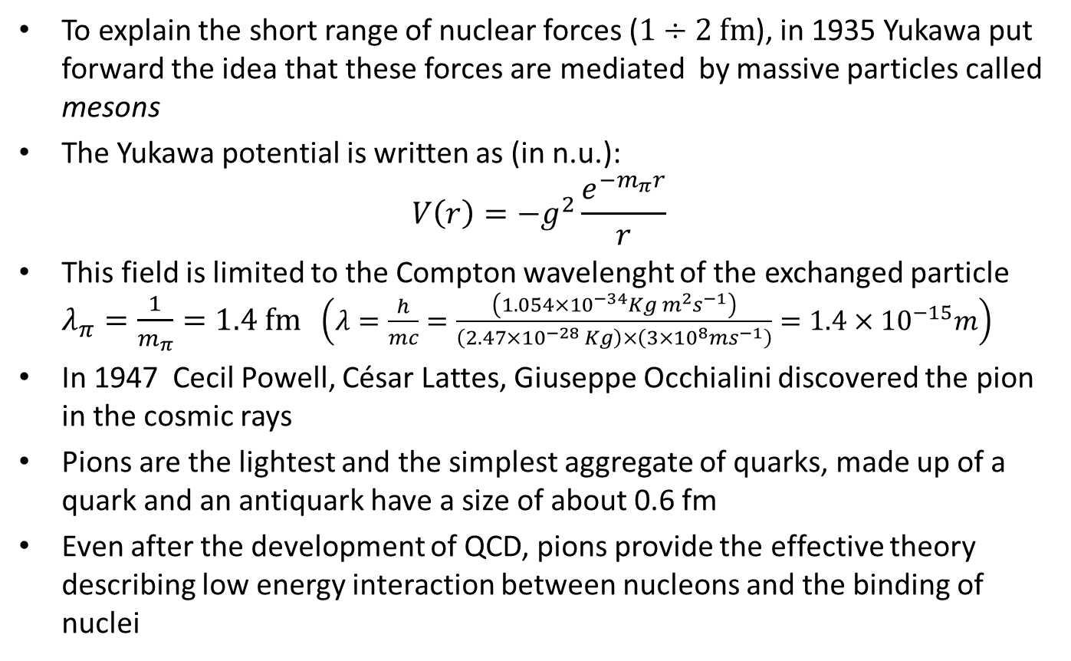
The pion
To explain the short range of nuclear forces ($1÷2 fm$), in 1935 Yukawa put forward the idea that these forces are mediated by massive particles called mesons
The Yukawa potential is written as (in n.u.):
$$V\left(r\right)=−g^{2}\frac{e^{−m_{π}r}}{r}$$
This field is limited to the Compton wavelenght of the exchanged particle $λ_{π}=\frac{1}{m_{π}}=1.4 fm$ $\left(λ=\frac{h}{mc}=\frac{\left(1.054×{10}^{−34}Kg m^{2}s^{−1}\right)}{\left(2.47×{10}^{−28} Kg\right)×\left(3×{10}^{8}ms^{−1}\right)}=1.4×{10}^{−15}m\right)$
In 1947 Cecil Powell, César Lattes, Giuseppe Occhialini discovered the pion in the cosmic rays
Pions are the lightest and the simplest aggregate of quarks, made up of a quark and an antiquark have a size of about 0.6 fm
Even after the development of QCD, pions provide the effective theory describing low energy interaction between nucleons and the binding of nuclei

Slide 10
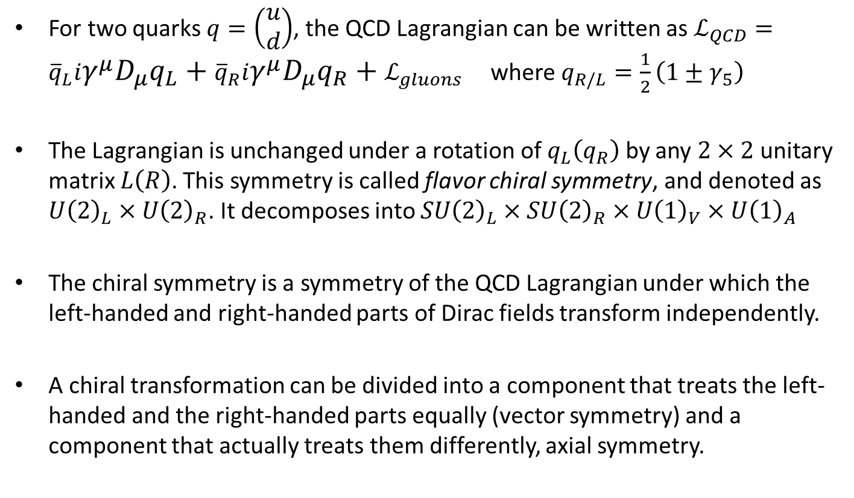
Chiral Symmetry
For two quarks $q=\left(\begin{matrix}u \\ d\end{matrix}\right)$, the QCD Lagrangian can be written as $ℒ_{QCD}={\overline{q}}_{L}iγ^{μ}D_{μ}q_{L}+{\overline{q}}_{R}iγ^{μ}D_{μ}q_{R}+ℒ_{gluons}$ where $q_{R/L}=\frac{1}{2}\left(1±γ_{5}\right)$
The Lagrangian is unchanged under a rotation of $q_{L}\left(q_{R}\right)$ by any $2×2$unitary matrix $L\left(R\right)$. This symmetry is called flavor chiral symmetry, and denoted as $U{\left(2\right)}_{L}×U{\left(2\right)}_{R}$. It decomposes into $SU{\left(2\right)}_{L}×SU{\left(2\right)}_{R}×U{\left(1\right)}_{V}×U{\left(1\right)}_{A}$
The chiral symmetry is a symmetry of the QCD Lagrangian under which the left-handed and right-handed parts of Dirac fields transform independently.
A chiral transformation can be divided into a component that treats the left-handed and the right-handed parts equally (vector symmetry) and a component that actually treats them differently, axial symmetry.

Slide 11
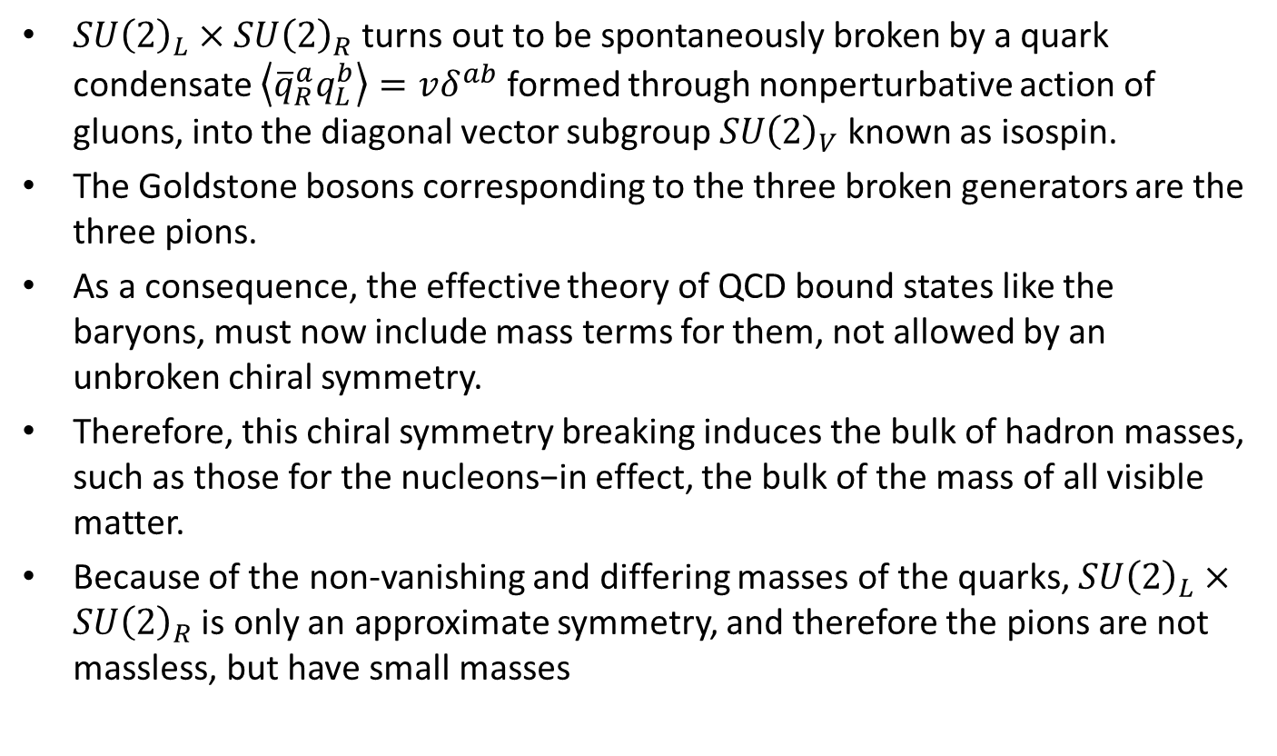
Breaking the Chiral Symmetry
$SU{\left(2\right)}_{L}×SU{\left(2\right)}_{R}$ turns out to be spontaneously broken by a quark condensate $\left\langle {\overline{q}}_{R}^{a}q_{L}^{b}\right\rangle =vδ^{ab}$ formed through nonperturbative action of gluons, into the diagonal vector subgroup$SU{\left(2\right)}_{V}$ known as isospin.
The Goldstone bosons corresponding to the three broken generators are the three pions.
As a consequence, the effective theory of QCD bound states like the baryons, must now include mass terms for them, not allowed by an unbroken chiral symmetry.
Therefore, this chiral symmetry breaking induces the bulk of hadron masses, such as those for the nucleons−in effect, the bulk of the mass of all visible matter.
Because of the non-vanishing and differing masses of the quarks, $SU{\left(2\right)}_{L}×SU{\left(2\right)}_{R}$ is only an approximate symmetry, and therefore the pions are not massless, but have small masses

Slide 12
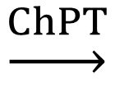
How to understand quark-gluon dynamics?
$$\underset{→}{ChPT}$$
effective degrees of freedom
at low energy: mass, charge,
spin, effective (self-)coupling
complicated system of interacting quarks and gluons
An approach pioneered by S. Weinberg and worked out by
J. Gasser and H. Leutwyler

Slide 13
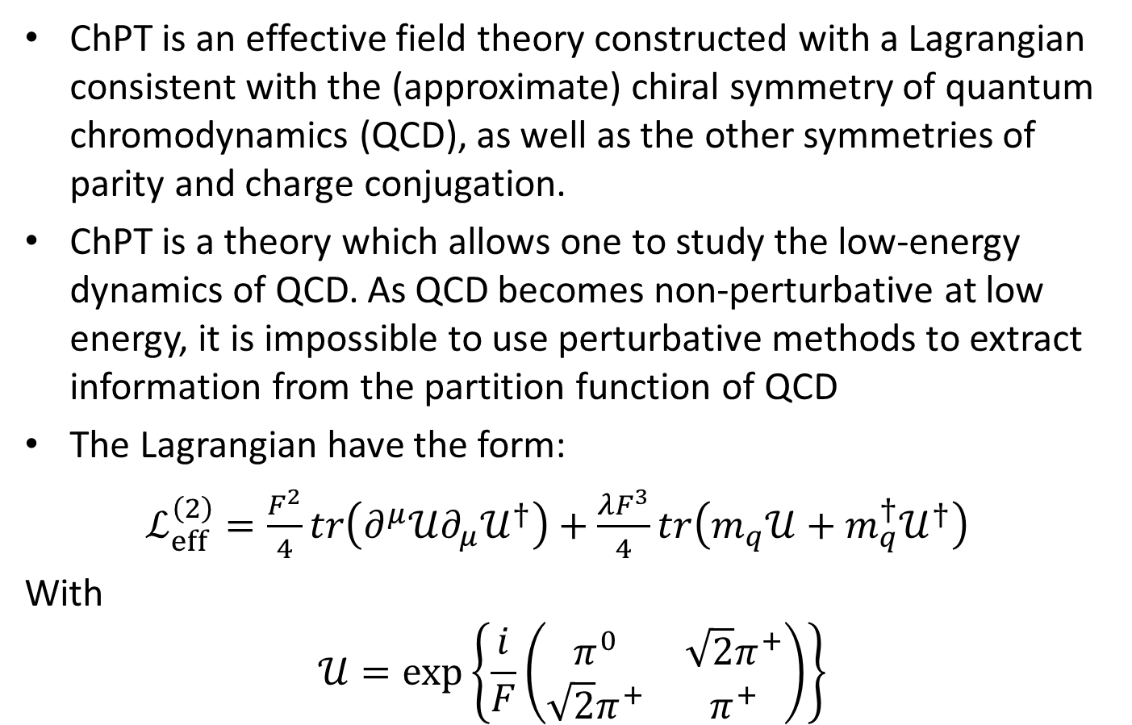
Chiral perturbation theory ChPT
ChPT is an effective field theory constructed with a Lagrangian consistent with the (approximate) chiral symmetry of quantum chromodynamics (QCD), as well as the other symmetries of parity and charge conjugation.
ChPT is a theory which allows one to study the low-energy dynamics of QCD. As QCD becomes non-perturbative at low energy, it is impossible to use perturbative methods to extract information from the partition function of QCD
The Lagrangian have the form:
$ℒ_{eff}^{\left(2\right)}=\frac{F^{2}}{4}tr\left(∂^{μ}𝒰∂_{μ}𝒰^{†}\right)+\frac{λF^{3}}{4}tr\left(m_{q}𝒰+m_{q}^{†}𝒰^{†}\right)$
With
$$𝒰=\exp\left\{\frac{i}{F}\left(\begin{matrix}π^{0} & \sqrt{2}π^{+} \\ \sqrt{2}π^{+} & π^{+}\end{matrix}\right)\right\}$$

Slide 14
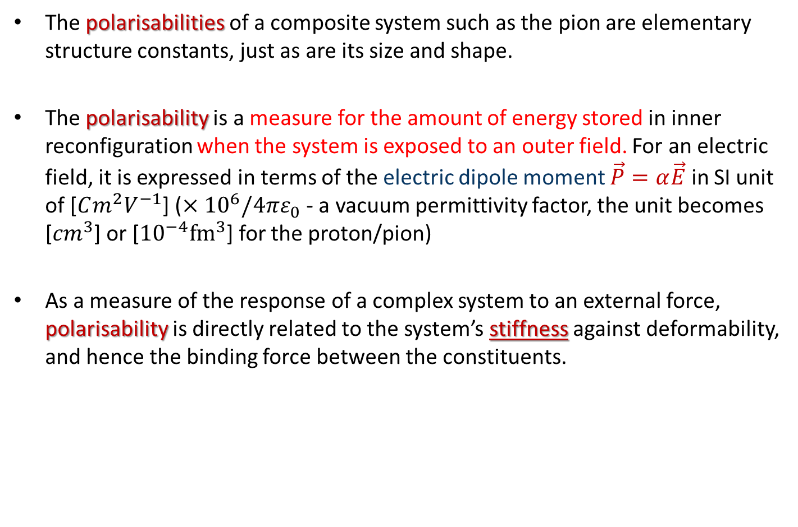
Pion polarizability of a composite system
The polarisabilities of a composite system such as the pion are elementary structure constants, just as are its size and shape.
The polarisability is a measure for the amount of energy stored in inner reconfiguration when the system is exposed to an outer field. For an electric field, it is expressed in terms of the electric dipole moment $\vec{P}=α\vec{E}$ in SI unit of [$Cm^{2}V^{−1}$] ($×{10}^{6}/4πε_{0}$ - a vacuum permittivity factor, the unit becomes [${cm}^{3}$] or [${10}^{−4}{fm}^{3}$] for the proton/pion)
As a measure of the response of a complex system to an external force, polarisability is directly related to the system’s stiffness against deformability, and hence the binding force between the constituents.

Slide 15
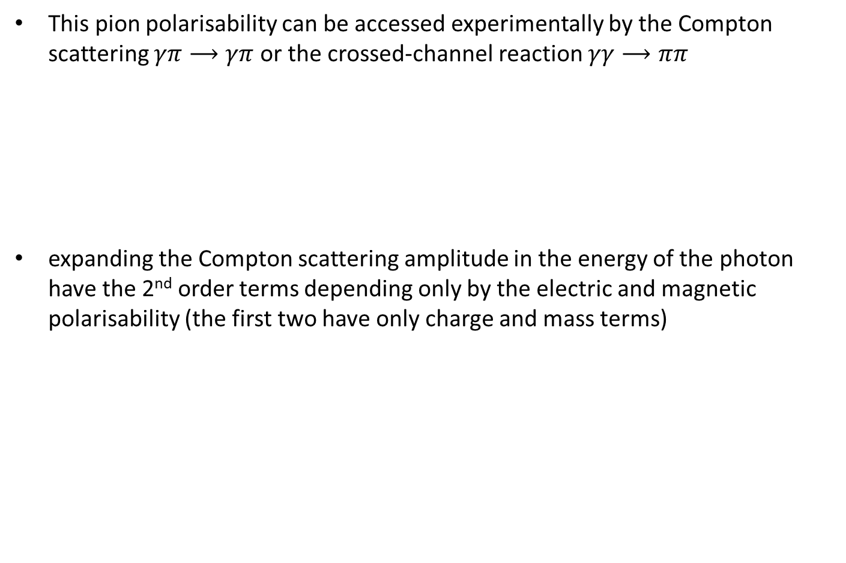
Pion polarisability
This pion polarisability can be accessed experimentally by the Compton scattering $γπ⟶γπ$ or the crossed-channel reaction $γγ⟶ππ$
expanding the Compton scattering amplitude in the energy of the photon have the 2nd order terms depending only by the electric and magnetic polarisability (the first two have only charge and mass terms)
γ
γ

Slide 16
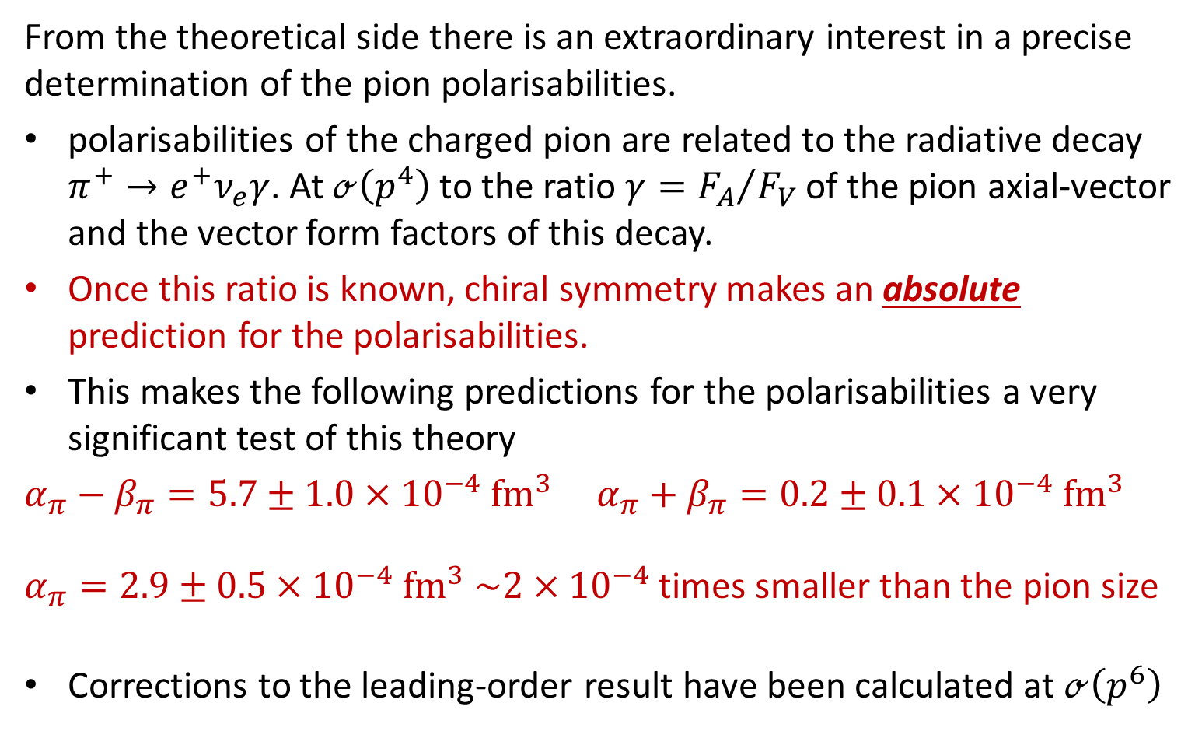
Importance of pion polarisability measurements
From the theoretical side there is an extraordinary interest in a precise determination of the pion polarisabilities.
polarisabilities of the charged pion are related to the radiative decay $π^{+}→e^{+}ν_{e}γ$. At $ℴ\left(p^{4}\right)$ to the ratio $γ={F_{A}}/{F_{V}}$ of the pion axial-vector and the vector form factors of this decay.
Once this ratio is known, chiral symmetry makes an absolute prediction for the polarisabilities.
This makes the following predictions for the polarisabilities a very significant test of this theory
$α_{π}−β_{π}=5.7±1.0×{10}^{−4} {fm}^{3}$ $α_{π}+β_{π}=0.2±0.1×{10}^{−4} {fm}^{3}$
$α_{π}=2.9±0.5×{10}^{−4} {fm}^{3}$ $\sim 2×{10}^{−4}$ times smaller than the pion size
Corrections to the leading-order result have been calculated at $ℴ\left(p^{6}\right)$

Slide 17
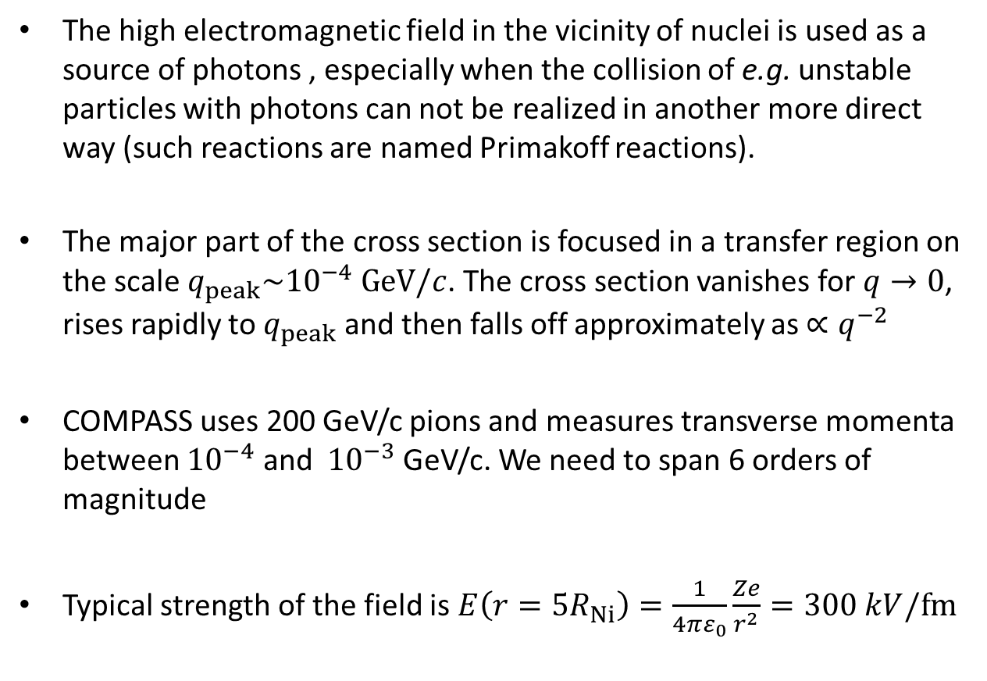
Primakoff way to access Compton scattering
The high electromagnetic field in the vicinity of nuclei is used as a source of photons , especially when the collision of e.g. unstable particles with photons can not be realized in another more direct way (such reactions are named Primakoff reactions).
The major part of the cross section is focused in a transfer region on the scale $q_{peak}\sim {10}^{−4} GeV/c$. The cross section vanishes for $q→0$, rises rapidly to $q_{peak}$ and then falls off approximately as $∝q^{−2}$
COMPASS uses 200 GeV/c pions and measures transverse momenta between ${10}^{−4}$ and ${10}^{−3}$ GeV/c. We need to span 6 orders of magnitude
Typical strength of the field is $E\left(r=5R_{Ni}\right)=\frac{1}{4πε_{0}}\frac{Ze}{r^{2}}=300 kV/fm$

Slide 18
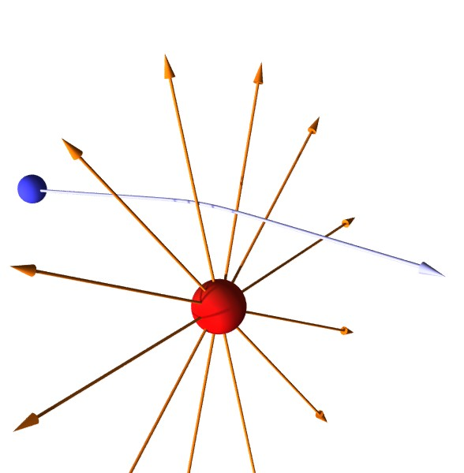
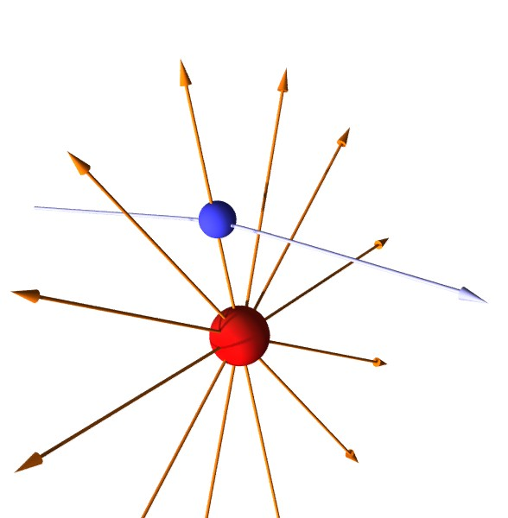
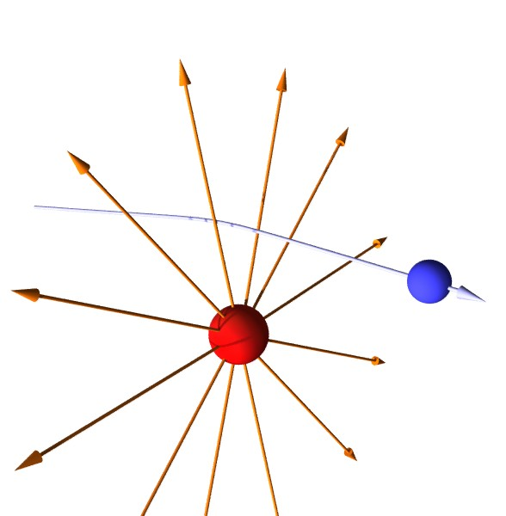
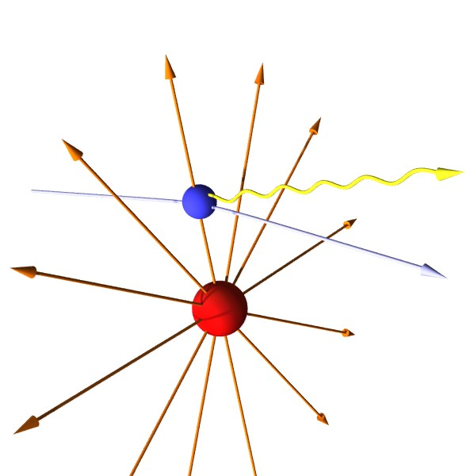
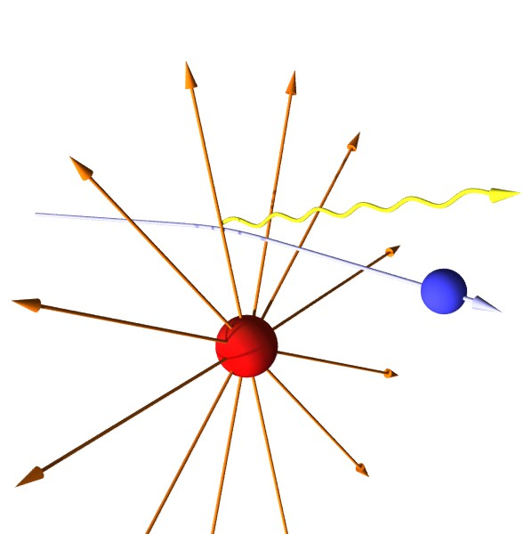
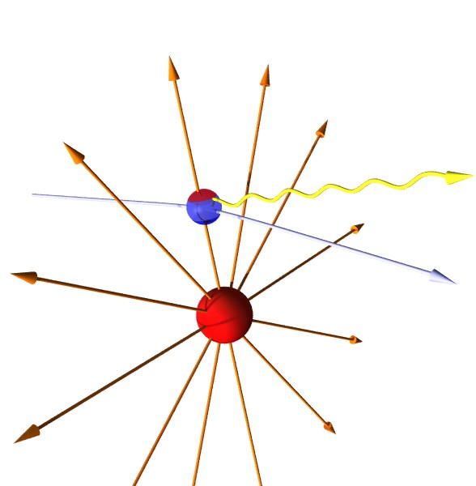

Primakoff reactions
Charged pions passing trough the nucleus electric field ($E\left(r=5R_{Ni}\right)=300 kV/fm$)
Bremsstrahlung emission
  particle scatters off equivalent photons
  tiny momentum transfer
  $Q_{}^{2}≈{10}^{−5} {\left(GeV/c\right)}^{2}$
  Pion/muon (quasi-) real Compton scattering
Polarisability contribution
  Compton cross-section typically diminished
  Theory prediction:
  $α_{π}^{ChPT}=2.9±0.5×{10}^{−4} {fm}^{3}$
  Expected charge separation:
  $$\sim {10}^{−5} fm∙e$$

Slide 19
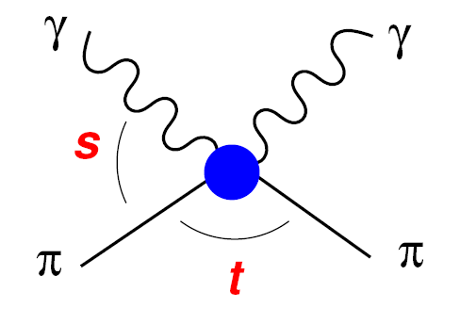

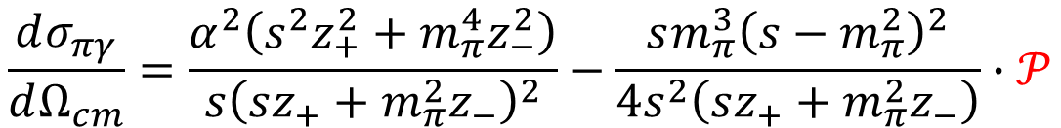
Primakoff cross-section
$$z_{±}=1±\cos{θ_{cm}}$$
$$\frac{dσ_{πγ}}{dΩ_{cm}}=\frac{α^{2}\left(s^{2}z_{+}^{2}+m_{π}^{4}z_{−}^{2}\right)}{s{\left(sz_{+}+m_{π}^{2}z_{−}\right)}^{2}}−\frac{sm_{π}^{3}{\left(s−m_{π}^{2}\right)}^{2}}{4s^{2}\left(sz_{+}+m_{π}^{2}z_{−}\right)}∙𝒫$$
$$𝒫=z_{−}^{2}\left(α_{π}−β_{π}\right)+\frac{s^{2}}{m_{π}^{4}}z_{+}^{2}\left(α_{π}+β_{π}\right)−\frac{{\left(s−m_{π}^{2}\right)}^{2}}{24s}z_{−}^{3}\left(α_{2}−β_{2}\right)$$

Slide 20
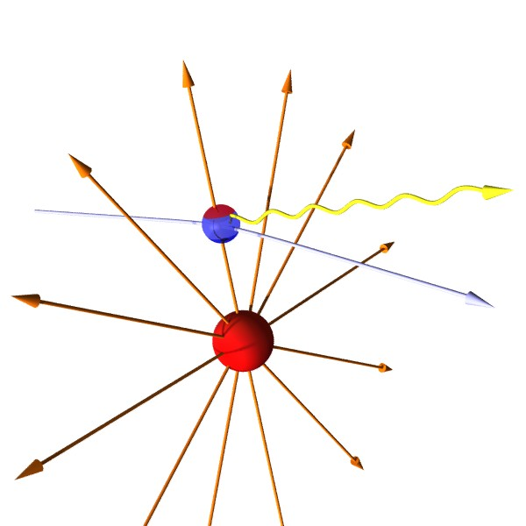
Physical regions
Primakoff region
Strong interactions

Slide 21
What does “COMPASS” stand for?
COMPASS: NA58, EHN2, building 888:
COmmon
Muon
Proton
Apparatus for
Structure and
Spectroscopy
COMPASS is the largest surface experiment at CERN

Slide 22













COMPASS Collaboration
Дубна (LPP and LNP), Москва (INR, LPI, State University), . Протвино
Bochum, Bonn (ISKP & PI), Erlangen, Freiburg, Mainz, München TU
CERN
Warsawa (NCBJ),
Warsawa (TU)
Warsawa (U)
USA (UIUC)
Yamagata
Praha
Saclay
Lisboa
Torino
(University,INFN),
Trieste
(University,INFN)
Burden, Calcutta
Tel Aviv
  about 220 members
  from 13 different countries
  involving 24 universities and research institutes
Taipei (AS)

Slide 23
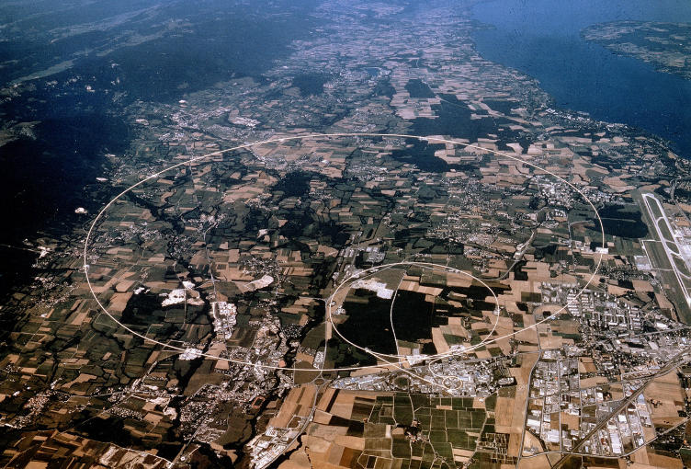

Where is COMPASS located? View from SW
SPS experiment in the North Area at the CERN Prevessin site
LHC
Prevessin site
SPS
Meyrin site

Slide 24

Where is COMPASS located? View from NW
SPS experiment in the North Area at the CERN Prevessin site

Slide 25
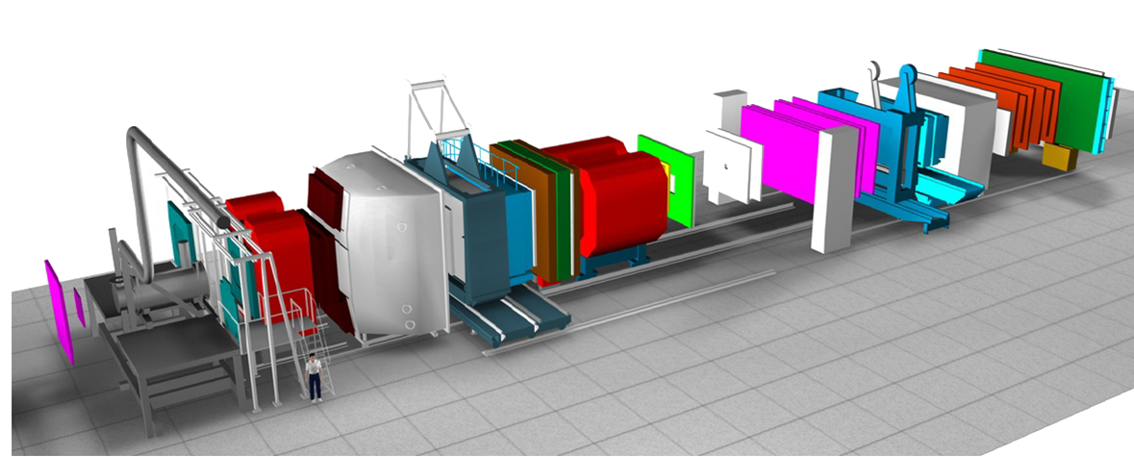
What does COMPASS look like?
Flexible fixed-target experiment, two-stage forward large-angle spectrometer
Second stage: small angle acceptance
First stage: large angle acceptance
Target area
≈60m
beam
Our size

Slide 26

Principle of the measurement
$$πγ_{\left\{Ni→{Ni}^{′}\right\}}→πγ$$

Slide 27
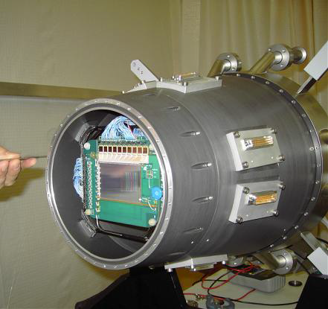
Very Small Area Trackers - Silicons
Specifications
  5x7 cm², 1280 and 1024 strips
  5 N-cooled stations
  52 µ and 55 µ pitch
  2 projections per detector
  Designed for high fluencies
  R/O: APV25 chip, 128 ch
Performances
  Time resolution: 1.4 ns
  Spatial resolution: 6 – 11 µm
preliminary
preliminary
Very good spatial resolution

Slide 28
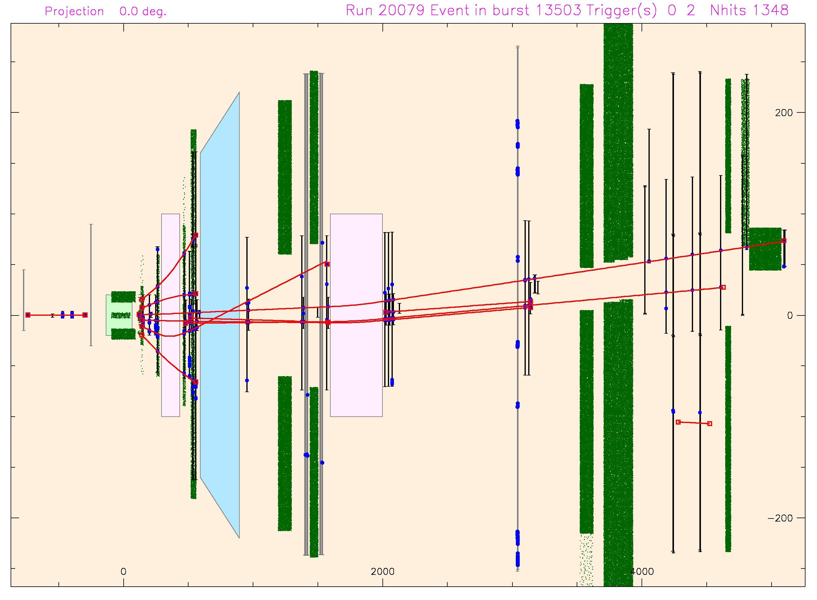
Spectrometer: momentum determination
Magnet1
RICH
Magnet2
Magnets bend charged particle tracks.
Knowing the magnetic field and the hits of the track on the detectors,
we can reconstruct the path of the charged particle through the detector.
Target

Slide 29
Electromagnetic calorimeters (x2)
ECAL1
  1500 channels
  Pb0 modules (3 dimensions)
    18-20 X₀
  Energy range: 0.2-60 GeV
ECAL2
  2180 Pb0 type modules
  888 “Shashlik” type (Pb/Scint)
    (radiation hardness)
  Energy range: 1-200 GeV
  Detect photons and electrons = maximize RADIATION Length

Slide 30
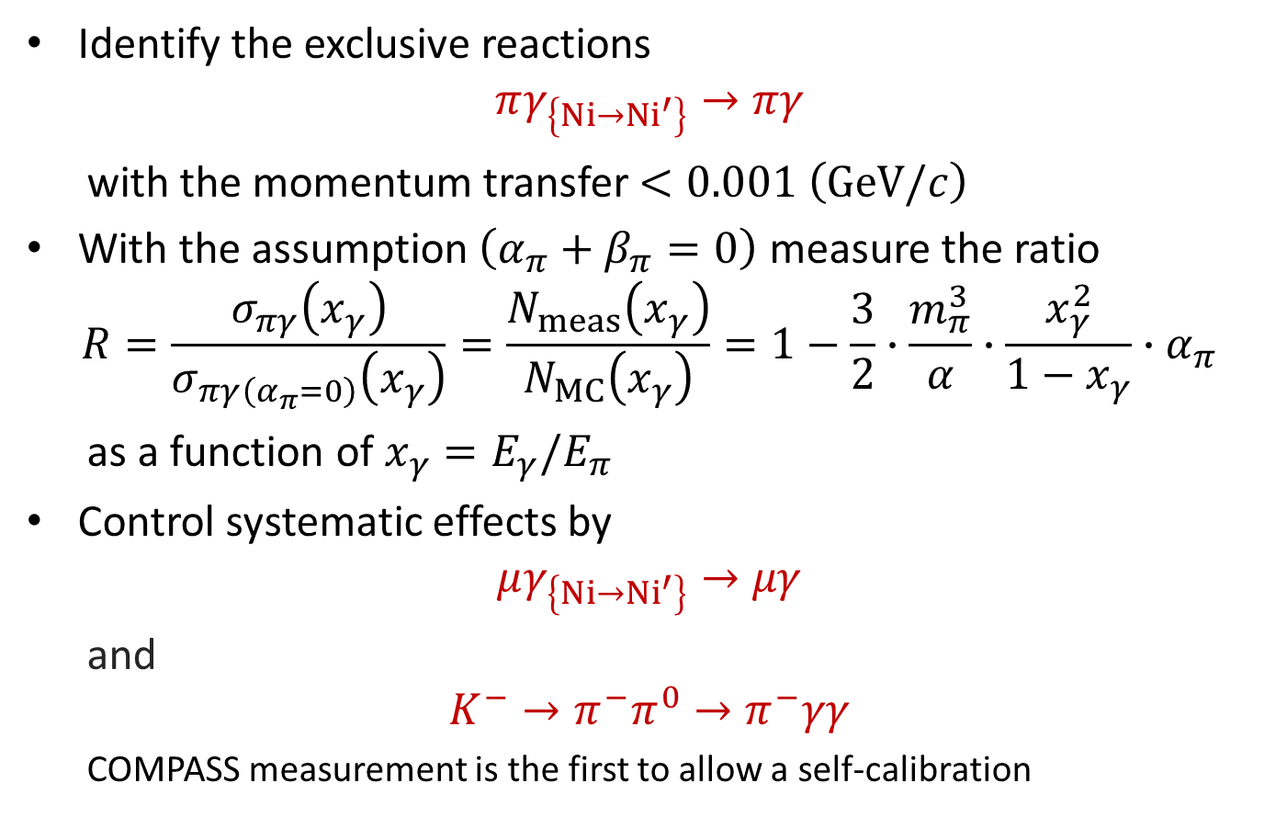
Extraction of pion polarisability
Identify the exclusive reactions
$$πγ_{\left\{Ni→{Ni}^{′}\right\}}→πγ$$
with the momentum transfer $<0.001 {\left(GeV/c\right)}^{}$
With the assumption $\left(α_{π}+β_{π}=0\right)$ measure the ratio
$$R=\frac{σ_{πγ}\left(x_{γ}\right)}{σ_{πγ\left(α_{π}=0\right)}\left(x_{γ}\right)}=\frac{N_{meas}\left(x_{γ}\right)}{N_{MC}\left(x_{γ}\right)}=1−\frac{3}{2}∙\frac{m_{π}^{3}}{α}∙\frac{x_{γ}^{2}}{1−x_{γ}}∙α_{π}$$
as a function of $x_{γ}=E_{γ}/E_{π}$
Control systematic effects by
$$μγ_{\left\{Ni→{Ni}^{′}\right\}}→μγ$$
and
$$K^{−}→π^{−}π^{0}→π^{−}γγ$$
  COMPASS measurement is the first to allow a self-calibration

Slide 31
Pion polarisability: COMPASS result

Slide 32
COMPASS Broad Physics Program
Located at CERN North Area beam line (Possible beams: µ⁺, µ⁻, π⁺, π⁻, K → Several physics programs)
  1996: COMPASS proposal
  1999-2000: construction and installation
  2001: commissioning run
Lead by F. Bradamante
Lead by S. Paul
Experiments with muon beam
  Spin structure: Gluon polarization
  u,d,s flavor decomposition of the nucleon spin
  Transverse spin
  Quark transverse momentum distribution
  ‘3D’ structure of the nucleon (DVCS)
  Unpolarised quark transverse momentum distribution and strangeness
Experiments with hadron beams
  Pion polarisability
  Search for exotic states:
    Light meson spectroscopy
    Baryon spectroscopy
  Pion and Kaon polarisabilities
  Polarized Drell-Yan: universality of transverse momentum distribution
COMPASS - I (2002 – 2011)
COMPASS - II (2012 – 2017)

Slide 33
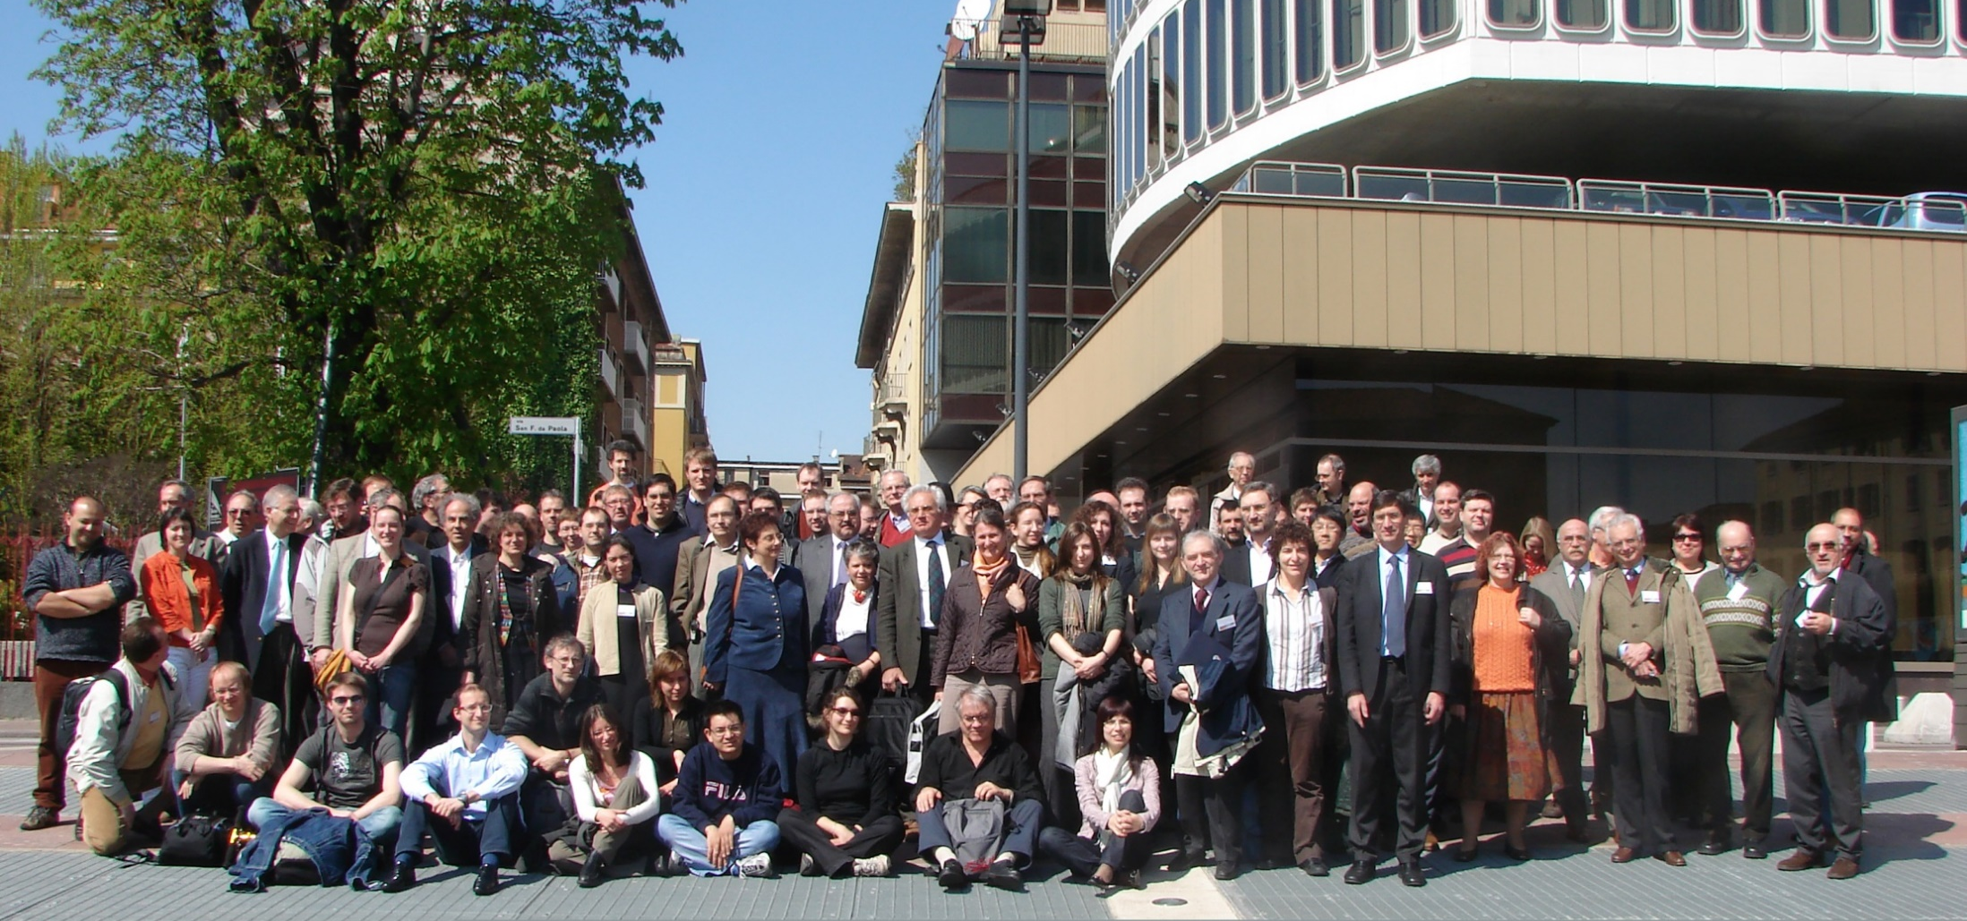
The People
Trieste GROUP in COMPASS, >18 persone
Physics Department: F. Bradamante, A. Bressan,
N. Makke, A. Martin, G. Sbrizzai, P. Schiavon
INFN: R. Birsa, S. Dalla Torre, S. Dasgupta, S. Levorato, S. Tessaro, F. Tessarotto, C. Santos …
ICTP: A. Cicuttin, M.L. Crespo
TRIL: B. Parsamyam,
MANY IMPORTANT PAST/PRESENT RESPONSIBILITIES within COMPASS
Transversity Physics Subgroup (1/3 of our physics): A. Martin
RICH detector/Photon detector: S. Dalla Torre/F. Tessarotto
Analysis Coordination: A. Martin (till 2000) A. Bressan (2007)
Spokespersonship: F. Bradamante (till 2003) A. Bressan (from 2011)

Slide 34
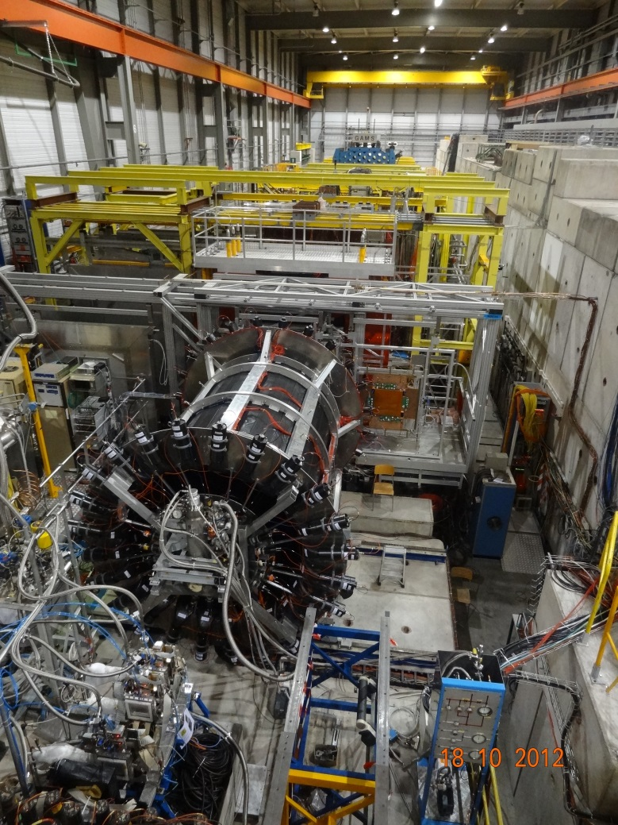
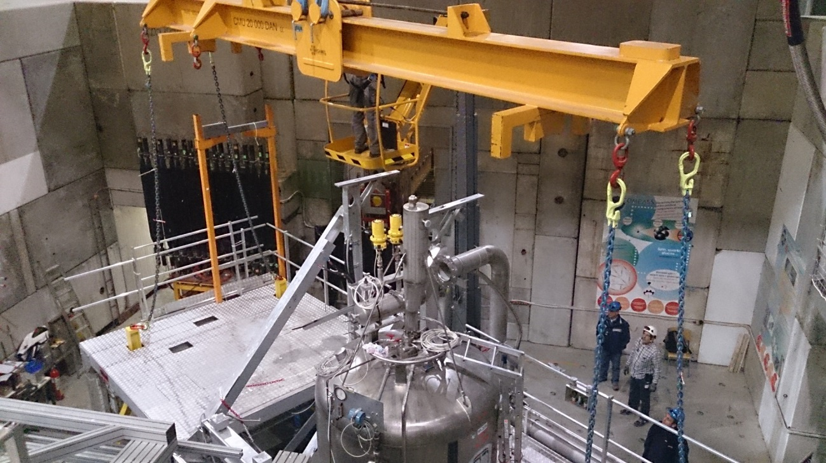
The target area
Since COMPASS has several physics goals, different physics runs are performed, requiring different targets:
Solid materials (C, Cu, Ni or Pb)
Liquid hydrogen
Polarized target (⁶LiD or NH₃)

Slide 35
Polarized target
1.2 m long, 40 mm diameter, 5-6 l
Temperature 50mK (-273.09 °C) with a record of 30 mK
⁶LiD, deuterated lithium – deuterium acts as target
NH₃ ammonia – hydrogen acts as target
Polarization is obtained by Dynamic Nuclear Polarization
Three things are needed: high magnetic field to align the spins, a very low temperature to reduce thermal energy and microwaves to transfer spin from the electrons to the nucleons
A 2.5 T solenoid field is applied by a superconducting magnet with a 10⁻⁴ homogeneity over the target volume

Slide 36
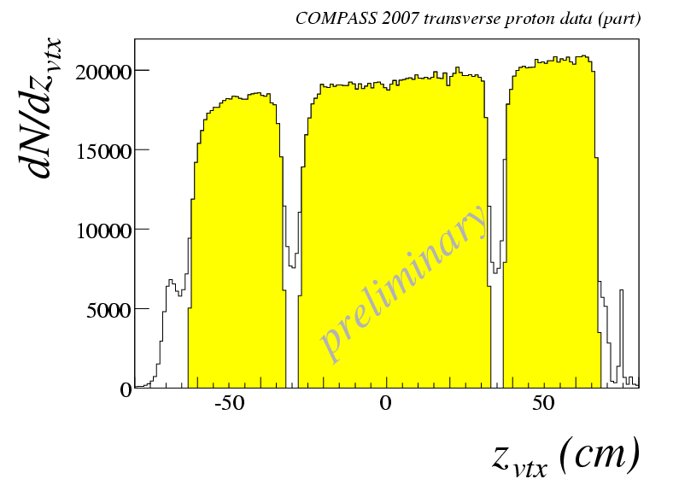
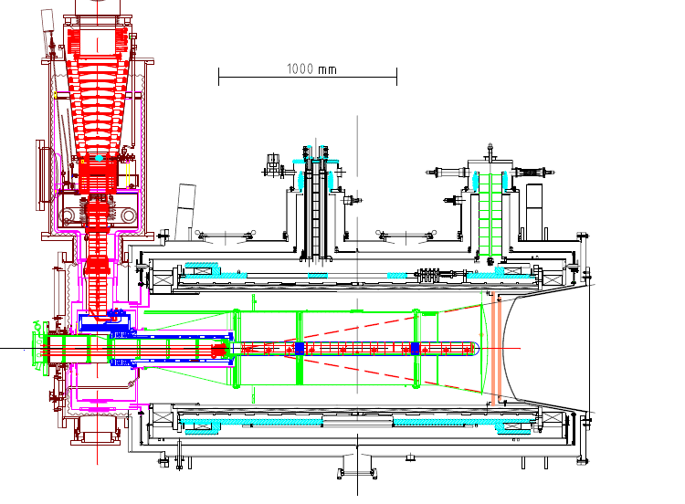
the polarized target system
³He – ⁴He dilution refrigerator (T~50mK)
solenoid 2.5T
dipole magnet 0.6T
acceptance > ± 180 mrad
3 target cells
30, 60, and 30 cm long
μ
opposite polarisation
d (⁶LiD) p (NH₃)
polarization 50% 90%
dilution factor 40% 16%

Slide 37
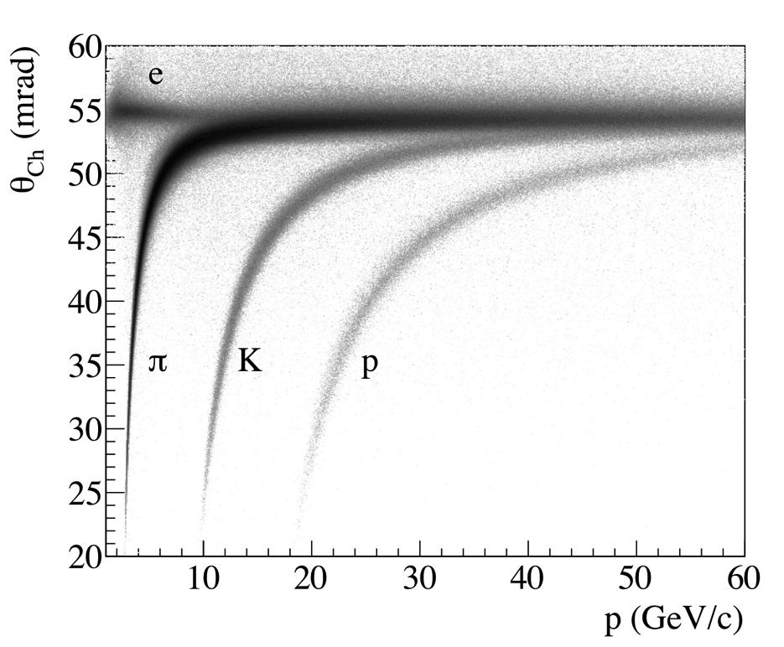
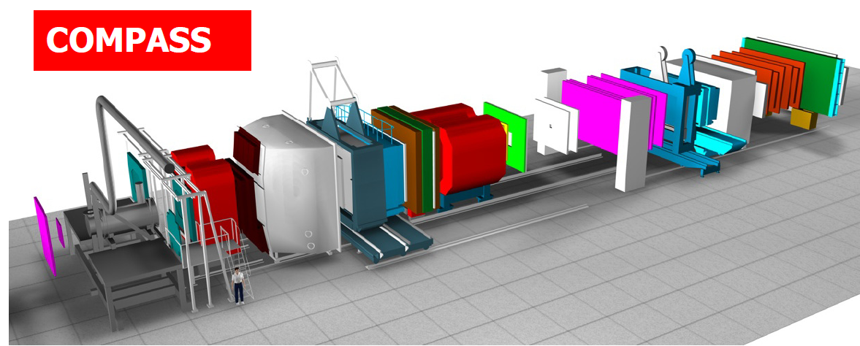
RING IMAGING CHERENKOV: RICH
radiator C₄F₁₀
threshold: π ~2 GeV/c
K ~ 10 GeV/c
RICH
Notes:
37

Slide 38
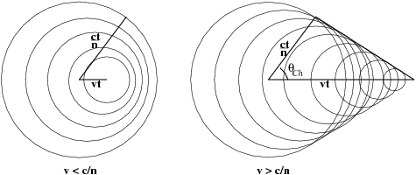

Velocity determination
The Cherenkov effect
A charged particle travelling in a dielectric medium faster than light in that medium, emits a cone of light which amplitude is proportional to the speed of the particle.

Slide 39
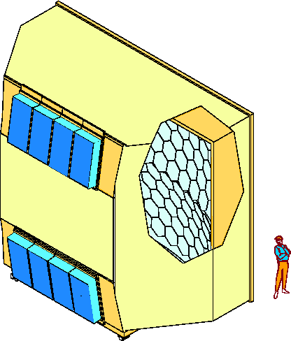
3 m
6 m
vessel
mirror
wall
photon
detectors:
CsI MWPC
5 m
radiator:
C₄F₁₀
radiator:
C₄F₁₀
detection of
VUV photons
(165-200 nm)‏

Slide 40
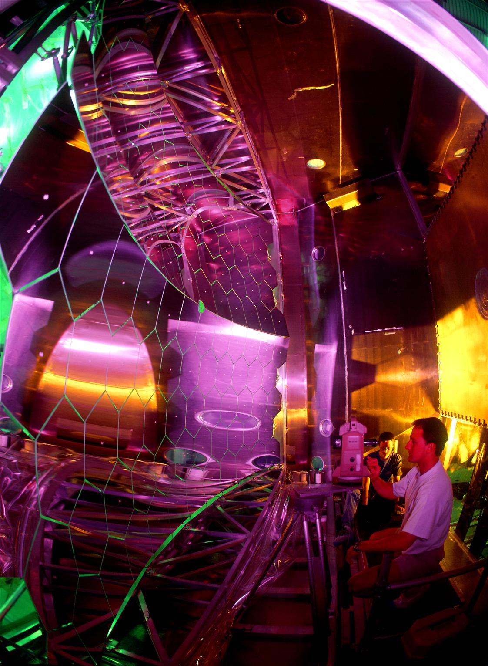

Slide 41
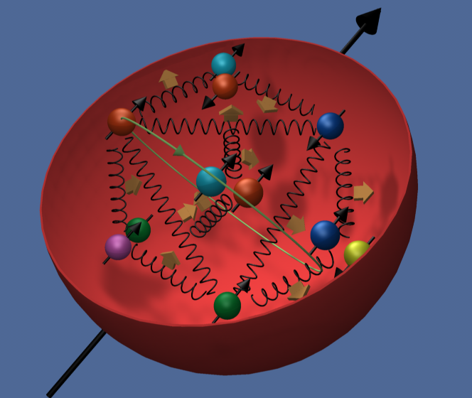
The Quest for the spin of the proton !
or
“You think you understand something?
Now add spin…” - R. Jaffe

Slide 42
The nucleon spin
The driving question for QCD spin physics is where the nucleon spin come from?
Total proton spin = 1/2
Quark spin measured
In DIS
“Dark” angular momentum?

Slide 43
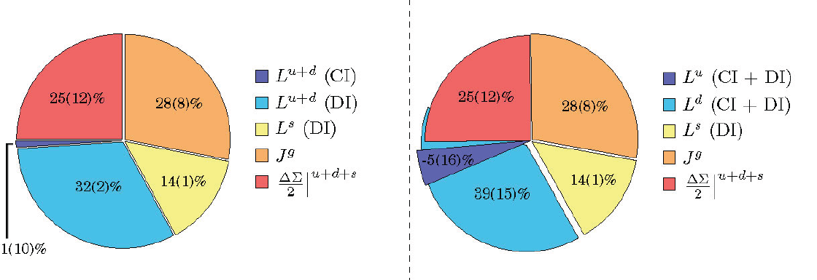

Status of Proton Spin
Quark spin ΔΣ ~ 20 - 30% of proton spin (DIS, Lattice)
Glue spin ~ 0.2$÷$0.4 (STAR, COMPASS)
Quark orbital angular momentum? (lattice calculation)
From `proton spin crisis’ to `missing spin search’.

Slide 44
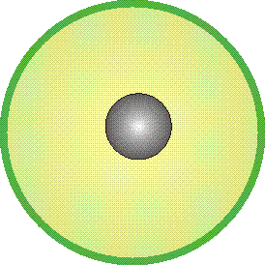
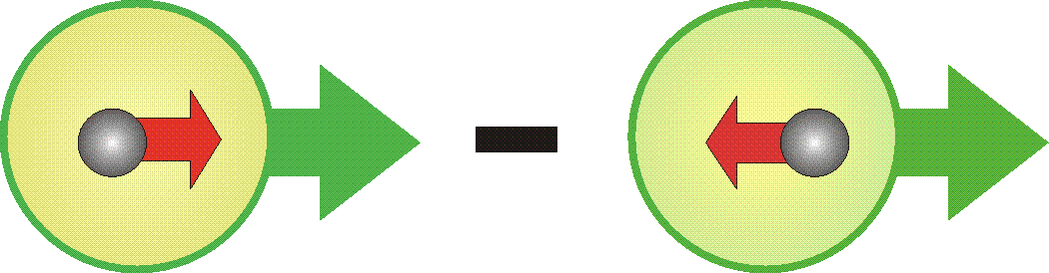
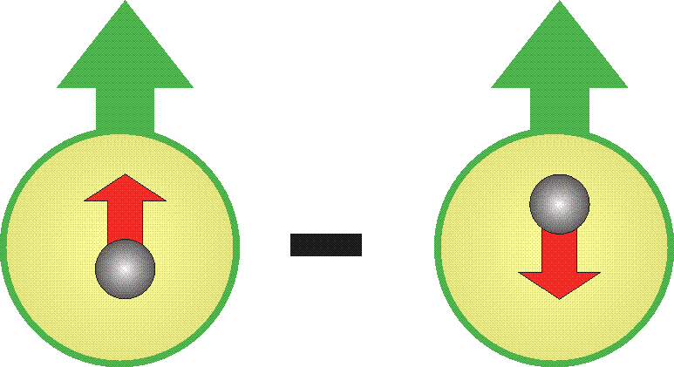
The nucleon structure
three distribution functions
are necessary to describe the structure of the nucleon at LO:
q(x) : number density or unpolarised distribution
 | probability of finding a quark with a fraction x of the longitudinal momentum of the parent nucleon
Δq(x) = q- q: longitudinal polarization or helicity distribution
 | in a longitudinally polarised nucleon, probability of finding a quark with spin parallel to that of the parent nucleon and a momentum fraction x and
Δ_{T}q(x) = q☺- q: transverse polarization or transversity distribution
 | in a transversly polarised nucleon, probability of finding a quark with spin parallel to that of the parent nucleon and a momentum fraction x and
q quark or antiquark with a specific flavor
ALL OF EQUAL IMPORTANCE !

Slide 45
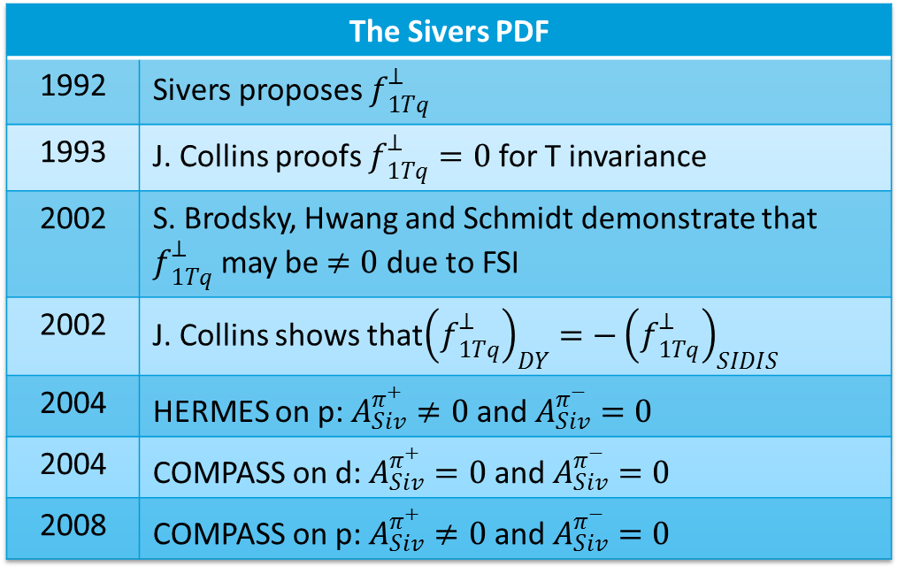

Sivers Asymmetry
Sivers: correlates nucleon spin & quark transverse momentum k_{T} /T-ODD
at LO:
$$μp^{↑}→μXh^{±}$$
The Sivers PDF
1992 | Sivers proposes $f_{1Tq}^{⊥}$
1993 | J. Collins proofs $f_{1Tq}^{⊥}=0$ for T invariance
2002 | S. Brodsky, Hwang and Schmidt demonstrate that $f_{1Tq}^{⊥}$ may be $≠0$ due to FSI
2002 | J. Collins shows that${\left(f_{1Tq}^{⊥}\right)}_{DY}=−{\left(f_{1Tq}^{⊥}\right)}_{SIDIS}$
2004 | HERMES on p: $A_{Siv}^{π^{+}}≠0$ and $A_{Siv}^{π^{−}}=0$
2004 | COMPASS on d: $A_{Siv}^{π^{+}}=0$ and $A_{Siv}^{π^{−}}=0$
2008 | COMPASS on p: $A_{Siv}^{π^{+}}≠0$ and $A_{Siv}^{π^{−}}=0$

Slide 46

Key COMPASS measurements
$$g_{1}^{d}\left(x\right), \int{g_{1}^{d}\left(x\right)dx}$$ | Confirmation of SMC result on d (at variance with E142 claims)
$$Δg/g$$ | first hint that $Δg$ is small, at variance with predictions
$$A_{Col, d}^{h}$$ | first measurement of transversity on deuteron $h_{1}^{u}≃−2h_{1}^{d} H_{1, fav}^{⊥}≃−H_{1, unf}^{⊥}$
$$A_{p, d}^{2h}$$ | Only polarimeter for transversity extraction from 2h asymmetries transversity extracted directly from the data, following Pavia group
$$A_{Siv, p}^{h}$$ | Evolution of Sivers
$$a_{1}^{}(1420)$$ | New state
Radiative width of $a_{2}^{}\left(1320\right)$ and $π_{2}^{}(1670)$ | Confirmation of VMD model, EPJ highlight
Pion Polarisability | Confirmation of ChPT prediction

Slide 47




Quantum tomography of the nucleon
Join the real
3D experience !!
TMDs
GPDs
2D+1 picture in momentum space
  transverse momentum
  dependent distributions
2D+1 picture in coordinate space
  generalized parton distributions
  exclusive reaction like DVCS
Quarks
unpolarised polarised

Slide 48

Near COMPASS future is defined:
2014-2015: Transversely polarized DY to check pseudo-universality (${\left[f_{1T}^{⊥}\left(x, Q^{2}\right)\right]}_{DY}≈−{\left[f_{1T}^{⊥}\left(x, Q^{2}\right)\right]}_{SIDIS}$)
2016-2017: Unpolarised DVCS/HVMP
(B slope and GPD H)
and unpolarised SIDIS on ${LH}_{2}$
${{dn}^{h}}/{\left({dN}^{μ}dz dp_{T}^{2}\right)}$ i.e. $p_{T}$ dependent multiplicities, and $h_{1T}^{⊥}$ Boer-Mulders TMD PDF
2018 to be discussed having in hand the performances in the previous years

Slide 49

More in the FUTURE:

Slide 50

THANK
YOU

Slide 51
Quantum Chromodynamics (QCD)
Theory is rich in symmetries:
QCD - “nearly perfect” fundamental quantum theory of quark
and gluon fields F.Wilczek, hep-ph/9907340
i
ii
iii
Gauge “color” symmetry: unbroken but confined
Global “chiral” symmetry: exact for massless quarks
Baryon number and axial charge (m=0) are conserved
Scale invariance of quark (m=0) and gluon fields
Discrete C,P & T symmetries
Chiral, Axial, Scale and (in principle) P &T broken by
vacuum/quantum effects - ”emergent” phenomena
Inherent in QCD are the deepest aspects of relativistic Quantum Field Theories (confinement, asymptotic freedom, anomalies, spontaneous breaking of chiral symmetry)

Slide 52

Importance of pion polarisability measurements
From the theoretical side there is an extraordinary interest in a precise determination of the pion polarisabilities.
Within the framework of the partially conserved axial-vector current (PCAC) hypothesis and current algebra the electromagnetic polarisabilities of the charged pion are related to the radiative decay $π^{+}→e^{+}ν_{e}γ$.
The result obtained using ChPT at leading nontrivial order $ℴ\left(p^{4}\right)$ is equivalent to the original PCAC result, $α_{π^{+}}=−β_{π^{+}}\sim {\overline{l}}_{∆}$ where ${\overline{l}}_{∆}$ is a linear combination of scale-independent parameters of the Gasser and Leutwyler Lagrangian.
At $ℴ\left(p^{4}\right)$ this difference is related to the ratio $γ={F_{A}}/{F_{V}}$ of the pion axial-vector and the vector form factors of the radiative pion $β$ decay .
Once this ratio is known, chiral symmetry makes an absolute prediction for the polarisabilities.

Slide 53
Measurement of the pion polarisabilities

Slide 54

Identify the $πγ→πγ$ reaction
$∆Q_{T}≈12 MeV/c$ (190 GeV$/c$ beam → requires few-μrad angular resolution)
first diffractive minimum on Ni nucleus at $Q→190 MeV/c$

Slide 55
Photon energy spectra for muon and pion beam

Slide 56

Identify the $πγ→πγ$ reaction
Energy balance $∆E=E_{π}^{′}+E_{γ}−E_{π}$
Exclusivity peak $σ≈2.6$ GeV (1.4%)
63 000 exclusive events ($x_{γ}>0.4$)

Slide 57
Pion polarisability: world data including COMPASS
The new COMPASS result is in significant tension with the earlier measurements of the pion polarisability
The expectation from ChPT is confirmed within the uncertainties

Slide 58
Primakoff
Chiral Perturbation Theory

Slide 59

Primakoff
Chiral Perturbation Theory

Slide 60


Primakoff
Chiral Perturbation Theory

Slide 61

Primakoff
Chiral Perturbation Theory

Slide 62

Primakoff
Chiral Perturbation Theory

Slide 63

Primakoff
Chiral Perturbation Theory

