Slide 1
COMPASS studies of TMDs; recent results and future perspectives

Slide 2
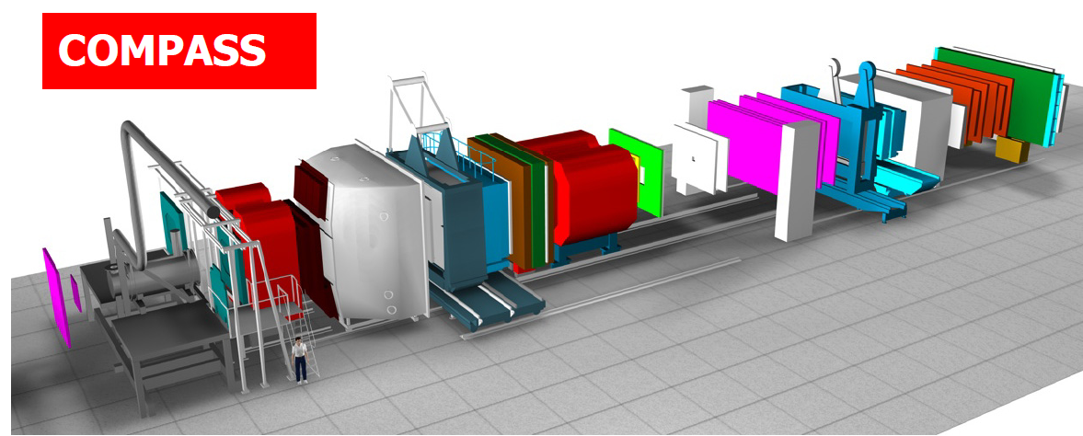
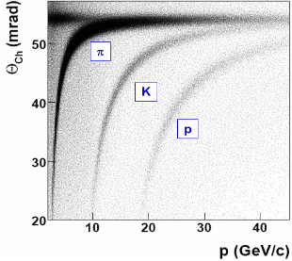
Muon beam: SIDIS setup
high energy beam
large angular acceptance
broad kinematical range
two stages spectrometer
  Large Angle Spectrometer (SM1)
  Small Angle Spectrometer (SM2)
radiator C₄F₁₀
threshold: π ~2 GeV/c
K ~ 10 GeV/c
SM2
MuonWall
E/HCAL
SM1
RICH
MuonWall
Target
E/HCAL
variety of tracking detectors to cope with different particle flux from θ = 0 to θ ≈ 200 mrad
Notes:
2

Slide 3
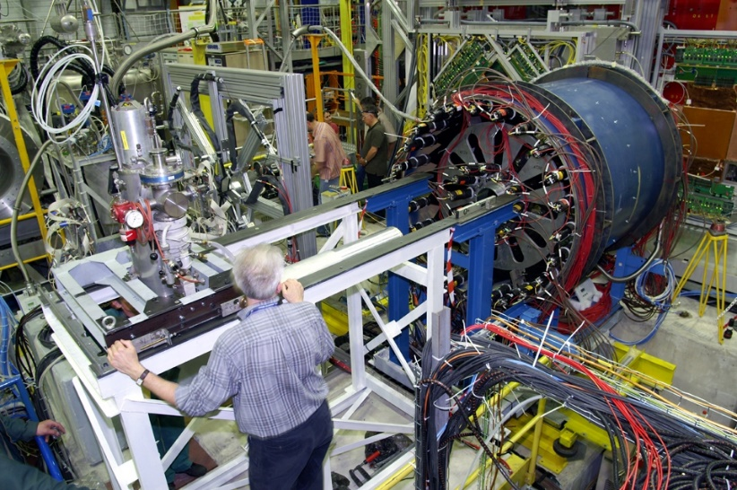
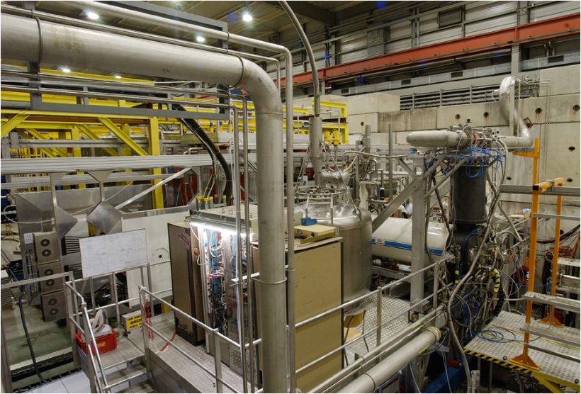
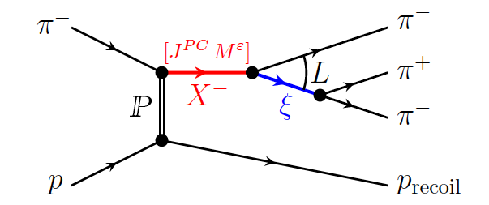
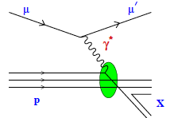
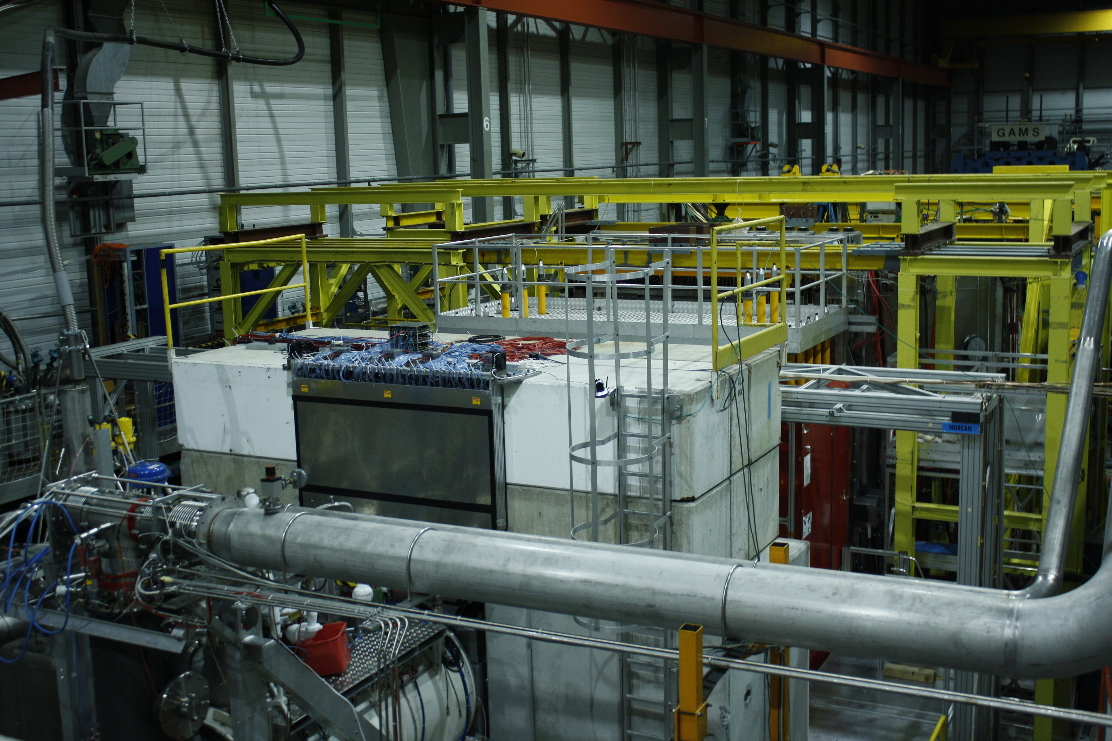
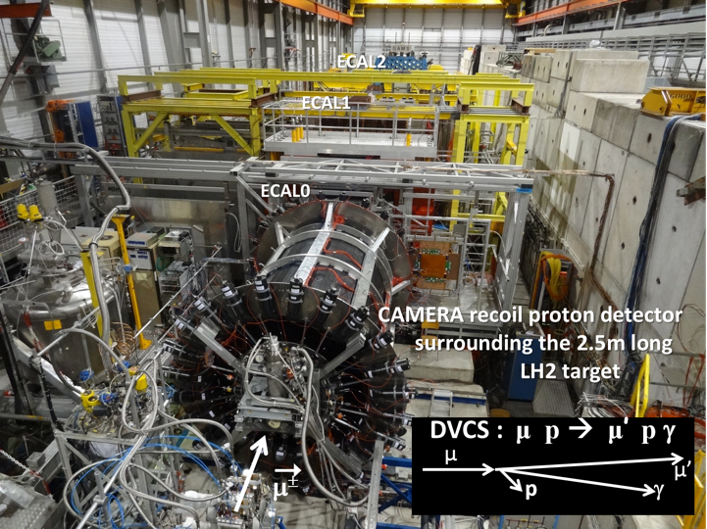
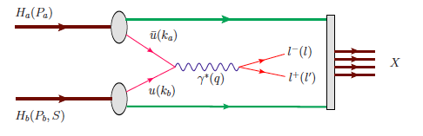
COMPASS target area
Hadron Spectroscopy
Polarised SIDIS
COMPASS-I
1997-2011
Polarised Drell-Yan
DVCS (GPDs) + unp. SIDIS
COMPASS-II
2012-2020

Slide 4
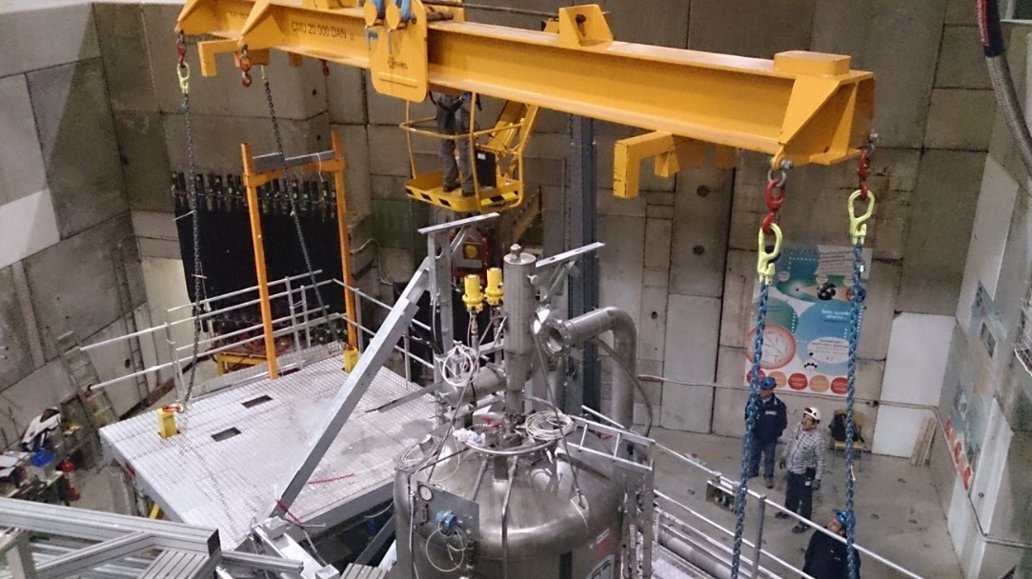
Operations on the target area

Slide 5
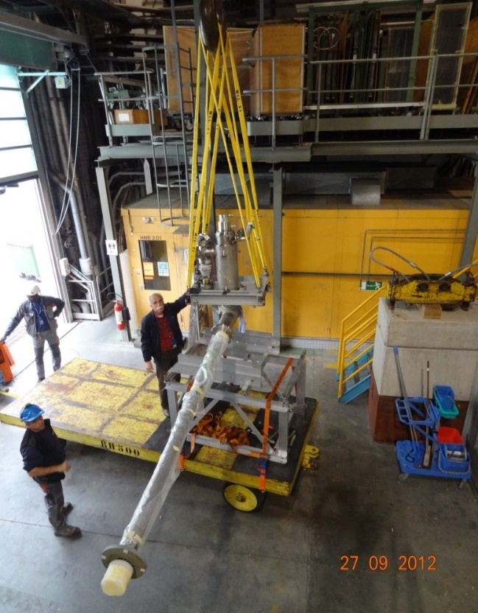
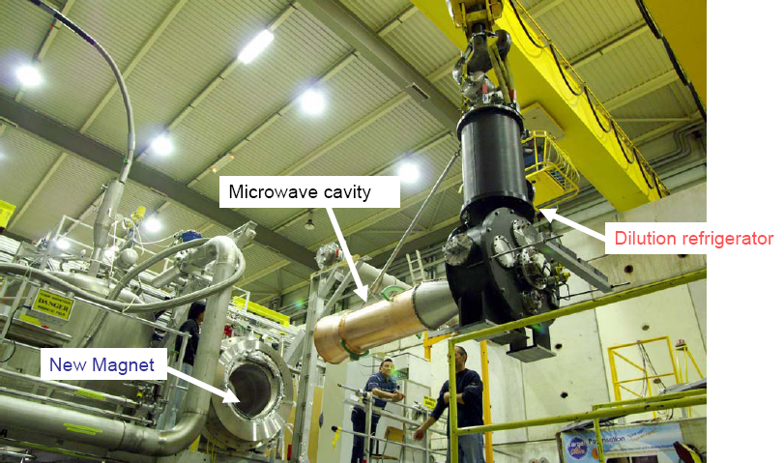
Targets

Slide 6
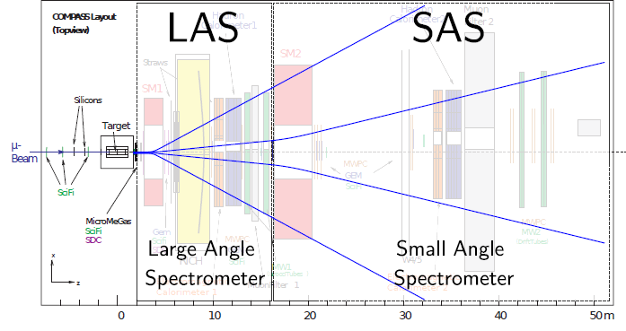
Two stage spectrometer

Slide 7
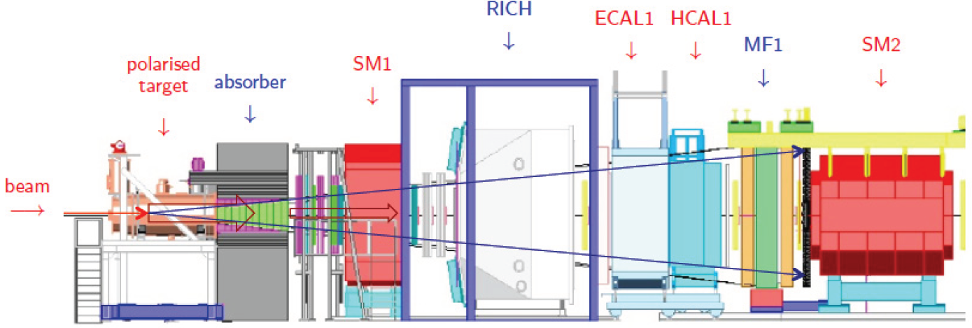
Hadron beam: Drell-Yan setup

Slide 8
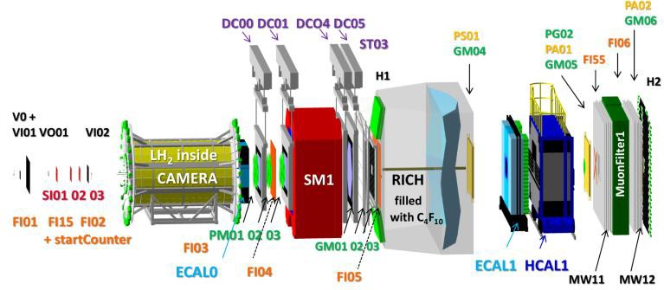
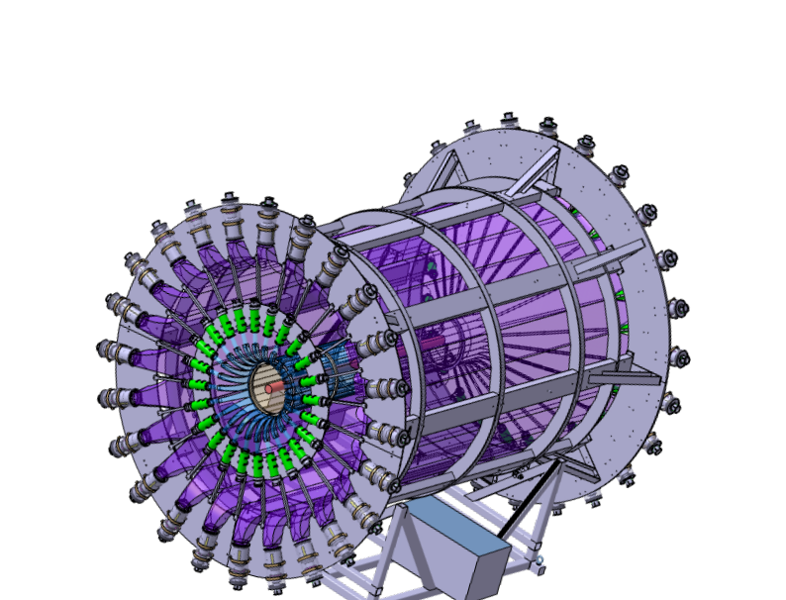
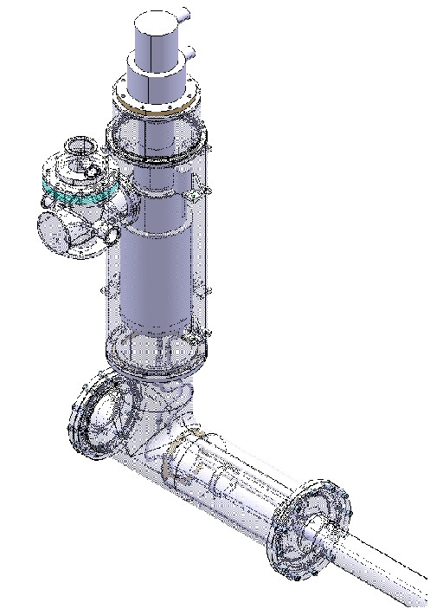
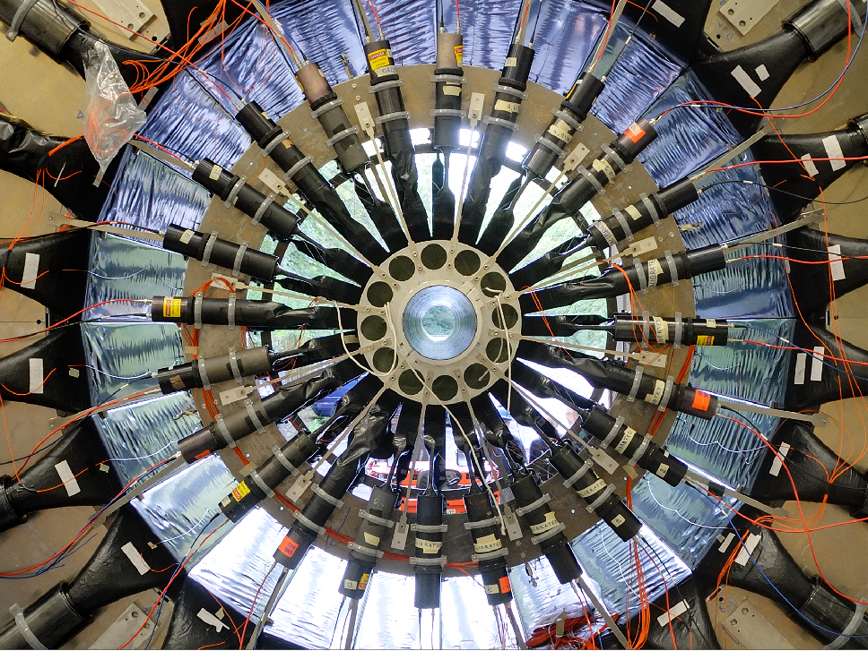
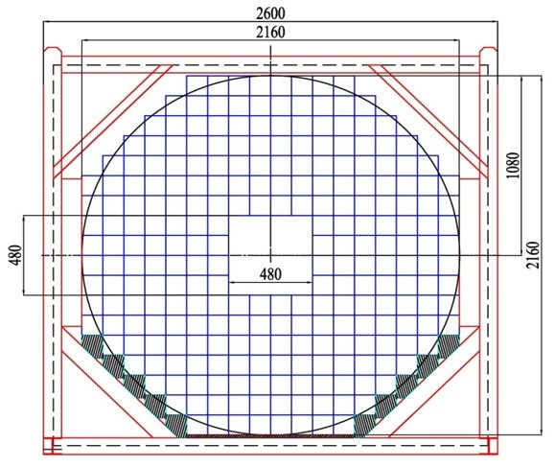
Muon beam – DVCS setup

Slide 9
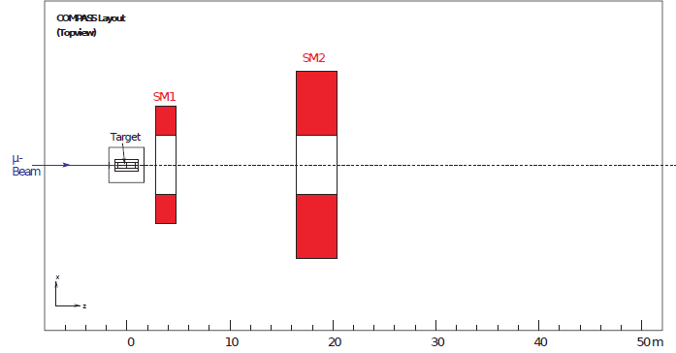
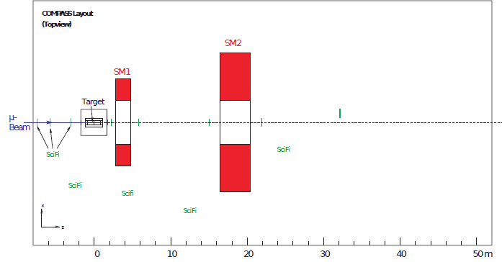
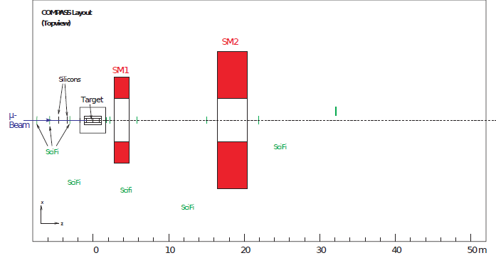
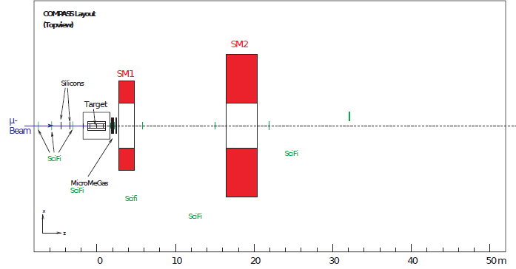
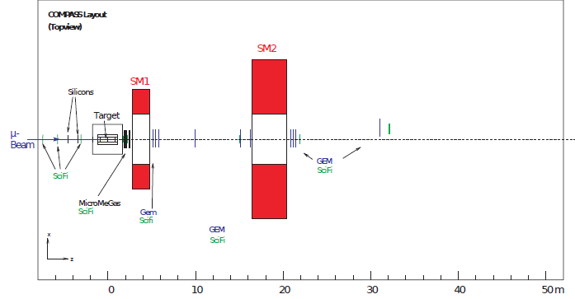
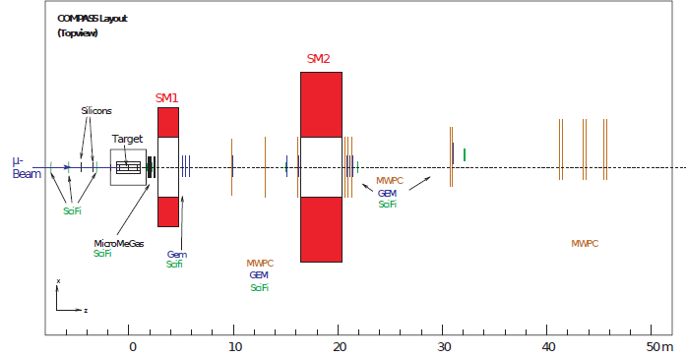
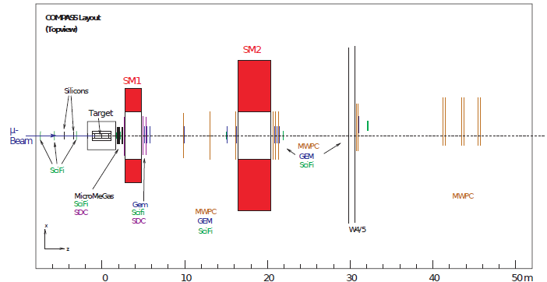

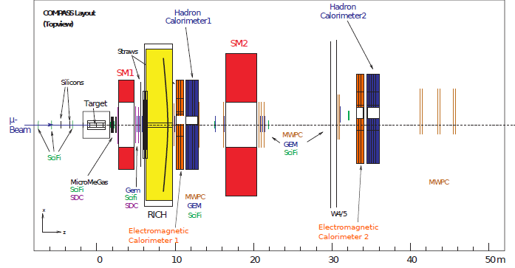
Spectrometer elements

Slide 10
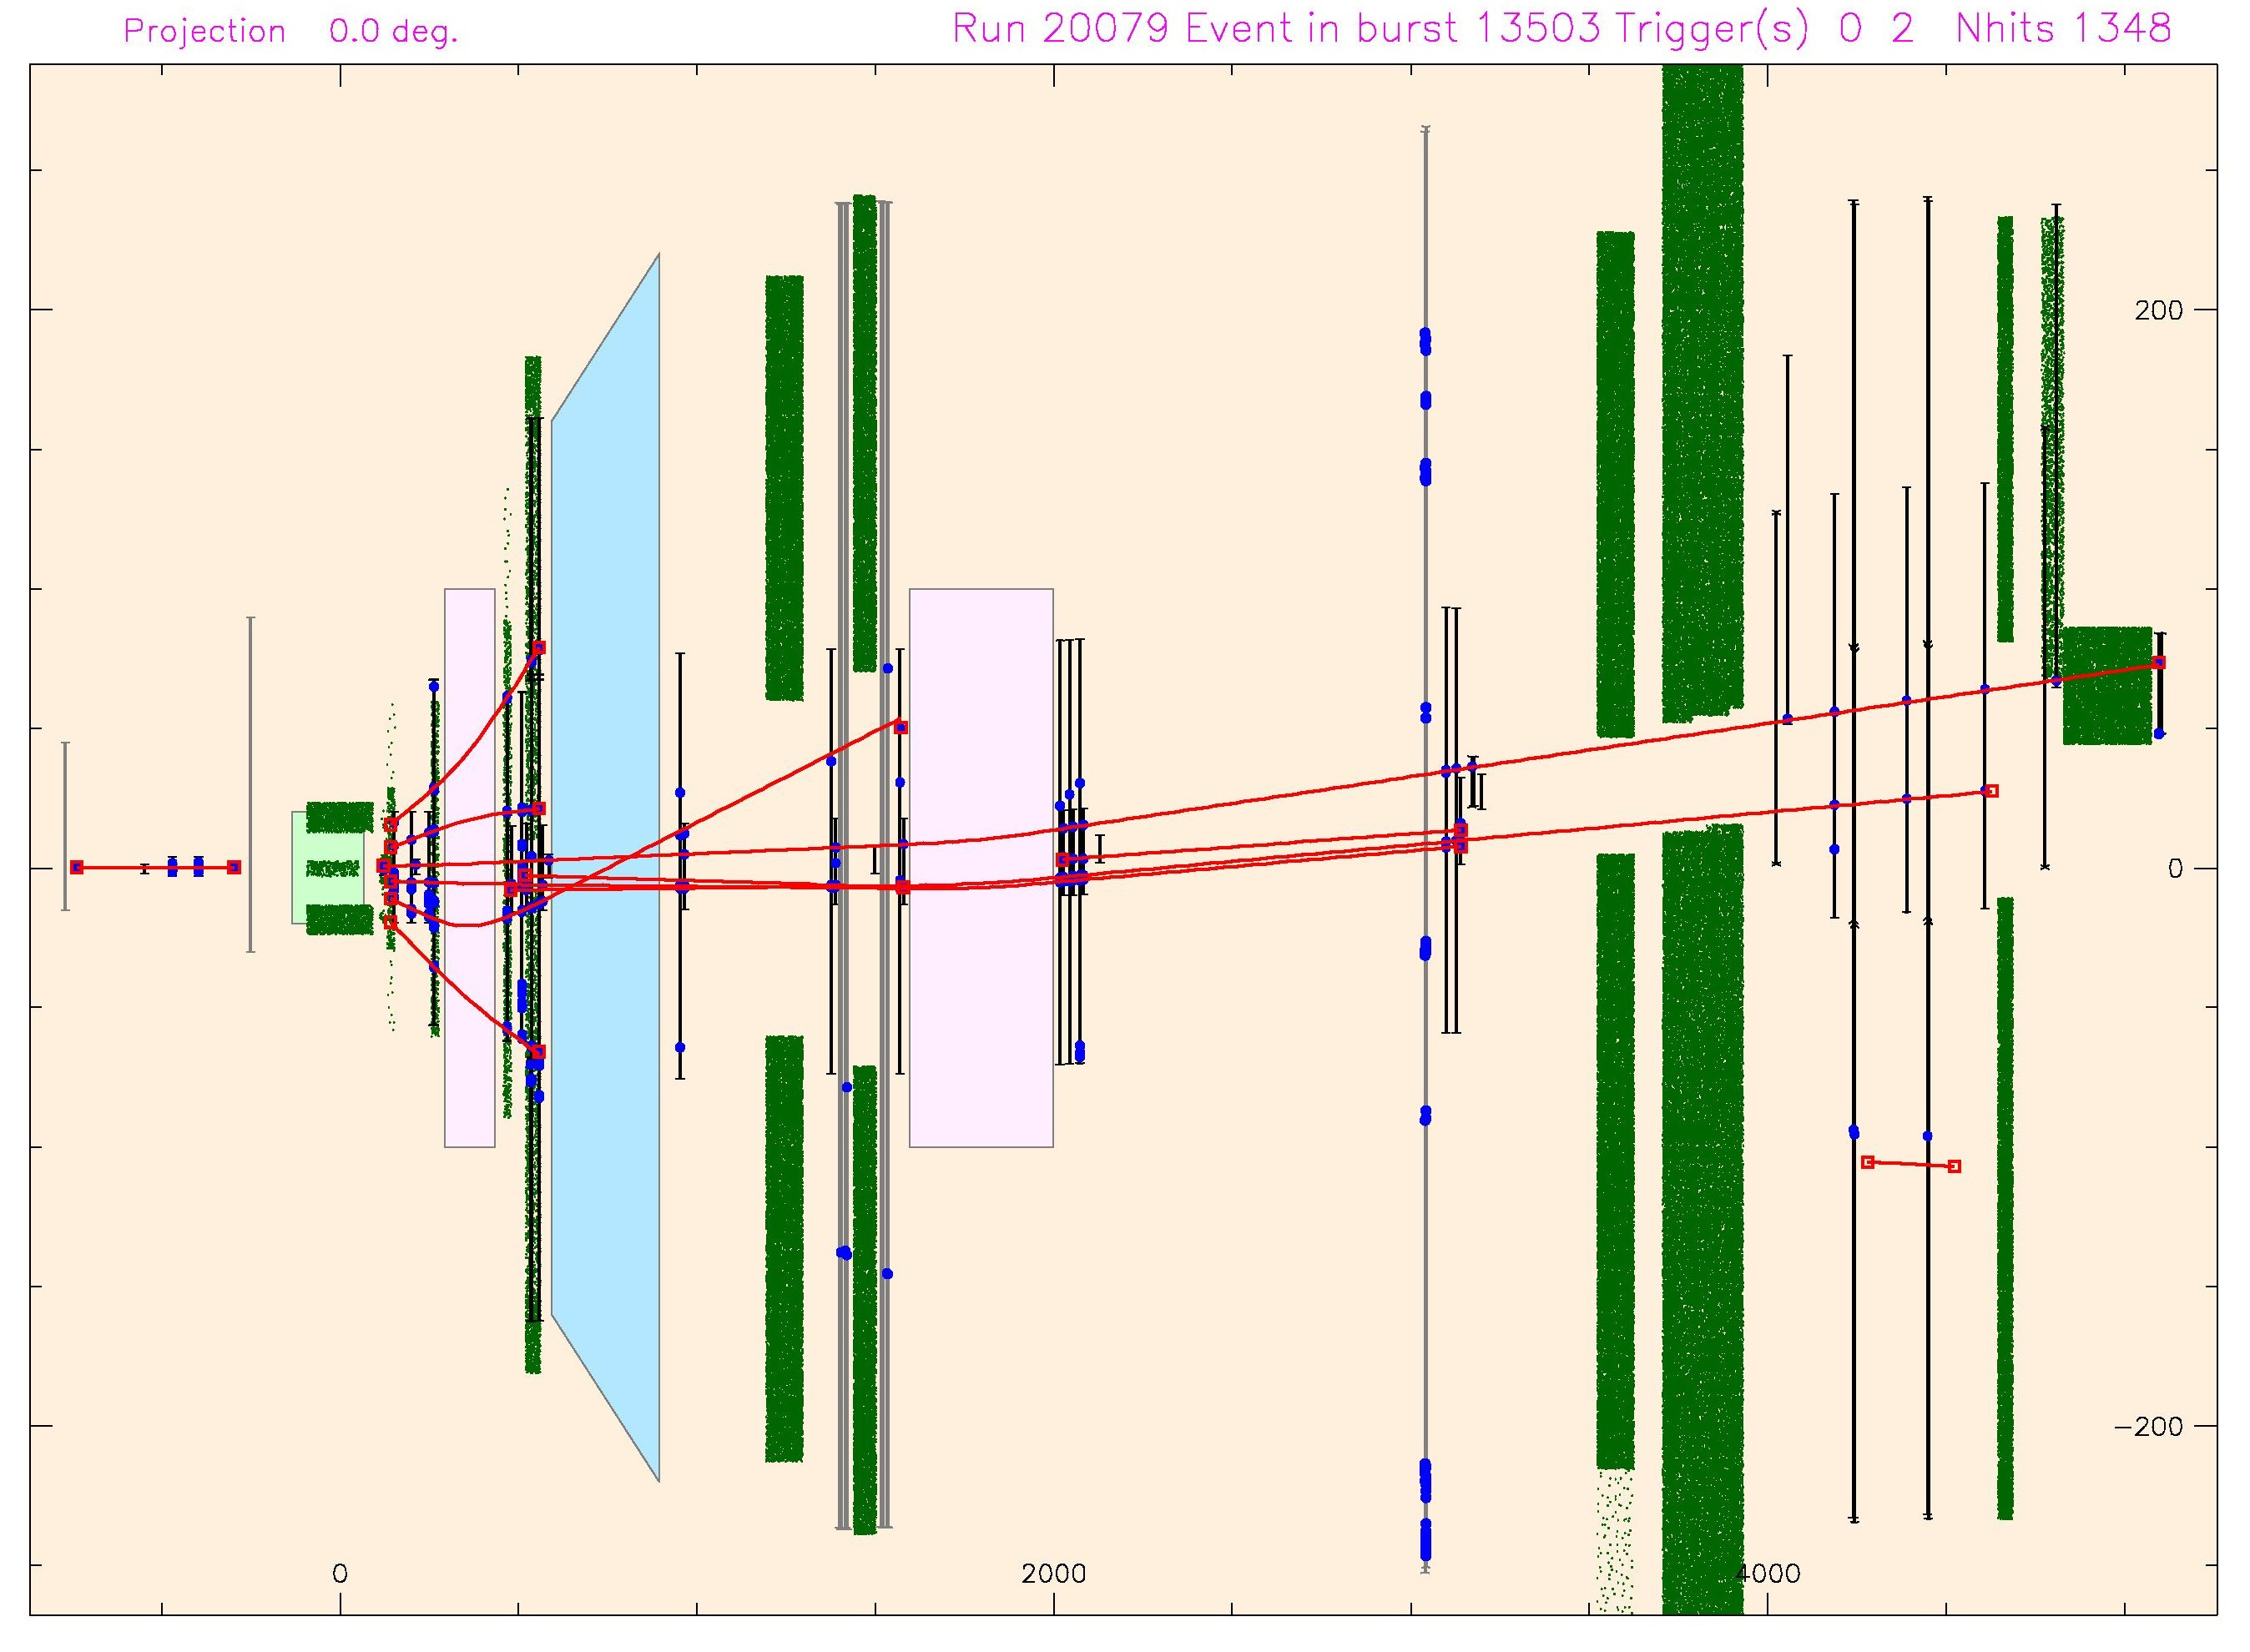
Spectrometer: momentum determination
Magnet1
RICH
Magnet2
Target

Slide 11
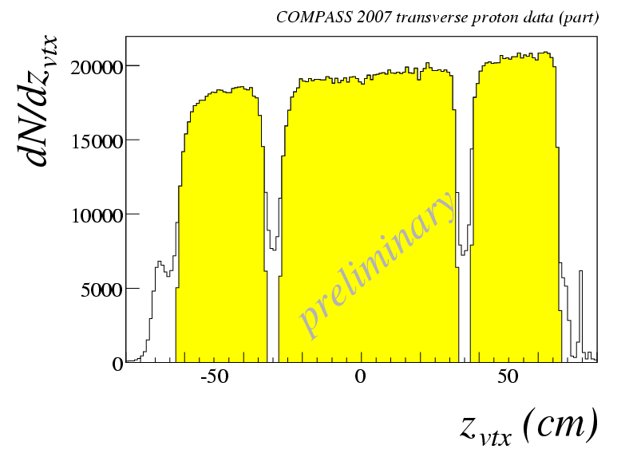
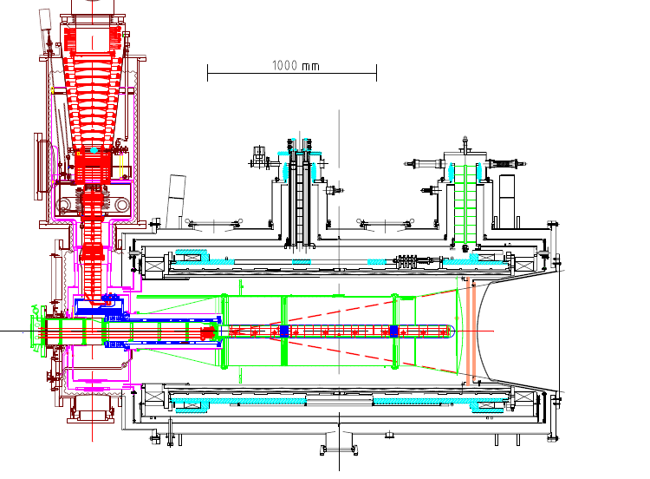
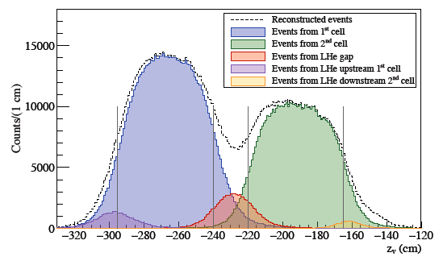
the polarized target system (>2005)
³He – ⁴He dilution refrigerator (T~50mK)
acceptance > ± 180 mrad
3 target cells
30, 60, and 30 cm long
μ
opposite polarisation
d (⁶LiD) p (NH₃)
polarization 50% 90%
dilution factor 40% 16%
solenoid 2.5T
dipole magnet 0.6T
no evidence for relevant
nuclear effects (160 GeV)

Slide 12
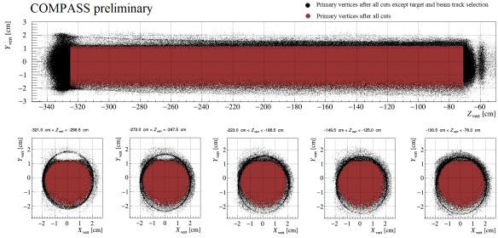
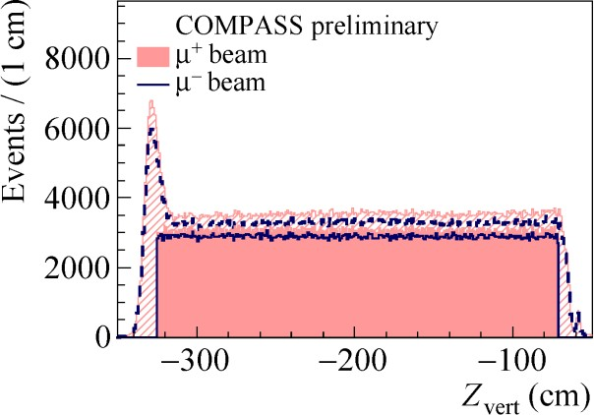
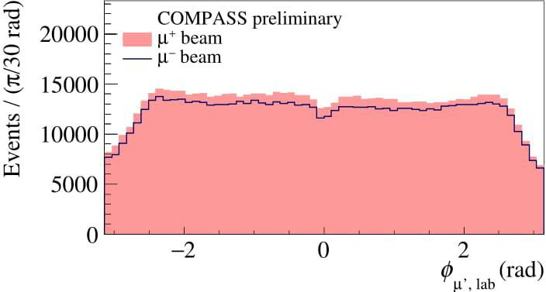
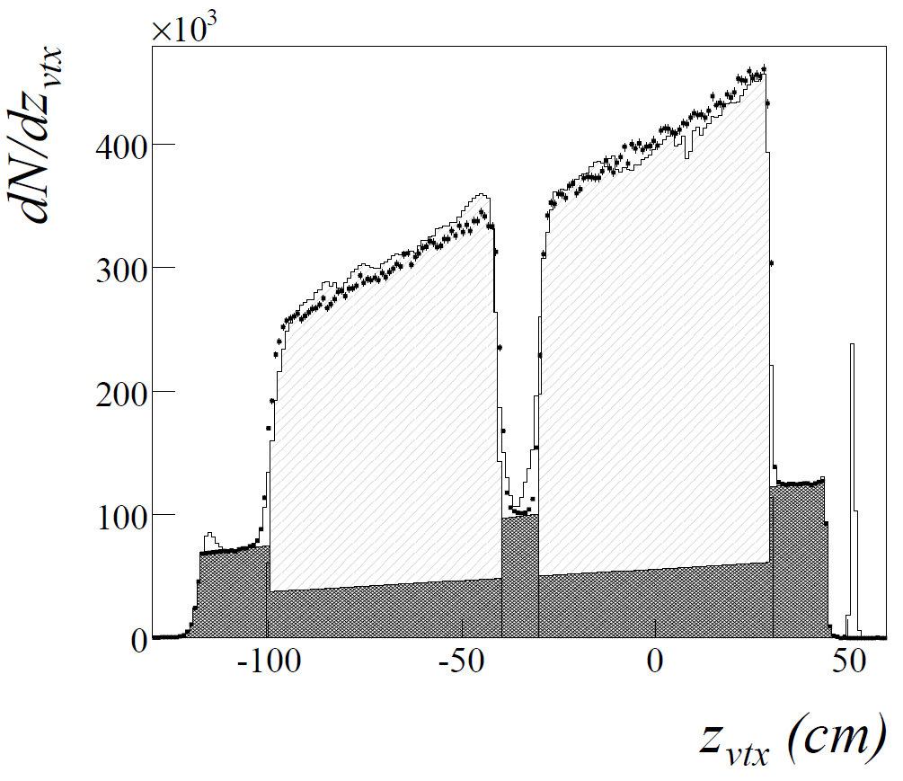
Vertex determination

Slide 13
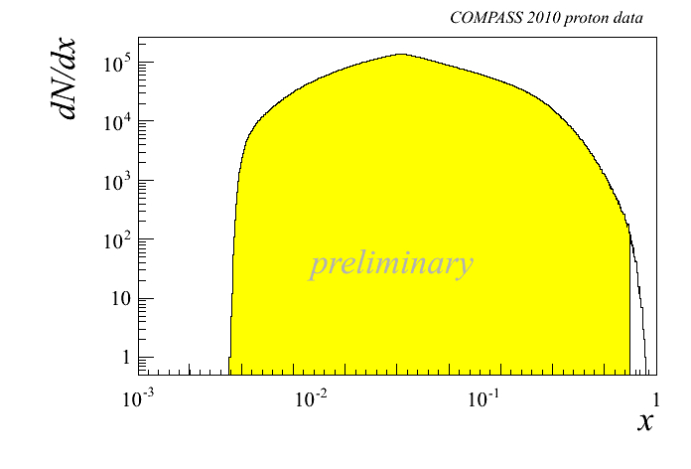
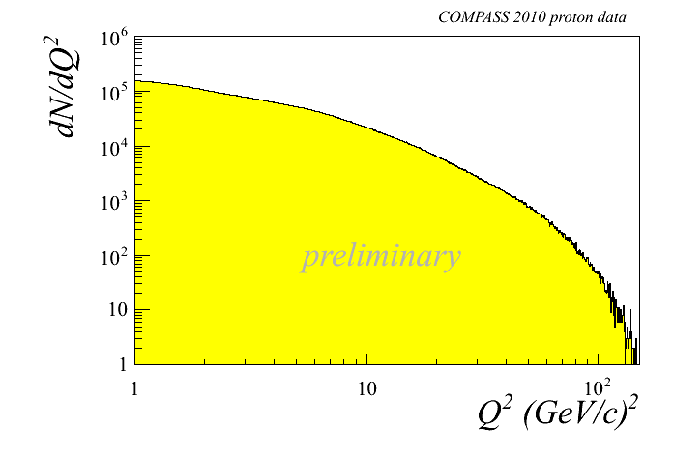
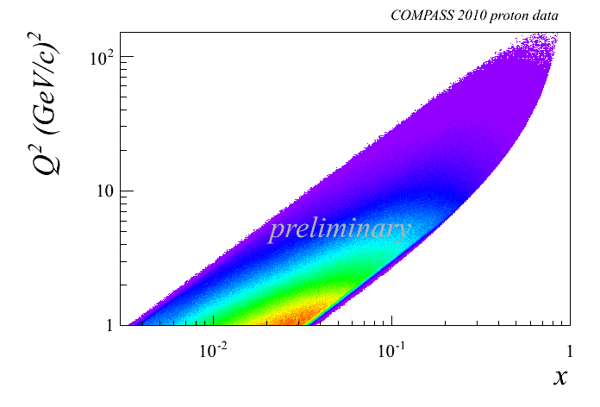
Kinematic distributions
DIS cuts: Q² > 1 (GeV/c)²
0.1 < y < 0.9
W > 5 GeV/c²
Notes:
13

Slide 14
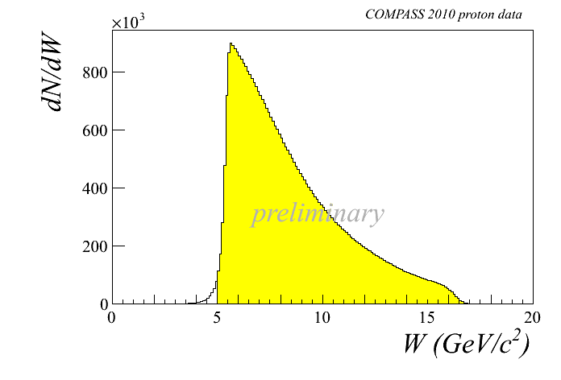
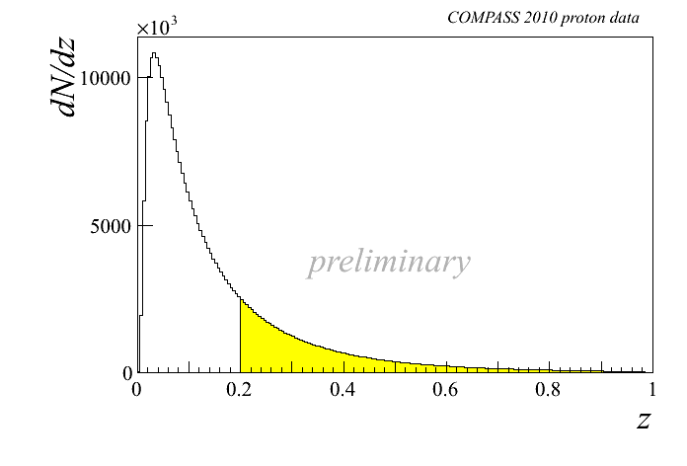
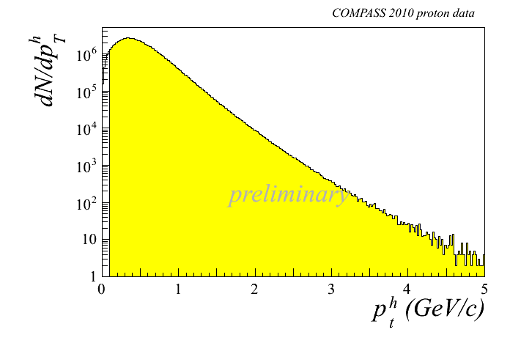
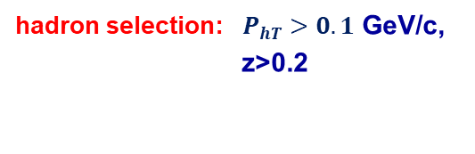
Kinematic distributions - 2
DIS cuts: Q² > 1 (GeV/c)²
0.1 < y < 0.9
W > 5 GeV/c²
hadron selection: $P_{hT}>0.1$ GeV/c,
z>0.2
Notes:
14
14

Slide 15
COMPASS data taking
muon beam | deuteron (⁶LiD) PT | 2002 2003 2004 | 80% L/20% T target polarisation
 |  | 2006 | L target polarisation
 | proton (NH₃) PT | 2007 | 50% L /50% T target polarisation
Hadron | LH target | 2008 2009
muon beam | proton (NH₃) PT | 2010 | T target polarisation
 |  | 2011 | L target polarisation
Hadron | Ni target | 2012 | Primakoff
muon beam | LH2 target | 2012 | Pilot DVCS & unpol. SIDIS
Hadron | Proton (NH3) DT PT | 2014 2015 2018 | Pilot DY run DY run DY run
muon beam | LH2 target | 2016 2017 | DVCS & unpol. SIDIS

Slide 16
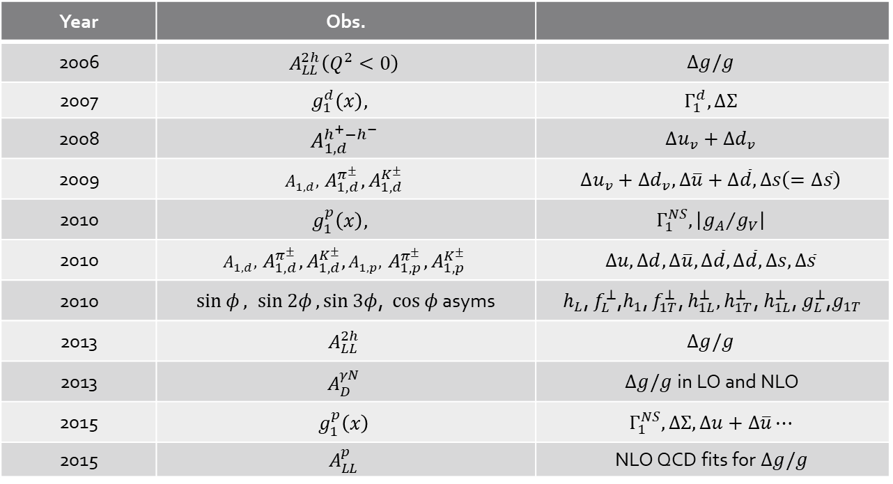
Measurements with the target longitudinally polarized:
Year | Obs.
2006 | $$A_{LL}^{2h}\left(Q^{2}<0\right)$$ | $$Δg/g$$
2007 | $$g_{1}^{d}\left(x\right),$$ | $$Γ_{1}^{d}, ∆Σ$$
2008 | $$A_{1,d}^{h^{+}−h^{−}}$$ | $$Δu_{v}+Δd_{v}$$
2009 | $$A_{1,d}^{},{ A}_{1,d}^{π^{±}},A_{1,d}^{K^{±}}$$ | $$Δu_{v}+Δd_{v},Δ\overline{u}+Δ\overline{d}, Δs\left(=Δ\overline{s}\right)$$
2010 | $$g_{1}^{p}\left(x\right),$$ | $$Γ_{1}^{NS}, \left|{g_{A}}/{g_{V}}\right|$$
2010 | $$A_{1,d}^{},{ A}_{1,d}^{π^{±}},A_{1,d}^{K^{±}},A_{1,p}^{},{ A}_{1,p}^{π^{±}},A_{1,p}^{K^{±}}$$ | $$Δu, Δd,Δ\overline{u}, Δ\overline{d},Δ\overline{d}, Δs,Δ\overline{s}$$
2010 | $\sin{φ}, \sin{2φ}, \sin{3φ}$, $\cos{φ}$ asyms | $h_{L}$, $f_{L}^{⊥}$,$h_{1}$, $f_{1T}^{⊥}$, $h_{1L}^{⊥}, h_{1T}^{⊥}$, $h_{1L}^{⊥}$, $g_{L}^{⊥}$,$g_{1T}$
2013 | $$A_{LL}^{2h}$$ | $$Δg/g$$
2013 | $$A_{D}^{γN}$$ | $Δg/g$ in LO and NLO
2015 | $$g_{1}^{p}\left(x\right)$$ | $$Γ_{1}^{NS}, ΔΣ,Δu+Δ\overline{u}⋯$$
2015 | $$A_{LL}^{p}$$ | NLO QCD fits for $Δg/g$

Slide 17
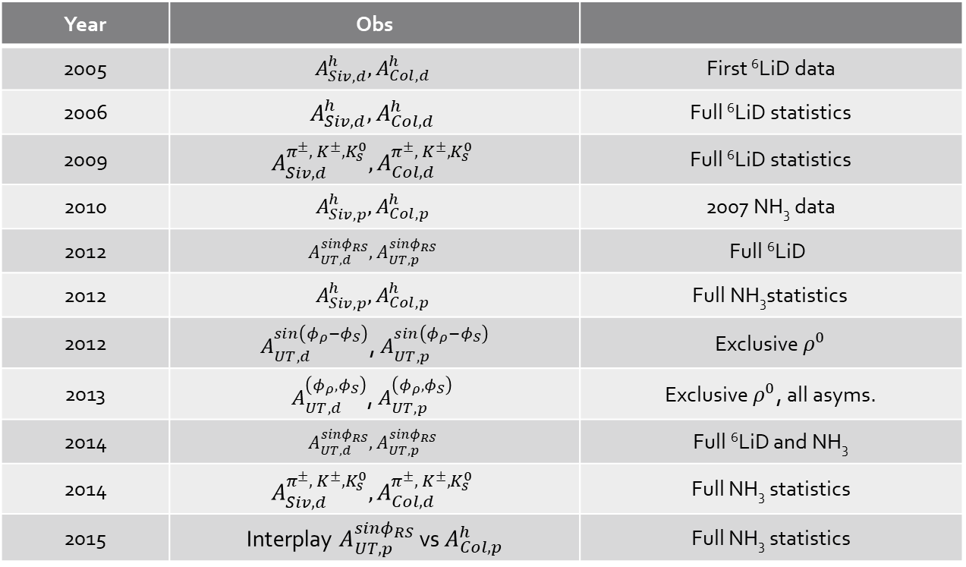
Measurements with the target transversely polarized:
Year | Obs
2005 | $$A_{Siv, d}^{h}, A_{Col, d}^{h}$$ | First ⁶LiD data
2006 | $$A_{Siv, d}^{h}, A_{Col, d}^{h}$$ | Full ⁶LiD statistics
2009 | $$A_{Siv, d}^{π^{±},{ K}^{±}, K_{s}^{0}}, A_{Col, d}^{π^{±},{ K}^{±}, K_{s}^{0}}$$ | Full ⁶LiD statistics
2010 | $$A_{Siv, p}^{h}, A_{Col, p}^{h}$$ | 2007 NH₃ data
2012 | $$A_{UT,d}^{sinφ_{RS}},A_{UT,p}^{sinφ_{RS}}$$ | $$\text{Full} \text{6}\text{LiD}$$
2012 | $$A_{Siv, p}^{h}, A_{Col, p}^{h}$$ | $$\text{Full} \text{NH}\text{3}\text{statistics}$$
2012 | $A_{UT,d}^{sin\left(φ_{ρ}−φ_{S}\right)}$, $A_{UT,p }^{sin\left(φ_{ρ}−φ_{S}\right)}$ | Exclusive${ ρ}^{0}$
2013 | $$A_{UT,d}^{\left(φ_{ρ},φ_{S}\right)}\text{, }A_{UT,p }^{\left(φ_{ρ},φ_{S}\right)}$$ | Exclusive${ ρ}^{0}$, all asyms.
2014 | $$A_{UT,d}^{sinφ_{RS}},A_{UT,p}^{sinφ_{RS}}$$ | $\text{Full} \text{6}\text{LiD}$and NH₃
2014 | $$A_{Siv, d}^{π^{±},{ K}^{±}, K_{s}^{0}}, A_{Col, d}^{π^{±},{ K}^{±}, K_{s}^{0}}$$ | Full NH₃ statistics
2015 | Interplay $A_{UT,p}^{sinφ_{RS}}$ vs $A_{Col, p}^{h}$ | Full NH₃ statistics

Slide 18
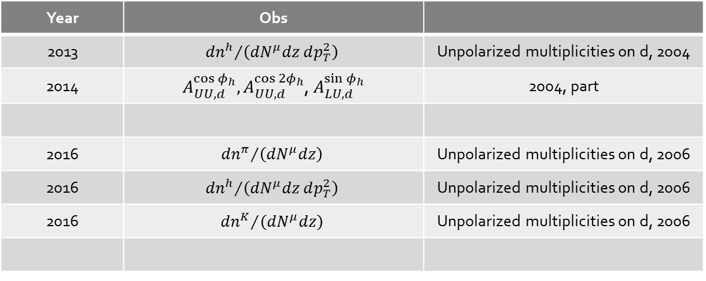
Measurements with unpolarised targets:
Year | Obs
2013 | $${{dn}^{h}}/{\left({dN}^{μ}dz dp_{T}^{2}\right)}$$ | Unpolarized multiplicities on d, 2004
2014 | $A_{UU,d}^{\cos{φ_{h}}},A_{UU,d}^{\cos{{2φ}_{h}}}$, $A_{LU,d}^{\sin{φ_{h}}}$ | 2004, part
2016 | $${{dn}^{π}}/{\left({dN}^{μ}dz\right)}$$ | Unpolarized multiplicities on d, 2006
2016 | $${{dn}^{h}}/{\left({dN}^{μ}dz dp_{T}^{2}\right)}$$ | Unpolarized multiplicities on d, 2006
2016 | $${{dn}^{K}}/{\left({dN}^{μ}dz\right)}$$ | Unpolarized multiplicities on d, 2006

Slide 19
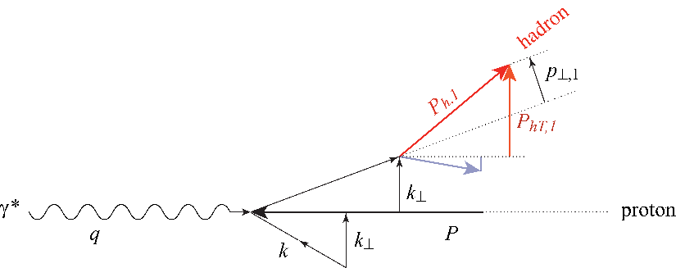
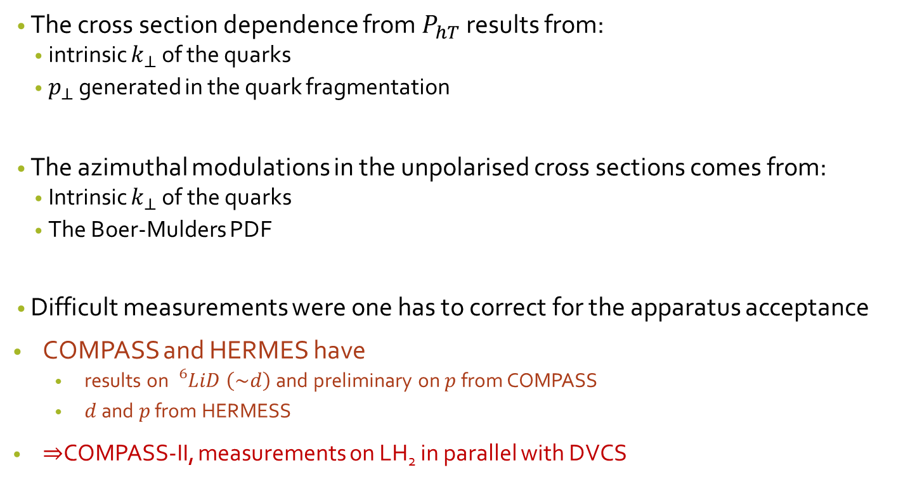
Importance of unpolarized SIDIS
The cross section dependence from $P_{hT}$ results from:
  intrinsic $k_{⊥}$ of the quarks
  $p_{⊥}$ generated in the quark fragmentation
The azimuthal modulations in the unpolarised cross sections comes from:
  Intrinsic $k_{⊥}$ of the quarks
  The Boer-Mulders PDF
Difficult measurements were one has to correct for the apparatus acceptance
COMPASS and HERMES have
  results on ${}_{}^{6}{LiD} \left(\sim d\right)$ and preliminary on $p$ from COMPASS
  $d$ and $p$ from HERMESS
$⇒$COMPASS-II, measurements on LH₂ in parallel with DVCS

Slide 20
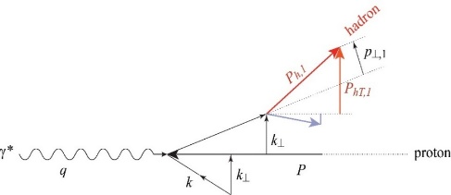


Positive vs Negative charged hadrons (${}_{}^{6}{LiD}$)
$$F_{UU}^{h}\left(x, z, P_{hT}^{2}; Q^{2}\right)=x\sum_{q}{e_{q}^{2}\int{d^{2}{\vec{k}}_{⊥}d^{2}{\vec{p}}_{⊥}δ\left({\vec{p}}_{⊥}+z{\vec{k}}_{⊥}−{\vec{P}}_{hT}\right) f_{1}^{q}\left(x, k_{⊥}^{2};Q^{2}\right)D_{1}^{q→h}\left(z,p_{⊥}^{2};Q^{2}\right)}}$$
$\left\langle Q^{2}\right\rangle =9.78 {\left(GeV/c\right)}^{2}$and $\left\langle x\right\rangle =0.149$

Slide 21

Positive vs Negative charged hadrons ($p$)

Slide 22

Positive charged hadrons ($p$)

Slide 23

Negative charged hadrons ($p$)

Slide 24

The matching problem (${q_{T}}/Q>1$region)
N. Sato

Slide 25


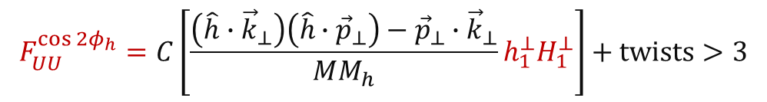
Unpolarised Azimuthal Modulation
When looking at the content of the structure functions/modulations in terms of TMD PDFs for the $\cos{φ_{h}}$ and $\cos{{2φ}_{h}}$ we can write:
In the $\cos{{2φ}_{h}}$ Cahn effects enters only at twist4
$$F_{UU}^{\cos{φ_{h}}}=−\frac{2M}{Q}C\left[\frac{\hat{h}∙{\vec{k}}_{⊥}}{M}f_{1}D_{1}−\frac{p_{⊥}k_{⊥}}{M}\frac{{\vec{P}}_{hT}−z\left(\hat{h}∙{\vec{k}}_{⊥}\right)}{zM_{h}M}h_{1}^{⊥}H_{1}^{⊥}\right]+twists>3$$
$$F_{UU}^{\cos{{2φ}_{h}}}=C\left[\frac{\left(\hat{h}∙{\vec{k}}_{⊥}\right)\left(\hat{h}∙{\vec{p}}_{⊥}\right)−{\vec{p}}_{⊥}∙{\vec{k}}_{⊥}}{MM_{h}}h_{1}^{⊥}H_{1}^{⊥}\right]+twists>3$$
$$F_{Cahn}^{\cos{{2φ}_{h}}}≈\frac{2}{Q^{2}}C\left[\left\{2{\left(\hat{h}∙{\vec{k}}_{⊥}\right)}^{2}−k_{⊥}^{2}\right\}f_{1}D_{1}\right]$$

Slide 26

Azimuthal modulations on $p$
Nice agreement between positive and negative muon beams

Slide 27

Contribution of diffractive VMs
Determined from $z_{1}+z_{2}>0.95$
Selecting $ρ^{0}$ and $φ$
Smaller, but not negligible, effect for $\cos{2φ_{h}}$

Slide 28




Transversity PDF
$h_{1}^{q}(x)=q^{↑↑}(x)−q^{↑↓}(x)$
$q=u_{v},d_{v}, q_{sea}$
quark with spin parallel to the nucleon spin in a transversely polarised nucleon
probes the relativistic nature of quark dynamics
no contribution from the gluons  simple $Q^{2}$ evolution
Positivity: Soffer bound…………….. $2\left|h_{1}^{q}\right|≤f_{1}^{q}+g_{1}^{q}$
first moments: tensor charge………. $δq\left(Q^{2}\right)=\int_{0}^{1}{dx\left[h_{1}^{q}\left(x\right)−h_{1}^{\overline{q}}\left(x\right)\right]}$
is chiral-odd: decouples from inclusive DIS
Soffer, PRL 74 (1995)
Bakker, Leader, Trueman, PRD 70 (04)

Slide 29

Transversity
is chiral-odd:
observable effects are given only by the
product of $h_{1}^{q}$ (x) and an other chiral-odd function
can be measured in SIDIS on a transversely polarised target
via “quark polarimetry”
“Collins” asymmetry “Collins” Fragmentation Function
“two-hadron” asymmetry “Interference” Fragmentation Function
Λ polarisation Fragmentation Function of q↑Λ

Slide 30


$A_{Coll}^{p}$ on proton and ${}_{}^{3}{P_{0}}$ model for FF
Albi Kerbizi @ DSPIN17 http://theor.jinr.ru/~spin/2017/
Phys. Rev. D 97, 074010 (2018)/arXiv:1802.00962
The curves are fits of the Monte Carlo data, scaled by $λ\sim \left\langle {h_{1}^{u}}/{f_{1}^{u}}\right\rangle \sim 0.055$
Agreement with the measured Collins asymmetry is quite satisfactory
Notes:
30

Slide 31


2h asymmetries on p and ${}_{}^{3}{P_{0}}$ model for FF
$$A_{UT}^{\sin\left(φ_{R}+φ_{S}−π\right)}=\frac{\sum_{q}{e_{q}^{2}h_{1}^{q}\left(x\right)H_{q→h_{1}h_{2}}^{∡}\left(z, ℳ_{h_{1}h_{2}}^{2}\right)}}{\sum_{q}{e_{q}^{2}q\left(x\right)D_{q}^{h_{1}h_{2}}\left(z, ℳ_{h_{1}h_{2}}^{2}\right)}}$$
$a_{P}^{u↑⟶h^{+}h^{−}X}=\left\langle \sin\left(φ_{R}+φ_{S}−π\right)\right\rangle$ and $\vec{R}=\frac{z_{2}{\vec{P}}_{h1}−z_{1}{\vec{P}}_{h2}}{z_{1}+z_{2}}$ and as before $λ\sim \left\langle {h_{1}^{u}}/{f_{1}^{u}}\right\rangle \sim 0.055$

Slide 32



$Λ$ transverse spin transfer from COMPASS
$$P_{Λ\left(\overline{Λ}\right)}\left(x,z\right)=\frac{\sum_{q}{e_{q}^{2}h_{1}^{q}\left(x\right)}H_{1}^{Λ\left(\overline{Λ}\right)}\left(z\right)}{\sum_{q}{e_{q}^{2}f_{1}^{q}\left(x\right)}D_{1}^{Λ\left(\overline{Λ}\right)}\left(z\right)}$$
$$\frac{dN}{d\cos{θ^{∗}}}∝A\left(1+αP_{Λ\left(\overline{Λ}\right)}\cos{θ^{∗}}\right)$$

Slide 33


Sivers Asymmetry
Sivers: correlates nucleon spin & quark transverse momentum k_{T} /T-ODD
at LO:
$$μp^{↑}→μXh^{±}$$
The Sivers PDF
1992 | Sivers proposes $f_{1T}^{⊥}$
1993 | J. Collins proofs $f_{1T}^{⊥}=0$ for T invariance
2002 | S. Brodsky, Hwang and Schmidt demonstrate that $f_{1Tq}^{⊥}$ may be $≠0$ due to FSI
2002 | J. Collins shows that${\left(f_{1T}^{⊥}\right)}_{DY}=−{\left(f_{1T}^{⊥}\right)}_{SIDIS}$
2004 | HERMES on p: $A_{Siv}^{π^{+}}≠0$ and $A_{Siv}^{π^{−}}=0$
2004 | COMPASS on d: $A_{Siv}^{π^{+}}=0$ and $A_{Siv}^{π^{−}}=0$
2008 | COMPASS on p: $A_{Siv}^{π^{+}}≠0$ and $A_{Siv}^{π^{−}}=0$

Slide 34

Sivers Asymmetry
$$A_{Siv}\left(x,z\right)=\frac{F_{UT}^{sinΦ_{Siv}}(x,z) }{F_{UU}(x,z)}= \frac{\sum_{q}{e_{q}^{2}xf_{1T}^{⊥q}\left(x,{ k}_{⊥}^{2}\right)⨂D_{1q}^{h}(z, p_{⊥}^{2})}}{\sum_{q}{e_{q}^{2}xf_{1}^{q}\left(x, k_{⊥}^{2}\right)⨂D_{1q}^{h}(z, p_{⊥}^{2})}}$$
To evaluate it we need to solve the convolutions (i.e. make hypothesis on the transverse momenta dependences of the TMDs)
Gaussian ansatz: $f_{1T}^{⊥q}\left(x\right)\frac{e^{−k_{⊥}^{2}/{\left\langle k_{⊥}^{2}\right\rangle }_{S}}}{π{\left\langle k_{⊥}^{2}\right\rangle }_{S}} D_{1q}^{h}\left(z\right)\frac{e^{−p_{⊥}^{2}/\left\langle p_{⊥}^{2}\right\rangle }}{π\left\langle p_{⊥}^{2}\right\rangle }$
Leading to:$A_{Siv,G}\left(x,z\right)=\frac{\sqrt{π}M}{\sqrt{{z^{2}\left\langle k_{T}^{2}\right\rangle }_{S}+\left\langle p_{T}^{2}\right\rangle }}\frac{\sum_{q}{e_{q}^{2} xf_{1T}^{⊥\left(1\right)q}\left(x\right)zD_{1q}^{h}\left(z\right)}}{\sum_{q}{e_{q}^{2}{xf}_{1}^{q}\left(x\right)D_{1q}^{h}}\left(z\right)}$ with $f_{1T}^{⊥\left(1\right)q}(x)=\int{d^{2}{\vec{k}}_{T}}\frac{k_{T}^{2}}{2M^{2}}f_{1T}^{⊥q}(x,k_{T}^{2})$

Slide 35



Sivers asymmetry on p
charged pions (and kaons), HERMES and COMPASS

Slide 36






Drell-Yan measurements at COMPASS
1 < Mμμ/(GeV/c²) < 2, “Low mass”
    Large background contamination
2 < Mμμ/(GeV/c²) < 2.5, “Intermediate mass”
    High DY cross section.
    Still low DY-signal/background ratio
  2.5 < Mμμ/(GeV/c²) < 4.3, “Charmonia mass”
  Strong $J/ψ$ signal: $J/ψ$ physics.
  Good signal/background.
4.3 < Mμμ/(GeV/c²) < 8.5, “High mass” background < 4%
    Valence quark region ➔ Largest asymmetries!
    Low DY cross-section
〈Mμμ〉= 5.3 GeV/c²
〈xπ〉 = 0.5
〈xN〉 = 0.17

Slide 37


Transverse Spin Asymmetry in Drell-Yan
190 GeV/c π– beam, transversely polarized NH3 target
Sivers
Transversity
Pretzelosity

Slide 38

The weighted Sivers asymmetry
If we weight the spin dependent part of the cross-section
$$F_{UT}^{sinΦ_{Siv}}\left(x,z\right){=Σ}_{q}e_{q}^{2}\int{d^{2}{\vec{P}}_{T}P_{T}F_{q}(x,z,P_{T}^{2})}$$
with $w=P_{T}/zM$, i.e.
$$F_{UT}^{sinΦ_{Siv}, w}\left(x,z\right){=Σ}_{q}e_{q}^{2}\int{d^{2}{\vec{P}}_{T}{\frac{P_{T}^{2}}{zM}F}_{q}(x,z,P_{T}^{2})}{=2 Σ}_{q}e_{q}^{2}xf_{1T}^{⊥\left(1\right)q}(x)D_{1q}^{h}(z)$$
and $F_{q}\left(x,z,P_{T}^{2}\right)=\int{d^{2}{\vec{k}}_{T}}\int{d^{2}{\vec{p}}_{T} δ^{2}\left({\vec{P}}_{T}−z{\vec{k}}_{T}−{\vec{p}}_{T}\right)\frac{{\vec{P}}_{T}⋅{\vec{k}}_{T}}{MP_{T}^{2}}}xf_{1T}^{⊥q}{\left({x,k}_{T}^{2}\right) D}_{1q}^{}({z,p}_{T}^{2})$
we have no longer a convolution but a product of two integrals and we can write
$$A_{Siv}^{w}\left(x,z\right)=\frac{F_{UT}^{sinΦ_{Siv},w}\left(x,z\right)}{F_{UU}\left(x,z\right)}=2\frac{\sum_{q}{e_{q}^{2}xf_{1T}^{⊥\left(1\right)q}\left(x\right)D_{1q}^{h}}(z)}{\sum_{q}{e_{q}^{2}xf_{1}^{q}(x)D_{1q}^{h}(z)}}$$
with $f_{1T}^{⊥\left(1\right)q}(x)=\int{d^{2}{\vec{k}}_{T}}\frac{k_{T}^{2}}{2M^{2}}f_{1T}^{⊥q}(x,k_{T}^{2})$

Slide 39




The weighted Sivers asymmetry
$$A_{Siv}^{w}\left(x\right)=2\frac{\sum_{q}{e_{q}^{2}xf_{1T}^{⊥\left(1\right)q}(x)\int{D_{1q}^{h}(z)dz}}}{\sum_{q}{e_{q}^{2}xf_{1}^{q}(x)\int{D_{1q}^{h}(z)dz}}}$$
standard cuts
z>0.2
$$w=P_{T}/zM$$
$$\sim 2\frac{f_{1T}^{⊥\left(1\right)u}(x)}{f_{1}^{u}(x)}$$
both $f_{1T}^{⊥\left(1\right)u}$ and $f_{1T}^{⊥\left(1\right)d}$
contribute

Slide 40





The weighted Sivers asymmetry
$$A_{Siv}^{w}\left(x\right)=2\frac{\sum_{q}{e_{q}^{2}xf_{1T}^{⊥\left(1\right)q}(x)\int{D_{1q}^{h}(z)dz}}}{\sum_{q}{e_{q}^{2}xf_{1}^{q}(x)\int{D_{1q}^{h}(z)dz}}}$$
standard cuts
z>0.2
$$w=P_{T}/zM$$
$$• 4\left\langle x\right\rangle /πM\left\langle zP_{T}\right\rangle$$
The ratio between weighted and unweighted Sivers asymmetries follows the average of $4\left\langle x\right\rangle /πM\left\langle zP_{T}\right\rangle$ of the unpolarised sample

Slide 41



$q_{T}$ weighted asymmetries: 2015+2018
₎ T
COMPASS Drell-Yan
2015
2015+2018 preliminary
4.3<M_{μμ}/(GeV/c ²)<8.5
S M_{N}
0.5 COMPASS Drell-Yan
q
0.4
2015 + 2018 preliminary
0.2
sin(φ )
S
sin(φ
A_{T}
A_{T}
0
0
−0.2
−0.4
₎ T
2
N
₁₀−1
₁₀−1
−0.2 0
0.2 0.4 0.6 0.8
x
1 2 3
4 5 6 7 8
M (GeV/c²)
_{q}3
2M _{π} M
20
0
−20
5
0
−5
x_{N}
x
π
F
q (GeV/c)
μμ
T
S
sin(2φ+φ
A_{T}
0.4
₎ T
S M _{π}
0.2
q
sin(φ )
S
sin(2φ−φ
A_{T}
0
A_{T}
−0.2
−0.4
0.1 0.2
0.3 0.2 0.4 0.6 0.8 0 0.2 0.4 0.6 4
x_{N xπ}
5
6 7
M [GeV/c²]
x
F
The $q_{T}$-weighted asymmetries extracted in the HM range from the combined 2015-2018 Drell Yan data samples. For 2018, only 50% of the data have been used.
Additional uncertainties of about 5% from the polarization and 8% from dilution factor calculation have to be added to the systematic errors.

Slide 42


Weighted asymmetries: from SIDIS to DY
Assuming:
$u$-dominance
$$A_{T}^{\sin\left(φ_{s}\right)\frac{q_{T}}{M_{N}}}\sim \frac{f_{1T}^{⊥\left(1\right)u}}{f_{1}^{u}}$$
Same $Q^{2}$ for SIDIS and DY
Sine change ${\left.f_{1T}^{⊥\left(1\right)u}\right|}_{DY}={\left.f_{1T}^{⊥\left(1\right)u}\right|}_{DIS}$
1st $k_{⊥}^{2}$-moment of the Sivers function from SIDIS data at $Q_{SIDIS}^{2}\left(x\right)$

Slide 43



Sivers Asymmetry for Gluon from SIDIS
C. Adolph et al. (COMPASS Collaboration), Phys. Lett. B 772, 854 (2017).

Slide 44
WHAT WILL COME NEXT

Slide 45


2021 Deuteron run
Benchmark: $h_{1}$ extraction from Collins asymmetries
Transversity extracted as in PRD 91(2015) 014034

Slide 46

2021 Deuteron Run
COMPASS proposed to CERN to run a full year with the transversely polarized deuteron target and this proposal has been approved

Slide 47



New deuteron data
1 full year (same as 2010). We also gain from $\frac{f_{p}P_{pT}}{f_{D}P_{DT}}=\frac{0.155×0.8}{0.40×0.5}=0.6$
projected
present
Transversity extracted as in PRD 91(2015) 014034

Slide 48
COMPASS deuteron data in 2021
Expected gain in precision on u- and d-quark transversity

Slide 49
New QCD facility at CERN M2
https://arxiv.org/abs/1808.00848

Slide 50


Thank you

