Slide 1

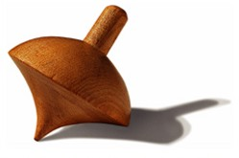
COMPASS
Present issues and near future
On the strange quark PDFs
The COMPASS programme for GPDs
Stephane Platchkov
  IRFU*/Department of Nuclear Physics, CEA Saclay
  *Institute for Research on the Fundamental laws of the Universe

Slide 2
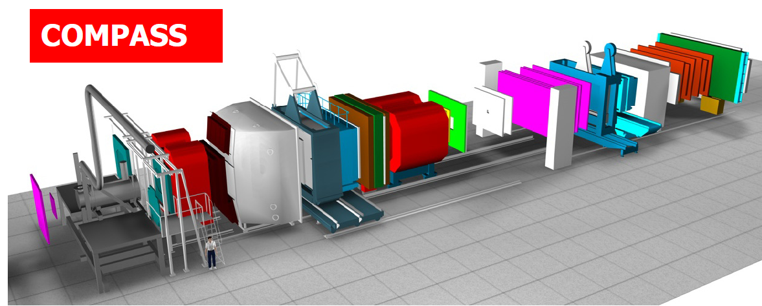
COMPASS: experimental setup (for a muon beam)
50 m
beam
Various beams: polarised µ⁺/µ⁻ (P_{µ}=80%), p, π⁺, π⁻, e⁻
High beam energy: 100-200 GeV
Large acceptance, Particle identification detectors
High amount of collected data: up to 1000 TB/y
Large polarized target

Slide 3
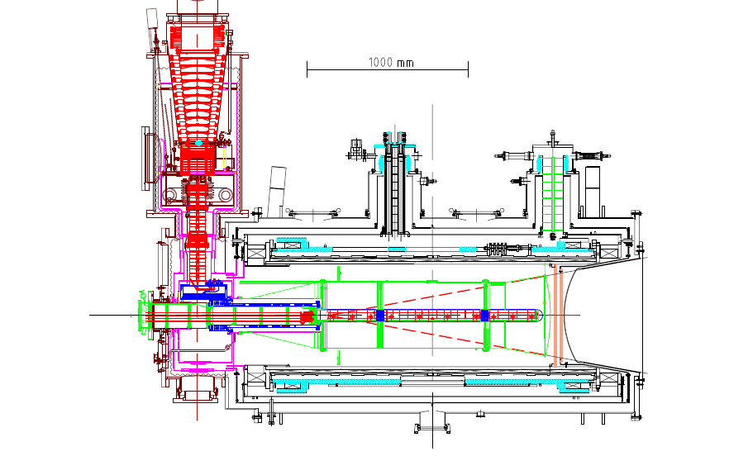
Polarized target system
³He – ⁴He dilution
refrigerator (T~50mK)
Superconducting solenoid
(B=2.5 T)
⁶LiD(d) or NH₃(p)
50% 90% pol.
40% 16% dil. factor
μ
The largest polarized target in the world
The « coldest place » at CERN (60 mK in frozen spin mode)

Slide 4
COMPASS + World g₁(x) deuteron and proton data
Deuteron
Proton
COMPASS data: 2007 - 2011
COMPASS data: to 0.0025 ≤ x_{Bj} ≤ 0.7 - lowest x values today.
and 1 (GeV/c)² ≤ Q² ≤ 120 (GeV/c)²
Data are used as an input for a QCD fit, based on
Parton Distribution Function (PDF) parameterizations and Q²-evolution

Slide 5
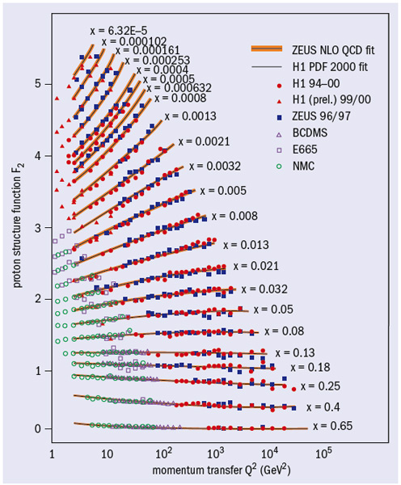
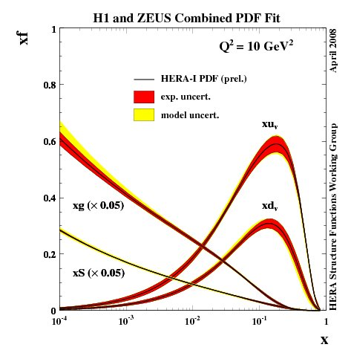
World data and QCD fits to F₂ (unpolarized!)
Input: data
Output: PDFs
Domain of polarized data

Slide 6
QCD fit results (at NLO)
From Asymmetry Analysis Collaboration, Phys. Rev D74, 2006
Δu(x)
Δd(x)
Δs(x)
Similar results:
COMPASS 2006, 2012 (prelim)
LSS-06 : Phys. Rev. D73, 2006
GRSV-05: Phys.Rev. D63, 2005
BB-02: Nucl.Phys. B636, 2002
etc...
Reasonably well determined quark distributions, ΔΣ ≈ 0.3. There are two issues:
Δs(x) is negative!

Slide 7
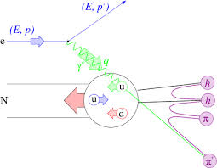
Accessing Δq and ΔG with Semi-Inclusive DIS
f: dilution factor
P_{B}: beam polarisation
P_{T}: target polarisation
D: depolarisation factor
Inclusive scattering
Semi-inclusive scattering
Fragmentation Function: D_{1f}^{h}(z,Q²)
z is the fraction of energy carried by the detected hadron

Slide 8
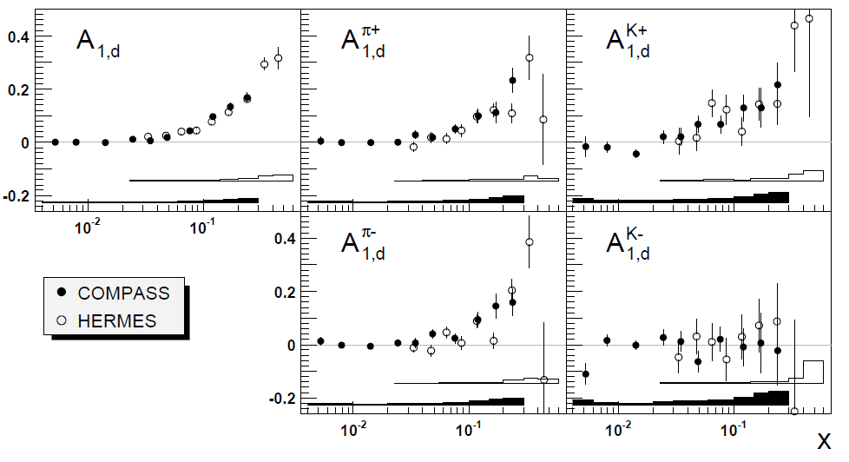
SIDIS asymmetries - deuteron
Deuteron data: 2002 – 2004, 2006
Both pions and kaons are identified

Slide 9
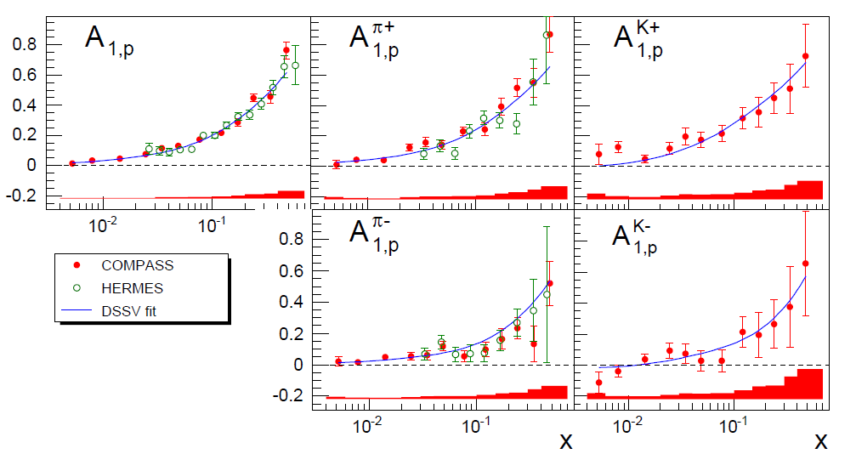
COMPASS: SIDIS asymmetries - proton
Proton data, 2007 : (Phys. Lett. B693, 2010.)
COMPASS preliminary
Leading Order (LO) fit of the 10 asymmetries (2x5)
Determine 6 flavor separated PDFs :

Slide 10
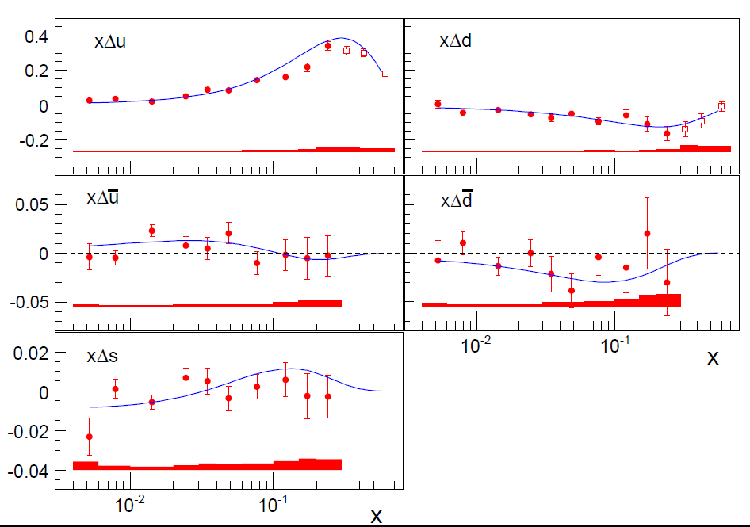
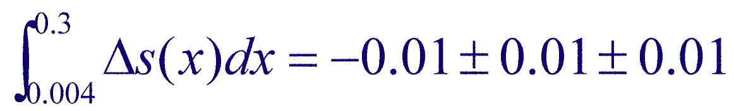
Results for Δu(x), Δd(x), Δs(x)
COMPASS data Phys. Lett. B693, 2010.
DSSV, Phys. Rev. D80, 2009
Δs: Truncated first moment:

Slide 11
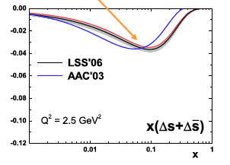
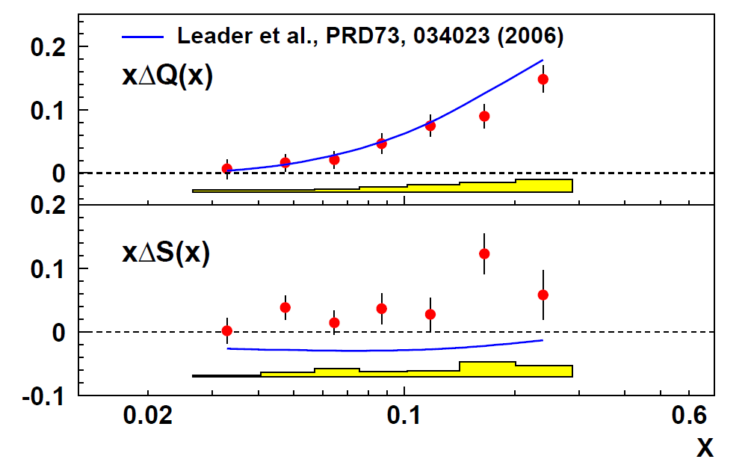
The strangeness puzzle
DIS – all data
Analysis of PV ep and vp data
Pate et al., PRC78, 2008
2Δs = -0.08 ± 0.01 ± 0.01
SIDIS – COMPASS
Δs = -0.01 ± 0.01 ± 0.02
SIDIS – HERMES
Δs = +0.037 ± 0.019 ± 0.027
“Favours” negative G^{s}_{A}

Slide 12
The strange quark polarization puzzle
DIS (only) data:
  Sensitive to the integral value of Δs(x); assuming that SU(3) is valid and using hyperon decay data:
SIDIS data:
  Measures the Δs(x) directly; assuming that the fragmentation functions, specifically D_{s}^{K}, is known:
Possible explanations:
  Changing sign of Δs(x)
      DSSV and LSS global QCD fits
  Assume strong SU(3) violation
      Bass and Thomas, PLB 684(2010)216.
  Large uncertainty on the D_{s}^{K} fragmentation function
      2013: data from Hermes and Compass

Slide 13
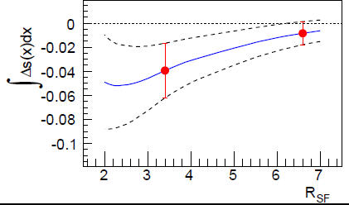
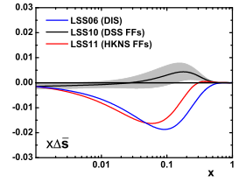
Δs vs Fragmentation Functions
Dependence on the FF ratios
Compass Coll: PLB 693(2010)227
LSS, Phys.Rev. D84 (2011) 014002
DSS: De Florian, Sassot, Stratman, Phys. Rev. D75, 2007
EMC: EMC collaboration, Arneodo et al, Nucl. Phys. B321, 1989
HKNS: Hirai et al., Phys. Rev. D 75, 2007
SIDIS analysis strongly depends on the s-->K FF

Slide 14
Hadron multiplicities in SIDIS
Pros
  Allows flavour/charge separation
  Map out z dependence
  Relevant for spin physics studies
Cons
  Dependence on the PDFs
Requirements
  High statistics: bins in x, z, Q², ...
  Particle identification: pions, kaons
  Excellent acceptance corrections (MC simulation)

Slide 15
FF: use symmetries to reduce their number

Slide 16
Charged pion multiplicities

Slide 17
Charged kaon multiplicities

Slide 18
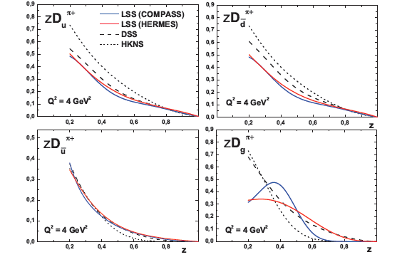
Results for pion FF (fit by LSS, arXiv:1312.5200)
NLO fit to ~200 exp. points
“Reasonable” agreement with older extractions

Slide 19
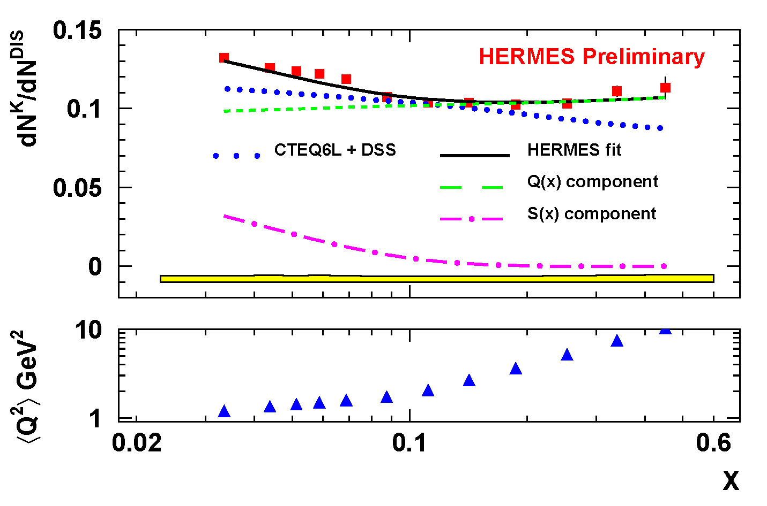
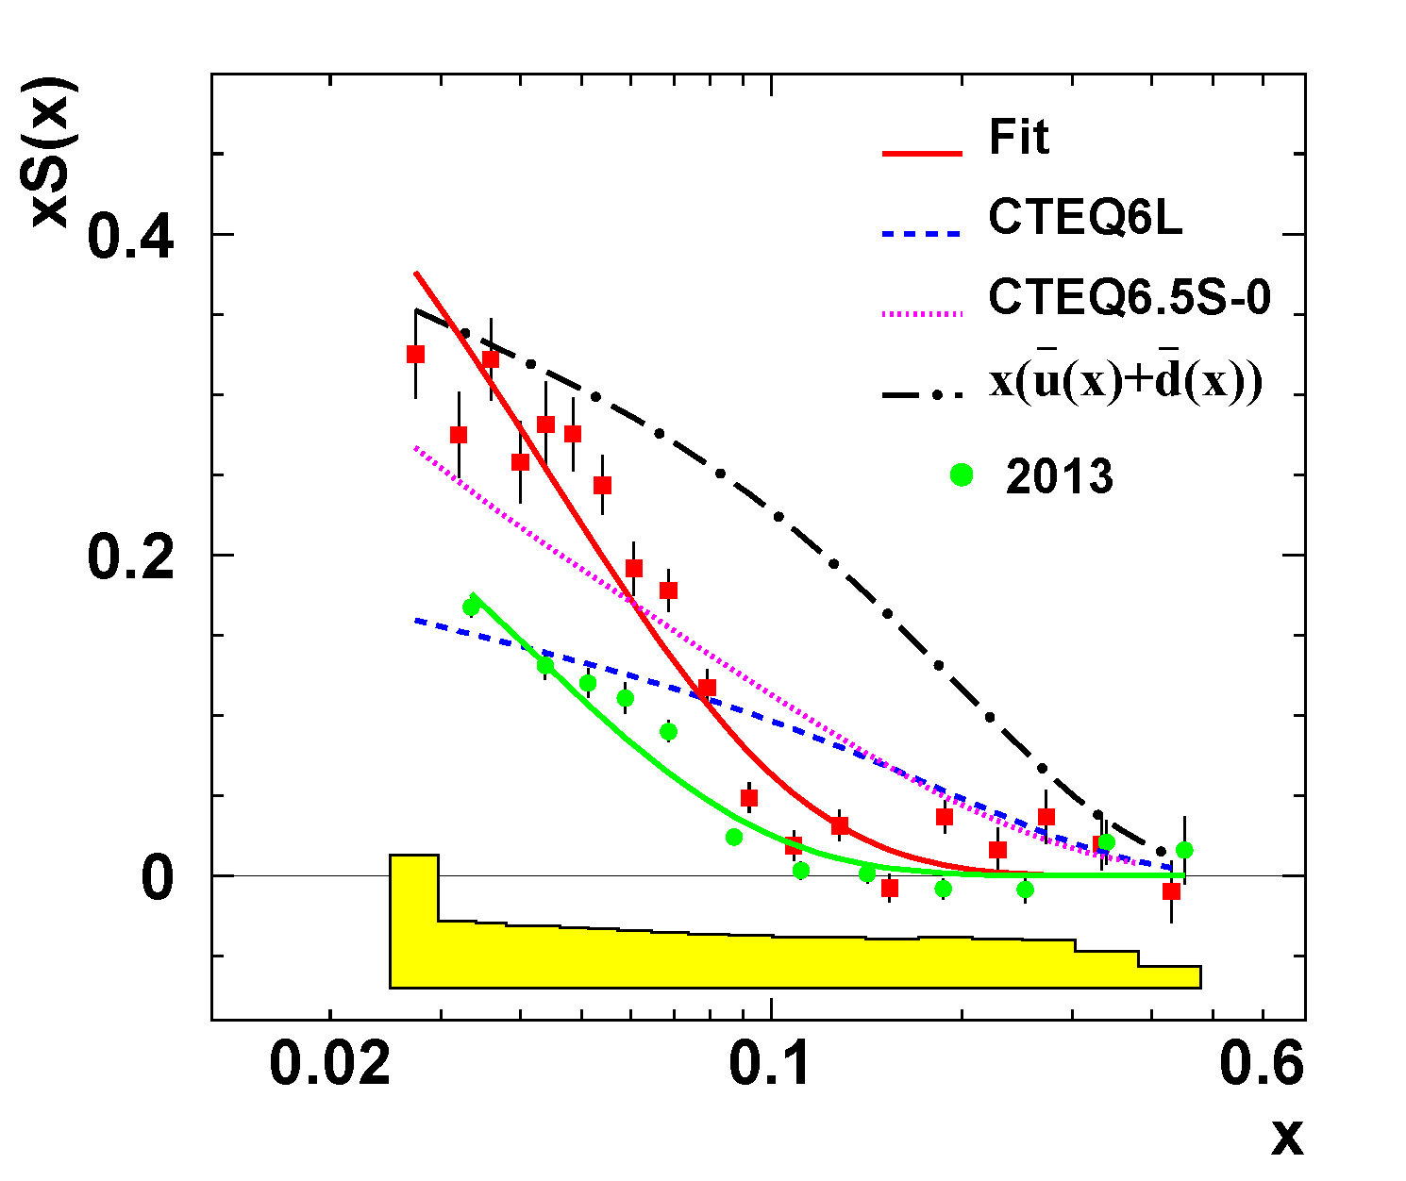
Extraction of s(x) from multiplicity data
Agreement COMPASS vs HERMES is marginal
PDFs are sensitive to FFs and FFs to PDFs

Slide 20
Summary: strange quarks
The Δs puzzle is not yet really understood.
New multiplicity data (COMPASS + HERMES) –> improved FF fits
The unpolarized PDF s(x) is not well known, as it relies on the strange FF. A way out would be a common determination of both FFs and s(x), if enough data are available.

Slide 21
COMPASS II
(2012 - 2017)

Slide 22
COMPASS – a fixed target experiment
Beams
  Possible beams: µ+, µ-, π+, π-, e- => Several physics programs
Experiments with muon beam
  Spin structure, Gluon polarization
  Flavor decomposition
  Transversity
  Transverse Momentum-dependent Distributions
  DVCS and HEMP
  Unpolarized SIDIS and TMDs
Experiments with hadron beams
  Pion polarizability
  Diffractive and Central production
  Light meson spectroscopy
  Baryon spectroscopy
  Pion and Kaon polarizabilities
  Drell-Yan studies
COMPASS - I (2002 – 2011)
COMPASS - II (2012, 2015 – 2017)

Slide 23
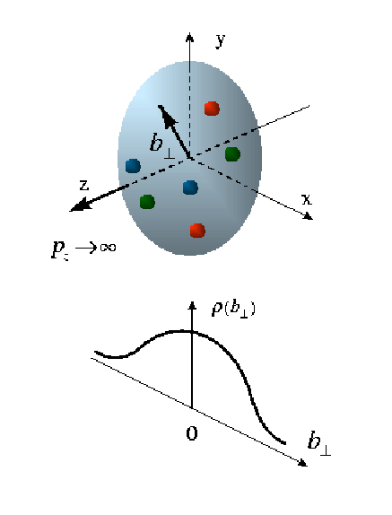
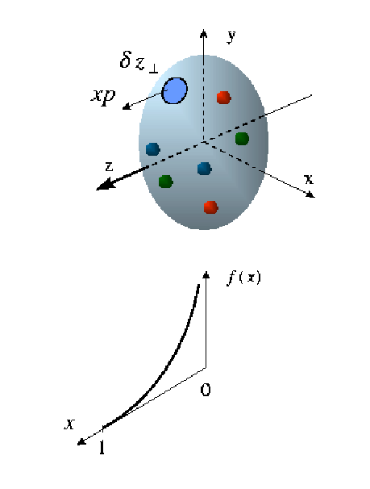
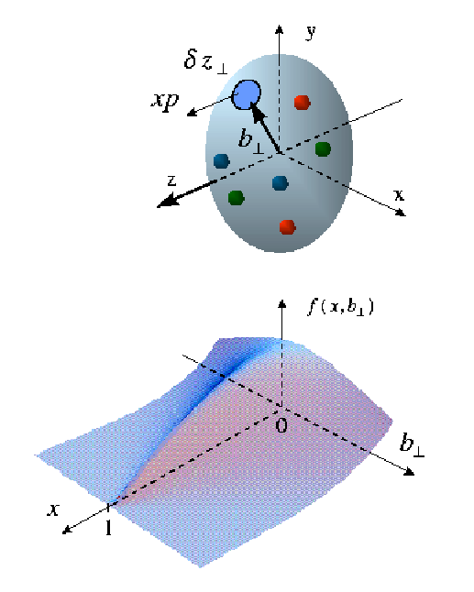
Towards a 3-dimensional view of the nucleon
“Actually all the electromagnetic structure of the proton is, in principle, described by the behavior of these quantities (the FF) as a function of q.”
R. Hofstadter,
Nobel lecture 1961
“This expression [..] summarizes all the information about the structure of the target- particles obtainable by scattering unpolarized electrons from an unpolarized target.”
H. Kendall,
Nobel lecture 1990
Elastic Scattering Form Factors
Distributions in
coordinate space
Deep Inelastic Scattering
Quark distributions in momentum space
Generalized Parton Distributions
Distributions in both momentum and coordinate
space

Slide 24
Exclusive measurements – new processes
DVCS DVMP
p
t=(p-p’)²
p’
Generalized parton distributions:
Specific cases:
momentum distribution
elastic form factor
Ji relation:
maybe the only access to the orbital-momentum
contribution to the nucleon spin

Slide 25
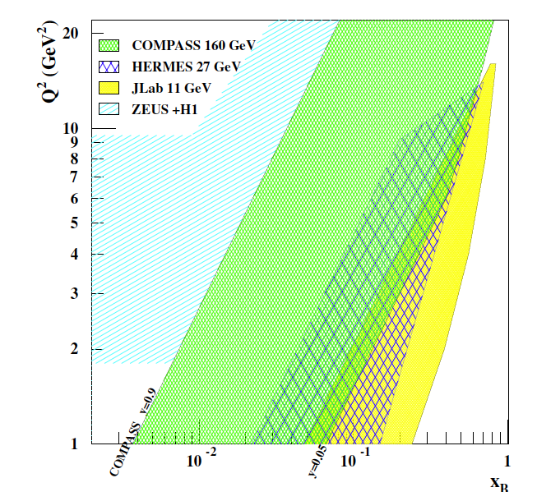
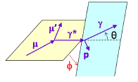
DVCS – COMPASS kinematical coverage
Beams
  100 – 190 GeV
  Polarization: ~80%
  Both μ⁺ and μ⁻ beams
x-Q² region: ≈ 0.01 – 0.1
  Between HERA – Jlab/Hermes
Detect both outgoing photon and recoiling proton

Slide 26
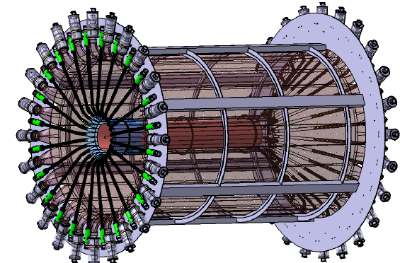
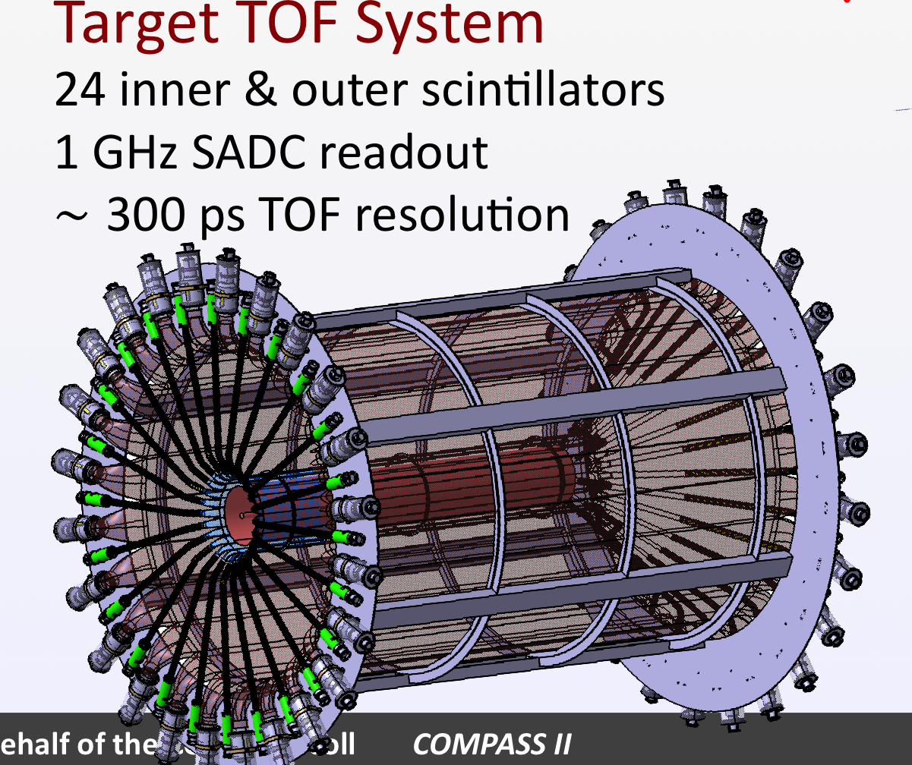
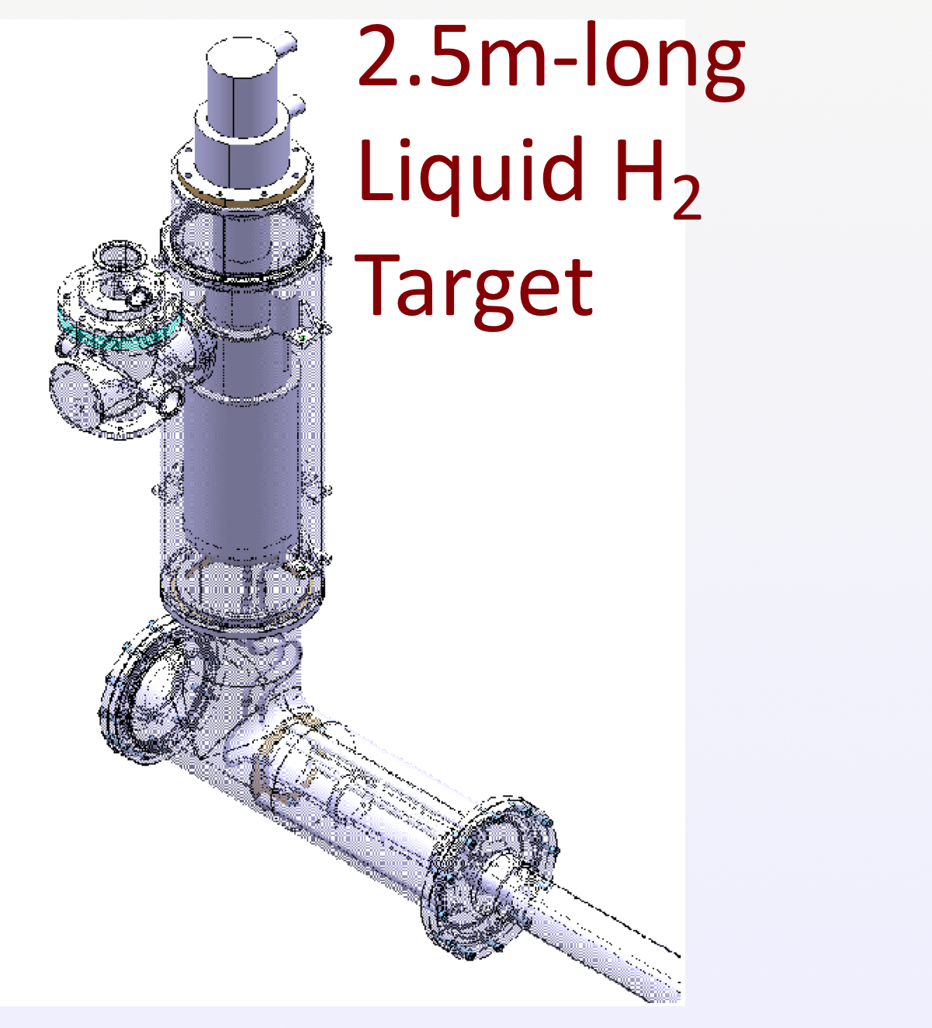
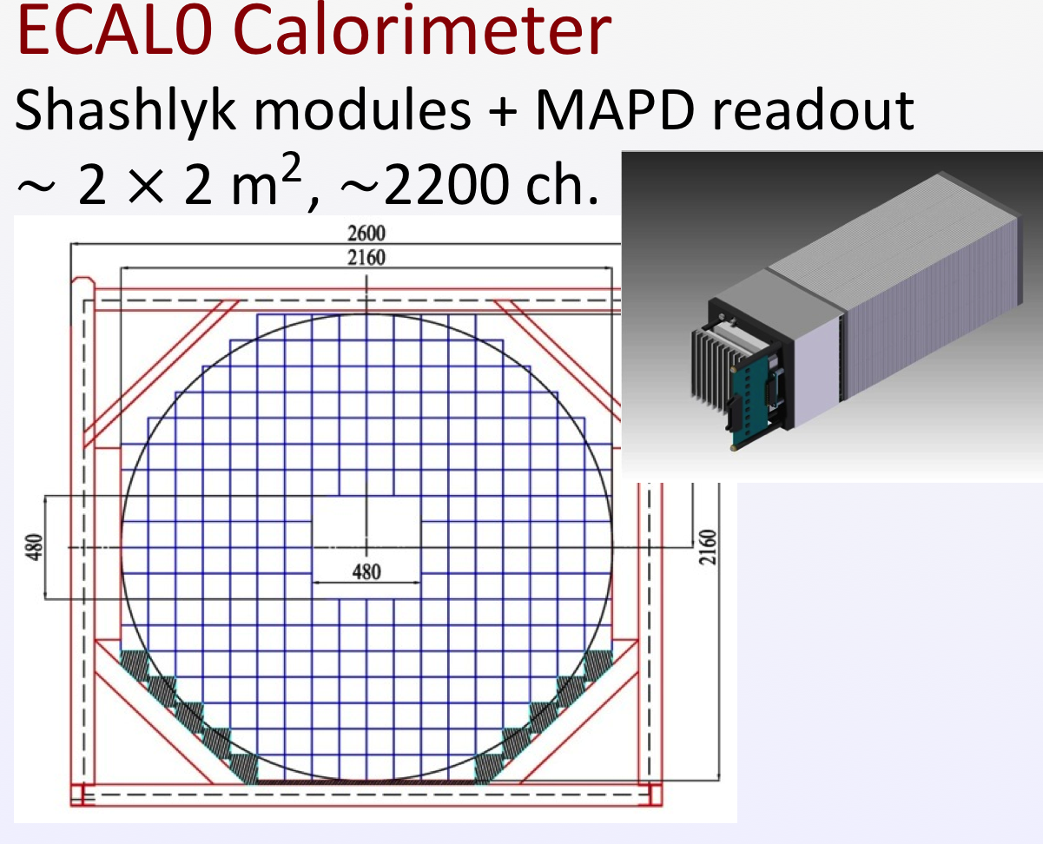
DVCS – main new equipments
ECAL1
ECAL2
50 m

Slide 27
Transverse size of the nucleon vs x_{B}

Slide 28
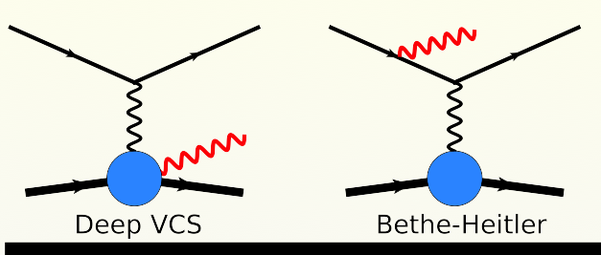
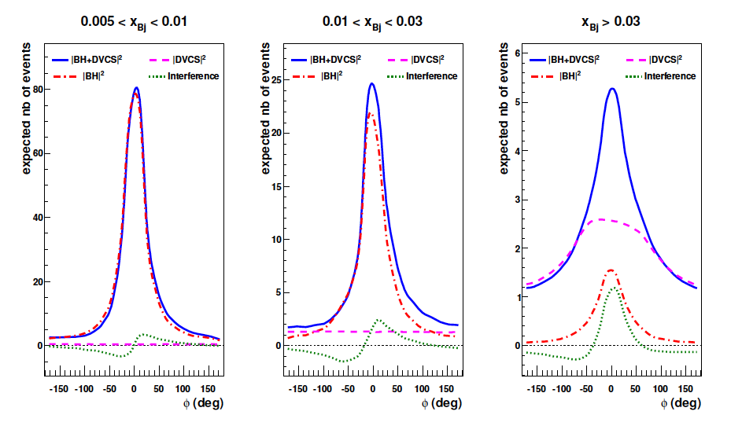
DVCS – the COMPASS x_{B} regions – Simulation
DVCS and BH relative amplitudes change significantly as a function of x

Slide 29
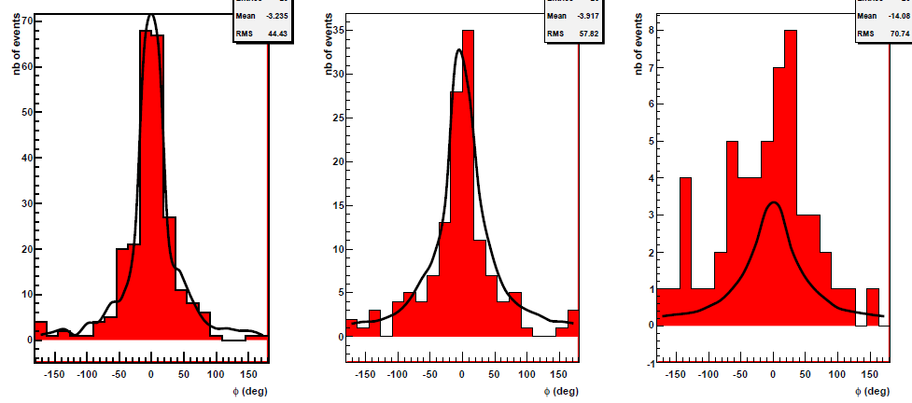
DVCS – the COMPASS x_{B} regions – REAL DATA
0.005 < x_{B} < 0.01 0.01 < x_{B} < 0.03 0.03 < x_{B}
251 evts
135 evts
54 evts
|BH|²
|BH|²
|BH|²
PRELIMINARY
PRELIMINARY
PRELIMINARY
BH
From 10 days tests in 2009: 40 cm long target, small recoil detector
Clear sign for a DVCS signal

Slide 30

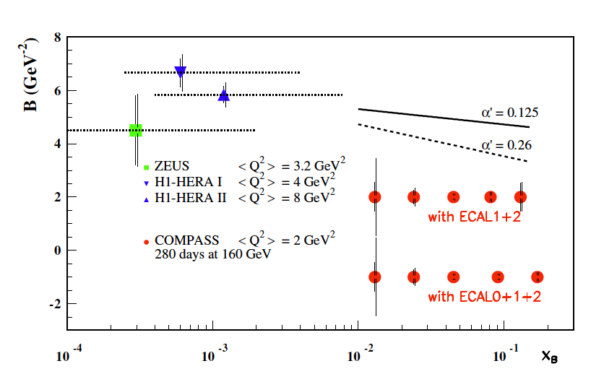
DVCS – SUM of μ⁺ and μ⁻ cross sections
COMPASS expected results (2016+2017):
40 weeks of data,
2.5 m LH target
Transverse imaging: parton distribution as a function of x

Slide 31
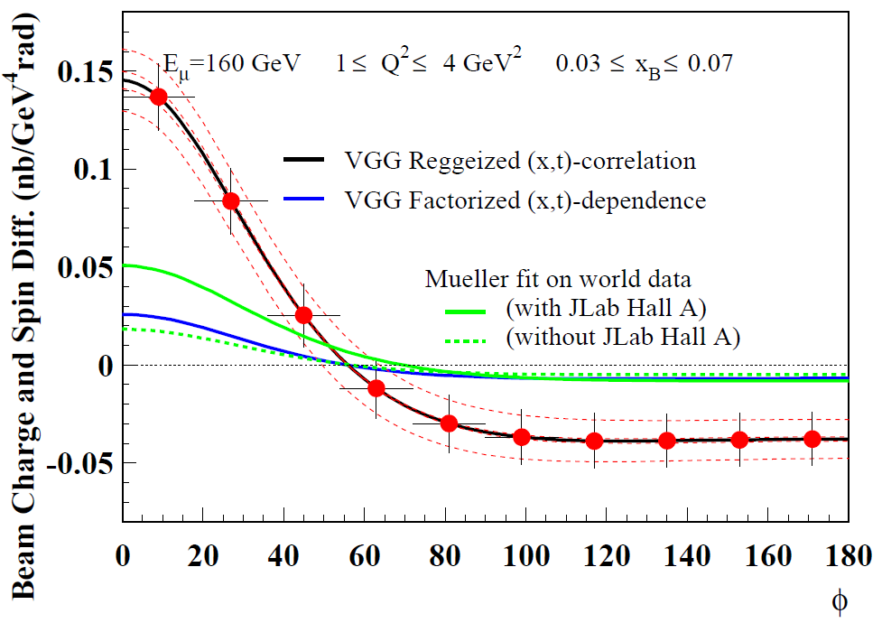
DVCS – DIFFERENCE of μ⁺ and μ⁻ cross sections

Slide 32
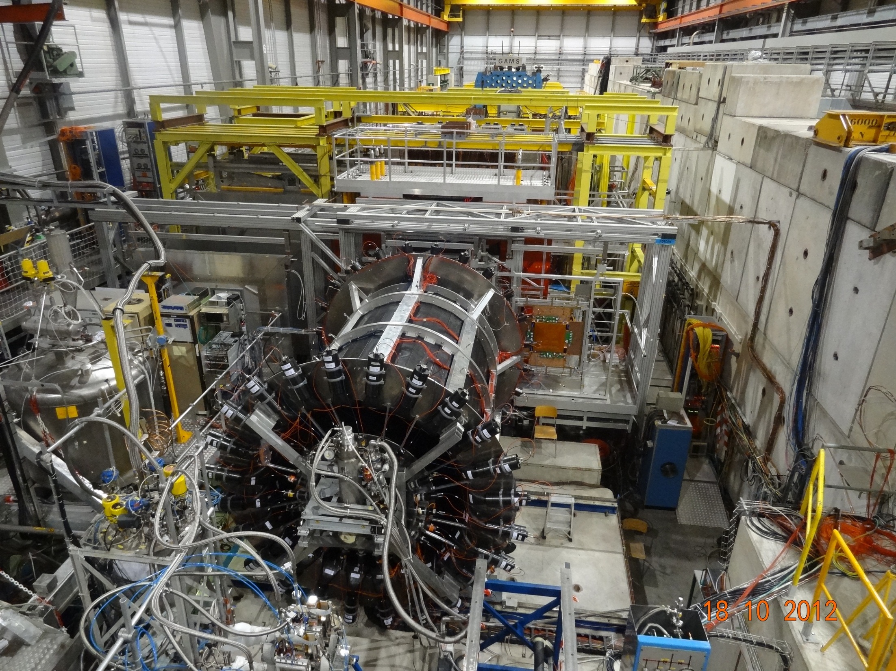
ECAL2
ECAL1
ECAL0
Recoil proton detector (CAMERA)
surrounding the 2.5m long
LH2 target

18 -10- 2012
μ±

Slide 33
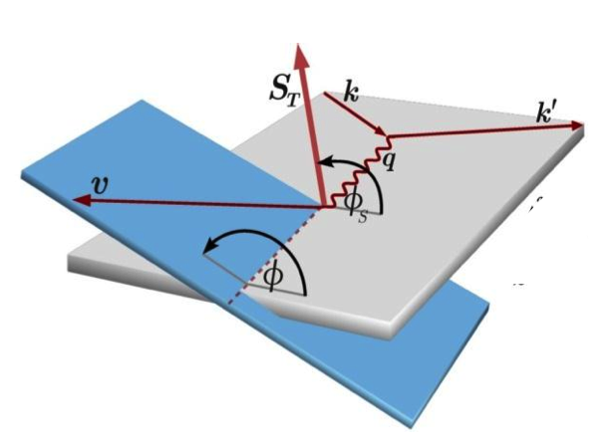
DVCS strategy
Unpolarized beam: Constrain GPD-H (2016-2017)
  Sum of cross sections: imaginary part of the Compton FF
  Difference of cross sections: real part of the Compton FF
Transversely polarized target: Access GPD-E ( > 2018)
  new proposal

Slide 34
Present polarized target system
(not suitable for polarized DVCS)
³He – ⁴He dilution
refrigerator (T~50mK)
⁶LiD(d) or NH₃(p)
50% 90% pol.
40% 16% dil. factor
μ

Slide 35
DVCS with a transversely polarized target
2 “years” of data taking, after 2018....
E = 160 GeV,
New polarized target
10% efficiency

Slide 36
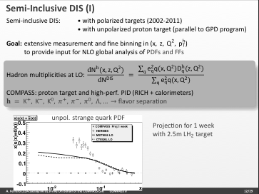
In parallel: SIDIS – expected results

Slide 37
Summary: COMPASS as a laboratory for QCD
A versatile experimental setup
  several beams available: muon, hadron, positive and negative
  “easily” reconfigurable target region
Hadron spectroscopy (not covered)
  search for new light-quark resonances
Present and near future :
  2012: pion and kaon polarizabilities
  2013/14: CERN shutdown
  2015: Drell-Yan measurements
  2016: DVCS and DVMP measurements
  2017: DVCS and DVMP measurements
    in parralel: SIDIS and TMDs

Slide 38
SPARES

Slide 39
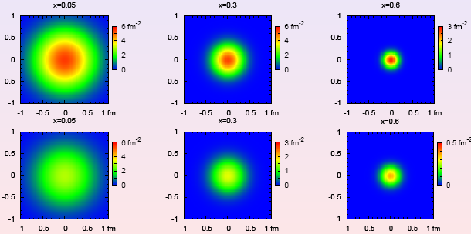
“Tomography” = transverse size vs x
Nucleon “tomography”, or transverse imaging
  Integrate over φ and subtract BH:
Impact
parameter
X=0.05
X=0.3
X=0.5
B(x) = b₀ + 2 α’ ln(x₀/x)
From fit to FF data, Diehl, Feldmann, Jakob, Kroll, 2005

Slide 41
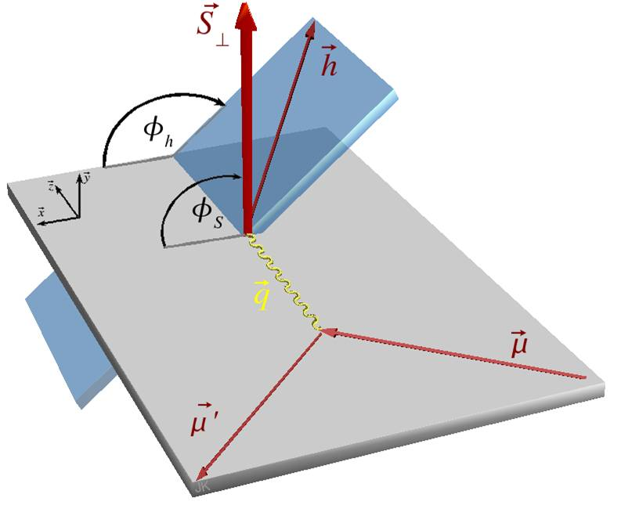
The eight leading-twist PDFs (TMDs)
Symbol | k⊥-dep | Azimuth | Beam | Tgt | Χ-odd | T-odd | PDF name
 |  | ⎯ | U | U |  |  | Mom. density
 | yes | cos(2φ) | U | U | X-odd | T-odd | Boer-Mulders
 | yes | sin(2φ) | U | L | X-odd |  | Worm-gear 1
 |  | ⎯ | L | L |  |  | Helicity
 |  | sin(φ+φ_{s}) | U | T | X-odd |  | Transversity
 | yes | sin(φ−φ_{s}) | U | T |  | T-odd | Sivers
 | yes | sin(3φ−φ_{s}) | U | T | X-odd |  | Pretzelosity
 | yes | cos(φ−φ_{s}) | L | T |  |  | Worm-gear 2
NB: Amsterdam notation
f₁(x), g₁(x) and h₁(x) are integrated over k⊥

Slide 42
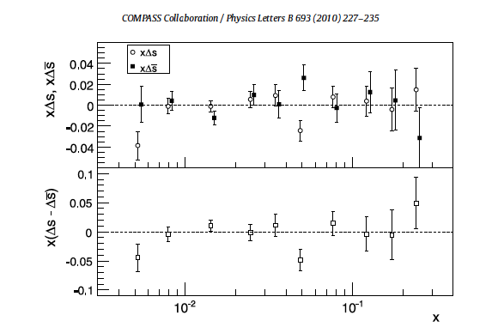
Check the assumption Δs = Δs (a 6 flavors fit)
xΔs and xΔs
x(Δs – Δs)
Both strange and anti-strange distributions are compatible with 0

