Slide 1



COMPASS:
COmmon Muon and Proton Apparatus for Structure and Spectroscopy"
Gerhard K. Mallot /CERN-PH
LHC
SPS

Slide 2


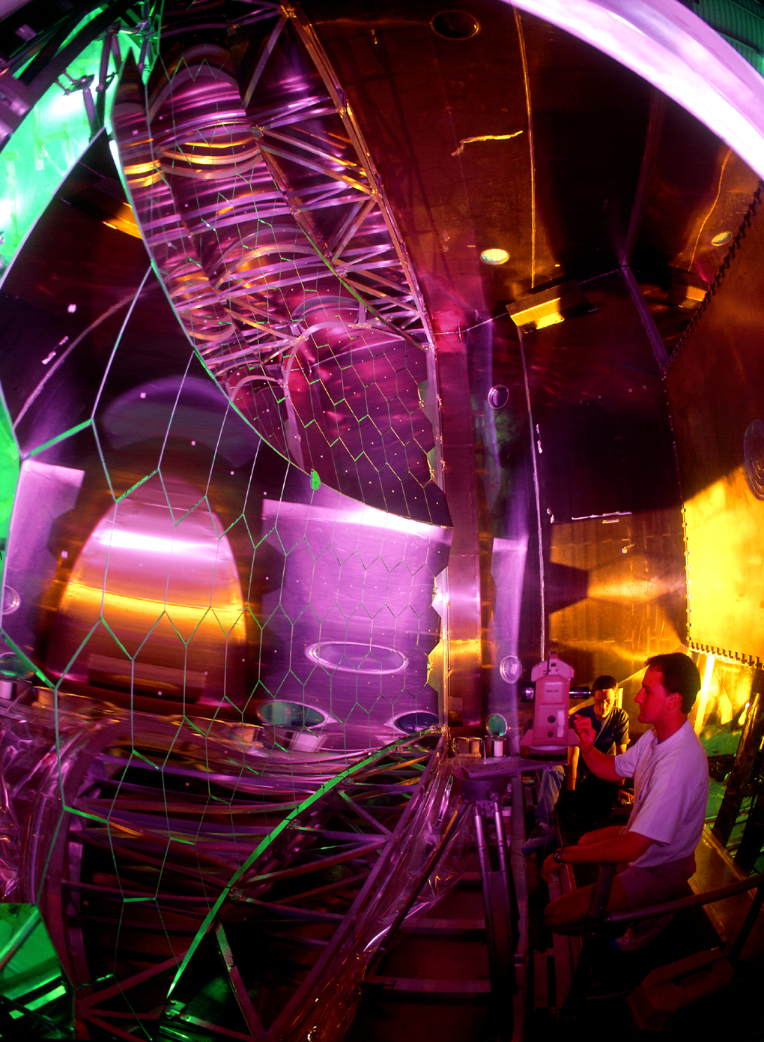


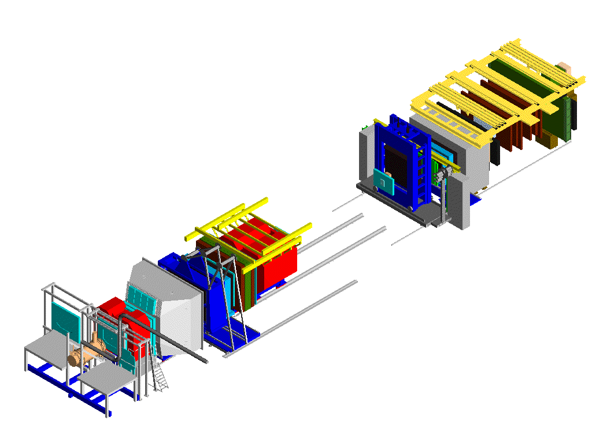
COMPASS: QCD structure of hadrons data taking since 2002
nucleon spin-structure (μ)
  helicity distributions of gluons and quarks
  transverse spin structure
  3D structure of the nucleon
hadron spectroscopy (p, π, K)
  light mesons, glue-balls
  exotic mesons
  polarisability of pion and kaon
members:
  220 physicists,
  23 institutes,
  13 countries
COMPASS RICH

Slide 3
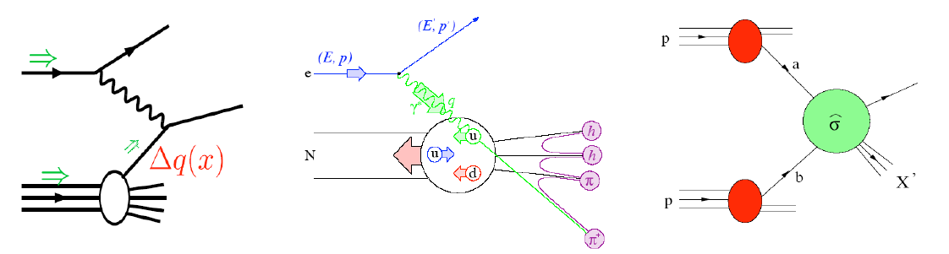
Tools to study the nucleon structure
Factorization of hard interaction and nonperturbative nucleon structure/fragmentation:
PDF parton distribution functions
FF fragmentation functions
DIS
SIDIS
pp
PDF
PDF⊗FF
PDF⊗PDF

Slide 4
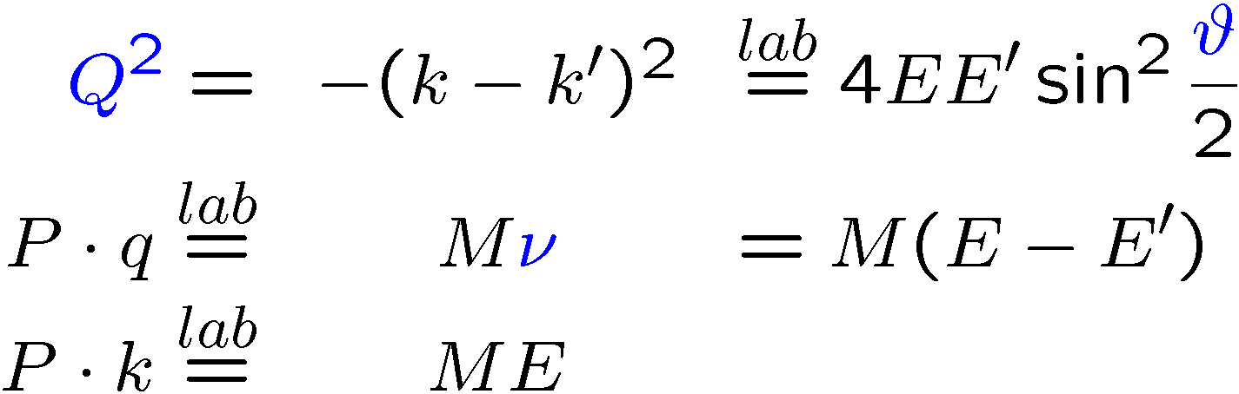
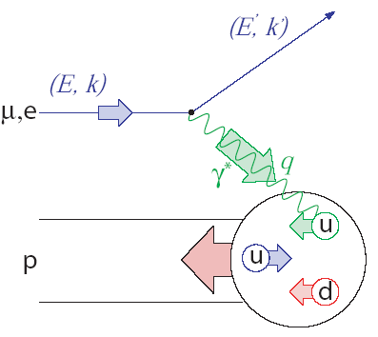
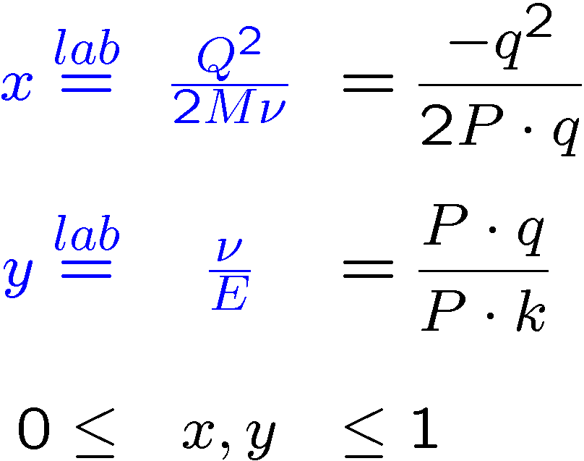
Deep inelastic scattering
Bjorken-x: fraction of longitudinal momentum carried by the struck quark in infinite- momentum frame (Breit)

Slide 5
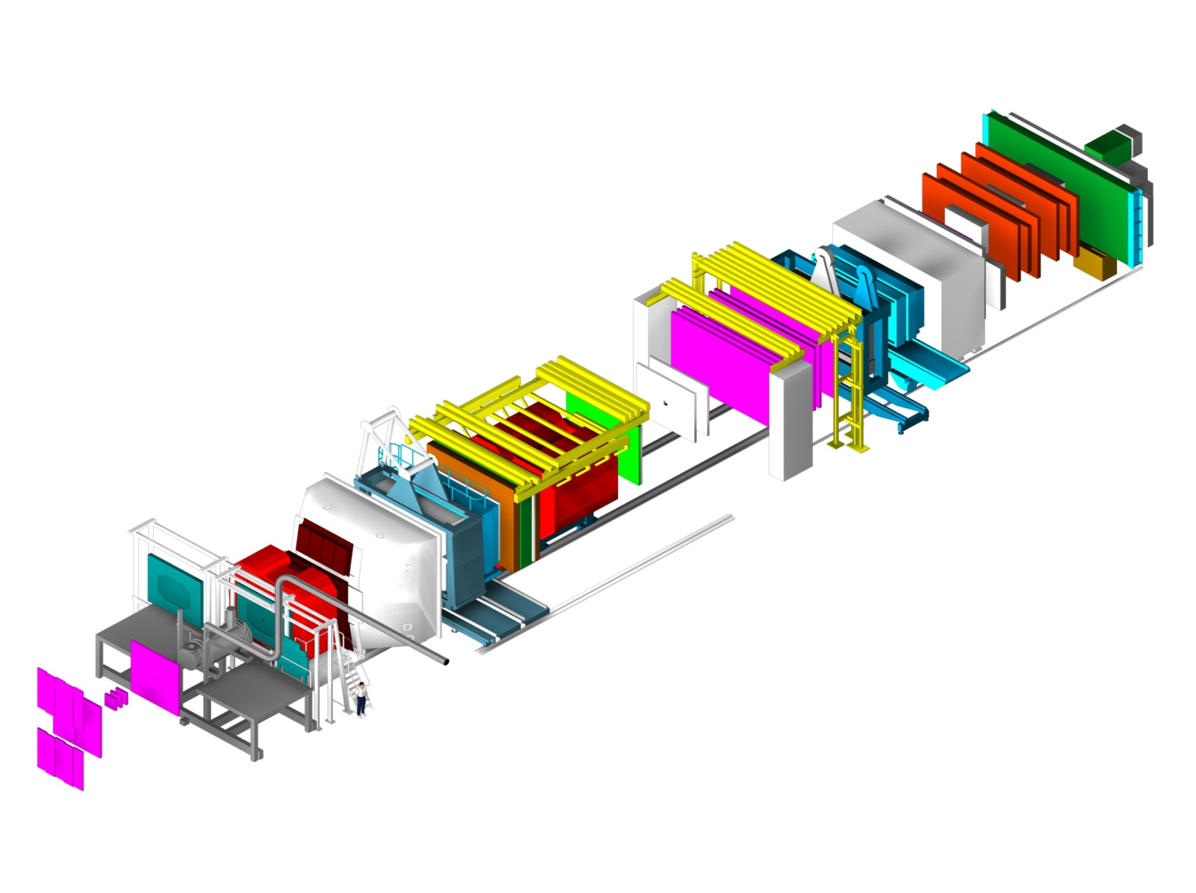
COMPASS spectrometer
h⁺ beam: 190 GeV, p/π/K 75/24/1%
h⁻ beam: 190 GeV, π/K/p 97/2/1%
μ⁺ beam: 160/200 GeV, 2×10⁷/s
Hodoscopes
E/HCAL2
E/HCAL1
SM2
RICH1
Muon Wall 2,
MWPC
SM1
Polarised Target
MWPC, Gems, Scifi,
W45
Muon Wall 1
Straws, Gems
60m long
Scifi, Silicon
Micromegas, DC, Scifi

Slide 6
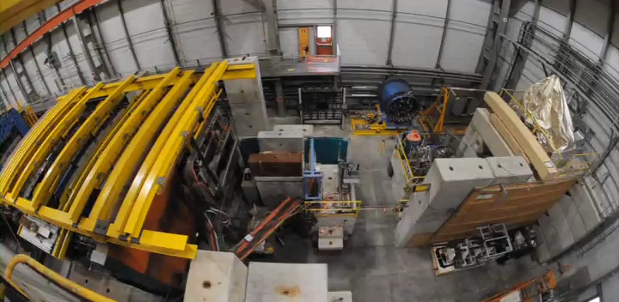
COMPASS Spectrometer

Slide 7
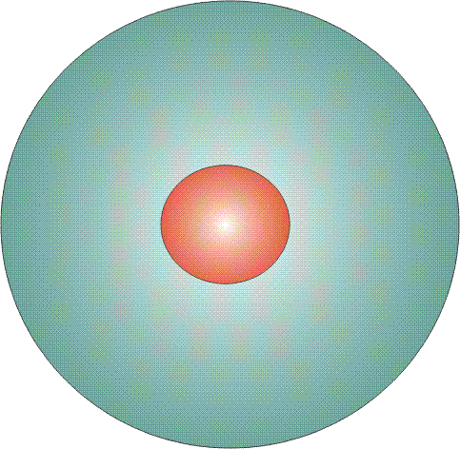
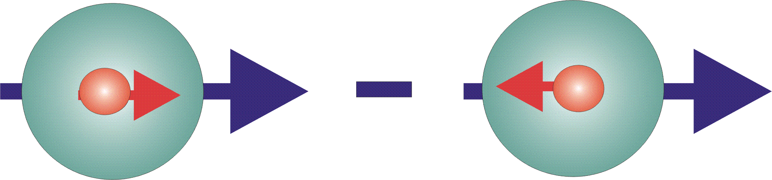

Structure: Parton Distribution Functions
Three twist-2 PDFs
q(x)
f₁^{q} (x)
unpolarised PDF
quark/gluon with momentum xP in a nucleon
well known – unpolarized DIS
Δq(x)
g₁^{q}(x)
helicity PDF
quark/gluon with spin parallel to the nucleon spin in a longitudinally polarised nucleon
known – polarized DIS
transversity PDF
quark with spin parallel to the nucleon spin in a transversely polarised nucleon
Δ_{T}q(x)
h₁^{q}(x)
chiral odd, fairly known

Slide 8
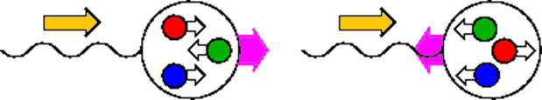
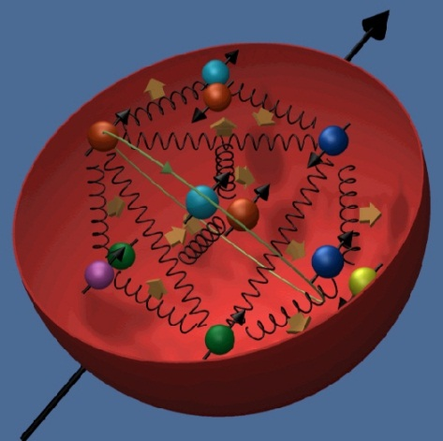
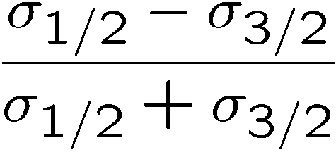
Photoabsorption & long. spin structure
J_{z:}
3/2
1/2
photon
nucleon
Measure cross-section asymmetry
Need polarised beam & target
(for longitudinal spin structure)

Slide 9
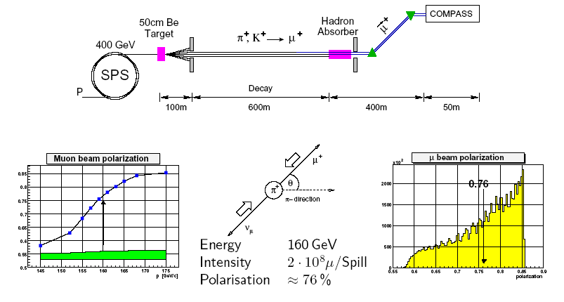
The CERN Muon Beam
0.85
0.50

Slide 10

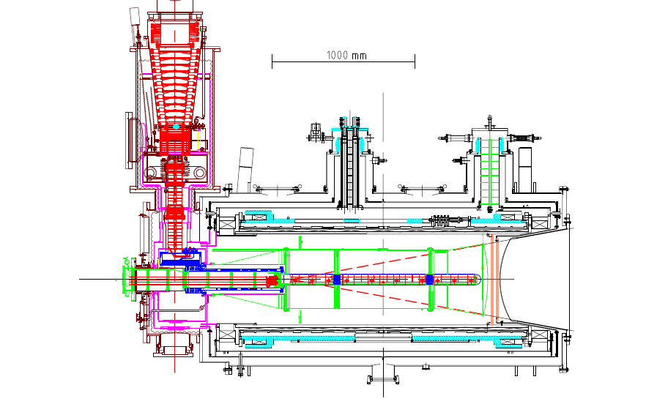
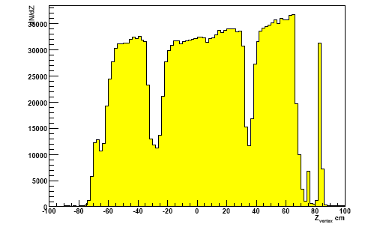
Polarized target system
solenoid 2.5T
dipole magnet 0.6T
acceptance ± 180 mrad
³He – ⁴He dilution
refrigerator (T~50mK)
⁶LiD/NH₃ (d/p)
50/90% pol.
40/16% dil. factor
μ
Recontructed interaction vertices

Slide 11
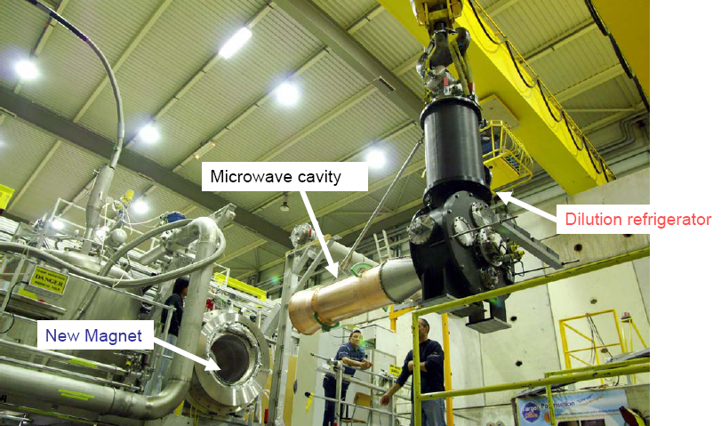
Polarized target system

Slide 12
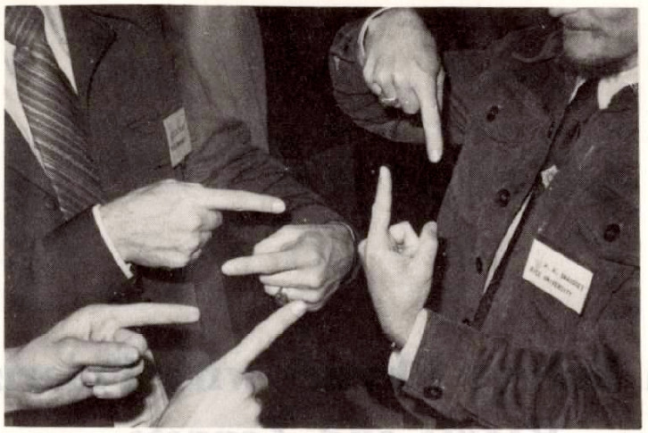
helicity structure of the nucleon

Slide 13
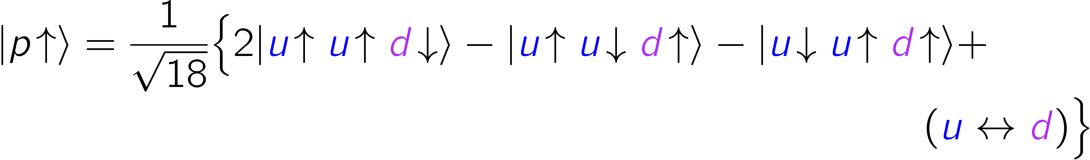
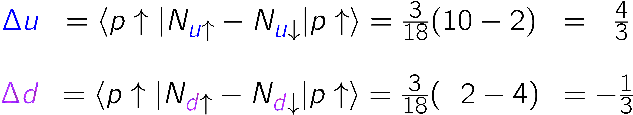
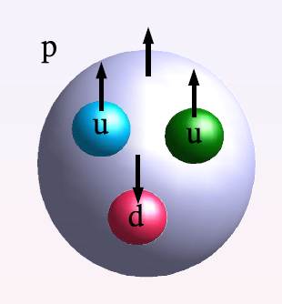

Spin: Static Quark model
SQM: up and down quarks carry the nucleon spin!
EMC: Quarks spins contribute little (1987/88)
ΔΣ = 0.12
Notes:
s

Slide 14
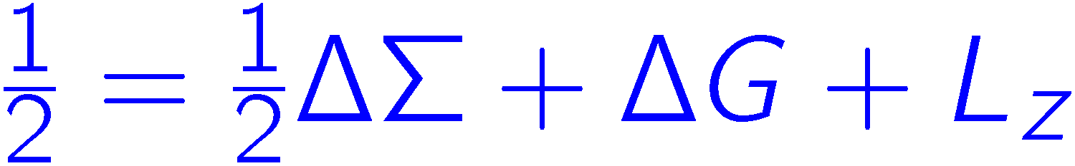
Where is the proton spin?
small
smallish,
till poorly known
unknown

Slide 15
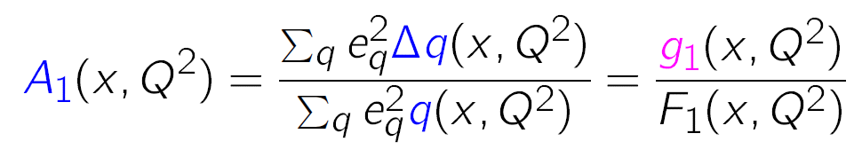
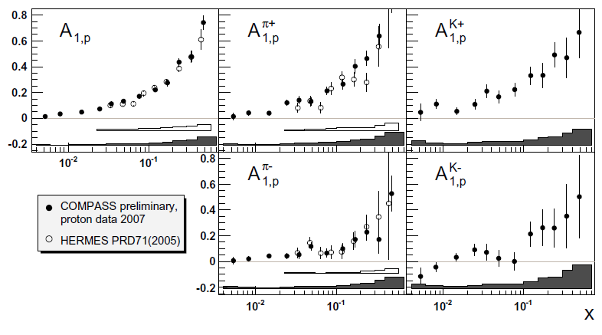
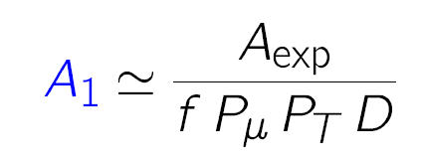
Asymmerties & SF
longitudinal double-spin x-sect. asymmetries
+
f: dilution factor
D: depolarisation factor
P_{μ}: beam polarisation
P_{T}: target polarisation
x: Bjorken x, fraction of nucleon momentum carried by struck
quark in inf. mom. frame
inclusive scattering:

Slide 16
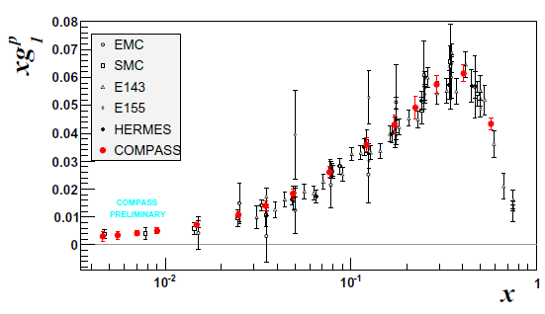
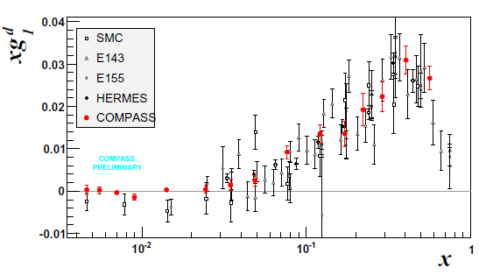
Structure function g₁(x,Q²)
p
very precise data
only COMPASS for
x < 0.01 (Q² > 1)
deuteron data:
  ΔΣ=
  0.33±0.03±0.05
  Δs+Δs=
  −0.08±0.01±0.02
d

Slide 17
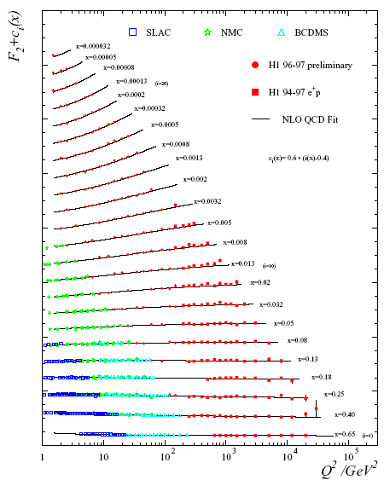
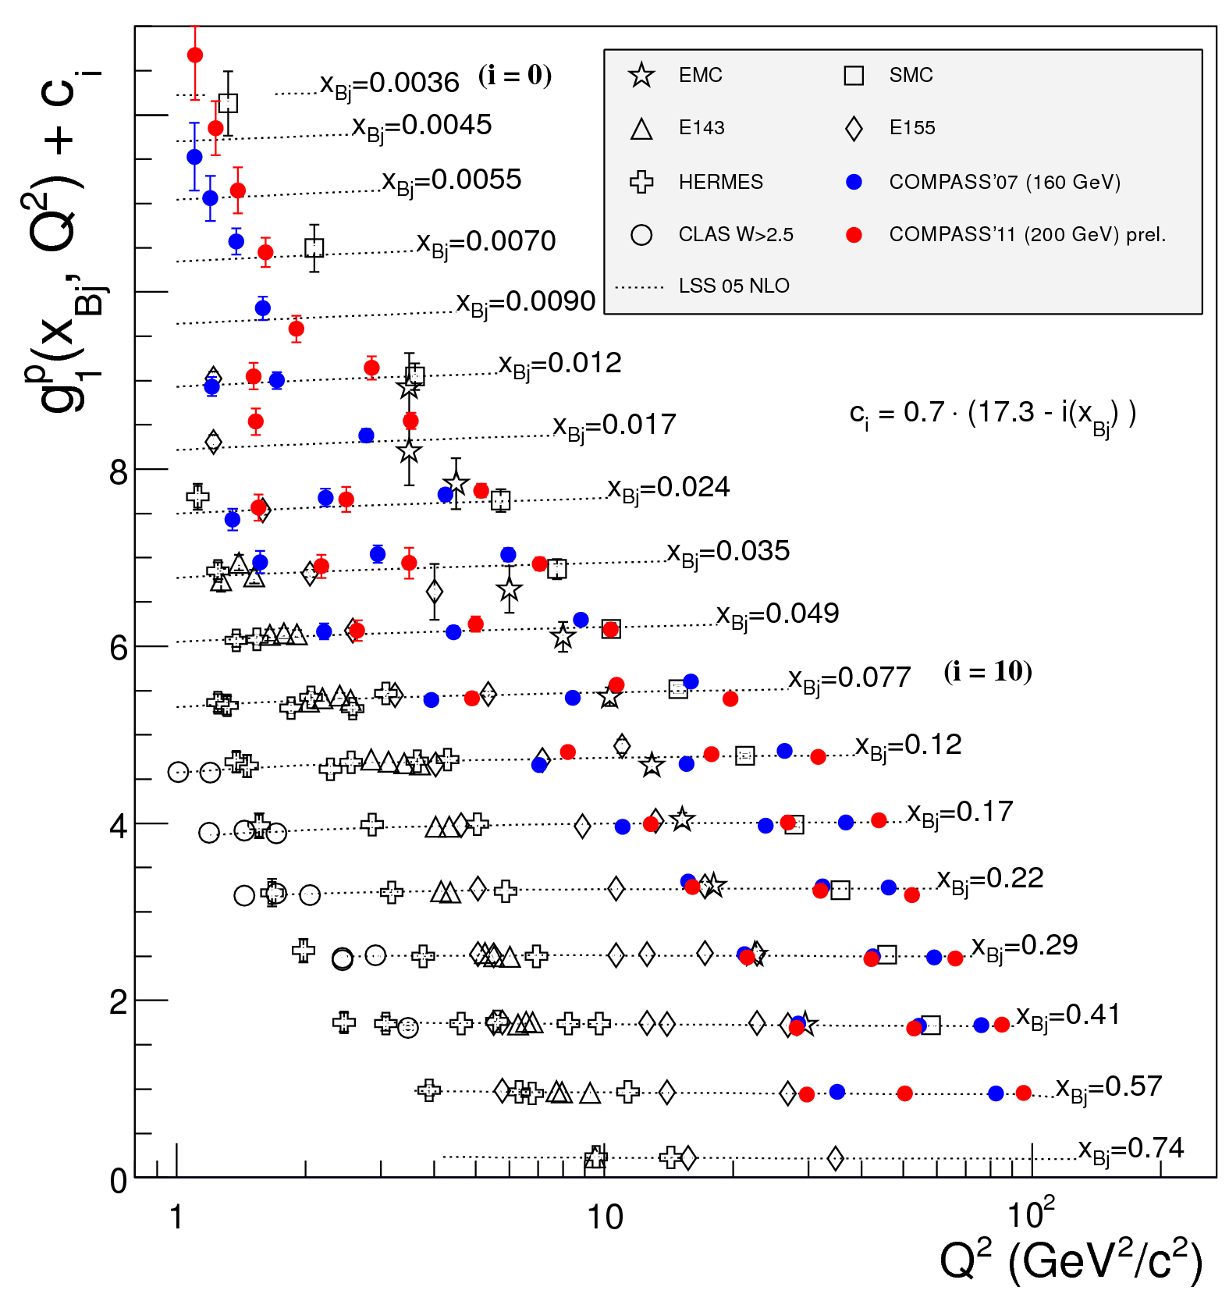
F₂(x,Q²)
g₁(x,Q²)
p

Slide 18
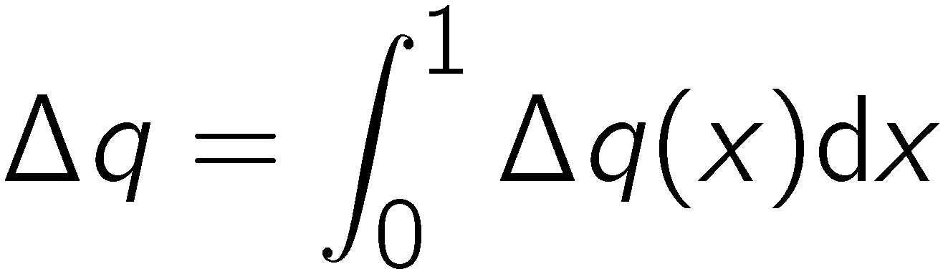
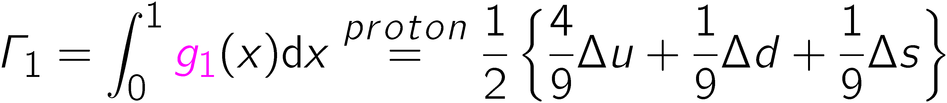
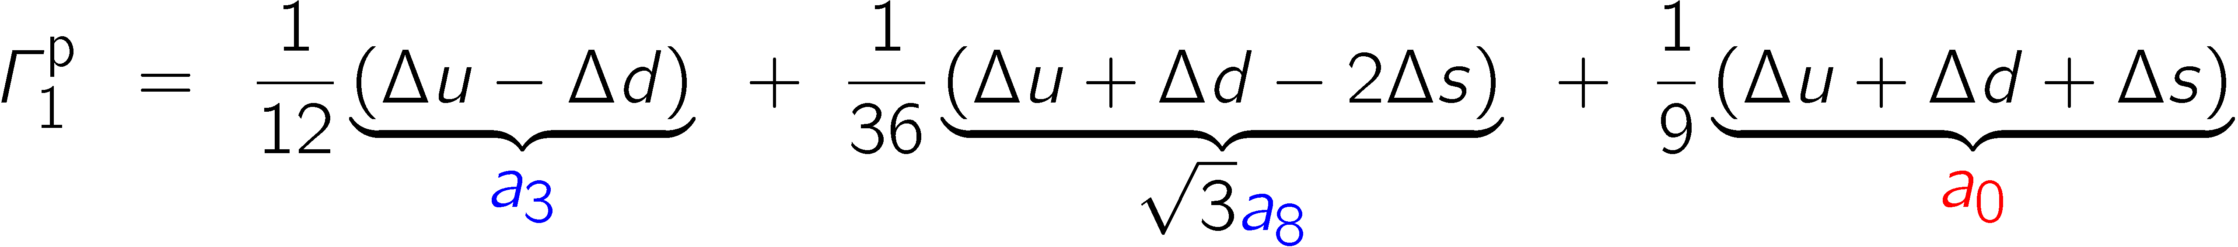
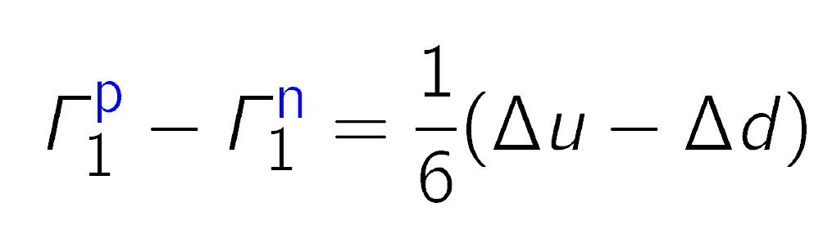
Sum rules for g₁
first moment Γ₁ of g₁ with
Neutron decay
a₃ = |g_{a}/g_{v}|
Hyperon decay
(3F-D)/3
∆Σ
Bjorken sum rule:

Slide 19
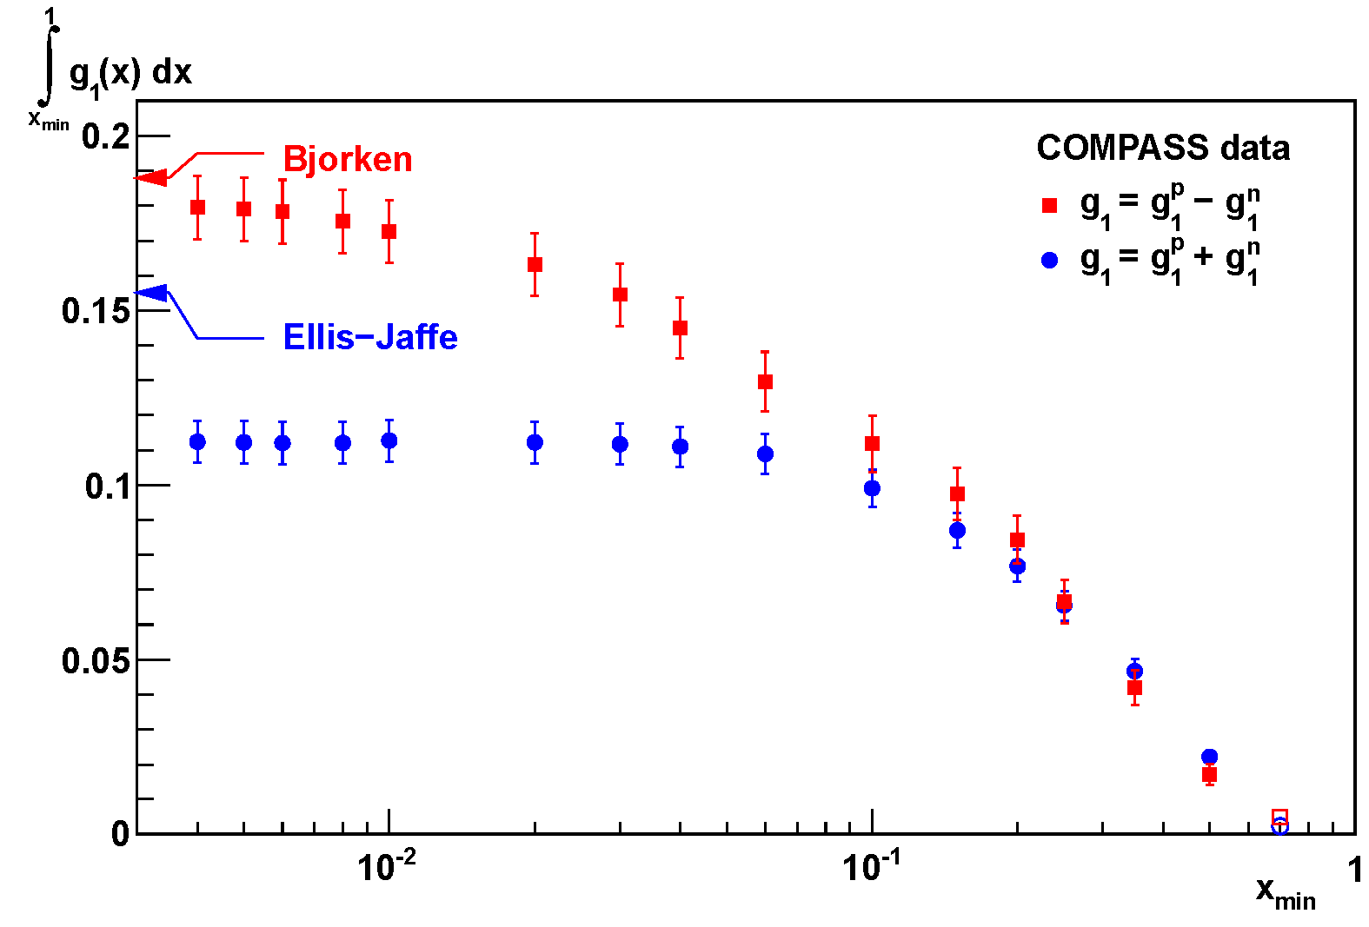



Sum rules
PLB 690 (2010) 466
from neutron β decay

Slide 20
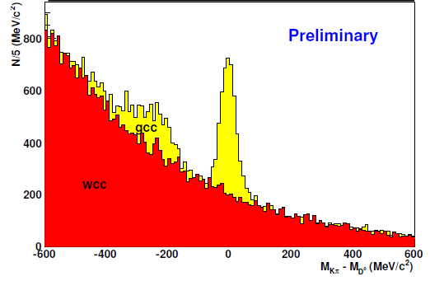
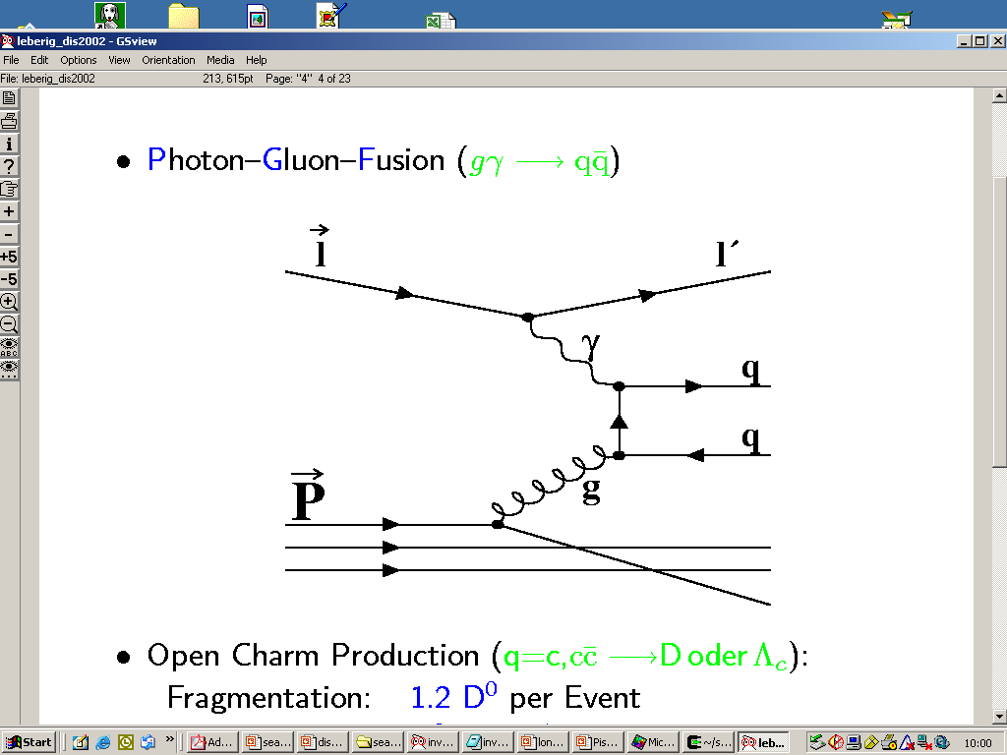
Gluon polarisation from PGF
open charm: single D meson
cleanest process wrt physics background
high-p_{T} hadron pairs with Q² > 1 GeV²
high-p_{T} hadron pairs with Q² < 1 GeV²
single hadron production Q² < 0.1 GeV²
D⁰ → K π
g
D⁰ → K π π⁰

Slide 21
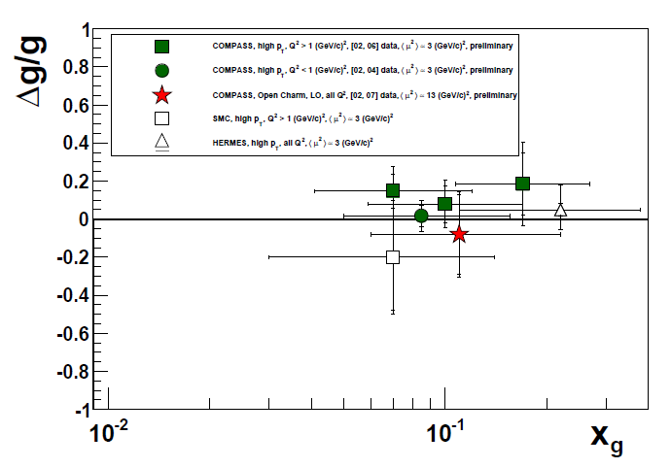
Δg/g from PGF (LO)
The gluon polarisation is rather small
confirmed by polarised pp at RHIC

Slide 22
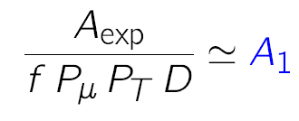
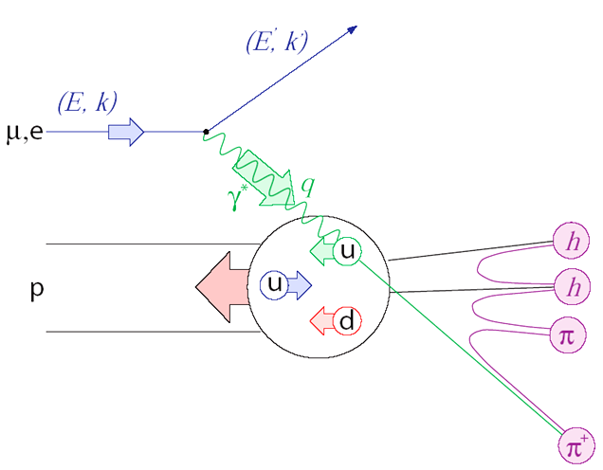
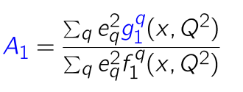
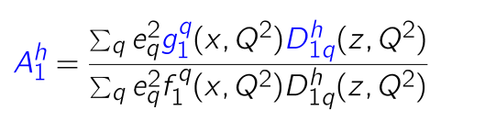

Semi-inclusive DIS
Inclusive scattering
Semi-inclusive scattering

Slide 23
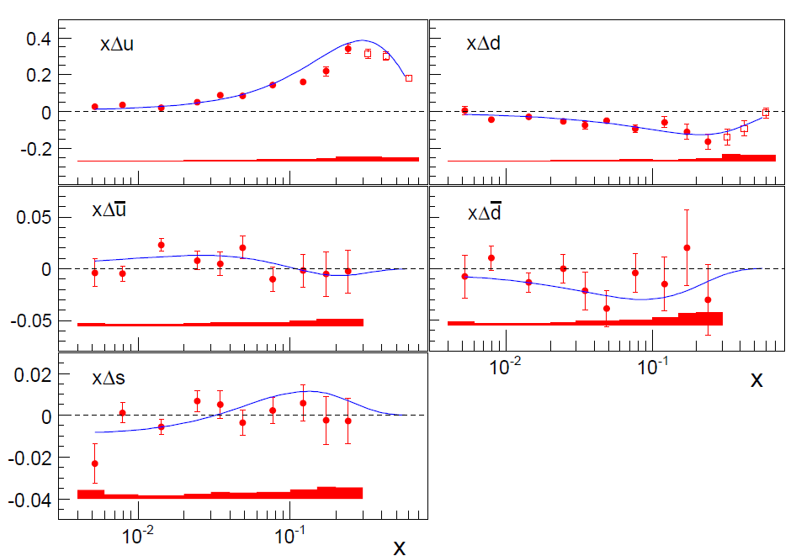
The role of quark flavours
LO analysis of 5p+5d asymmetries, DSS FF
Line: NLO DSSV not including these data
5-flavour fit,
assuming Δs = Δs
Data (LO analysis):
PLB693 (2010) 227
PRD80 (2009) 034030

Slide 24
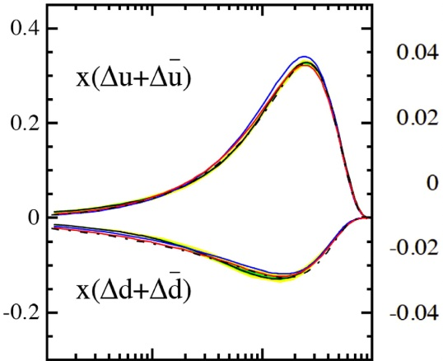
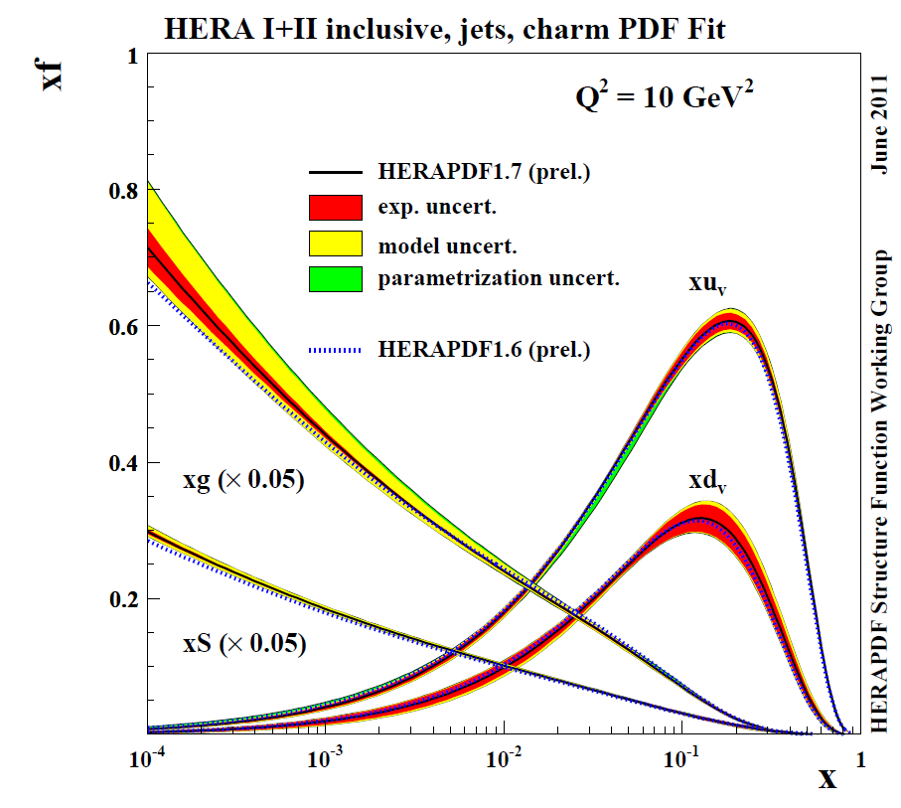

Status of PDFs: global analyses
DSSV PPNP (2012) 251

Slide 25
Transverse spin structure

Slide 26
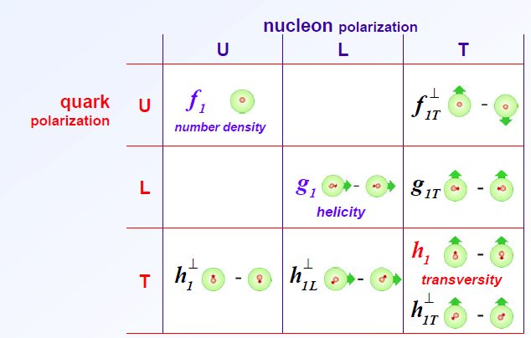


TMD parton distributions
8 intrinsic-transverse-momentum dependent PDFs at leading twist
Azimuthal asymmetries with different angular modulations in the hadron and spin azimuthal angles, Φ_{h} and Φ_{s}
Vanish upon integration over k_{T} except f₁ , g₁ , and h₁
aka
Sivers
Transversity
Boer–
Mulders
chiral odd

Slide 27
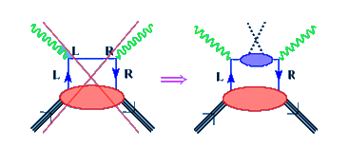
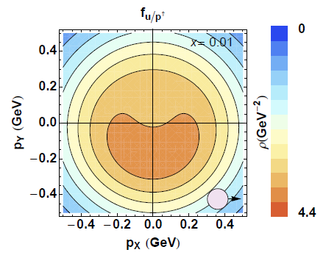
SSA: transversity (Collins) and Sivers
Transversity
  chiral odd, can be measured
  in SIDIS (not in incl. DIS)
  leads to an azimuthal asymmetry if the chiral-odd Collins fragmentation function is non-zero
Sivers function
  leads to a azimuthal asymmetry
  naive T-odd
  final/initial state interaction
  should change sign for SIDIS/DY
  related to orbital angular momentum

Slide 28
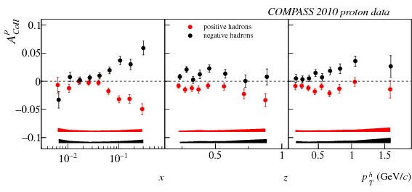
Collins Asymmetries
large asymmetry for proton ~10%
zero deuteron result important ⇒ opposite sign of u and d
proton
h⁻
h⁺
PLB717 (2012) 326

Slide 29
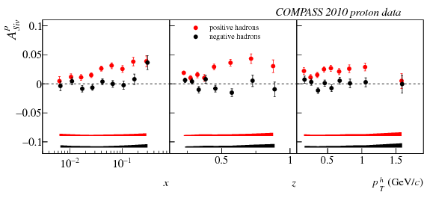
Proton Sivers Asymmetry
compatible with zero for the deuteron
non-zero asymmetry for pos. hadrons
h⁺
h⁻

Slide 30
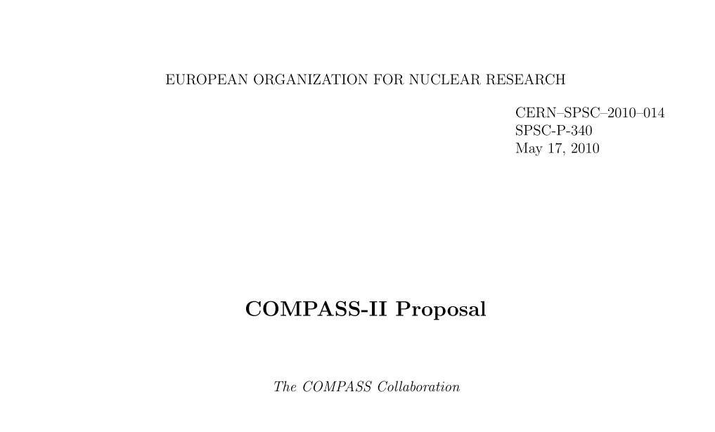
COMPASS-II
Generalized Parton Distributions (GPD):
simultaneously SIDIS on proton: (2012), 2015/16, ...
TMD in π─ + p Drell-Yan: 2014, ...
Pion (and kaon) polarizabilities 2012
Approved December 2010, first measurements 2012
wwwcompass.cern.ch/compass/proposal/compass-II_proposal/compass-II_proposal.pdf

Slide 31




Generalized PDF’s
DVCS
H (E) for nucleon helicity (non)conservation
PDFs and elastic FF as limiting cases
H, H → f₁ , g₁ for ξ→ 0;
Correlating transverse spatial and longitudinal momentum DoF
tools: DVCS, HEMP (vector & pseudoscalar)
~
Total orbital momentum:
X.-D. Ji, PRL 78 (1997) 610

Slide 32



Restricted universality in SIDIS and pol. DY
T-odd TMD
`gauge link changes sign
for T-odd TMD’, restricted
universality of T-odd TMDs
J.C. Collins, PLB536 (2002) 43
Sivers
Boer-Mulders

Slide 33

Physics with hadron beams
Proton, pion (and kaon) beams
hydrogen, nickel and lead targets
Inserting the liquid
hydrogen target in
the recoil detector

Slide 34


COMPASS hadron programme: Tests of χPT
Chiral perturbation theory: low energy limit of QCD
Pion (and kaon) polarisability via Primakoff scattering
control measurement with muons
present exp. situation confused

Slide 35

Pion polarisability

Slide 36






COMPASS spectroscopy
Mesons quantum numbers in CQM
forbidden (exotic QN’s)
more states in QCD:
hybrids , glueballs , multiquark states
Diffractive dissociation:

Slide 37

π⁻p → π⁻π⁺π⁻p
Isobar model:
X decay is chain of successive two-body decays
Analysis:
  Partial wave analysis (PWA) in mass bins with up to 88 waves labelled J^{PC} M^{ε} Isobar L
  fit of spin-density matrix for major waves with Breit-Wigner as function of mass

Slide 38

Major waves
S. Paul
Major waves
2
mass independent fits
minimal m = (0,1) waves

Slide 39
Mass-dependent fit
S. Paul
Use only lowest m = 0,1 waves (so far)
This work: 6 waves + non resonant term
Model:
1⁺⁺1⁺ ρπ S 2 resonances : a₁(1260) and a₁´ + non resonant term
2⁺⁺0⁺ ρπ D 2 resonances : a₂(1320) and a₂´ + non resonant term
4⁺⁺1⁺ ρπ G 1 resonance : a₄(2040) + non resonant term
2⁻⁺0⁺ f₂π S 2 resonances : π₂(1670) and π₂´ + non resonant term
1⁺⁺ f₀(980)π P 1 resonance : a₁(1420) + non resonant term
0⁻⁺ f₀(980)π S 1 resonance : π (1800) + non resonant term
231 mass distributions with 23100 data points
352 free parameters
systematic studies with 5 and 7 waves performed

Slide 40

COMPASS Spin-Density Matrix
S. Paul
Reference waves
Interferometry
low t’-slice only

Slide 41

Phase: a₁(1420)
S. Paul
Fit in 11 t-bins:
medium t’
fit range
a₁(1420)
a₁’
a₂’
a₄
π₂

Slide 42





Results of Mass-Dependent Fit
PDG
new meson

Slide 43
Summary
COMPASS has a rich programme on QCD and hadron physics
Nucleon spin:
  Essential contributions to clarify the spin structure of the nucleon both longitudinal and transverse
  Gluon polarisation
  Flavour separation (SIDIS)
  unpolarised asymmetries and fragmentation (not covered)
Huge data set on hadron spectroscopy
  tests of chiral perturbation theory
  new meson discovered, exotic mesons being studied
  many more channels, e.g. π⁰, η, η’, pp → p_{fast}π⁺π⁻p_{slow}
  just the beginning...
Future experiments
  Starting future program on GPDs and TMD PDFs
  Maybe come back to spectroscopy

Slide 44
Thank you!

Slide 45
Backup

Slide 46
Deep Inelastic Scattering
Bjorken-x: fraction of longitudinal momentum carried by the struck quark in infinite- momentum frame (Breit)

Slide 47




Sum Rules
Bjorken
sum rule
if wrong ⇒ QCD wrong,
“worthless equation”, needs neutron measurement
PR 148 (1966) 1467
Ellis-Jaffe
sum rule
PR D9 (1974) 1444
formulated for ∆s=0,
unpolarised strange quarks
Consequences of violation:
EMC 1987

Slide 48


Measurable asymmetries
P_{b}, P_{t} beam and target polarisations,
f target dilution factor = polarisable N/total N
note: linear in error: f=1/2 => requires 4 times statistics
huge rise of F₂ / 2x at small x
D depolarisation factor, kinematics, polarisation transfer from
polarised lepton to photon, D ≈ y
Even big g₁ at small x causes very small asymmetries

Slide 49



Asymmerties & SF
spin-averaged structure function:
spin-dependent structure function:
inclusive scattering:

Slide 50
COMPASS-II schedule
  2012 Primakoff scattering: Polarizabilities of p and K
  DVCS pilot run: t-slope, transverse size
  2013 Accelerator shutdown
  2014 Drell-Yan: Universality of TMDs
  2015−2016 DVCS and DVMP: Study GPDs,
  “nucleon tomography”
  Unpolarized SIDIS: FF, strangeness PDF, TMDs
  ... DVCS and HEMP with transversely polarised target
  ... further spectroscopy measurements

Slide 51
Polarized target system

Slide 52


COMPASS Spectrometer

Slide 53

Polarised target
⁶LiD/NH₃
50/90% polarisation
50/16% dilution fact.
2.5 T
50 mK
μ

Slide 54

QCD Fits
Marco Stratmann (tomorrow)

Slide 55
Incl. & semi-incl. A₁
proton
incl.
π⁺
K⁺
π –
K⁻

Slide 56

Incl. & semi-incl. A₁
deuteron
incl.
π⁺
K⁺
π –
K⁻

Slide 57



t-slope for ρ⁰ production
ρ⁰
also φ, ω, ..
Wollny, Wed 15:15

Slide 58

Proj. charge & spin asymmetry

Slide 59

Beam charge-and-spin asym.
amplitude of cos φ modulation as fctn of -t
fits by Kumericki, Mueller

Slide 60


COMPASS-II Polarised Drell-Yan
COMPASS-II: 190 GeV/c π⁻ beam on transversely pol. proton target
π⁻ valence u-antiquark picks nucleon’s u quark
in valence region (u-quark dominance)
Access to transversity , the T-odd Sivers and Boer-Mulders TMDs

Slide 61

Target region for DY
Quench and Exhaust Lines
Cable trays
Transfer Line
Absorber
Control Racks
Pol. target
He-pipes
Micro Wave guides

