Slide 1
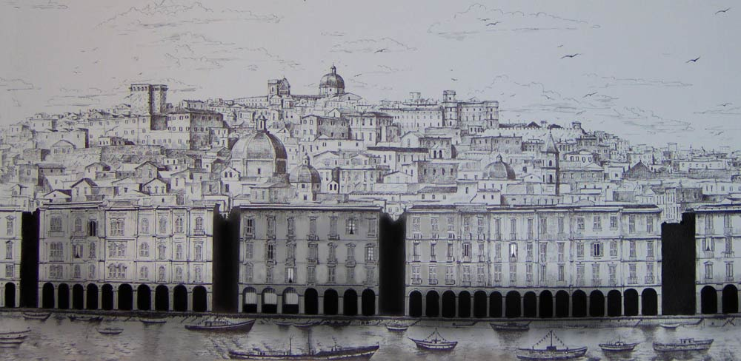
DVCS and exclusive channels
Nicole d’Hose, Irfu, CEA Saclay
Transversity 2014, 9-13 June, 2014, Chia, Cagliari

Slide 2
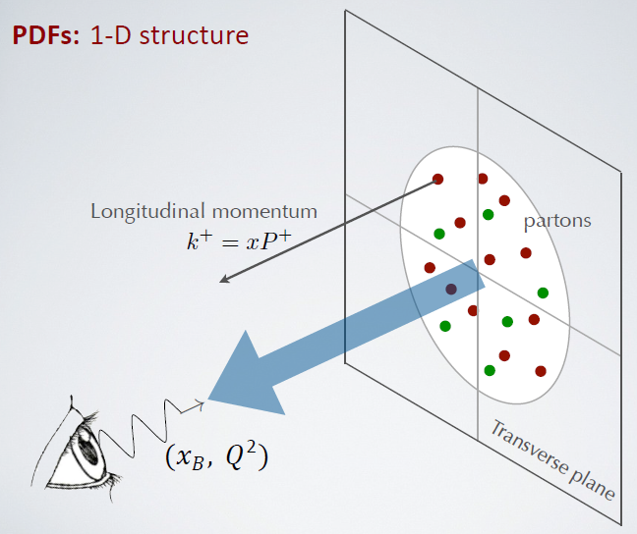
From PDFs to TMDs and GPDs
PDF (x)
PDF measured in Deep Inelastic Scattering
ℓp → ℓ’X

Slide 3
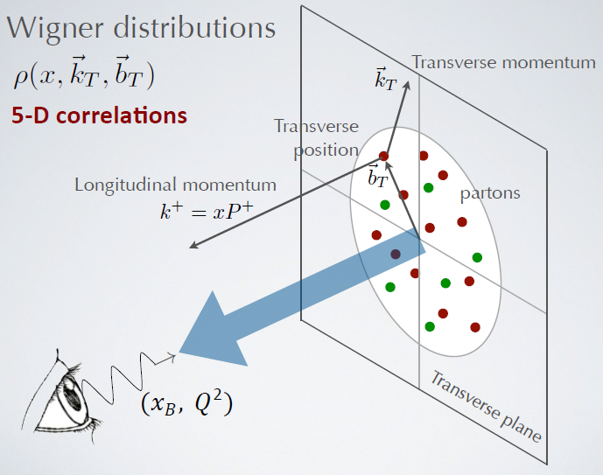

From PDFs to TMDs and GPDs
3-dimensional nucleon structure
in momentum and configuration space:
GPD (x, b⊥) :
Generalised Parton Distribution
(position in the transverse plane)
TMD (x, k⊥) :
Transverse Momentum Distribution
(momentum in the transv. plane)
TMD accessible in SIDIS and DY
GPD in Exclusive reactions
DVCS and HEMP

Slide 4
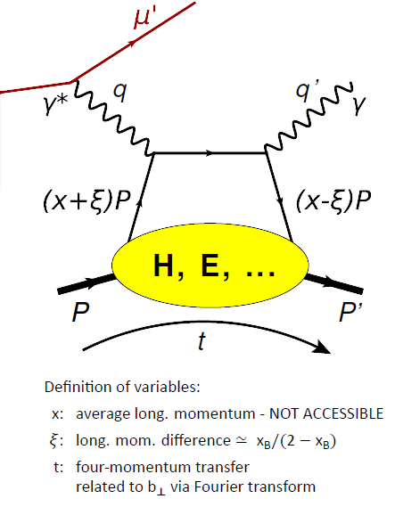
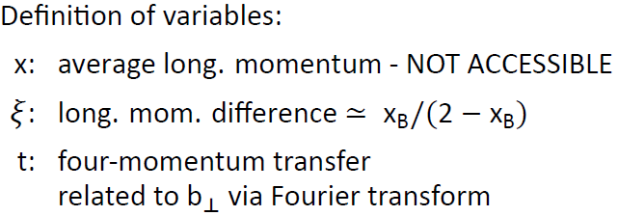
Exclusive reactions: DVCS and HEMP
ℓ’
DVCS: ℓp→ ℓ’ p’ γ (golden channel)
HEMP: ℓp→ ℓ’ p’ ρ or φ or J/ψ,…
ℓ
Q²,x_{B}
γ*
γ or ρ, φ, J/ψ,…
GPDs
D. Mueller et al, Fortsch. Phys. 42 (1994)
X.D. Ji, PRL 78 (1997), PRD 55 (1997)
A. V. Radyushkin, PLB 385 (1996), PRD 56 (1997)

Slide 5
Exclusive reactions: DVCS and HEMP
Q²
Deeply Virtual Compton Scattering (DVCS):
Factorisation:
Collins et al.
γ*
γ*
Q²
γ
γ
hard
x + ξ
x - ξ
x + ξ
x - ξ
soft
GPDs
GPDs
Q² large
t << Q²
+ γ*
p
p’
p
p’
p’
t
t
Hard Exclusive Meson Production (HEMP):
Q²
meson
Q²
meson
γ*
γ*
L
L
L
hard
L
x + ξ
x - ξ
x + ξ
x - ξ
soft
GPDs
GPDs
Meson w.f.
Large power & NLO
Very slow scaling
p
p’
p
p’
t
t
Quark contribution
Gluon contribution

Slide 6




8 GPDs  8 TMDs
Model dependent relations
4 Chiral-even
H  q or f₁
γ*_{L} p→ ρ⁰_{L} p L=0
⊥
-
E  f_{1T}
Sivers: quark k_{T}
& nucleon transv. Spin
‘’Elusive’’
γ*_{L} p→ ρ⁰_{L} p L=1
Ji: 2J^{q} = ∫ x (H^{q} (x,ξ,0) +E^{q} (x,ξ,0) ) dx
q
q
Relation to OAM
p
E
p
t
+ their partner for polarised quarks
~
H  Δ q or g_{1L}
E  g_{1T}
~

Slide 7



8 GPDs  8 TMDs
Model dependent relations
2 of the 4 Chiral-even
H  q or f₁
γ*_{L} p→ ρ⁰_{L} p L=0
⊥
-
E  f_{1T}
Sivers: quark k_{T}
& nucleon transv. Spin
‘’Elusive’’
γ*_{L} p→ ρ⁰_{L} p L=1
Ji: 2J^{q} = ∫ x (H^{q} (x,ξ,0) +E^{q} (x,ξ,0) ) dx
2 of the 4 Chiral-odd
-
H_{T}  h₁
Transversity: quark spin
& nucleon transv. spin
γ*_{T} p→ ρ⁰_{L} p L=0
~
⊥
-
E_{T} =
2H_{T} + E_{T} h₁
Boer-Mulders: quark k_{T}
& quark transverse spin
γ*_{T} p→ ρ⁰_{L} p L=1

Slide 8
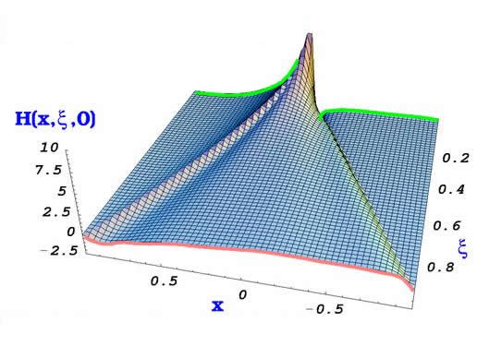
γ*
Q²
γ
Compton Form Factors
are measured in DVCS
hard
x + ξ
x - ξ
soft
GPDs
p
p’
The amplitude DVCS at LT & LO in α_{S}:
t
Real part Imaginary part
t, ξ~x_{Bj/2} fixed
Im part measured in
Beam Spin
or Target Spin asymmetries
q(x)
DGLAP
DGLAP
Real part measured in
Beam Charge asymmetry
or cross section
ERBL

Slide 9
γ*
Q²
γ
Compton Form Factors (CFF)
are measured in DVCS
hard
x + ξ
x - ξ
soft
GPDs
p
p’
The amplitude DVCS at LT & LO in α_{S}:
t =Δ²
Real part Imaginary part
t, ξ~x_{Bj/2} fixed
Im part measured in
Beam Spin
or Target Spin asymmetries
∫
Re H (ξ,t) = P dx Im H (x,t) + D (t)
x-ξ
Real part measured in
Beam Charge asymmetry
or cross section
D term related to the Energy-Momentum Tensor :
Polyakov, PLB 555 (2003) 57-62

Slide 10
DVCS (golden channel) CFF GPD H (E)
Exclusive Single Photon production ℓp→ ℓ’ p’ γ
DVCS
BH
ℓ
ℓ
γ
γ
GPD
p
small t
slow p
p
small t
slow p
dσ α |T^{BH}|² + Im(T^{DVCS}) ⋅T^{BH} + Re(T^{DVCS}) ⋅T^{BH} + |T^{DVCS}|²
Known to 1 % Linear combination of GPDs bilinear combination of GPDs

Slide 11
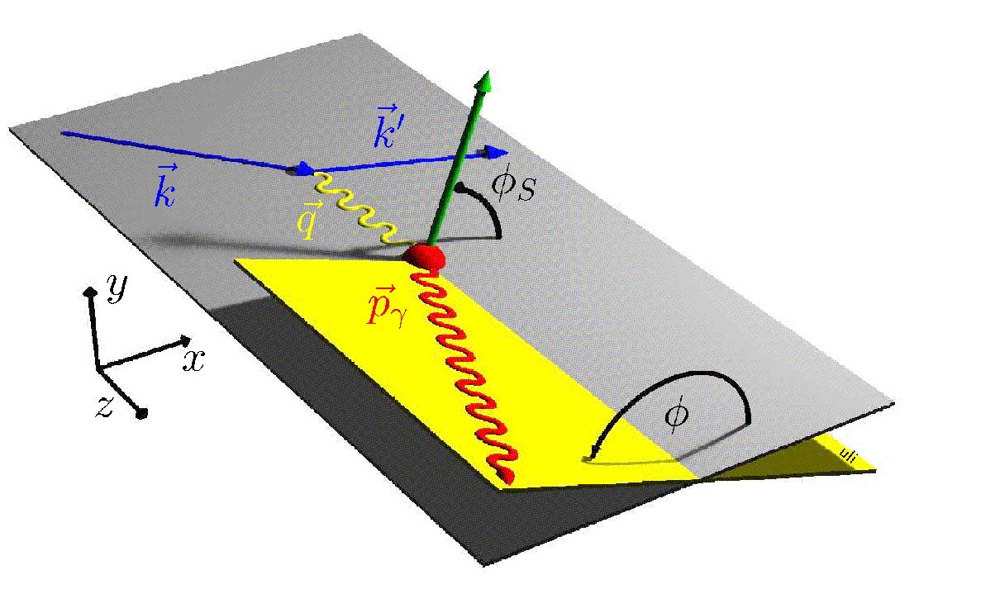
DVCS (golden channel) CFF GPD H (E)
Exclusive Single Photon production ℓp→ ℓ’ p’ γ
DVCS
BH
ℓ
ℓ
γ
γ
GPD
p
small t
slow p
p
small t
slow p
dσ α |T^{BH}|² + Im(T^{DVCS}) ⋅T^{BH} + Re(T^{DVCS}) ⋅T^{BH} + |T^{DVCS}|²
Known to 1 % Linear combination of GPDs bilinear combination of GPDs
{
Beam Charge Asym on proton
A_{C}^{cosφ} = Re (F₁H + ξ( F₁ + F₂ )H − t/4m² F₂E ))  Re (F₁H )
Beam Spin Asym on proton
A_{LU}^{sinφ} = Im (F₁H + ξ( F₁ + F₂ )H − t/4m² F₂E ))  Im (F₁H )
~
small x_{B}
~

Slide 12
DVCS (golden channel) CFF GPD H (E)
Exclusive Single Photon production ℓp→ ℓ’ p’ γ
DVCS
BH
ℓ
ℓ
γ
γ
GPD
p
small t
slow p
p
small t
slow p
dσ α |T^{BH}|² + Im(T^{DVCS}) ⋅T^{BH} + Re(T^{DVCS}) ⋅T^{BH} + |T^{DVCS}|²
Known to 1 % Linear combination of GPDs bilinear combination of GPDs
{
Beam Charge Asym on proton
A_{C}^{cosφ} = Re (F₁H + ξ( F₁ + F₂ )H − t/4m² F₂E ))  Re (F₁H )
Beam Spin Asym on proton
A_{LU}^{sinφ} = Im (F₁H + ξ( F₁ + F₂ )H − t/4m² F₂E ))  Im (F₁H )
BSA on neutron A_{LU}^{sinφ}  Im (F_{1n}H - F_{2n}E )
Target Spin Asym on proton
A_{UT}^{sin(φ- φs) cos φ}  Im (F₂ H − F₁E )
~
small x_{B}
~
{

Slide 13
HEMP  (MFF)² filter of GPDs and flavors
Hard Exclusive Meson Production (HEMP):
Vector meson production (ρ,ω,φ, J/ψ…) ⇒ H & E
Pseudo-scalar production (π,η… ) ⇒ H & E
~
~
Hρ⁰ = 1/√2 (2/3 H^{u} + 1/3 H^{d} + 3/8 H^{g})
Hω = 1/√2 (2/3 H^{u} – 1/3 H^{d} + 1/8 H^{g})
Hφ = -1/3 H^{s} - 1/8 H^{g}
Ration φ/ ρ = 2/9 in the gluon sector

Slide 14
The ideal experiment
High beam energy
ensure hard regime and large kinematic domain
polarized beam
availability of positive and negative leptons
variable energy for:
L/T separation for pseudo scalar prod
ε separation for DVCS² and Interf DVCS
H₂, D₂, Long. Pol., Transv. Pol. Target
High luminosity
small cross section
fully differential analysis (x_{B}, Q², t, φ)
Hermetic detectors
ensure exclusivity
but does not exist (yet)

Slide 15
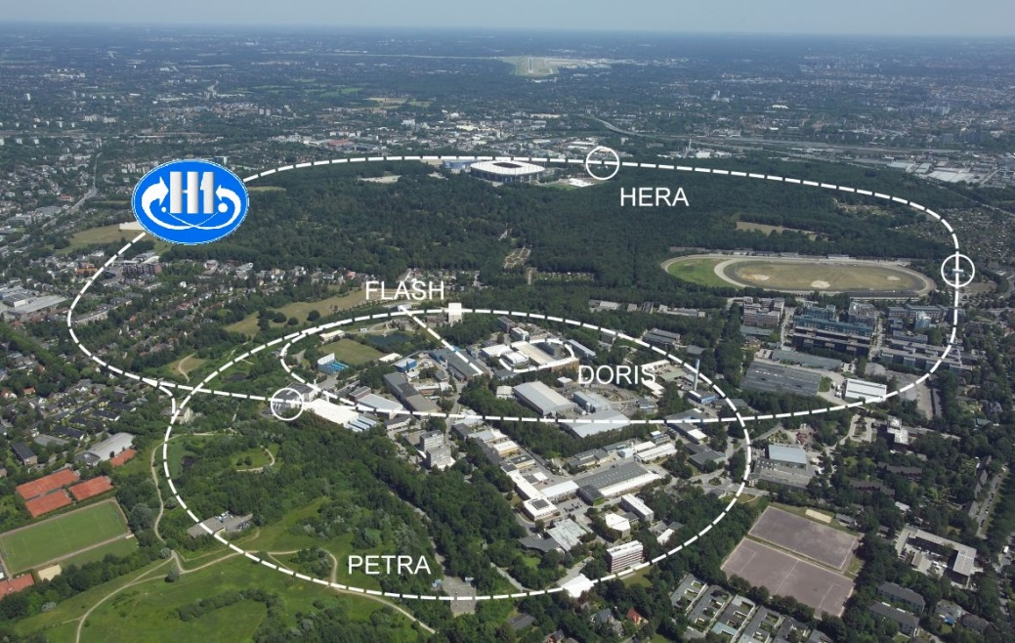


The past and future experiments
Collider mode e-p forward fast proton
HERA till 2007
Polarised 27 GeV e-/e+
Unpolarised 920 GeV p
∼ Full event reconstruction

Slide 16

The past and future experiments
Collider mode e-p forward fast proton
HERA till 2007
Polarised 27 GeV e-/e+
Unpolarised 920 GeV p
∼ Full event reconstruction
Fixed target mode slow recoil proton
Polarised 27 GeV e-/e+
Long, Trans polarised p, d target
Missing mass technique
2006-07 with recoil detector

Slide 17
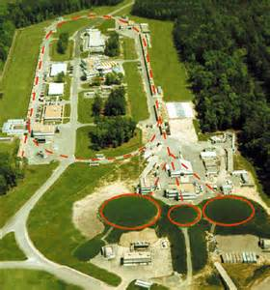
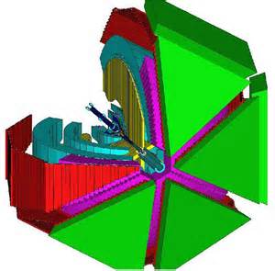
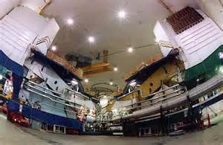
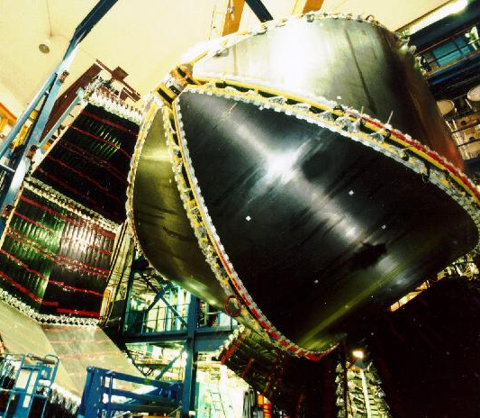
The past and future experiments
Collider mode e-p forward fast proton
HERA till 2007
Polarised 27 GeV e-/e+
Unpolarised 920 GeV p
∼ Full event reconstruction
CEBAF
at JLab
Fixed target mode slow recoil proton
Polarised 27 GeV e-/e+
Long, Trans polarised p, d target
Missing mass technique
2006-07 with recoil detector
HallA
High lumi, highly polar. 6 & 12 GeV e-
Long, (Trans) polarised p, d target
Missing mass technique
CLAS
HallA CLAS
Spectrometer large acceptance det

Slide 18


The past and future experiments
Collider mode e-p forward fast proton
HERA till 2007
Polarised 27 GeV e-/e+
Unpolarised 920 GeV p
∼ Full event reconstruction
CEBAF
at JLab
Fixed target mode slow recoil proton
Polarised 27 GeV e-/e+
Long, Trans polarised p, d target
Missing mass technique
2006-07 with recoil detector
HallA
High lumi, highly polar. 6 & 12 GeV e-
Long, (Trans) polarised p, d target
Missing mass technique
CLAS
LHC
COMPASS
Highly polarised 160 GeV μ+/μ-
p target, (Trans) polarised target
with recoil detection
SPS

Slide 19
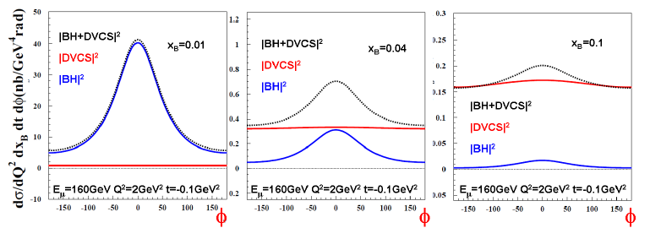
High Beam Energy
Example at E_{ℓ} =160 GeV
x_{B}  _{BH} 
x_{B}=0.01
x_{B}=0.04
x_{B}=0.1
BH dominates
Reference yield
Access to DVCS ampl.
Via interference
DVCS dominates
Study of dσ/dt
E_{ℓ}  _{BH} 
Jlab
HERMES, H1
COMPASS
Only for high energy
H1 & ZEUS
COMPASS

Slide 20
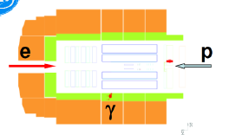
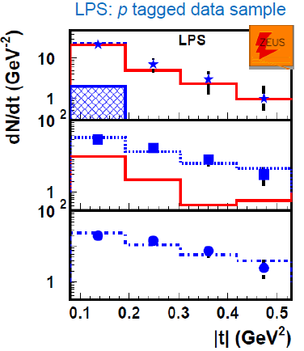
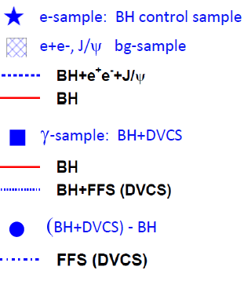
Exclusivity: ep  e + γ + p
Collider mode e-p forward fast proton
Outgoing proton escapes through the beam pipe
Tagged in forward proton spectrometer
e’
p’
Interference term integrated over φ  pure DVCS cross section

Slide 21
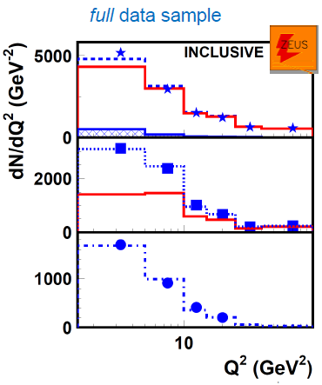
Exclusivity: ep  e + γ + p
Collider mode e-p forward fast proton
Outgoing proton escapes through the beam pipe
Tagged in forward proton spectrometer
e’
p’
Interference term integrated over φ  pure DVCS cross section

Slide 22
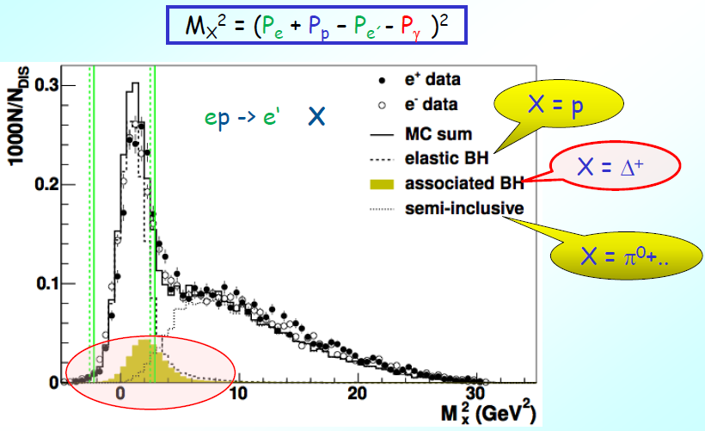
Exclusivity: ep  e + γ + p
Fixed target mode slow recoil proton
without recoil detector
ℓp→ ℓ’+γ (+p’)
ℓp→ ℓ’+γ (+Δ⁺)
ℓp→ ℓ’+γ (+ γ + p’+…)
from π⁰ decay…

Slide 23
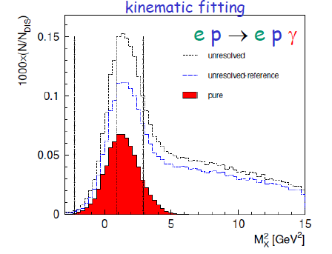
Exclusivity: ep  e + γ + p
Fixed target mode slow recoil proton
without recoil detector
ℓp→ ℓ’+γ (+p’)
ℓp→ ℓ’+γ (+Δ⁺)
ℓp→ ℓ’+γ (+ γ + p’+…)
from π⁰ decay…
ep  e + γ (+ p +…)
ep  e + γ (+ p _{in acceptance} +…)
ep  e + γ + p
with recoil detector

Slide 24
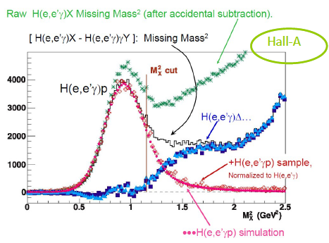
Exclusivity: ep  e + γ + p
Fixed target mode slow recoil proton
without recoil dtector
ℓp→ ℓ’+γ (+p’)
ℓp→ ℓ’+γ (+Δ⁺)
ℓp→ ℓ’+γ (+ γ + p’+…)
HallA
from π⁰ decay…

Slide 25
Selected Results (and perspectives)
Cross sections measurements: DVCS and mesons
  Study of the GPD H with DVCS on proton
  Beam Spin Asym: HallA – CLAS - HERMES
  Beam Charge Asym: HERMES – H1 – (COMPASS)
  Cross section diff and sum: HallA – CLAS – (COMPASS)
Study of the GPD H
Long. Pol. Target Asym or cross section
Hunting the GPD E
  Beam Spin cross section on the neutron – HallA – (Jlab)
  Transv. Pol. Target Asym on the proton - HERMES - (JLab)
~
→ 3D proton imaging
from gluon to quark
→ ‘Holy grail’ for OAM

Slide 26
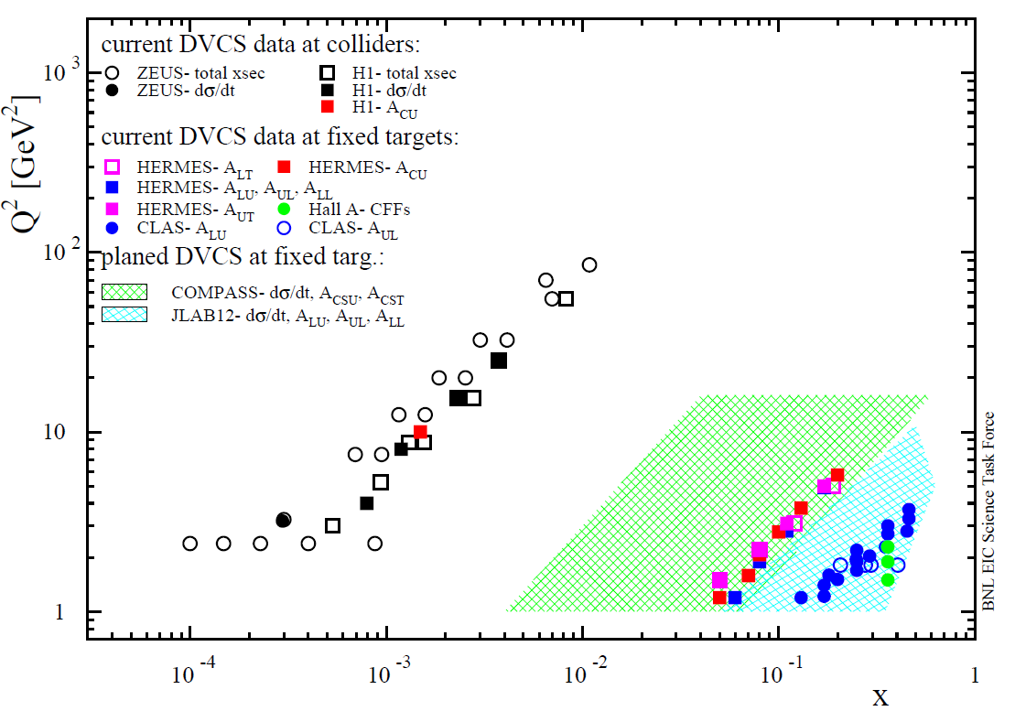
DVCS Results
Published Data for DVCS
Since 2 PRL in 2001
Gluons sea valence quarks

Slide 27
Meson and photon Cross sections

Slide 28
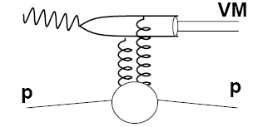
Meson and photon Cross sections
Are we in the hard regime ?
IP
g
g
‘soft’
‘hard’
δ increases from soft (~0.2) to hard (~0.8)
‘soft Pomeron’ xg(x,Q²)²
b decreases from soft (~10 GeV⁻²) to hard (~5 GeV⁻²)

Slide 29
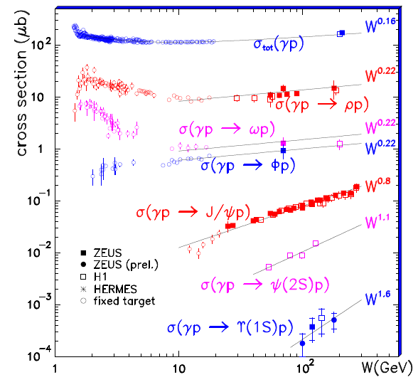
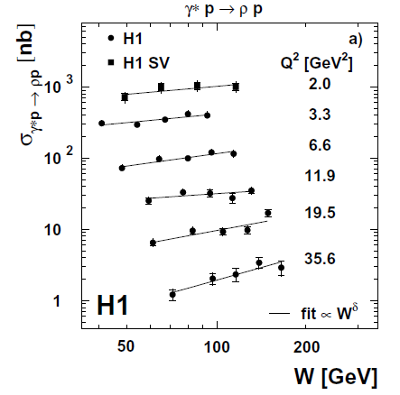
Cross sections and W dependence
Photoproduction
ρ
SOFT
HARD

Slide 30
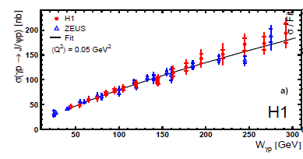
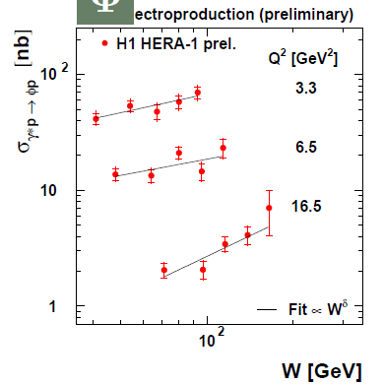
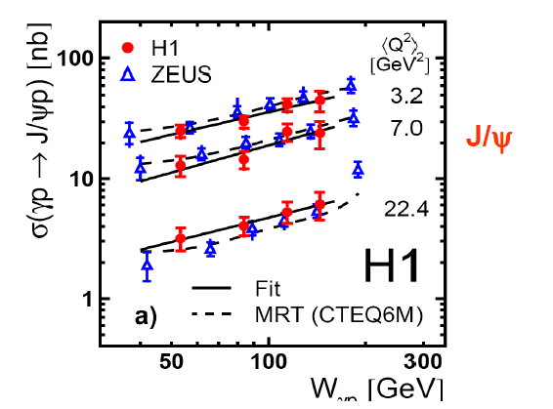
Cross sections and W dependence
Q²=0.05 GeV²
J/ψ
φ
J/ψ

Slide 31
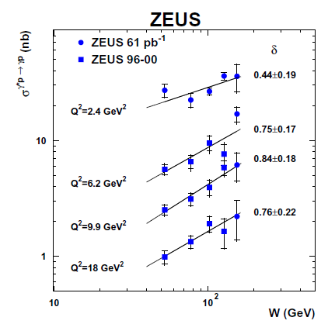
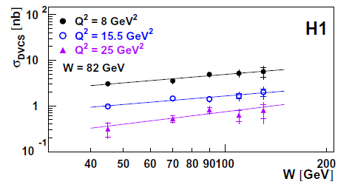
Cross sections and W dependence
DVCS
DVCS

Slide 32
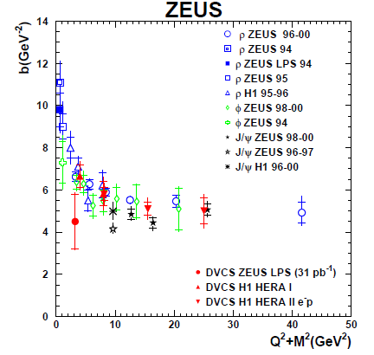
Cross sections and t dependence
sensitivity
to the nucleon transverse size
+ to the meson transverse size
J/ψ and DVCS in the hard regime
at small Q²

Slide 33
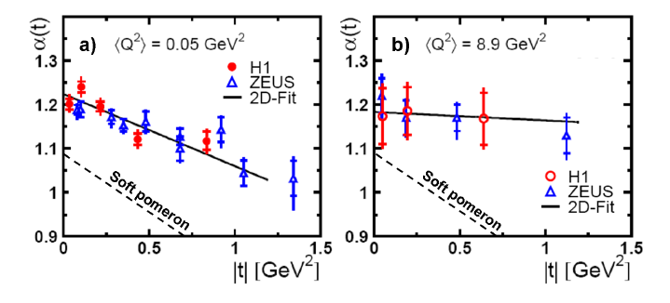
Cross sections and t dependence
Interplay between the W and t dependence
J/ψ production:
α’= 0.13 ± 0.03 GeV⁻²
at Q²=0.05 GeV²
α’= 0.05 ± 0.05 GeV⁻²
at Q²=10 GeV²
Soft pomeron
α’= 0.25 GeV⁻²
J/ψ
J/ψ

Slide 34
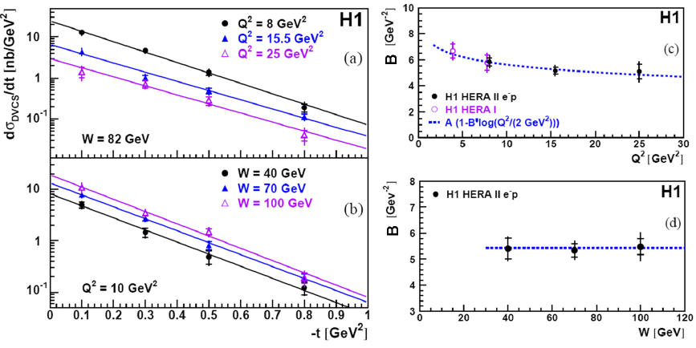
Cross sections and t dependence
Almost no evolution as a function of W
B= 5.45 ± 0.19 ± 0.34 GeV² at <Q²> = 8 GeV² and <x> = 1.2 10⁻³
= 0.65 ± 0.02 fm
< r⊥² (x_{B}) > ≈ 2 B(x_{B})

Slide 35
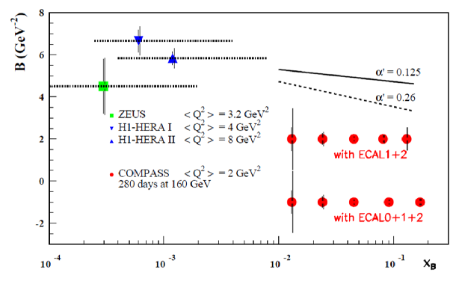
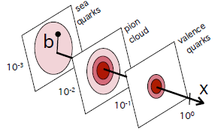
Cross sections and t dependence
Gluon and sea quark imaging
J/ψ slope
DVCS
HERA
as soft Pomeron
in 2 weeks in 2012
with 40 weeks in 2016-17
1rst bar= stat. error; 2nd = stat + syst. errors
DVCS Prediction at COMPASS
For 2 years 2016-17
< r⊥² (x_{B}) > ≈ 2 B(x_{B})
?
and gluons
1.
0.5
0.65 ±0.02 fm
H1 PLB659(2008)
r
0.01
COMPASS
0.1
x_{B}
1/3
x
1

Slide 36
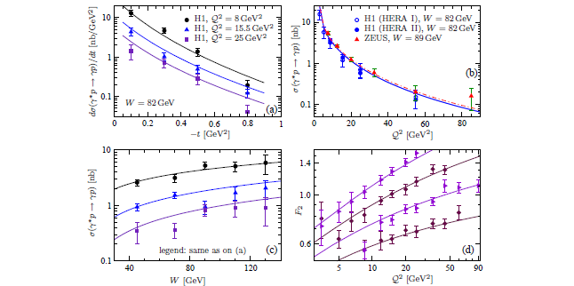
Predictions for DVCS from KM model
KM10: Kumericki and Mueller NPB (2010) 841; arXiv:0904.0458
one of the most general parameterization of GPDs based on their mathematic properties
fit to the DVCS data and DIS

Slide 37
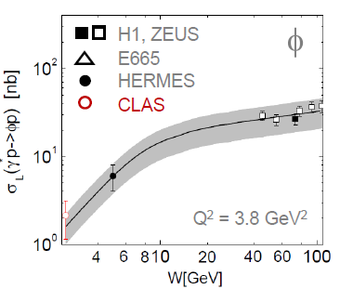
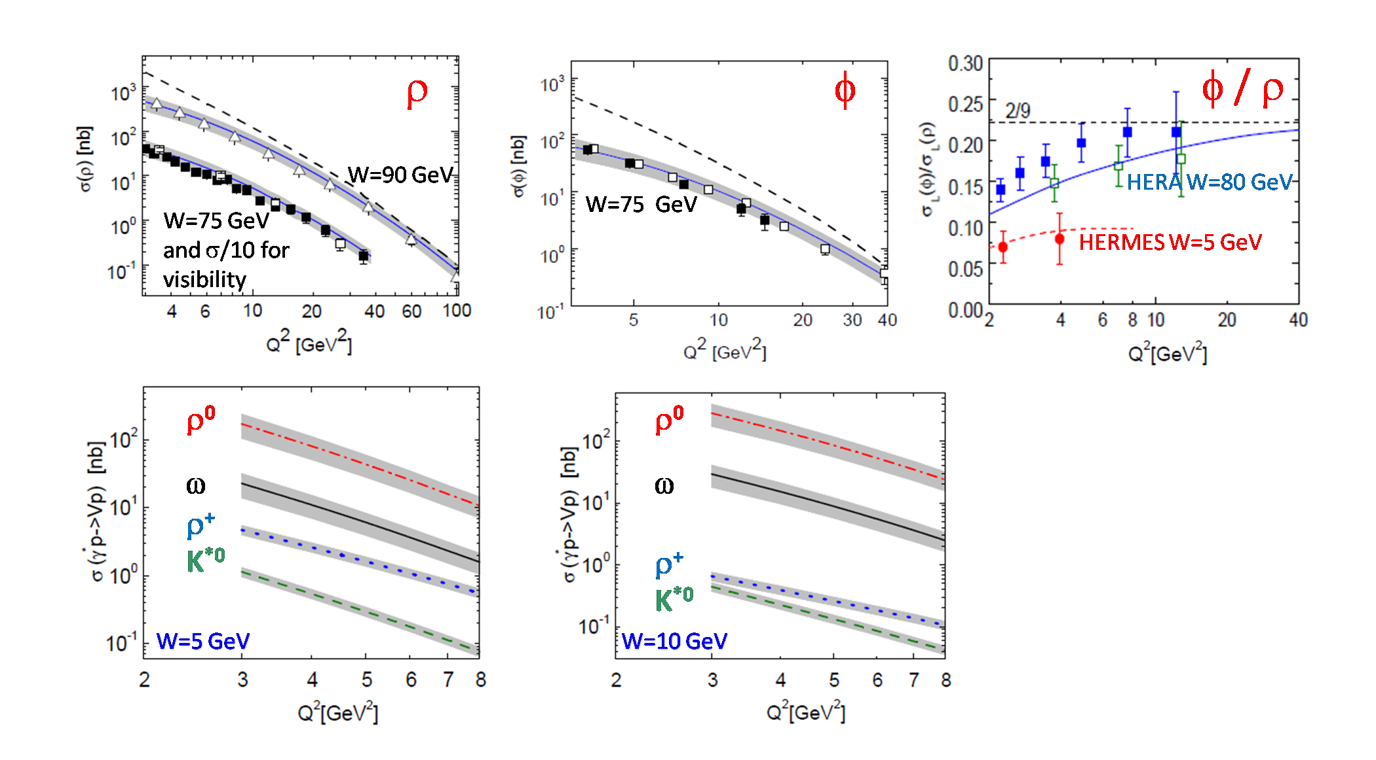
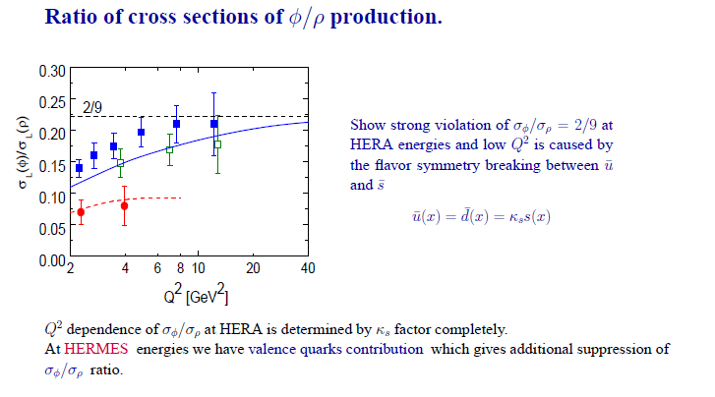
Predictions for mesons from GK model
GK model for GPDs ( determined for mesons) including
dominant (longitudinal) γ_{L}* p → ρ_{L} p and transv. polar. γ_{T}* p → ρ_{T}p
quark and gluon contributions and beyong leading twist
LO
ZEUS
H1
LO
ZEUS
H1

Slide 38
DVCS interference on the proton
→ Im DVCS with BSA or Beam Spin difference
→ Re DVCS with BCA or Beam Charge difference
→ mainly constrains on the GPD H

Slide 39
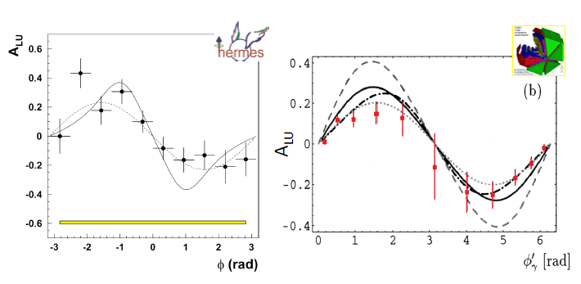
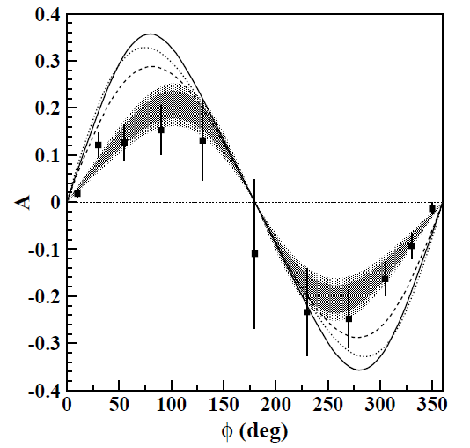
First DVCS interference signal
BSA asymmetries – PRL87 (2001)
A_{LU}
Validate the dominance of the handag contribution
(Fit and VGG model)

Slide 40
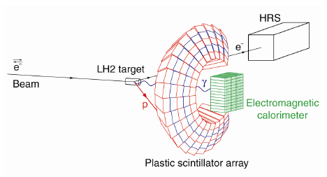
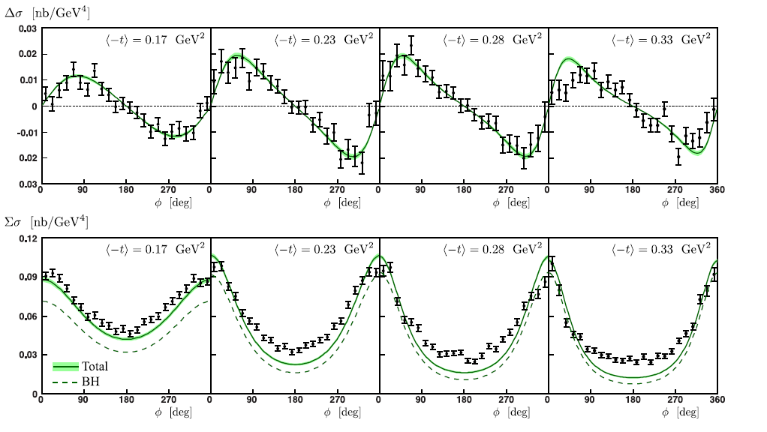
Beam Spin Sum and Diff of DVCS - HallA
E00-110 pioneer experiment with magnetic spectrometer
3 measurements: x_{B}=0.36 Q²= 1.5, 1.9, 2.3 GeV²
e p → e γ p
Data: Munoz et al. PRL97, 262002 (2006)
Model: Kroll, Moutarde, Sabatié, EPJC73 (2013) with GPDs from GK model
x_{B}=0.36 Q²= 2.3 GeV²
News:
- Re-analysis of the data
(MC, RC, normalisation/DIS)
- 2010: run E07-007
Rosenbluth-like DVCS²/Int
sparation
- 2014: HallA with 11 GeV
- 2018: HallC with 11 GeV
Beam Spin difference
Beam Spin Sum = Total cross section
Do we understand Hall A data?

Slide 41
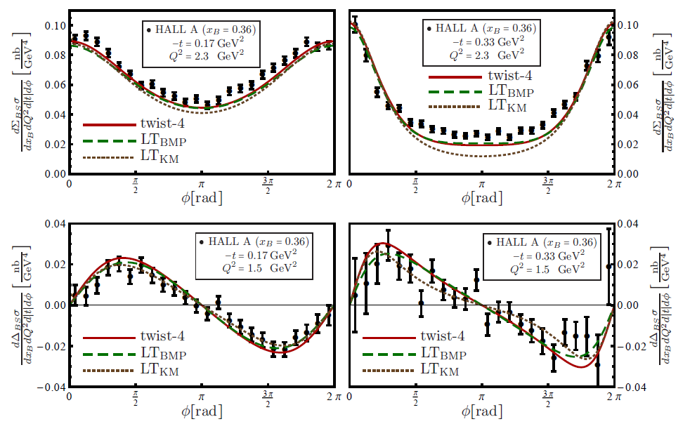
Beam Spin Sum and Diff of DVCS - HallA
Do we understand Hall A data?
Data: Munoz et al. PRL97, 262002 (2006)
Model: Braun, Manashov, Pirnay, Mueller PRD79 (2014) GK12 model evaluated
with KM and BMP
prescription
including
kinematic corrections
(finite-t, target mass corr.)
Beam Spin Sum = Total cross section
Beam Spin difference

Slide 42
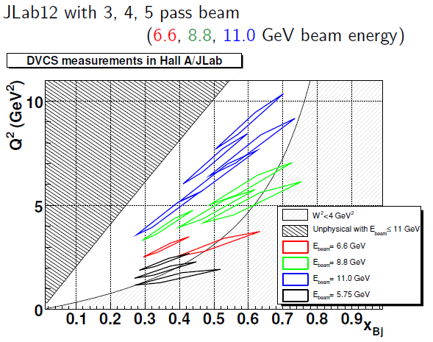
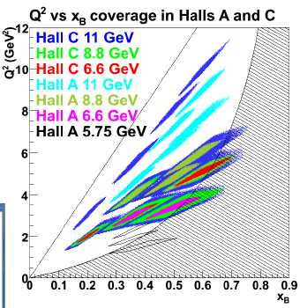
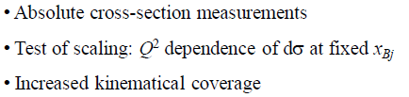

Beam Spin Sum and Diff of DVCS - future
with magnetic spectrometer + Calorimeter
First run after the 12GeV upgrade
Now 2014
Need a new challenging Calo
~ 2018

Slide 43
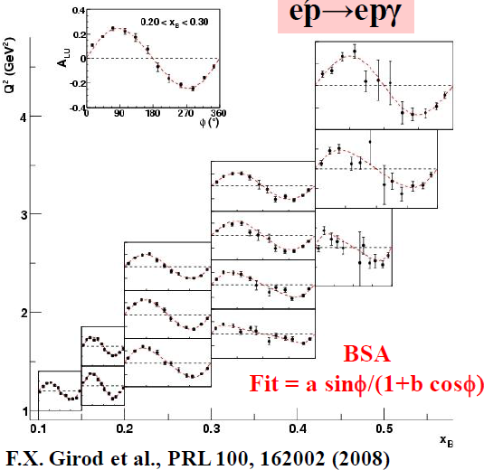
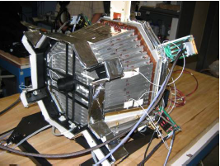

BSA in a large kinematic domain - CLAS
Part 1 of the E01-113 or e1-DVCS exp
e p → e γ p
CLAS + Inner Calorimter
Solenoid magnet
No simple
interpretation of α
Data: Girod et al. PRL100, 162002 (2008)

Slide 44
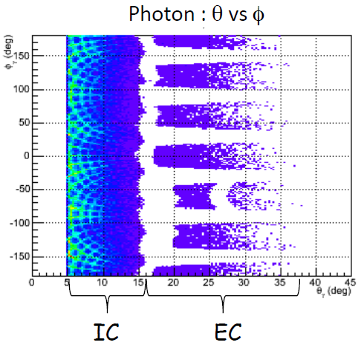
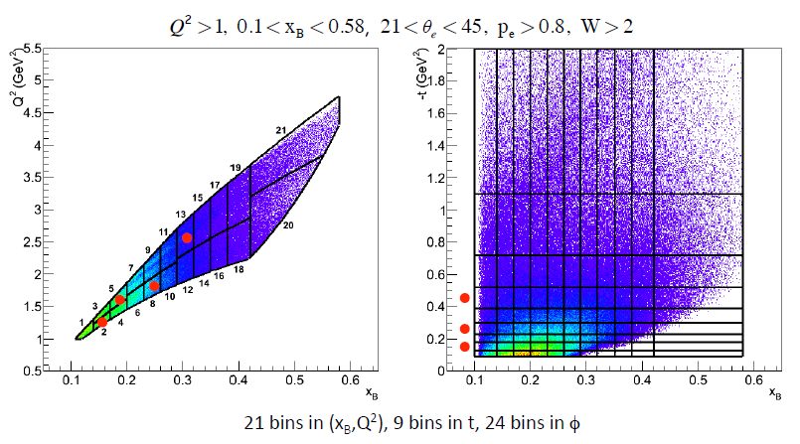
Cross section analysis - CLAS
Difficulty of the task
4 bins in Q²(x)
vs 3 bins in t

Slide 45

Beam Spin Diff - CLAS
(without Hall A)
0.15
0.26
0.45
|t|
(GeV²)
1.27 1.63 1.80 2.58 Q²(GeV²)
0.15 0.18 0.24 0.30 x_{B}

Slide 46

Beam Spin Sum - CLAS
(without Hall A)
0.15
0.26
0.45
|t|
(GeV²)
1.27 1.63 1.80 2.58 Q²(GeV²)
0.15 0.18 0.24 0.30 x_{B}

Slide 47



Future with CLAS12
E12-06-119
LH₂ Target and Long. Pol. Target
in 2016

Slide 48

BSA and BCA with HERMES
Last analyses with the complete set of data including 2006-07
Combined analysis of charge and polarisation observables
to separate interference term and DVCS² contributions

Slide 49



BSA with HERMES
Complete data set including 2006-07
(without Hall A)
sin φ term
Im F1 H
sinφ term
from DVCS²
sin 2φ term
higher twist
resonant fraction
ep → eγΔ⁺
KM:
GHL11: flexible parameterization

Slide 50

BSA with recoil detector with HERMES
data set 2006-07
High-purity event selection shows that there is only
a small influence on the extracted BSA amplitude
from events involving a Δ particle (associated DVCS)
The leading asymmetry has increased by 0.054 ± 0.016
Mainly dilution due to the associated DVCS
ep  e + γ ( + p +…)
p _{in accepta}
ep  e + γ + p

Slide 51

BSA with recoil detector with HERMES
Without recoil detection 1995-2007
With recoil detection 2006-2007
Model: Kroll, Moutarde, Sabatié,
EPJC73 (2013)
with GPDs from GK model
High-purity event selection shows that there is only
a small influence on the extracted BSA amplitude
from events involving an Δ particle (associated DVCS)
The leading asymmetry has increased by 0.054 ± 0.016
Mainly dilution due to the associated DVCS

Slide 52

BCA with HERMES
Complete data set including 2006-07 witjour recoil detection
constant term
without Hall A)
cos φ term
Re F1 H
cos 2φ term
higher twist
cos 3φ term
gluon twist
resonant fraction
ep → eγΔ⁺
KM:
GHL11:

Slide 53

BCA with H1
First measuremeent at a collider
Low x_{B} = 10⁻⁴ – 10⁻²
65 < Q² < 80 GeV²
30 < W < 140 GeV
|t| < 1 GeV²
Positive cosφ amplitude
Sign change compared to HERMES
Re H > 0 at H1

Slide 54

Beam Charge & Spin Sum & Diff @ COMPASS
cross-sections on proton for μ^{+↓}, μ^{-↑} beam with opposite charge & spin (e_{μ}& P_{μ})
D_{CS,U}
≡ dσ(μ ^{+↓}) - dσ(μ ^{-↑}) → Re F1 H
S_{CS,U}
≡ dσ(μ ^{+↓}) + dσ(μ ^{-↑}) → Im F1 H

Slide 55




Beam Charge and Spin Difference → Re F1 H
Comparison to different models
α’= 0.8
α’= 0.05
ZOOM
Kroll, Moutarde, Sabatié
EPJC 73 (2013) 2278
DVCS Prediction at COMPASS
For 2 years 2016-17
(without Hall A)

Slide 56

D_{CS,U}
≡ dσ(μ ^{+↓}) - dσ(μ ^{-↑}) ∝
and ∼ F₁ Re H
Re H > 0 at H1
< 0 at HERMES/JLab
Value of x_{B} for the node?
Predictions with
VGG and D.Mueller
HERMES
JLab
COMPASS
2 years of data
Eμ= 160 GeV 1 < Q² < 8 GeV²
with ECAL2 + ECAL1 + ECAL0

Slide 57


Impact of DVCS @ COMPASS in global analysis ?
Beam Spin and Charge Diff. and Sum (Cross section measurement)
dominance of H on a proton target at COMPASS
Sensitivity to the Re H linked to the D term
HERMES+CLAS
+ HallA
x
From Müller, COMPASS workshop, Venise, 2010
Kumericki, Müller, NPB 841 (2010) 1-58
Müller, Lautenschlager, Passek-Kumericki,
Schaefer, arXiv:1310.5394, 125p

Slide 58

Impact of DVCS @ COMPASS in global analysis ?
Beam Spin and Charge Diff. and Sum (Cross section measurement)
dominance of H on a proton target at COMPASS
Sensitivity to the Re H linked to the D term
HERMES+CLAS
+ HallA
t=-0.1GeV²
LO
NLO, no gluon
Full NLO
x
From Müller, COMPASS workshop, Venise, 2010
Kumericki, Müller, NPB 841 (2010) 1-58
Müller, Lautenschlager, Passek-Kumericki,
Schaefer, arXiv:1310.5394, 125p
Moutarde, Pire, Sabatié, Szymanowski,
Wagner,PRD87(2013) 054029, 15p

Slide 59
Hunting the GPD E
Transv. Target Spin asymmetry of DVCS –HERMES
→ Beam Spin Diff of DVCS on a neutron - JLab
→ ρ production with TTSA - COMPASS

Slide 60

Trans. Target Spin Asymmetry on a proton – HERMES
But also Large
A_{UT,DVCS} sin(φ-φ_{S})
With strong xB depend.
Large
A_{UT,I} sin(φ-φ_{S}) cos φ
Sensitive to Ju, Jd
(VGG model)

Slide 61

Trans. Target Spin Asymmetry on a proton – HERMES
Model: Kroll, Moutarde, Sabatié, EPJC73 (2013) with GPDs from GK model
E sea < 0 is favored by HERMES data

Slide 62


DVCS on a neutron – HALL A
DVCS on LD2 target= DVCS on quasi- free proton + quasi-free neuton + coherent DVCS on D
Proton Including
Fermi motion
Next:
- 2010: run E08-025 with LD2 target
Rosenbluth-like DVCS²/Int separation
- 2016: CLAS12 with 11 GeV with LD2 target + neutron detector (ToF)

Slide 63


Hinting the GPD E with CLAS12 at Jlab
e d → e n γ (p) E12-11-003
With LD2 target + CLAS12
+ Forward Calorimeter
+ Neutron Detector ToF
e p → e p γ E12-12-010
With the HD ice target
(transv pol =60% H )
+ CLAS12
Δσ_{LU} ~ Im (F_{1n} H - F_{2n} E )
Δσ_{UT} ^{sin(φ- φs) cos φ} = Im (F₂ H − F₁E ))
Δσ_{LT} ^{sin(φ- φs) cos φ} = Re (F₂ H − F₁E ))
Selected in the
«High Impact » experiments
FTOF
DC
R3
R2
R1
EC
RICH
HTCC
HD-Ice
PCAL
Solenoid
Torus

Slide 64

exclusive ρ⁰ production with Transv. Polar. Target
μ p → μ’ + ρ⁰ + p_{non détecté}
 π⁺π⁻
COMPASS 2007-2010,with transv. polar. NH3 target,
without recoil detector
sin(φ - φ_{S})
A_{UT} ∝ Im( E* H )
Eρ⁰ ∝ 2/3 E^{u} + 1/3 E^{d} + 3/8 E^{g}
Cancellation between gluon and sea contributions and E^{u val} ∼ -E^{d val}
COMPASS, NPB865 (2012) 1-20
(similar res HERMES PLB679(2000) 100)
ω production very interesting
analysis on going

Slide 65
exclusive ρ⁰ production with Transv. Polar. Target
μ p → μ’ + ρ⁰ + p_{non détecté}
 π⁺π⁻
COMPASS 2007-2010,without recoil detector
sin(φ - φ_{S})
A_{UT} ∝ Im( E* H )
NEW RESULTS
sin(2 φ -φ_{S})
A_{UT} ∝ Im( E* E )
T
sin(φ_{S})
A_{UT} ∝ Im( E* E - H *H )
T T
➔ H_{T} should not be small
COMPASS, PLB 731 (2014) 96

Slide 66
Conclusions and perspectives
Since more than 10 years large experimental efforts for DVCS and HEMP
Validity of GPD analysis of DVCS data, Dominance of twist-2
Dominance of the GPD H: ImH rather well known,
ReH poorly constrained  Beam Charge Diff. and cross section measurements
The GPD E poorly constrained  Transversely Pol. Target measurements on proton
or measurements on neutron
Progress in theory and phenomenolgy
Beyound Leading Order, Leading Twist
Extraction of the GPDs:
  local fits of the CFF for each kinematic bin independently
  global fits using paramaterisation of the GPDs
  neural network: same technique as for PDFs (with error estimate)
a lot of work for challenging experiments and theory

Slide 67

DVCS with JLAB12, COMPASS, and collider
+ talks on Friday for HERMES , Jlab 6 and 12 GeV

Slide 69
From PDFs to TMDs and GPDs
From Wigner distribution we can build ‘’mother distributions’’
W (x, b⊥ , k⊥) → 3-dimensional nucleon structure
in momentum and configuration space:
PDF (x)
Deep Inelastic Scattering
GPD (x, b⊥) : Generalised Parton Distribution
(position in the transverse plane)
TMD (x, k⊥) :Transverse Momentum Distribution
(momentum in the transv. plane)
ℓp → ℓ’X
ℓ’
ℓ
Q²x_{B}
γ*
x
z
z
p
k⊥
x P
x P
b⊥
y
y
TMD accessible in SIDIS and DY
GPD in Exclusive reactions
DVCS and DVMP
x boost
x
Partons Distrib. q (x )

Slide 70
From inclusive reactions
to exclusive reactions
ℓp→ ℓ’ p’ γ = DVCS (golden channel)
ℓp→ ℓ’ p’ meson
PDF (x)
Deep Inelastic Scattering
Deeply Virtual Compton Scattering
ℓp → ℓ’X
ℓp→ ℓ’p’γ
ℓ’
ℓ
Q²x_{B}
γ*
Q²
γ
γ*
x+ξ
x-ξ
x
p
z
p
GPDs
P’
z
t
x P
x P
b⊥
y
x boost
y
x boost
Partons Distrib. q (x )
Generalized Partons Distrib. H(x,ξ,t )

Slide 71


Slide 72



Cross sections and QCD models

Slide 73

Cross sections and t dependence
Very slight difference between dipole t dependence and exp t dependence
KM10: Kumericki and Mueller NPB (2010) 841; arXiv:0904.0458

Slide 74

Cross sections and t dependence
Gluon and sea quark imaging
Q² _{eff}= 3 GeV ²
From Frankfurt, Strikman, Weiss:
PRD83 (2011) 054012; arXiv: 1009.2559

Slide 75


Exclusive ρ⁰ production
transv.
polar.
target
transv.
polar.
target
+ long. Polar.
beam
σ
Dominant interference terms:
LL
then LT
i j for nucleon helicity
mn for photon helicity
γ*_{L} → ρ⁰_{L}
γ*_{T} → ρ⁰_{L}

Slide 76



Plan for DVCS after 2018 with Transv. Polarized target
with μ^{+↓}, μ^{-↑} beam and transversely polarized NH3 (proton) target
μ’
γ*
γ
μ
θ
∝ Im(F₂ H – F₁ E) sin(φ- φ_{S}) cos φ
D_{CS,T}
≡ dσ_{T} (μ ^{+↓}) – dσ_{T} (μ ^{-↑})
φ
p
CS,T
related to H and E
related to H and E
(only stat .error)
2 years of data 160 GeV muon beam
1.2 m polarised NH₃ target ε_{global} = 10%
CS,T
With ECAL2 + ECAL1

Slide 77


Guidal, Moutarde,
Vanderhaeghen,
Rept. Prog. Phys. 76 (2013) 066202
CLAS HERMES
X_{B} =0.001
Sea quark polarized sea quark
Mueller, 2011

Slide 78


Different local fits
Guidal, Moutarde,
Vanderhaeghen,
Rept. Prog. Phys. 76 (2013) 066202

Slide 79

DVCS on a neutron at Jlab 12 GeV
e d → e n γ (p) E12-11-003
With LD2 target + CLAS12
+ Forward Calorimeter
+ Neutron Detector
Δσ_{LU} ~ Im (F_{1n} H - F_{2n} E )

Slide 80


DVCS on a Transv. Pol. proton at Jlab 12 GeV
e p → e p γ E12-12-010
With the HD ice target
(transv pol =60% H )
+ CLAS12
Δσ_{UT} ^{sin(φ- φs) cos φ} = Im (F₂ H − F₁E ))
Δσ_{LT} ^{sin(φ- φs) cos φ} = Re (F₂ H − F₁E ))
Hightly sensitive
to the u-quark
contribution
to the nucleon spin

