Slide 1
Measurements of transverse momentum dependent effects in COMPASS

Slide 2
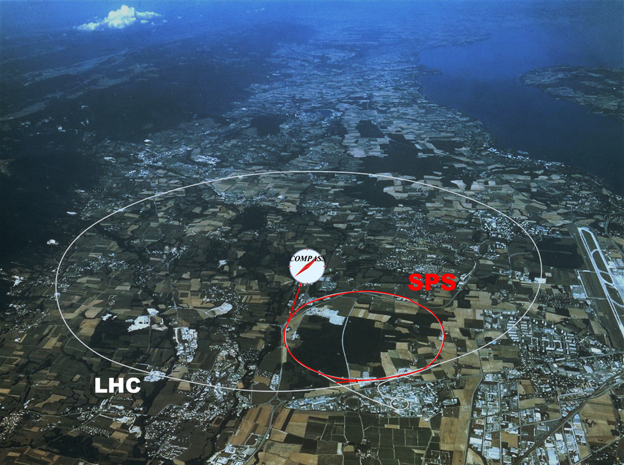
COmmon
Muon and
Proton
Apparatus for
Structure and
Spectroscopy
Collaboration ~ 250 physicists from 24 Institutions of 13 Countries
fixed target
experiment
at the CERN SPS
data taking: since 2002

Slide 3
COMPASS Collaboration
Дубна (LPP and LNP), Москва (INR, LPI, State University), . Протвино
Bochum, Bonn (ISKP & PI), Erlangen, Freiburg, Mainz, München TU
CERN
Warsawa (NCBJ),
Warsawa (TU)
Warsawa (U)
USA (UIUC)
Yamagata
Praha (CU/CTU)
Liberec (TU)
Brno (ISI-ASCR)
Saclay
Lisboa/Aveiro
Torino
(University,INFN),
Trieste
(University,INFN)
Calcutta (Matrivian)
Tel Aviv
Taipei (AS)

Slide 4
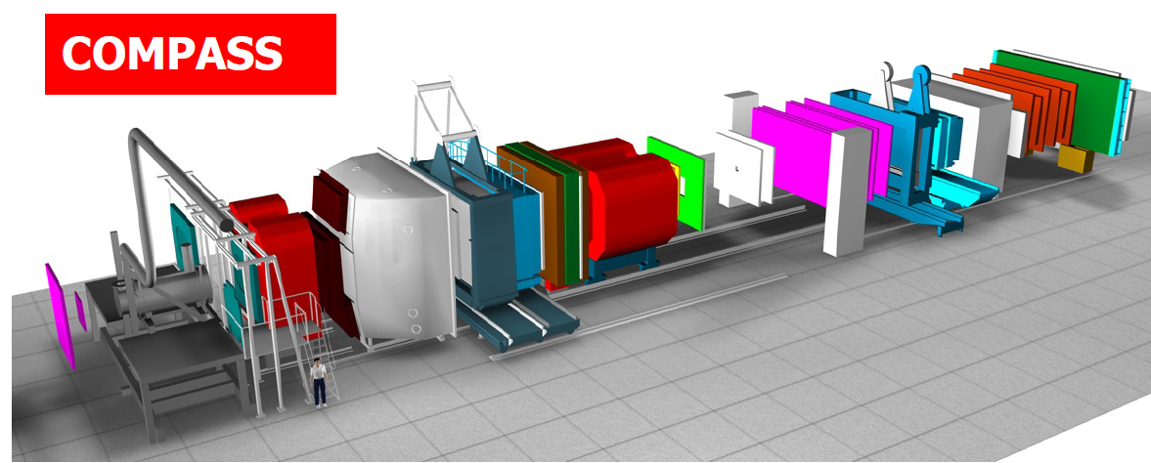
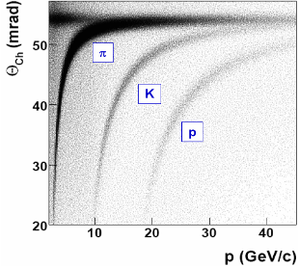
COMPASS
high energy beam
large angular acceptance
broad kinematical range
two stages spectrometer
Large Angle Spectrometer (SM1)
Small Angle Spectrometer (SM2)
radiator C₄F₁₀
threshold: π ~2 GeV/c
K ~ 10 GeV/c
SM2
MuonWall
E/HCAL
SM1
RICH
MuonWall
Target
E/HCAL
variety of tracking detectors to cope with different particle flux from θ = 0 to θ ≈ 200 mrad
Notes:
4

Slide 5
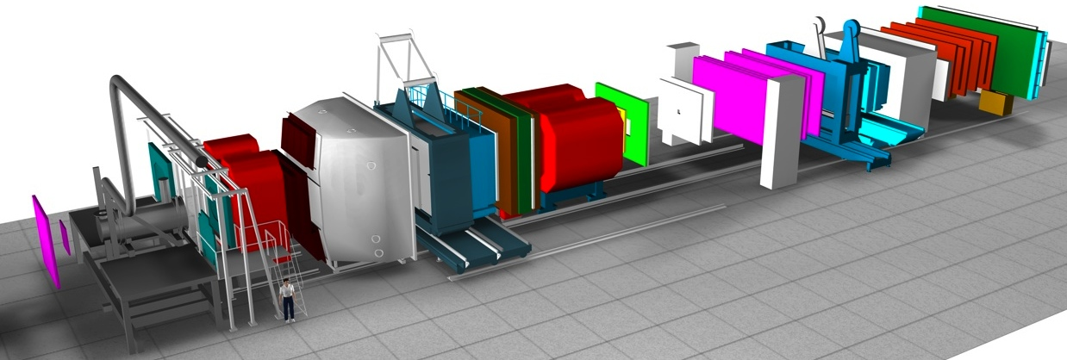
Space resolution
Target
region
Large
Angle
Spectrometer
Small
Angle
Spectrometer
SM2
SM1
10 µ 100µ 200µ 500µ 1 mm
Space resolution is function of the distance to the target

Slide 6
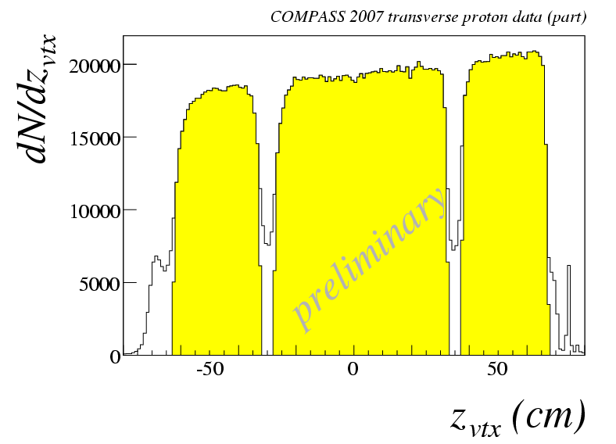
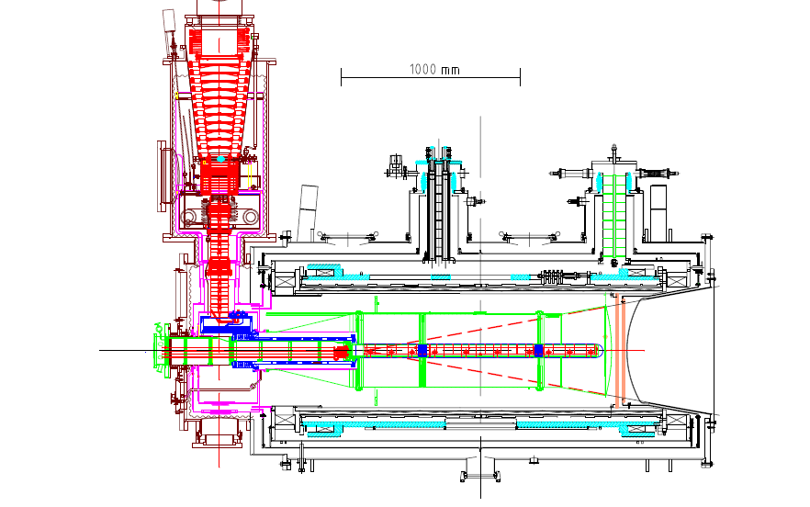
The polarized target system (>2005)
³He – ⁴He dilution refrigerator (T~50mK)
solenoid 2.5T
dipole magnet 0.6T
acceptance > ± 180 mrad
3 target cells
30, 60, and 30 cm long
μ
opposite polarisation
d (⁶LiD) p (NH₃)
polarization 50% 90%
dilution factor 40% 16%
no evidence for relevant
nuclear effects (160 GeV)

Slide 7
COMPASS – some facts
Located at CERN North Area beam line
Possible beams: µ⁺, µ⁻, π⁺, π⁻, K → Several physics programs
Experiments with muon beam
Spin structure, Gluon polarization
Flavor decomposition
Transversity
Transverse Momentum-dependent PDF
DVCS and HEMP
Unpolarized SIDIS and TMDs
Experiments with hadron beams
Pion polarizability
Diffractive and Central production
Light meson spectroscopy
Baryon spectroscopy
Pion and Kaon polarizabilities
Drell-Yan studies
COMPASS - I (2002 – 2011)
COMPASS - II (2012 – 2017)

Slide 8
COMPASS – some facts
Located at CERN North Area beam line
Possible beams: µ⁺, µ⁻, π⁺, π⁻, K → Several physics programs
Experiments with muon beam
Spin structure
p, d polarized target (L & T)
DVCS/Unpol SIDIS
Long LH₂ target
Experiments with hadron beams
Hadron spectroscopy
Small LH₂ or nuclear targets
Drell-Yan studies
Polarized target (T)
COMPASS - I (2002 – 2011)
COMPASS - II (2012 – 2017)
Reconfigurable target region - versatile experimental setup!

Slide 9
Summary of Results on TMDs
Year
2005 | $$A_{Siv, d}^{h}, A_{Col, d}^{h}$$ | First ⁶LiD data
2006 | $$A_{Siv, d}^{h}, A_{Col, d}^{h}$$ | Full ⁶LiD statistics
2009 | $$A_{Siv, d}^{π^{±},{ K}^{±}, K_{s}^{0}}, A_{Col, d}^{π^{±},{ K}^{±}, K_{s}^{0}}$$ | Full ⁶LiD statistics
2010 | $$A_{Siv, p}^{h}, A_{Col, p}^{h}$$ | 2007 NH₃ data
2012 | $$A_{UT,d}^{sinφ_{RS}},A_{UT,p}^{sinφ_{RS}}$$ | $$\text{Full} \text{6}\text{LiD} \text{and} \text{NH}\text{3}\text{statistics}$$
2012 | $$A_{Siv, p}^{h}, A_{Col, p}^{h}$$ | $$\text{Full} \text{NH}\text{3}\text{statistics}$$
2012 | $A_{UT,d}^{sin\left(φ_{ρ}−φ_{S}\right)}$, $A_{UT,p }^{sin\left(φ_{ρ}−φ_{S}\right)}$ | Exclusive${ ρ}^{0} \text{production}\text{− }\text{Full} \text{6}\text{LiD} \text{and} \text{NH}\text{3}\text{statistics}$
2013 | $${{dn}^{h}}/{\left({dN}^{μ}dz dp_{T}^{2}\right)}$$ | Unpolarized multiplicities on d
2014 | $A_{UU,d}^{\sin{φ_{h}}}$, $A_{UU,d}^{\cos{φ_{h}}},A_{UU,d}^{\cos{{2φ}_{h}}}$ $A_{UT,p }^{sinφ_{S}}$, $A_{LT,p }^{cosφ_{S}},A_{UT,p }^{sin\left({2φ}_{ρ}−φ_{S}\right)}$… $$A_{Siv, p}^{π^{±},{ K}^{±}, K_{s}^{0}}, A_{Col, p}^{π^{±},{ K}^{±}, K_{s}^{0}}, A_{Siv, d}^{g}$$ | Unpol. azimuthal asymm.s Excl$.{ ρ}^{0} \text{production}$ on $\text{NH}\text{3}$ $\text{Full} \text{NH}\text{3} \text{statistics}$, preliminary

Slide 10
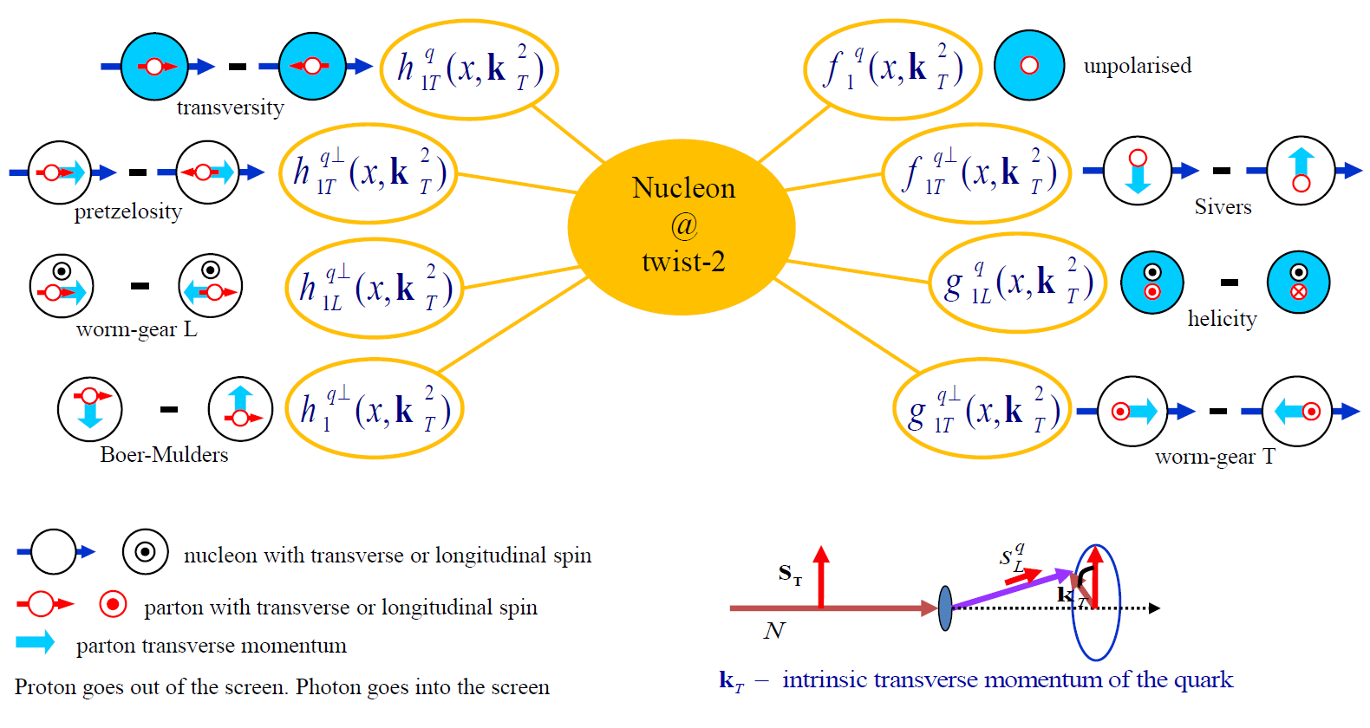
TMD Distribution Functions

Slide 11
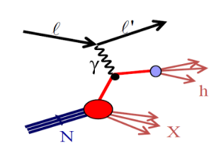
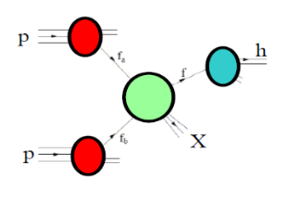
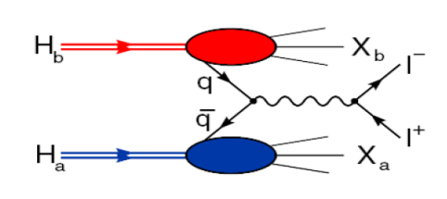
Accessing TMD PDFs
SIDIS off polarized p, d, n targets
hard polarised pp scattering
polarised Drell-Yan
HERMES
COMPASS
JLab
future: eN colliders?
RHIC
COMPASS
RHIC
FNAL
future: FAIR, JPark, NICA

Slide 12
Few comments:
The measurement of transversity was in the COMPASS 1996 proposal
The measurement of the Sivers PDF was added to the program soon after … the other TMD with the developments over the years
Measurements started in 2002 by HERMES (p) and COMPASS (d)
This field has grown considerably in the last years and comes one of high priority measurements for the JLab12 program

Slide 13
Collins and Sivers asym.
T polarized target, SIDIS:
μ p μ p h^{+/−}
Measure azimuthal asymmetries:
Collins: Outgoing hadron direction & quark transverse spin
Sivers: Nucleon spin & quark transverse momentum k_{T}
Collins
Transversity h₁
Sivers
at LO:
TMD
Quark
fragmentation
function
Collins fragmentation function, depends on spin
note: h₁ also measured using
‘’Two hadron’’ fragmentation function

Slide 14
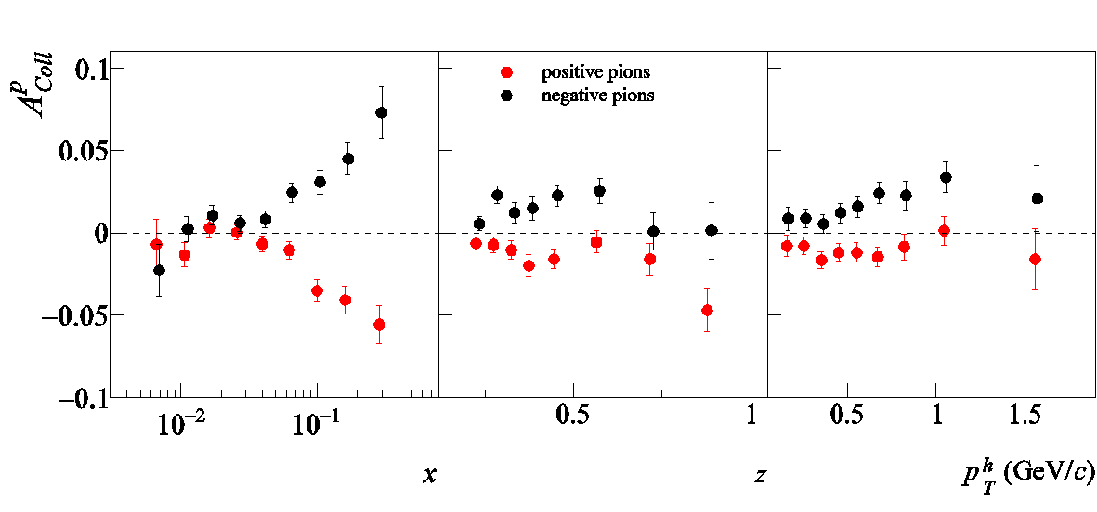
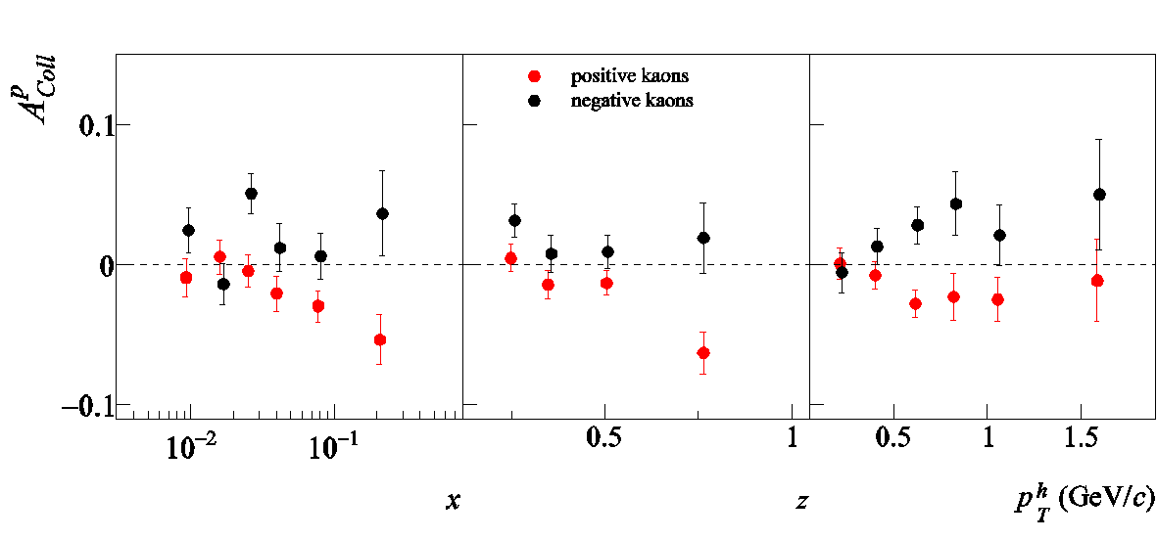
Collins Asymmetry on NH₃ for π e K
Correlation between outgoing hadron & quark transverse spin ${⟶h}_{1}^{u} and h_{1}^{d}$
π-
combined 2007 – 2010 results
~ h⁺ / h⁻
π+
preliminary
K⁻
compatible
with π⁺ / π⁻
K⁺
preliminary
Agreement HERMES/COMPASS (not shown) → no Q² dependence seen
(factor of ~3 inQ²)
Now also produced in bins of z and y

Slide 15
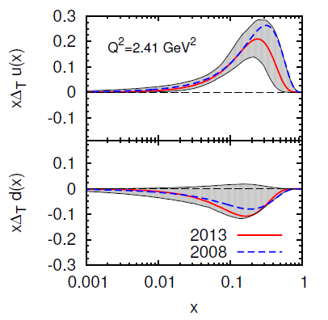
Transversity from Collins
Combined analyses of HERMES, COMPASS and BELLE fragm.fct. data
Anselmino et al. arXiv: 1303.3822

Slide 16
[M. Radici, IWHSS2013]

Slide 17
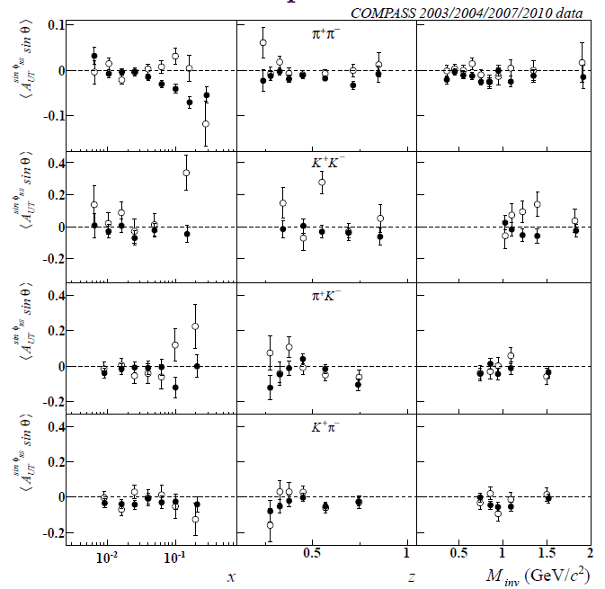
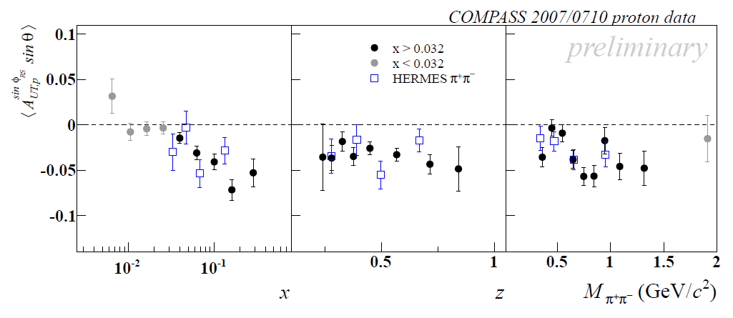
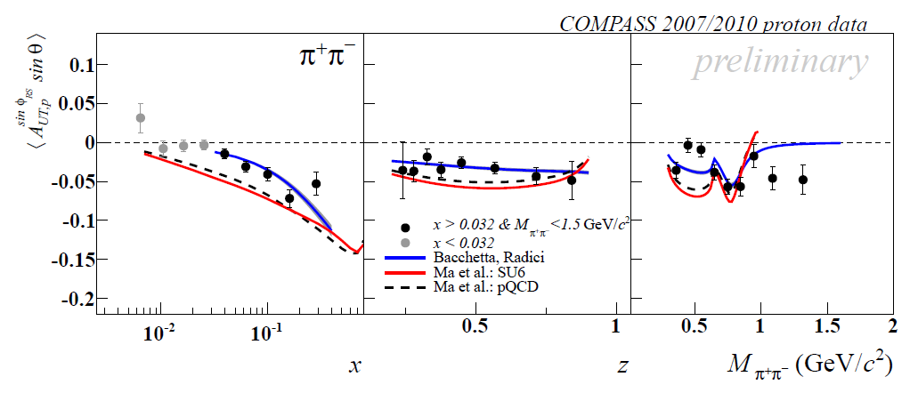
2h asymmetries on p
$$A_{UT}^{\sin\left(φ_{R}+φ_{S}−π\right)}=\frac{\sum_{q}{e_{q}^{2}h_{1}^{q}\left(x\right)H_{q→h_{1}h_{2}}^{∡}\left(z, ℳ_{h_{1}h_{2}}^{2}\right)}}{\sum_{q}{e_{q}^{2}q\left(x\right)D_{q}^{h_{1}h_{2}}\left(z, ℳ_{h_{1}h_{2}}^{2}\right)}}$$

Slide 18
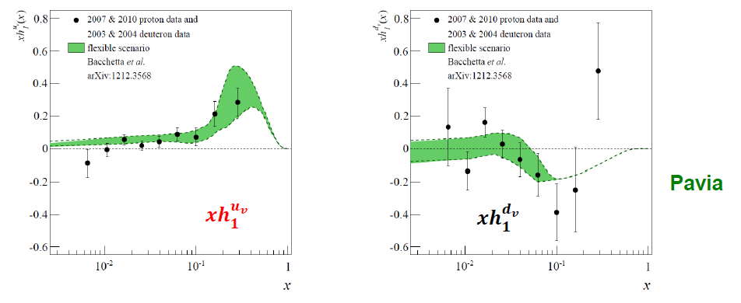
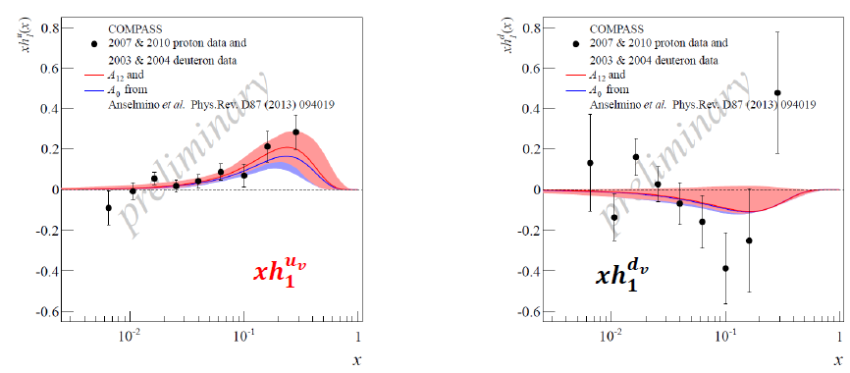
Transversity from 2h p and d results
use the same coefficients evaluated by A. Bacchetta et al. from Belle data [JHEP1303 (2013)119]

Slide 19
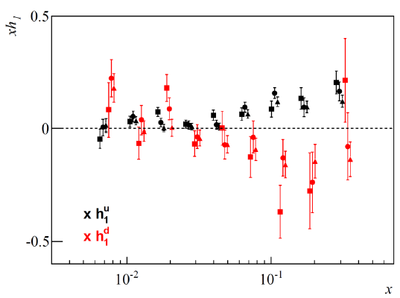
Transversity extraction (2)
For 2$π$, directly use the Belle data following Bacchetta et al., PRL107(2011)012001
For Collins, analysing power from Belle data
A=$\frac{\left\langle H_{1}^{⊥,fav}\right\rangle }{\left\langle D_{1}^{fav}\right\rangle }$
Bradamante, Martin, Barone
QCD Evolution, Santa Fe

Slide 20
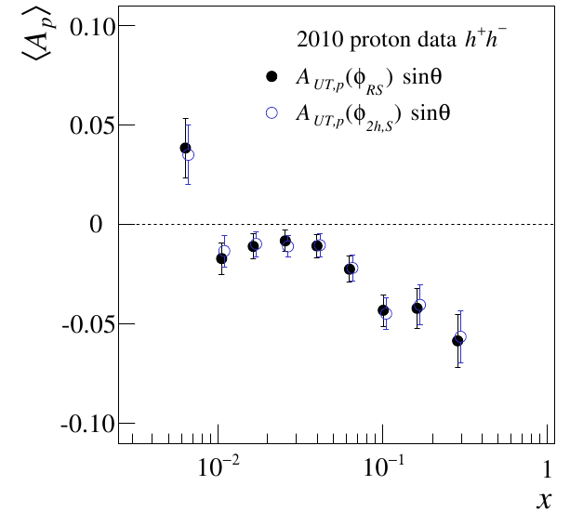
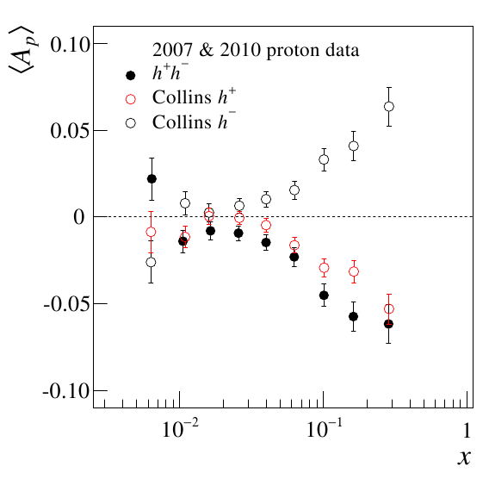
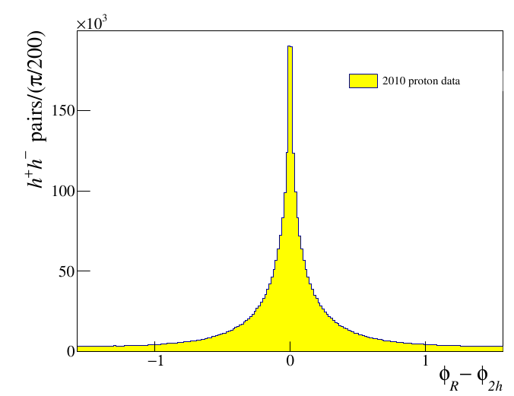
Interplay between Collins and 2h
common hadron sample for Collins and 2h analysis
$φ_{2h}$ azimuthal angle of ${\vec{R}}_{N}={\hat{p}}_{{T, h}^{+}}−{\hat{p}}_{{T, h}^{−}}$
$φ_{R}$ azimuthal angle of ${\vec{R}}_{T}$
Hint to a at a common physical origin for the $H_{1}^{⊥}$and the $H_{1}^{∢}$as suggested by different models

Slide 21
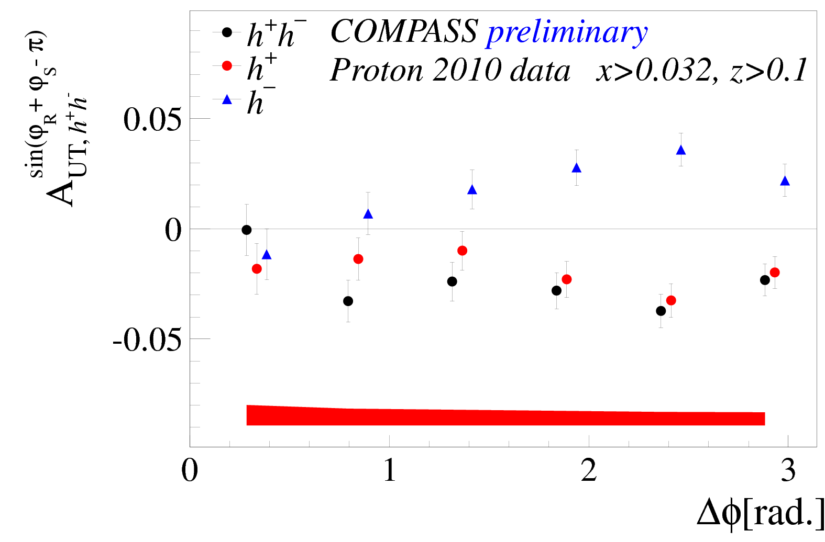
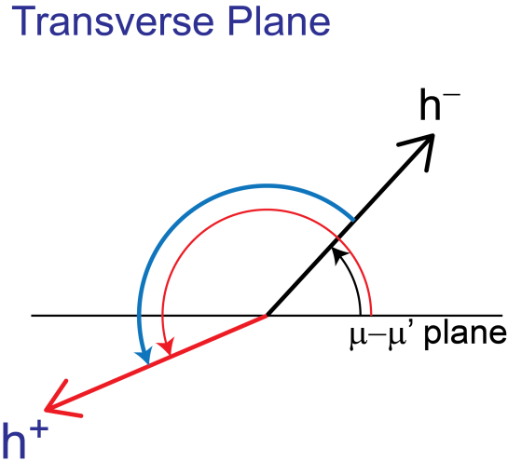
A natural question
Is there any correlation between the azimuthal angle between the 2 hadrons and the size of the asymmetry?
We went to check
$$Δϕ$$
More news @ SPIN

Slide 22
Sivers Asymmetry
Sivers: correlates nucleon spin & quark transverse momentum k_{T} /T-ODD
at LO:
$$μp^{↑}→μXh^{±}$$
The Sivers PDF
1992 | Sivers proposes $f_{1T}^{⊥}$
1993 | J. Collins proofs $f_{1T}^{⊥}=0$ for T invariance
2002 | S. Brodsky, Hwang and Schmidt demonstrate that $f_{1Tq}^{⊥}$ may be $≠0$ due to FSI
2002 | J. Collins shows that${\left(f_{1T}^{⊥}\right)}_{DY}=−{\left(f_{1T}^{⊥}\right)}_{SIDIS}$
2004 | HERMES on p: $A_{Siv}^{π^{+}}≠0$ and $A_{Siv}^{π^{−}}=0$
2004 | COMPASS on d: $A_{Siv}^{π^{+}}=0$ and $A_{Siv}^{π^{−}}=0$
2008 | COMPASS on p: $A_{Siv}^{π^{+}}≠0$ and $A_{Siv}^{π^{−}}=0$

Slide 23
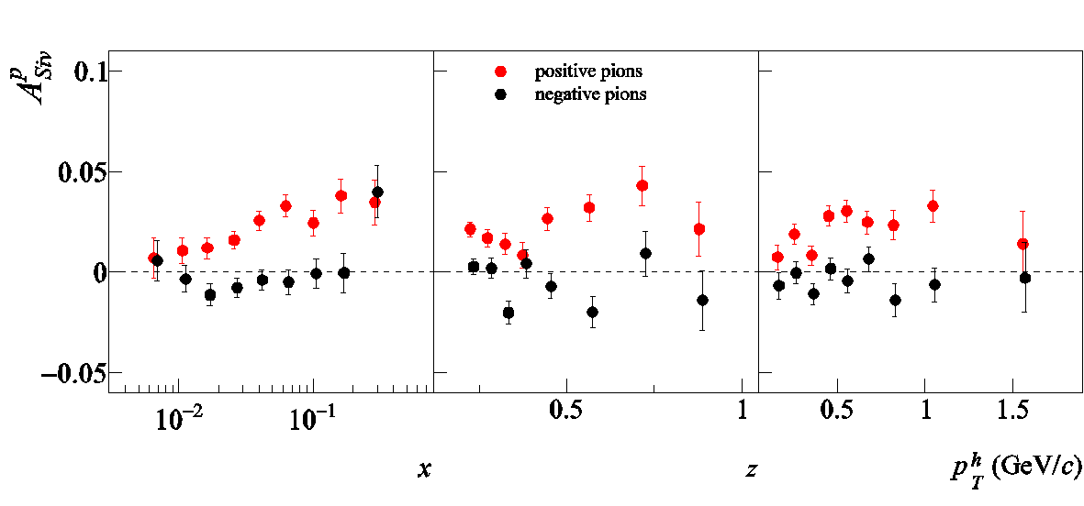
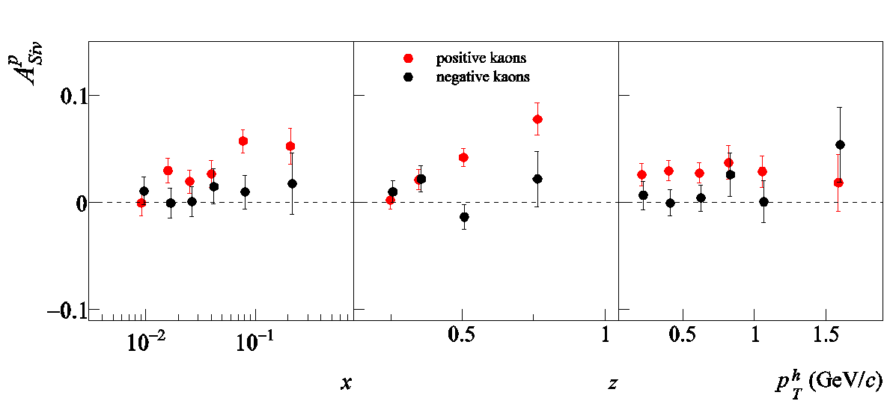
Sivers asymmetry on NH₃ - π, K
Correlation between nucleon spin & quark transverse momentum k_{T}
combined 2007 – 2010 results
π+
~ h⁺ / h⁻
π-
preliminary
K⁺
larger than
for π⁺
K⁻
preliminary
In region of overlap, agreement with HERMES, but smaller strength
Now also produced in separate bins of z and y.

Slide 24
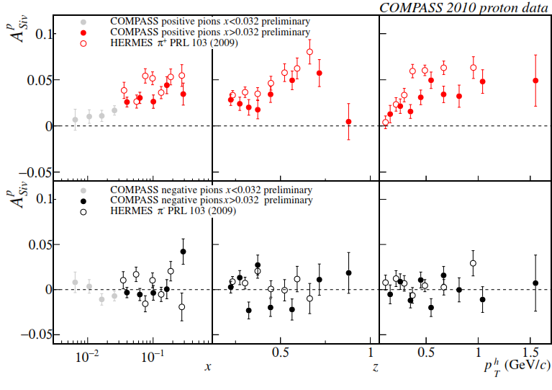
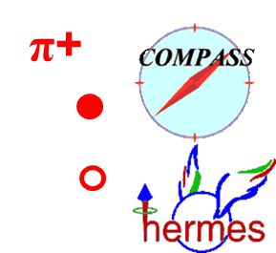
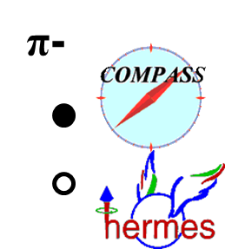
Sivers asymmetry on NH3, $x>0.032$
charged pions (and kaons), 2010 data
comparison with HERMES results
For $π^{+}$as for h+, smaller values measured by COMPASS;
same indication for K+

Slide 25
Test of universality
T-odd character of the Boer-Mulders and Sivers functions
In order not vanish by time-reversal invariance T-odd SSA require an interaction phase generated by a rescattering of the struck parton in the field of the hadron remnant
SIDIS
these functions are process dependent, they change sign to provide the gauge invariance
Time reversal
Boer-Mulders
Sivers

Slide 26
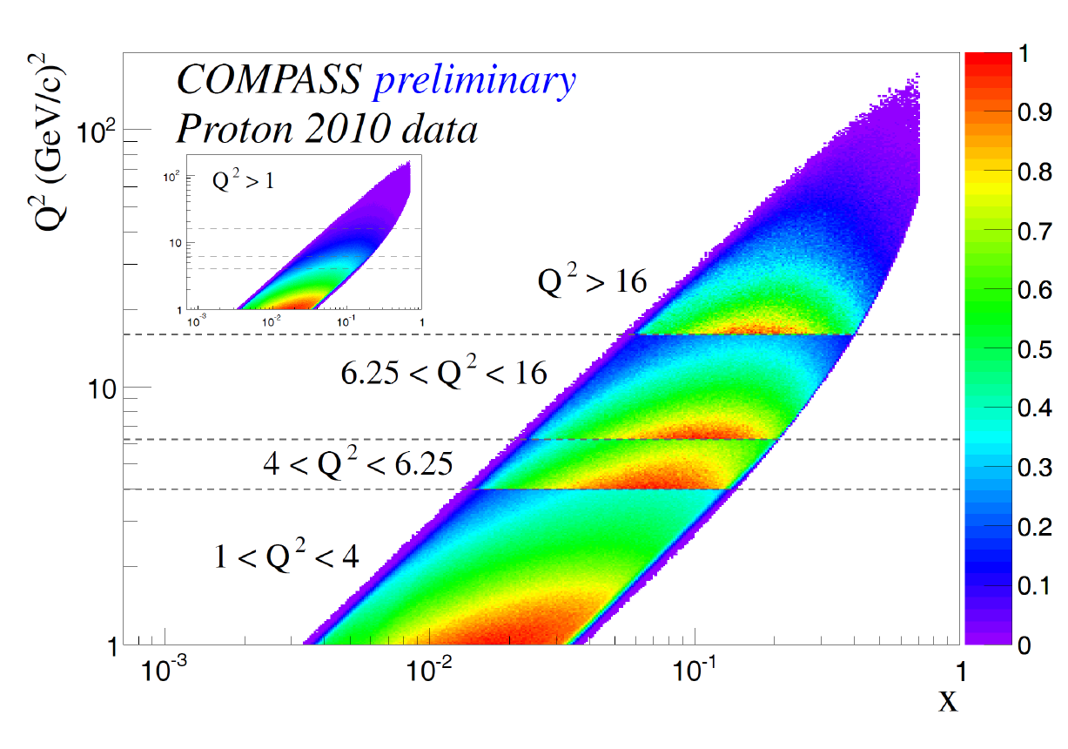
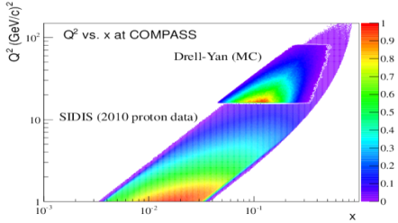
$Q^{2}$ vs $x$ phase space at COMPASS
The phase space of the two processes overlaps at COMPASS
➔ Consistent extraction of TMD DPFs in the same kinematic region

Slide 27
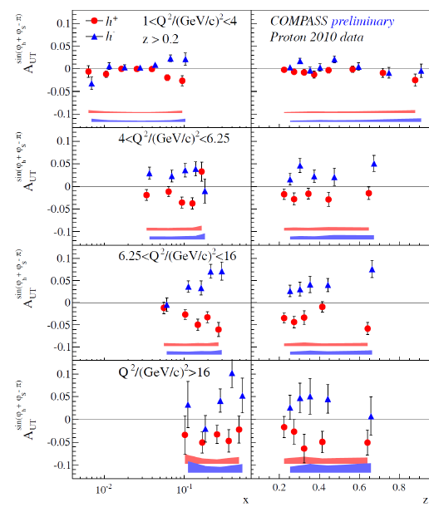
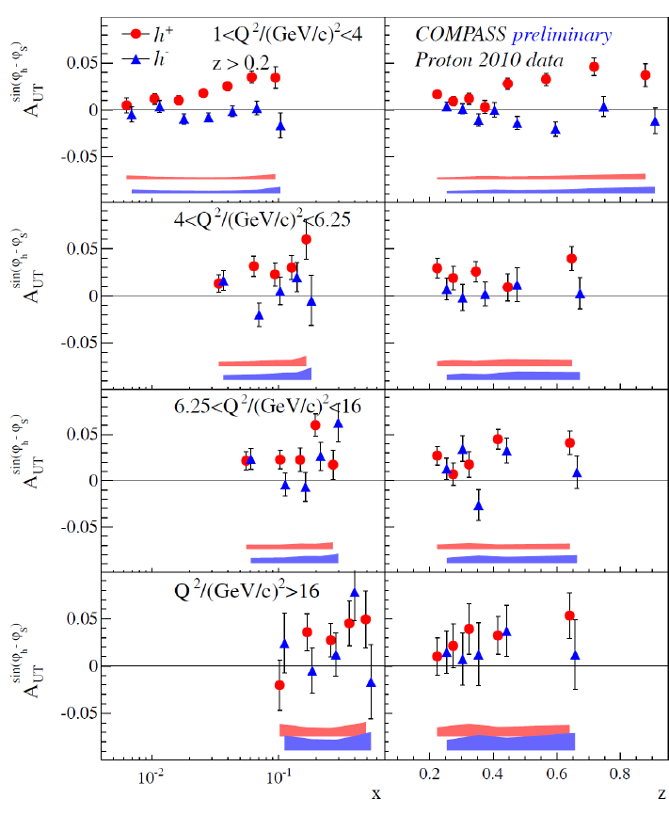
Collins and Sivers for different $Q^{2}$
π-
$$\underset{⇔}{COMPASS DY}$$
Notes:
27

Slide 28
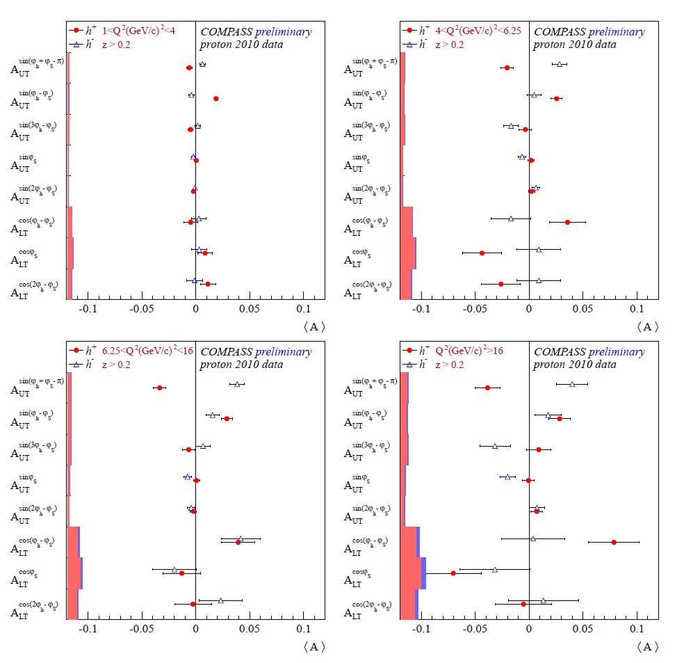
Mean TMD SSA for the four $Q^{2}$
$$\underset{⇐}{COMPASS DY}$$

Slide 29
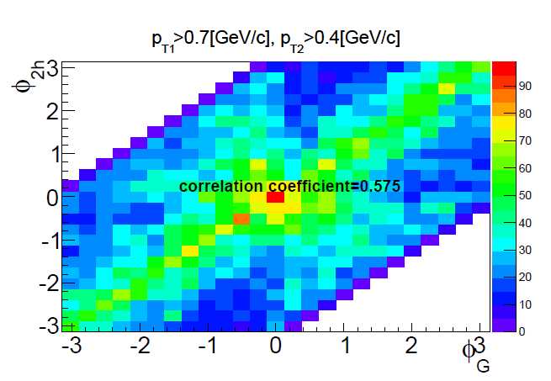
Sivers asymmetry for Gluons
$A_{UT}^{\sin\left(φ_{2h}−φ_{S}\right)}\left(x\right)=R_{LO}A_{LO}^{\sin\left(φ_{2h}−φ_{S}\right)}\left(x\right)+R_{QCDC}A_{QCDC}^{\sin\left(φ_{2h}−φ_{S}\right)}\left(x_{C}\right)+R_{PGF}$ $A_{PGF}^{\sin\left(φ_{2h}−φ_{S}\right)}\left(x_{g}\right)$
Correlation between azimuthal angle of the gluon $φ_{g}$ and azimuthal angle of the two hadrons $φ_{2h}$ (assumption ${\vec{p}}_{g}≈{\vec{p}}_{h1}+{\vec{p}}_{h2}$)

Slide 30
Sivers asymmetry for Gluons
First extraction of the Sivers function for gluons
$$A_{PGF}^{\sin\left(φ_{2h}−φ_{S}\right)}\left(x_{g}≈0.126\right)=−0.14±0.15±0.06$$
Measured asymmetry is small in agreement with expectations
Based on deuteron COMPASS data, Brodsky and Gardner [Phys.Lett.B643:22-28,2006] foresaw gluon Sivers $f_{1T,g}^{⊥}=0$
From the analysis of PHENIX data at mid rapidity, Anselmino et al. [Phys.Rev.D74:094011,2006 ] put constrains to $f_{1T,g}^{⊥}$ at small $x$

Slide 31
Other TSAs
k_{T} effects → modulations in SIDIS cross-section
μ p μ p h^{+/-}
Major progress in TMD measurement
Powerful tool to understand correlations
shown as example
In agreement with HERMES prelim., and with theoretical predictions

Slide 32
FUTURE

Slide 33
Near COMPASS future is defined:
2014-2015: Transversely polarized DY to check pseudo-universality (${\left[f_{1T}^{⊥}\left(x, Q^{2}\right)\right]}_{DY}≈−{\left[f_{1T}^{⊥}\left(x, Q^{2}\right)\right]}_{SIDIS}$)
2016-2017: Unpolarised DVCS/HVMP
(B slope and GPD H)
and unpolarised SIDIS on ${LH}_{2}$
${{dn}^{h}}/{\left({dN}^{μ}dz dp_{T}^{2}\right)}$ i.e. $p_{T}$ dependent multiplicities, and $h_{1T}^{⊥}$ Boer-Mulders TMD PDF
2018 to be discussed having in hand the performances in the previous years

Slide 34
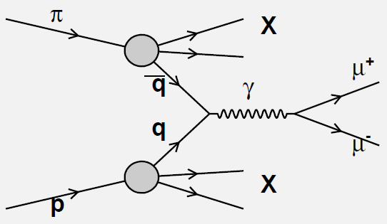
Polarized Drell-Yan to study TMDs
Drell –Yan π⁻ p → μ⁺μ⁻X
-
Cross sections:
In SIDIS: convolution of a TMD with a fragmentation function
In DY: convolution of 2 TMDs ‘’’’
→ complementary information and universality test
‘

Slide 35
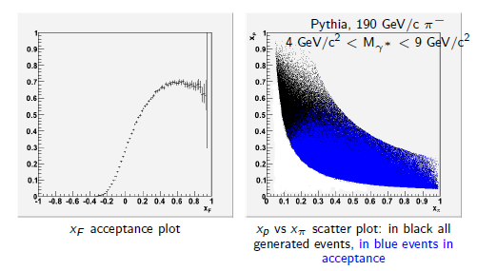
Pros of DY $π^{−}p^{↑}$ at COMPASS?
σ^{DY} dominated by the annihilation of a valence anti-quark from the pion and a valence quark from the polarised proton
Othe DY experiments at
RHIC (STAR, PHENIX) collider ($p^{↑}p$)
Fermilab fixed target ($p^{↑→}H, pH^{↑→}$)
J-PARC fixed target ($pp^{↑}, πp^{↑},pp^{↑}$)
FAIR (PAX) collider ($\overline{p}p^{↑}$)
NICA collider ($p^{↑}p^{↑},d^{↑}d^{↑}$)
large acceptance of COMPASS
in the valence quark region for p and π
where SSA are expected to be larger

Slide 36
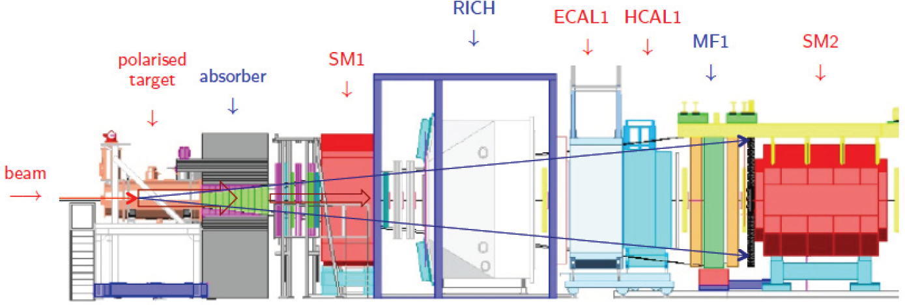
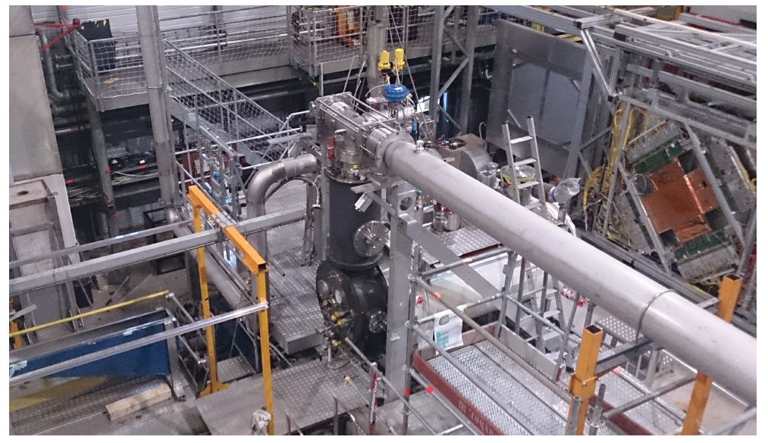
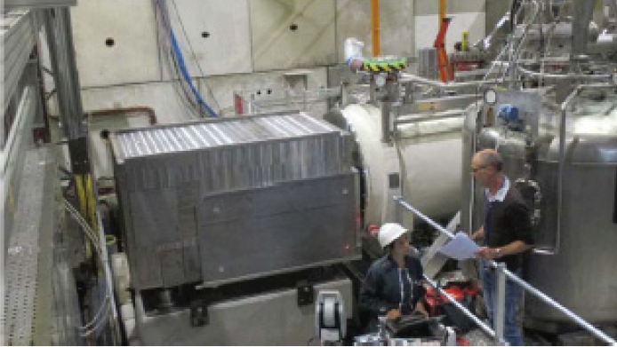
COMPASS DY Setup

Slide 37
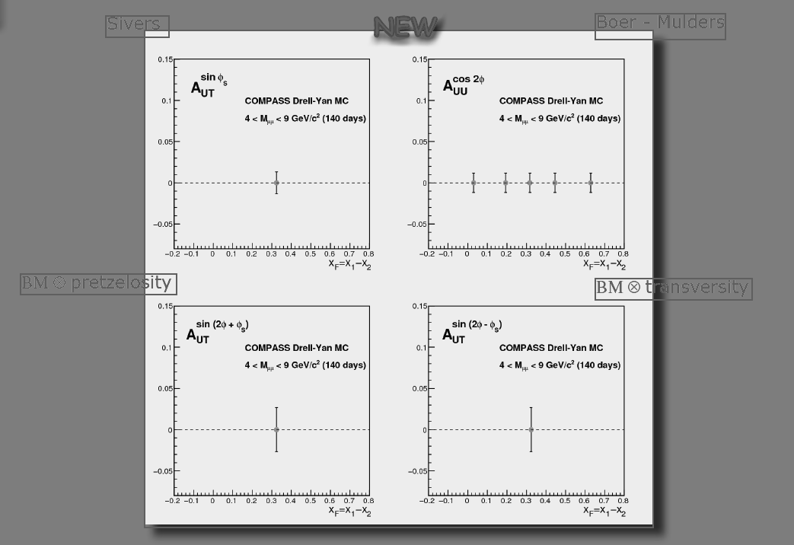
Error projection
140 days Drell-Yan at COMPASS

Slide 38
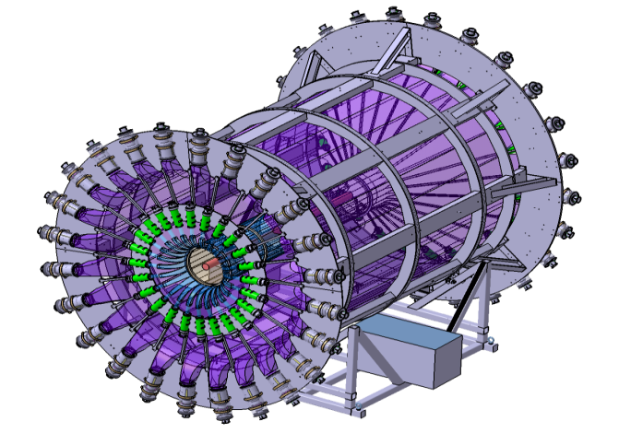
Spectrpmeter for DVCS
$$μp⟶μ^{′}pγ$$
$$μ’$$
$$μ$$
$$p$$
$$$$
New equipements:
2.5m LH2 target
4m ToF Barrel CAMERA
ECAL0
ECAL0
CAMERA

Slide 39
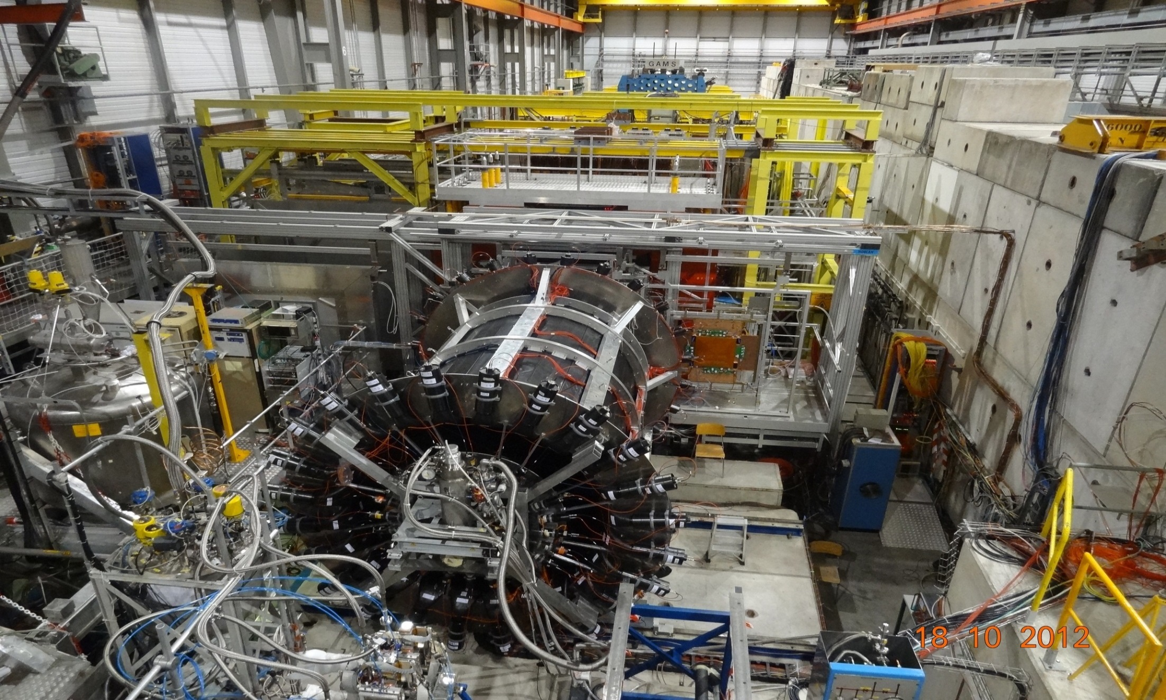
ECAL2
ECAL1
ECAL0
CAMERA recoil proton detector
surrounding the 2.5m long
LH2 target

18 -10- 2012
μ±

Slide 40
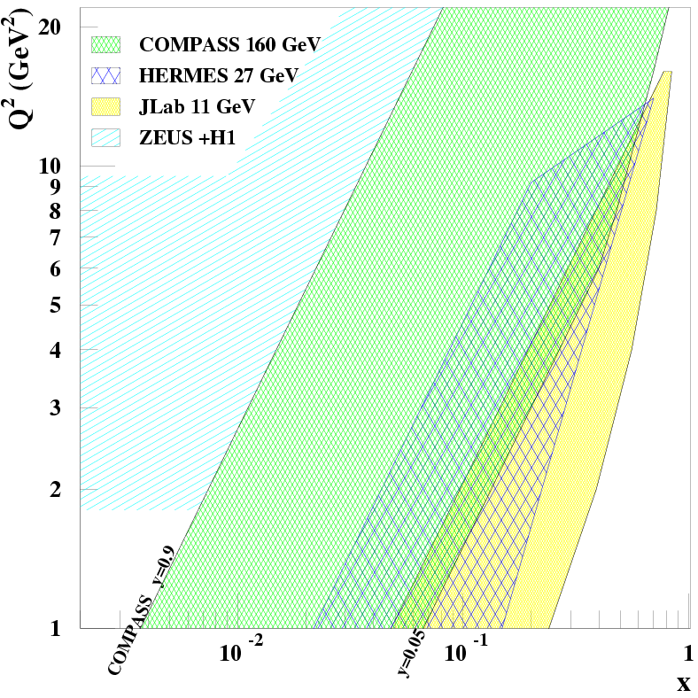
Kinematic $\left(Q^{2}, x\right)$ for GPDs
COMPASS unique for GPDs
}
CERN High energy muon beam
100 - 190 GeV
μ^{+↓} and μ^{-↑} available
80% Polarisation
with opposite polarization
fixed target
collider
4.6 10⁸ μ⁺
Lumi= 10³² cm⁻² s⁻¹
with 2.5m LH2 target
Explore the intermediate x_{Bj} region
Uncovered region between
ZEUS+H1 & HERMES + Jlab
before new colliders may be available
E=160 GeV
E=27 GeV
E=11 GeV
W > 2GeV
It’s time to show the impact
of COMPASS
=> goal of the 2012 DVCS pilot run

Slide 41
Unpolarized SIDIS & TMD
The cross-section dependence from $p_{T}^{h}$ results from:
intrinsic k_{T} of the quarks
$p_{⊥}$ generated in the quark fragmentation
The azimuthal modulations in the unpolarized cross-sections comes from:
Intrinsic k_{T} of the quarks
The Boer-Mulders PDF
These are difficult measurements requiring to take into account apparatus acceptance
COMPASS has
results on ${}_{}^{6}{LiD} \left(\sim d\right)$ from 2004/6 data
No measurements on $p$ since on $NH_{3} \left(\sim p\right)$ nuclear effects may be important
$⇒$COMPASS-II, measurements on LH₂ in parallel with DVCS

Slide 42
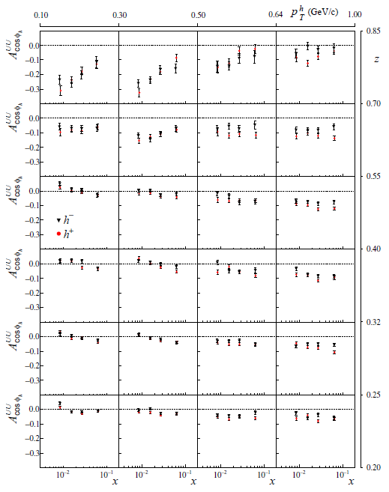
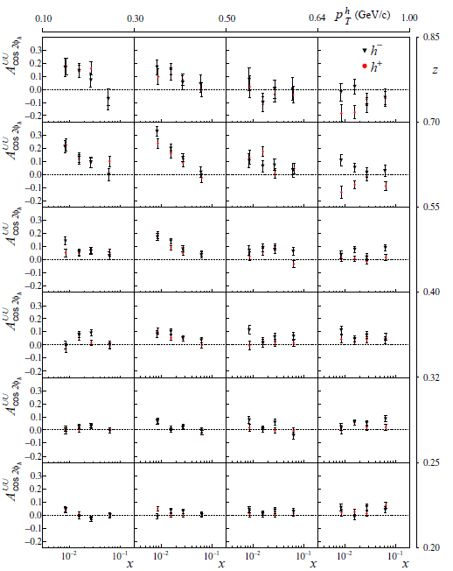
Boer-Mulders and Cahn effects
➔many data collected and still to be collected in SIDIS with GPD program

Slide 43
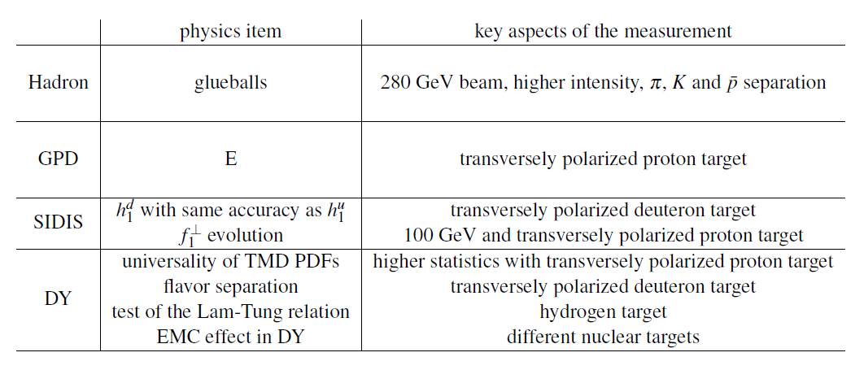
More in the FUTURE:

Slide 44
For the next 10 years
before any collider is available,
and complementary to Jlab 12 GeV
COMPASS@CERN can be a major player in QCD physics using its unique high energy both:
hadron beam and
positive and negative muon beams
Looking even further…a polarized lepton-nucleon collider well be a mandatory tool

Slide 45
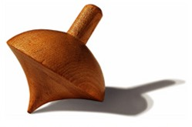
Thank You

Slide 46
SPARES

Slide 47
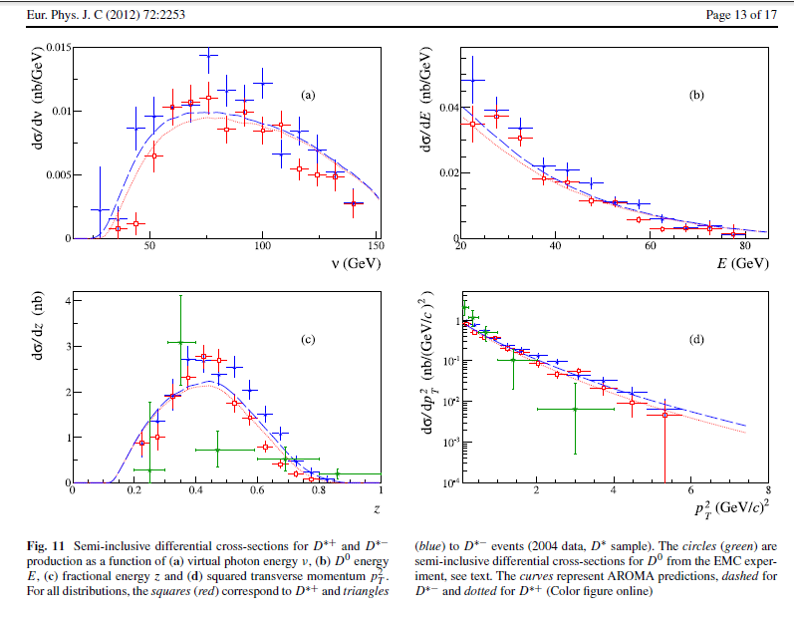
Intrinsic charm

Slide 48
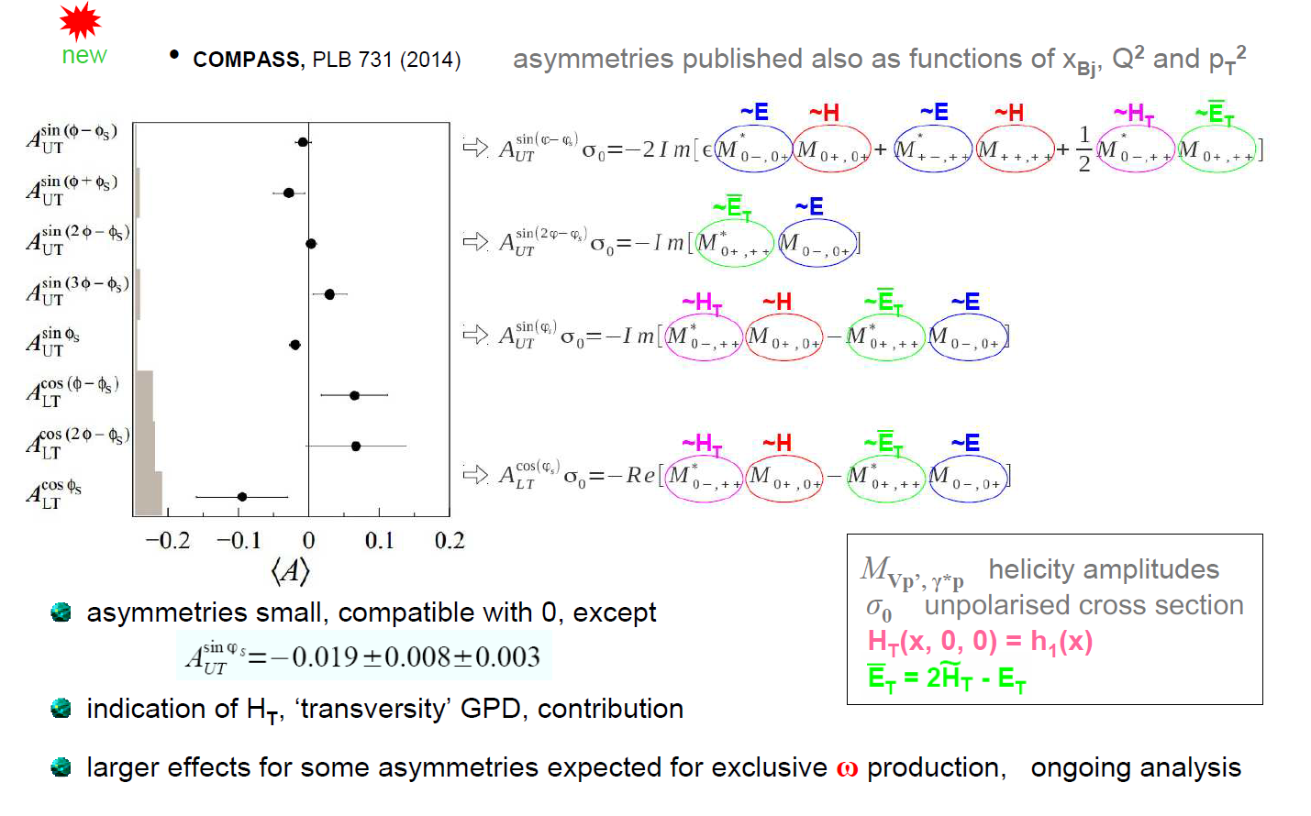
Exclusive ρ0 production on p↑

Slide 49
Beam Sum Integrated
$$\begin{matrix}dσ_{\left(μp→μpγ\right)}= & dσ_{}^{BH}+dσ_{unpol}^{DVCS}+P_{μ}dσ_{pol}^{DVCS}+ \\ & e_{μ}a^{BH}ℛeA_{}^{DVCS}+{e_{μ}P}_{μ}a^{BH}ImA_{}^{DVCS}\end{matrix}$$
the transverse imaging
with $μ^{+↓}$, $μ^{−↑}$ beams and unpolarized 2.5m long LH₂ target
$${\text{S}}_{CS, U}≡dσ\left(μ^{+↓}\right)+dσ\left(μ^{+↓}\right)∝dσ^{BH}+dσ_{unpol}^{DVCS}+K⋅s_{1}^{Int}\sin{φ}$$

Using ${\text{S}}_{CS, U}$, BH subtraction and integrating over $φ$
$${dσ_{unpol}^{DVCS}}/{dt\sim e^{−B\left|t\right|}}$$
μ’
γ*
γ
μ
θ
φ
p

Slide 50
Transverse Image
$${dσ_{unpol}^{DVCS}}/{dt\sim e^{−B\left|t\right|}}$$
2 years of data
160 GeV muon beam
2.5m LH₂ target
$ε_{global}=10\%$
with 40 weeks in 2015-16
1rst bar= stat. error; 2nd = stat + syst. errors
at small x_{B} ansatz inspired by Regge Phenomenology:
$B\left(x_{B}\right)=b_{0}+2α′\ln\left({x_{0}}/{x_{B}}\right)$
$α′$ slope of Regge trajectory

Slide 51
Beam Sum and Difference
$$\begin{matrix}dσ_{\left(μp→μpγ\right)}= & dσ_{}^{BH}+dσ_{unpol}^{DVCS}+P_{μ}dσ_{pol}^{DVCS}+ \\ & e_{μ}a^{BH}ℛeA_{}^{DVCS}+{e_{μ}P}_{μ}a^{BH}ImA_{}^{DVCS}\end{matrix}$$
Contrains of GPD H
with $μ^{+↓}$, $μ^{−↑}$ beams and unpolarized 2.5m long LH₂ target
$${\text{D}}_{CS, U}≡dσ\left(μ^{+↓}\right)−dσ\left(μ^{+↓}\right)∝c_{0}^{Int}+c_{1}^{Int}\cos{φ}$$
$$ℛe\left(F_{1}H\right)$$
$${\text{S}}_{CS, U}≡dσ\left(μ^{+↓}\right)+dσ\left(μ^{+↓}\right)∝dσ^{BH}+c_{0}^{DVCS}+K⋅s_{1}^{Int}\sin{φ}$$
$$Im\left(F_{1}H\right)$$
Note: dominance of H at COMPASS kinematics
$$Im ℋ(,t)= H(x= ,,t)$$
$ℛe ℋ \left(ξ,t\right)=P\int{dx \frac{H\left(x,ξ,t\right)}{x−ξ}}=P\int{dx \frac{H(x,x,t)}{x−ξ}}+D(t)$
Re part of the Compton Form Factors linked to the D term
$$  xB / (2−xB)$$

Slide 52
Summary for GPD @ COMPASS
GPDs investigated with Hard Exclusive Photon and Meson Production
COMPASS-II 2016-17: with LH₂ target + RPD (phase 1) μ^{+↓}, μ^{-↑} 160 GeV
the t-slope of the DVCS and HEMP cross section
→ transverse distribution of partons
the Beam Charge and Spin Sum and Difference
Re σ^{DVCS} and Im σ^{DVCS} for the GPD H determination
Vector Meson ρ⁰,ρ⁺,ω, Φ
Pseudo-saclar π⁰
Using the 2007-10 data: transv. polarized NH₃ target without RPD
In a future addendum > 2017: transv. polarised NH₃ target with RPD (phase 2)
the Transverse Target Spin Asymm
→ GPD E and chiral-odd (transverse) GPDs

Slide 53
SIDIS x-Section

Slide 54
LO modulations for SIDIS & DY
SIDIS
DY

Slide 55
Key COMPASS measurements
$$g_{1}^{d}\left(x\right), \int{g_{1}^{d}\left(x\right)dx}$$ | Confirmation of SMC result on d (at variance with E142 claims)
$$Δg/g$$ | first hint that $Δg$ is small, at variance with predictions
$$A_{Col, d}^{h}$$ | first measurement of transversity on deuteron $h_{1}^{u}≃−2h_{1}^{d} H_{1, fav}^{⊥}≃−H_{1, unf}^{⊥}$
$$A_{p, d}^{2h}$$ | Only polarimeter for transversity extraction from 2h asymmetries transversity extracted directly from the data, following Pavia group
$$A_{Siv, p}^{h}$$ | Evolution of Sivers
$$π_{1}^{}\left(1600\right)$$ | $$\text{Hint} \text{for} \text{an} \text{exotic} \text{state}$$
$$a_{1}^{}(1420)$$ | New state
Radiative width of $a_{2}^{}\left(1320\right)$ and $π_{2}^{}(1670)$ | Confirmation of VMD model, EPJ highlight

