Slide 1
Nucleon 3D structure - Experimental data and perspectives

Slide 2

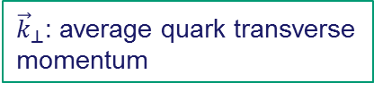

Top→Bottom
GTMDs
$ξ$: fraction of longitudinal momentum transfer
$x$: average fraction of quark
longitudinal momentum
${\vec{Δ}}_{⊥}\text{:}$: average transverse momentum transfer
${\vec{k}}_{⊥}$: average quark transverse
momentum
GTMDs
Wigner
TMDs
GPDs
Spin
PDFs

Slide 3
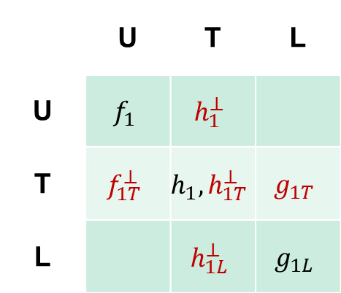
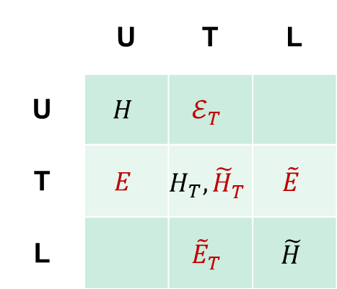
Top→Bottom
GTMDs
16 functions
TMDs
GPDs
8 functions
Nucleon polarization
Nucleon polarization
 | U | T | L
U | $$f_{1}$$ | $$h_{1}^{⊥}$$
T | $$f_{1T}^{⊥}$$ | $$h_{1}, h_{1T}^{⊥}$$ | $$g_{1T}$$
L |  | $$h_{1L}^{⊥}$$ | $$g_{1L}$$
 | U | T | L
U | $$H$$ | $$ℰ_{T}^{}$$
T | $$E$$ | $$H_{T}, {\tilde{H}}_{T}^{}$$ | $$\tilde{E}$$
L |  | $${\tilde{E}}_{T}^{}$$ | $$\tilde{H}$$
Parton polarization
Parton polarization
distributions in red vanish if there is no quark orbital angular momentum
quark GPDs (at ξ=0) and TMDs given by the same overlap of LCWFs but in different kinematics
  each distribution contains unique information
  no model-independent relations between GPDs and TMDs

Slide 4
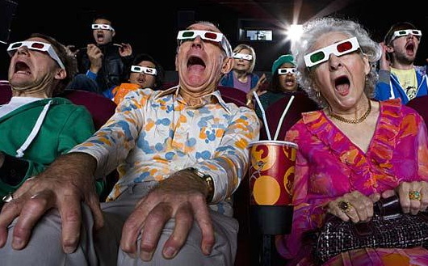
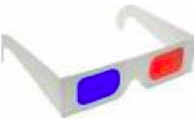
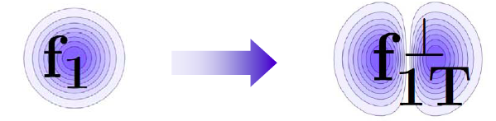
Quantum tomography of the nucleon
Join the real
3D experience !!
TMDs
GPDs
2D+1 picture in momentum space 2D+1 picture in coordinate space
  transverse momentum generalized parton distributions
  dependent distributions → exclusive reaction like DVCS
Quarks
unpolarised polarised

Slide 5
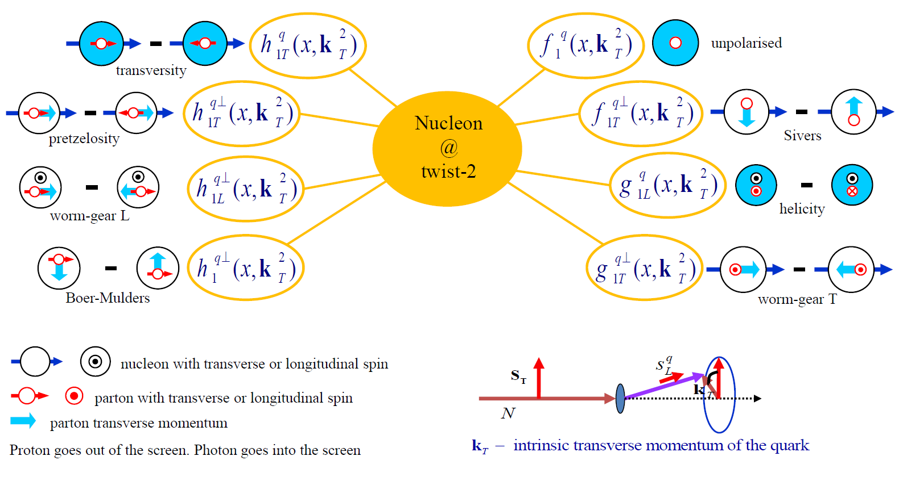
TMD Distribution Functions

Slide 6
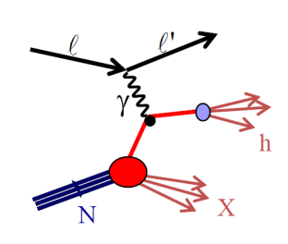
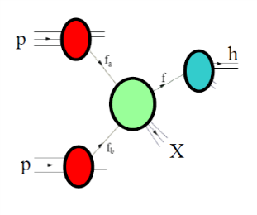
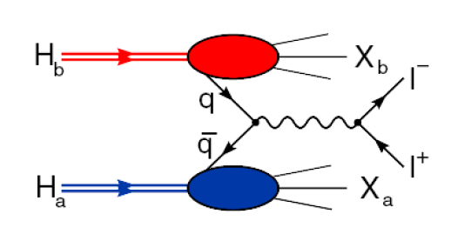
Accessing TMD PDFs
SIDIS off polarized p, d, n targets
hard polarised pp scattering
polarised Drell-Yan
HERMES
COMPASS
JLab
future: eN colliders?
RHIC
COMPASS
RHIC
FNAL
future: FAIR, JPark, NICA

Slide 7
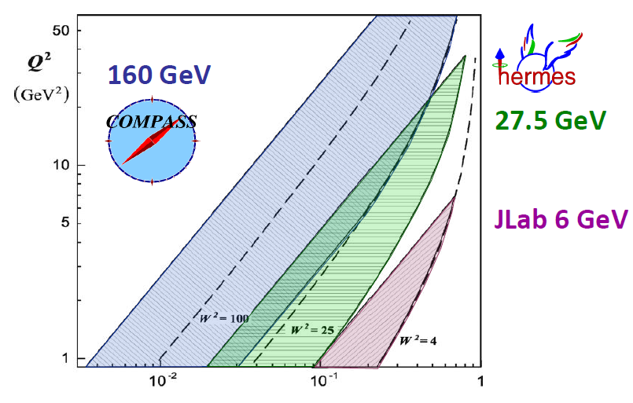
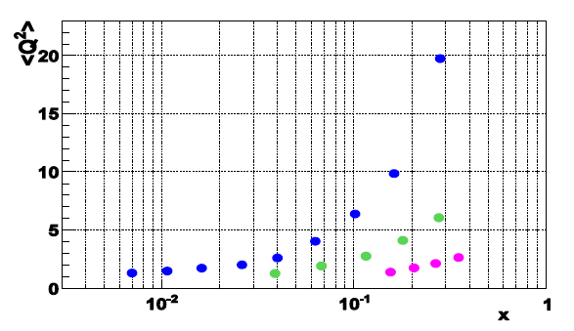
Phase space of different SIDIS -experiments
0.004 < x < 0.3, 25<W²<200GeV²
0.023 < x < 0.4, 10<W²< 50GeV²
0.14 < x < 0.5, 4<W²< 10GeV²

Slide 8
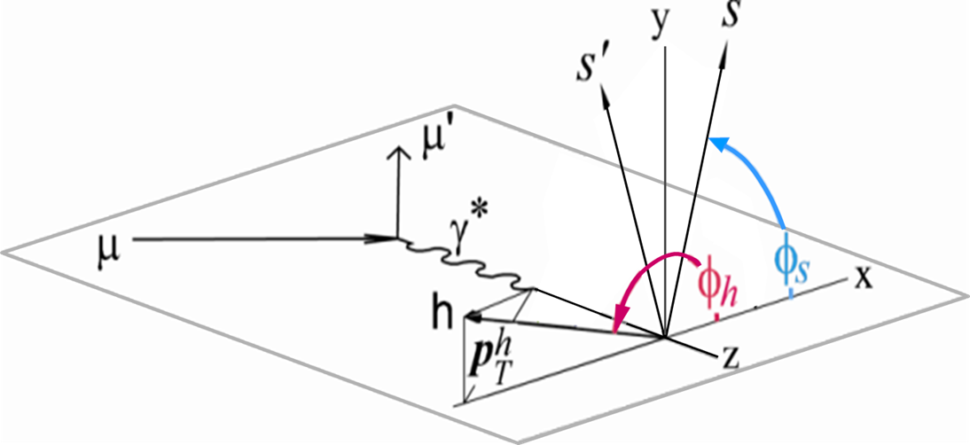
SIDIS x-Section

Slide 9
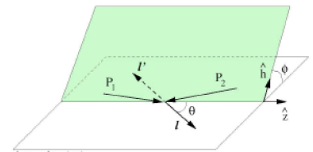
The polarized Drell-Yan process in π⁻ p
Collins-Soper frame (of virtual photon)
θ, ϕ lepton plane wrt hadron plane
target rest frame
ϕ_{S} target transverse spin vector /virtual photon
Hadron plane
Lepton plane

Slide 10
LO content
SIDIS
DY

Slide 11
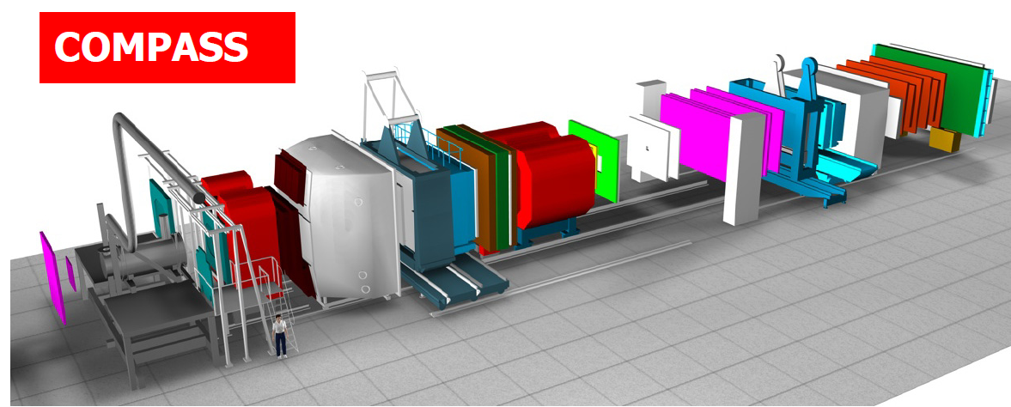
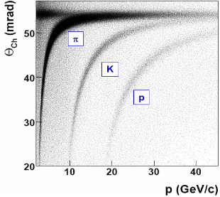
COMPASS-I
high energy beam
large angular acceptance
broad kinematical range
two stages spectrometer
  Large Angle Spectrometer (SM1)
  Small Angle Spectrometer (SM2)
radiator C₄F₁₀
threshold: π ~2 GeV/c
K ~ 10 GeV/c
SM2
MuonWall
E/HCAL
SM1
RICH
MuonWall
Target
E/HCAL
variety of tracking detectors to cope with different particle flux from θ = 0 to θ ≈ 200 mrad
Notes:
11

Slide 12
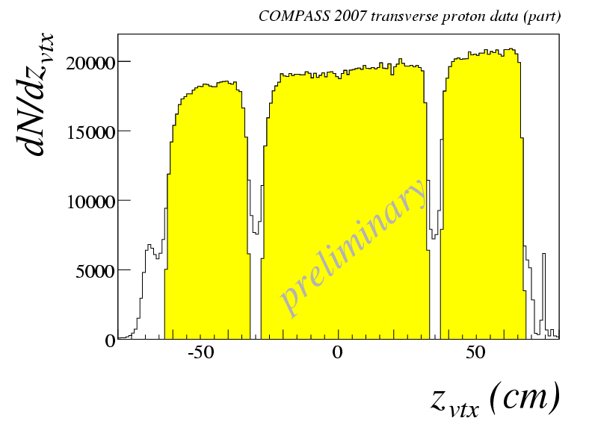
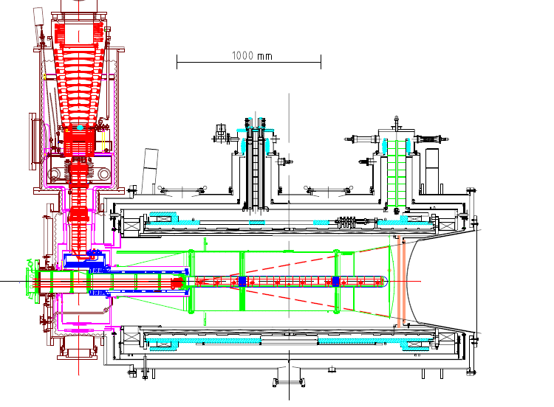
the polarized target system (>2005)
³He – ⁴He dilution refrigerator (T~50mK)
solenoid 2.5T
dipole magnet 0.6T
acceptance > ± 180 mrad
3 target cells
30, 60, and 30 cm long
μ
opposite polarisation
d (⁶LiD) p (NH₃)
polarization 50% 90%
dilution factor 40% 16%
no evidence for relevant
nuclear effects (160 GeV)

Slide 13
COMPASS data taking
muon beam | deuteron (⁶LiD) polarised target | 2002 2003 2004 | L/T target polarisation
 |  | 2006 | L target polarisation
 | proton (NH₃) polarised target | 2007 | L /T target polarisation
hadron | LH target | 2008 2009
muon beam | proton (NH₃) polarised target | 2010 | T target polarisation
 |  | 2011 | L target polarisation
Hadron | Ni target | 2012
muon beam | LH2 target | 2012 | Pilot DVCS & unpol. SIDIS
muon beam: 160 GeV/c longitudinal polarisation -80%
intensity 2·10⁸ µ⁺/spill (4.8s/16.2s)

Slide 14
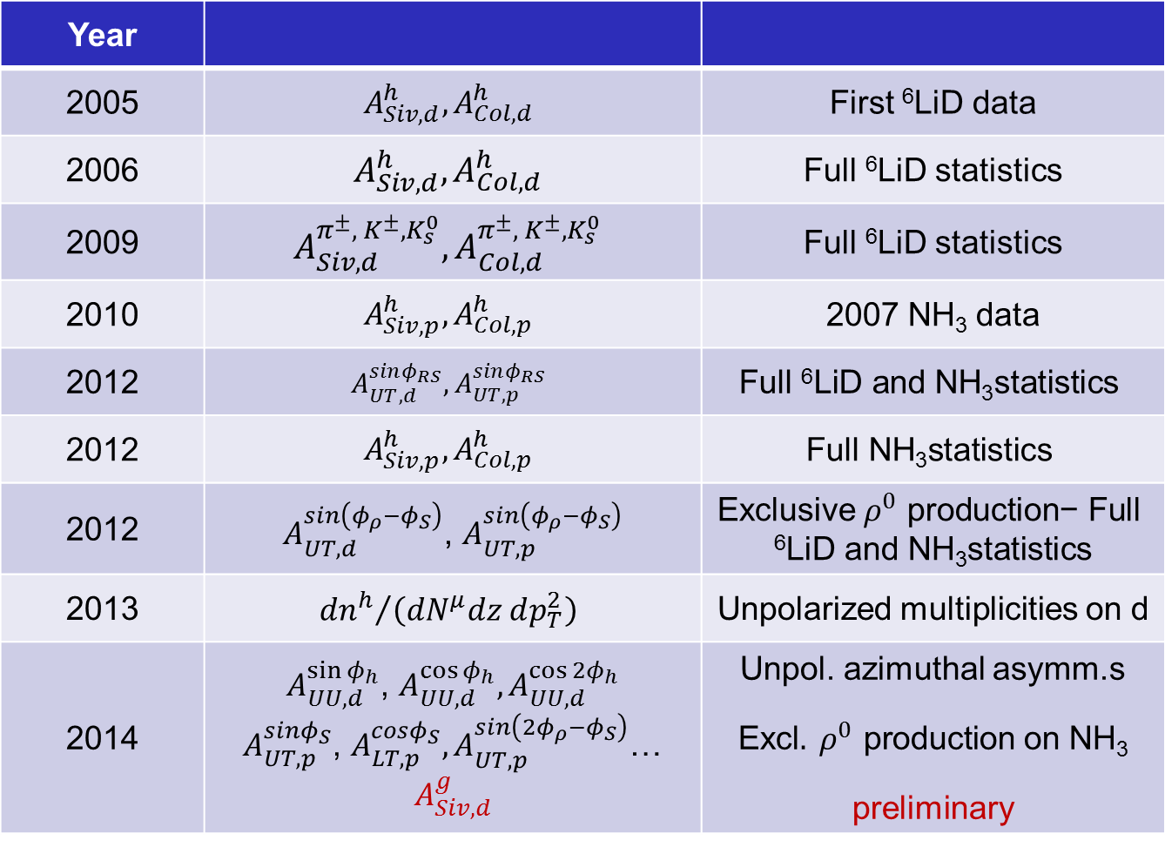
Results:
Year
2005 | $$A_{Siv, d}^{h}, A_{Col, d}^{h}$$ | First ⁶LiD data
2006 | $$A_{Siv, d}^{h}, A_{Col, d}^{h}$$ | Full ⁶LiD statistics
2009 | $$A_{Siv, d}^{π^{±},{ K}^{±}, K_{s}^{0}}, A_{Col, d}^{π^{±},{ K}^{±}, K_{s}^{0}}$$ | Full ⁶LiD statistics
2010 | $$A_{Siv, p}^{h}, A_{Col, p}^{h}$$ | 2007 NH₃ data
2012 | $$A_{UT,d}^{sinφ_{RS}},A_{UT,p}^{sinφ_{RS}}$$ | $$\text{Full} \text{6}\text{LiD} \text{and} \text{NH}\text{3}\text{statistics}$$
2012 | $$A_{Siv, p}^{h}, A_{Col, p}^{h}$$ | $$\text{Full} \text{NH}\text{3}\text{statistics}$$
2012 | $A_{UT,d}^{sin\left(φ_{ρ}−φ_{S}\right)}$, $A_{UT,p }^{sin\left(φ_{ρ}−φ_{S}\right)}$ | Exclusive${ ρ}^{0} \text{production}\text{− }\text{Full} \text{6}\text{LiD} \text{and} \text{NH}\text{3}\text{statistics}$
2013 | $${{dn}^{h}}/{\left({dN}^{μ}dz dp_{T}^{2}\right)}$$ | Unpolarized multiplicities on d
2014 | $A_{UU,d}^{\sin{φ_{h}}}$, $A_{UU,d}^{\cos{φ_{h}}},A_{UU,d}^{\cos{{2φ}_{h}}}$ $A_{UT,p }^{sinφ_{S}}$, $A_{LT,p }^{cosφ_{S}},A_{UT,p }^{sin\left({2φ}_{ρ}−φ_{S}\right)}$… $$A_{Siv, d}^{g}$$ | Unpol. azimuthal asymm.s Excl$.{ ρ}^{0} \text{production}$ on $\text{NH}\text{3}$ preliminary

Slide 15
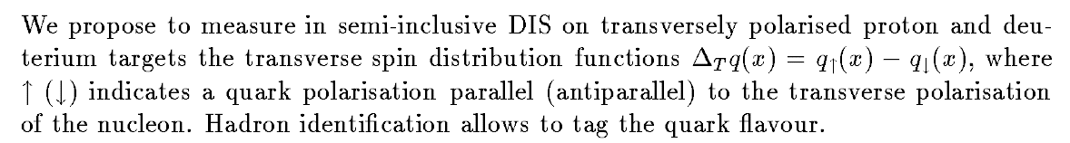
Few facts:
The measurement of transversity was in the COMPASS 1996 proposal
The measurement of the Sivers PDF was added in the program soon after … the other TMD with the developments over the years
This field has grown considerably

Slide 16
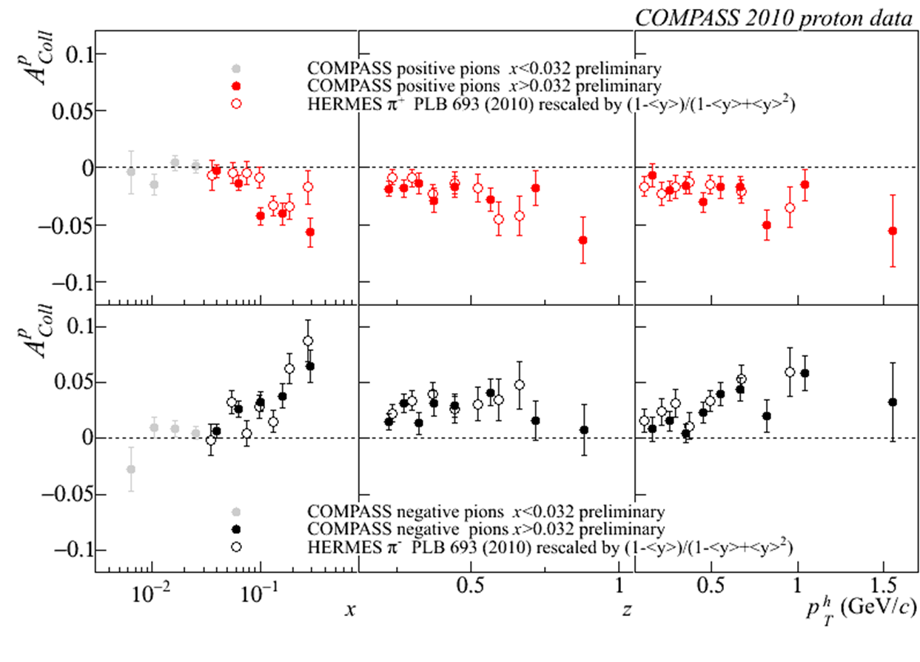
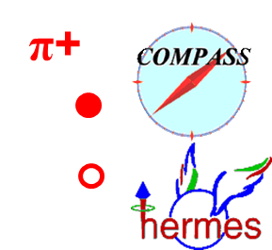
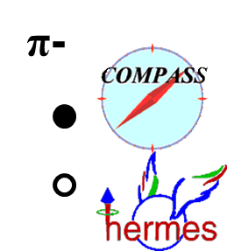

Collins Asymmetry on p - π, K id.
Correlation between outgoing hadron & quark transverse spin
→ $h_{1}^{u} \& h_{1}^{d}$
π-
combined 2007 – 2010 results
π+
preliminary
Agreement HERMES/COMPASS → no Q² dependence seen
(factor of ~3 inQ²)
Now also produced in bins of z and y

Slide 17
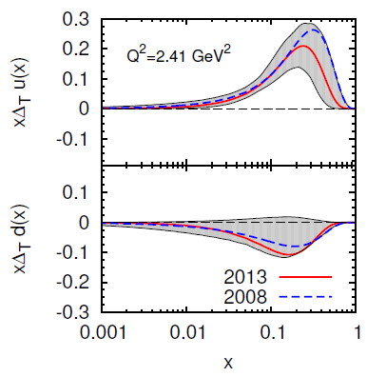
Transversity from Collins
Combined analyses of HERMES, COMPASS and BELLE fragm.fct. data
Anselmino et al. arXiv: 1303.3822

Slide 18
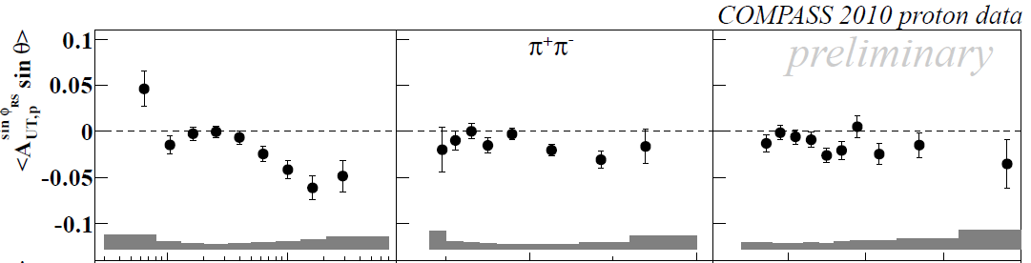
2-hadron asymmetries
Another access to transversity h₁
h₁^{u} & h₁^{d} extraction
Also measured for the first time for K⁺K⁻ , π⁺K⁻ and K⁺π⁻ pairs

Slide 19
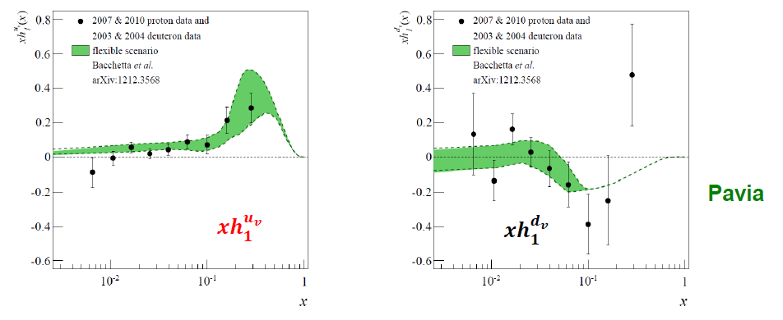

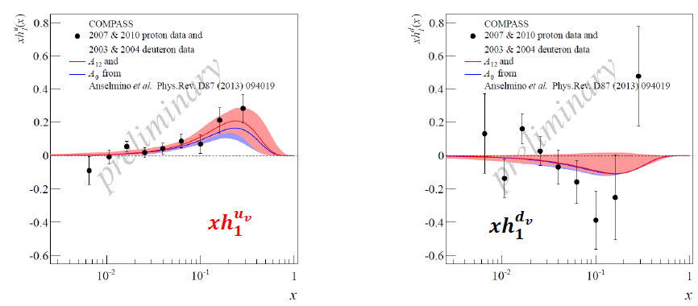
Transversity from 2h p and d results

Slide 20
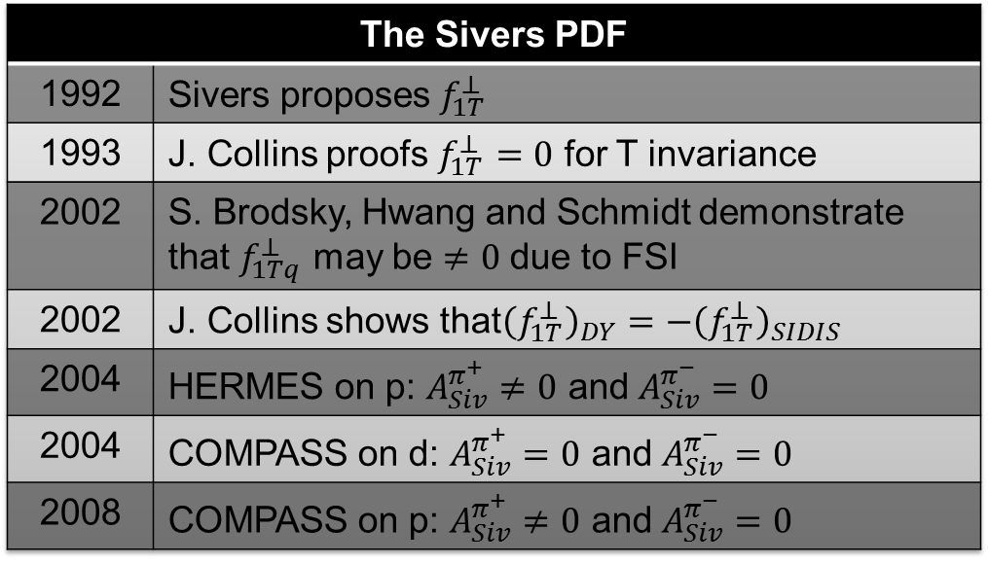

Sivers Asymmetry
Sivers: correlates nucleon spin & quark transverse momentum k_{T} /T-ODD
at LO:
$$μp^{↑}→μXh^{±}$$
The Sivers PDF
1992 | Sivers proposes $f_{1T}^{⊥}$
1993 | J. Collins proofs $f_{1T}^{⊥}=0$ for T invariance
2002 | S. Brodsky, Hwang and Schmidt demonstrate that $f_{1Tq}^{⊥}$ may be $≠0$ due to FSI
2002 | J. Collins shows that${\left(f_{1T}^{⊥}\right)}_{DY}=−{\left(f_{1T}^{⊥}\right)}_{SIDIS}$
2004 | HERMES on p: $A_{Siv}^{π^{+}}≠0$ and $A_{Siv}^{π^{−}}=0$
2004 | COMPASS on d: $A_{Siv}^{π^{+}}=0$ and $A_{Siv}^{π^{−}}=0$
2008 | COMPASS on p: $A_{Siv}^{π^{+}}≠0$ and $A_{Siv}^{π^{−}}=0$

Slide 21
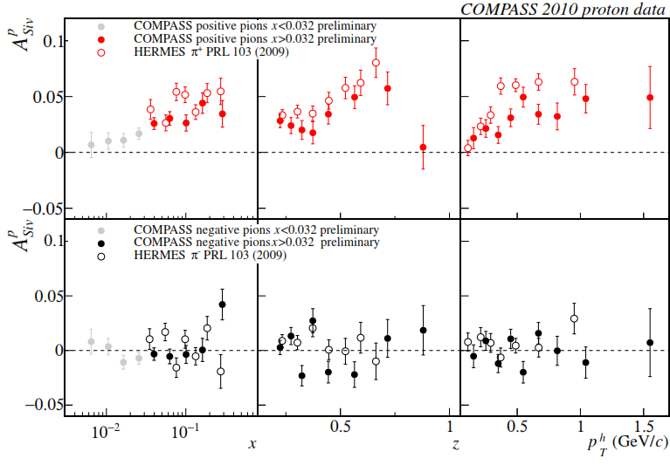
Sivers asymmetry on p, x > 0.032
charged pions (and kaons), 2010 data
comparison with HERMES results
as for h+, smaller values measured by COMPASS;
same indication for K+

Slide 22
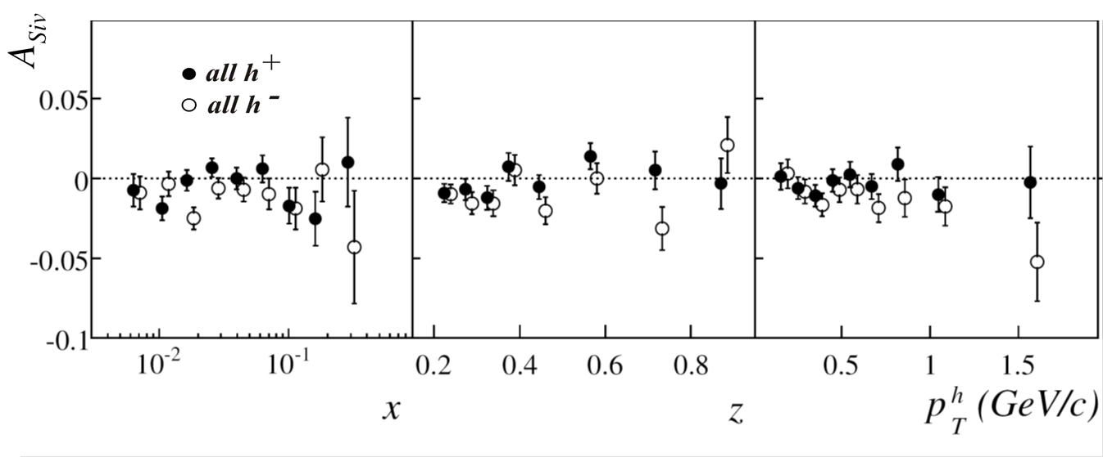

Sivers asymmetry on deuteron
final results 2003-2004 data
PLB 673 (2009) 127
understood as
u – d cancellation
$$f_{1T,u}^{⊥}≈−f_{1T,d}^{⊥}$$

Slide 23
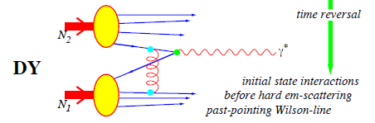

Test of universality
T-odd character of the Boer-Mulders and Sivers functions
In order not vanish by time-reversal invariance T-odd SSA require an interaction phase generated by a rescattering of the struck parton in the field of the hadron remnant
Time reversal
SIDIS
these functions are process dependent, they change sign to provide the gauge invariance
Boer-Mulders
Sivers

Slide 24
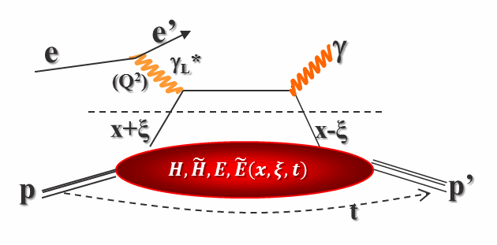
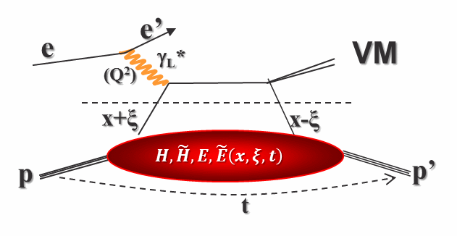
Accessing GPDs
DVCS (golden channel)
HVMP (also promising)
Zeus, H1, HERMES
JLab
COMPASS (near future)
future: eN colliders?
HERMES
COMPASS

Slide 25
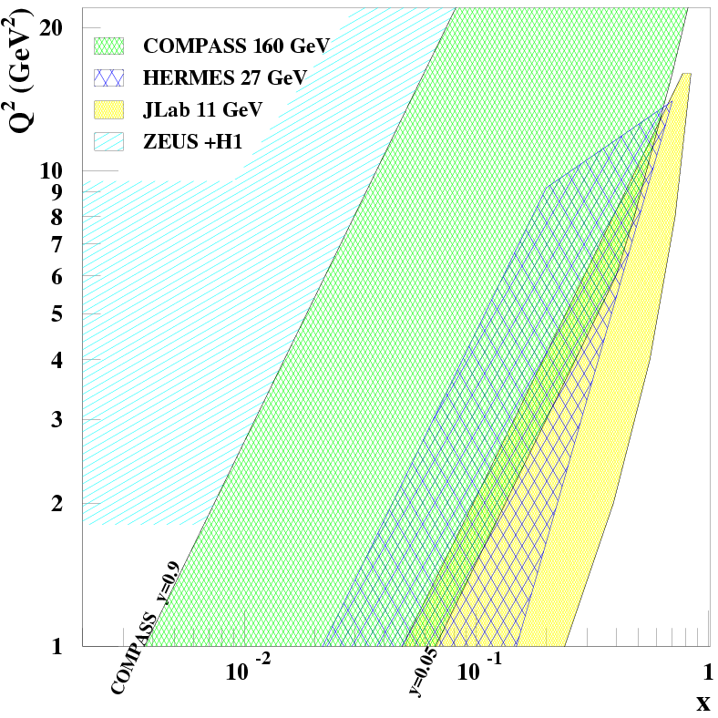
Future DVCS: Kinematic domain (Q², x_{B}) for GPDs
COMPASS unique for GPDs
}
CERN High energy muon beam
  100 - 190 GeV
  μ^{+↓} and μ^{-↑} available
  80% Polarisation
  with opposite polarization
fixed target
collider
4.6 10⁸ μ⁺
Lumi= 10³² cm⁻² s⁻¹
with 2.5m LH2 target
Explore the intermediate x_{Bj} region
Uncovered region between
ZEUS+H1 & HERMES + Jlab
before new colliders may be available
E=160 GeV
E=27 GeV
E=11 GeV
It’s time to show the impact
of COMPASS
=> goal of the 2012 DVCS pilot run

Slide 26
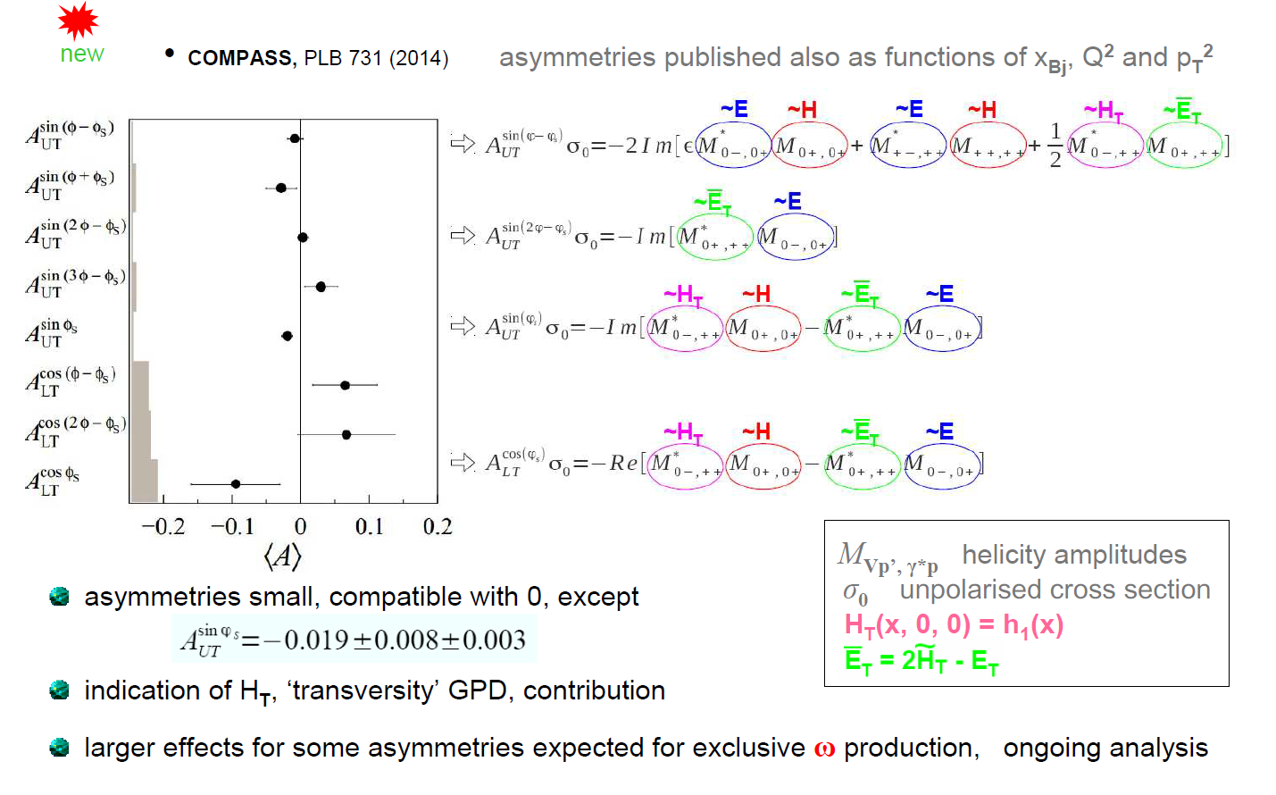
Azimuthal asymmetries for exclusive ρ⁰ production on p↑

Slide 27
NEAR FUTURE:
− polarized DY
− unpolarized SIDIS
− DVCS

Slide 28
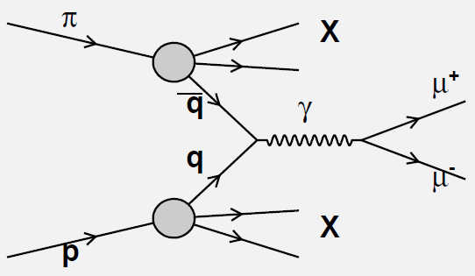


Polarized Drell-Yan
Drell-Yan $π^{−}p^{↑}→μ^{+}μ^{−}X$
O. Denisov
-
Cross sections:
In SIDIS: convolution of a TMD with a fragmentation function
In DY: convolution of 2 TMDs ‘’’’
→ complementary information and universality test
‘

Slide 29
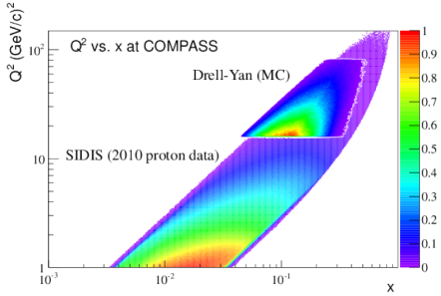
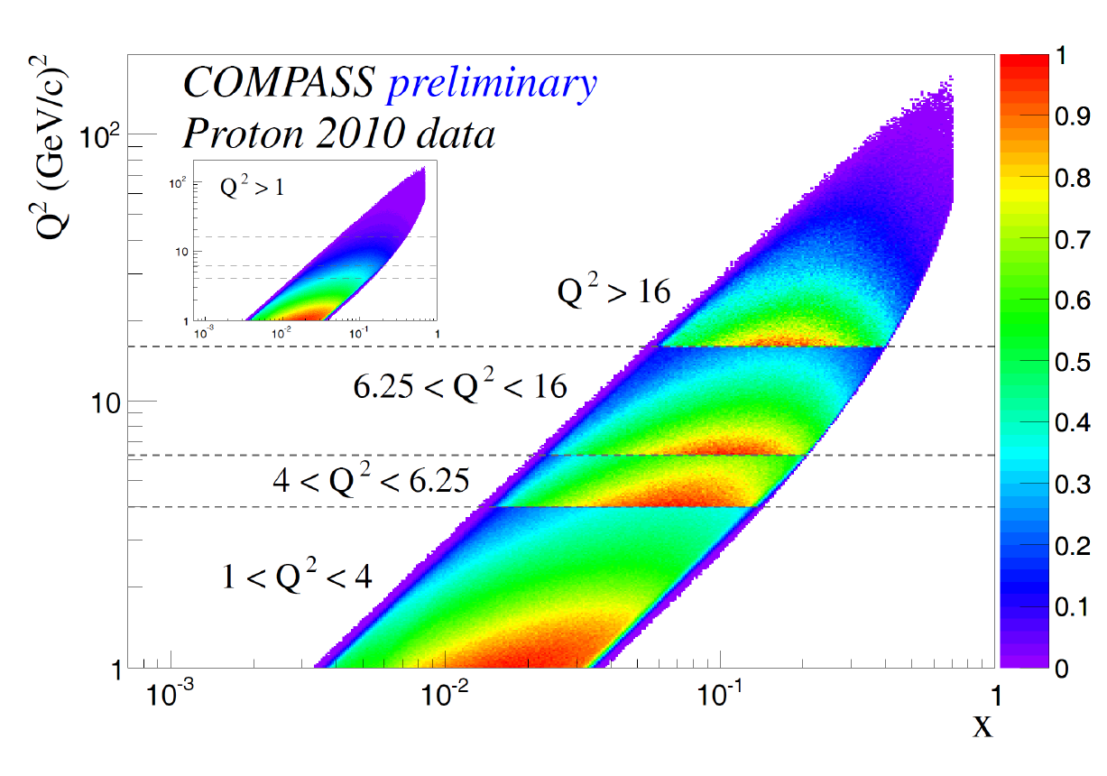
Q² vs x phase space at COMPASS
The phase spaces of the two processes overlap at COMPASS
➔ Consistent extraction of TMD DPFs in the same region

Slide 30
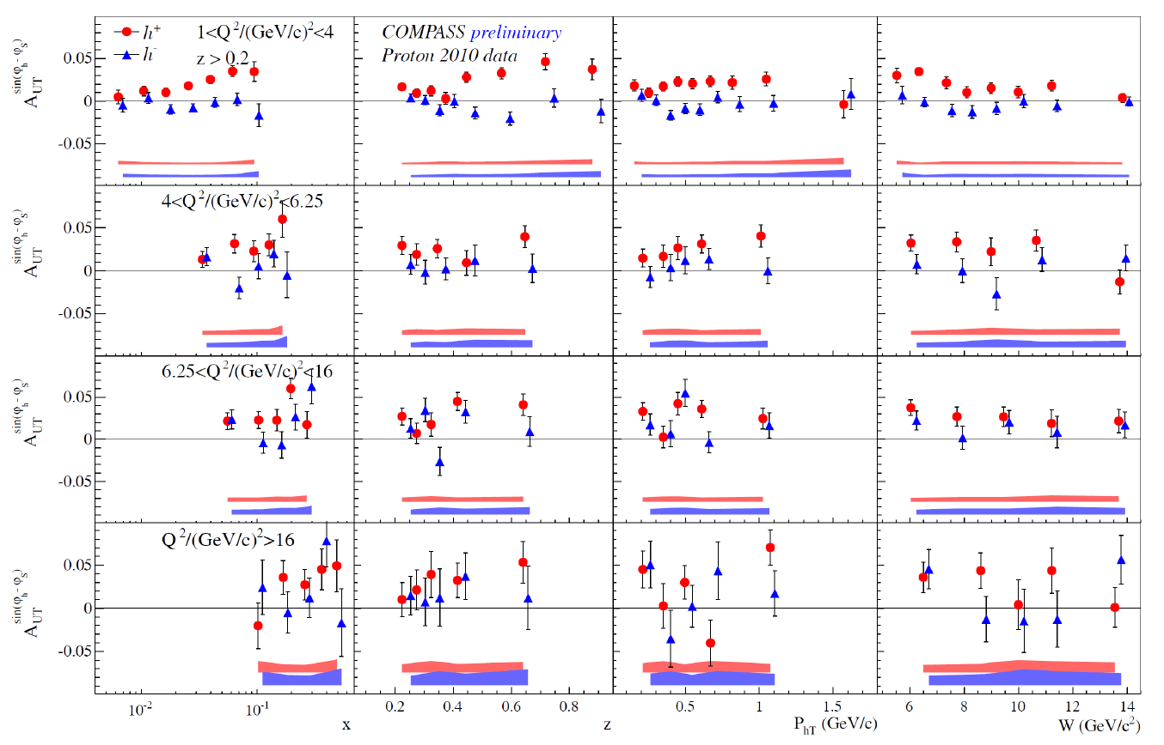
Sivers in DY range

Slide 31
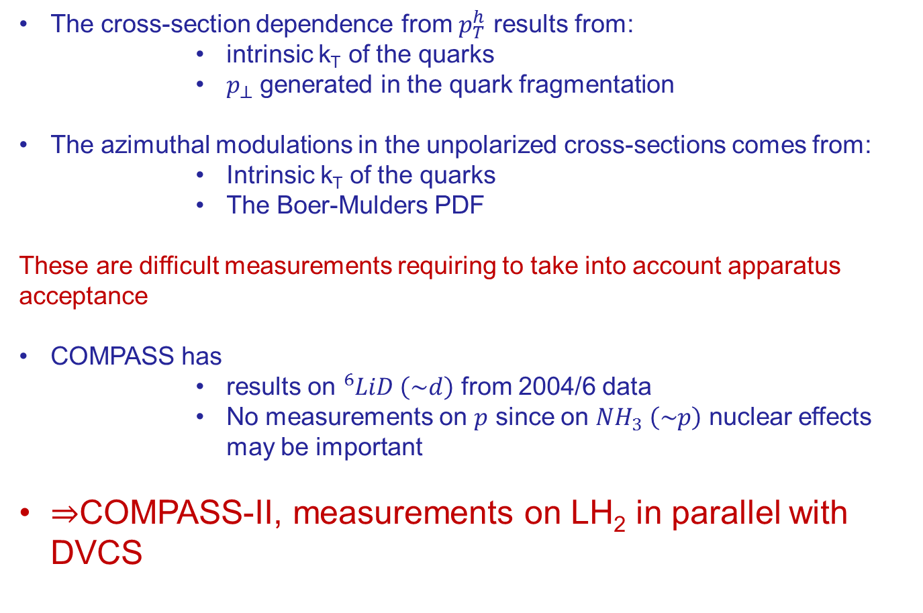
Importance of unpolarized SIDIS
For TMDs
The cross-section dependence from $p_{T}^{h}$ results from:
  intrinsic k_{T} of the quarks
  $p_{⊥}$ generated in the quark fragmentation
The azimuthal modulations in the unpolarized cross-sections comes from:
  Intrinsic k_{T} of the quarks
  The Boer-Mulders PDF
These are difficult measurements requiring to take into account apparatus acceptance
COMPASS has
  results on ${}_{}^{6}{LiD} \left(\sim d\right)$ from 2004/6 data
  No measurements on $p$ since on $NH_{3} \left(\sim p\right)$ nuclear effects may be important
$⇒$COMPASS-II, measurements on LH₂ in parallel with DVCS

Slide 32
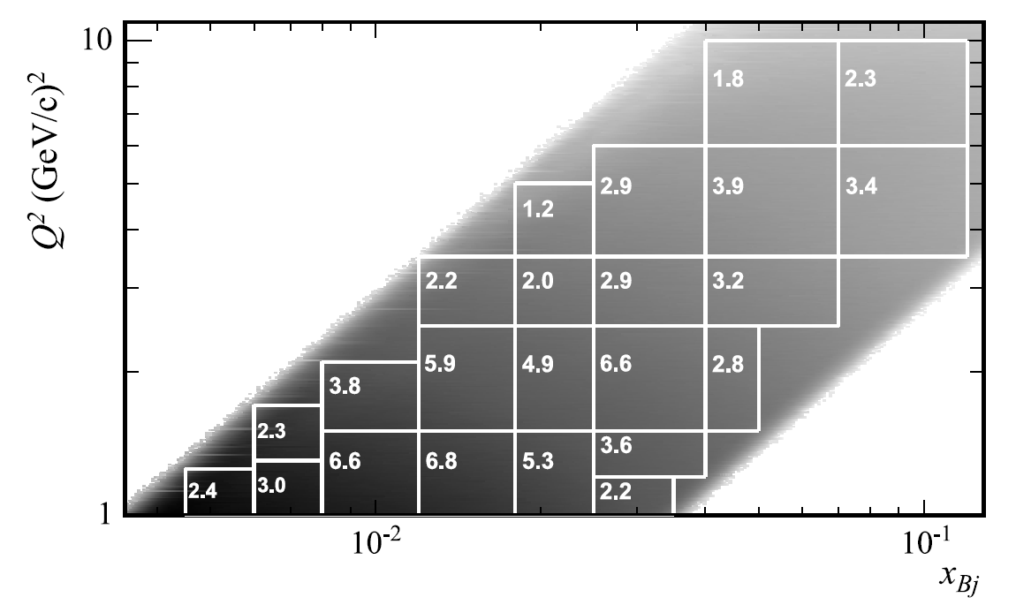
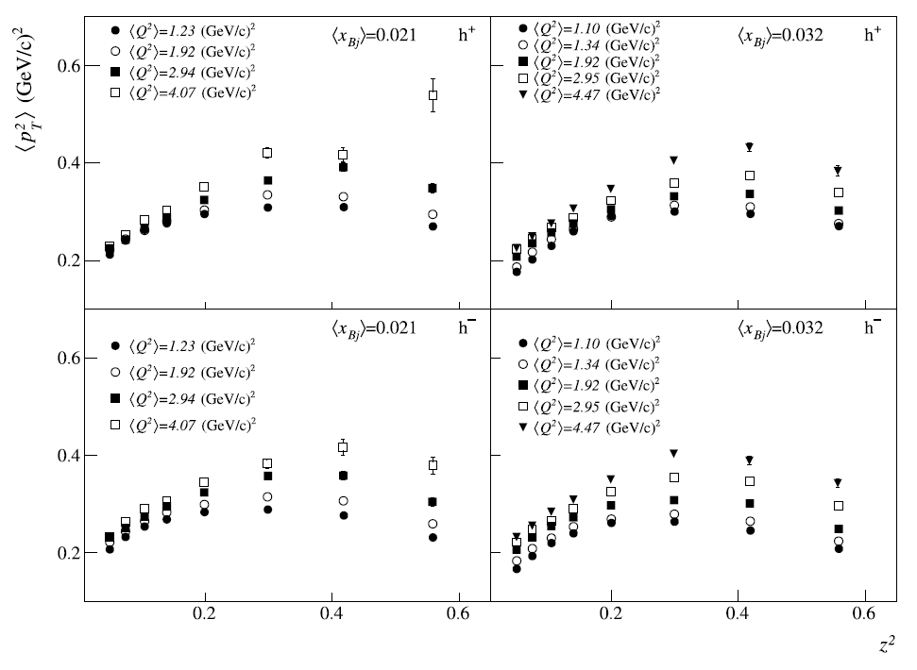
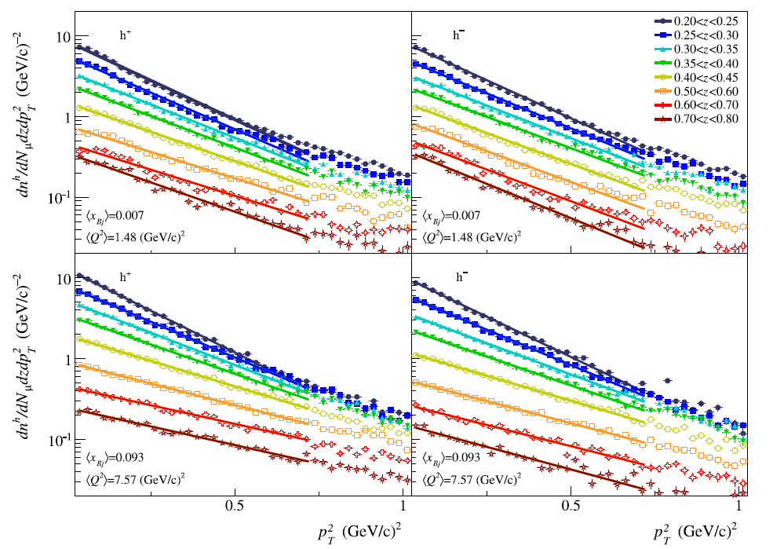

X-section dep. from $p_{T}^{h}$

Slide 33
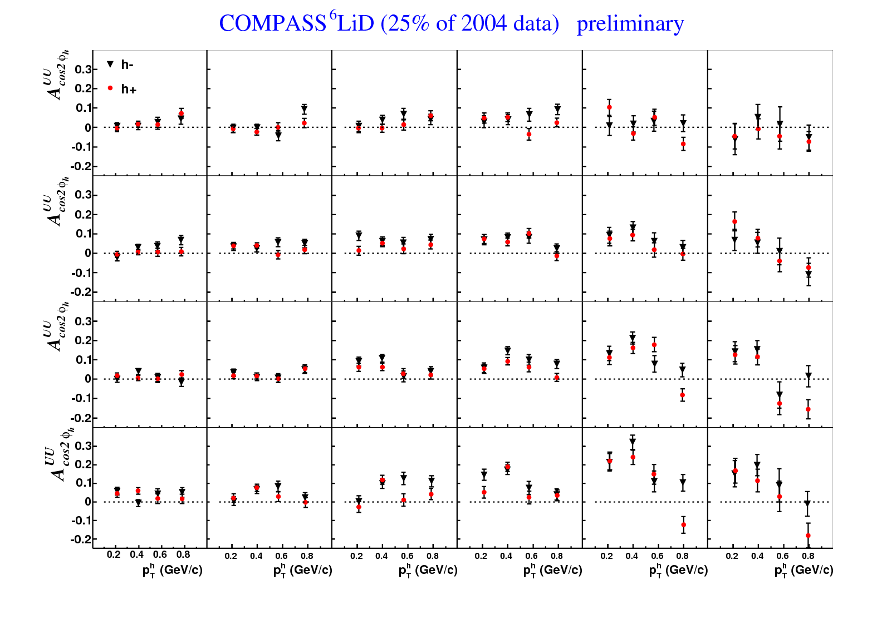
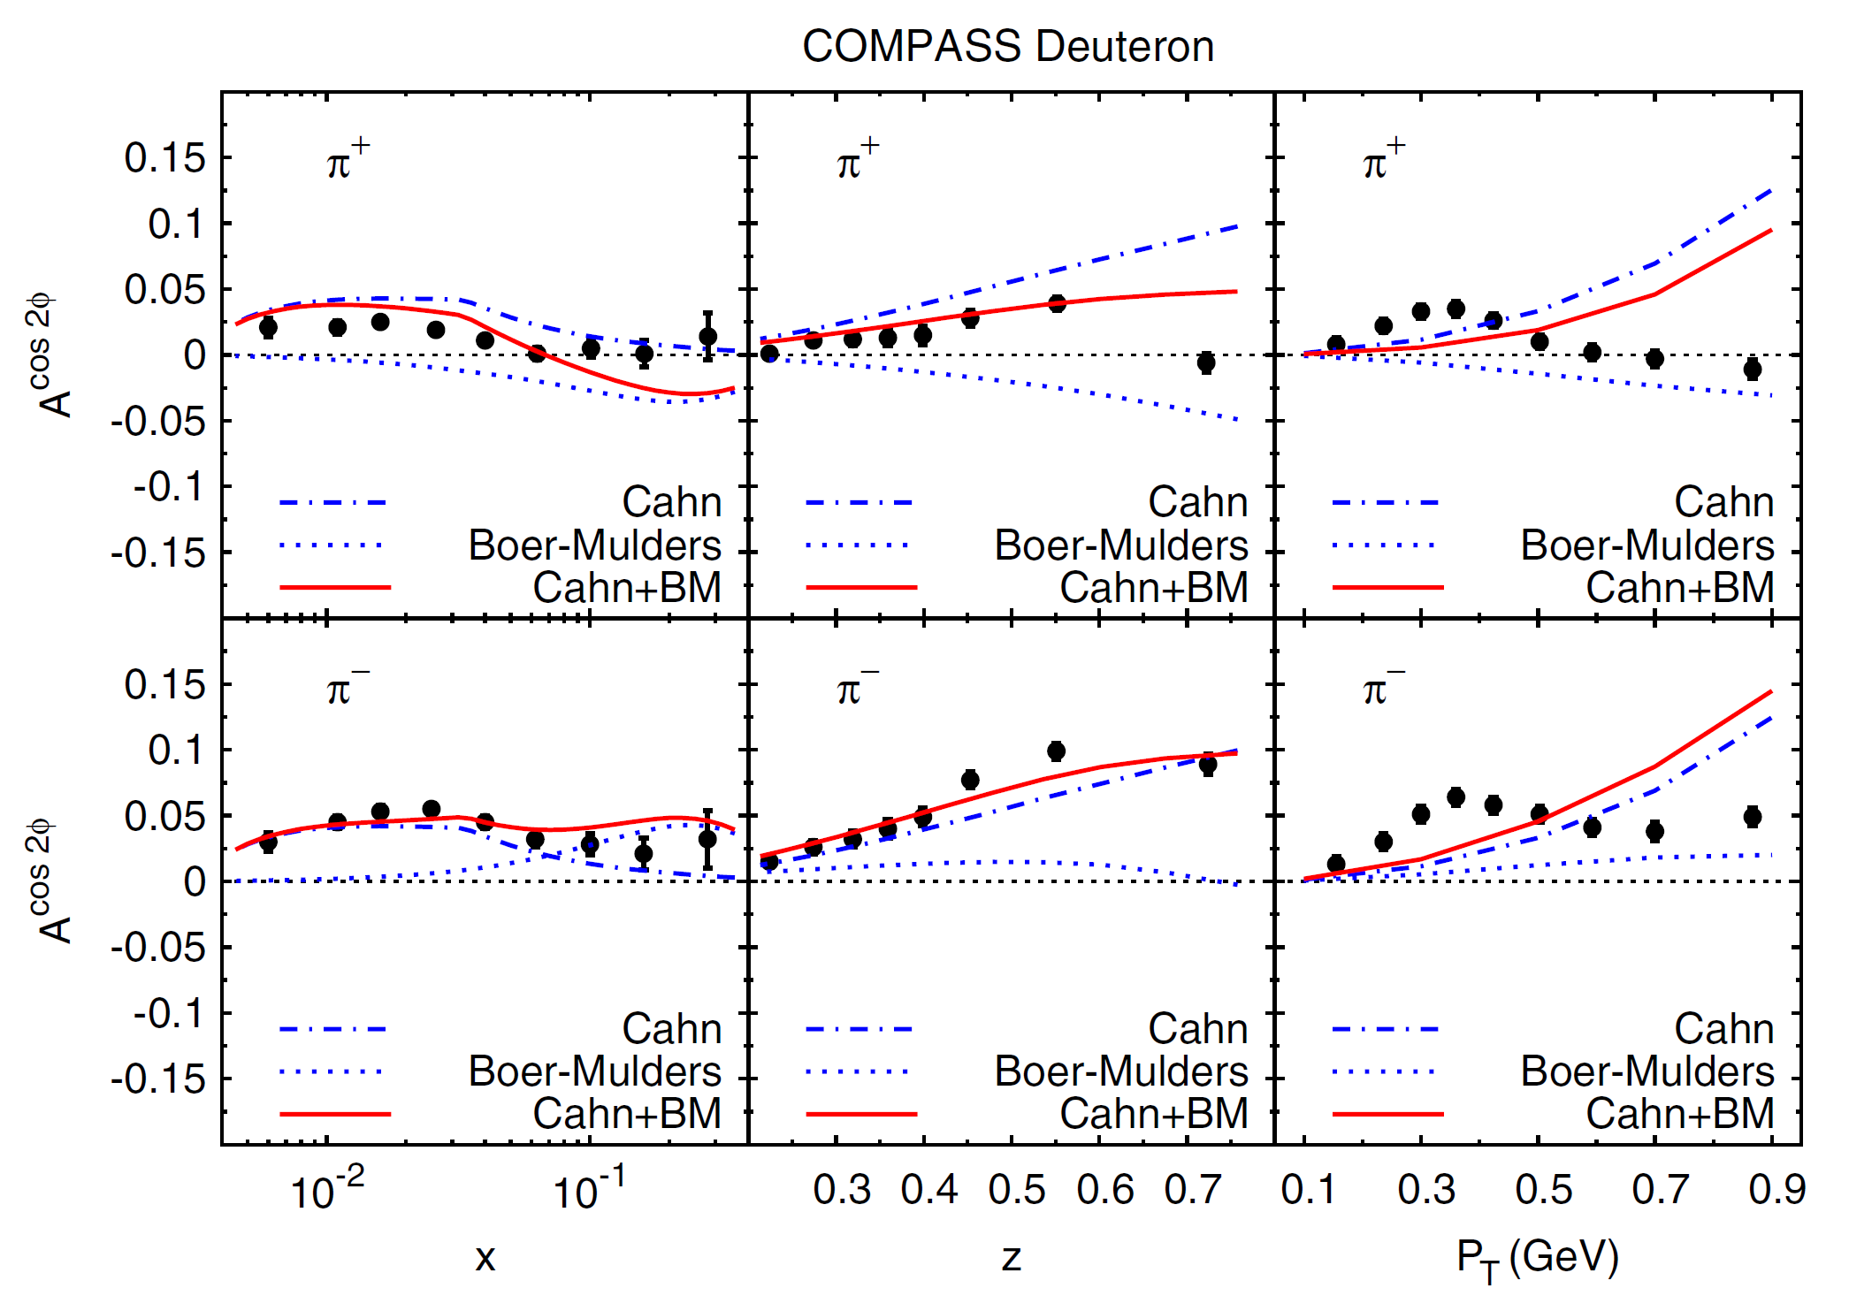
Boer-Mulders and Cahn effects
➔many data collected and still to be collected in SIDIS with GPD program

Slide 34
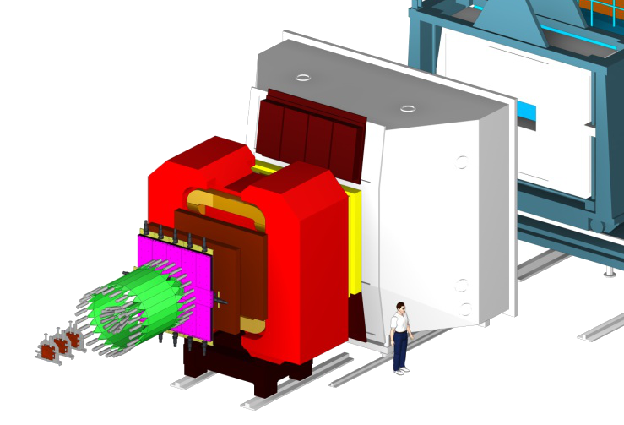
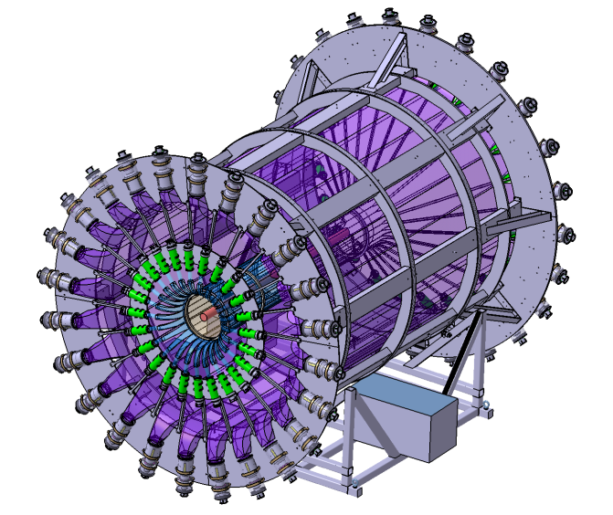
Upgrades of the COMPASS spectrometer
DVCS : μ p → μ’ p γ
μ
μ’
p
γ
New equipements:
2.5m LH2 target
4m ToF Barrel CAMERA
ECAL0
ECAL0
CAMERA

Slide 35
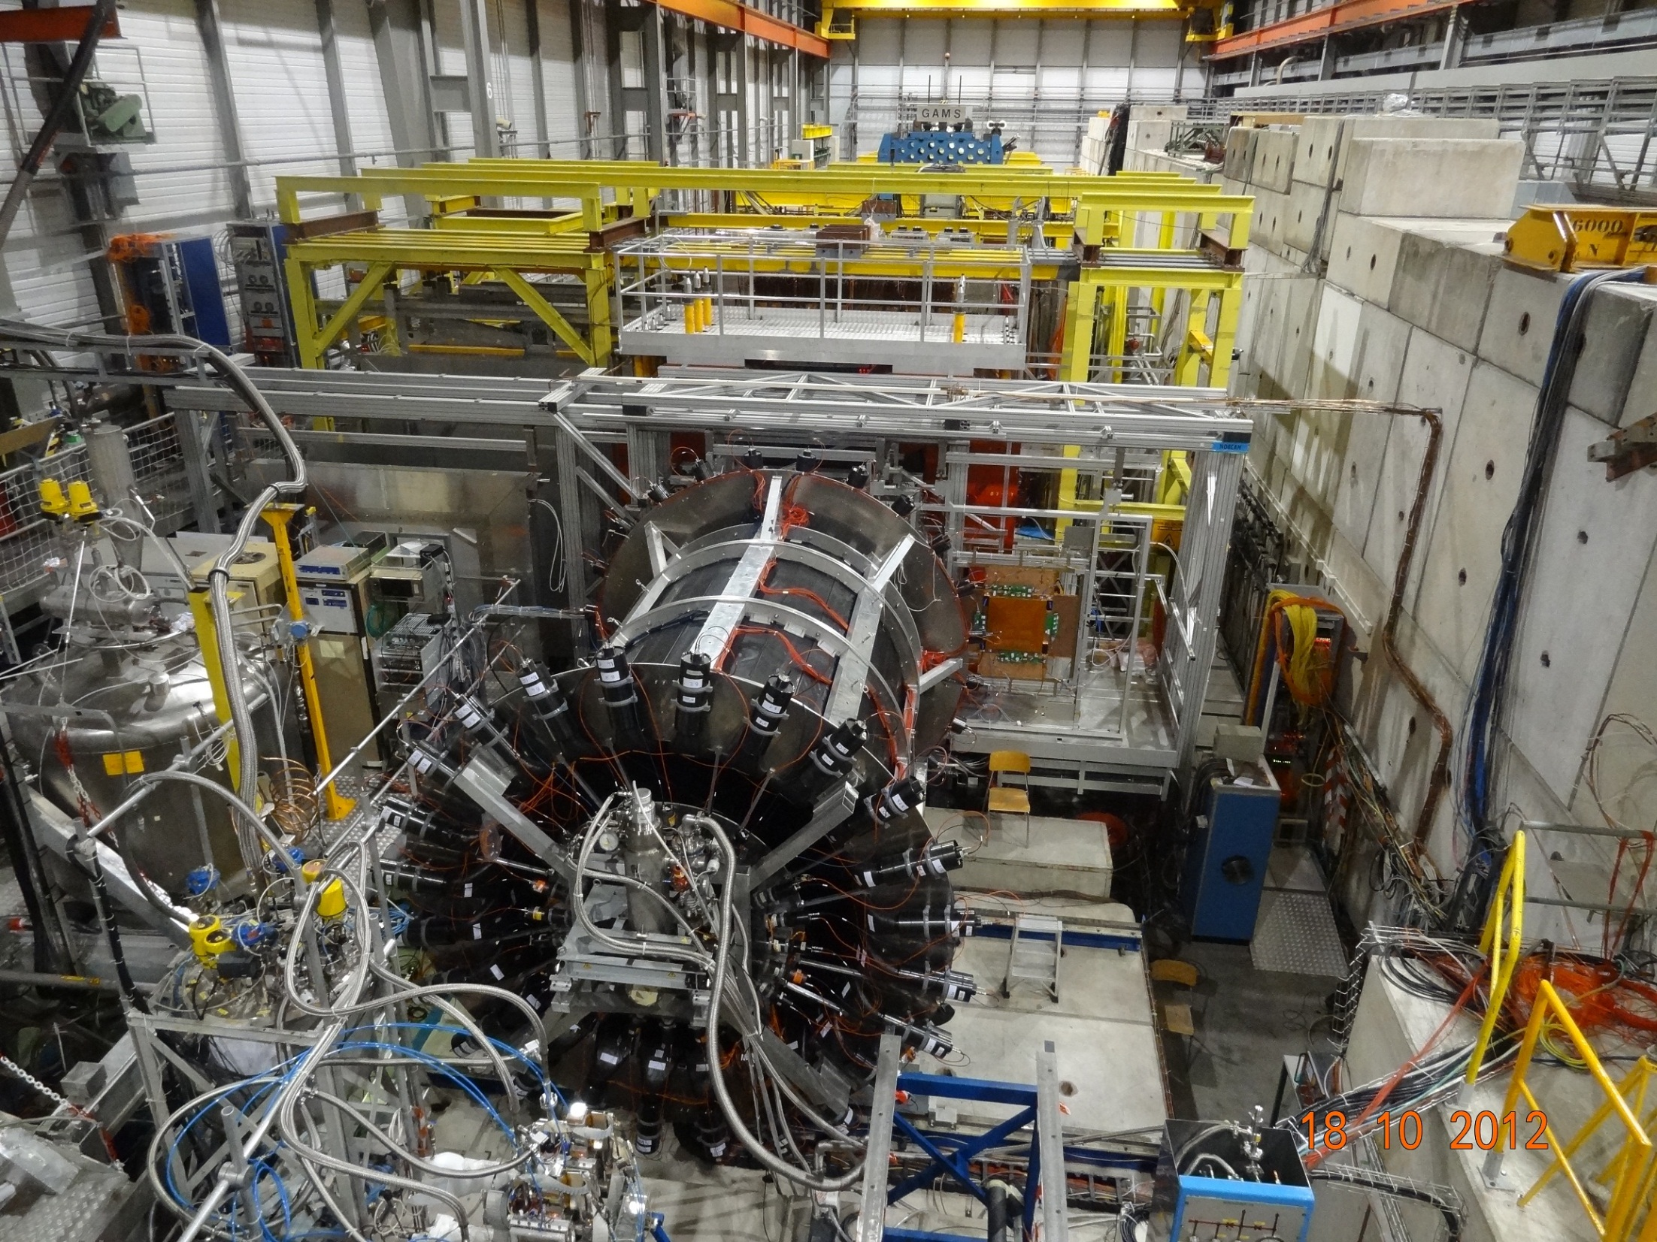
ECAL2
ECAL1
ECAL0
CAMERA recoil proton detector
surrounding the 2.5m long
LH2 target

18 -10- 2012
μ±

Slide 36
Deeply Virtual Compton Scattering
dσ_{(μp→μpγ)} = dσ^{BH} + dσ^{DVCS}_{unpol} + P_{μ} dσ^{DVCS}_{pol}
+ e_{μ} a^{BH} Re A^{DVCS} + e_{μ} P_{μ} a^{BH} Im A^{DVCS}
Phase 1: the transverse imaging
with μ^{+↓}, μ^{-↑} beam + unpolarized 2.5m long LH2 (proton) target
S_{CS,U}
≡ dσ(μ ^{+↓}) + dσ(μ ^{-↑}) ∝

Using S_{CS,U} and BH subtraction
dσ ^{DVCS} /dt ~ exp(-B|t|)
and integration over φ
μ’
γ*
γ
μ
θ
φ
p

Slide 37
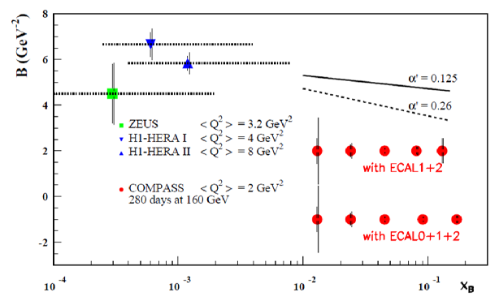
Transverse imaging
dσ ^{DVCS} /dt ~ exp(-B|t|)
2 years of data
160 GeV muon beam
2.5m LH₂ target
ε_{global} = 10%
as soft Pomeron
ansatz at small x_{B}
inspired by
Regge Phenomenology:
B(x_{B}) = b₀ + 2 α’ ln(x₀/x_{B})
with 40 weeks in 2015-16
1rst bar= stat. error; 2nd = stat + syst. errors
α’ slope of Regge traject
?
1.
0.5
0.65 ±0.02 fm
H1 PLB659(2008)
< r⊥² (x_{B}) > ≈ 2 B(x_{B})
COMPASS
x_{B}

Slide 38
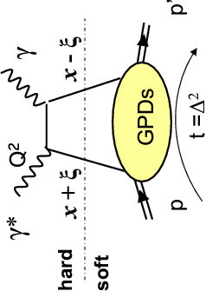
Deeply Virtual Compton Scattering
dσ_{(μp→μpγ)} = dσ^{BH} + dσ^{DVCS}_{unpol} + P_{μ} dσ^{DVCS}_{pol}
+ e_{μ} a^{BH} Re A^{DVCS} + e_{μ} P_{μ} a^{BH} Im
Phase 1: DVCS experiment to constrain GPD H
with μ^{+↓}, μ^{-↑} beam + unpolarized 2.5m long LH2 (proton) target
D_{CS,U}
≡ dσ(μ ^{+↓}) - dσ(μ ^{-↑}) ∝
and ∼ Re(F₁ H)
S_{CS,U}
and ∼Im(F₁ H)
≡ dσ(μ ^{+↓}) + dσ(μ ^{-↑}) ∝
Note: dominance of H at COMPASS kinematics
Im H (ξ,t)= H(x= ξ,ξ,t)
∫
∫
Re H (ξ,t)= P dx H(x,ξ,t) = P dx H(x,x,t) + D(t)
x-ξ
x-ξ
ξ ∼ x_{B} / (2-x_{B})
Re part of the Compton Form Factors linked to the D term

Slide 39
Summary for GPD @ COMPASS
GPDs investigated with Hard Exclusive Photon and Meson Production
COMPASS-II 2016-17: with LH₂ target + RPD (phase 1) μ^{+↓}, μ^{-↑} 160 GeV
    the t-slope of the DVCS and HEMP cross section
      → transverse distribution of partons
    the Beam Charge and Spin Sum and Difference
      Re T^{DVCS} and Im T^{DVCS} for the GPD H determination
    Vector Meson ρ⁰,ρ⁺,ω, Φ
    Pseudo-saclar π⁰
Using the 2007-10 data: transv. polarized NH₃ target without RPD

Slide 40

Near COMPASS future is more ore less defined:
2014-2015: Transversely polarized DY to check pseudo-universality (${\left[f_{1T}^{⊥}\left(x, Q^{2}\right)\right]}_{DY}≈−{\left[f_{1T}^{⊥}\left(x, Q^{2}\right)\right]}_{SIDIS}$)
2016-2017: Unpolarised DVCS/HVMP
(B slope and GPD H)
and unpolarised SIDIS on ${LH}_{2}$
${{dn}^{h}}/{\left({dN}^{μ}dz dp_{T}^{2}\right)}$ i.e. $p_{T}$ dependent multiplicities, and $h_{1T}^{⊥}$ Boer-Mulders TMD PDF
2018 to be discussed having in hand the performances in the previous years

Slide 41

More in the FUTURE:

Slide 42
For the next 10 years
  before any collider is available,
  and complementary to Jlab 12 GeV
COMPASS@CERN can be a major player in QCD physics using its unique high energy both:
  hadron beam and
  positive and negative muon beams
Looking even further…a polarized lepton-nucleon collider well be a mandatory tool

Slide 43

Key COMPASS measurements
$$g_{1}^{d}\left(x\right), \int{g_{1}^{d}\left(x\right)dx}$$ | Confirmation of SMC result on d (at variance with E142 claims)
$$Δg/g$$ | first hint that $Δg$ is small, at variance with predictions
$$A_{Col, d}^{h}$$ | first measurement of transversity on deuteron $h_{1}^{u}≃−2h_{1}^{d} H_{1, fav}^{⊥}≃−H_{1, unf}^{⊥}$
$$A_{p, d}^{2h}$$ | Only polarimeter for transversity extraction from 2h asymmetries transversity extracted directly from the data, following Pavia group
$$A_{Siv, p}^{h}$$ | Evolution of Sivers
$$π_{1}^{}\left(1600\right)$$ | $$\text{Hint} \text{for} \text{an} \text{exotic} \text{state}$$
$$a_{1}^{}(1420)$$ | New state
Radiative width of $a_{2}^{}\left(1320\right)$ and $π_{2}^{}(1670)$ | Confirmation of VMD model, EPJ highlight

Slide 44


Thank You
Longitudinal Structure of the Nucleon

Slide 45


SIDIS AT COMPASS-II
1 week with the 2.5 m long LH2 target

Slide 46




Hadron multiplicities
N. du Fresne
h=π,K (identified by Ring Imaging Cerenkov)
  ➤M^{h} depend on unpolarized PDF’s:
                u(x),d(x) unpolarized PDF well known
  strange PDF s(x) less well known

Slide 47
COMPASS – some facts
Located at CERN North Area beam line
  Possible beams: µ⁺, µ⁻, π⁺, π⁻, K → Several physics programs
Experiments with muon beam
  Spin structure, Gluon polarization
  Flavor decomposition
  Transversity
  Transverse Momentum-dependent PDF
  DVCS and HEMP
  Unpolarized SIDIS and TMDs
Experiments with hadron beams
  Pion polarizability
  Diffractive and Central production
  Light meson spectroscopy
  Baryon spectroscopy
  Pion and Kaon polarizabilities
  Drell-Yan studies
COMPASS - I (2002 – 2011)
COMPASS - II (2012 – 2017)

Slide 48
COMPASS – some facts
Located at CERN North Area beam line
  Possible beams: µ⁺, µ⁻, π⁺, π⁻, K → Several physics programs
Experiments with muon beam
  Spin structure
  p, d polarized target (L & T)
  DVCS/Unpol SIDIS
  Long LH₂ target
Experiments with hadron beams
  Hadron spectroscopy
  Small LH₂ or nuclear targets
  Drell-Yan studies
  Polarized target (T)
COMPASS - I (2002 – 2011)
COMPASS - II (2012 – 2017)
Reconfigurable target region - versatile experimental setup!

