Slide 1

The virtue of precision spectroscopy :
A new axial-vector meson and
The structure of the (ππ) S-wave isobar
Stephan Paul
for the COMPASS collaboration
TUM

Slide 2
Brief Overview
Introduction
Data-set and PWA analysis
  mass-independent fit
  mass-dependent fit
    results for resonance parameters
    Details on a₁(1420)
ππ S-wave extraction
    results for 0⁻⁺, 1⁺⁺, 2⁻⁺
    Role of f₀(980)
Conclusions

Slide 3
Light Mesons, Quarks and Gluons
Quark model mesons (u, d, s quarks)
q
q
Glueballs (gluons and no valence quarks)
q
q
Multiquarks (quark-antiquark pairs)
q
q
Hybrids (quarks and gluonic excitation, which contribute to static properties)
q
q
Klempt Zaitsev Phys Rep 454 (2007) 1

Slide 4
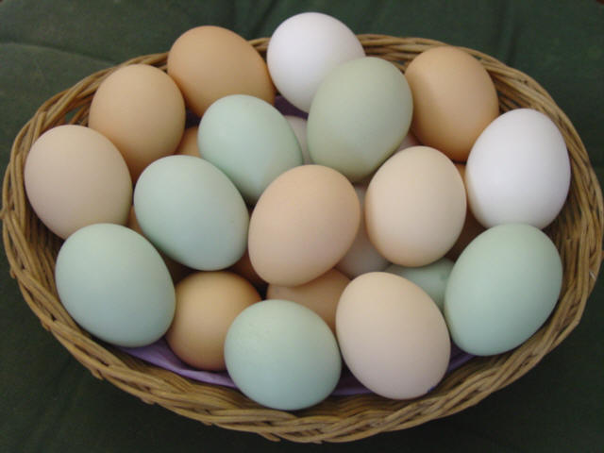
K_{1B}
Normal mesons
`
f₂
K₀*
K₂*
K_{1A}
h₁
f₀
ϕ
ρ
f₂
a₂
a₀
f₀
f₁
h₃
a₁
b₁
ω
taken from
Mike pendlebury
‘
f₀

Slide 5
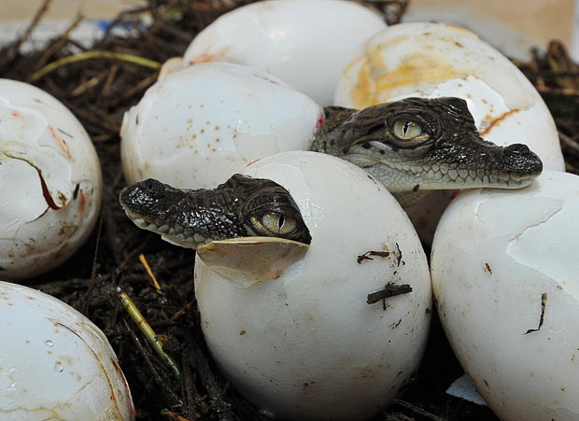
More Surprising States?
taken from
Mike pendlebury

Slide 6
How to produce “other” mesons
Diffraction: πp_{target} ➝ X + p_{recoil}➝ nπ + p_{recoil}
  isospin = 1
  spin-alignment M of resonance X w.r.t. to production mormal
  PWA is clean
  isospin = 0 possible in decay products of X
Central production: pp_{target} ➝ p_{fast} + X + p_{recoil}
➝ p_{fast} + nπ/Κ/η + p_{recoil}
  isospin = 0
  “glue-rich” systems
  PWA with ambiguities for n=2
  typically populating low spin states J
J/ψ-decays: J/ψ ➝ X + γ_{recoil}
pp-annihilations or heavy meson decays (Dalitz plot analysis)
  typically populating low spin states J

Slide 7
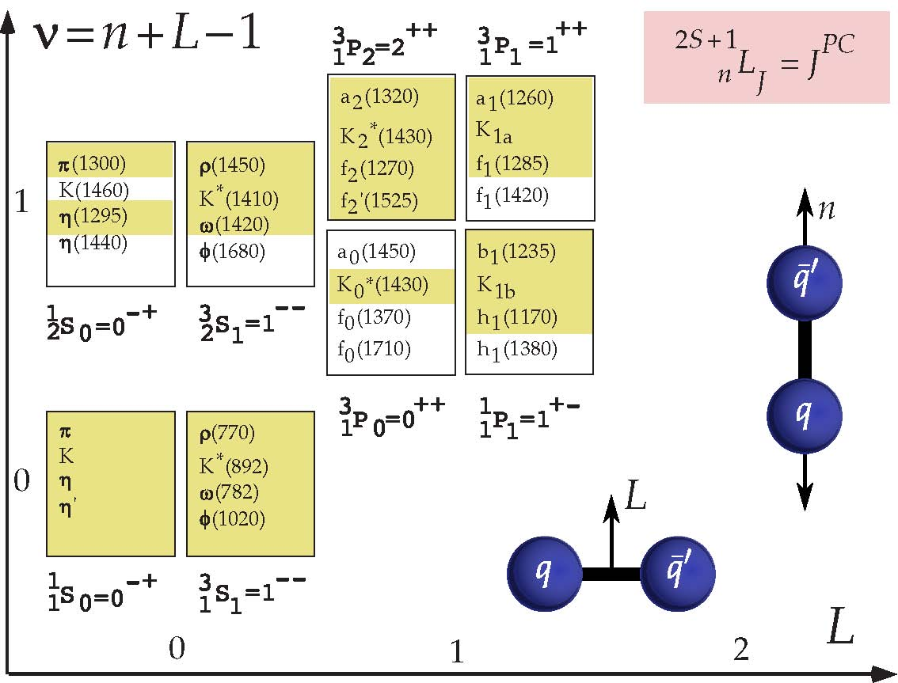
Constituent Quarks and Mesons
Spectrum of light mesons:

Slide 8
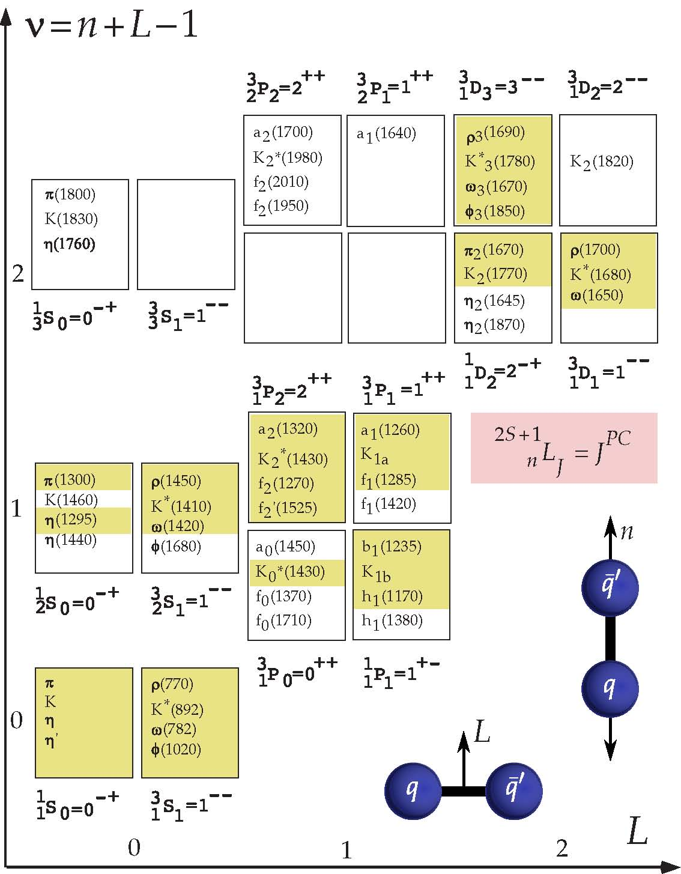
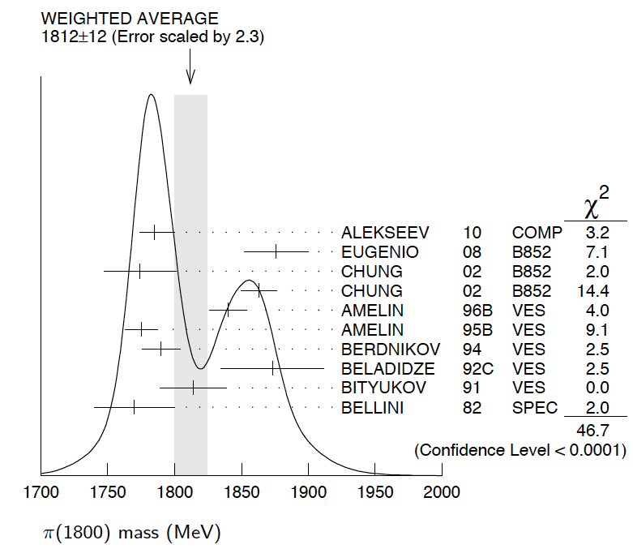

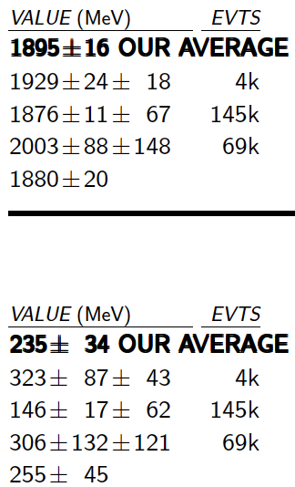

Constituent Quarks and Mesons
a₄(2040)
2
Limits for light mesons
many missing/disputed
states in mass region
m ~ 2 GeV/c²
Identification of heavy
states difficult
  broad states
  large number
  overlap + mixing
π₂(1880)
2
f₀(500)
f₀(980)
f₀(1500)

Slide 9
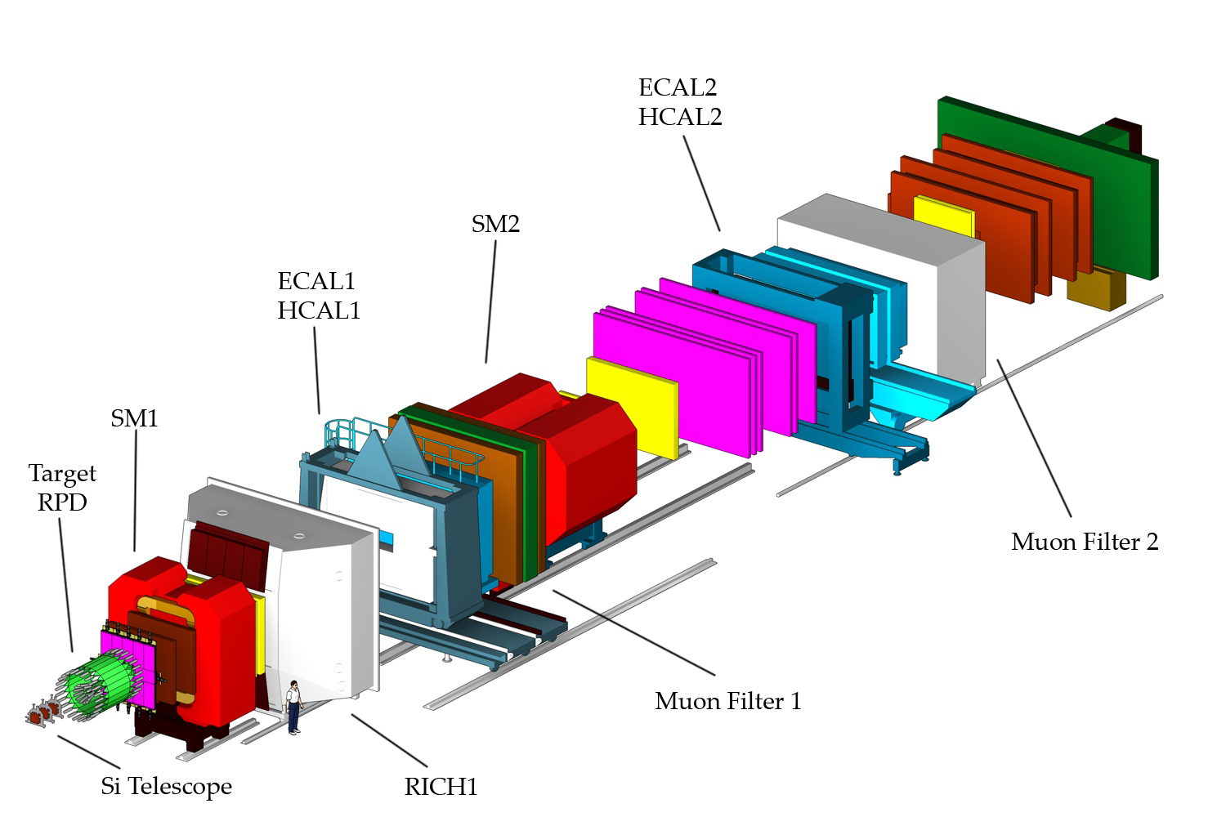
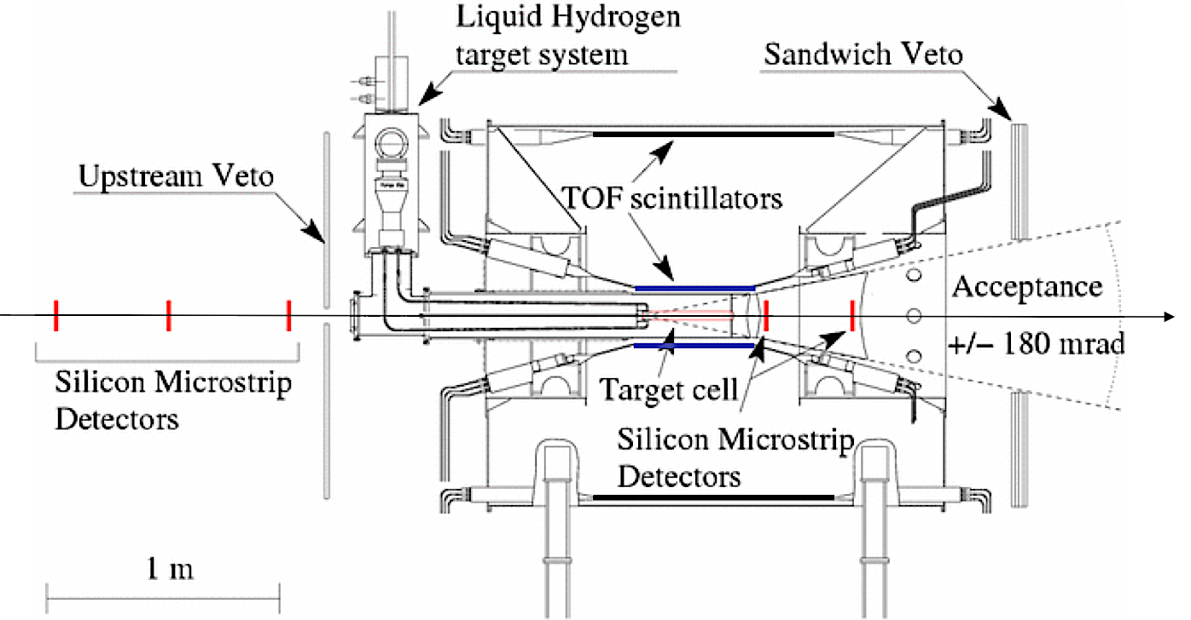
The COMPASS Experiment
CERN SPS
Hadron beam:
190 GeV/c π, K, p
5∙10⁷ particles/SPS-spill
60 days data taking 2008
Trigger: RPD hit, beam veto
50m

Slide 10
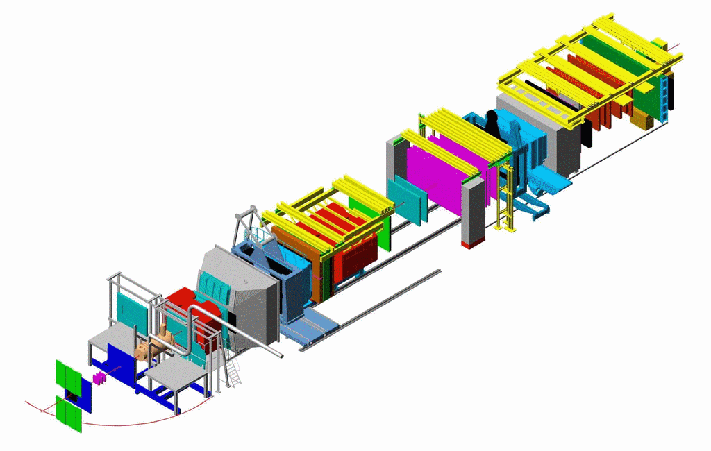
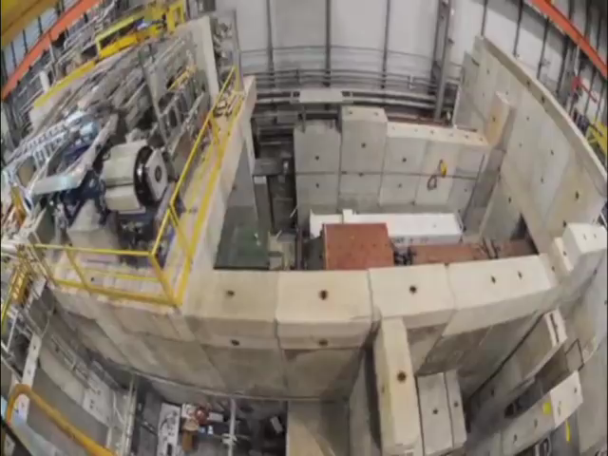
The COMPASS Experiment
COMPASS@CERN
Fixed Target Experiment
Streuexperimente
ca. 50m

Slide 11
The Process
Preliminary
w coplanarity
generic process
w/o coplanarity
exclusive reaction
zoom
what we are after
Preliminary
5∙10⁷ evts

Slide 12
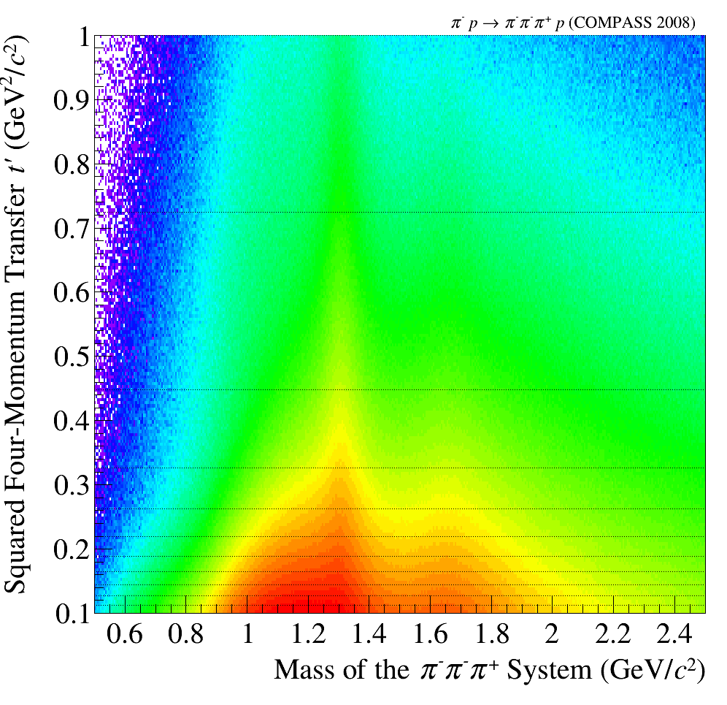
Kinematics and Isobars
isobar model
low t’
high t’
0.8< m_{3π}<0.85
1.6 < m_{3π}<1.65
grid of t’ used
Δm: 20 MeV/c²

Slide 13
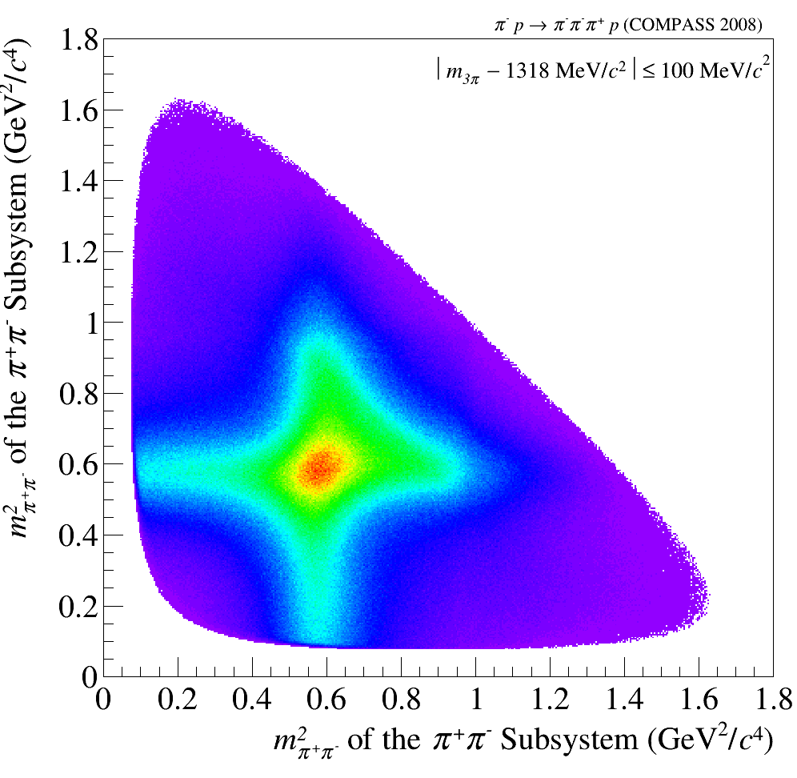
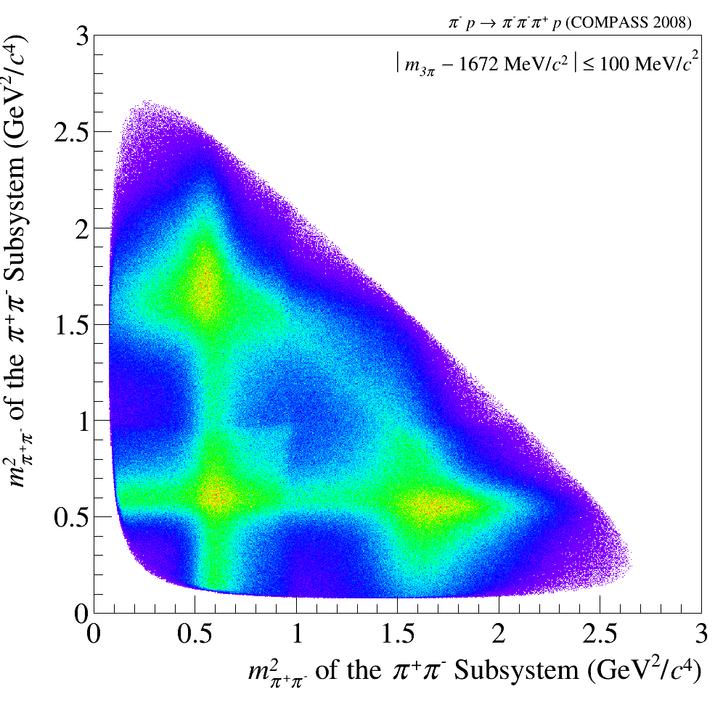
First Impressions
Motivation for Isobar Model
m²_{2π}
m²_{2π}
Preliminary
Preliminary
Preliminary
f_{f}(1270)
ρ
ρ
m²_{2π}
m²_{2π}
t’_{3π}
used in analysis
Preliminary

Slide 14
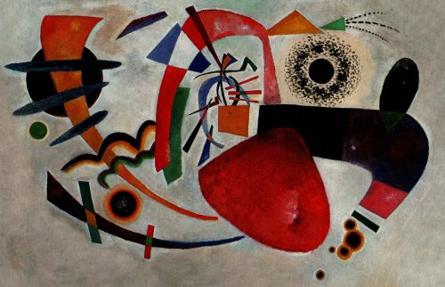
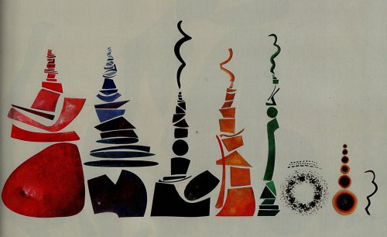
Partial wave analysis
inspired by M. Pennington
raw data
after PWA
πf₂
πf₀
Flat wave
(ππ)_{S} π
ρ(770)π
Art taken from Urs Wehrli: “Kunst aufgeräumt”

Slide 15
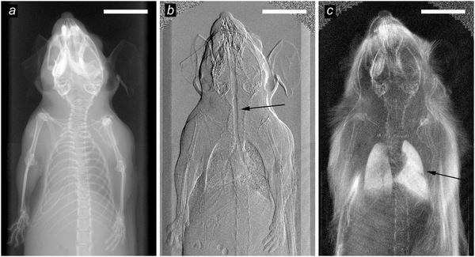
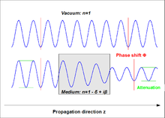
Phase contrast tomography
n=1-δ+iβ
X-rays
Absorption
Phase contrast

Slide 16
Partial wave analysis
Whats PWA ?
Describe population in 5-dimensional phase space in πππ by model
Define a set of quantum numbers J^{PC}
Define a set of possible decay channels for each J^{PC}
(X⁻ → isobar + π; isobar→ππ ) : wave (88 waves used)
  each such “wave” has a pre-determined population in phase space
  each wave may have alignment of J described by quantum number m
For each bin of 20 MeV/c² mass of πππ: determine which coherent combination of waves fits distribution best
Obtain spin-density matrix
Describe spin density matrix (submatrix) by model containing resonances and non-resonant contributions connecting all mass bins
Determine resonance parameters
step 1
step 2

Slide 17
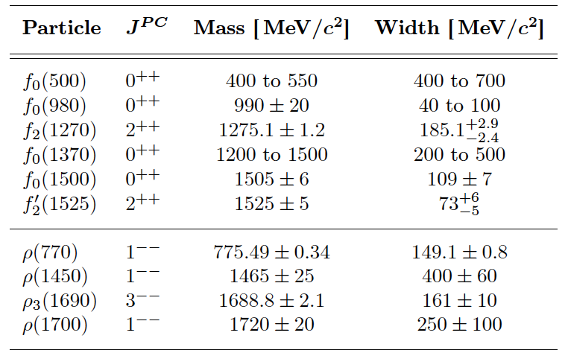
Fit Model - Isobars
[ππ]_{S}
not used

Slide 18
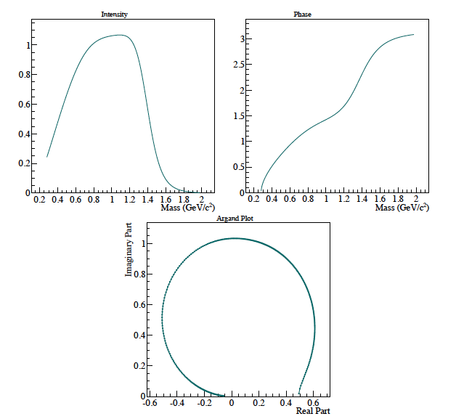
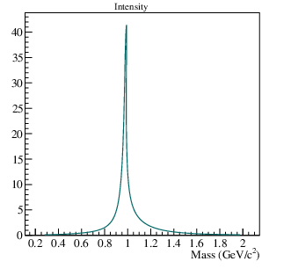
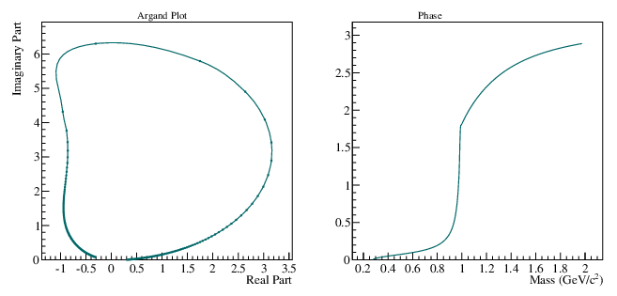

Isobars: Introduction
[ππ]_{S}
f₀(980) parametrization
use BES parametrization: as it decays into ππ and KK (threshold effect)

Slide 19
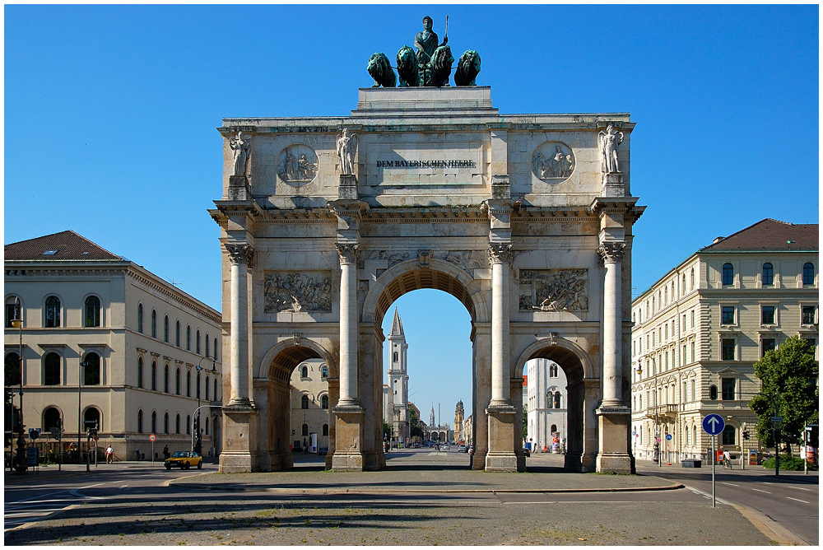
3π-City

Slide 20
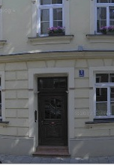
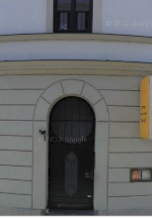
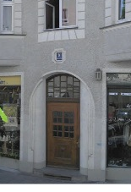
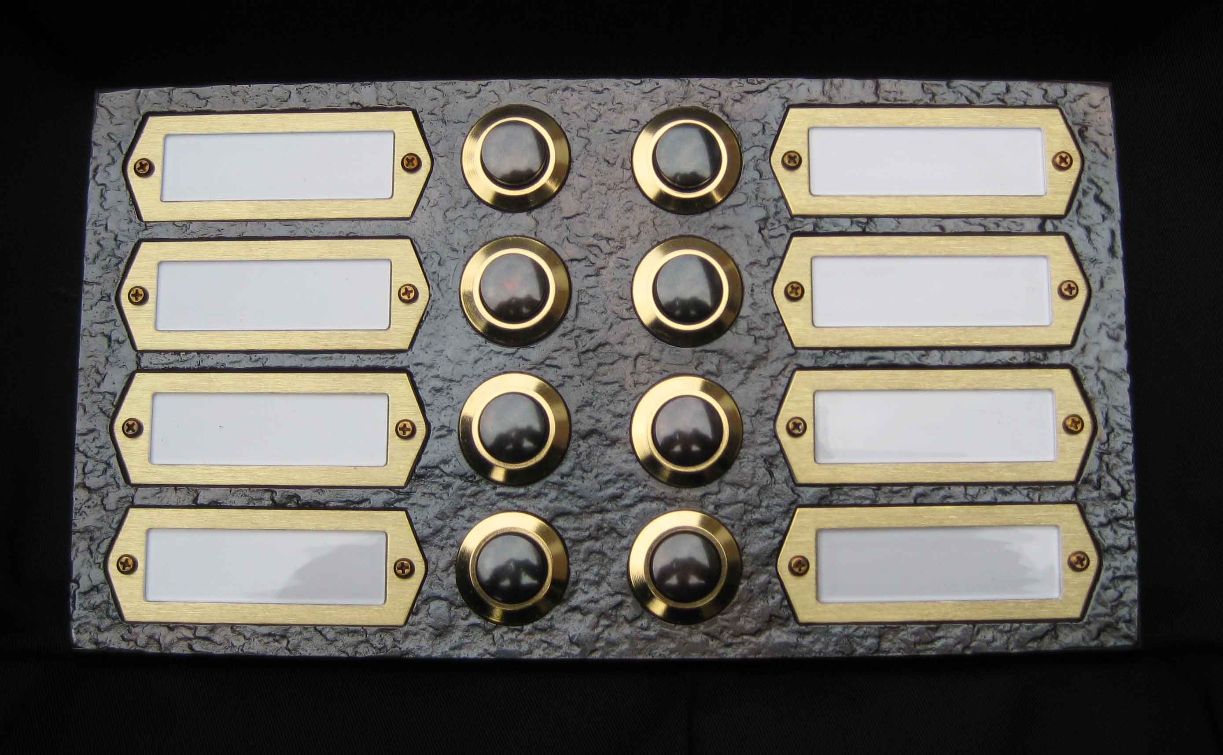
J^{PC}0⁺ [ππ]_{S}*π L
J^{PC}M⁺ [isobar]π L
2⁺⁺
2⁻⁺
4⁺⁺
COMPASS
1⁺ ρπ S
0⁺ f₀ π S
0⁺ f₀ π P
0⁺ ρπ S
1⁺ ρπ D
1⁺ ρπ G
COMPASS
0⁻⁺
1⁺⁺
COMPASS
COMPASS
0⁺ f₂ π S

Slide 21
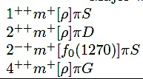

Major waves
Major waves
J^{PC}m^{ε}[isobar]πL
2
mass independent fits
minimal m = (0,1) waves
compare: π⁻π⁺π⁻ and : π⁻π⁰π⁰

Slide 22
Major waves m = 1
mass independent fits
m = 1 = m_{min} + 1 waves
compare: π⁻π⁺π⁻ and : π⁻π⁰π⁰

Slide 23
t’ dependence of mass distributions
low t
high t’
high t
1⁺⁺0⁺ρπ S
2⁺⁺1⁺ ρπ D
2⁻⁺0⁺ f₂ π S
4⁺⁺1⁺ ρπ G

Slide 24
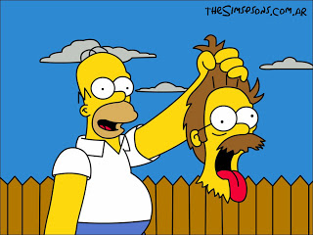
More exotic families
f₀(980)

Slide 25
Waves involving f₀(980)
1⁺⁺0⁺ f₀(980) π P
0⁻⁺0⁺ f₀(980) π S
2⁻⁺0⁺ f₀(980) π D

Slide 26
Waves involving [ππ]_{S}
1⁺⁺0⁺[ππ]_{S} π P
0⁻⁺0⁺[ππ]_{S} π S
2⁻⁺0⁺[ππ]_{S} π D

Slide 27
1⁺⁺0⁺ ρπ S
2⁺⁺1⁺ ρπ D
4⁺⁺1⁺ ρπ G
2⁻⁺0⁺ f₂ π S
0⁻⁺ 0⁺ f₀π S
1⁺⁺0⁺ f₀ π S

Slide 28
Mass-dependent fit
Use only lowest m = 0,1 waves (so far)
This work: 6 waves
Model:
2 resonances : a₁(1260) and a₁´ + non resonant term
2 resonances : a₂(1320) and a₂´ + non resonant term
1 resonance : a₄(2040) + non resonant term
2 resonances : π₂(1670) and π₂´ + non resonant term
1 resonance : a₁(1420) + non resonant term
1 resonance : π (1800) + non resonant term
  231 mass distributions with 23100 data points
  352 free parameters
  systematic studies with 5 and 7 waves performed
1⁺⁺0⁺ρπ S
2⁺⁺1⁺ ρπ D
4⁺⁺1⁺ ρπ G
2⁻⁺0⁺ f₂ π S
1⁺⁺f₀(980) π P
0⁻⁺f₀(980) π S

Slide 29


Non-resonant processes
Resonance
Deck
π⁻
π⁺
π⁺
π⁺
π⁻
π⁻
π⁻
p
n
p
ρ, σ
π⁻
ρ, σ
P
R
R
π⁻
π⁻
p
p
p

Slide 30
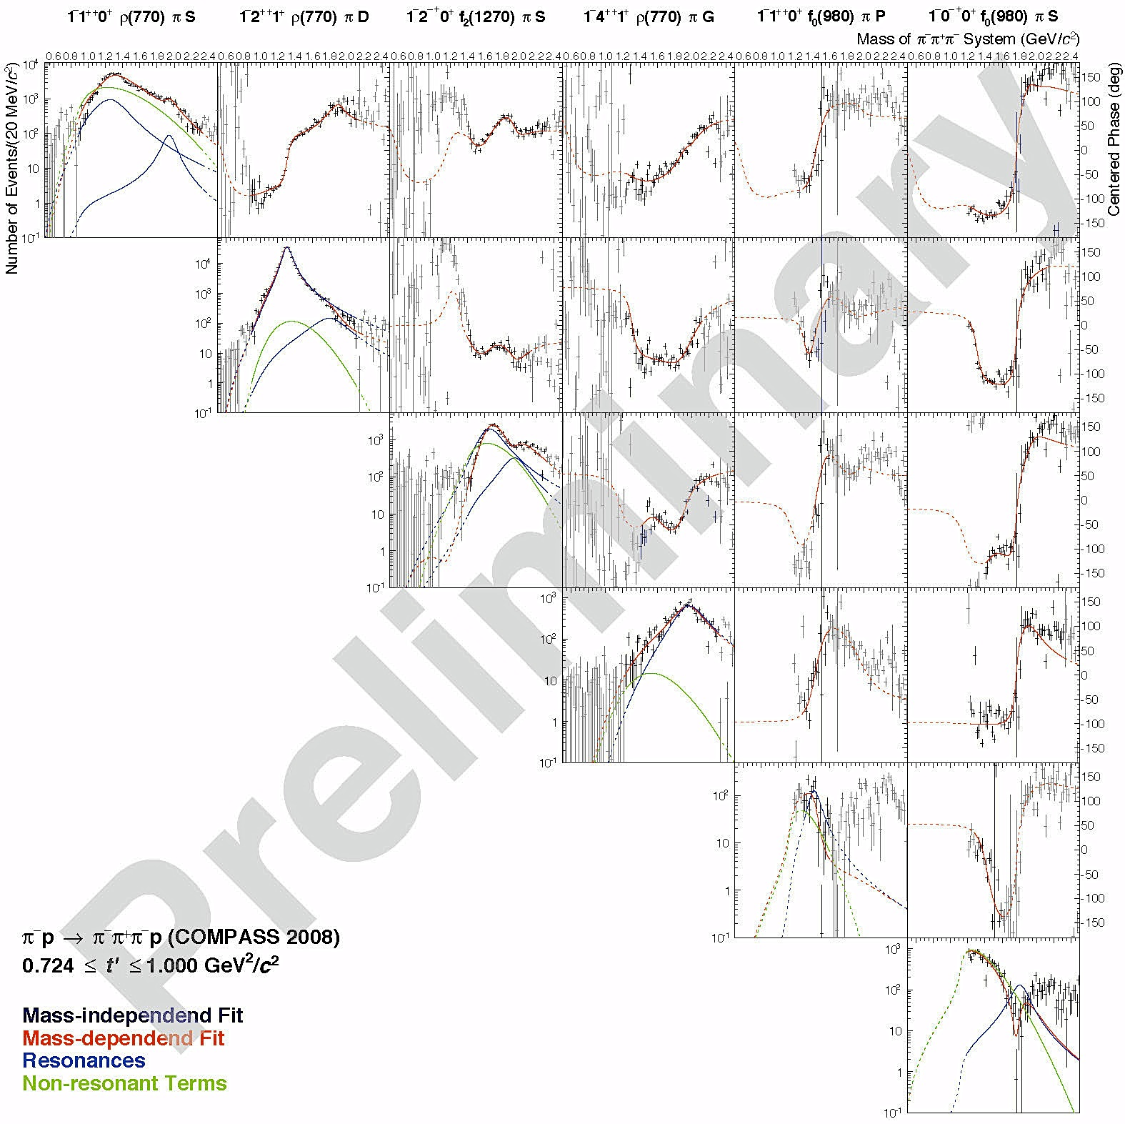
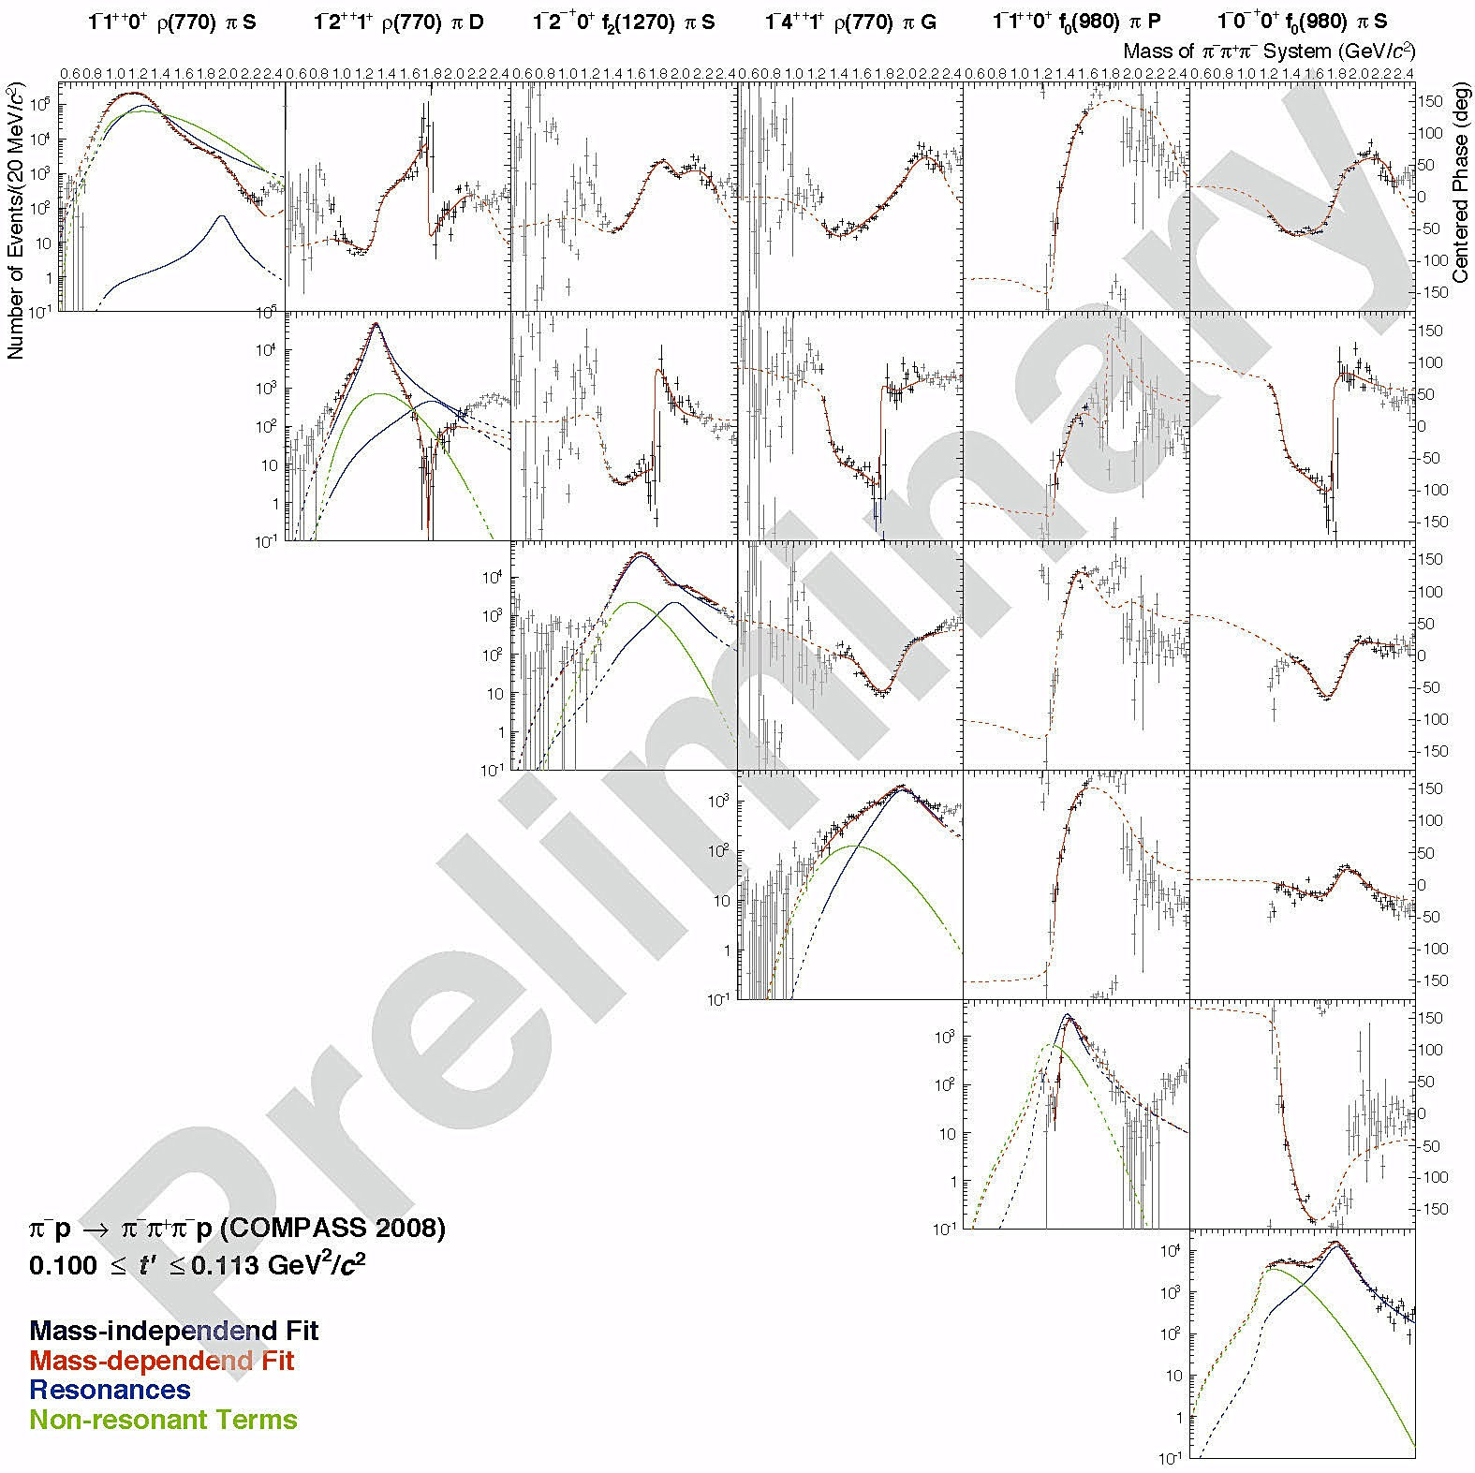
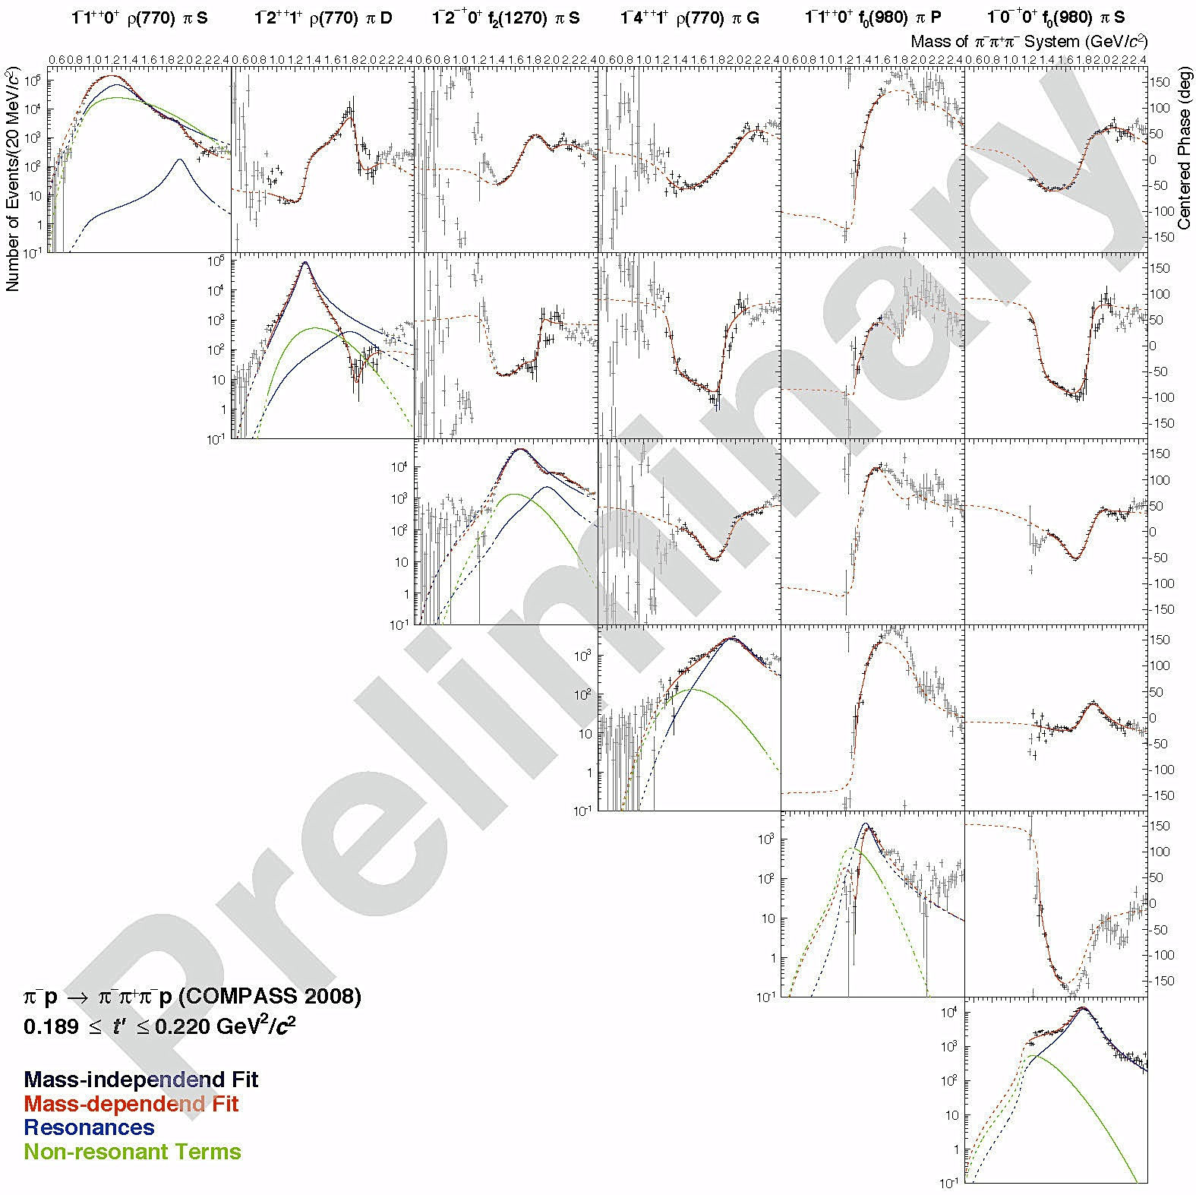
COMPASS “Colour Holography”
Reference
waves
Interferometry
simultaneous fit in 11 t-bins

Slide 31
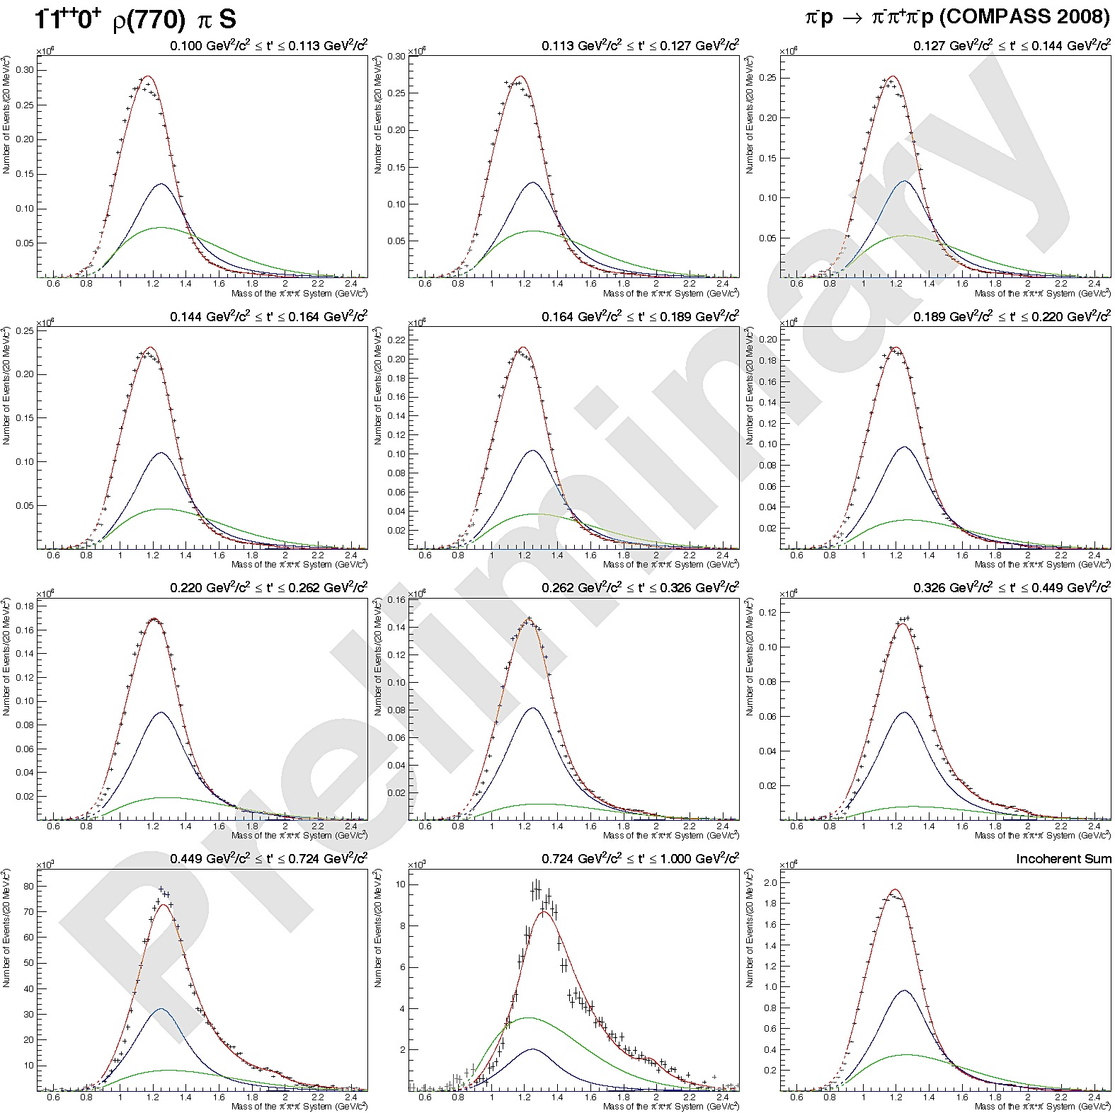

Mass dependent fits
Fit in 11 t-bins
t
t
incoherent sum

Slide 32
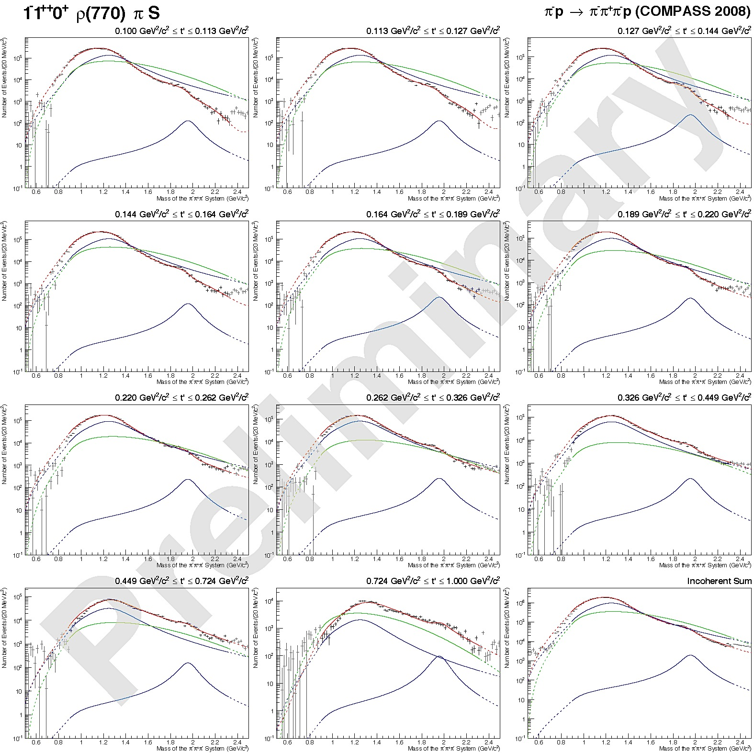
Mass dependent fits
Fit in 11 t-bins
t
t
incoherent sum

Slide 33
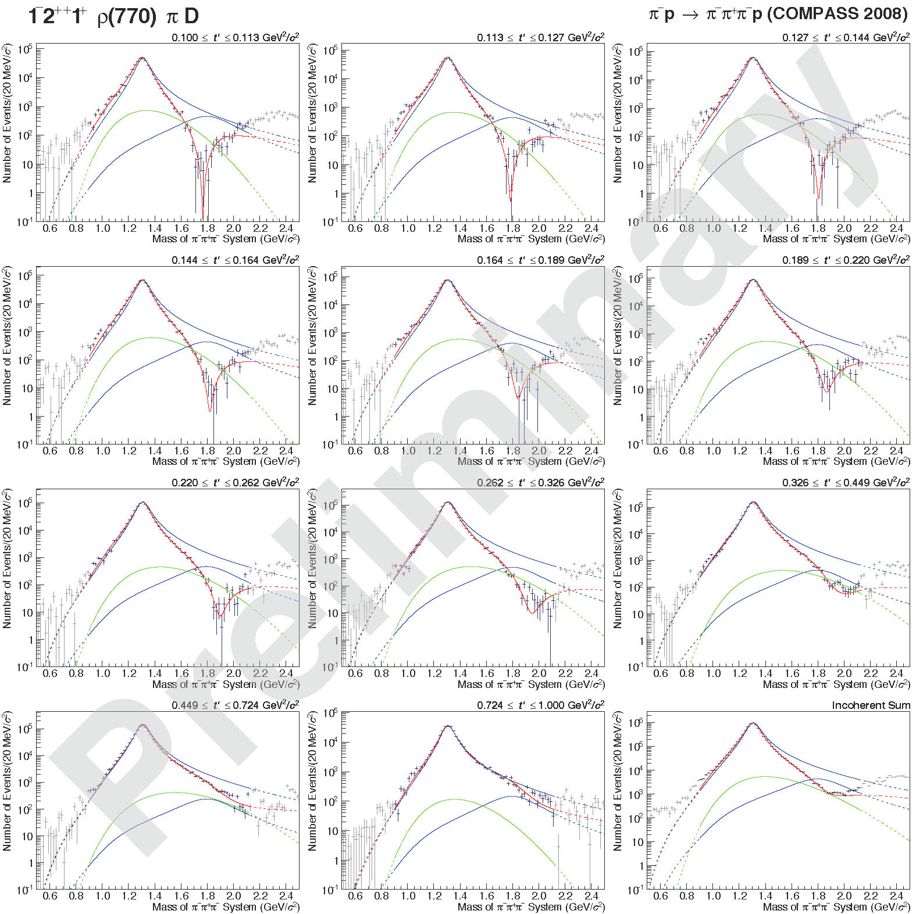
Mass dependent fits a₂(1320)
t
t

Slide 34

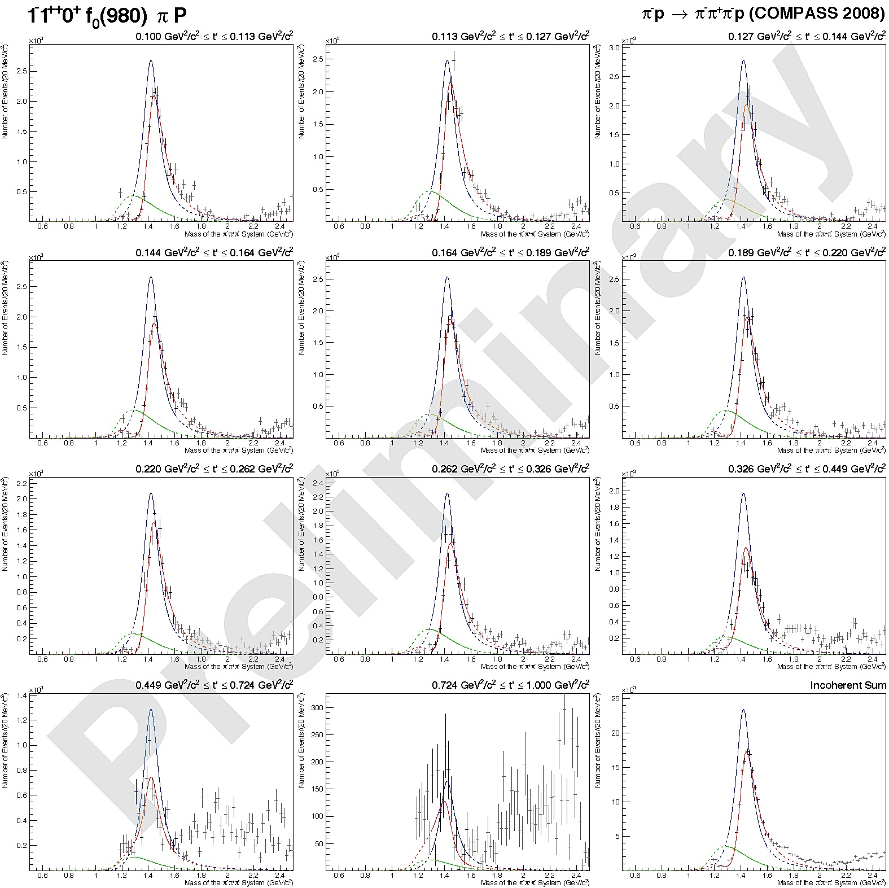

Mass dependent fits a₁(1420)
t
Fit in 11 t-bins
t
incoherent sum

Slide 35
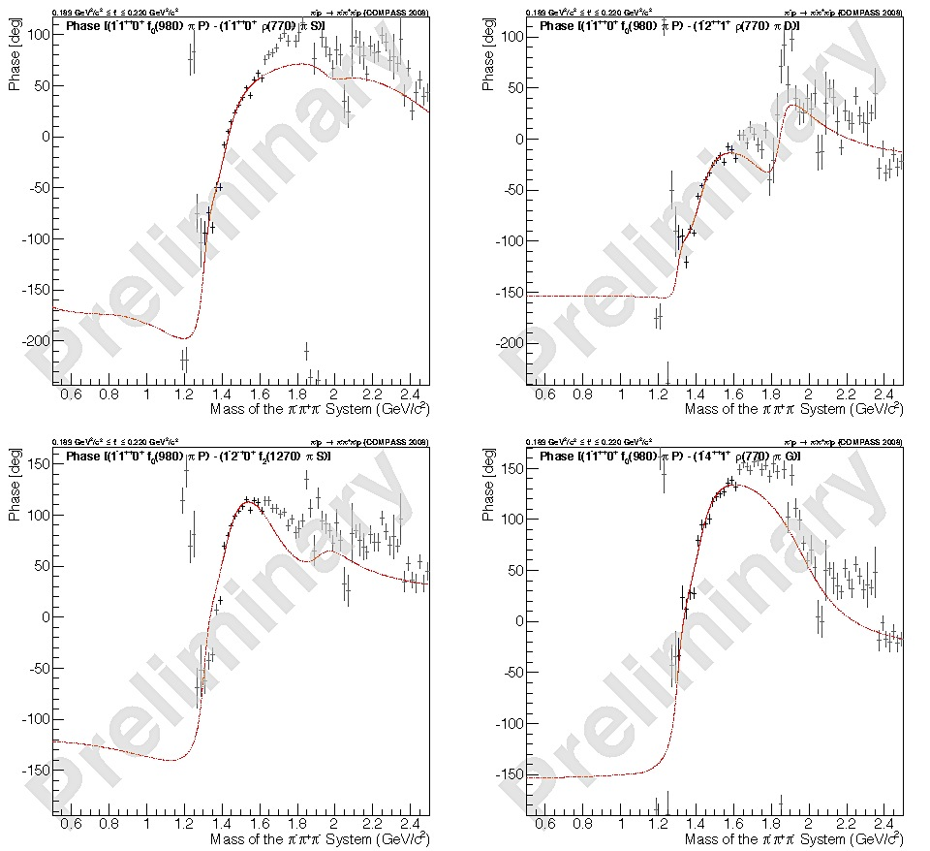
Phase: a₁(1420)
Fit in 11 t-bins:
medium t
fit range
a₁(1420)
a₁’
a₂’
a₄
π₂

Slide 36
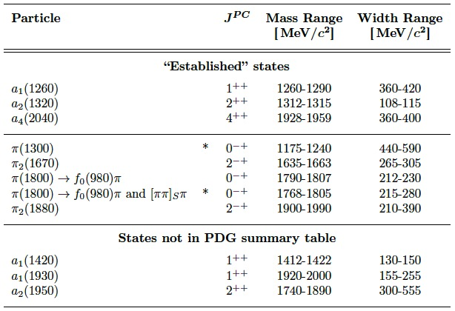




Results of Mass-Dependent Fit
PDG
Compass is a bit on the low side

Slide 37
t’ dependence of amplitudes
amplitudes
production phases
interference minimum
phase jump
non-resonant: b > 10
resonant : b < 10
phases measured w.r.t. a₁(1260)

Slide 38

What about Appt-sharing ?
1⁺⁺ 1⁺ ρπ S
4⁺⁺ 1⁺ ρπ G
2⁺⁺ 1⁺ ρπ D
1⁺⁺ 0⁺ ρπ S
2⁻⁺ 0⁺ f₂ π S
[ππ]_{S} p S
1 x
f₀ π S
2 x

Slide 39

[] = [ππ]_{S}
0⁻⁺0⁺ []π S
2⁻⁺0⁺ []π S
1⁺⁺0⁺ []π S
π⁻π⁺π⁻ road
π⁻π⁺π⁻ road
π⁻π⁺π⁻ road
[ππ]_{S} p S
1 x
[f₀] π S
2 x

Slide 40
(ππ)_{S-wave}
m
Method:
Replace 2-body fixed parametrisation
  e.g. Breit-Wigner/Flatté description of an isobar or (ππ)_{S} (à la Pennington)
  by histogram [2m_{π}, m_{3π}−m_{π}]
Histogram-entries are free parameters
  instead of e.g. 3 isobars with J^{PC} = 0⁺⁺ use n histogram bins of two body mass [m₁₂ , m₁₂ + δm] with these quantum numbers
  δm = 40 MeV/c²
  δm = 10 MeV/c² around f₀(980) (± 80 MeV/c² )
obtain new phase information:
Need of reference wave (analyzer):
  J^{PC} = 1⁺⁺0⁺ ρπ S (wave containing a₁(1260) and a₁’)

Slide 41
Correlation: m_{2π} – m_{3π}
low t
high t

Slide 42
Correlation: m_{2π} – m_{3π}
high t’

Slide 43
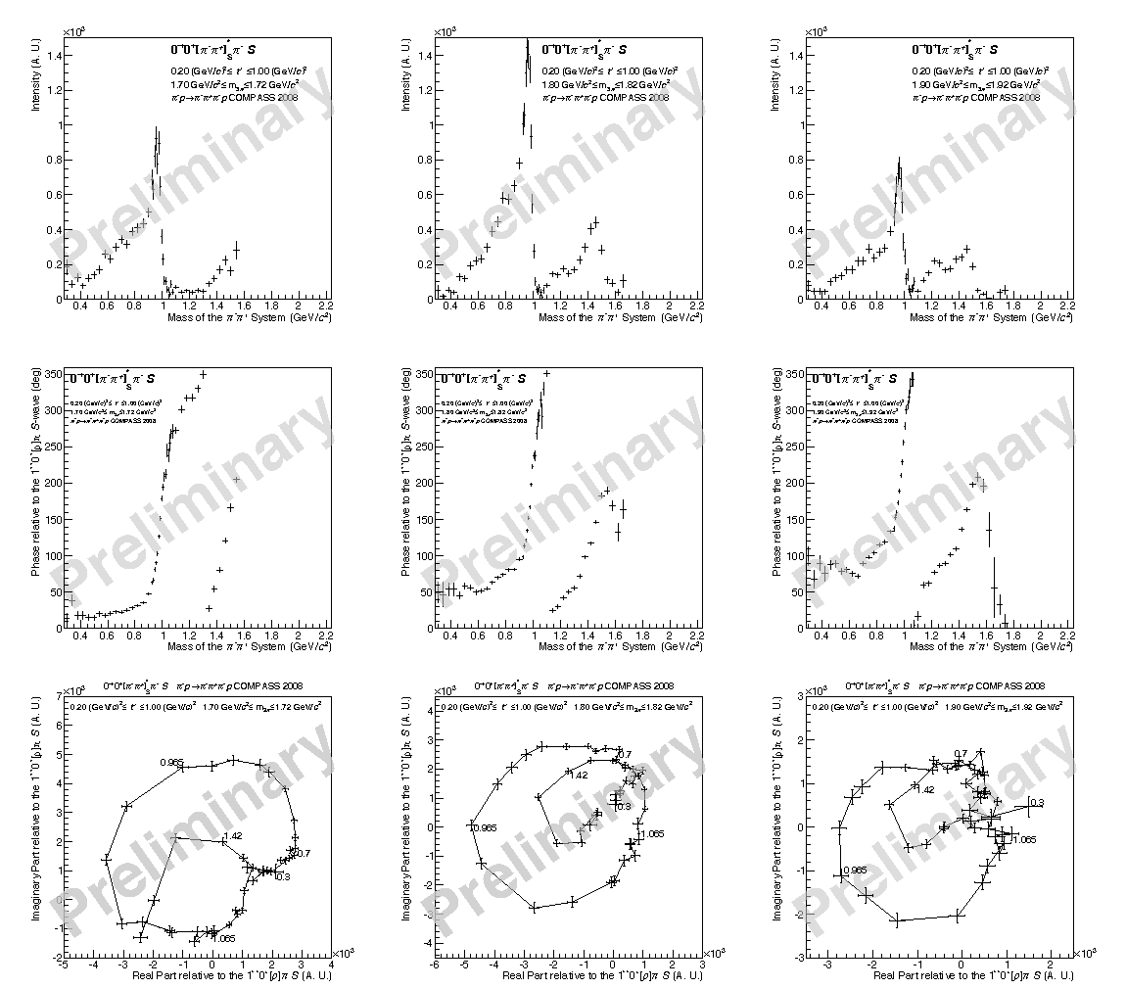
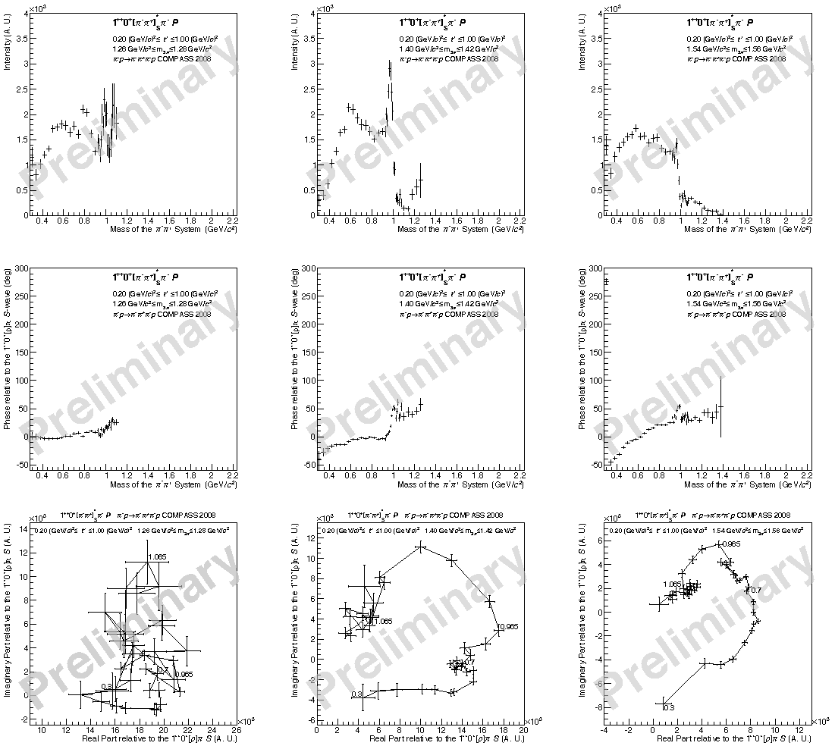
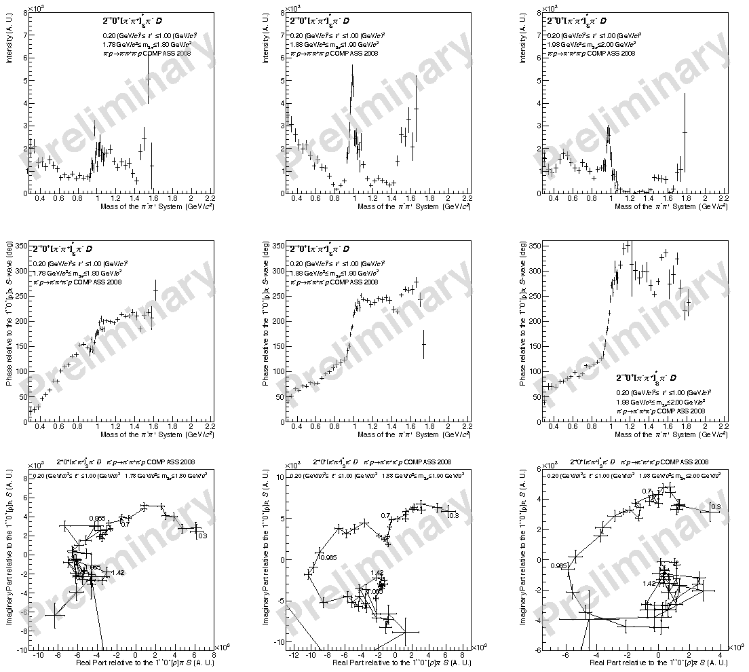
Details on (ππ)_{S-wave}
at π(1800)
at a₁(1420)
at π₂(1880)
ππ_{S} Intensities
in the resonance
region
ππ_{S} phases
in the resonance
region
φ_{production} + φ_{decay}
f₀(980)
f₀(980)
high t’

Slide 44
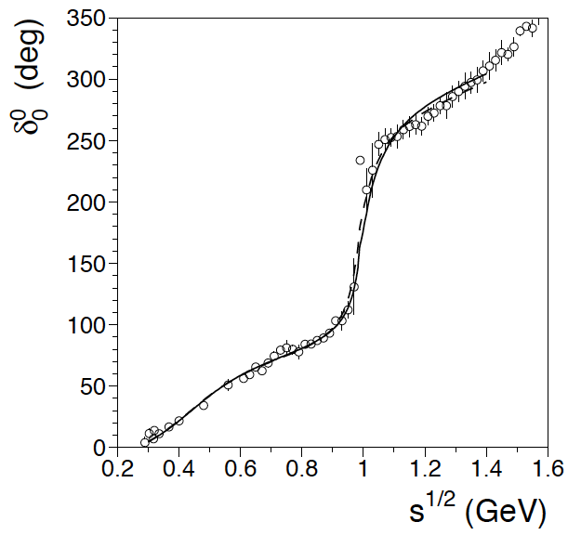
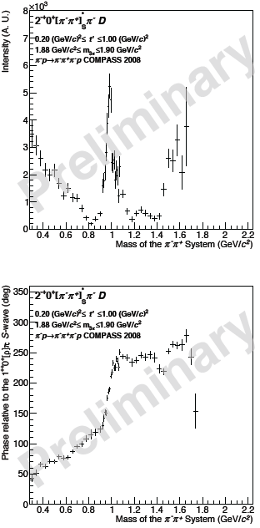
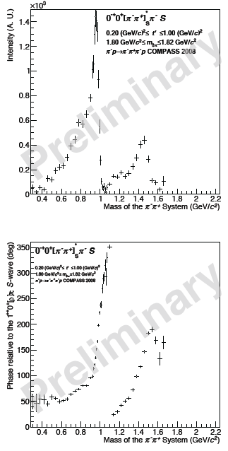
Some intriguing aspects
π⁻ p➝π⁻ π⁺ n
1974/1975
f₀(1370)
K_{e4} (ππνe)
Locher et al.
1997
COMPASS 2⁻⁺
COMPASS 0⁻⁺
f₀(1370) ?
f₀(1500)

Slide 45
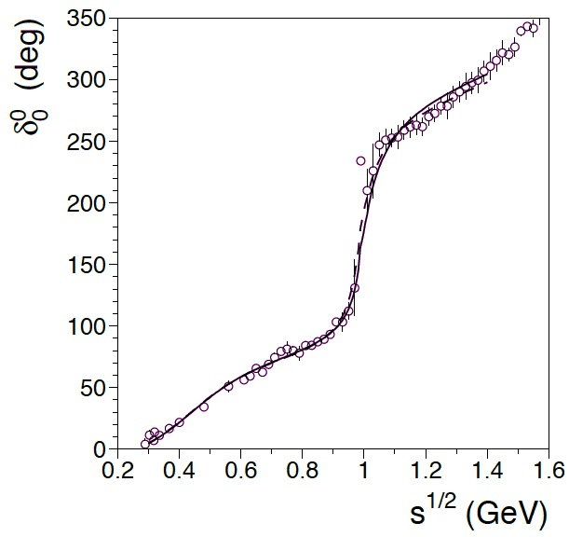
Some intriguing aspects
CERN/Munich
K-decays
Locher
COMPASS 2⁻⁺
COMPASS 0⁻⁺
f₀(1370) ?
f₀(1500)

Slide 46
Conclusion
Establish new “2D” fit method to perform PWA
  mass independent: m_{3π} bins and t’ bins
  Observe “various components” of resonances with different t’-dependencies:
    extract resonance parameters
    Identify non-resonant components
Establish new method to establish shape of isobar-spectrum
  first application: [ππ]_{S}*:
    Shows strong dependence on mother wave
    Shows strong dependence on m_{3π}
    no unique parametrization yet
  Reveals information on scalar isobars
  Reveals different faces of f₀(980)
  Allows to measure phases in decays

Slide 47
Conclusion I
Study of a₁(1260)
  Observe “various components” of a₁(1260) with different t’-dependencies: Strong constraints on resonance parameters (w.r.t. PDG)
  M_{a1(1260)} = 1260-1290 MeV/c² , Γ_{a1(1260)} = 360 – 420 MeV/c²
Find new iso-vector state a₁(1420)
  M_{a1(1420)} = 1412-1422 MeV/c² , Γ_{a1(1420)} = 130-150 MeV/c²
  decay into f₀(980)π in relative P-wave
  observe full phase motion with respect to reference waves
  coupling seems exclusively to f₀(980)
  Phase-behavior of (ππ)_{S} hints to strong ss-component
  Phase behavior opposite to (ππ)_{S} – coupling of π(1800) and π₂(1880) ?
  Nature of a₁(1420) ? Isospin partner of f₁(1420) (considered to be exotic) ?
  Dynamically generated through a₁(1260) ⟷ KK* ⟷ f₀ (980) channel ?

Slide 48
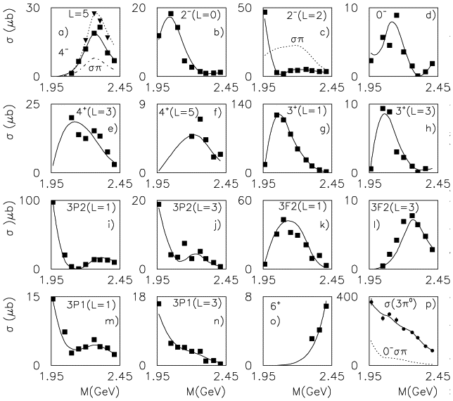
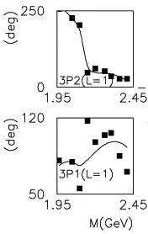
Conclusion II
Sort out higher excitations of a₁ , a₂
States observed in reanalysis of CB-data
  both states found at being at phase-space boundary by Bugg et al.
  COMPASS:
  reasonable constraints on a₁’
  M_{a1(1930)} = 1920-2000 MeV/c² , Γ_{a1(1930)} = 155 – 255 MeV/c²
  poorer constraints on a₂’
  M_{a2(1950)} = 1740-1800 MeV/c² , Γ_{a2(1950)} = 300 – 555 MeV/c²
Radial excitation of π
  π(1800) well known: COMPASS observes decay into f₀(980) and f₀(1500) with two full circles from the Argand-diagram. Shape of f₀(980) and f₀(1500) to be investigated
  Μ_{π(1800)} = 1768-1807 MeV/c² , Γ_{π(1800)} = 215 – 280 MeV/c²
a₂(1950)
a₁(1930)

Slide 49
Conclusion III
Orbital-excitation of π
  π₂(1670) well known: COMPASS observes decay into f₂(1270)
  Μ_{π2(1670)} = 1635-1663 MeV/c² , Γ_{π2(1670)} = 265-305 MeV/c²
  no evidence so far for strong coupling into [ππ]_{S}*
  π₂(1880) : Clear signal observed in f₂ and f₀. Strong coupling to iso-scalar sector
  COMPASS: Decays observed into f₀(980) and f₂(1270)
  Μ_{π2(1880)➝f2(1270) π}= 1900-1990 MeV/c² , Γ_{π2(1880)➝f2(1270) π}= 210-390 MeV/c²
Other mesons:
  a₂(1320) clearly identified:
  M_{a2(1320)} = 1312-1315 MeV/c² , Γ_{a2(1320)} = 108-115 MeV/c²
  a₄(2040) clearly identified:
  M_{a4(2040)} = 1928-1959 MeV/c² , Γ_{a4(2040)} = 360-400 MeV/c²
  comes our lighter and broader than PDG consistent with 2004 and η(’)π

Slide 50
Prospects
Perform fits to 25-20 waves simultaneously (or more)
  fix branching fractions being independent of t’
  Gain stability
  Obtain reliable values for mass, width, branching ratios
  Identify nature of light meson spectrum
Extend de-isobarred analysis to (ππ)_{L=0,1,2}
Perform mass-dependent fits to (ππ)_{L=0,1,2}
  de-convolute spectral function and phases f(M_{2π},M_{3π},φ_{2π},t’)
  de-convolute Deck and rescattering
Perform joint fits for: π⁻π⁺π⁻ and π⁻π⁰π⁰
Other final states 5π, πηη, KK(nπ)..

Slide 51
Sneak Preview on (ππ) S-wave
from J^{PC}= 0⁻⁺
t’
t’

Slide 52
Sneak Preview – Large Fits
Preview to
21 wave-fit
in 2 bins of t’

Slide 53
Preview into πηη

Slide 54
The End
a₁(1420)
a₁’
a₂’
π₂
a₄

Slide 55
Extra Material

Slide 56
Quick Check for “odd” waves
About 5% absorbed
by “odd” waves

Slide 57
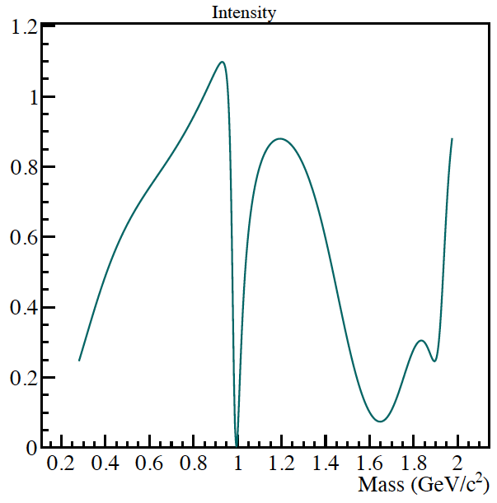
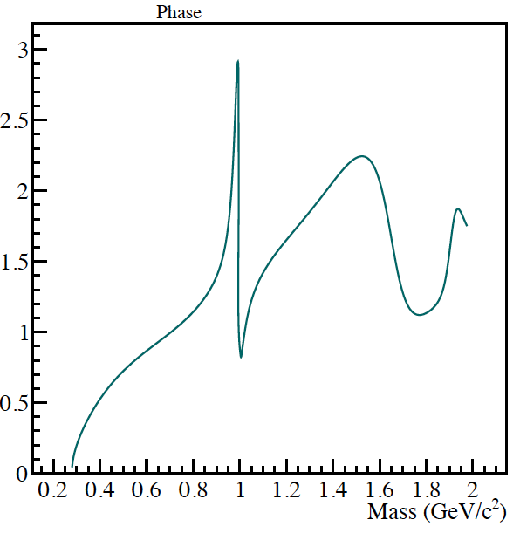
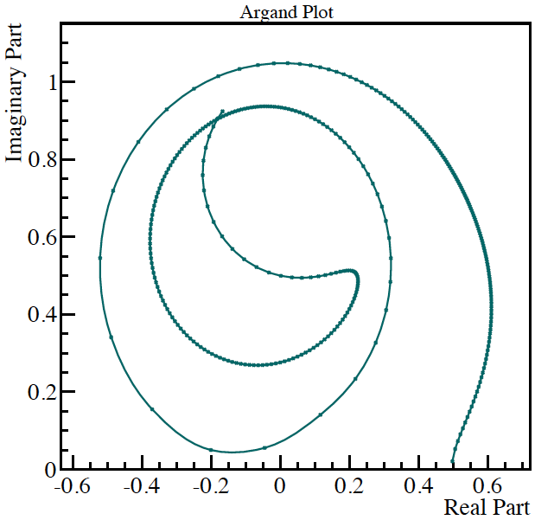
Isobars: Introduction
Kachaev-solution
with f₀(980) removed
for f₀(980): use BES parametrization: as it decays into ππ and KK (threshold effect)

Slide 58
First Conclusions about f₀(980)
f₀(980) observed in 0⁻⁺, 2⁻⁺, and 1⁺⁺ final state
  Shape and phase w.r.t. broad [ππ]_{S}* varies
    0⁻⁺ : [φ(π₁₈₀₀) ~ 70⁰]+[φ(f₉₈₀) ~ 180⁰] - [φ(ππ) ~ 20⁰] = 270⁰
    + [φ(f₁₅₀₀) ~ 150⁰]
    Shape has long tail to low ππ-masses
    1⁺⁺ : [φ(a₁₄₂₀) ~ 130⁰]+[φ(f₉₈₀) ~ -150⁰] - [φ(ππ) ~ -20⁰] = 40⁰
    Shape: sharp peak structure above broad ππ-component
    2⁻⁺ : [φ(π₁₈₈₀) ~ 0⁰]+[φ(f₉₈₀) ~ 150⁰] - [φ(ππ) ~ - 20⁰] = 120⁰
    + [φ(f₁₅₀₀) ~ 0⁰]
    φ(π_{2_1880}) – φ(a₁₉₅₀) ~ - 30⁰ ?
    (requires mass dependent fit around 1.6-2.0 GeV/c²)
    no phase motion at f₀(1500) seen
    Shape: symmetric peak structure
    no broad ππ-component interference
  f₀(980) has (at least) two components and scattering results
  ππ ➝ ππ and ππ ➝ KK show opposite phase
  Interpretation:
    a₁₄₂₀ couples to ss-component
    π_{2_1880} couples to qq-component
    π₁₈₀₀ couples to qq-component

Slide 59
v
v

Slide 60
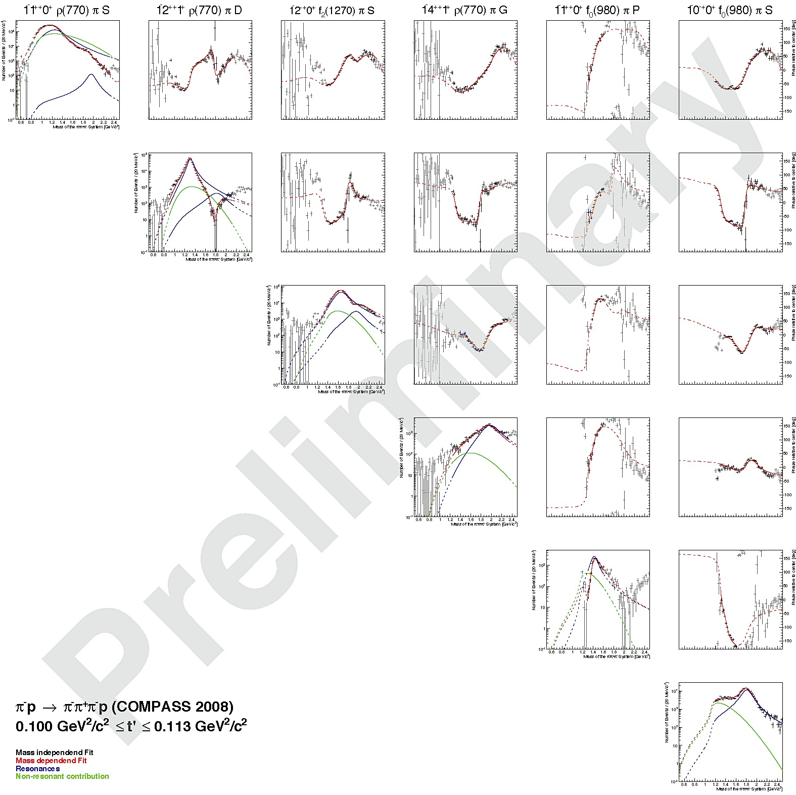
COMPASS Spin-Density Matrix
Reference waves
Interferometry
low t’-slice only

Slide 61

COMPASS Spin-Density Matrix
Reference waves
Interferometry
high t’-slice only

Slide 62





Examples for a₁(1260) and a₂(1420)
CEX reaction at 8 GeV : π⁻ p → π⁰ π⁺ π⁻
Deck
a₁
a₂
incl. Deck

Slide 63
Study of (ππ=f₉₈₀)* 1⁺⁺
_{S-wave}
low t’
high t’
f₀(980) correlated with a₁(1420)
non-resonant contributions at low t’
warning !! just intensity cuts, amplitude selection
☞ mass dependent fit

Slide 64


How to reconstruct an Image
Bright field microscopy
maps distribution of
imaginary part of refractive
index
Peak hunting
Phase contrast microscopy
maps distribution of complex
refractive index modulation
using interference effects
Dalitz plot analysis
n=1-δ+iβ
analyzer
grating
phase
grating
with X-rays:
Re(n) < 1
Phase shift translated into deflection
detect via X-ray grating
Measure with reference(analyzer) grating

Slide 65

Add more dynamics
Optical methods:
If you have enough lasers.. you can add color to your phase shift holography
solves sign of phase shift ambiguities
useful for recording dynamic processes
Compass: Combine results at different t’

Slide 67
Non-resonant processes
Rescattering
Deck
π⁻
π⁺
π⁺
π⁻
π⁻
ρ, σ
π⁻
p
ρ, σ
p
ρ, σ
ρ, σ
P
R
π⁻
π⁻
p
p

Slide 68
(ππ)*_{S-wave} 2⁻⁺
below resonance
at π₂(1880)
above resonance
high t’

Slide 69
(ππ)*_{S-wave} 1⁺⁺
below resonance
at a₁(1420)
above resonance
high t’

Slide 70
(ππ)*_{S-wave} 0⁻⁺
below resonance
at π(1800)
above resonance
f₀(980)
f₀(1500)
high t’

Slide 71







Discussion of ππ−Phases
2⁻⁺0⁺f₀(980) π D
2⁻⁺0⁺f₀(980) π D
Production phase
using f₀(980)
not for release
ππ_{S} Intensities
in the resonance
region
ππ_{S} phases
in the resonance
region
φ_{production} + φ_{decay}

Slide 72
(ππ)*_{S-wave} 0⁻⁺
below resonance
at π(1800)
above resonance
f₀(980)
f₀(1500)
high t’

Slide 73




(ππ)_{S-wave}
absorb complex strength functions f_{k} into
write intensity as:
and fit f_{k} :
  for each 2-body mass bin k (bin width variable)
  for each 3-body mass bin m_{X} (bin width 20 MeV/c²)
Determine phase as usual : w.r.t.
Mass dependent fit:
  use anchor wave with parametrization of 2π-isobars
  use model for 3π-isobars and 2π-isobars:

Slide 74

Mass distributions
m_{3π}
m_{2π}
m_{3π}
rejected by CP-cut
used for analysis
after all cuts
m_{3π}
m_{2π}

Slide 75


Technical plots
z-vertex
x/y-vertex
RICH before
PID cuts

Slide 76
# of parameters
6 waves: (9 BW + 6 NR)*11(t’-bins)=165 couplings
  for each complex coupling: 2 parameters
  minus 11 since 1 coupling for each t’ bin is real
  319 parameters
18 parameters for BW
15 parameters for NR
Total: 352 real parameters

Slide 77

Mass dependent fit
Use only lowest m = 0,1 waves (so far)
Model:
2 resonances : a₁(1260) and a₁´
2 resonances : a₂(1320) and a₂´
1 resonance : a₄(2040)
2 resonances : π₂(1670) and π₂´
1 resonance : a₁(1420)
1 resonance : π (1800)
1⁺⁺1⁺ρπ S
2⁺⁺0⁺ ρπ D
4⁺⁺1⁺ ρπ G
2⁻⁺0⁺ f₂ π S
1⁺⁺f₀(980) π P
0⁻⁺f₀(980) π S
+

Slide 78


Fit Functions
Resonances
non-resonant
big waves
small waves

Slide 79

Mass dependent fits
Fit in 11 t-bins
4⁺⁺1⁺ ρπ D
incoherent sum

Slide 80

Mass dependent fits
Fit in 11 t-bins
4⁺⁺1⁺ ρπ D
incoherent sum

Slide 81

Mass dependent fits
Fit in 11 t-bins
2⁻⁺0⁺ f₂ π S
incoherent sum

Slide 82

Mass dependent fits
Fit in 11 t-bins
2⁻⁺0⁺ f₂ π S
incoherent sum

Slide 83

Mass dependent fits
Fit in 11 t-bins
0⁻⁺0⁺ f₀(980) π S
incoherent sum

Slide 84


Data-MC comparison
low t’
3π
2π
Gottfried-Jackson frame
Helicity frame
Gottfried-Jackson frame
Helicity frame

Slide 85


Data-MC comparison
high t’
3π
2π
low masses
Gottfried-Jackson frame
Helicity frame
Gottfried-Jackson frame
Helicity frame

Slide 86
Quick Check for “odd” waves
About 5% absorbed
by “odd” waves

Slide 87
Mass-dependent fit (ππ)_{S-wave}
and fit decay amplitudes f_{k} :
  for each 2-body mass bin k (bin width variable: 10-20 MeV/c²)
  for each 3-body mass bin m_{X} (bin width 20 MeV/c²)
Determine phase as usual : w.r.t.
Mass dependent fit:
  use anchor wave with parametrization of 2π-isobars
  use model for 3π-isobars and 2π-isobars:
non-resonant
anchor wave
j = 1: 0 ⁻ ⁺ j = 2: 1⁺ ⁺

Slide 88

Mass independent fit

