Slide 1
experiment NA58
The COMPASS experiment at CERN
Oleg Kouznetsov JINR, Dubna
On behalf of the COMPASS Collaboration

Slide 2

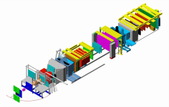
Lake LEMAN
LHC
COMPASS
CNGS
Gran Sasso
732 km
CERN (France)
N
SPS
CERN (Suisse)

Slide 3
COmmon Muon and Proton Apparatus
for Structure and Spectroscopy
~210 physicists
11 counties 29 Institutes
COMPASS I 2002-2011
Hadron beam
Muon beam

Slide 4
COmmon Muon and Proton Apparatus
for Structure and Spectroscopy
~210 physicists
11 counties 29 Institutes
COMPASS I 2002-2011
Hadron beam
Muon beam
Unpolarised
physics
Polarised
physics

Slide 5
COmmon Muon and Proton Apparatus
for Structure and Spectroscopy
~210 physicists
11 counties 29 Institutes
COMPASS I 2002-2011
Hadron beam
Muon beam
Unpolarised
physics
Polarised
physics
Trans
polar. .
Long.
polar.
Exc. V meson production
Λ hyperon polarization
Quark den- sities Δq
Heavy hyperons
Quark den- sities Δ_{T}q
Gluon den- sities Δg

Slide 6
COmmon Muon and Proton Apparatus
for Structure and Spectroscopy
~210 physicists
11 counties 29 Institutes
COMPASS I 2002-2011
Hadron beam
Muon beam
Unpolarised
physics
Polarised
physics
Coulomb
production
Central production
Diffractive
scattering
Trans
polar. .
Long.
polar.
Exc. V meson production
Λ hyperon polarization
Quark den- sities Δq
Heavy hyperons
Quark den- sities Δ_{T}q
Gluon den- sities Δg

Slide 7
COmmon Muon and Proton Apparatus
for Structure and Spectroscopy
~210 physicists
11 counties 29 Institutes
COMPASS I 2002-2011
Hadron beam
Muon beam
Unpolarised
physics
Polarised
physics
Coulomb
production
Central production
Diffractive
scattering
Trans
polar. .
Long.
polar.
Polarizabilities
Exc. V meson production
Glueballs
Spectroscopy
Λ hyperon polarization
Quark den- sities Δq
Hybrids
Multiquarks
Heavy hyperons
Quark den- sities Δ_{T}q
Gluon den- sities Δg

Slide 8

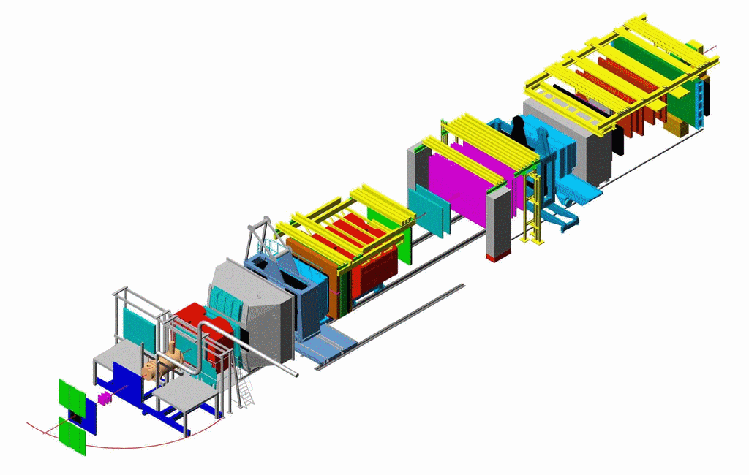
COMPASS in μ run
NIM A 577(2007) 455
Trigger Hodoscopes
ECALs
& HCALs
MWPCs
50 m
SM2
RICH
μ Filters/Walls
SM1
Drift
Chambers
Straws
GEMs
160 GeV μ
190 GeV π
Si
Micromegas
SciFi
veto

Slide 9
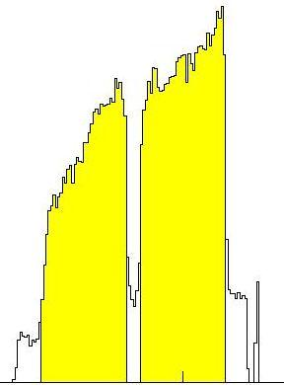
COMPASS in μ run
NIM A 577(2007) 455
⁶LiD target μ run
Trigger Hodoscopes
ECALs
& HCALs
MWPCs
50 m
SM2
RICH
μ Filters/Walls
SM1
Drift
Chambers
Straws
GEMs
160 GeV μ
190 GeV π
Si
Micromegas
SciFi
veto

Slide 10
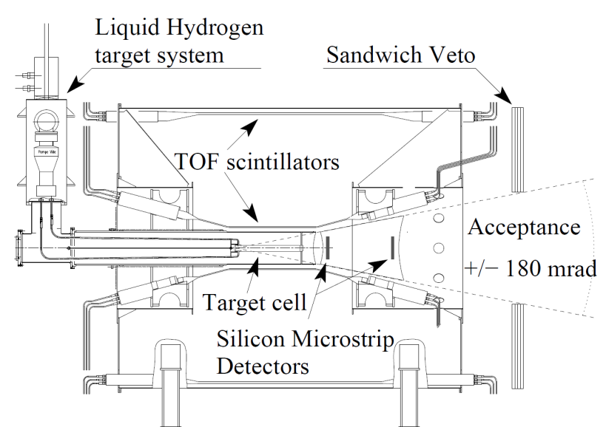
COMPASS in μ run
NIM A 577(2007) 455
⁶LiD target μ run
Trigger Hodoscopes
ECALs
& HCALs
MWPCs
50 m
SM2
RICH
μ Filters/Walls
SM1
LH₂ target π run
Drift
Chambers
Straws
GEMs
160 GeV μ
190 GeV π
Si
Micromegas
SciFi
veto

Slide 11
Outline
Part I: nucleon spin structure

Slide 12
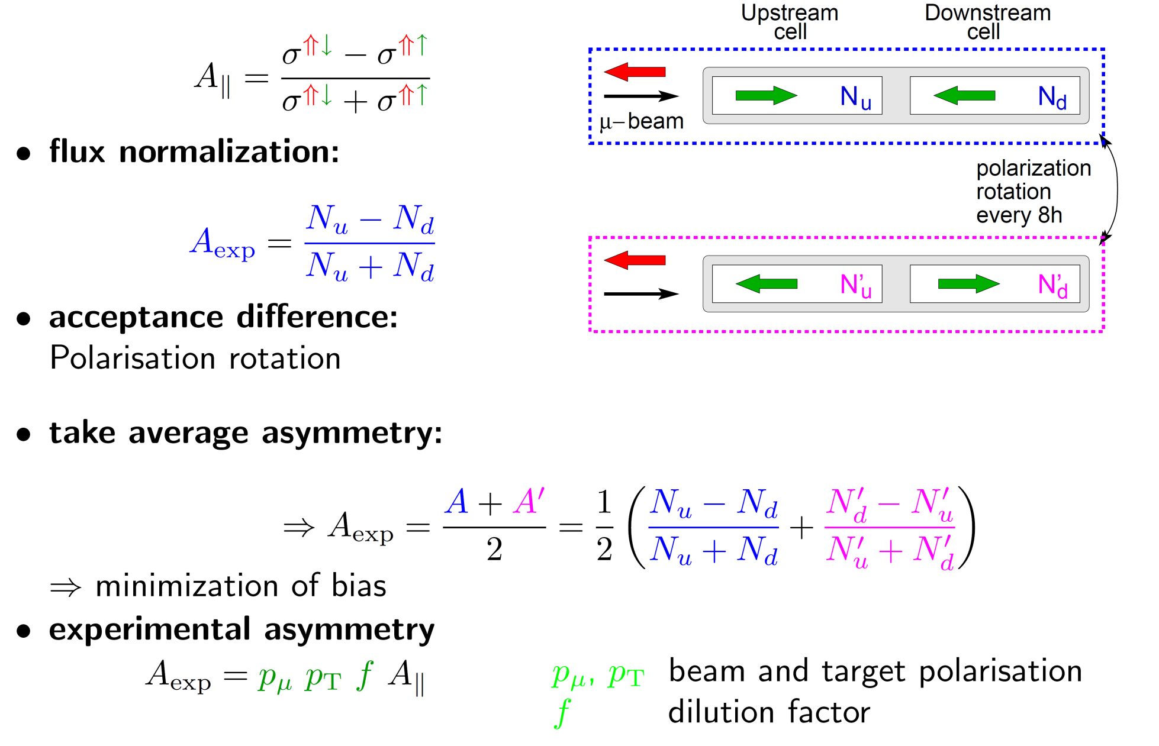
Outline
Asymmetry measurement
Part I: nucleon spin structure

Slide 13
Outline
Data taken
2002-2004:160 GeV μ on ⁶LiD L,T
2006 :160 GeV μ on ⁶LiD L
2007 :160 GeV μ on NH₃T
2010 :160 GeV μ on NH₃ T
:200 GeV μ on NH₃ L
Part I: nucleon spin structure

Slide 14
Outline
Data taken
2002-2004:160 GeV μ on ⁶LiD L,T
2006 :160 GeV μ on ⁶LiD L
2007 :160 GeV μ on NH₃T
2010 :160 GeV μ on NH₃ T
:200 GeV μ on NH₃ L
Part I: nucleon spin structure
Part II: hadron reactions

Slide 15
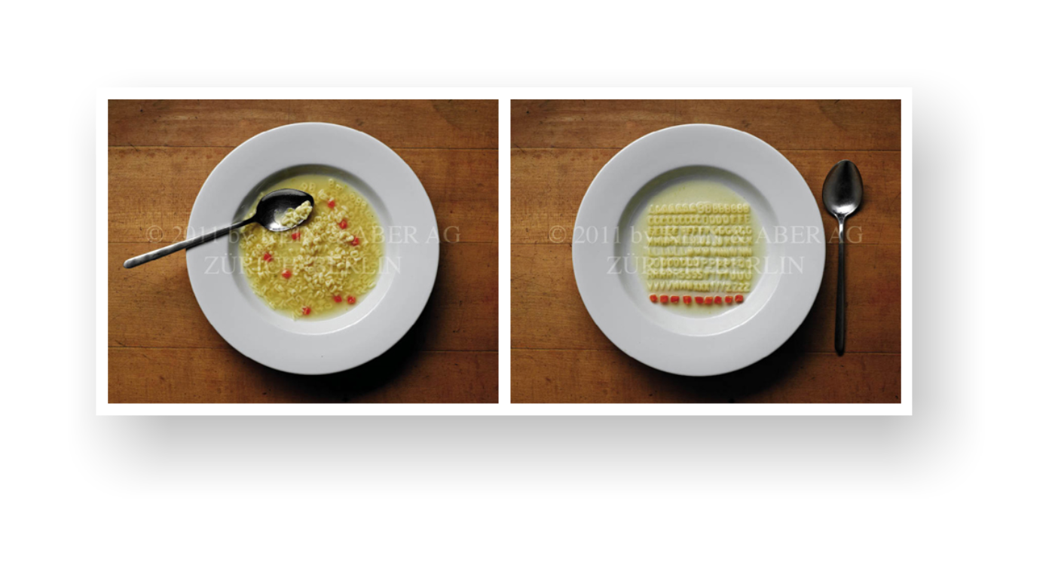
Outline
Data taken
2002-2004:160 GeV μ on ⁶LiD L,T
2006 :160 GeV μ on ⁶LiD L
2007 :160 GeV μ on NH₃T
2010 :160 GeV μ on NH₃ T
:200 GeV μ on NH₃ L
Part I: nucleon spin structure
Part II: hadron reactions
Before and After PWA
This picture was taken from the talk of S.Paul who has been inspired by M.Pennington

Slide 16
Outline
Data taken
2002-2004:160 GeV μ on ⁶LiD L,T
2006 :160 GeV μ on ⁶LiD L
2007 :160 GeV μ on NH₃T
2010 :160 GeV μ on NH₃ T
:200 GeV μ on NH₃ L
Part I: nucleon spin structure
190 GeV π⁻, μ on Pb (2 weeks )
2008 190 GeV π⁻ on LH₂
2009 190 GeV p,π⁺ on LH₂, Pb, Ni, W
Part II: hadron reactions

Slide 17
Outline
Data taken
2002-2004:160 GeV μ on ⁶LiD L,T
2006 :160 GeV μ on ⁶LiD L
2007 :160 GeV μ on NH₃T
2010 :160 GeV μ on NH₃ T
:200 GeV μ on NH₃ L
Part I: nucleon spin structure
190 GeV π⁻, μ on Pb (2 weeks )
2008 190 GeV π⁻ on LH₂
2009 190 GeV p,π⁺ on LH₂, Pb, Ni, W
Part II: hadron reactions
  2112, SPS/LHC shutdown, 2015, 2016, 2017
  Part III: COMPASS-II or our future

Slide 18
Part I: nucleon spin structure
 | 1970 | 1980 | 1990 | 2000
SLAC
CERN
DESY
JLab
RHIC
E80
E130
E142/3 E154/5
EMC
SMC
COMPASS I
HERMES
CLAS/HALL-A
Phenix/Star
A worldwide effort since decades

Slide 19
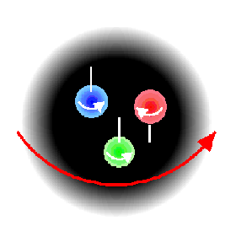
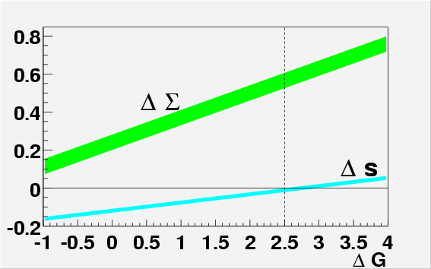
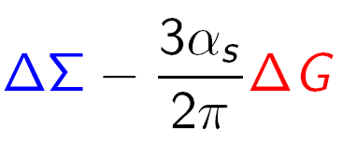
Nucleon spin puzzle since 1988
½= ½ΔΣ + ΔG + <L_{z}>
quarks gluons orb. mom.
“past” “present” “future” experiments
Measurement of ΔG is important for two reasons:
- as an element of nucleon spin puzzle - possible role of axial anomaly in the a₀ interpretation (a₀ ≠ ΔΣ)
a₀ (= ΔΣ) is measured to be
~0.30-0.35 instead of expected 0.6
a₀ =

Slide 20
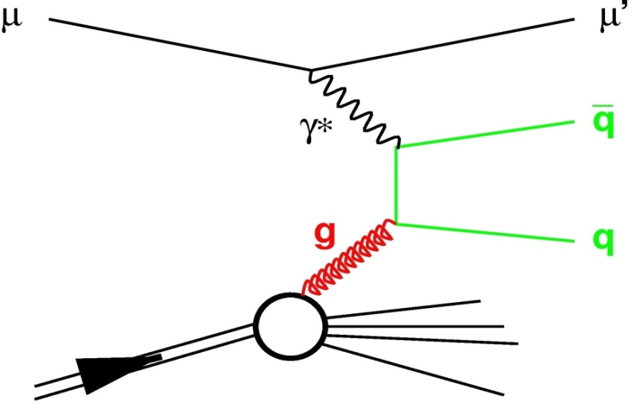
Gluon polarisation Δg/g from μ N scattering
Photon Gluon Fusion (PGF)
Open Charm
→ clean channel
→ but experimentally difficult
σ ≈ 100 nb… limited statistics
High-pT Hadron Pairs
→ easy to get a statistics
→ but physical background
2 cases Q² <1 GeV² (90% stat) & Q² > 1 GeV² (10% stat)
N
A|| = R_{PGF} <a_{LL}> <Δg/g> + A_{bkg}
Spin asymmetry of cross sections for longitudinal polarizations of beam and target, parallel and antiparallel

Slide 21
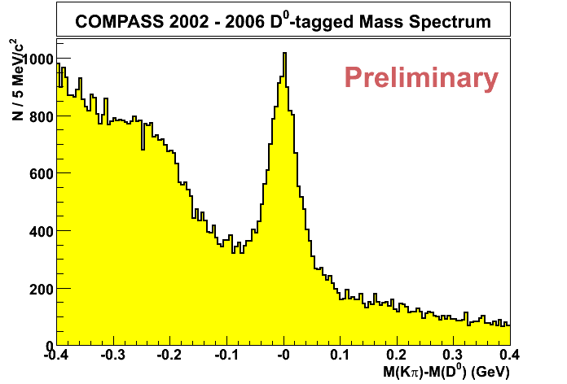
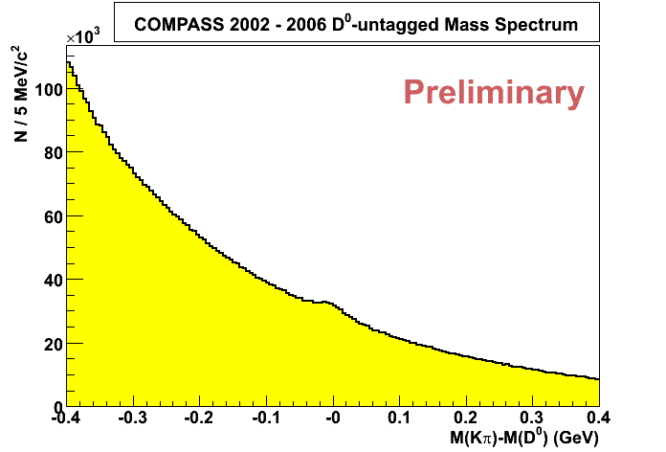
Open charm (example)
D* tag
D⁰ → K π
N_{D}=8650
D⁰→ K π π⁰
only
Also were used:
D⁰ ➔ Kπππ
D⁰ ➔ Kππ⁰ (no π⁰ rec)
D⁰ ➔ K_{sub}π (no K ID)
Total number: 86250 D⁰ mesons
D⁰ → K π
no D* tag
N_{D}=37750

Slide 22
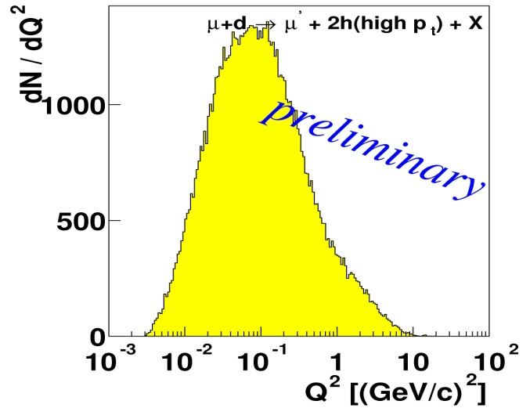
high p_{T} hadron pairs
- considerably higher statistics … but physical background, resolved photons processes (last 4) are important only
for low Q²
10% of
statistics
QCD-
Compton
+
LO DIS
+
qg
gq
qq
gg
+
+

Slide 23

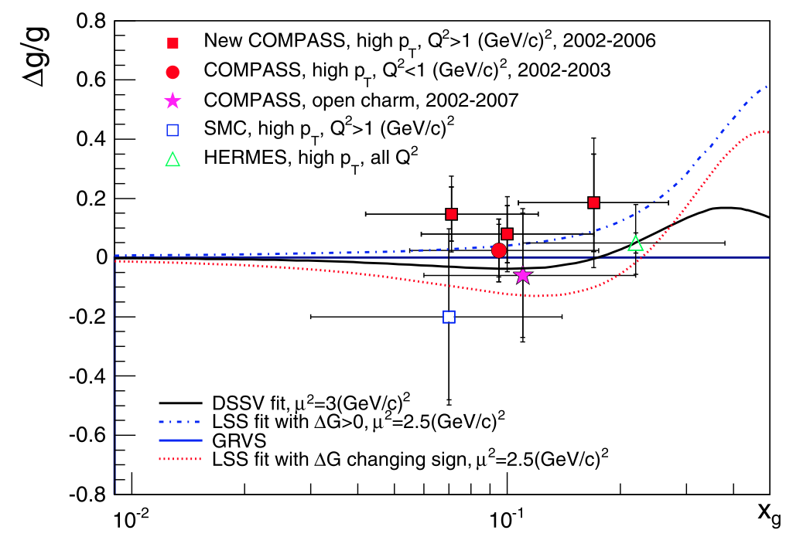
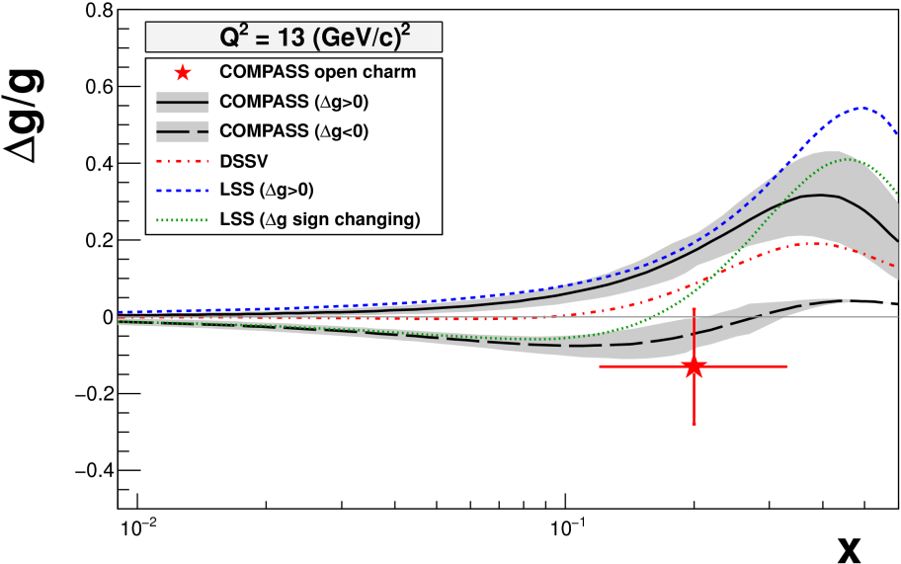
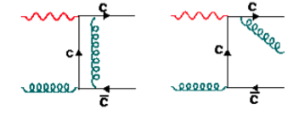
5 points from COMPASS
World direct measurements on Δg/g in LO
Phys. Lett. B 718 (2013) 922
Δg/g(x=0.09) = 0.125 ± 0.06 ± 0.63
All measurements compatible with 0
Open charm NLO (first time)
PRD 87 (2013) 052018
Δg/g(x=0.2) = -0.13 ± 0.15 ± 0.15

Slide 24
Another
results from muon beam data
Taken from the “COMPASS status report to SPSC” June 25
g₁^{p} spin structure function 200 GeV (2011) L
π/K multiplicities for quark FF
Collins/ Sivers asymmetries for π / K T
2-h asym. ( π/ K) + 2-h multiplicities T
Six TT-spin asymmetries (TMDs) T
Cross section: high p_{T} hadron g-prod.
Σ(1385) and Ξ(1321) production in DIS

Slide 25
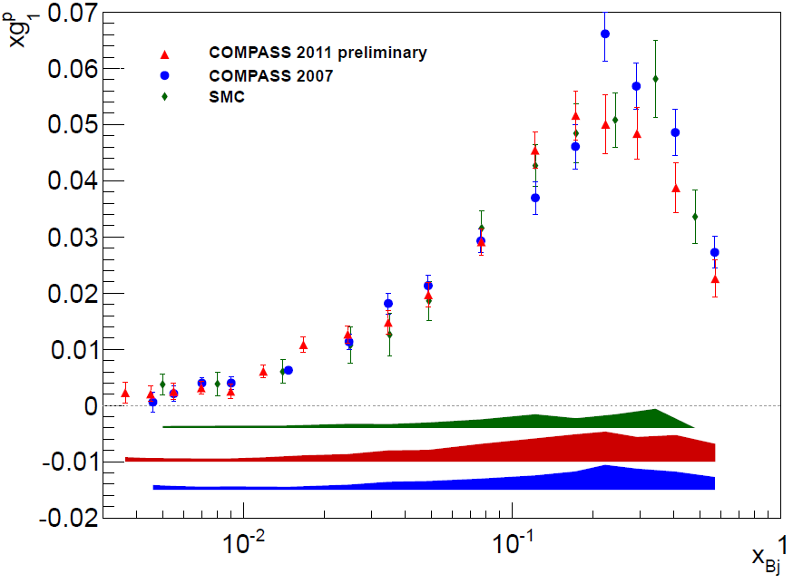
g₁^{p} spin structure function
2011 data - First polarised DIS data at 200 GeV GeV

Slide 26
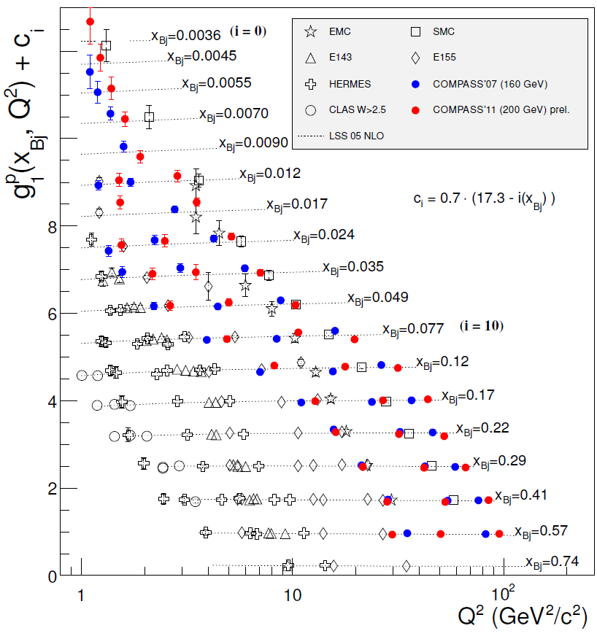
g₁^{p} world data
COMPASS 200 GeV
COMPASS 160 GeV
--- LSS QCD fit
Large set of data, extending to lower x and higher Q² region
Will be included in QCD global analyses

Slide 27
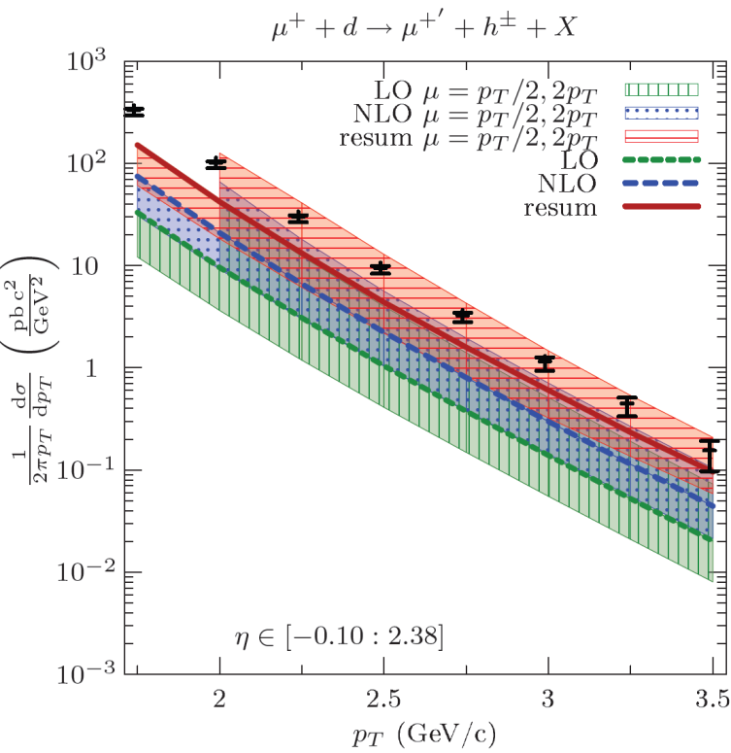
High p_{T} hadron photo production cross-section
Absolute cross-section measurement
μ d → μ’ h^{+/-} X
2004 data, 4 weeks
pQCD calculation with resummation ‘all orders’ (soft gluons, leading logs)
--- Resummation
--- NLO
--- LO
Bands= scale uncertainty
De Florian, Pfeuffer; Schaeffer, Vogelsang, APS/123-QED
Data /Theory in agreement over 4 orders of magnitude

Slide 28
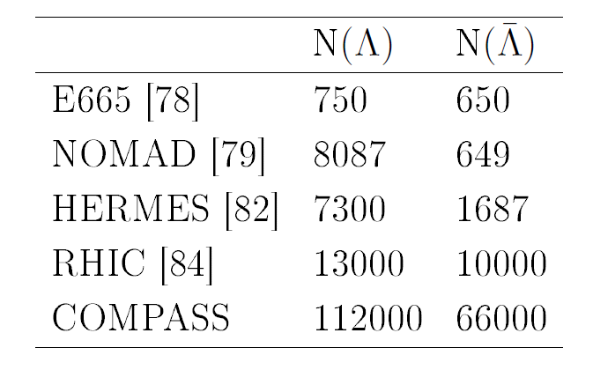
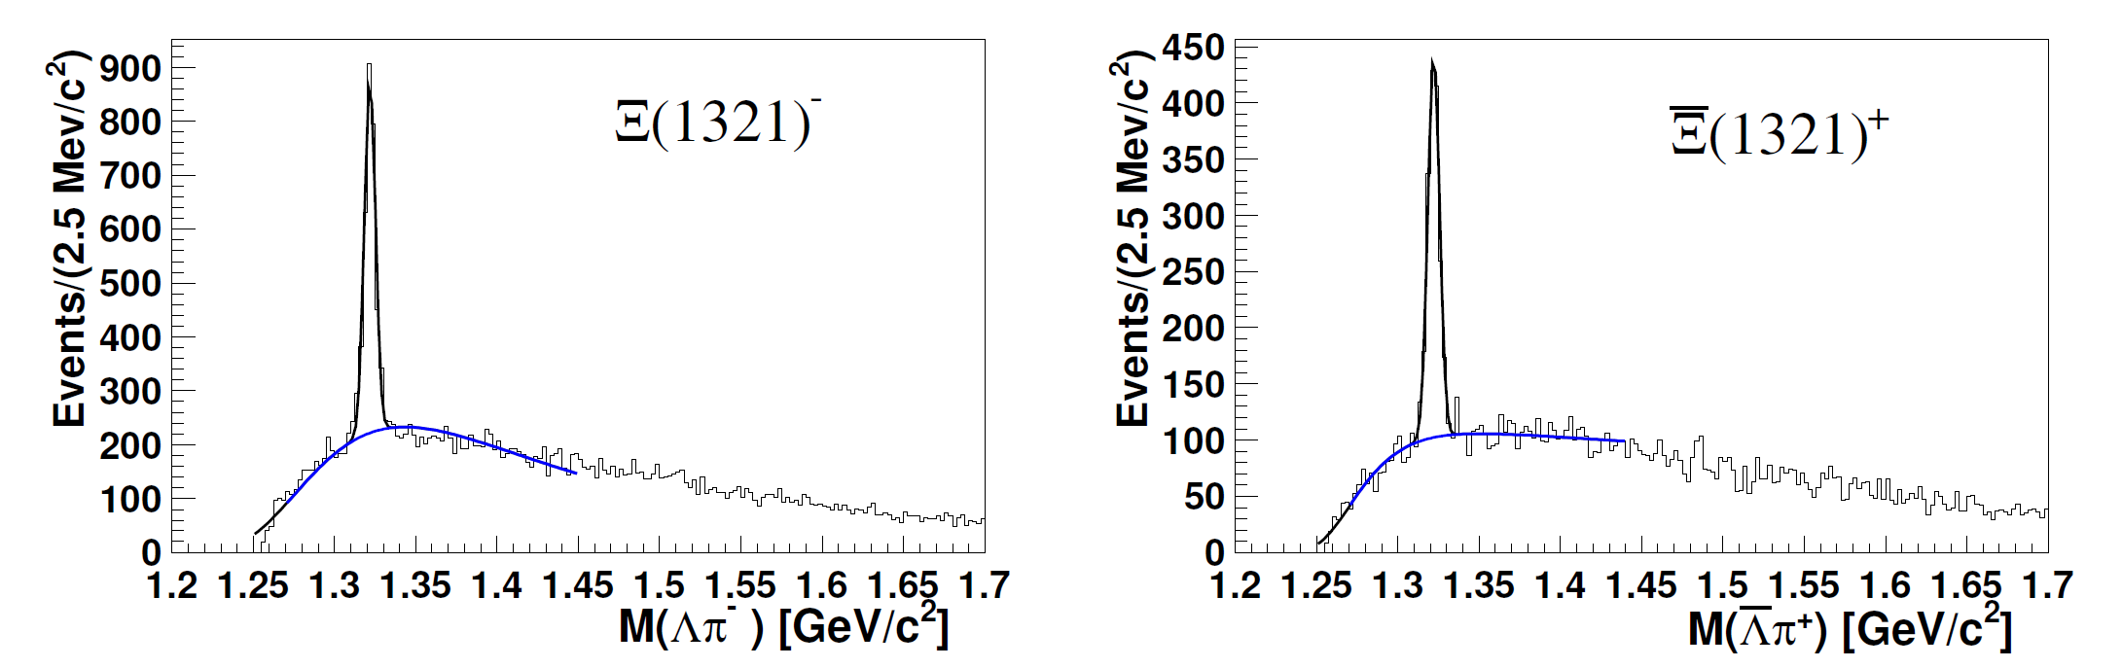
Σ(1385) and Ξ(1321) hyperon and antihyperon production in DIS (1)
Decay channel Σ(1385), Ξ(1321) ➔ Λπ
hep-ex/1304.0952 accepted by EPJC for publication
Best Λ hyperon statistics
Example ➔ Ξ(1321) signal
2320 ± 68
1147 ± 49.

Slide 29
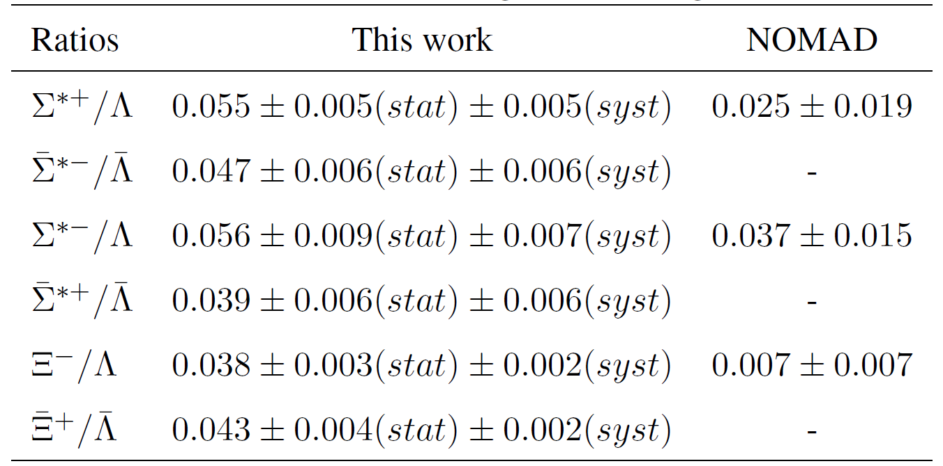
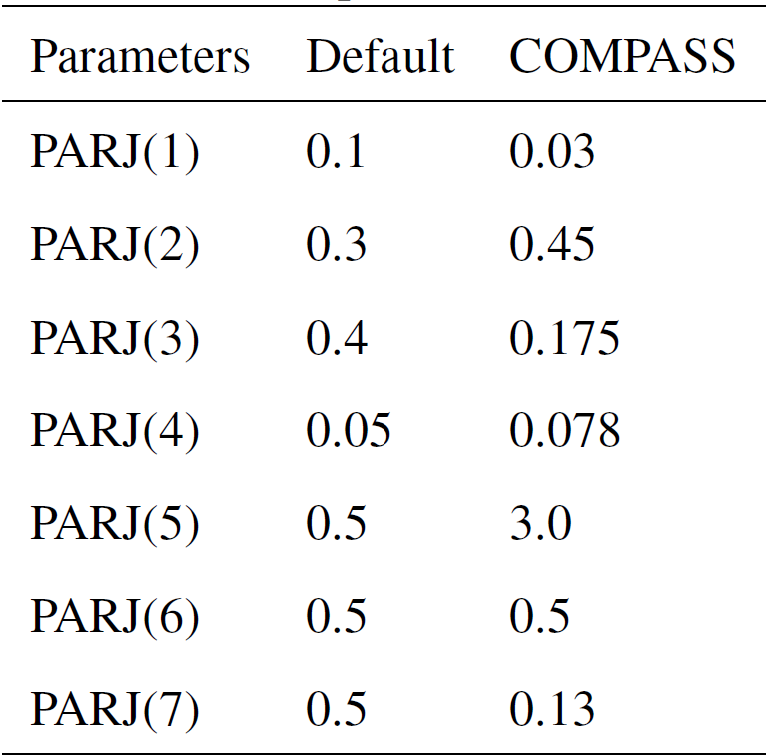
Σ(1385) and Ξ(1321) hyperon and antihyperon production in DIS (2)
First time the yields of antihyperons were measured in DIS
Measured ratios
Tuning of LEPTO/JETSET parameters related to the strange baryon productions was done
fraction of indirectly produced Λ(anti-Λ) was found to be 37(32)%

Slide 30
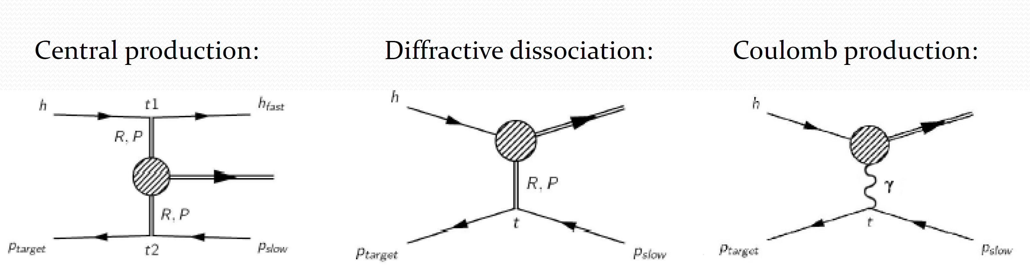
Part II: Hadron reactions
Gluon-rich environment
Rapidity gap
Spin-exotic mesons
Forward kinematics
Test of ChPT
Radiative widths
2009 run
2008 run
2012 run

Slide 31
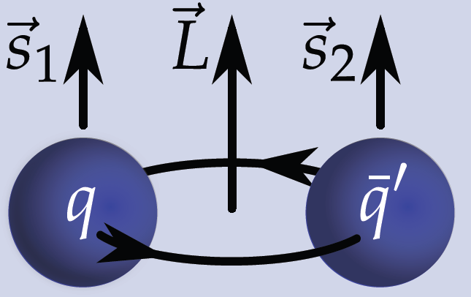
Mesons in the Constituent Quark Model
Spin-parity rules for bound system
Quark spins couple to total intrinsic spin
S = 0 (singlet) or 1 (triplet)
Relative orbital angular Momentum
and total spin couple to
meson spin
Parity P = (_1)^{L+1}
Charge conjugation C = (_1)^{L+S}
Forbidden ➔J^{PC} = 0⁻⁻ , 0⁺⁻, 1⁻⁺, 2⁺⁻ , 3⁻⁺ , . . .
QCD allows for states beyond the CQM
Hybrids , glueballs , multi-quark states
“Exotic” mesons have quantum numbers forbidden for
Particularly interesting: J^{PC}-exotic states

Slide 32
From old experiments: hybrids with J^{PC} = 1⁻⁺
Light meson sector exotics J^{PC}=1⁻⁺:
π₁(1400)
  (E852, VES)
  (Crystal Barrel)
  (Crystal Barrel)
π₁(1600)
  (E852, VES)
  (Crystal Barrel)
π₁(2000)
  (Crystal Barrel)
The identification of exotics demands complete information on all neighbouring states and thus requires in particular:
• Reconstruction of final states containing both neutral and charged particles
• Observation of the same meson resonance in several different channels
• Production of resonances in different reactions
resonant nature controversial...

Slide 33
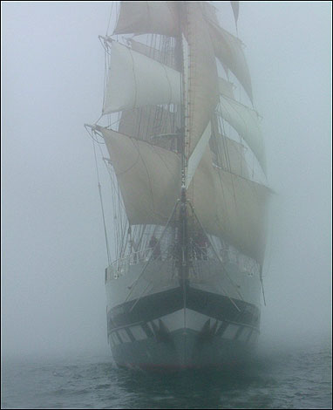
Hadron reactions: processes & beam & statistics
π⁻ p → π⁺ π⁻ π⁻ and π⁰π⁰ π⁻ (2008/2009 data)
π⁻ p → 5π-final state at low four-momentum transfer (2004 data)
π⁻ p → ηπ and η’π (2008/2009 data)
π⁺ π⁻ in central production pp → p_{fast}π⁺π⁻p_{slow} (2009 data)
Spectroscopy using initial/final states with strangeness
Beam intensity: 5·10⁶ had/s
Negative: 96% π, 3.5% K Positive: 75% p, 25% π
  A large amount of data were collected with hadron beam in 2008/2009 (10 – 100 times world statistics).
The hybrids, glueballs , multi-quark states are still “terra incognita”

Slide 34
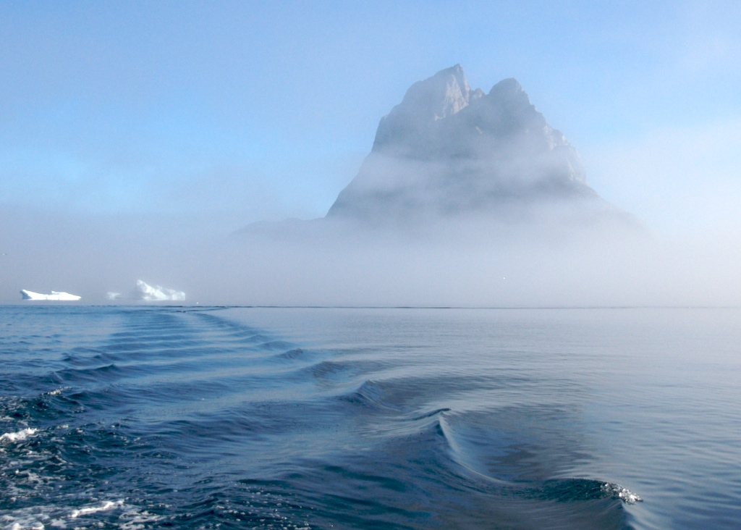
π₁(1600)

Slide 35
π₁(1600)

Slide 36
π₁(1600)

Slide 37
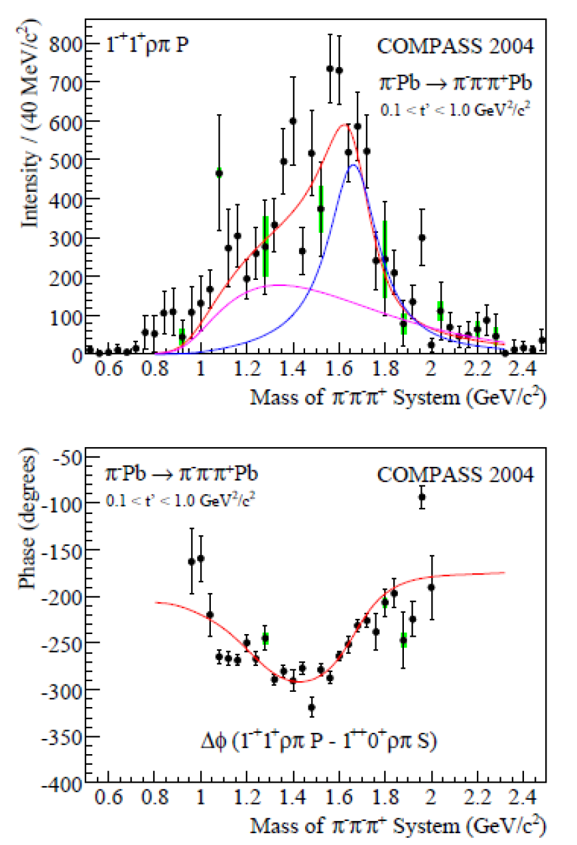
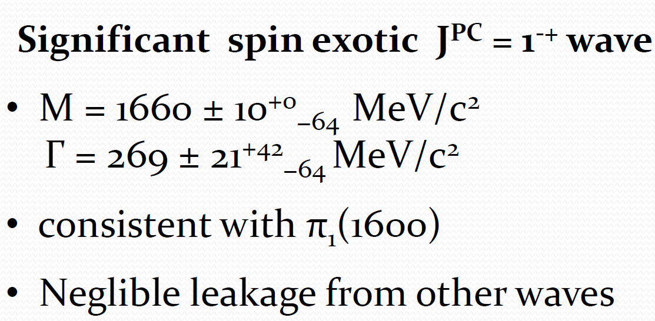
Diffractive pion dissociation ➔ exotic π₁(1600) state
COMPASS, Phys. Rev. Lett. 104 (2010) 241803
PWA analysis of 420000 events
mom transfer 0.1 < t’< 1 (GeV/c)²
quasi-free nucleons in Pb
a₁(1260), a₂(1320) and π₂(1670) are clearly visible

Slide 38
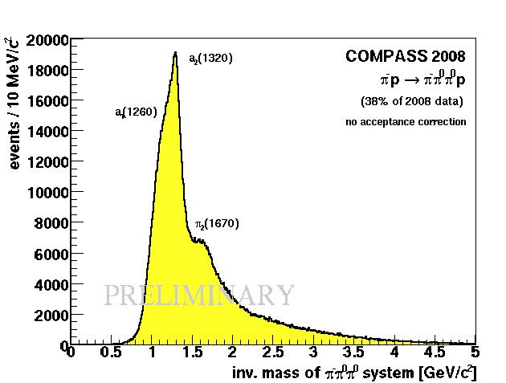
Diffractive dissociation: 3π final states
420k events
96M events
> 2.4M events
Target: 3 mm Pb
Trigger: Multiplicity
No RPD
Target: 40 cm LH₂
Trigger: Recoil proton
RPD
Cross-check:
  tracking vs
  ECAL
Search for exotic J^{PC}=1⁻⁺ in all 3 samples

Slide 39
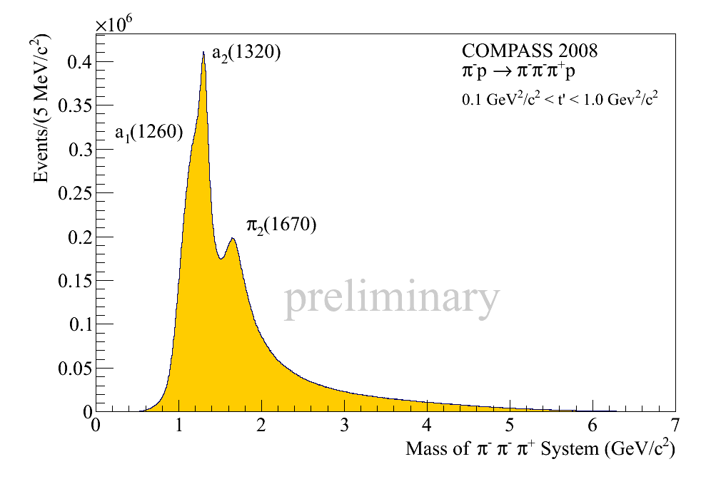
Difractive dissociation: π⁻ p → π⁻ π⁻ π⁺ p
96M exclusive events (2008)

Slide 40
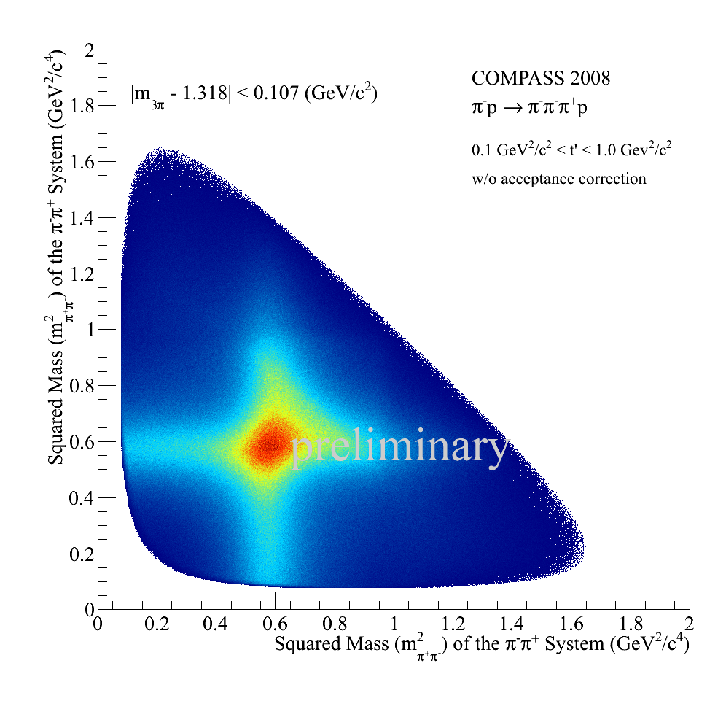
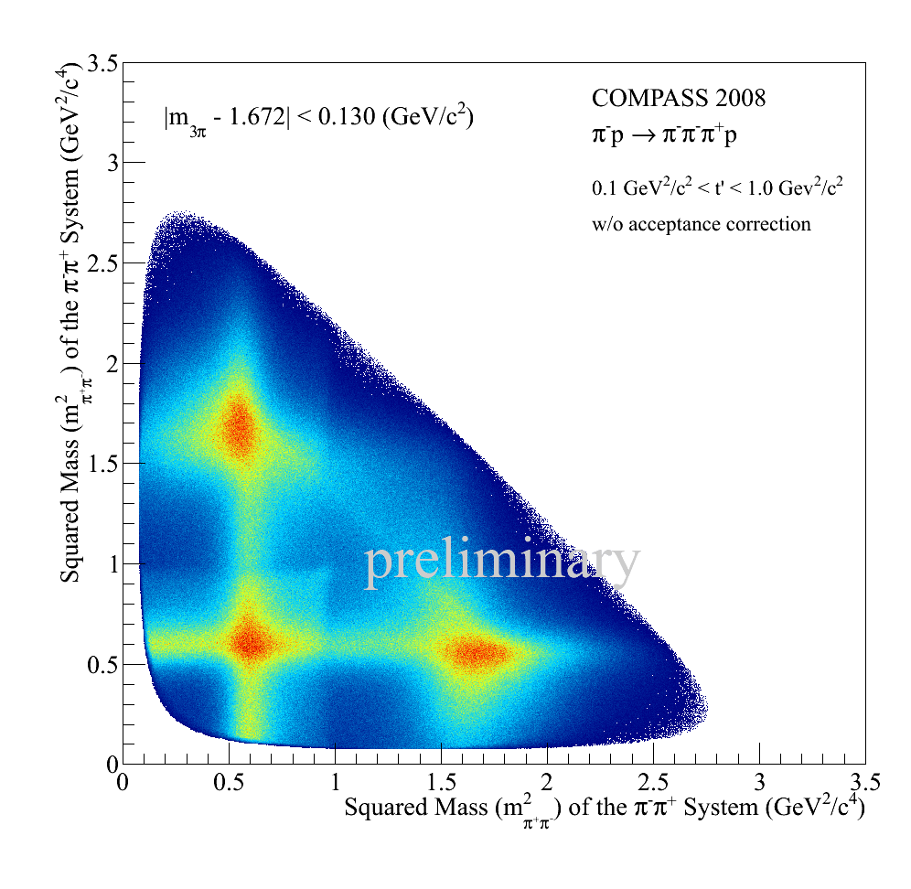
Difractive dissociation: π⁻ p → π⁻ π⁻ π⁺ p
Left: Dalitz plot for a₂(1320), events selected by ± Γ₀ around a₂ mass.
Right: Dalitz plot for π₂(1670) with ± 0.5Γ₀

Slide 41
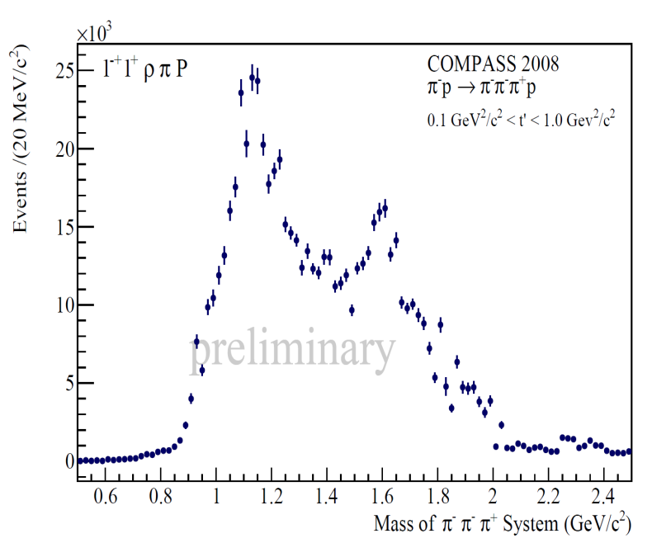
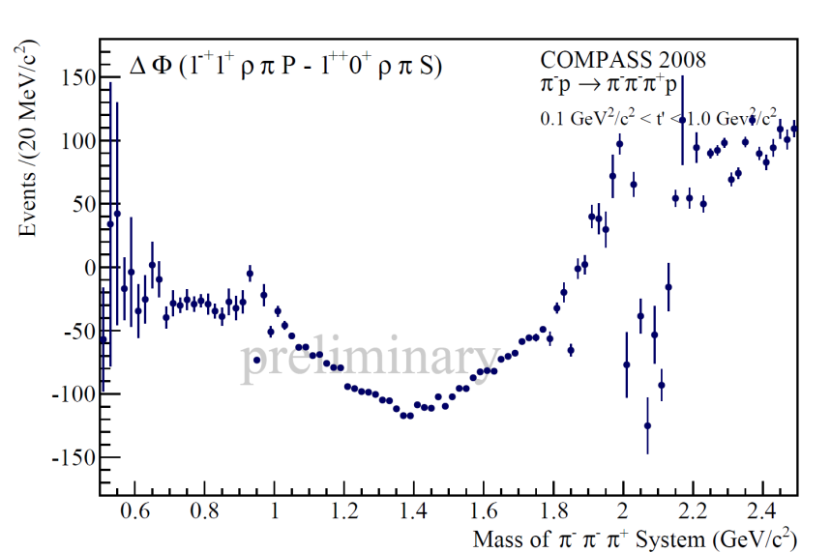
2004 data Pb target vs 2008 proton target

Slide 42
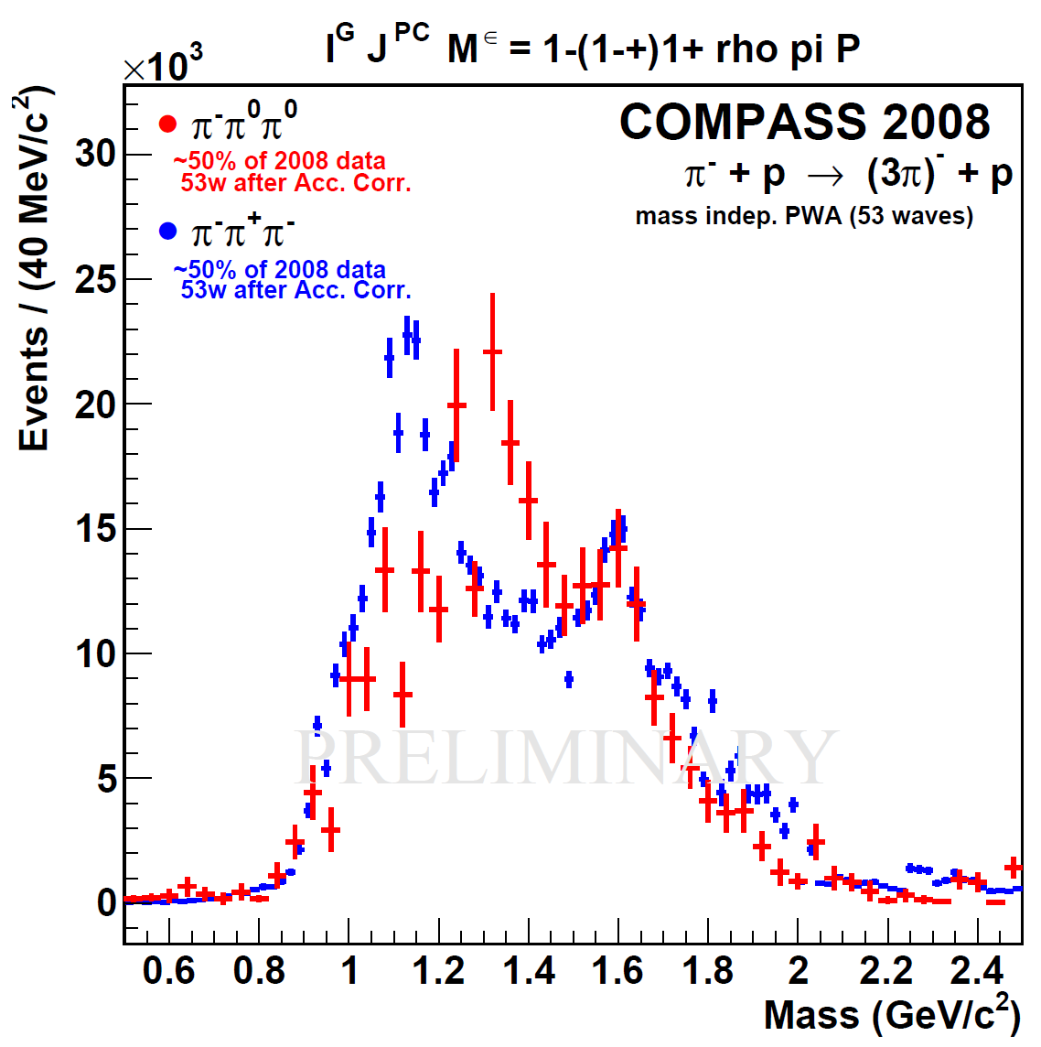
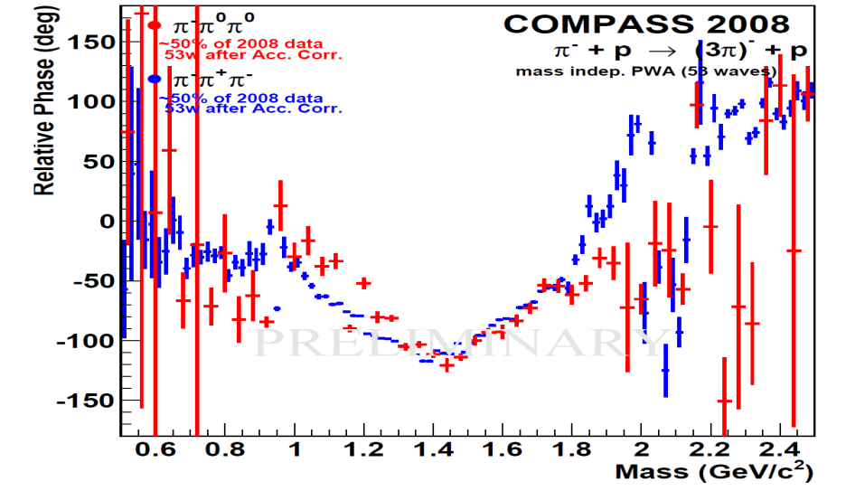
2008 proton target: π⁺ π⁻ π⁻ vs π⁰π⁰ π⁻
Peak at 1.67 GeV/c²
Phase motion indicates resonant behavior
Structure at 1.2 GeV/c² unstable w.r.t. fit model

Slide 43
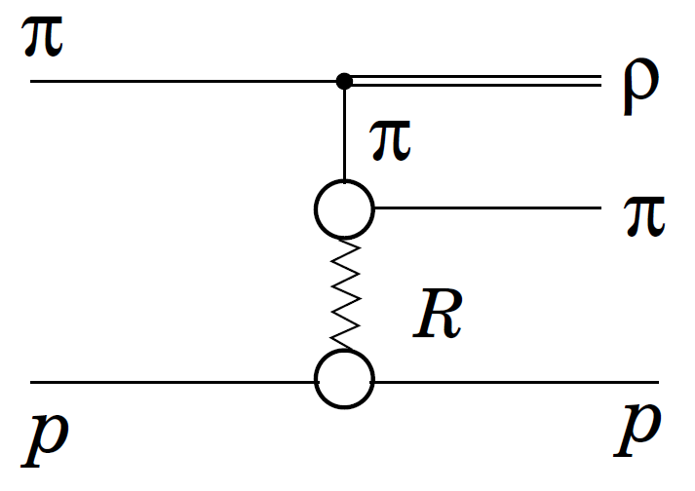
2008 proton target: π⁺ π⁻ π⁻ vs π⁰π⁰ π⁻
Peak at 1.67 GeV/c²
Phase motion indicates resonant behavior
Structure at 1.2 GeV/c² unstable w.r.t. fit model
Non-resonant background to be understood (Deck effect)

Slide 44
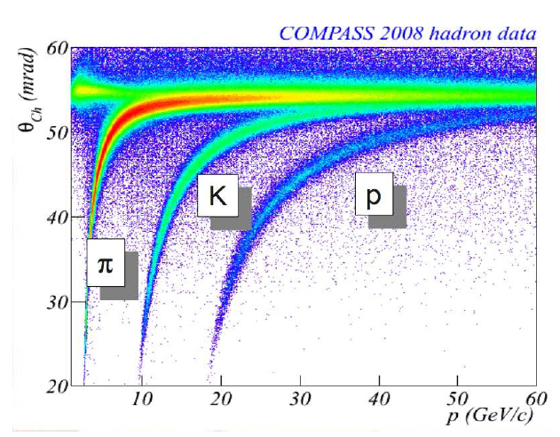
Final states with strangeness: π & K beams
Glueball candidates decaying into KK
f₀(1380),f₀(1500): qq mixing with gg ?
Hybrid candidates decaying into KKπ
π(1800): usual 3¹S₀ or Hybrid?
K from beam identified by CEDAR
K⁺ K⁻ identified by RICH:
10 GeV/c< P_{K} < 30 GeV/c
π – p→K ⁺K – π – p,
π – p→ K_{s}⁰K_{s}⁰ π – p,
π – p→ K_{s}⁰K_{L}⁰ π – p,
Κ – p→ Κ –π –π ⁺ p,
….

Slide 45

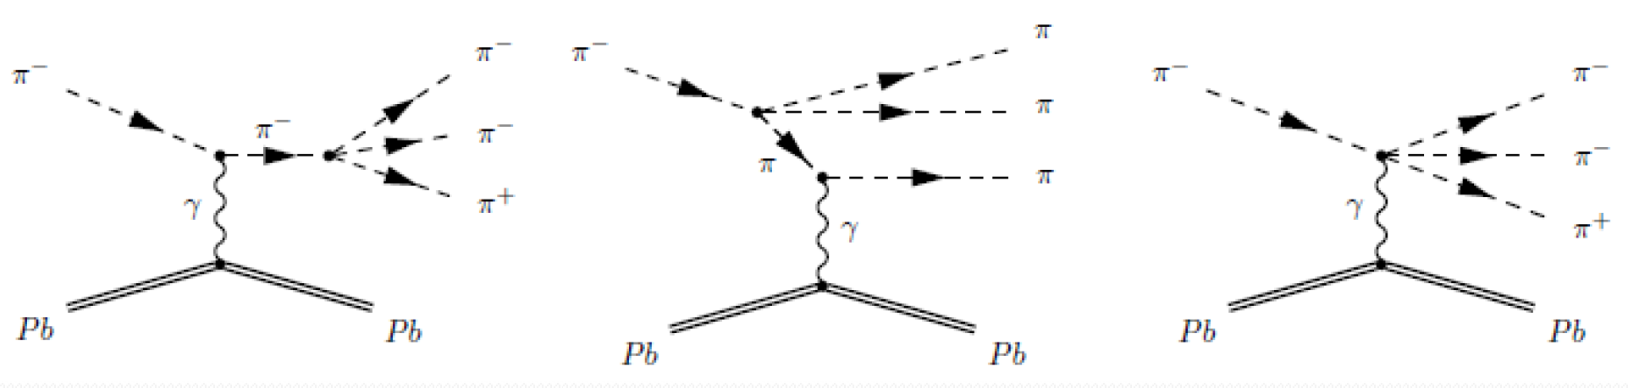
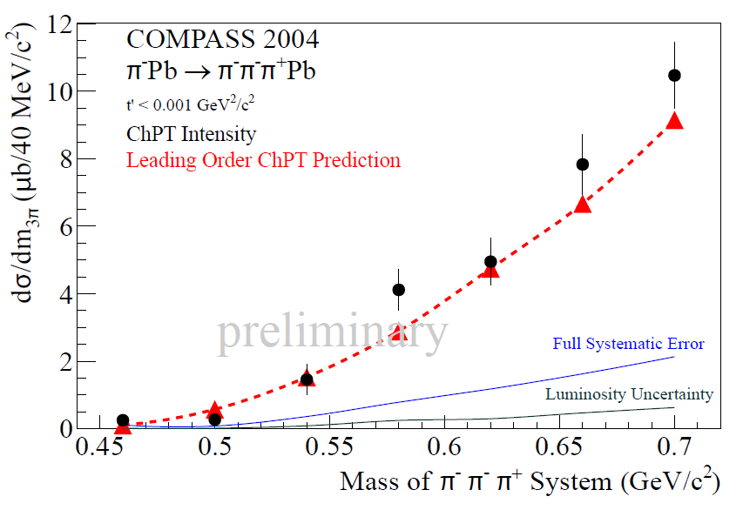
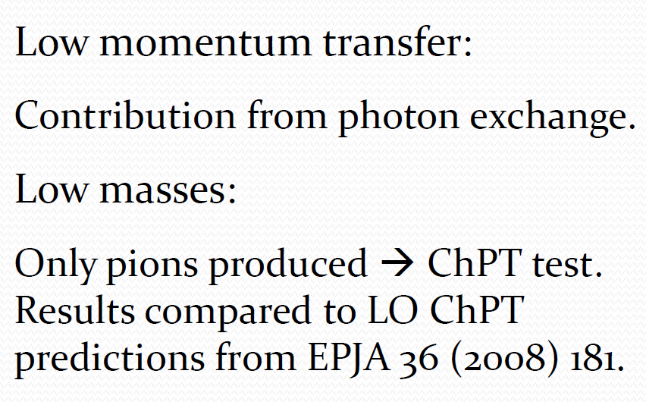
First Measurement of Chiral Dynamics in
PRL 108, 192001 (2012)

Slide 46
Part III: COMPASS II phase
COMPASS-II was approved by the CERN Research Board: Dec. 1, 2010.
  COMPASS II
  2012, SPS/LHC shutdown, 2015, 2016, 2017
Primakoff
  Polarizabilities of π and K
DVSC & DVMP
  Study Generalised Parton distributions
Unpolarized SIDIS
Fragmentation Functions, s-PDFs, TMDs
Drell-Yan
Universality of TMDs

Slide 47
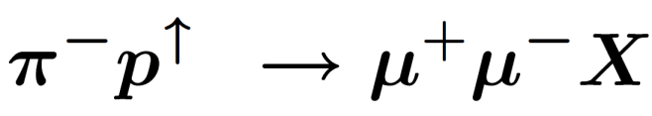
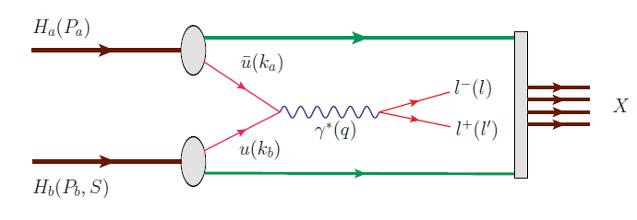
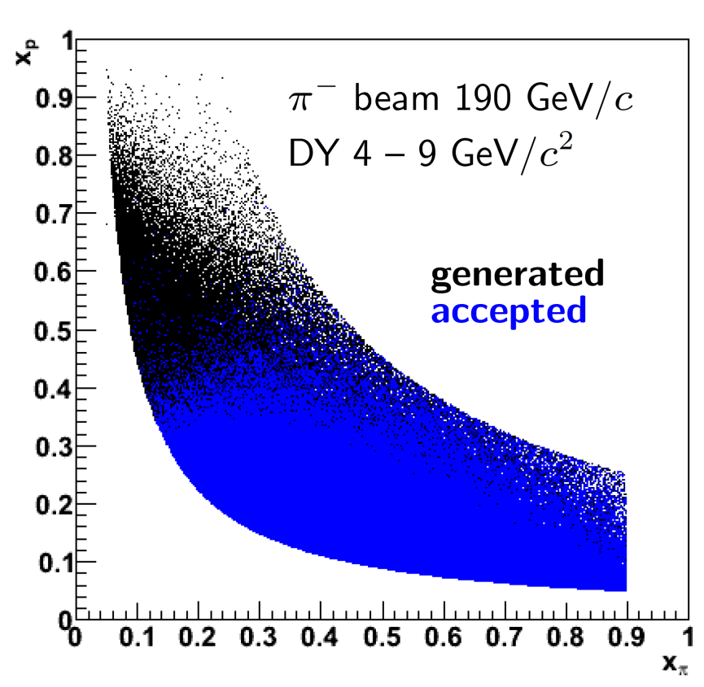

Polarized Drell-Yan measurements
→pion valence anti-u annihilates with proton u
→access to 4 azimuthal modulations: Boer-Mulders, Sivers, pretzelosity and transversity PDFs
gauge link changes sign for T-odd TMD’, restricted universality of T-odd TMDs
J.C. Collins, PLB536 (2002) 43

Slide 48
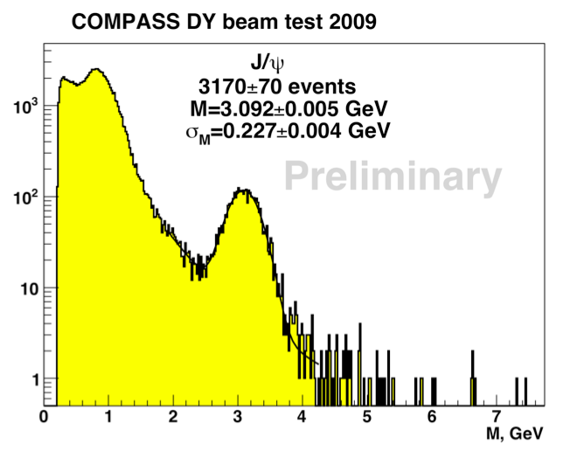
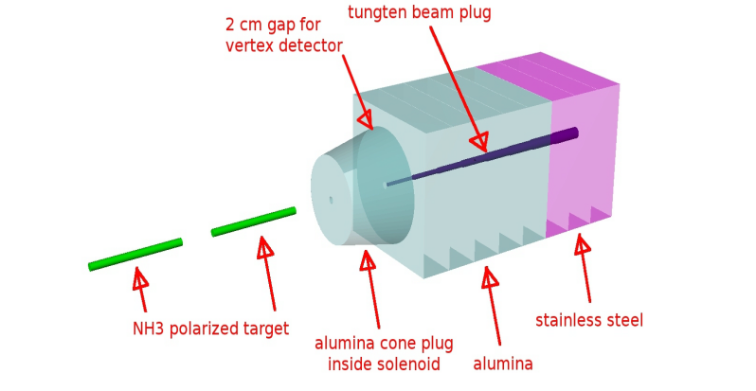
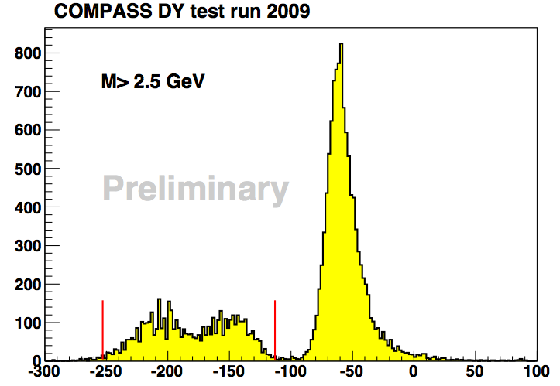
Feasibility of the measurement (DY test 2009)
 | Expected | Found
J/ψ | 3600±600 | 3170±70
DY M>4 GeV | 110±22 | 84±10
di-muon mass
J/ψ region
→Promising results of the test
For future : intensity up to 10⁹ π/spill
new full size Absorber
→ new tracking planes after the target
4 < M_{μ+μ-} < 9 GeV
Safe region
Possible region
Z vertex position
Absorber

Slide 49
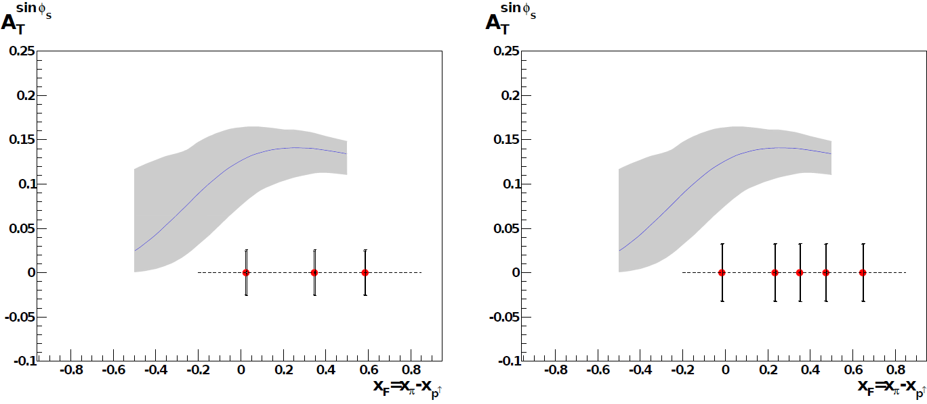
Expected event rates & projections
With a beam intensity I_{beam}=6x10⁷ particles/second, a luminosity of L=1.2x10³²cm⁻²s⁻¹ can be obtained:
→ expect 800/day DY events with
Assuming 2 years of data-taking (140 days/year), one can collect: ≈230000 events
Expected statistical error of the Sivers asymmetry for a measurement in three (left) and five (right) bins in x_{F} . The smaller error bar is the statistical only, while the larger one corresponds to the quadratic sum of statistical and systematic errors. The theoretical prediction of the asymmetry from Anselmino et al. is also shown.

Slide 50
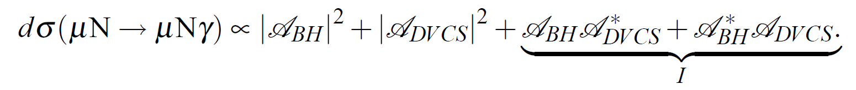


Exclusive single-photon production
COMPASS experiment has excellent opportunity for studying Generalized Parton Distributions (GPDs), through Deeply Virtual Compton Scattering (DVCS) using highly-polarized μ± beam line of the CERN SPS. DVCS is considered to be the theoretically cleanest of the experimentaly accessible processes to measure GPDs. The physical background - Bethe-Heitler (BH) process - is well studied.

Slide 51

Kinematic domain accessible at COMPASS
CERN High energy muon -beam 100 - 190 GeV
  μ+ and μ- available
  80% Polarisation
  with opposite polarization
Luminosity limit
with a 2.5m long LH₂ target
L = 10³² cm⁻² s⁻¹
Q² → 8 GeV²
→ 16 GeV² if luminosity increased by factor 4
~10⁻² < x < ~10⁻¹
x → 0.20 with extension of present calorimetry

Slide 52

DVCS data taking from 1-11 to 2-12-2012
ECAL2
ECAL1
ECAL0
CAMERA recoil proton detector
surrounding the 2.5m long
LH2 target

μ±

Slide 53

DVCS 2012 pilot run - projection for t-slope
σ ^{DVCS}/dt ~ exp^{-B|t|} B(x_{B}) = ½ < r⊥² (x_{B}) >
transverse size
of the nucleon
2 weeks in 2012
40 weeks > 2015
Projection for ~ 2 weeks : B ≈ 5 ± 0.7 ~ 80 DVCS events.
Full experiment : 40 weeks B ≈ 5 ± 0.15

Slide 54
Conclusion
COMPASS is one of major players in nucleon spin studies and in particular in the direct measurements of the gluon polarisation Δg/g …
but the "spin crisis” is unsolved yet
COMPASS has excellent potential to contribute for hybrids, glueballs , multi-quark states searches in diffractive dissociation & central production
Evidence for these QCD allowed states still not beyond doubt
  Future
  The feasibility of the Drell-Yan measurements was confirmed by the
  4 beam tests performed in 2007-2012.
The feasibility of the DVCS measurements was confirmed by the
3 beam tests performed in 2008-2012.

Slide 55



New large-angle electromagnetic calorimeter ECAL0 (Dubna)
Requirements
- Photon energy range 0.2- 30 GeV
- Size: 360cm x 360cm ;
- Granularity 4x4 – 6x6 cm²
- Energy resolution < 10.0%/√E (GeV)
- Thickness < 50 cm,
- Insensitive to the magnetic field.
Prototype under studies
Shaschlyk module with AMPD readout
ECAL1&2
DVCS+BH
new shashlyk modules for tests in 2011
109 plates made of Sc 0.8 mm /Pb 1.5 mm
Avalanche Micropixel Photo Diodes
251mm or 15 radiation length
3 x 3 mm², density of pixels 40 000/mm²
Total length 470mm
with electronics
342 mm

