Slide 1


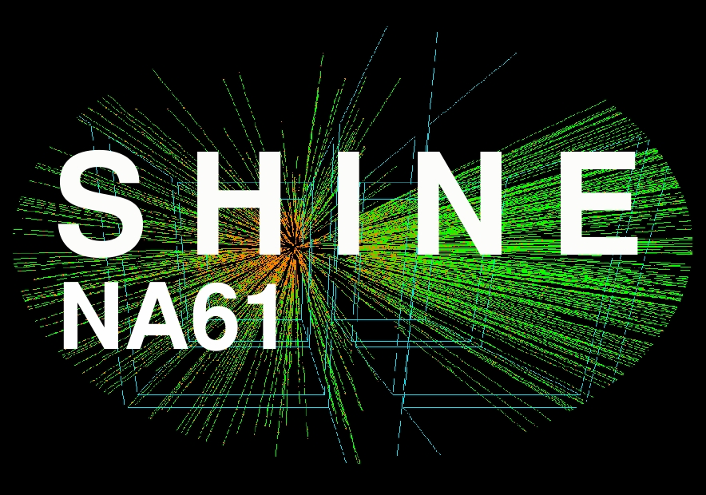
CERN Academic training lecture
Physics at the AD/PS/SPS (2/4)
QCD and hadron physics: COMPASS, NA61, DIRAC
Gerhard K. Mallot /CERN
LHC
SPS
DIRAC

Slide 2
Study of non-perturbative QCD
Properties of hadrons
  structure functions
  hadron spectrum
Properties of quark matter
  deconfinement
  critical point
Low energy QCD – chiral perturbation theory
  pion/kaon polarisability
  ππ scattering length
COMPASS SHINE DIRAC

Slide 3

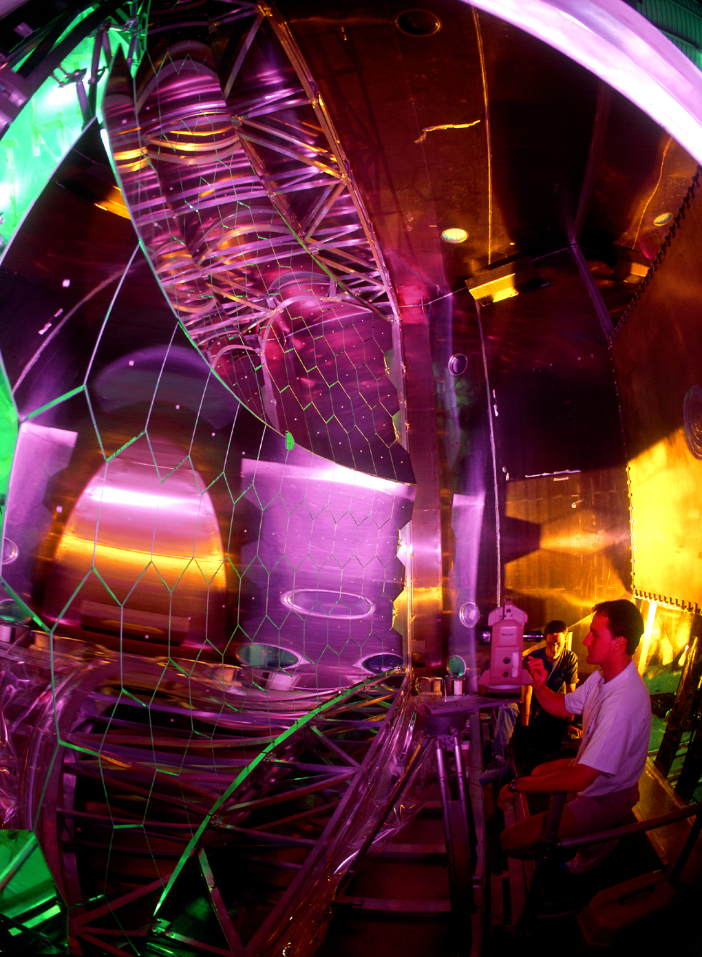

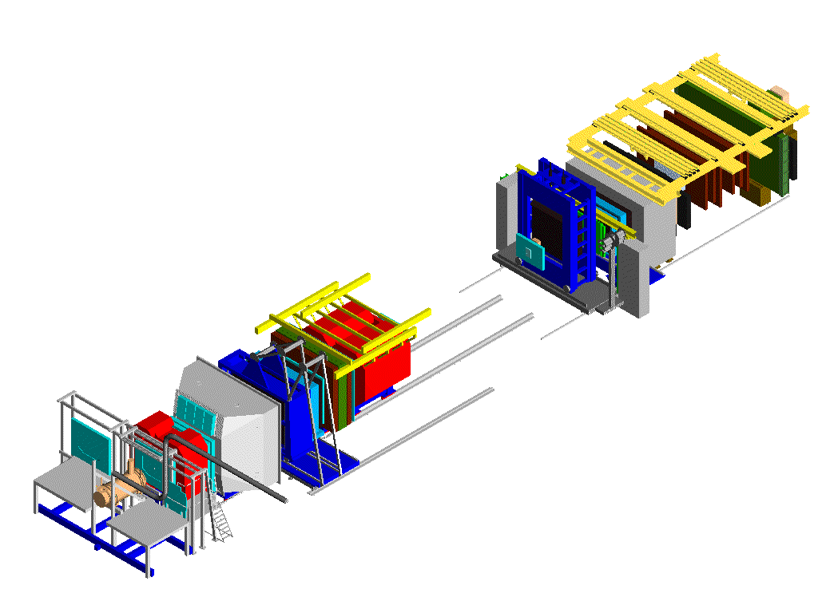
COMPASS: QCD structure of hadrons data taking since 2002
nucleon spin-structure (μ)
  helicity distributions of qluons and quarks
  transverse spin structure
  3D structure of the nucleon
hadron spectroscopy (p, π, K)
  light mesons, glue-balls
  exotic mesons
  polarisability of pion and kaon
members:
  210 physicists,
  29 institutes,
  11 countries
COMPASS RICH

Slide 4
LHC
SPS
DIRAC

Slide 5
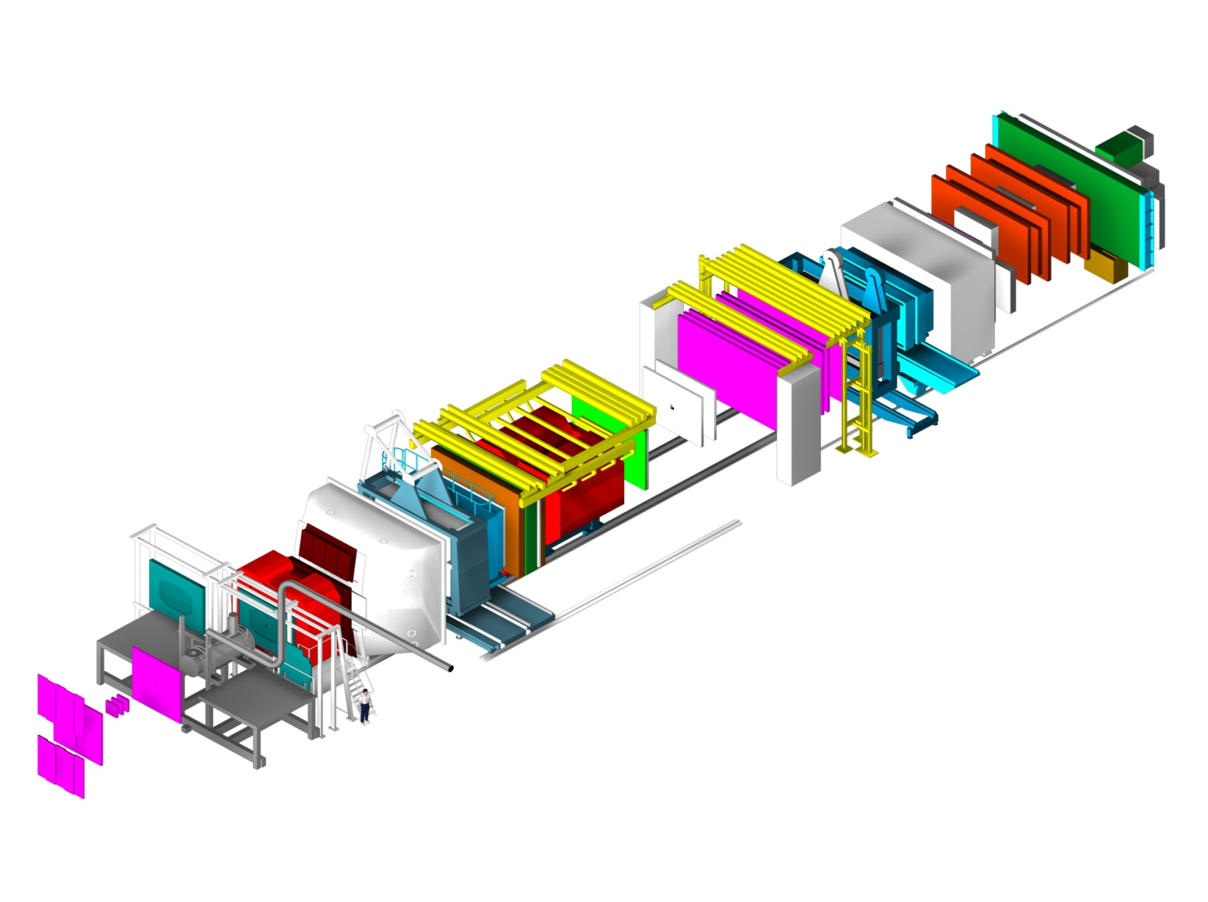
COMPASS spectrometer
h⁺ beam: 190 GeV, p/π/K 75/24/1%
h⁻ beam: 190 GeV, π/K/p 97/2/1%
μ⁺ beam: 160/200 GeV, 2×10⁷/s
Hodoscopes
E/HCAL2
E/HCAL1
SM2
RICH1
Muon Wall 2,
MWPC
SM1
Polarised Target
MWPC, Gems, Scifi,
W45
Muon Wall 1
Straws, Gems
60m long
Scifi, Silicon
Micromegas, DC, Scifi

Slide 6

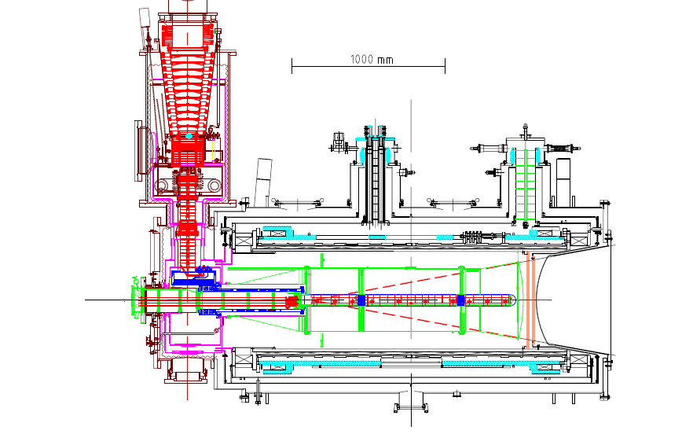
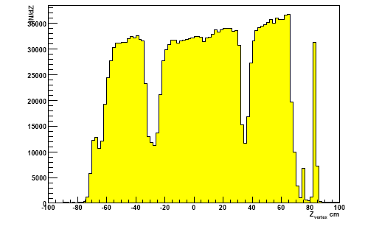
Polarized target system
solenoid 2.5T
dipole magnet 0.6T
acceptance ± 180 mrad
³He – ⁴He dilution
refrigerator (T~50mK)
⁶LiD/NH₃ (d/p)
50/90% pol.
40/16% dil. factor
μ
Recontructed interaction vertices

Slide 7
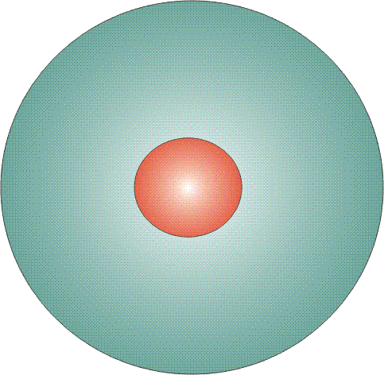
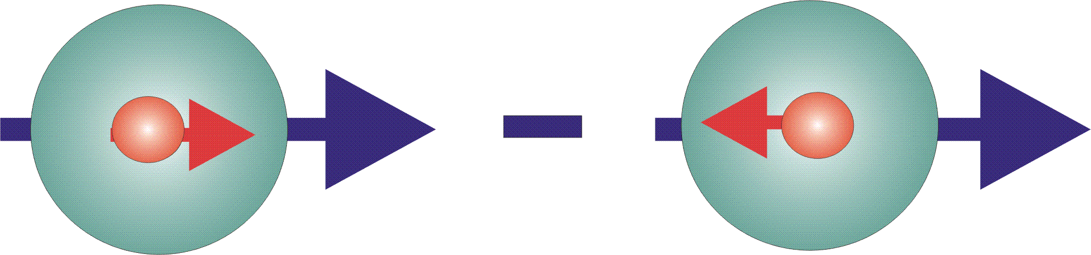

Structure: Parton Distribution Functions
Three twist-2 PDFs
q(x)
f₁^{q} (x)
unpolarised PDF
quark/gluon with momentum xP in a nucleon
well known – unpolarized DIS
Δq(x)
g₁^{q}(x)
helicity PDF
quark/gluon with spin parallel to the nucleon spin in a longitudinally polarised nucleon
known – polarized DIS
transversity PDF
quark with spin parallel to the nucleon spin in a transversely polarised nucleon
Δ_{T}q(x)
h₁^{q}(x)
chiral odd, fairly known

Slide 8
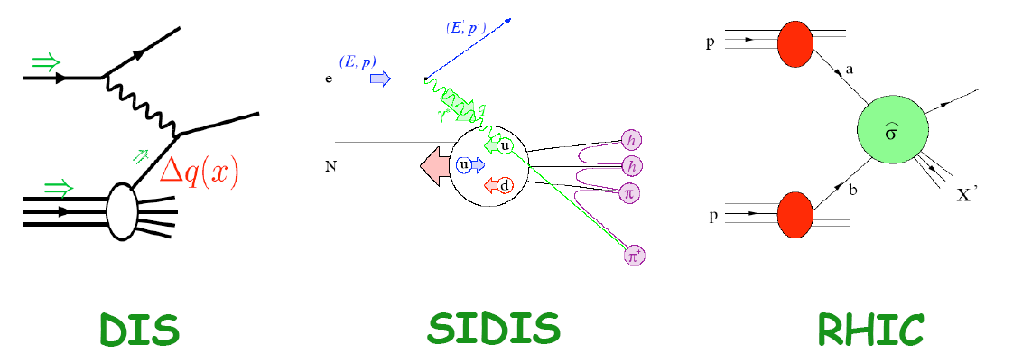
Tools to study the spin structure
Factorization of hard interaction and fragmentation
(additional input from e⁺e⁻)
polarised
DIS
SIDIS
pp

Slide 9
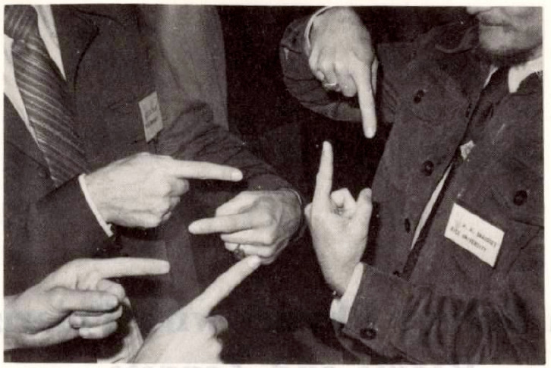
helicity structure of the nucleon

Slide 10
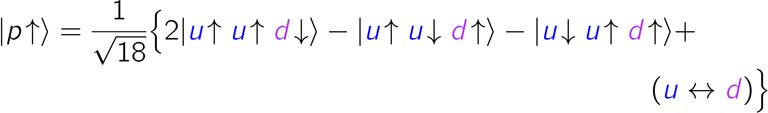
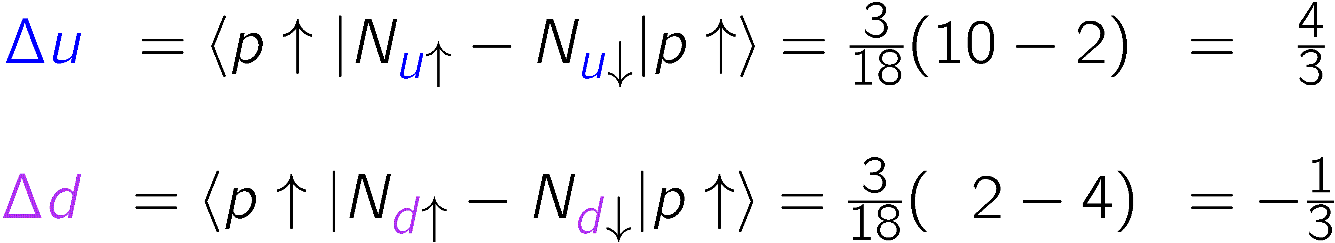
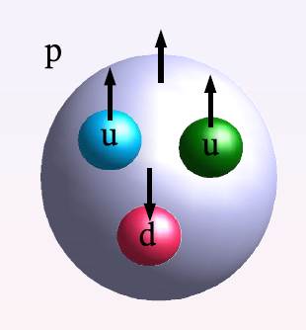
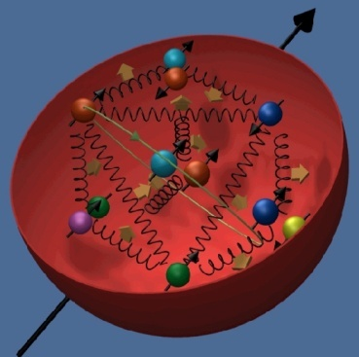
Spin: Static Quark model
SQM: up and down quarks carry the nucleon spin!
EMC: Quarks spins contribute little (1987/88)
ΔΣ = 0.12
Notes:
s

Slide 11
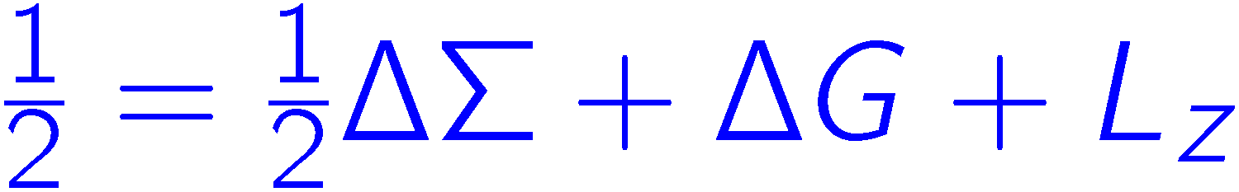
Where is the proton spin?
small
smallish,
till poorly known
unknown

Slide 12
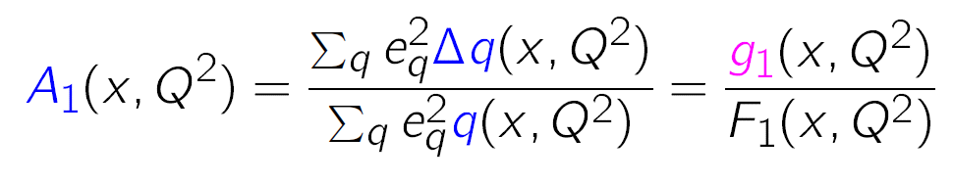
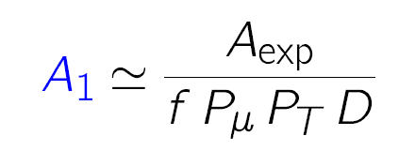
Asymmerties & SF
longitudinal double-spin x-sect. asymmetries
+
f: dilution factor
D: depolarisation factor
P_{μ}: beam polarisation
P_{T}: target polarisation
x: Bjorken x, fraction of nucleon momentum carried by struck
quark in inf. mom. frame
inclusive scattering:

Slide 13
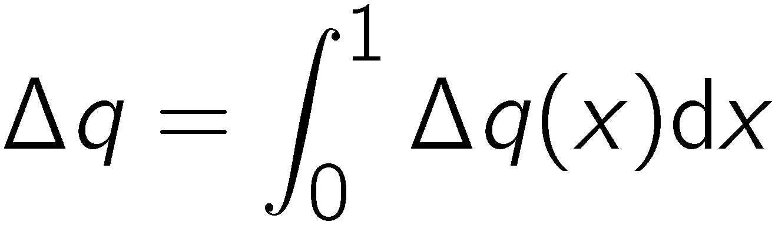
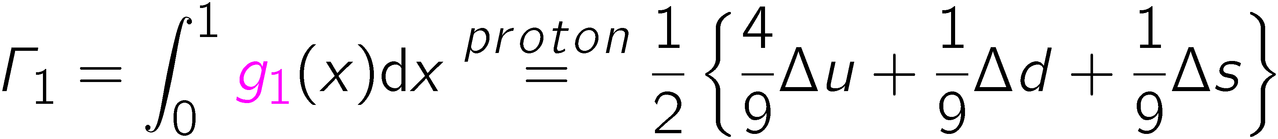
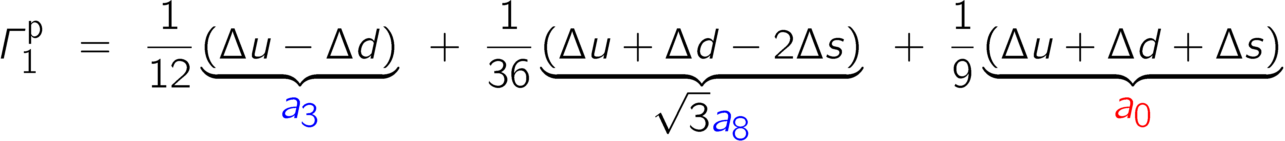
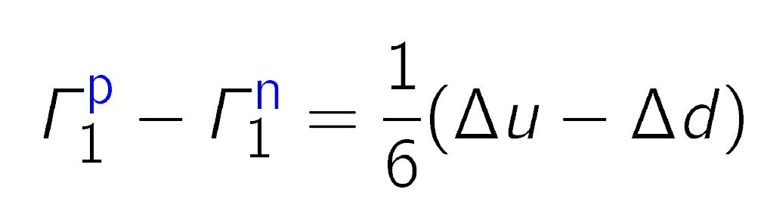
Sum rules for g₁
first moment Γ₁ of g₁ with
Neutron decay
a₃ = |g_{a}/g_{v}|
Hyperon decay
(3F-D)/3
∆Σ
Bjorken sum rule:

Slide 14
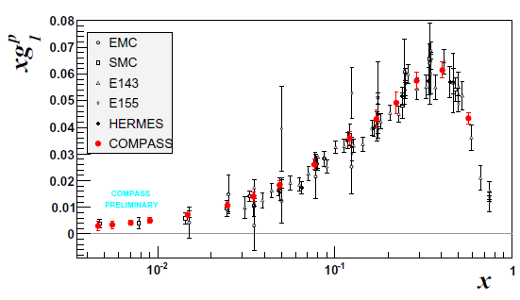
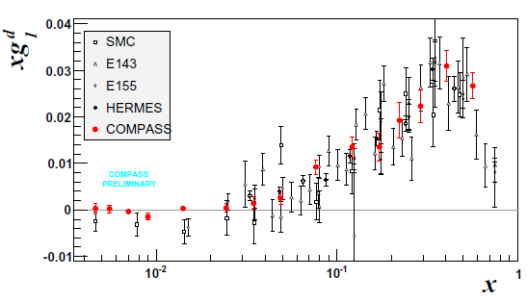
Structure function g₁(x,Q²)
p
very precise data
only COMPASS for
x < 0.01 (Q² > 1)
deuteron data:
  ΔΣ=
  0.33±0.03±0.05
  Δs+Δs=
  −0.08±0.01±0.02
d

Slide 15


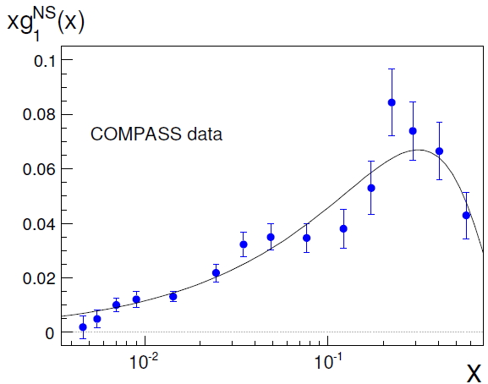
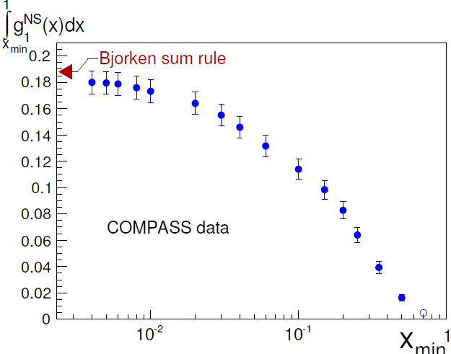

Bjorken sum rule
PLB 690 (2010) 466
from neutron β decay

Slide 16
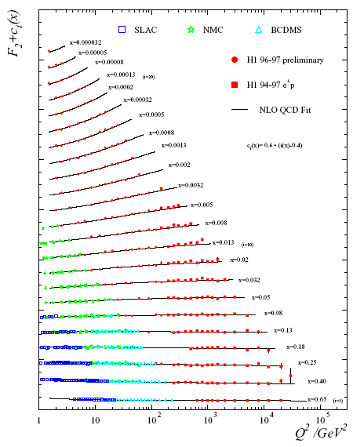
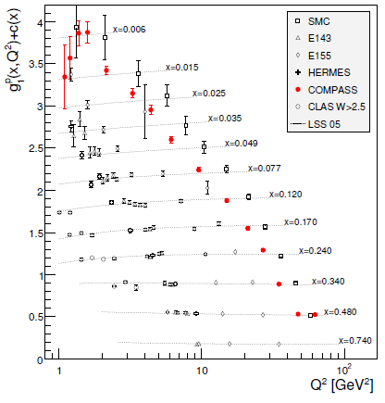
F₂(x,Q²)
g₁(x,Q²)
p

Slide 17
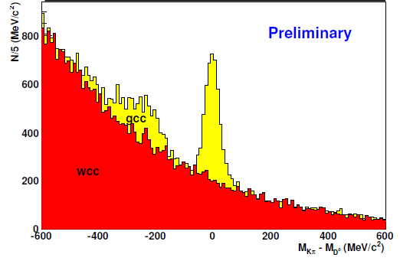
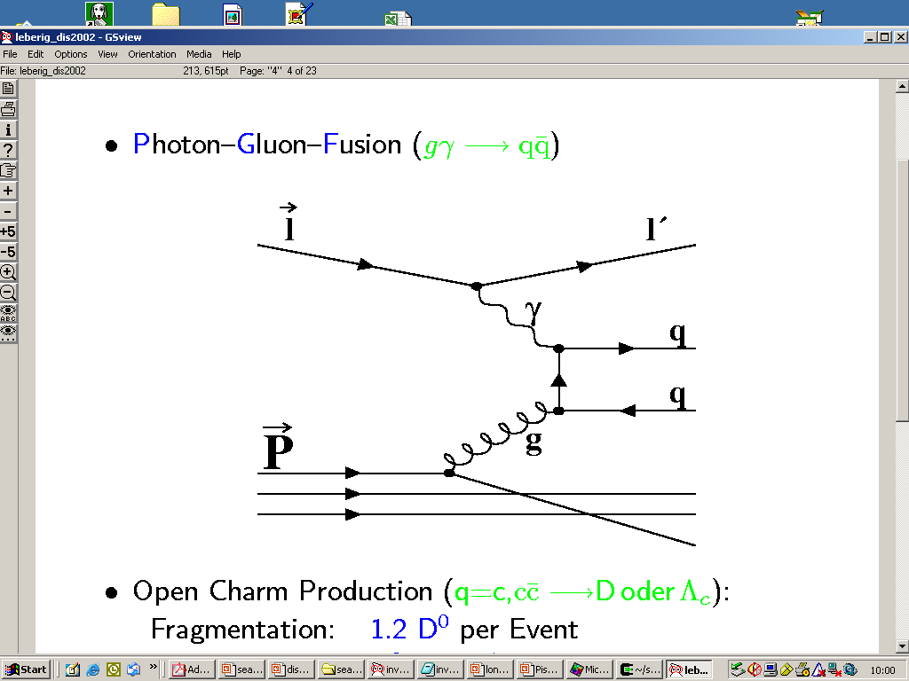
Gluon polarisation from PGF
open charm: single D meson
cleanest process wrt physics background
high-p_{T} hadron pairs with Q² > 1 GeV²
high-p_{T} hadron pairs with Q² < 1 GeV²
Single hadron production Q² < 0.1 GeV²
D⁰ → K π
g
D⁰ → K π π⁰

Slide 18
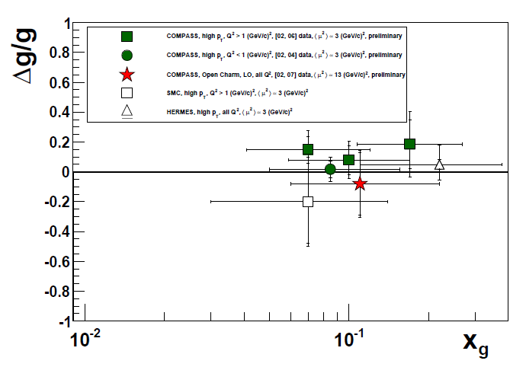
Δg/g from PGF (LO)
The gluon polarisation is rather small
confirmed by polarised pp at RHIC

Slide 19
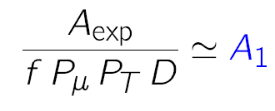
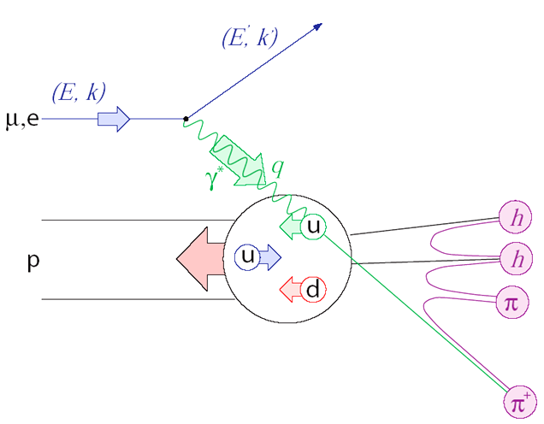
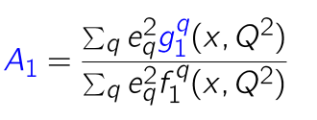
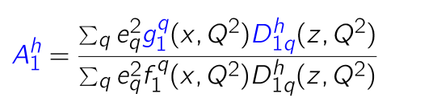

X-sect. asymmetries
Inclusive scattering
Semi-inclusive scattering

Slide 20
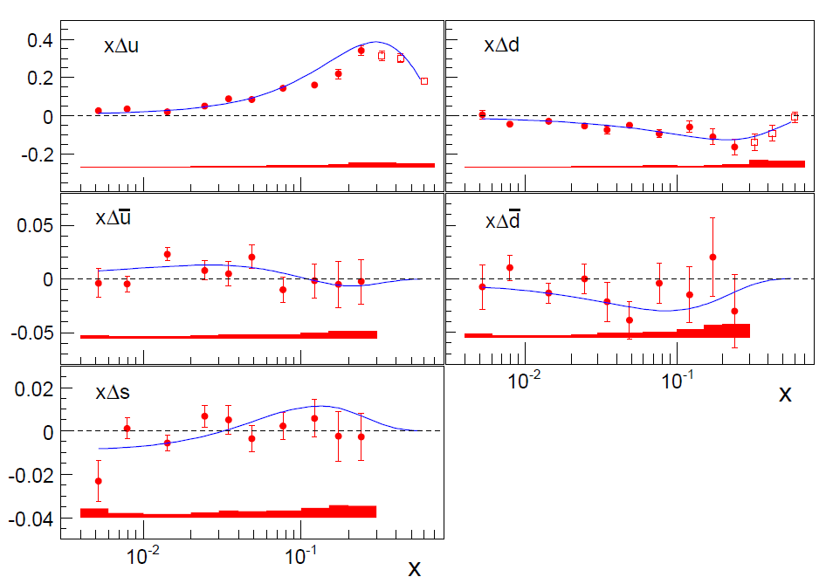
Flavour distributions
LO analysis of 5p+5d asymmetries, DSS FF
Line: NLO DSSV not including these data
PLB693 (2010) 227
PRD80 (2009) 034030
5-flavour fit, assuming Δs = Δs

Slide 21
Transverse spin structure

Slide 22
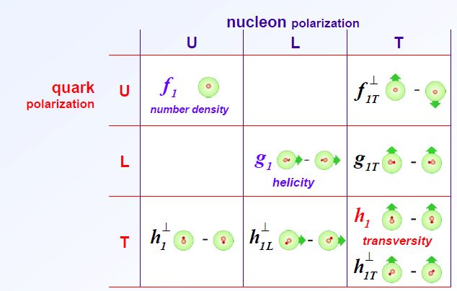


TMD parton distributions
8 intrinsic-transverse-momentum dependent PDFs at leading twist
Azimuthal asymmetries with different angular modulations in the hadron and spin azimuthal angles, Φ_{h} and Φ_{s}
Vanish upon integration over k_{T} except f₁ , g₁ , and h₁
aka
Sivers
Transversity
Boer–
Mulders
chiral odd

Slide 23
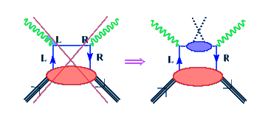
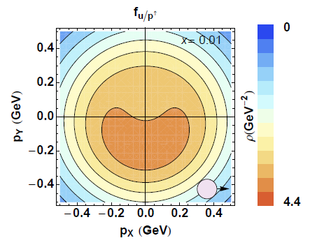
SSA: transversity (Collins) and Sivers
transversity
  chiral odd, can be measured
  in SIDIS (not in incl. DIS)
  leads to an azimuthal asymmetry if the chiral-odd Collins fragmentation function is non-zero
Sivers function
  leads to a azimuthal asymmetry
  naive T-odd
  final/initial state interaction
  should change sign for SIDIS/DY
  related to orbital angular momentum

Slide 24
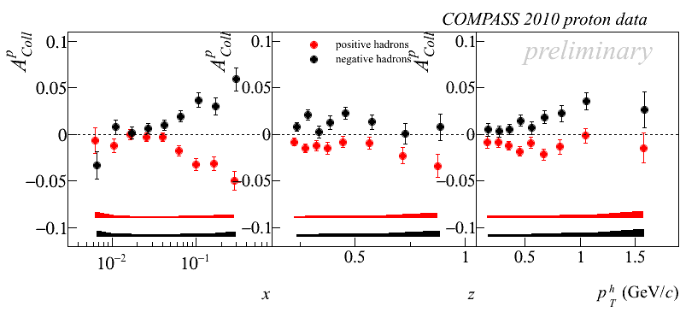
Collins Asymmetries
large asymmetry for proton ~10%
zero deuteron result important ⇒ opposite sign of u and d
proton
h⁻
h⁺

Slide 25
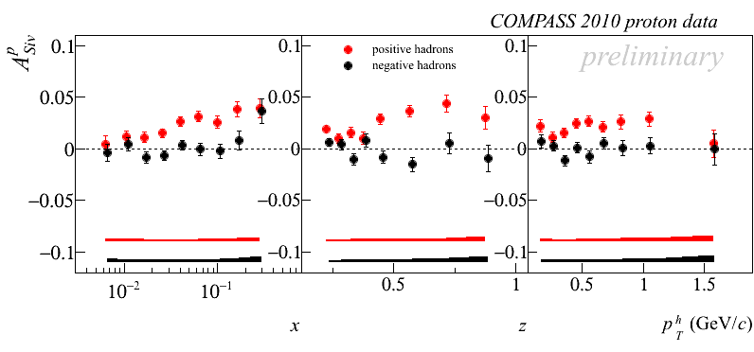
Proton Sivers Asymmetry
compatible with zero for the deuteron
non-zero asymmetry for pos. hadrons
h⁺
h⁻

Slide 26
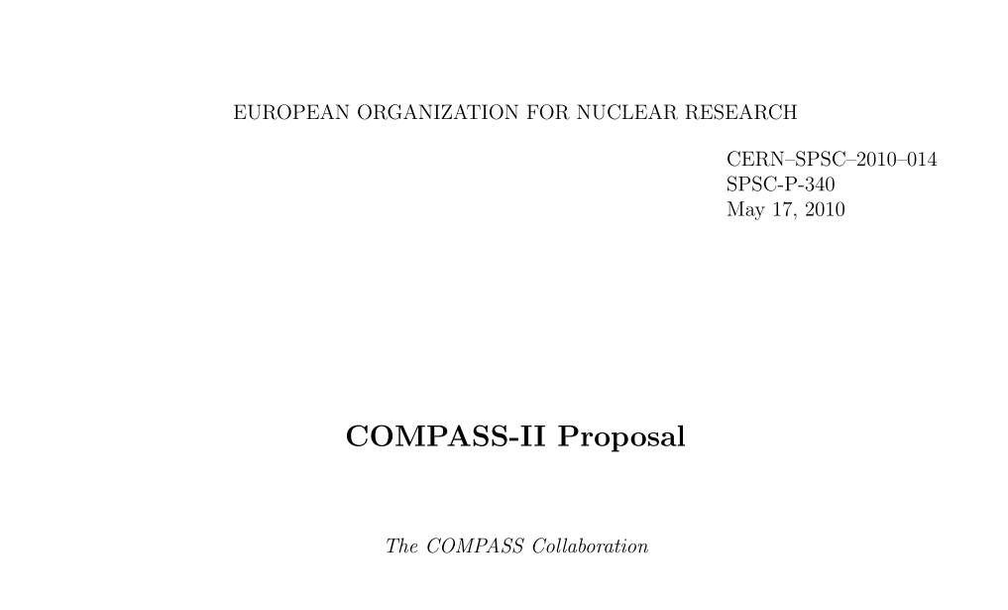
COMPASS-II
Generalized Parton Distributions (GPD):
simultaneously SIDIS on proton: (2012), 2015/16, ...
TMD in π─ + p Drell-Yan: 2014, ...
Pion (and kaon) polarizabilities 2012
Approved December 2010, first measurements 2012
wwwcompass.cern.ch/compass/proposal/compass-II_proposal/compass-II_proposal.pdf

Slide 27
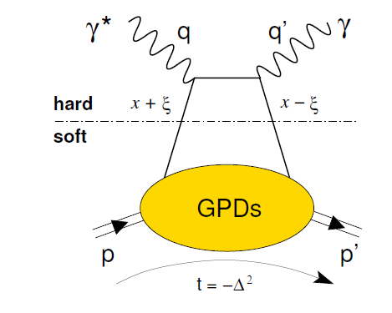
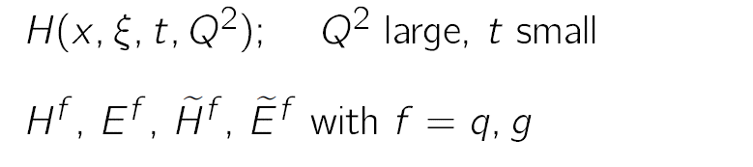
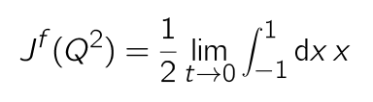

GPD’s
DVCS
H (E) for nucleon helicity (non)conservation
PDFs and elastic FF as limiting cases
H, H → f₁ , g₁ for ξ→ 0;
Correlating transverse spatial and longitudinal momentum DoF
tools: DVCS, HEMP (vector & pseudoscalar)
~
Total orbital momentum:
X.-D. Ji, PRL 78 (1997) 610

Slide 28
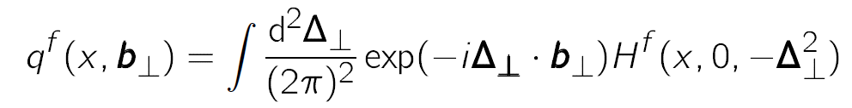
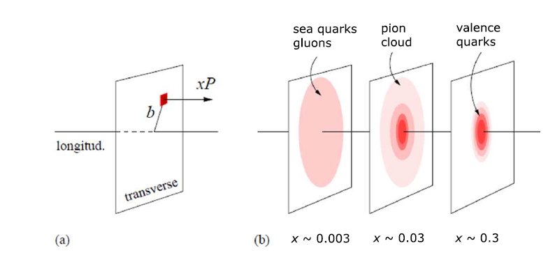
`Tomography’
ξ=0 → t = −Δ_{T}² , no long. transfer
Transverse size as function of longitudinal momentum fraction
adapted from JLAB 12 GeV CDR

Slide 29



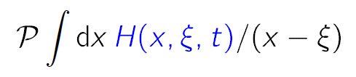
DVCS
DVCS can be separated from BH and constrain the GPD H e.g. using cross-sections for different μ beam charge & spin (e_{μ}& P_{μ})
Deep VCS
Bethe-Heitler
Note: μ± have opposite polarisation at COMPASS
Charge & Spin difference and sum:
Im and Re related to

Slide 30
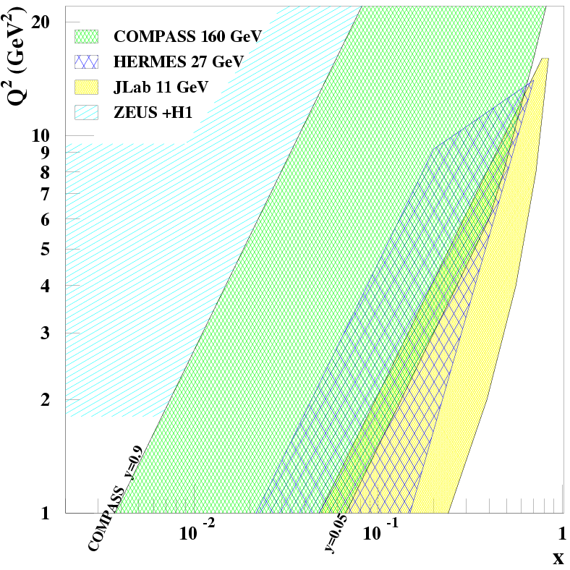
DVCS
DVCS is the cleanest process to determine GPDs
need a world-wide effort
global analysis over large kinematic range mandatory
COMPASS-II: from HERA to JLAB 12 GeV kinematics
}
fixed target
collider
E=160 GeV
E=27 GeV
E=11 GeV
W > 2GeV
B

Slide 31





transverse proton size
The distance ⟨r⊥² ⟩ between struck quark and spectator c.m.
given by t-slope of DVCS cross-section σ₀ (as function of x_{Bj}, LO)
Reminder
Subtract BH from , integrate over φ → σ₀
H1 found 0.65 ± 0.02 fm at x_{Bj} ≈ 10⁻³
Parametrisation
Transverse size as function of x_{Bj}
Reminder

Slide 32
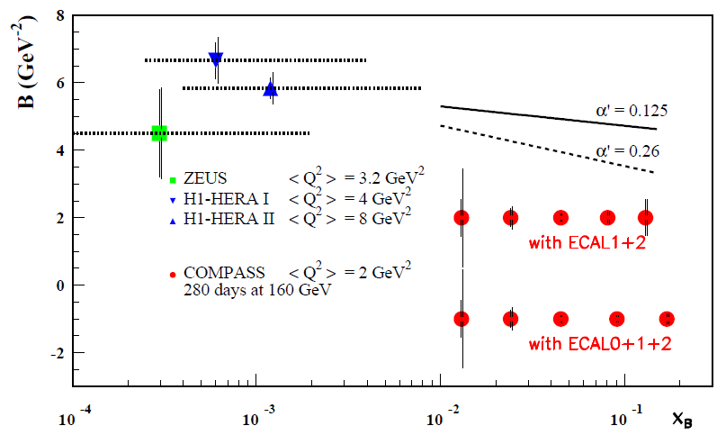


projected t-slope & transv. size
COMPASS-II projection, 2 years of data taking , pilot run 2012
x_{B} region unique to COMPASS
transition from HERA → HERMES/JLab

Slide 33
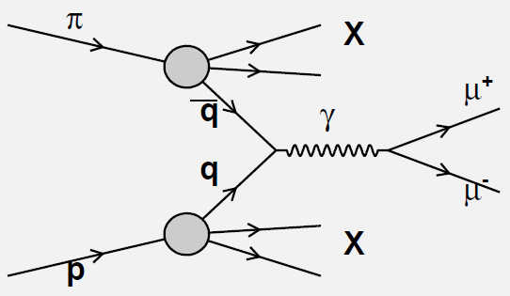


Drell−Yan Process
No fragmentation function involved
Convolution of two PDFs
Best: pol. antiproton−proton (long-term)
Simpler: negative pion on pol. proton (short-term)
Pion valence anti-u annihilates with proton u
‘

Slide 34



Restricted universality in SIDIS and pol. DY
T-odd TMD
`gauge link changes sign
for T-odd TMD’, restricted
universality of T-odd TMDs
J.C. Collins, PLB536 (2002) 43
Sivers
Boer-Mulders

Slide 35








Projected measurement
Sivers
Boer-Mulders
Sivers
Boer-Mulders
BM⊗Pretze.
BM⊗transv
BM⊗Pretze.
BM⊗transv
x_{F}=x_{π}-x_{p⇑}
x_{F}=x_{π}-x_{p⇑}
x_{F}=x_{π}-x_{p⇑}
x_{F}=x_{π}-x_{p⇑}

Slide 36



COMPASS hadron programme: Tests of χPT
Pion (and kaon) polarisability via Primakoff scattering
control measurement with muons
present exp. situation confused

Slide 37


COMPASS-II major new equipment
CAMERA recoil for GPD
ECAL0, RICH upgrade
Hadron absorber for DY

Slide 38






COMPASS-I spectroscopy
Mesons
quantum numbers in CQM
forbidden (exotic QN’s)
more states in QCD:
hybrids , glueballs , multiquark states
Diffractive dissociation:

Slide 39


1. Example: π⁻p → π⁻π⁺π⁻p
sample with 96 Mevents
around π₂ region

Slide 40

π⁻p → π⁻π⁺π⁻p
Isobar model:
X decay is chain of successive two-body decays
Analysis:
  Partial wave analysis (PWA) in mass bins with up to 53 waves
  fit of spin-density matrix for major waves with Breit-Wigner

Slide 41

Major waves

Slide 42




Exotic J^{PC}=1⁻⁺ wave [π₁(1600)]
2004 Pb
`work in progress’
2008 p
Phys. Rev. Lett. 104, 241803 (2010)
phase
motion
wrt a₁

Slide 43


2. Example: π⁻Pb → π⁻ π⁺π⁻ π⁺π⁻ Pb
5 pion final state
access to higher mass
region ~ 2 GeV
large number of possible
waves
spin density sub-matrix →
first 5-body final-state PWA
work in progress,
still simple model

Slide 44

Resonances in π⁻Pb → π⁻ π⁺π⁻ π⁺π⁻ Pb
Known states:
π₂(1670); π(1800)
Elusive:
π₂ (1880) in a₁ρ and a₂ρ
Two 1⁺⁺ resonances
Possible π₂(2200) signal
Boxes show systematic uncertainties from wave set variations, symbols values obtained in best fit

Slide 45
Further analysis
Huge data set:
neutral channels involving: π⁰, η, η’
glue balls searches in pp → p_{fast}π⁺π⁻p_{slow}
different t ranges
OZI rule
etc, ...
We are only at the beginning of the harvest

Slide 46



SHINE (NA61)
Threefold programme:
search for the critical point in strongly interacting matter & precision study of onset of deconfinement
(A+A, p+A, p+p)
hadron production for neutrino experiments (T2K target)
(p+C, π+C, long target)
hadron production hadron production for cosmic rays
(Pierre Auger, Kaskade)
(p+C, π+C)
quark-gluon plasma
slides adapted from M. Gazdzicki & Z. Fodor

Slide 47
LHC
SPS
DIRAC

Slide 48


NA61:
136 physicists from 27 institutes and 14 countries:
University of Athens, Athens, Greece
University of Belgrade, Belgrade, Serbia
University of Bergen, Bergen, Norway
University of Bern, Bern, Switzerland
KFKI IPNP, Budapest, Hungary
Jagiellonian University, Cracow, Poland
Joint Institute for Nuclear Research, Dubna, Russia
Fachhochschule Frankfurt, Frankfurt, Germany
University of Frankfurt, Frankfurt, Germany
University of Geneva, Geneva, Switzerland
Forschungszentrum Karlsruhe, Karlsruhe, Germany
Institute of Physics, University of Silesia, Katowice, Poland
Jan Kochanowski Univeristy, Kielce, Poland
Institute for Nuclear Research, Moscow, Russia
University of Nova Gorica, Nova Gorica, Slovenia
LPNHE, Universites de Paris VI et VII, Paris, France
Faculty of Physics, University of Sofia, Sofia, Bulgaria
St. Petersburg State University, St. Petersburg, Russia
State University of New York, Stony Brook, USA
KEK, Tsukuba, Japan
Soltan Institute for Nuclear Studies, Warsaw, Poland
Warsaw University of Technology, Warsaw, Poland
University of Warsaw, Warsaw, Poland
Univeristy of Wroclaw, Wroclaw, Poland
Universidad Tecnica Federico Santa Maria, Valparaiso, Chile
Rudjer Boskovic Institute, Zagreb, Croatia
ETH Zurich, Zurich, Switzerland

Slide 49

(upgraded NA49 detector)

Slide 50

NA61 spectrometer

Slide 51


Particle identification
Momentum measured with 2 superconducting magnets and TPCs (1.5 and 1.2 T)
Energy loss measurements in the TPCs
Time-of-flight counters at low p

Slide 52

Onset of deconfinement
Phase transition from hadron gas to Quark-Gluon-Plasma
Equilibrium of early state (fire ball) reflected in produced hadron multiplicities
Rapid changes of energy dependence of hadron production (discovery NA49)
Described by statistical model of the early stage SMES
Endpoint (critical point) of phase boundary in SPS range!
Pb-Pb collision (UrQMD)

Slide 53


EM and strong phase diagrams
water
strongly interacting matter
Temperature
Baryochemical potential
1st order phase transition
critical point

Slide 54


Hadron multiplicities
Fit chemical freeze-out temperature T and chemical potential μ_{B} (Hadron gas model)

Slide 55

Onset of deconfinement
T (MeV)
early-stage fire ball
chemical freeze-out
SPS energies in region of hypothetical critical point E
With increasing energy crossing transition region, onset of deconfinement
Critical point search by freeze-out point close to it
2D scan in system size and energy needed to study CP

Slide 56


2D scan in size and energy
SPS energies 13A-158A GeV
from p+p to Pb+Pb (system size)
T (MeV)
158A GeV
13A GeV
Beccatini, Manninen, Gaździcki, PRC73, 044905 (2006)

Slide 57
Signals of deconfinement
AGS SPS RHIC
hadrons mixed QGP
Kink
hadronic observables
Horn
AGS
SPS
RHIC
Step
collision energy
collision energy

Slide 58

The kink in pion multiplicity
AGSSPSRHIC LHC
Deconfinement
Increased entropy production
Steepening of the increase
of pion production
F >3.2
F < 1.85
pion multiplicity
number of interacting nucleons

Slide 59



The step in m_{T} slopes
AGS SPS RHIC LHC
Deconfinement
∗
Constant temperature and
pressure in the mixed phase
region
Weaker transverse expansion
and thus weaker energy
dependence of T∗
≈ p+p
T∗ – inverse slope parameter
of transverse mass spectra

Slide 60

The horn in strangeness yield
AGS SPS RHIC LHC
Deconfinement
Decrease of masses of
strangeness carriers and
the number ratio of strange
to non-strange degrees of
freedom
≈ p+p
A sharp maximum in the
strangeness to pion ratio

Slide 61

Systematic study of the onset of deconfinement
study transition with
light nuclei
?
Si+Si
C+C
13 20 30 40 80 158
energy (A GeV)

Slide 62

Search for the critical point
Signal: increased fluctuations due to
long-range correlations, e.g. in
multiplicities (ω), particle ratios, ...
Hill of fluctuations for freeze-out close to CP
2D scan in not too small systems with E > 30A GeV
Discovery potential
T
energy
Pb+Pb
A
Be+Be
µ_{B}
13

Slide 63

Hadron production data for T2K
High precision data on pion and kaon production on the T2K target needed to get the initial neutrino flux

Slide 64

Precise data for T2K

Slide 65


Extensive air showers
e.g. Pierre Auger Observatory
last interaction before muoproduction
in SPS range
important input

Slide 66

Precise spectra in π+C for PAO
also for 158 GeV/c

Slide 67
SHINE summary
The onset of deconfinement (OD) and the likely location of the critical point (CP) are at SPS energies
Precise mapping of OD and potential discovery of CP
Important supporting measurements for neutrino and cosmic ray experiments

Slide 68
LHC
SPS
DIRAC

Slide 69


DIRAC
1998

Slide 70








DIRAC Collaboration
CERN
Geneva, Switzerland
Tokyo Metropolitan University
Tokyo, Japan
Czech Technical University
Prague, Czech Republic
IFIN-HH
Bucharest, Romania
Institute of Physics ASCR
Prague, Czech Republic
JINR
Dubna, Russia
Nuclear Physics Institute ASCR
Rez, Czech Republic
SINP of Moscow State University
Moscow, Russia
INFN-Laboratori Nazionali di Frascati
Frascati, Italy
IHEP
Protvino, Russia
University of Messina
Messina, Italy
Santiago de Compostela University
Santiago de Compostela, Spain
KEK
Tsukuba, Japan
Bern University
Bern, Switzerland
Kyoto University
Kyoto, Japan
Zurich University
Zurich, Switzerland
Kyoto Sangyou University
Kyoto, Japan
7 countries, 17 Institutes, ~ 60 members

Slide 71
Introduction
electromagn. bound mesonic atoms
  e.g. π⁻π⁺ pionium (A_{2π}) and πK (A_{πK)}
ideal to study QCD at very low energies
  confinement region
strong interaction
  broadens and shifts atomic s-state levels
  dominate lifetime
ππ interaction well known
  A_{2π} lifetime → fundamental ππ scattering length
  ππ approx. chiral symmetry SU(2)
  πK extension to SU(3), role of strange quark

Slide 72

Dirac dimeson spectrometer
MDC - microdrift gas chambers, SFD - scintillating fiber detector, IH – ionization hodoscope. DC - drift chambers , VH – vertical hodoscopes, HH – horizontal hodoscopes, Ch – nitrogen Cherenkov , PSh - preshower detectors , Mu - muon detectors

Slide 73
A_{2π} observation
Target Ni 98 μm
A_{2π}
π⁺
A_{2π} lifetime given by breakup probability n_{A}/N_{A}
N_{A} = k × N_{C}; k calc.
n.C. and acc. pairs subtracted using ππ relative momentum,
reso. ~ 0.5 MeV/c
total n_{A}
2001-2003: 21000
2008-2010: 24000
p
(n_{A})
24 GeV/c
Atomic pairs
(N_{A})
π⁻
Interaction point
π⁺
Coulomb
correlated
pairs
p
(N_{C})
π⁻
24 GeV/c
Δ,ρ,ω,…
π⁺
p
π⁺
Non-Coulomb
pairs
24 GeV/c
π⁻
η, η’,…
π⁺
Interaction point
π⁰
p
π⁺
24 GeV/c
Accidental pairs
p
π⁻
~ 7 ×10^{–3} X₀

Slide 74

Longitudinal momentum ππ pairs
all pairs
atomic pairs

Slide 75




A_{2π} lifetime and scattering length
Lifetime provides difference of S-wave of isoscalar and isotensor scattering length |a₀ − a₂|
DIRAC lifetime and s.l. in (in 1/m_{π}) (2001−2003)
theory
NA48
K_{e4} & K_{3π}
Phys.Lett. B704 (2011) 24-29
EPJ C70 (2010) 635

Slide 76

III. The status of π⁻K⁺ and π⁺K‒atoms
A. Benelli, V. Yazkov
Run 2008-2010, statistics with low and medium background (⅔ of all statistics). Point-like production of all particles. The e⁺e‒ background was not subtracted.
Coulomb pairs
non-Coulomb pairs
Atomic pairs
Q – relative momentum in the πK c.m.s.

Slide 77


Possible measurement 2a₀+a₂
lamb shift in A_{2π} in sensitive to 2a₀+a₂
long-lived
separate a₀ and a₂ also from NA48 K_{e4}
$$∆_{2s−2p}^{str}=−\frac{α^{3}m_{π}}{8}\frac{1}{6}\left(2a_{0}+a_{2}\right)+…$$

Slide 78
Summary
CERN has a rich programme on QCD and hadron physics with a large community
Unique and indispensable
Excellent prospects for the future

Slide 79
Special thanks for slides to B. Grube, F. Haas, M. Gazdzicki, Z. Fodor, L. Nemenov and others
Thank you!

Slide 81
Backup

Slide 82



Deep Inelastic Scattering
Bjorken-x: fraction of longitudinal momentum carried by the struck quark in infinite- momentum frame (Breit)

Slide 83




Sum Rules
Bjorken
sum rule
if wrong ⇒ QCD wrong,
“worthless equation”, needs neutron measurement
PR 148 (1966) 1467
Ellis-Jaffe
sum rule
PR D9 (1974) 1444
formulated for ∆s=0,
unpolarised strange quarks
Consequences of violation:
EMC 1987

Slide 84


Measurable asymmetries
P_{b}, P_{t} beam and target polarisations,
f target dilution factor = polarisable N/total N
note: linear in error: f=1/2 => requires 4 times statistics
huge rise of F₂ / 2x at small x
D depolarisation factor, kinematics, polarisation transfer from
polarised lepton to photon, D ≈ y
Even big g₁ at small x causes very small asymmetries

Slide 85



Photoabsorption & Spinstructure
J_{z:}
3/2
1/2
photon
nucleon
Measure cross-section asymmetry
Need polarised beam & target
(for longitudinal spin structure)

Slide 86



Asymmerties & SF
spin-averaged structure function:
spin-dependent structure function:
inclusive scattering:

Slide 87
COMPASS-II schedule
  2012 Primakoff scattering: Polarizabilities of p and K
  DVCS pilot run: t-slope, transverse size
  2013 Accelerator shutdown
  2014 Drell-Yan: Universality of TMDs
  2015−2016 DVCS and DVMP: Study GPDs,
  “nucleon tomography”
  Unpolarized SIDIS: FF, strangeness PDF, TMDs
  ... DVCS and HEMP with transversely polarised target
  ... further spectroscopy measurements

Slide 88

Polarized target system

Slide 89


COMPASS Spectrometer

Slide 90

Polarised target
⁶LiD/NH₃
50/90% polarisation
50/16% dilution fact.
2.5 T
50 mK
μ

Slide 91

QCD Fits
Marco Stratmann (tomorrow)

Slide 92

Incl. & semi-incl. A₁
proton
incl.
π⁺
K⁺
π –
K⁻

Slide 93

Incl. & semi-incl. A₁
deuteron
incl.
π⁺
K⁺
π –
K⁻

Slide 94



t-slope for ρ⁰ production
ρ⁰
also φ, ω, ..
Wollny, Wed 15:15

Slide 95

Proj. charge & spin asymmetry

Slide 96

Beam charge-and-spin asym.
amplitude of cos φ modulation as fctn of -t
fits by Kumericki, Mueller

Slide 97

COMPASS-II Polarised Drell-Yan
COMPASS-II: 190 GeV/c π⁻ beam on transversely pol. proton target
π⁻ valence u-antiquark picks nucleon’s u quark
in valence region (u-quark dominance)
Access to transversity , the T-odd Sivers and Boer-Mulders TMDs

Slide 98

Target region for DY
Quench and Exhaust Lines
Cable trays
Transfer Line
Absorber
Control Racks
Pol. target
He-pipes
Micro Wave guides

