Slide 1
Hybrid Mesons
Bernhard Ketzer
Technische Universität München
6th International Conference on Quarks and Nuclear Physics
Palaiseau, France
19 April 2012

Slide 2
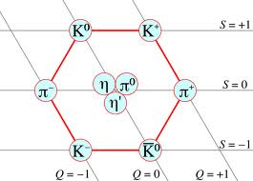
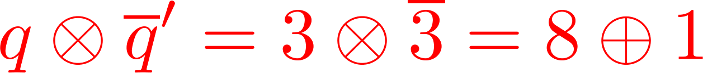
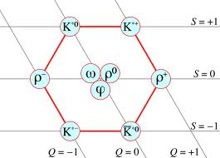
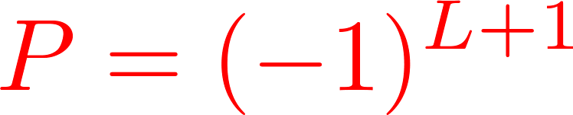
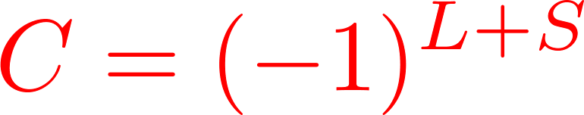
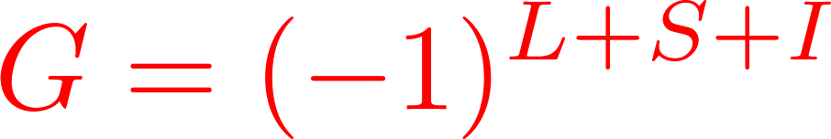
Mesons in the Quark Model
Mesons:
bound state of qq
SU(3)_{flavor}:
color singlets
Quantum numbers:
measured: I^{G} (J^{PC})
non-relativistic quark model: ^{2S+1}L_{J}
S=S₁+S₂ , J=L+S
L
S₁
S₂
q
q
Binding force?

Slide 3
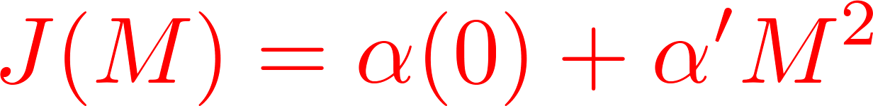
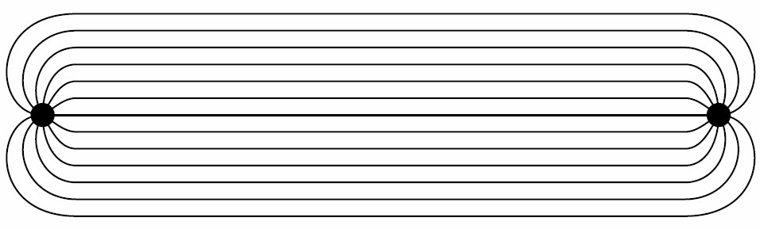
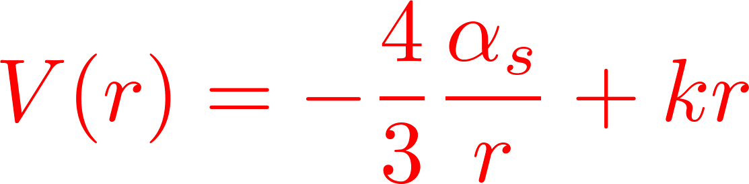
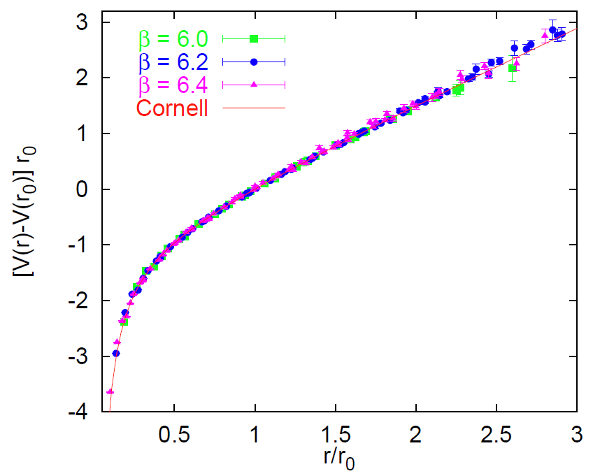
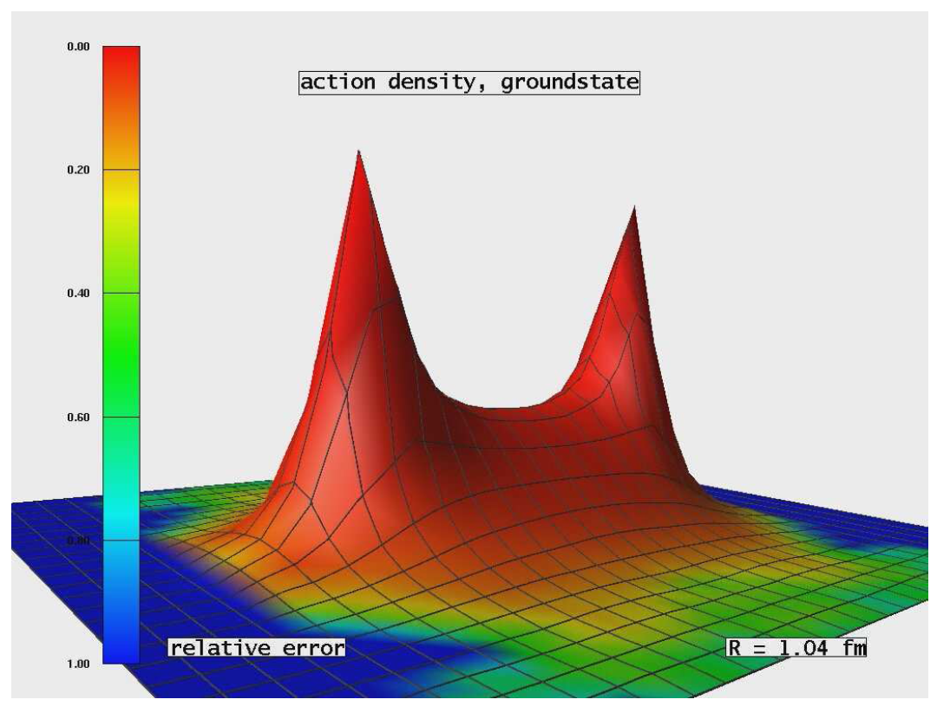
Confinement of Quarks
  string model (Nambu)
  flux tube model (Isgur, Paton)
Charmonia  potential models
Lattice QCD  confirms flux tube model
for heavy quarks
[G. Bali, arXiv/hep-ph 0001312 (2000)]
[G. Bali et al., Phys. Rev. D 71, 114513 (2005)]

Slide 4
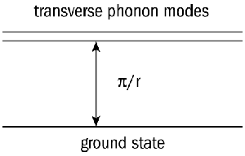
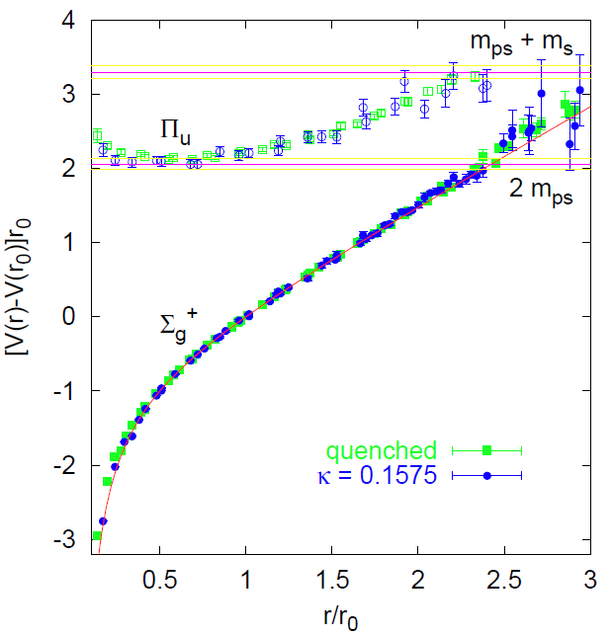
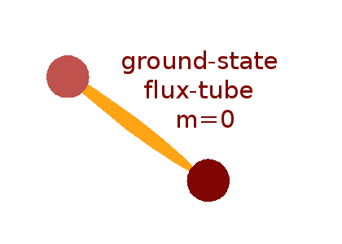
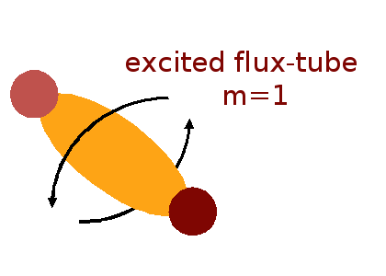
Gluonic Excitations: Hybrids
Normal mesons:
orbital, radial excitations
Hybrids:
excitation of gluonic degrees of freedom
angular momentum in flux tube
excited states also seen in L-QCD, bag,…
[G. Bali, arXiv/hep-ph 0003012 (2000)]

Slide 5
Spectrum of Hybrid Mesons
Bag model (Jaffe 76, Vainshtein 78, Barnes 83, Chanowitz 83)
confine quarks inside a cavity
apply boundary conditions on wall
allowed gluonic field modes: TE, TM
combine with S-wave qq pair
gluon | 1⁺⁻ (TE) | 1⁻⁺ (TM)
0⁻⁺ | 1⁻⁻ | 1⁺⁺
1⁻⁻ | (0,1,2)⁻⁺ | (0,1,2)⁺⁻
Mass | 1.0-1.4 GeV | heavier
qq
Flux tube model (Isgur 85, )
clockwise/anticlockwise rotation
linear combinations  definite J^{PC}
for m=1: J^{PC}=1⁺⁻, 1⁻⁺ of flux tube
8 degenerate nonets, ~1.9 GeV
gluon | 1⁻⁻
0⁻⁺ | 1⁺⁻
1⁻⁻ | (0,1,2)⁺⁺
1⁺⁻ | (0,1,2)⁻⁺
(0,1,2)⁺⁺ | 1⁻⁻ (0,1,2)⁻⁻ (1,2,3)⁻⁻
Constituent gluons (Szczepaniak 01, General 07, Guo 08)
hadronic Fock states of constituent quarks and gluons
transverse quasigluon with J^{PC}=1⁻⁻

Slide 6
Mesons in QCD
QCD: color-neutral bound system with integer spin
=
Observation of non-qq systems
overpopulation of QM spectrum
vanishing leading qq term
 exotic J^{PC}:
smoking gun
+
+
Molecule / 4 quarks
+
Hybrids
Glueballs
+ ...

Slide 7
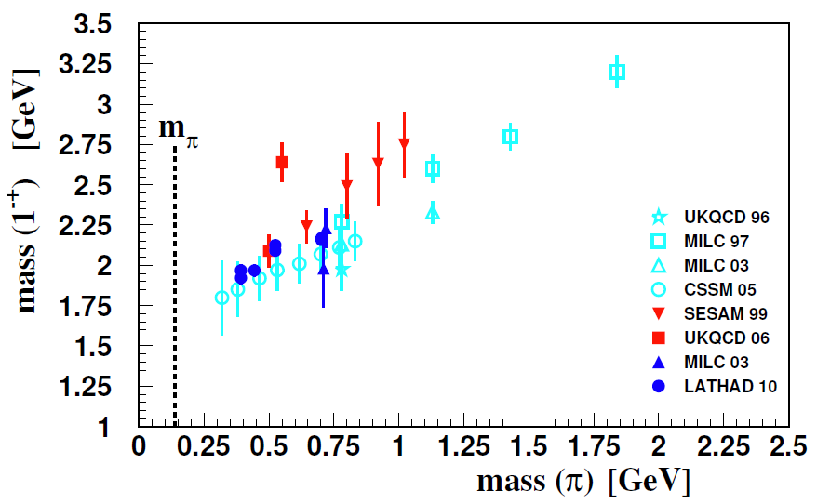
Hybrids with J^{PC} = 1⁻⁺
Mass
L-QCD predictions
Model | Mass (GeV/c²) | Reference
Bag Model | 1.0 – 1.4 | [Barnes and Close, Jaffe et al., Vainshtein et al]
QSSR | 1.0 – 1.9 | [Balitsky et al., Latorre et al., Narison et al.]
Flux Tube | 1.8 – 2.0 | [Isgur et al.]
Hamiltonian | 2.1 – 2.3 | [Cotanch et al.]
[C. Mayer et al., Phys. Rev. C 82, 025208 (2010)]
Decay
  by producing a qq pair with J=0, L=1, S=1 (J^{PC}=0⁺⁺)
  and quark rearrangement (³P₀ model, Micu 69)
  to an L=0 and an L=1 meson prefered (Isgur 85, Close 95),
  but depends on spatial wavefunctions
  symmetry arguments, e.g. J^{PC}=1⁻⁺
  decays to η’π, not to ηπ, if member of flavor octet
L=1
L_{flux}
L=0

Slide 8
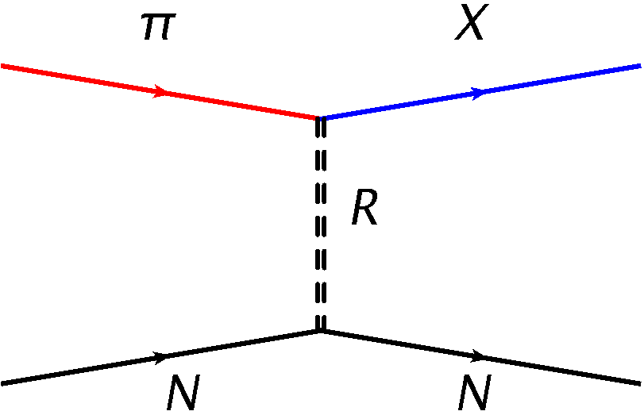
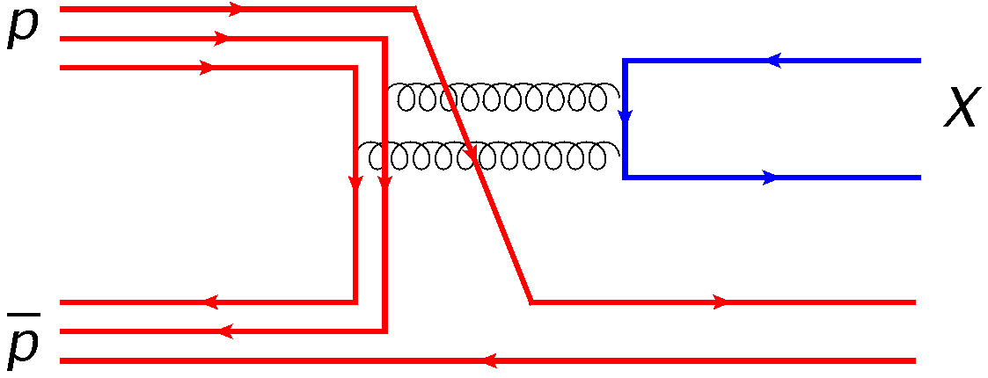
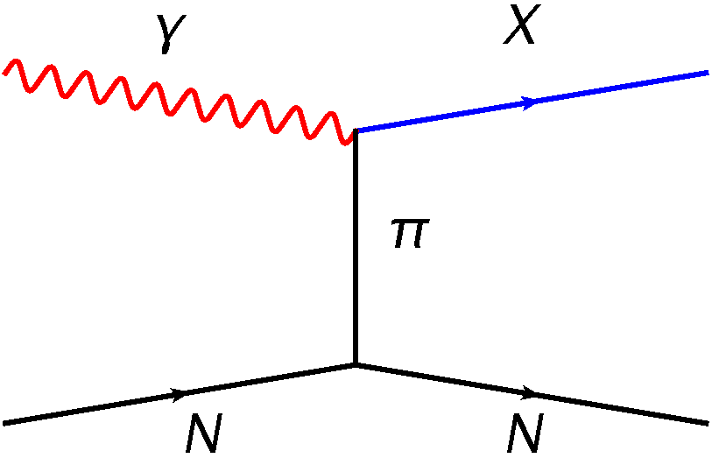
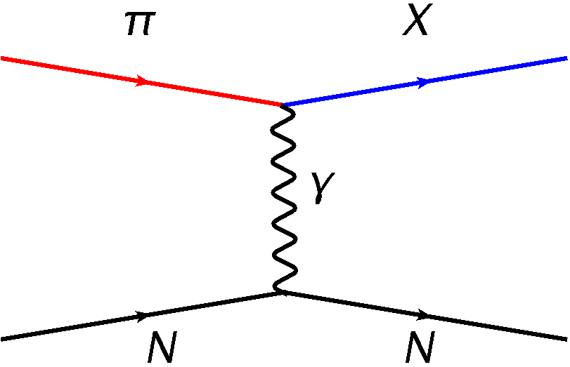
Production Mechanisms
Crystal Barrel
VES, E852, COMPASS
CLAS
COMPASS
Diffractive production: Regge- or Pomeron exchange
pN annihilation: formation and production
Photo-production

Slide 9
Old Experiments
Light meson sector exotics J^{PC}=1⁻⁺:
π₁(1400) (E852, VES, Crystal Barrel)
π₁(1600) (E852, VES, Crystal Barrel)
π₁(2015) (E852)
resonant nature controversial...
Events / 0.04 GeV/c²
M(3π) (GeV/c²)
[S.U. Chung et al., PRD 65, 072001 (2002)]
[A.R. Dzierba et al., PRD 73, 072001 (2006)]
 new experiments needed!

Slide 10
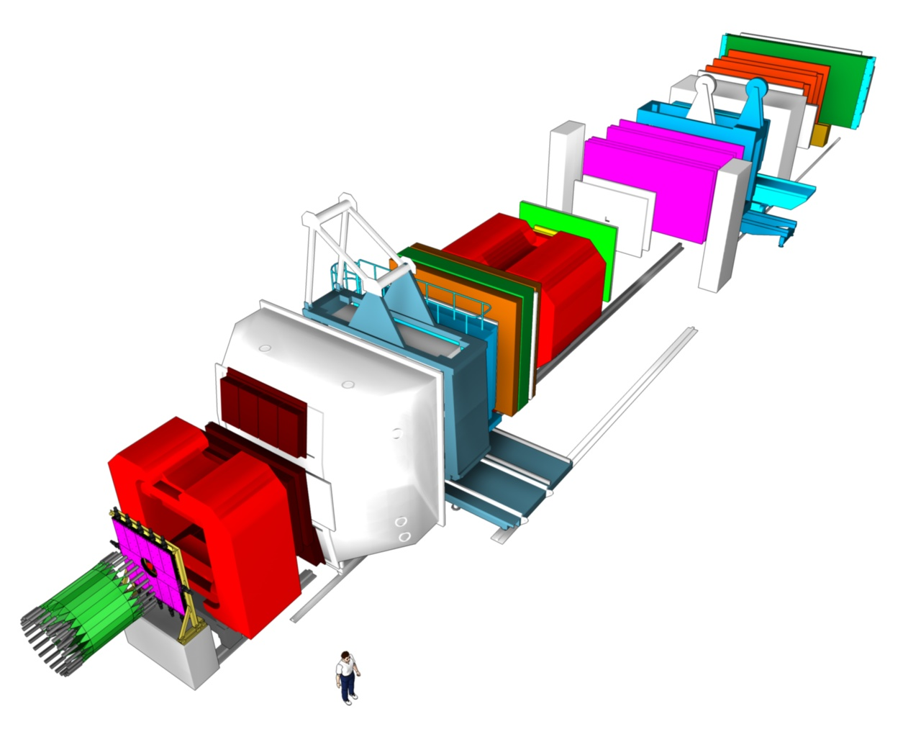
The COMPASS Experiment
Two-stage spectrometer
large angular acceptance
broad kinematical range
~250000 channels
> 1000 TB/year
MuonWall
SM2
E/HCAL
E/HCAL
50 m
Data taking periods:
2002-2004: 160 GeV/c μ⁺
2004: 2 weeks 190 GeV/c π⁻
2006-2007: 160 GeV/c μ⁺
2008-2009: 190 GeV/c π⁻
2010: 160 GeV/c μ⁺
2011: 200 GeV/c μ⁺
2012: 190 GeV/c π⁻
SM1
MuonWall
Target
RICH
Beam
RPD
[COMPASS, P. Abbon et al., NIM A 577, 455 (2007)]

Slide 11
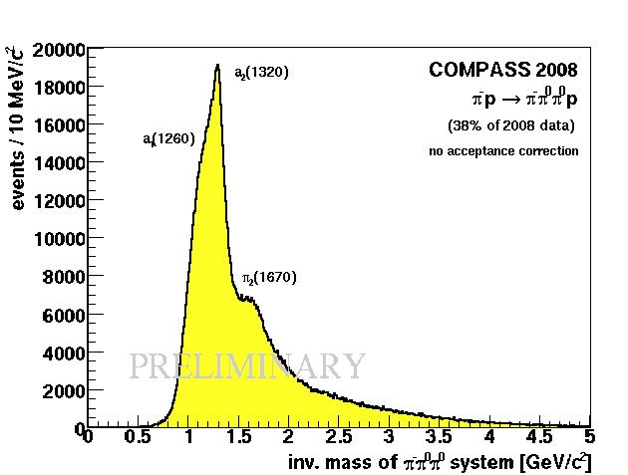
3π Final States 0.1 < t’ < 1 GeV²
420k events
96M events
> 2.4M events
Target: 3 mm Pb
Trigger: Multiplicity
No RPD
Target: 40 cm lH2
Trigger: Recoil proton
RPD
Cross-check:
  tracking vs
  ECAL
Isospin symmetry:
  I=1 vs I=0 isobars
  fulfilled

Slide 12
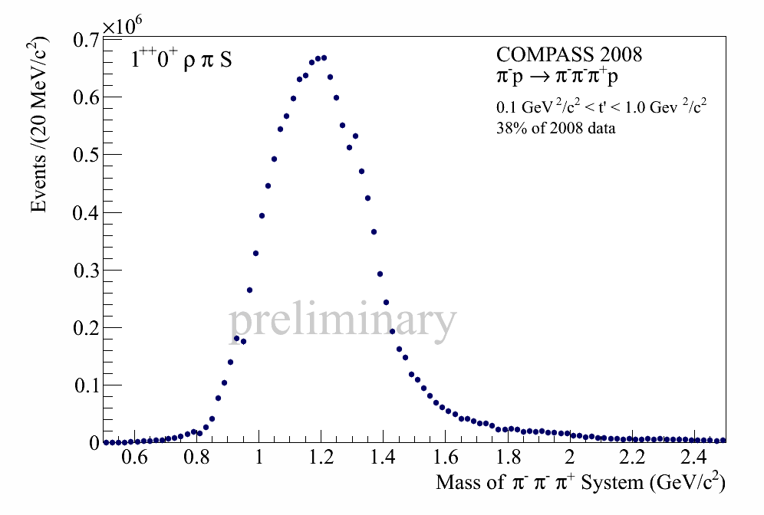
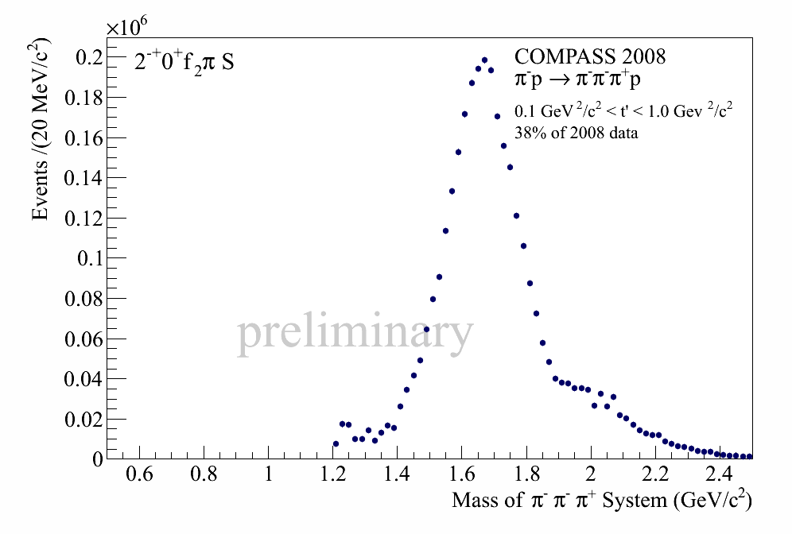
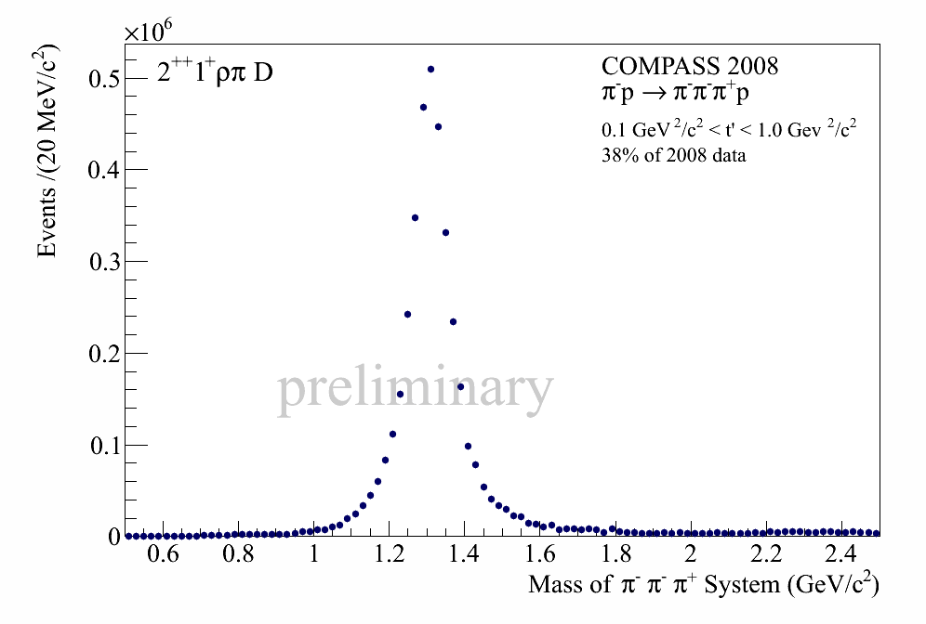
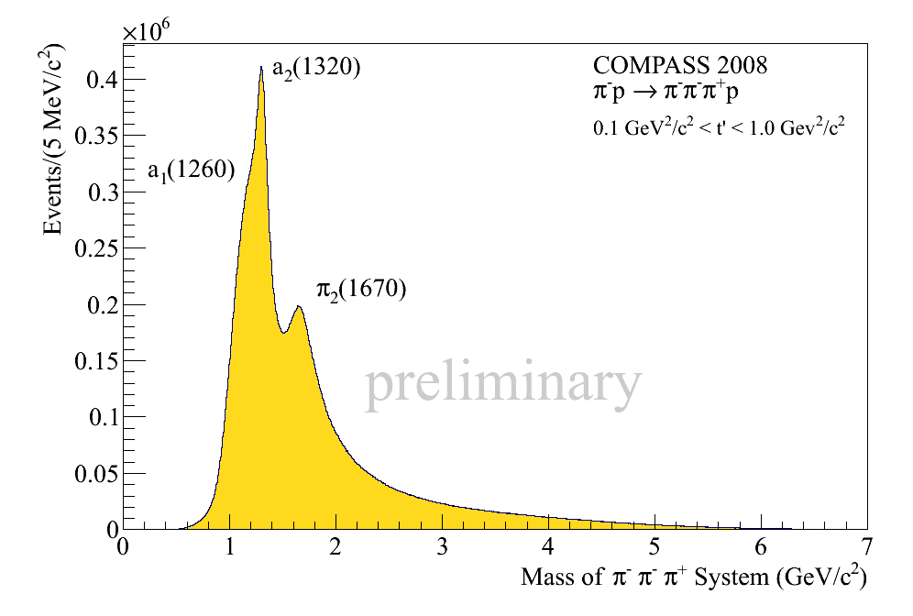
Intensities of Major Waves
a₁(1260)
π₂(1670)
a₂(1320)

Slide 13
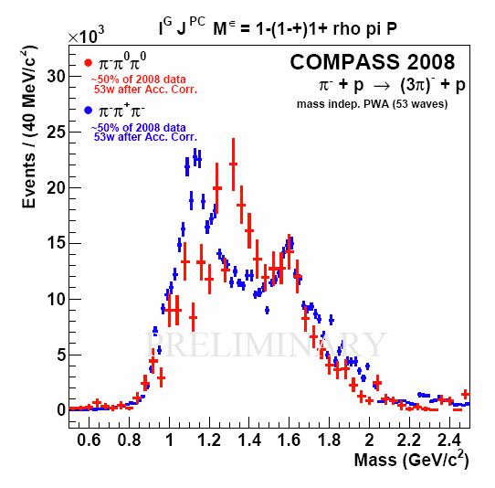
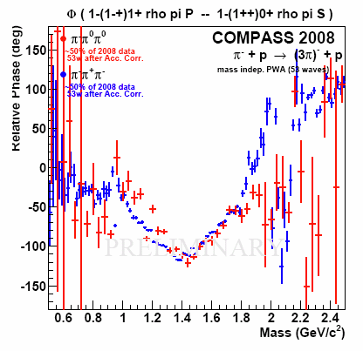
J^{PC}=1⁻⁺ ‒ Pb vs H Target
Peak at 1.67 GeV/c² for both targets
Phase motion indicates resonant behavior
Structure at 1.2 GeV/c² unstable w.r.t. fit model
No fit to spin-density matrix yet for H target
Production of M=1 states enhanced for heavy target
Non-resonant background to be understood
[Alekseev et al., Phys. Rev.
Lett. 104, 241803 (2010)]
[F. Haas, arXiv:1109.1789 (2011)]

Slide 14
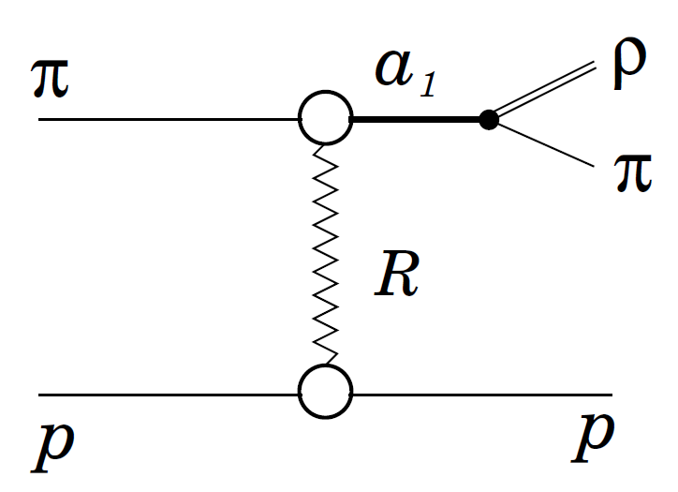
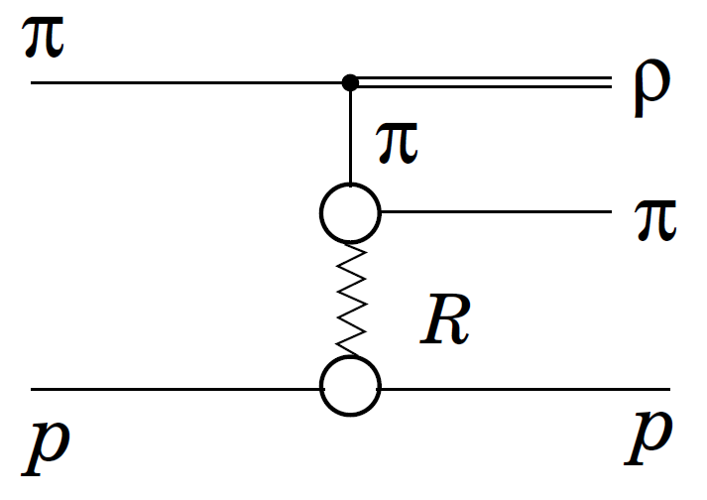
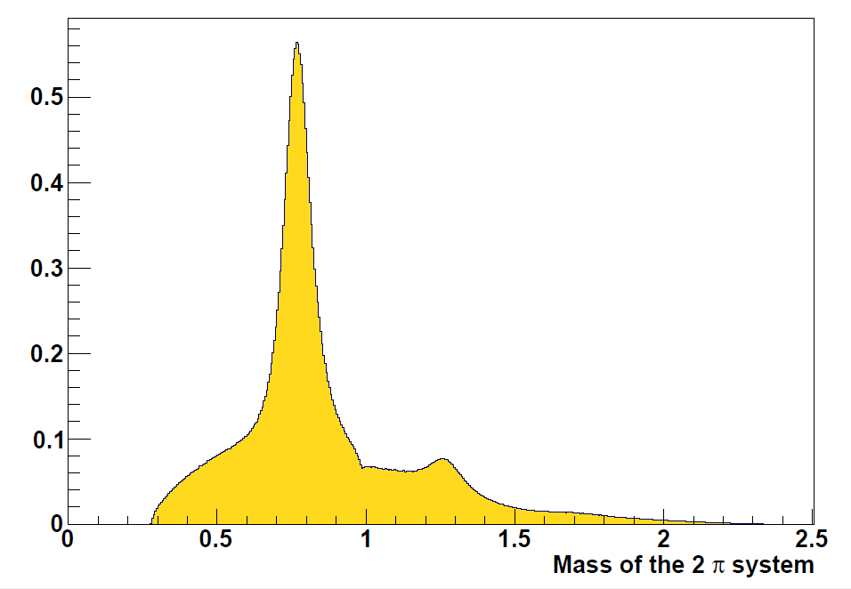
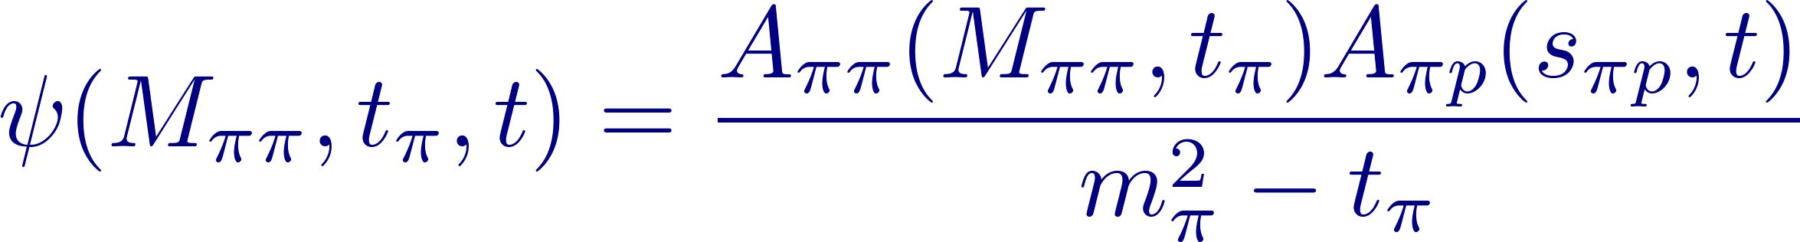
Deck Effect
Resonant production
Non-resonant production
Generate pure Deck-like events
[G. Ascoli et al., Phys. Rev. D 8, 3894 (1973)]
Pass through Monte Carlo & PWA
Normalize to 6⁻⁺0⁺ ρπ H wave
Examine intensity in other waves

Slide 15
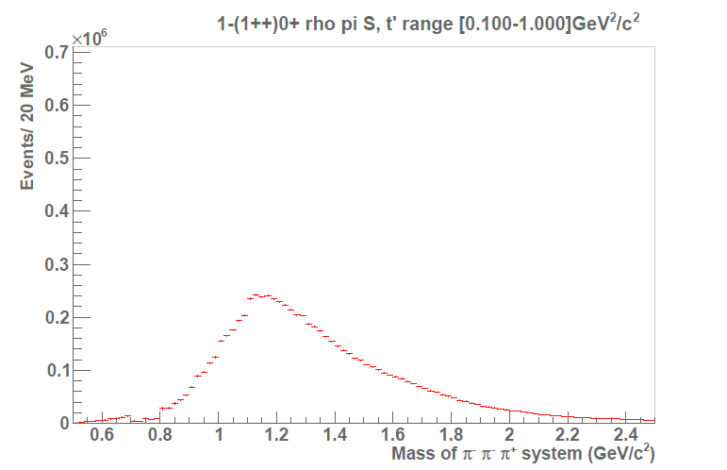
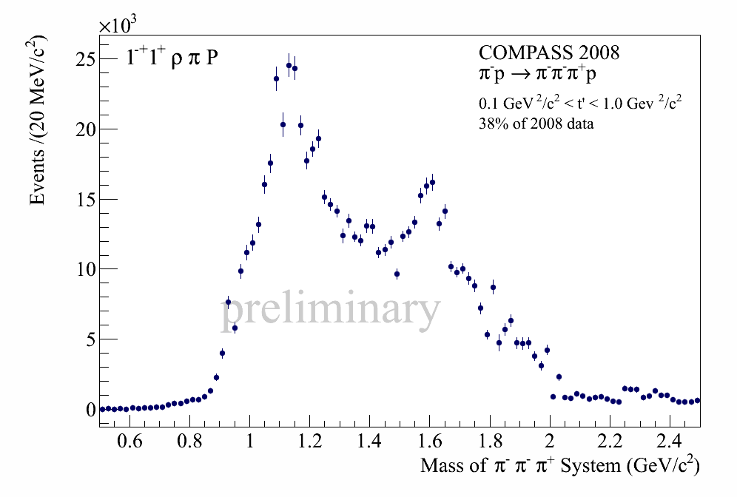
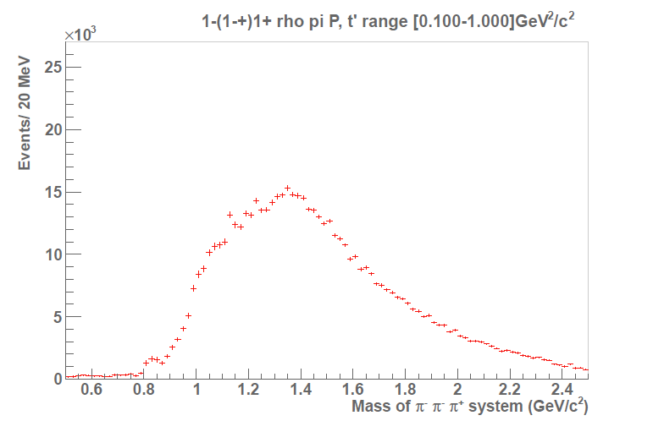
Deck Effect
a₁(1260)
Diffractive production of J^{PC}=1⁻⁺1⁺ and decay to ρπ:
large non-resonant contribution to J^{PC}=1⁻⁺ amplitude
no phase motion of pure background events
bin in mass and t  production mechanism
include Deck amplitudes in fit of spin-density matrix
π₁(1600)

Slide 16
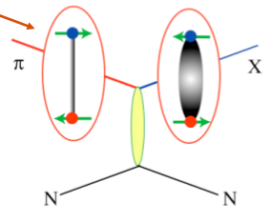
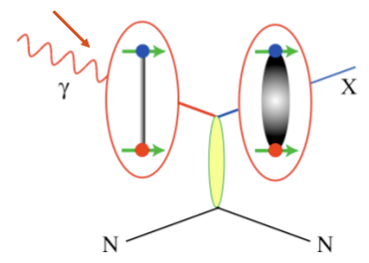
Photoproduction of J^{PC}=1⁻⁺
Flux tube model (Isgur 85, Close 95):
Pion beam:
J^{PC} = 0⁻⁺
  mainly S=0 hybrids: 1⁻⁻, 1⁺⁺
  mix with qq states
Photon beam:
J^{PC} = 1⁻⁻, VMD
   mainly S=1 hybrids
  exotic J^{PC} , strength comparable to a₂(1320)?
L-QCD (Dudek 09)
  strong photocoupling for cc hybrids
photoproduction more favorable for exotic hybrids?

Slide 17
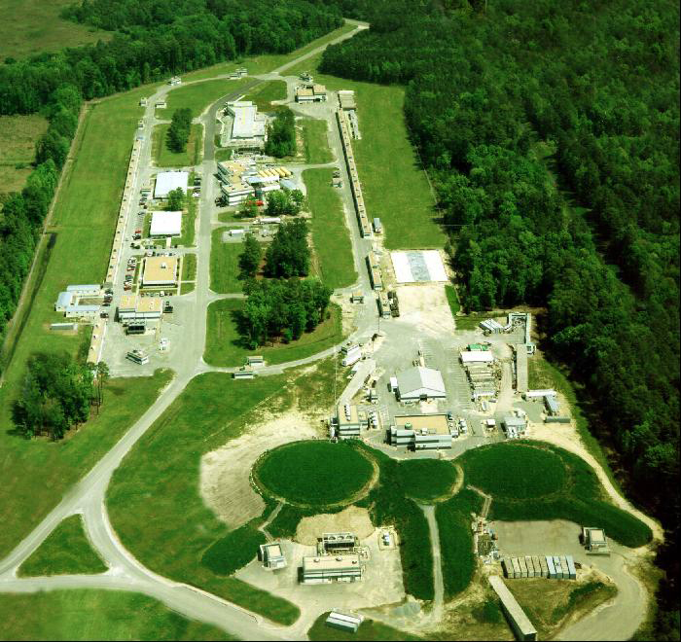
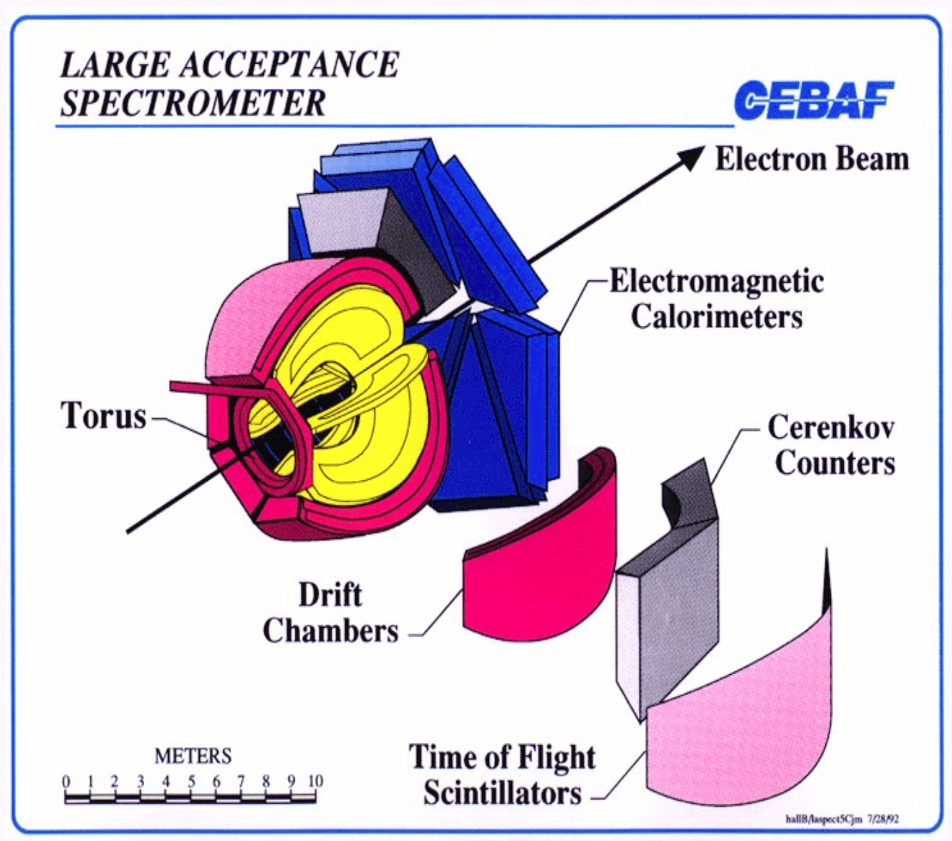
CLAS at CEBAF
[B. Mecking et al., NIM A 503, 513 (2003)]
Run g6c (2001) [M. Nozar et al., PRL 102, 102002 (2009)]
E_{e} = 5.744 GeV
tagged photon beam with E_{γ} up to 5.4 GeV
flux 5·10⁷ photons / s
18 cm liquid hydrogen target
83k ev.
Run g12 (2008) [C. Bookwalter, arXiv:1108.6112v1]
geometry optimized for peripheral production
E_{γ} up to 5.75 GeV
68 pb⁻¹  520k ev.
PWA with 19 waves: J^{PC} = 1⁺⁺, 2⁺⁺, 1⁻⁺, 2⁻⁺ (no J=0 expected)

Slide 18
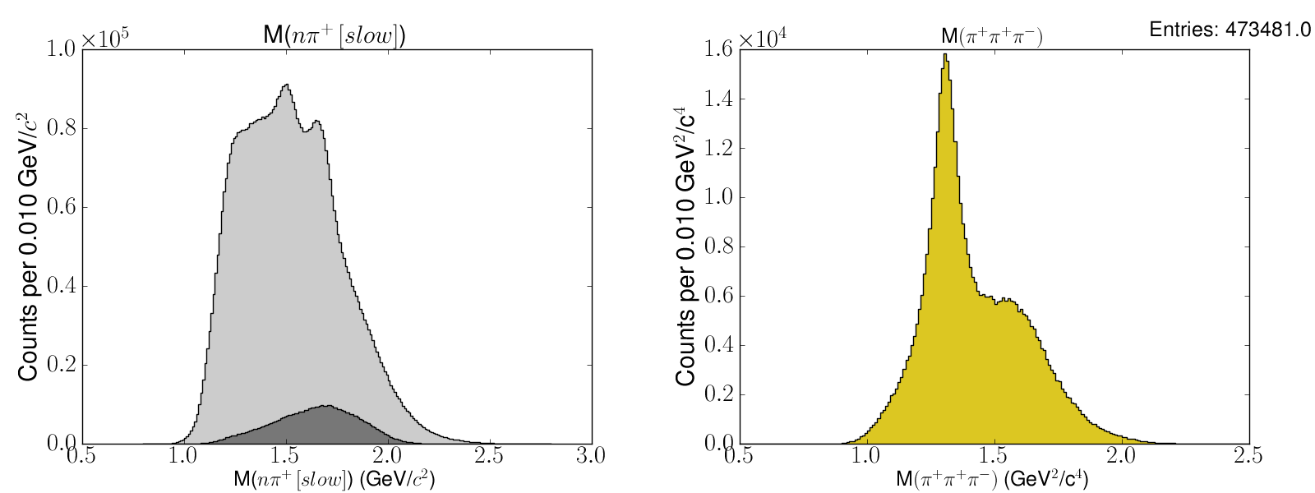
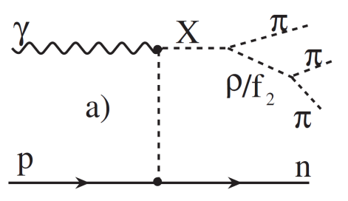
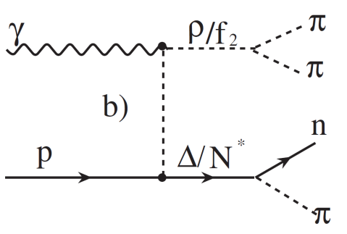

Data Selection
π⁺π⁺π⁻ identified by vertex and timing cuts
n selected via missing mass
Background from baryon resonances

Slide 19
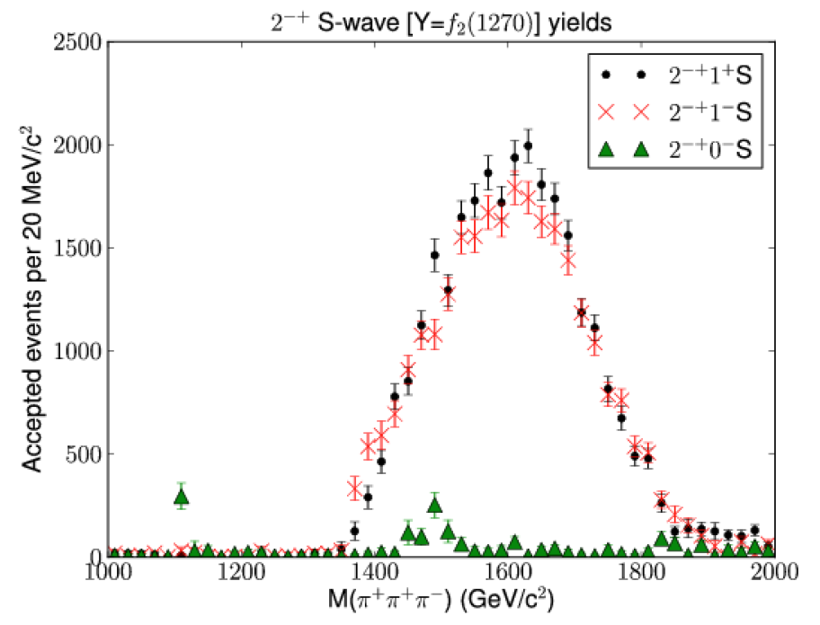
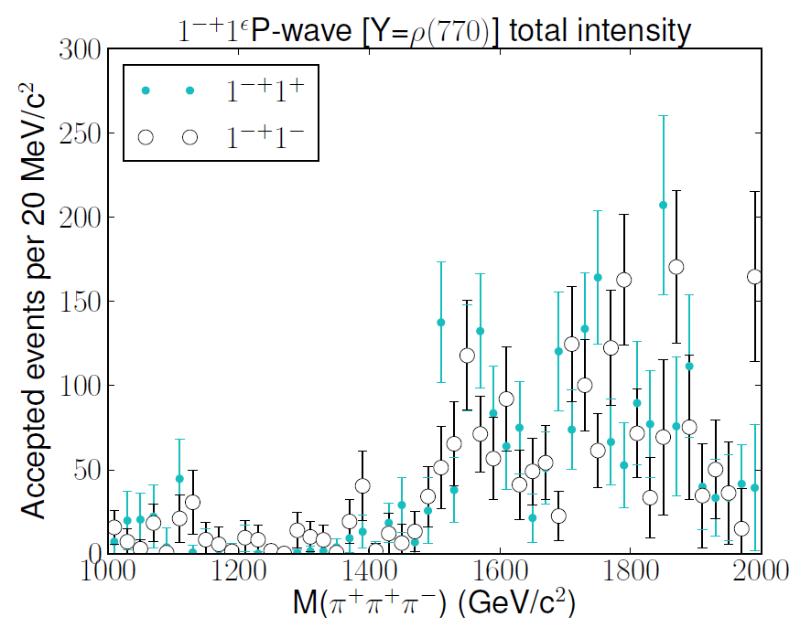
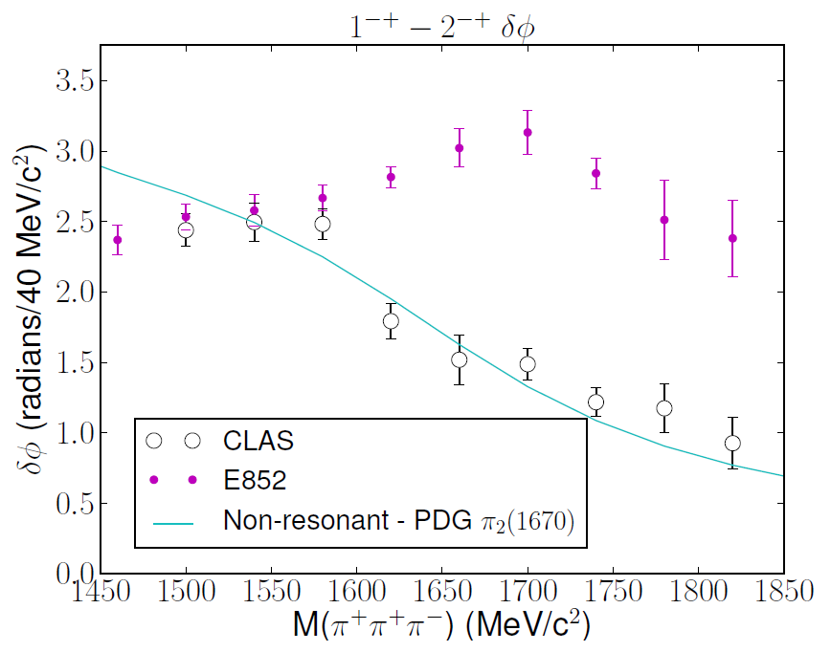
Results from PWA
Evidence for a₁(1260), a₂(1320), π₂(1670)
No evidence for 1⁻⁺ resonance
Upper limit: 2% of a₂(1320)
Population of M=0 waves  Deck effect?

Slide 20
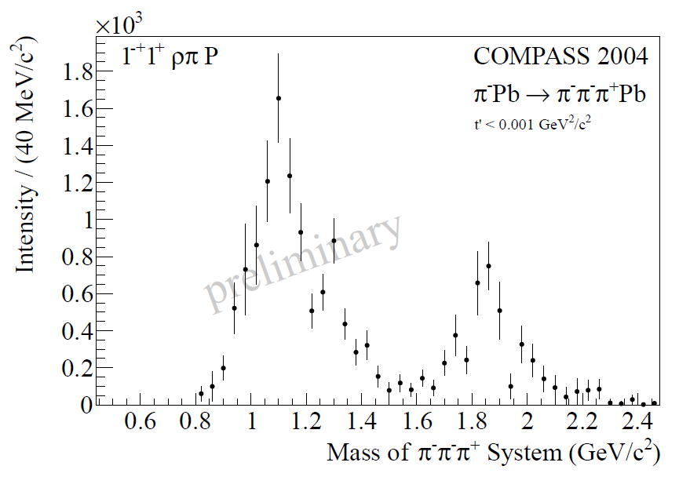
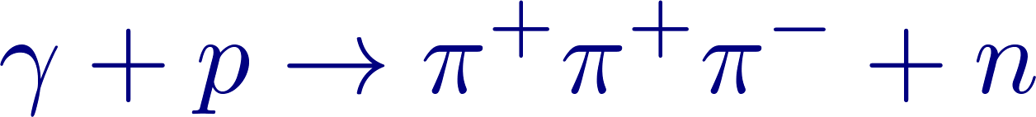
Photoproduction of J^{PC}=1⁻⁺
CLAS
COMPASS
 no evidence for π₁(1600) photoproduction!

Slide 21
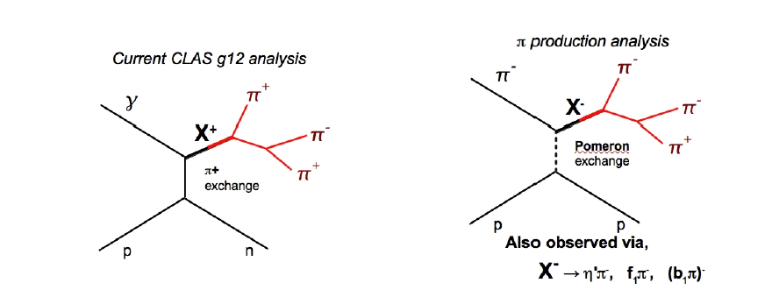
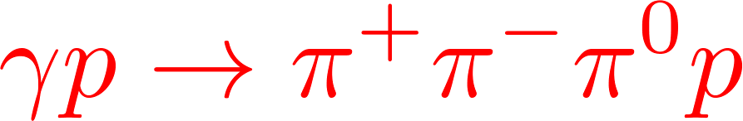
Photoproduction of J^{PC}=1⁻⁺
Intensity + phase motion at 1.7 GeV/c² in ρπ in diffractive production
No signal at 1.7 GeV/c² in ρπ in photoproduction
Pomeron vs charge exchange?
Look at in CLAS data

Slide 22
Multi-Particle (>3) Final States
Motivation:
Clarify the hybrid nature of the π₁  branching ratios to different channels
Model | b₁π | f₁π | ρπ | ηp | η’p | η(1295)p | Reference
Flux Tube, ³P₀ | 170 | 60 | 5 - 20 | 0 - 10 | 0 – 10 |  | [Isgur et al., Close et al.]
Flux Tube, IKP m=1.6 GeV/c² | 24 | 5 | 9 |  |  | 2 | [Isgur et al.]
Flux Tube, PSS m=1.6 GeV/c² | 59 | 14 | 8 |  |  | 1 | [Page et al.]
L-QCD | 66 | 15 |  |  |  |  | [McNeil and Michael]
Higher masses accessible  many disputed states: 0⁻⁺, 1⁺⁺, 2⁻⁺,...
Under investigation in COMPASS:

Slide 23
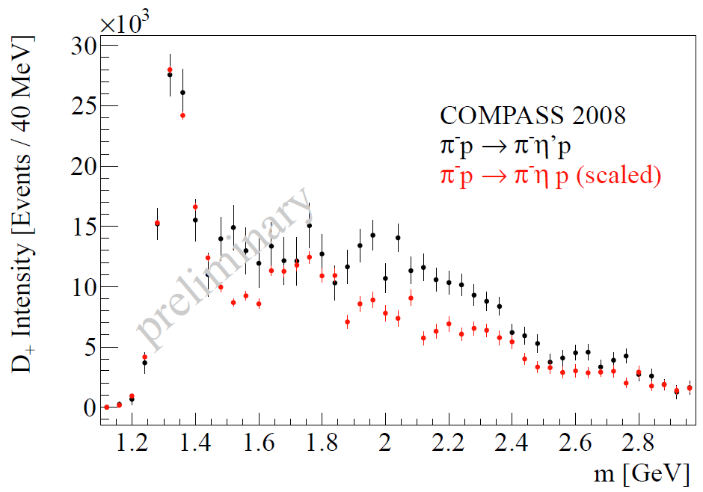


ηπ⁻ vs η’π⁻ Final States
ηπ⁻ waves scaled according to
phase space and BR to final state
D, G waves very similar
P wave very different in ηπ and η’π
 Talk by T. Schlüter at QNP12

Slide 24
Non-exotic Hybrid Candidates
Most observed resonances compatible with qq
Only few cases where experiment disagrees with expectations
Supernumerary states difficult to disentangle
Guidance from models, L-QCD

Slide 25



State of the Art Lattice QCD
exotic
positive parity
Structure of states: study
negative parity
with e.g.
[J. Dudek, Phys. Rev. D 84, 074023 (2011)]
[J. Dudek at al., Hadron Spectrum Collaboration, Phys. Rev. D 82, 034508 (2010)]

Slide 26



Comparison with Models
J^{PC} & Degeneracy pattern:
L-QCD
Bag
Flux tube
Constituent gluon
S wave
P wave
✗
✗
✓
✗
(0,1,1,1,2,2,3)⁺⁻
(0,1,2)⁺⁺
1⁺⁺,(0,1,2)⁺⁻
(0,1³,2²,3)⁻⁻
(0,1,2)⁻⁺
(0,1³,2²,3)⁺⁻
(0,1,2)⁺⁺
1⁺⁺,(0,1,2)⁺⁻
1⁻⁻,(0,1,2)⁻⁺
✓
✗
✓
(0,1,2)⁻⁺,1⁻⁻
1⁻⁻,(0,1,2)⁻⁺
1⁺⁻,(0,1,2)⁺⁺
1⁻⁻,(0,1,2)⁻⁺
Model with a quasigluon in a P-wave with respect to the qq pair,
i.e. with successfully reproduces the L-QCD multiplets

Slide 27




J^{PC} = 0⁻⁺
π(1800): M=1827±7 MeV/c² (COMPASS)
2 states expected: 3S qq, hybrid
hybrid expected to have large branching
to f₀π, no decay to ωρ
2 distinct states observed? (Barnes 97)

Slide 28







J^{PC} = 2⁻⁺
π₂(1670) + Deck?
π₂(2100)?

Slide 29







Y(4260)
Discovered by BaBar in ISR:
[Aubert et al., PRL 95, 142001 (2005)]
Confirmed by BELLE, CLEO
ISR  JPC = 1⁻⁻
CLEO found ratio
to be consistent with isoscalar
[T.E. Coan et al., PRL 96, 162003 (2006)]
Decay to , suppressed
  no simple cc interpretation?
Possible scenarios:
  4-quark
  baryonium
  charmonium hybrid
[BELLE, C.Z. Yuan et al., PRL 99, 182004 (2007)]
[BaBar, J.P. Lees et al., arXiv:1204.2158 (2012)]

Slide 30




Y(2175)
Discovered by BaBar in
ISR  J^{PC} = 1⁻⁻
Confirmed by BESII, BELLE
Similarity of decays
strangeonium hybrid?
Decay suggests quark S=1 (if quark spin
is preserved in decay)
Vector hybrid has quark S=0
No overpopulation of ss vector states
(as in charmonium)
[BaBar, B. Aubert et al., Phys. Rev. D 74, 091103 (2006)
[Belle, K.F. Chen et al., PRL 100, 112001 (2008)]

Slide 31
Conclusions
Hybrid mesons
  are allowed in QCD, but are they realized in nature?
  provide a test of flux tube formation  confinement
  can appear in exotic J^{PC} quantum numbers  smoking gun
High statistics data with π beam: COMPASS
  exotic 1⁻⁺ waves in ρπ, η’π, f₁π
  non-resonant and resonant contributions
  A dependence of M=1 production
Photoproduction: CLAS (also COMPASS)
  no evidence for π₁(1600) in charge transfer reaction
  examine Pomeron production
Have we observed the lowest hybrid nonet?
π₁(1600), π(1800), π₂(1880), ?

Slide 32
Outlook
L-QCD provides guidance to establish hybrid nonets
   quantum numbers, masses, decay modes
Data analysis:
  study model dependence
  include resonant and non-resonant amplitudes
  include rescattering effects
  perform coupled-channel analyses
  provide access to data

Slide 33




Outlook
L-QCD provides guidance to establish hybrid nonets
  Quantum numbers
  Masses
  Decay modes
Data analysis:
  study model dependence
  include resonant and non-resonant amplitudes
  include rescattering effects
  perform coupled-channel analyses
  provide access to data
New experiments:
  BESIII
  BELLEII
  GlueX, CLAS12
  PANDA

Slide 34
Spare Slides

Slide 35
Hybrids
Light meson sector exotics J^{PC}=1⁻⁺:
π₁(1400)
  (E852, VES)
  (Crystal Barrel)
  (Crystal Barrel)
π₁(1600)
  (E852, VES)
  (Crystal Barrel)
π₁(2000)
  (Crystal Barrel)
still controversial...

Slide 36
π₁(1600) – Positive Results in 3π
BNL E852: π⁻+pπ⁺π⁻π⁻+p’
p_{π}=18 GeV/c
limited statistics: 250k ev.
rank 2
mass dependent fit
[S.U. Chung et al., Phys. Rev. D 65, 072001 (2002)]
VES: π⁻+Aπ⁺π⁻π⁻+A’
p_{π}=37 GeV/c
full coherence
[Y. Khokhlov, Nucl. Phys. A 663, 596c (2000)]

Slide 37

π₁(1600) – Negative Results in 3π
BNL E852: π⁻+pπ⁺π⁻π⁻+p’
p_{π}=18 GeV/c
full statistics: 2.6M ev.
rank 1
extended wave set (2⁻⁺ waves)
no mass dependent fit
[A.R. Dzierba et al., Phys. Rev. D 73, 072001 (2006)]
VES: π⁻+Aπ⁺π⁻π⁻+A’
p_{π}=37 GeV/c
unlimited rank
[D.V. Amelin, Phys. Atom. Nucl. 68, 359 (2005)]

Slide 38
Partial Wave Analysis
Isobar model:
X decays via sequence of 2-body decays
Intermediate resonances: isobars
Partial wave: χ = J^{PC}M^{ε}[isobar R]L
Decay amplitudes A_{χ}(m,τ) calculable
  3 variables for each 2-body vertex
  in mother r.f.
  3π decay:
  contain angular distributions and
  isobar parameterizations
Reflectivity basis: linear combinations

Slide 39
PWA Technique
Illinois / Protvino / Munich Program – BNL / Munich Program
1. PWA of angular distributions in 40 MeV mass bins
Production amplitudes  extended maximum likelihood fit
Decay amplitudes (Zemach tensors, D functions)
41 partial waves i=J^{PC}M^{ε}[...]L
[...] = (ππ)_{S}, ρ(770), f₀(980), f₂(1270), ρ₃(1690)
Background wave added incoherently
No assumption on resonant behavior is made at this point!
2. Mass-dependent χ² fit to results of step 1
  6 waves
  Parameterized by Breit-Wigner
  Coherent background for some waves

Slide 40
Wave Set

Slide 41
Intensities of Major Waves
a₁(1260)
π₂(1670)
a₂(1320)

Slide 42
a₂(1320)
Two Breit Wigner functions required to describe phase motion
BW1 for a₂(1320)
BW2 for a₂(1700): M=1732 MeV/c², Γ=194 MeV/c² (fixed PDG values)

Slide 43
a₄(2040)
Constant width BW used for a₄(2040) (branching ratios not known)
BW parameters

Slide 44

Leakage Study
1150000 events generated from 15 dominant waves
  including J^{PC}=2⁻⁺ M=0,1
  excluding J^{PC}=1⁻⁺ exotic wave
full reconstruction + PWA
 less than 5% leakage into 1⁻⁺ wave

Slide 45

Systematic Studies

