Slide 1

Study of DVCS and HEMP processes
at COMPASS
CIPANP 2012
St. Petersburg (FL), June 2012
Horst Fischer*
ALU Freiburg
* on behalf of the COMPASS collaboration
Outline
New results – pol. target:
HE ρ0 production
Outlook:
DVCS & HEMP – LH₂ target
(DVCS & HEMP– pol. Target)

Slide 2













LHC
COMPASS
SPS
Versatile facility for
hadron structure studies
hadron spectroscopy
Celso Franco: Latest results on longitudinal spin
physics at COMPASS (next room)
→ Florian Haas: Hadron spectroscopy with COMPASS
Notes:
240 Physicists from 10 countries & CERN

Slide 3
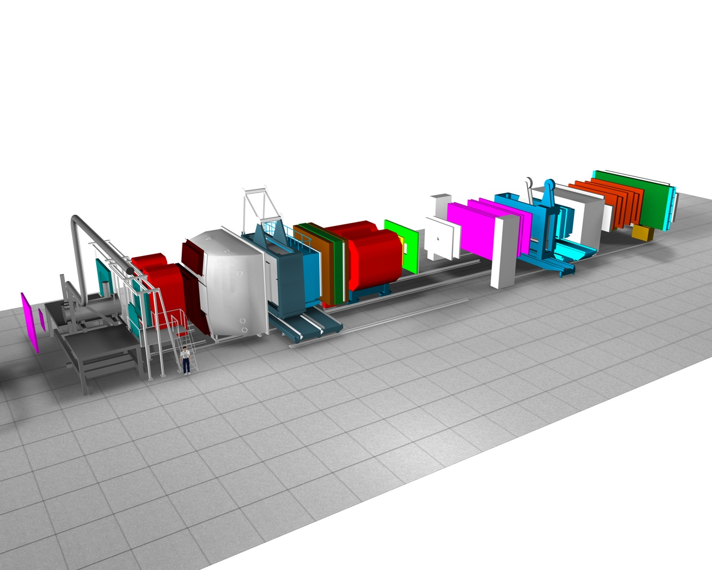
The COMPASS Experiment @ CERN
NIM A 577 (2007) 455
50m
Τwo stage magnetic spectrometer
large angular & momentum acceptance
Particle identification
- Ring Imaging Cerenkov Counter
- Electromagnetic calorimeters
- Hadronic calorimeters
- Hadron absorbers
μ⁺, μ⁻ or hadron (π, K, p) beam
- changeover within < 1h
momentum: 100 - 200 GeV/c
80% polarization
μ⁺ & μ⁻ with opposite polarization
Notes:
Luminosity: ~5 . 10³² cm⁻² s⁻¹
0.003 < x < 0.5 10-3 < Q2 < 10 (GeV/c)2

Slide 4
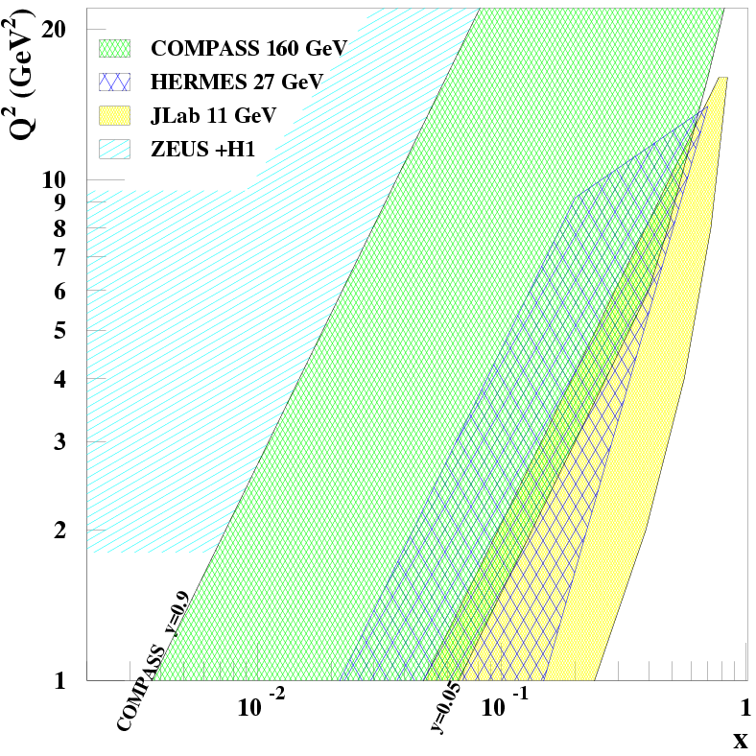
What makes COMPASS special for DVCS & HEMP
DVCS & HEMP
luminosity limit
10³² cm⁻²s⁻¹
μ⁺ and μ⁻ beam
100 - 200 GeV/c
80% polarization
μ⁺ and μ⁻ with
opposite polarization
Unique feature
of
COMPASS @ CERN/SPS
Explore uncovered region between ZEUS/H1 and HERMES & Jlab
Notes:
Lumi = 10**32 for 2.5m LH2 target
if Lumi × 4 → more comfortable statistics for Q² up to 12 GeV²
Uncovered region between ZEUS+H1 & HERMES + Jlab before new colliders may be available
➢Transverse structure at x~10-2 essential input for phenemenology of high-energy pp collision (LHC)

Slide 5
Hard Exclusive ρ⁰ Production
off Polarized Targets
(without recoil detector!)

Slide 6
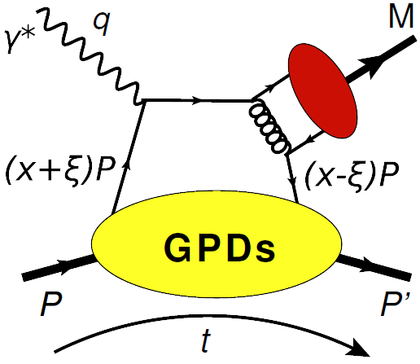
Hard Exclusive Meson Production
Cross section measurements:
Pseudo-scalar: π, η, … ⇒ H & E
Vector meson: ρ, ω, φ…⇒ H & E
~
~
ρ : ω : φ ∼ 9 : 1 : 2
(at large Q² )
Allows for flavor separation:
Eρ⁰ = 1/√2 (2/3 E^{u} + 1/3 E^{d} + 3/8 E^{g})
Eω = 1/√2 (2/3 E^{u} – 1/3 E^{d} + 1/8 E^{g})
Eφ = -1/3 E^{s} – 1/8 E^{g}
Presently studied at COMPASS
without RPD
Vector meson production from
transversely polarized target asymmetry ⇒ E/H

Slide 7
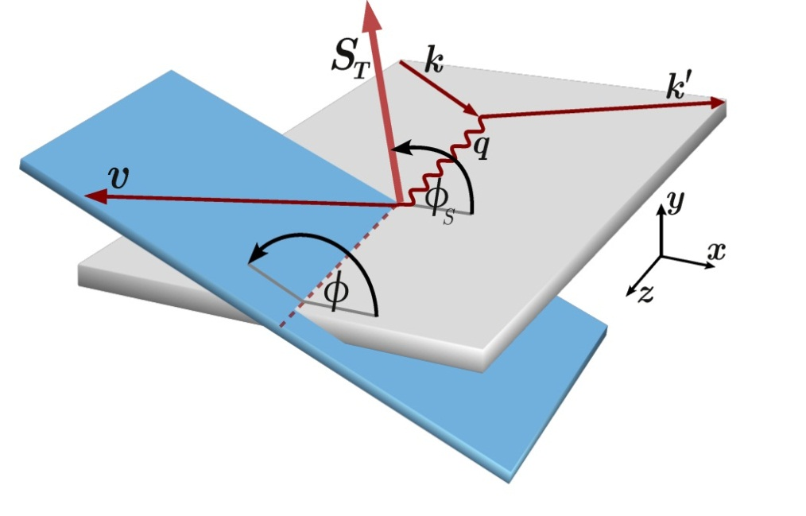
HEMP with polarized Target
E and H are weighted sums of GPD E_{q,g} & H_{q,g}
Provide access to GPD E
Constrain total angular momentum using Ji's relation:
Notes:
l/T separation still missing. Use angular distribution of Rho decay
Goloskokov Kroll Model – most complete model with H and E for quarks and gluons
quarks transverse degree of freedom taken into account
Account
the asymptotically dominant (longitudinal) amplitude for L* p Lpbut also the one for transversely polarized photons and vector mesons T* p Tp

Slide 8
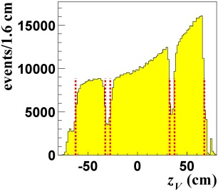
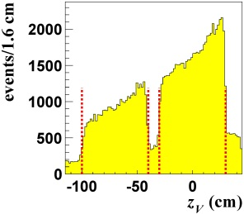
Experimental Set-Up: Beam & Targets
Beam:
160 GeV μ⁺
NH₃
Targets:
NH₃ - 2007 & 2010 (γ-proton asymmetries)
<P>= 0.8 <f>= 0.25
acceptance 70mrad → 180 mrad
⁶LiD - 2003 & 2004 (γ-deuteron asymmetries)
<P>= 0.5 <f>= 0.45
⁶LiD
Event Signature:
μ⁺ N −>μ⁺ N' ρ⁰
ρ⁰ −>π⁺ π⁻ (BR ~ 100%)

Slide 9
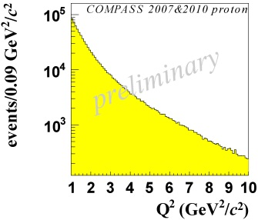
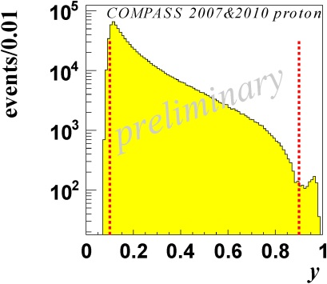
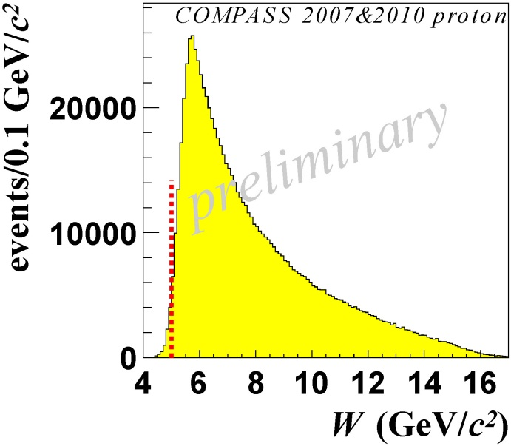
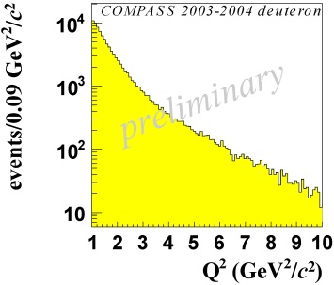
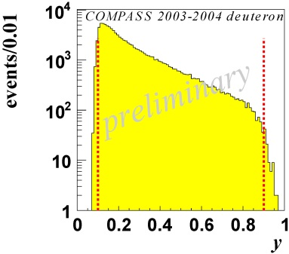
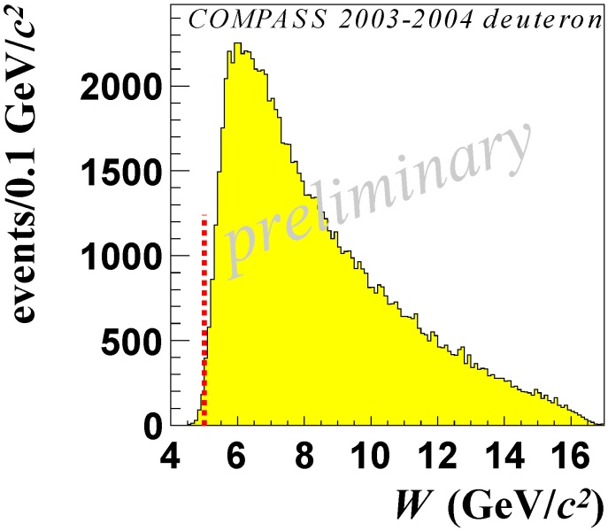
Selections to set Hard Scale

Slide 10
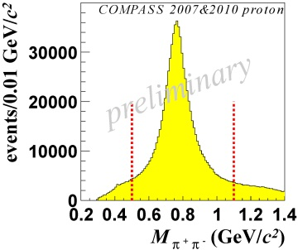
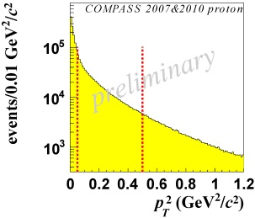
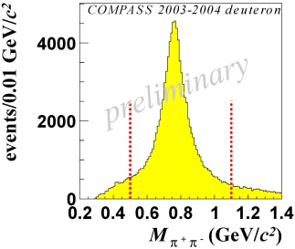
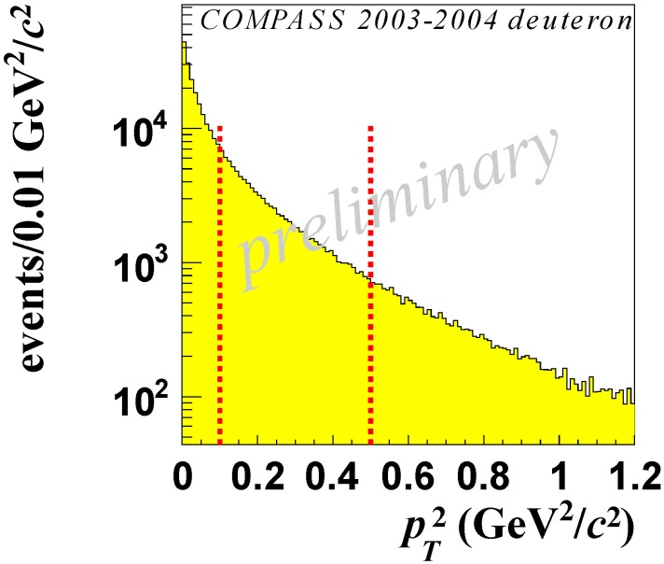
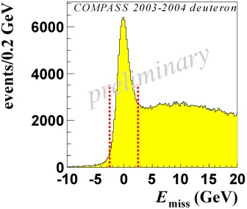
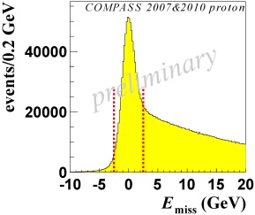
Selections for ρ⁰ Production
Assuming π mass
Cuts optimized to supress
non-resonant
coherent nuclear
SIDIS
background

Slide 11
Exclusivity Cuts
No recoil detector → assuming π and p masses
Missing Energy Technique:
14% contamination of diffractive dissociation
(no attempt to remove it)
Final sample:
NH₃: 797000 events
⁶LiD: 97000 events
… but still strong SIDIS background
Notes:
-2.5 GeV < Emiss < 2.5 GeV

Slide 12
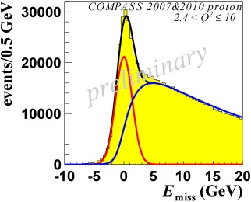
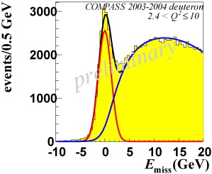
SIDIS Background Subtraction
Two examples:
Estimate & subtract background bin-by-bin
still 5…40% background from SIDIS
(depending on target cell, )
Fix shape of background using Data/MC like-sign events
Estimate SIDIS background from fit to data
Assume Gaussian shape for signal
total
exclusive
SIDIS
total
by a binned max. likelihood
exclusive
SIDIS
Notes:
-2.5 GeV < Emiss < 2.5 GeV

Slide 13
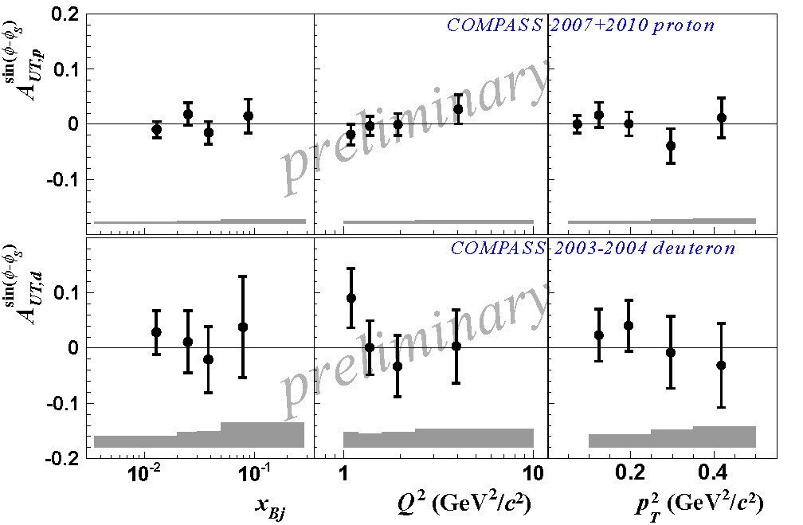
Exclusive ρ⁰ production on transverse pol. Targets
Unique!
Notes:
E^g and E^sea negligible – studied by assuming different strengths and comparing variations of A

Slide 14
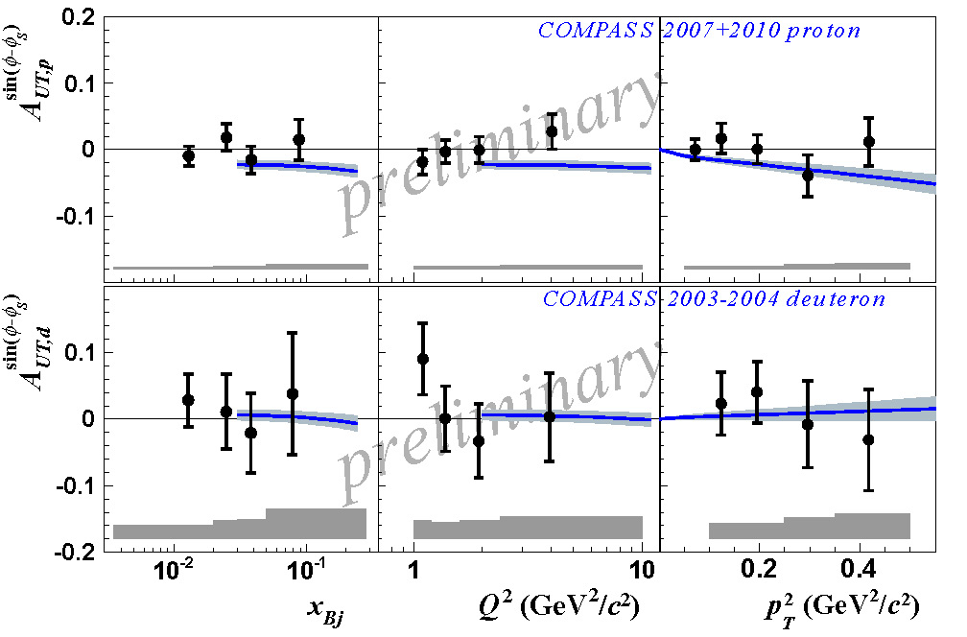
Exclusive ρ⁰ production on transverse pol. Targets
Goloskokov & Kroll, EPJ C59 (2009)
E^{u} and E^{d} cancel

Slide 15
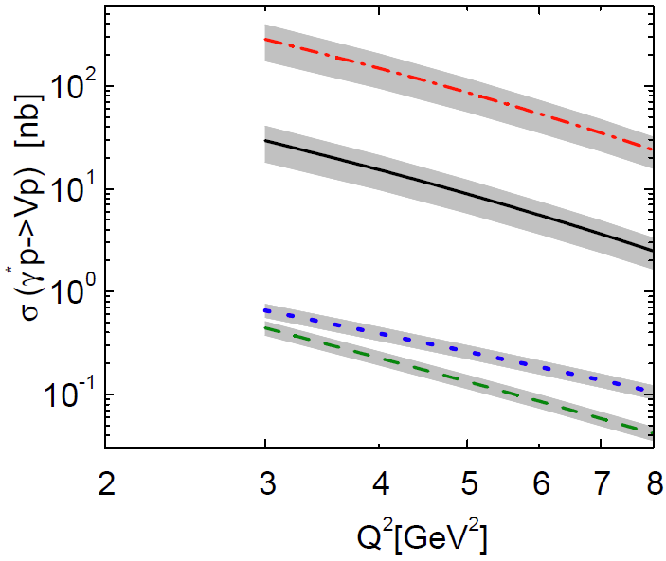
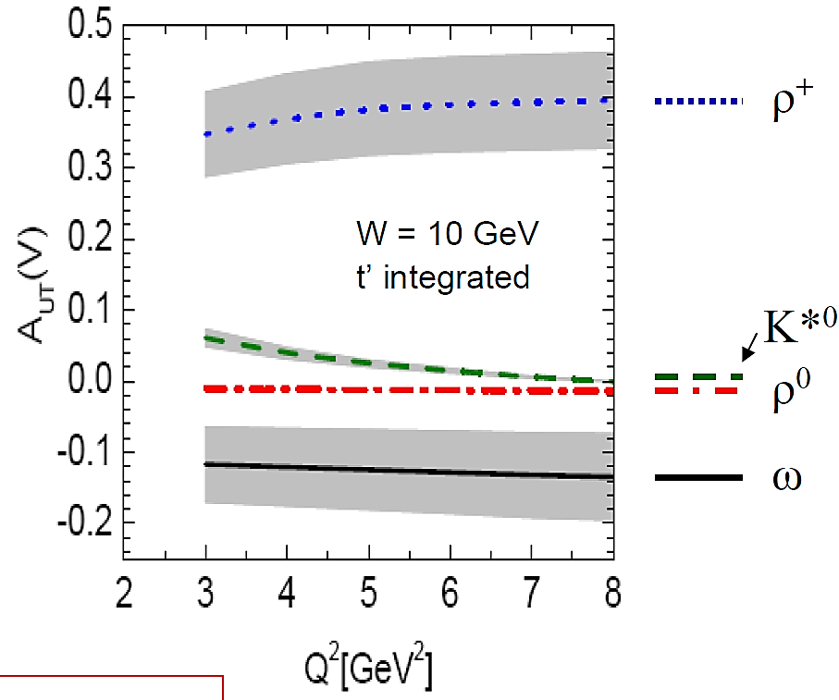
What's next?
Paper draft presently circulating inside collaboration
Analysis of exclusive ρ⁺, ω, φ
and γ final states ongoing
More modulations (higher twist)
Extraction of spin density matrix elements
Goloskokov, Kroll EPJ C53 (2008) 367
Notes:
l/T separation still missing. Use angular distribution of Rho decay
Goloskokov Kroll Model – most complete model with H and E for quarks and gluons
quarks transverse degree of freedom taken into account
Account
the asymptotically dominant (longitudinal) amplitude for L* p Lpbut also the one for transversely polarized photons and vector mesons T* p Tp

Slide 16
Outlook
COMPASS II

Slide 17
Content of Proposal for COMPASS-II
DVCS & HEMP Measurements
Transverse Imaging
Beam charge & spin sum,
difference and asymmetry
GPD H, later GPD E
Data taking (2012), 2015&16
Drell-Yan Measurements
Sivers PDF
Boer Mulders PDF
Test of factorization approach
Data taking 2014
PDFs and Fragmentation
s(x), Kaon FF
Data taking parasitically
Upgrade existing
COMPASS Spectrometer
@ CERN/SPS
Pion and Kaon Polarizability
Chiral Perturbation Theory
Data taking 2012
Proposal submitted to CERN: 05/2010
Approval 12/2010
CERN-SPSC-2010-014/SPSC-P-340

Slide 18
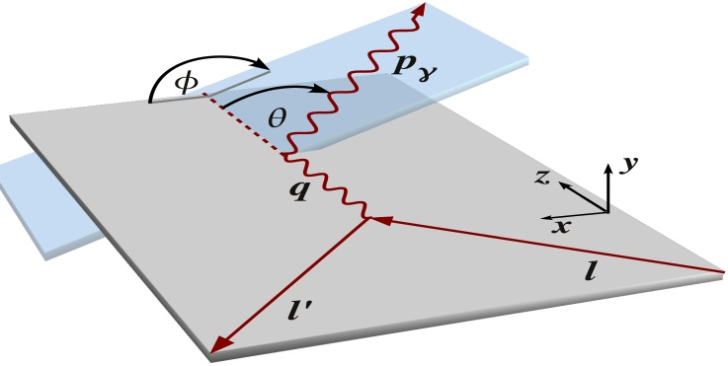
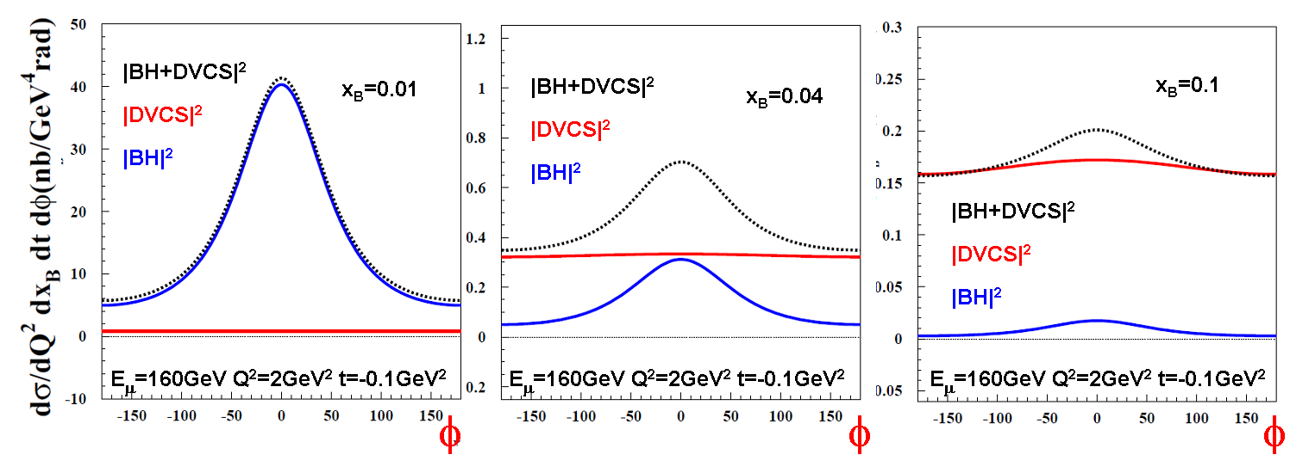
Bethe-Heitler & DVCS Cross Sections at 160GeV
DVCS :
Bethe-Heitler :
dσ α |T_{DVCS}|² + |T_{BH}|² + Interference Term
Low x_{B}: BH dominates
Large x_{B}: DVCS dominates
Reference yield
from almost pure BH
Study DVCS through
interference term
Re T^{DVCS} & Im T^{DVCS}
Study dσ^{DVCS}/dt
Transverse Imaging

Slide 19
Observables (Phase 1) – unpolarized Target
Beam Charge & Spin Sum:
Beam Charge & Spin Difference:

Slide 20
Projections
(some few examples)
    Unpolarized Target (COMPASS-II, Phase 1)
    Beam Charge and Spin Sum,
    Difference
    and Asymmetry
    … for DVCS and HEMP

Slide 21
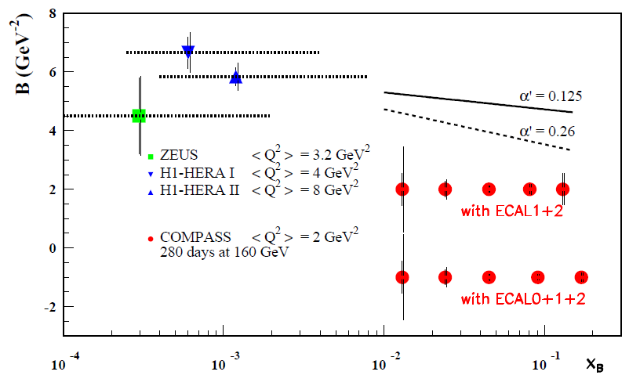
Beam Charge & Spin Difference S_{CS,U}
- Transverse imaging
Using S_{CS,U}
Integrating over ϕ
Subtracting BH
No Modell dependence
Ansatz at small x_{B} :
(x ~ x_{B})
L = 1222 pb⁻¹
ε_{global} = 10 %
?
measure α’ with accuracy >2.5 σ
for: α’ > 0.26 (with ECAL 1+2 )
α’ > 0.125 (with ECAL 0+1+2)
0.65 ±0.02 fm
H1 PLB659(2008)
COMPASS
x_{B}
Notes:
r_perp= distance between struck quark and spectator system ( also from Imaginary part of the exclusive process ) today no measurement x_B>10^-2
b_perp= " " " " " center of momentum ( fourier transformed of GPD H )
160 GeV muon beam
2.5m LH₂ target
2 years
L = 1222 pb⁻¹
ε_{global} = 10 %
R_perp = transverse size of nucleon
Assuming 3% syst. error
on BH subtraction

Slide 22

S_{CS,U} - Transverse imaging - 2012
Projection for commissioning run 10/2012
Notes:
r_perp= distance between struck quark and spectator system ( also from Imaginary part of the exclusive process ) today no measurement x_B>10^-2
b_perp= " " " " " center of momentum ( fourier transformed of GPD H )
160 GeV muon beam
2.5m LH₂ target
2 years
L = 1222 pb⁻¹
ε_{global} = 10 %
R_perp = transverse size of nucleon
Assuming 3% syst. error
on BH subtraction

Slide 23
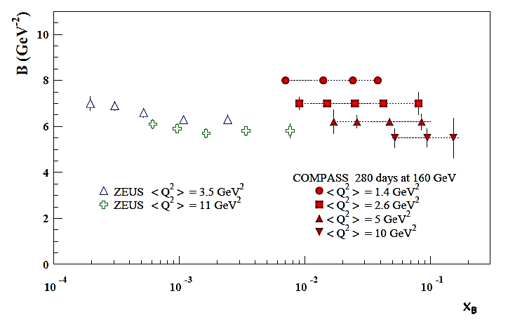
Complementary: Hard Exclusive ρ⁰ Production
Sensitive to the nucleon size
+ the transverse size of the meson
Q²= 1 GeV² B ~ 8 GeV⁻²
Q²= 10 GeV² B ~ 5.5 GeV⁻²
ρVMP model developed
by A. Sandacz
- Normalized according
Goloskokov and Kroll
Will help to constrain
Hρ⁰ = 1/√2 (2/3 H^{u} + 1/3 H^{d} + 3/8 H^{g})

Slide 24
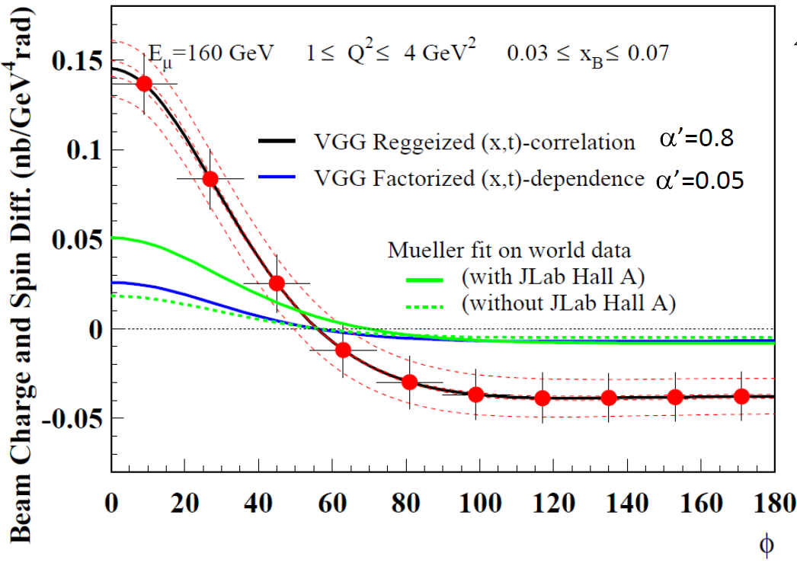

Beam Charge & Spin Difference D_{CS,U}
Phys. Rev. D60 (1999) 094017
arXiv:0904.0458
L = 1222 pb⁻¹
ε_{global} = 10 %
Control detector acceptance and beam flux with high precision
Error band assumes a 3% systematic uncertainty between µ⁺ and µ⁻
Use inclusive events and BH for check

Slide 25
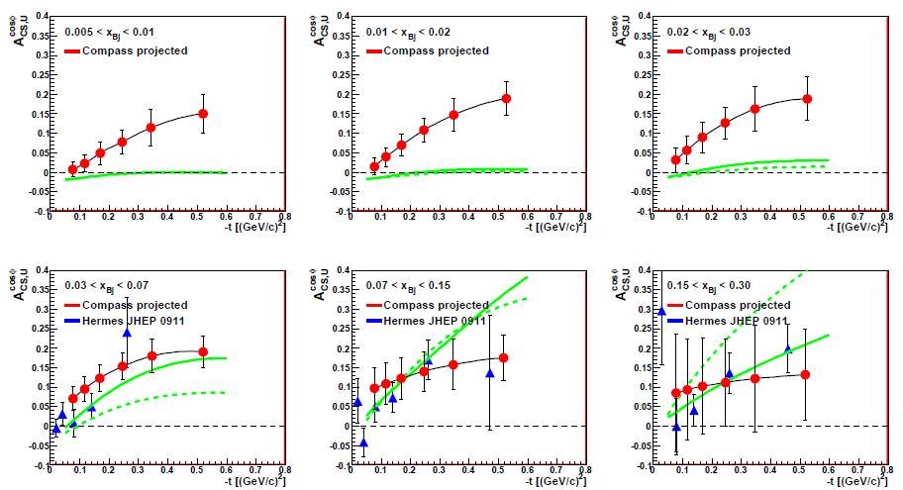
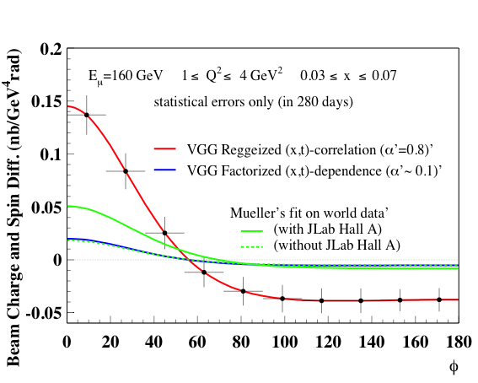
Beam Charge & Spin Asymmetry D_{CS,U} /S_{CS,U}
BCSA = D_{CS,U} /S_{CS,U}
= A₀ + A_{CS,U} cos ϕ + A₂ cos2ϕ
Re (F₁H ) > 0 @ H1
< 0 @ HERMES
Node?
Measurement of
Using VGG
_{B}
_{B}
_{B}
Kumericki, Müller
Incl. HALL A
Without HALL A
arXiv:0904.0458
Notes:
Projections (red) on curve with VGG Model (Regge ansatz) compared to HERMES
Green lines: solid – including JLAB HALL A, dashed without (Kumericki, Mueller arXiv:0904.0458)

Slide 26
Beam Tests @ COMPASS
    2008 (8 hours)
    2009 (10 * statistics of 2008)

Slide 27
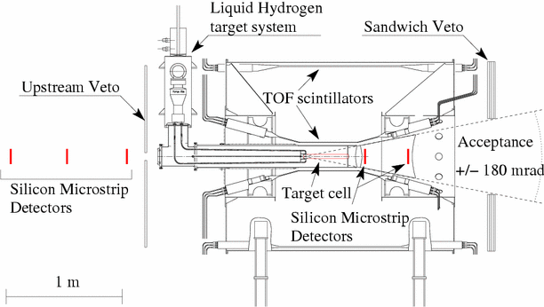
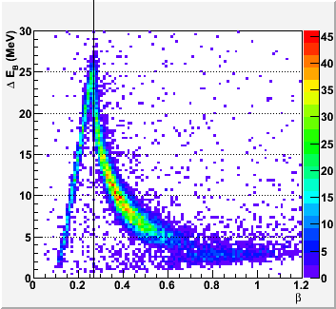
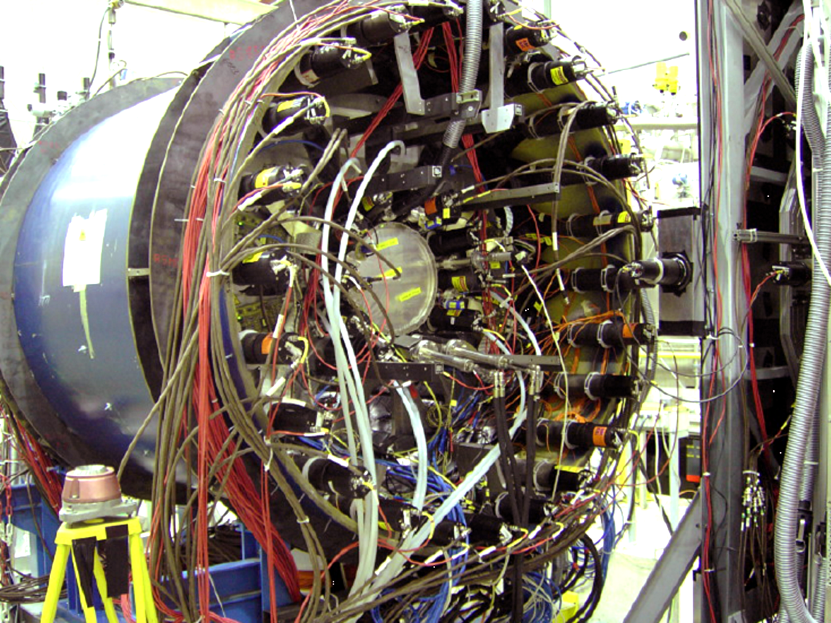
2008 & 2009 Beam Tests @ COMPASS
Target Setup for the
Hadron Programme
Ring B
Ring A
Target : 40 cm LH2
Recoil Detector (1m long)
ECAL 1 & ECAL 2

Slide 28
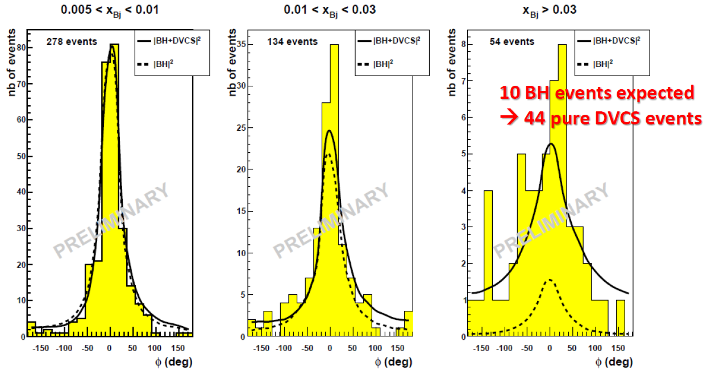
First DVCS Signal observed @ COMPASS
Detection efficiency :
ε _{μ+p->μ+p+γ} = 0.32+/-0.13
Global efficiency :
ε_{global} = 0.13 +/- 0.05
- μ+p → μ+p+γ efficiency
- SPS & COMPASS availability
- Dead time
- Trigger efficiency
Conclusion:
Projections of errors are realistic
Notes:
Maybe 13 pi0 events

Slide 29
Main Detector Upgrades
for COMPASS-II (DVCS/HEMP)
    Recoil-Proton Detector
    Electromagnetic Calorimeter (ECAL0)

Slide 30
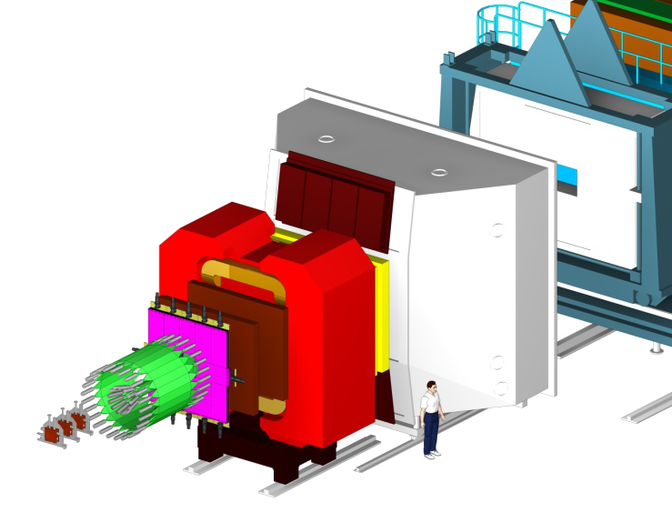
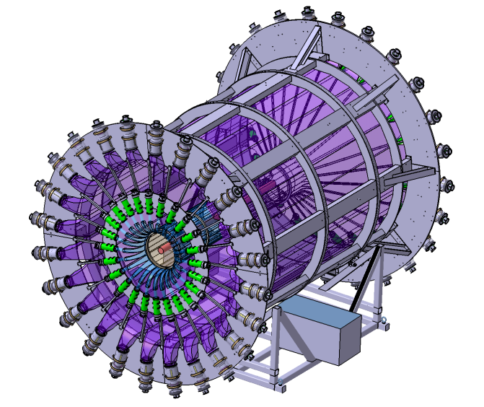
New Target & Recoil-Proton Detector
New:
2.5 m LH₂ Target
d=4 cm; Δρ/ρ<3%
4 m ToF Barrel (CAMERA)
σ_{t}<300ps for TOF
ECAL 0
4.20m
3.90m

Slide 31
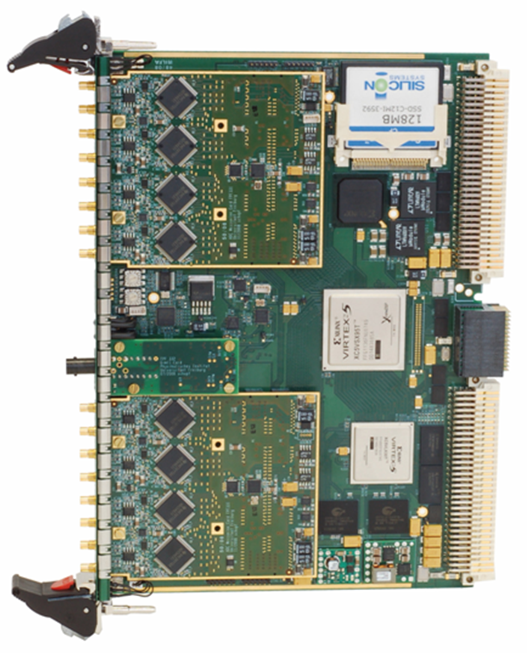
New Target & Recoil-Proton Detector
New:
2.5 m LH₂ Target
d=4 cm; Δρ/ρ<3%
4 m ToF Barrel (CAMERA)
σ_{t}<300ps for TOF
ECAL 0
GANDALF
4.20m
1 GHz digitization of PMT signal
Resolution >10 ENOB
real-time feature extraction
  1st level trigger
  detector signal digitization
3.90m

Slide 32
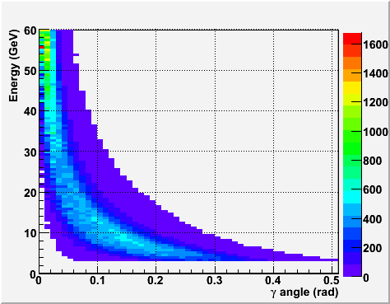
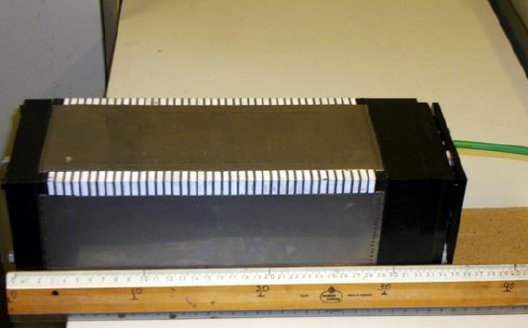
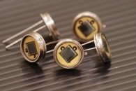
New Electromagnetic Calorimeter : ECAL0
existing
ECAL1&2
Requirements
Photon energy range 0.2- 30 GeV
Size: 260 x 260 cm² ;
Granularity 12 x 12 cm²
Energy resolution < 10.0%/√E (GeV)
Thickness < 50 cm,
Insensitive to the magnetic field.
DVCS+BH
Shaschlyk module
MAPD
All tested
Notes:
• Shashlik modules (length about 35 cm)
• scintillator lead sandwich
with 15 radiation length
• light read-out with
wave length shifting fibres
• avalanche micropixel photo diodes
need temp. stability 0.2K
• test at CERN T9 beam and
at muon beam
=) ok for GPD measurements N_photon=790phe/GeV im Vergeich zu 1700 phe/GEV fuer PM

Slide 33
Conclusions
Azimuthal Asymmetries in polarized exclusive ρ⁰ production
  small & compatible with zero
  reasonable agreement with Goloskokov&Kroll prediction
  may indicate E^{u} and E^{d} cancelation
COMPASS II: investigate quark GPDs using DVCS
  Covered x_{B} regime not accessible to any other experiment in near future
  Frequent changes of beam charge and polarization – UNIQUE!
  Study nucleon transversal dimension as function of x_{B} (Tomography)
  Constrain GPD H through φ dependence of D_{CS,U}
Phase 2: DVCS & HEMP with polarized NH₃ Target inside RPD
  Use knowledge of GPD H as input to constrain GPD E
  Requires highly sophisticated recoil detection & polarized target systems

Slide 35
Backup

Slide 36
Cross Section & Angular Dependence
Known
(good for reference)
Twist 2
Twist 3
Twist 2 gluon
Notes:
DVCS is considered the cleanest of the exp. Hard excl. processes because effects of NLO and subleading Twist (Twist 3) are under theo. control

Slide 37
Input for Projections
Naturally polarized µ Beam with 160 GeV/c momentum → P_{Beam}=80%
48 s SPS cycle with 9.6 s spill duration
beam intensity 4.6 x 10⁸ µ⁺/spill = 9.6 x 10⁶ µ⁺/s (DC)
3 times smaller intensity for µ⁻
data taking: 280 days → 70 days µ⁺, 210 days µ⁻
Target: a) 2.5m liquid Hydrogen → L = 1 x 10³² cm⁻²s⁻¹
b) 1.2m NH₃ (polarized) → L = 3.4 x 10³² cm⁻²s⁻¹
P_{target}=90%, dilution factor f=0.17
New recoil-proton detector
ECAL1 (40…150mrad), ECAL2 (0…40mrad) + new ECAL0 (150…300mrad)
Global efficiency ε=0.1 (SPS, COMPASS, tracking, photon)
Notes:
In NH3 hat man 10 Protonen und 7 Neutronen ➔ Anteil Protonen = 10/17
3 Protonen der 10 Protonen sind polarisierbar = 3/10
Dilution factor f = 10/17 * 3/10 =3/17 = 0.1764
Lumi von 3.4*10^32 ist die Lumi fuer NH3, also fuer die streuung an 17 nukleonen.

Slide 38
Parameterization of GPDs
Predictions based on different models
Factorisation: H(x,ξ,t) ∝ q(x) F(t)
Regge motivated t dependence: x-t correlation
    Core of fast partons, meson cloud at larger distance
    H(x,ξ,t) ∝ q(x) exp(-B|t|)
    Ansatz: (α' slope of Regge trajectory)
    Valence quarks: α' ~ 1 GeV⁻² from form factors
    Gluons: α' small

Slide 39
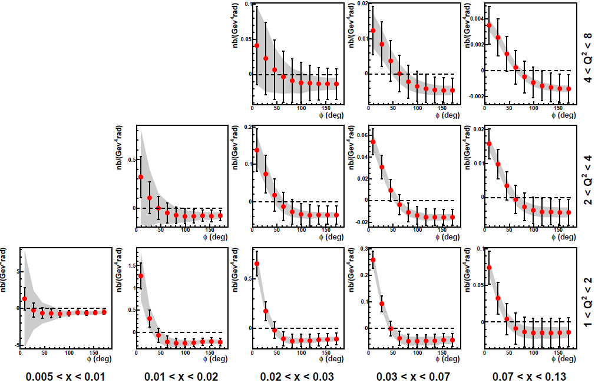
Beam Charge & Spin Difference D_{CS,U}
Projections using VGG model
Phys. Rev. D60 (1999) 094017
L = 1222 pb⁻¹
ε_{global} = 10 %
Syst. : 3% μ⁺/μ⁻
normalization

Slide 40
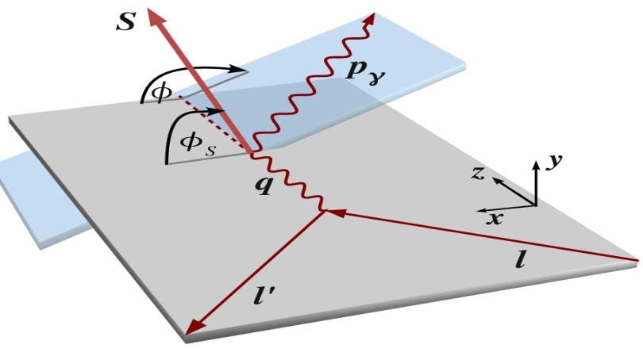
Observables (Phase 2) – polarized Target
Beam Charge & Spin Sum:
Beam Charge & Spin Difference:
Lepton-Charge-Averaged Unpolarized Cross-Section:

Slide 41

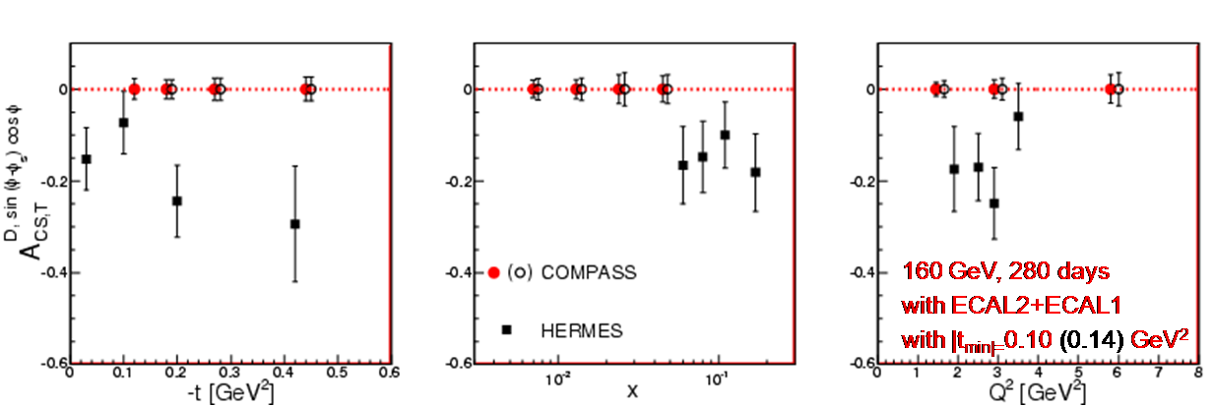
D_{CS,T} and Transverse Target Asymmetry
Beam: 160 GeV muon
Target: 1.2 m polarized NH₃
(P=90%, f=0.17)
2 years data taking
ε_{global} = 10 %
Constrain GPD E
Notes:
F_2 = Pauli ; F_1 = Dirac Form Factor

