Slide 1
The future COMPASS-II Drell-Yan program
M. Alexeev
INFN sez. di Trieste.
On behalf of the COMPASS collaboration.

Slide 2
Drell-Yan Process and its Kinematics
the momentum of the beam (target) hadron,
the total center-of-mass energy squared,
the momentum fraction carried by a parton from H_{a(b)} ,
the Feynman variable,
the invariant mass squared of the dimuon,
the transverse component of the quark momentum,
the transverse component of the momentum of the virtual photon.
Drell-Yan cross section includes a convolution of parton distribution functions.

Slide 3
Leading Order PDFs
At leading order, 3 PDFs are needed to describe the structure of the nucleon in the collinear approximation.
But if one takes into account also the quarks intrinsic transverse momentum k_{T}, 8 PDFs are needed:

Slide 4
Transverse Momentum Dependent PDFs
The three TMD PDFs below describe important properties of spin dynamics of nucleon.
: the Sivers effect describes the correlation of intrinsic transverse momentum of unpolarized quarks with nucleon transverse polarization.
: the Boer-Mulders function describes the correlation between the transverse spin and the transverse momentum of a quark inside the unpolarised hadron.
: the Pretzelosity function describes the polarisation of a quark along its intrinsic k_{T} direction making accessible the orbital angular momentum information.

Slide 5
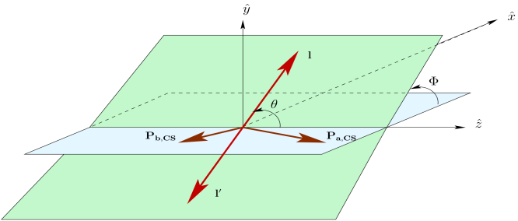
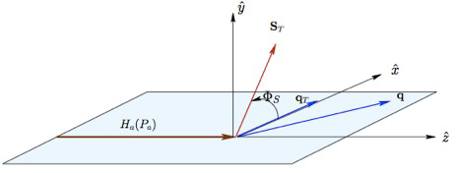
Single-polarised DY cross-section: Leading order QCD parton model
At LO the general expression of the DY cross-section simplifies to (COMPASS Note 2010-2) :
$$\frac{dσ^{LO}}{d^{4}qdΩ}=\frac{α_{em}^{2}}{Fq^{2}}{\hat{σ}}_{U}^{LO}\left\{\left(1+D_{\left[\sin^{2}{θ}\right]}^{LO}A_{U}^{\cos{2φ}}\cos{2φ}\right)+\left|{\vec{S}}_{T}\right|\left[A_{T}^{\sin{φ_{s}}}\sin{φ_{s}}+D_{\left[\sin^{2}{θ}\right]}^{LO}\left(A_{T}^{\sin\left(2φ+φ_{s}\right)}\sin\left(2φ+φ_{s}\right)+A_{T}^{\sin\left(2φ−φ_{s}\right)}\sin\left(2φ−φ_{s}\right)\right)\right]\right\}$$
Thus the measurement of 4 asymmetries (modulations in the DY cross-section):
$$A_{U}^{\cos{2φ}}$$
- gives access to the Boer-Mulders functions of the incoming hadrons,
$$A_{T}^{\sin{φ_{s}}}$$
- to the Sivers function of the target nucleon,
$$A_{T}^{\sin\left(2φ+φ_{s}\right)}$$
- to the Boer-Mulders functions of the beam hadron and to , the pretzelosity function of the target nucleon,
$$A_{T}^{\sin\left(2φ−φ_{s}\right)}$$
- to the Boer-Mulders functions of the beam hadron and to ,the transversity function of the target nucleon.

Slide 6
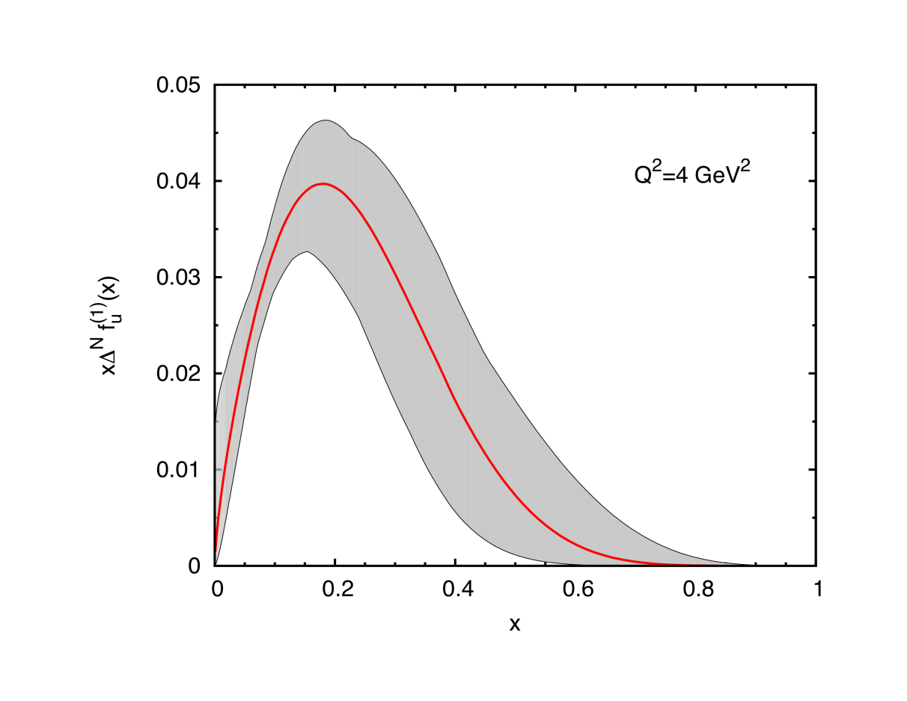
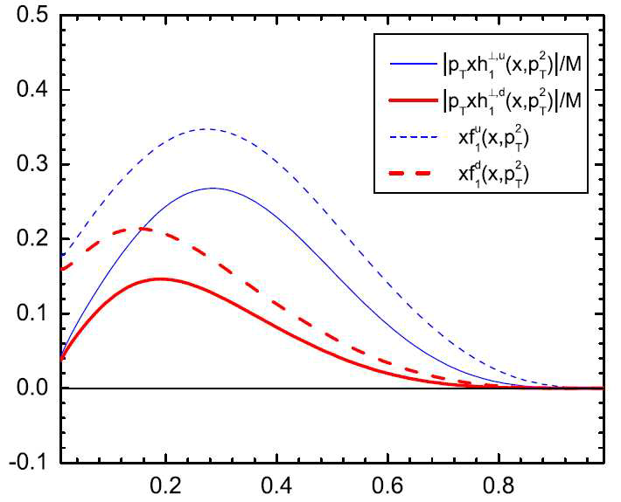
Some indications for the future Drell-Yan experiments
1. TMD PDFs – ALL are sizable in the valence quark region
Boer-Mulder function for u and d quarks as extracted from p+D data from Zhang et al. Phys.Rev. D77,0504011.
Sivers effect in Drell-Yan processes.
M. Anselmino, M. Boglione, U. D'Alesio, S.Melis, F. Murgia, A. Prokudin
Published in Phys.Rev.D79:054010, 2009.
2. - p_{T} should be small (~ 1 GeV), can be generated by intrinsic motion of quarks and/or by soft gluon emission. This is the region where TMD formalism applies.

Slide 7
TMDs universality SIDIS⬅➔DY
The time-reversal odd character of the Sivers and Boer-Mulders PDFs lead to the prediction of a sign change when accessed from SIDIS or from Drell-Yan processes:
Check the predictions:
Its experimental confirmation is considered a crucial test of the non-perturbative QCD.
The Universality test includes not only the sing-reversal character of the TMDs but also the comparison of the amplitude as well as the shape of the corresponding TMDs.

Slide 8
DY versus SIDIS at COMPASS
In COMPASS, we have the opportunity to test this sign change using
the same spectrometer and a transversely polarized target.
COMPASS has accessed the Sivers PDF from SIDIS.
In COMPASS-II this will also be done via the Drell-Yan process.
SIDIS
Asymmetry is convolution of a structure function with a fragmentation function:
DY
Asymmetry is convolution of structure
functions. If unpolarized beam and
transversely polarized target:
$$A_{Sivers}∝\frac{\sum_{q}{e_{q}^{2}f_{1T}^{⊥\left(1\right)}(x)D_{q}^{h}(z)}}{\sum_{q}{e_{q}^{2}f_{1}(x)D_{q}^{h}(z)}}$$
$$A_{Sivers}∝2\frac{\sum_{q}{e_{q}^{2}{\overline{f}}_{1q}(x_{1})f_{1Tq}^{⊥\left(1\right)}(x_{2})}}{\sum_{q}{e_{q}^{2}{\overline{f}}_{1q}(x_{1})f_{1q}(x_{2})}}$$

Slide 9
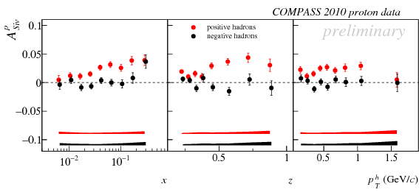
Sivers from SIDIS (I)
With transversely polarized proton target, the COMPASS SIDIS
measurements give:
A positive Sivers asymmetry for positive hadrons.
An asymmetry compatible with zero for negative hadrons.

Slide 10
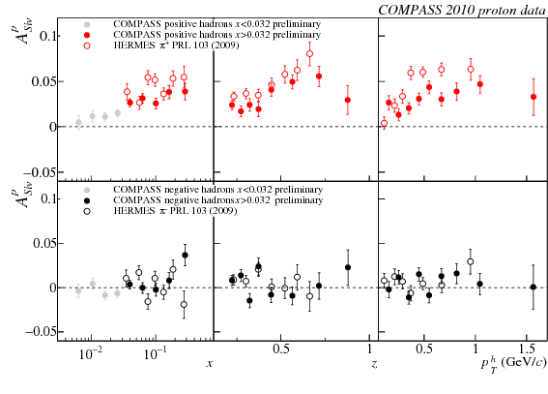
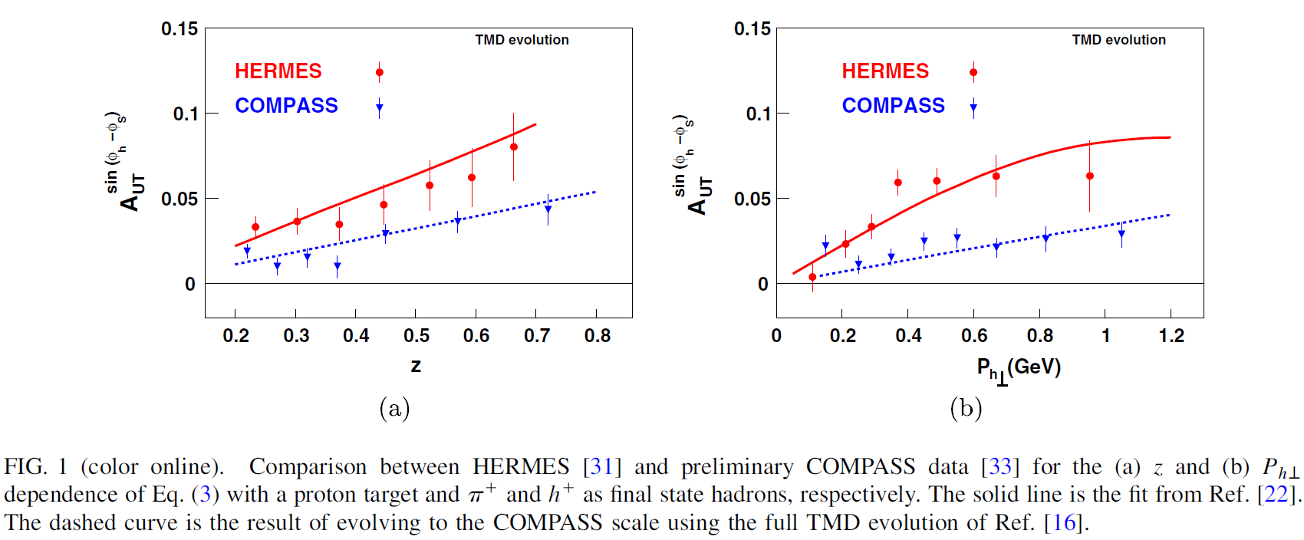
Sivers from SIDIS (II)
Qualitative agreement with HERMES results (PRL 103(2009)):
Recent suggestions that difference may be due to TMD evolution:
M. Aybat (2011), T. Rogers, A. Prokudin.

Slide 11
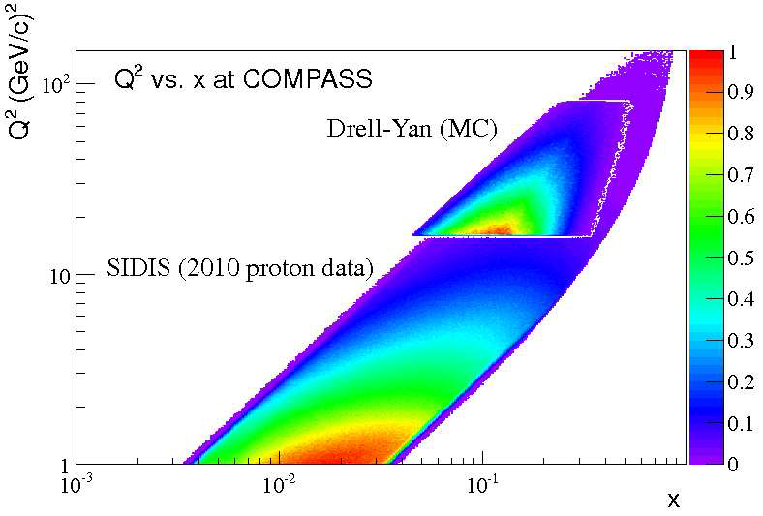
SIDIS and DY
The COMPASS SIDIS and DY experimental measurements have an
overlapping region.

Slide 12
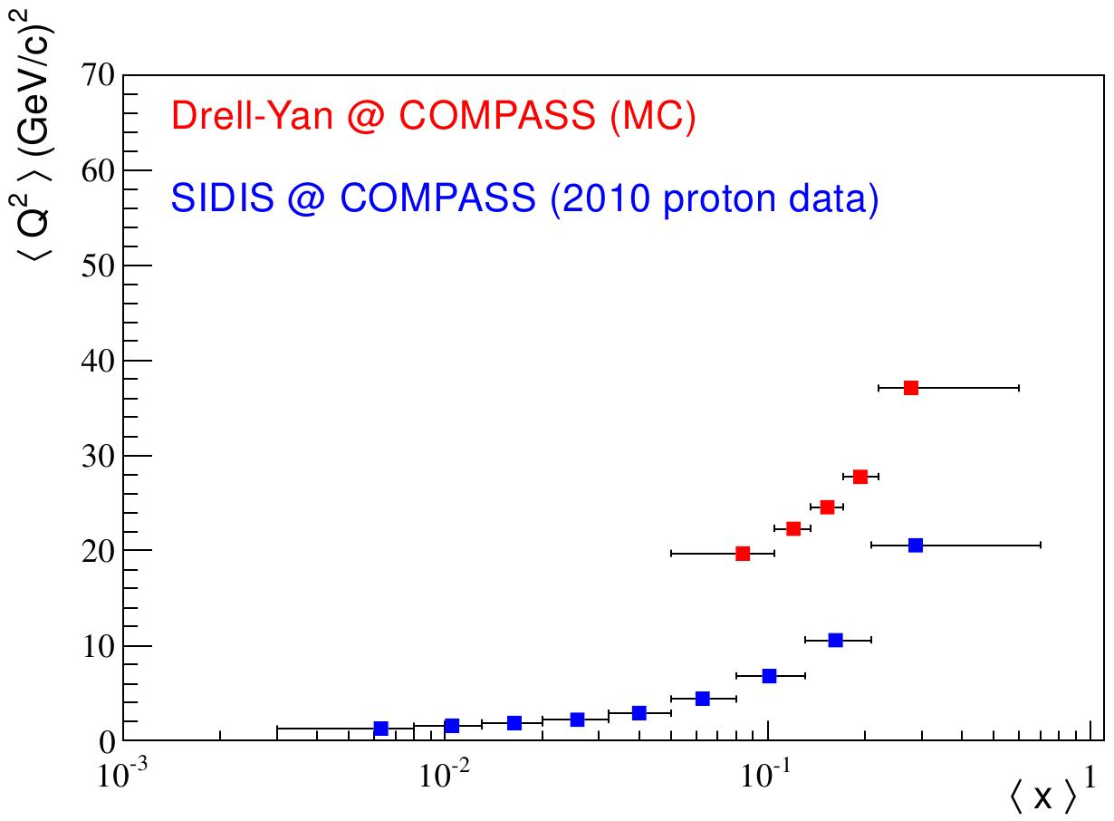
Mean values comparison
There is overlap in the phase-space accessed by the 2 measurements.
Nevertheless, when comparing the TMDs extracted, the QCD evolution
of the TMDs must be properly taken into account.

Slide 13
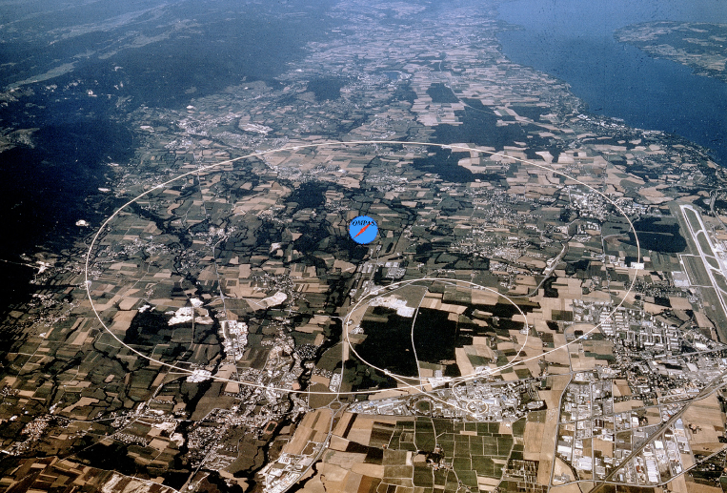
COmmon Muon Proton Apparatus for Structure and Spectoscopy

Slide 14
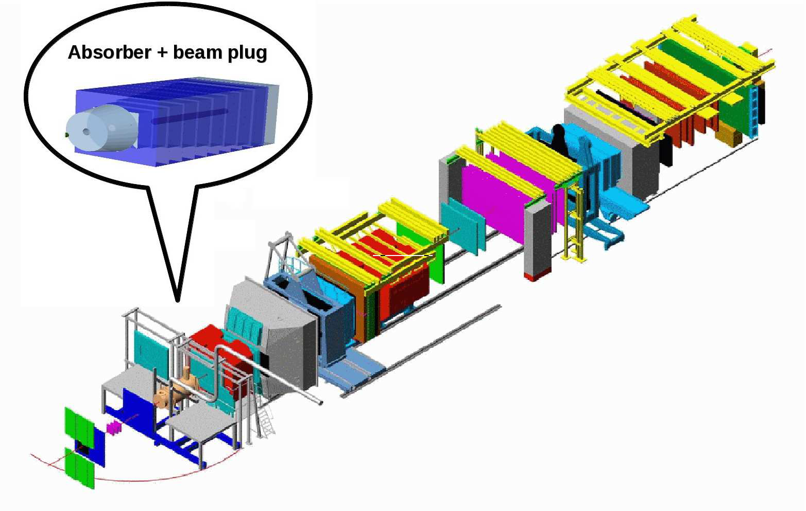
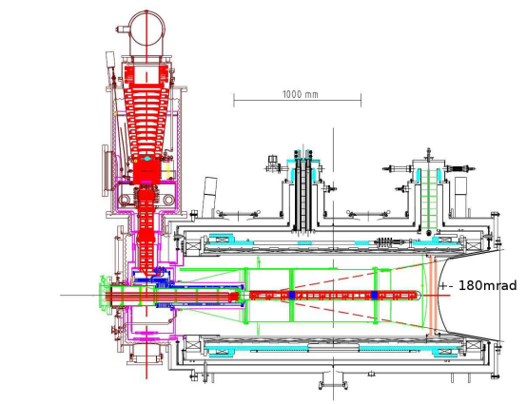
The spectrometer
Polarized target: NH₃
Acceptance
(360 mrad)
Muons & hadrons beams:
hadron⁻ => 95% π⁻, 2-3% κ⁻, 2% p⁻
hadron⁺ => 75% p⁺, 23% π⁺, 2% κ⁺

Slide 15
Why Drell-Yan @ COMPASS
Large angular acceptance spectrometer.
SPS M2 secondary beams with the intensity up to 10⁸ particles per second.
Transversely polarized solid state proton target with a large relaxation time and high polarization, when going to spin frozen mode.
a detection system designed to stand relatively high particle fluxes.
a Data Acquisition System (DAQ) that can handle large amounts of data at large trigger rates.
The dedicated muon trigger system.
For the moment we consider two step DY program:
The program with high intensity pion beam.
The program with Radio Frequency separated antiproton beam.

Slide 16
Choice of beam (I)
COMPASS uses the M2 SPS beam line. A secondary hadron beam is produced from SPS protons at 400 GeV/c colliding in a Be target.
Beam momentum can be in the range 100 - 280 GeV/c.
Experience namely with π⁻ beam at 190 GeV/c (± 1-2% RMS).
π⁻ beam with small contamination from other particles:
2% kaons, <1% $\overline{p}$. Muon halo contamination <1%.
High intensity beam, up to 1 × 10⁸/second is possible, it is limited by the allowed radiation levels.
106 GeV/c
160 GeV/c
190GeV/c
213 GeV/c
4 ≤ M_{µµ} < 9 GeV/c²

Slide 17
Choice of beam (II)
MC simulation shows that with higher beam momentum the phase
space accessible for DY dimuons with 4 ≤ M_{µµ} < 9 GeV/c² is
extending towards the lower-x region.
On the other hand, the DY cross-section is higher for higher beam
momentum (for 4 ≤ M_{μμ} < 9 GeV/c², K^{exp} factor = 2):
$p^{π}$(GeV/c) | 106 | 160 | 190 | 213
$σ_{πp}^{DY⟶µµ}∗K$(nb) | 0.164 | 0.252 | 0.290 | 0.318
↓
The π⁻ beam at 190 GeV/c seems to be a good compromise.

Slide 18
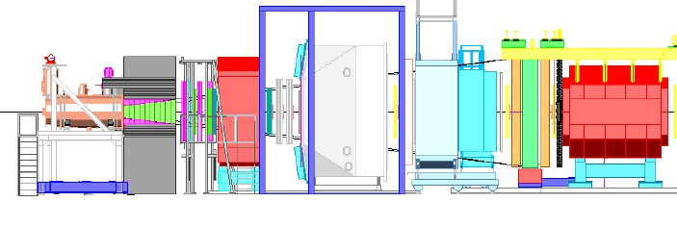
DY@COMPASS - set-up π⁻ p → μ⁻ μ X (190 GeV)
The main characteristics of the future fixed-target Drell-Yan experiment:
1. Small cross section ➔ High intensity hadron beam (up to 10⁹ pions per spill) on the
COMPASS PT
2. High intensity hadron beam on thick target ➔
Hadron absorber to stop secondary particles flux.
Beam plug to stop the non interacted beam.
Radioprotection shielding around to protect things and people.
High-rate-capable radiation hard beam telescope.
π⁻
190 GeV

Slide 19
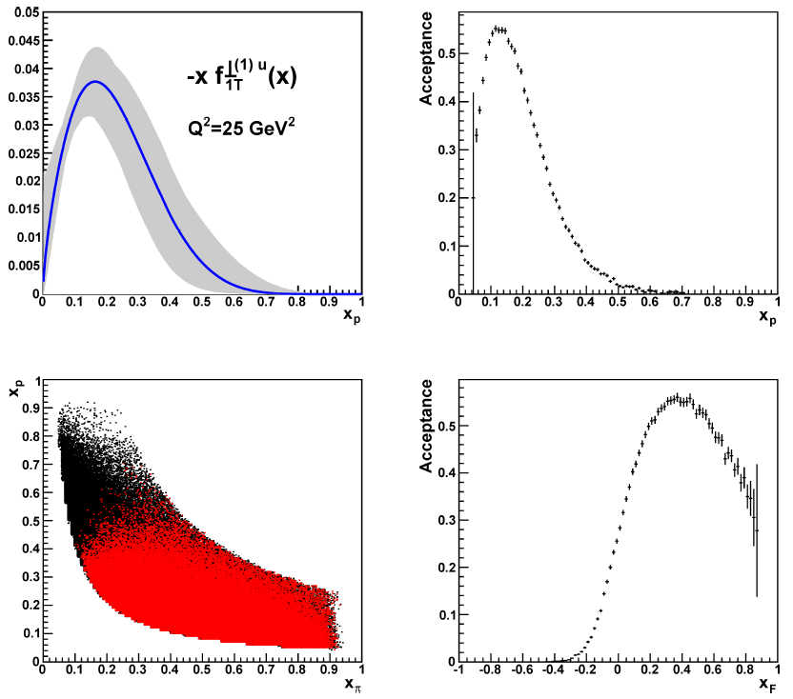
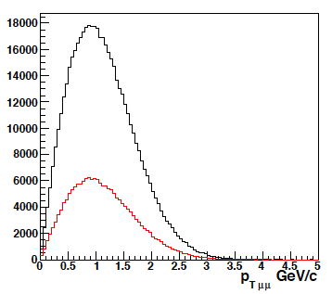
DY@COMPASS – kinematics - valence quark range π⁻ p → μ⁻ μ X (190 GeV pion beam)
In our case (π⁻ p → μ⁻ μ X) contribution from valence quarks is dominant.
In COMPASS kinematics u-ubar dominance.
<P_{T}> ~ 1GeV – TMDs induced effects expected to be dominant with respect to the higher QCD corrections.

Slide 20
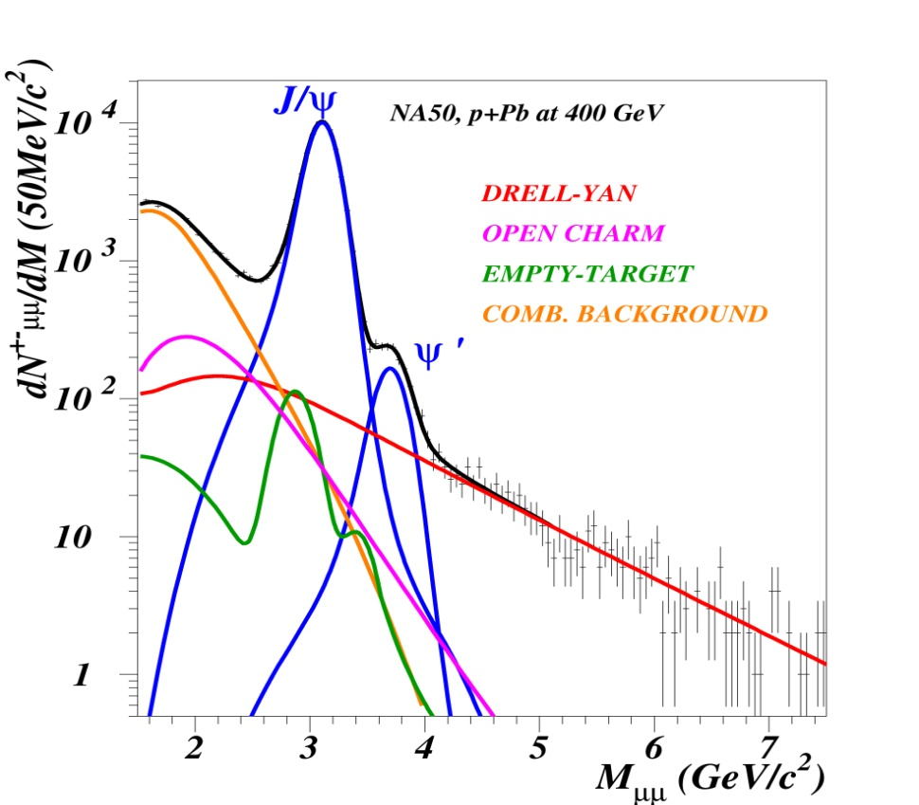
DY@COMPASS - High mass Drell-Yan
Detailed simulations using PYTHIA and GEANT were performed. Results were compared with published cross-sections from past Drell-Yan experiments – good agreement.
Even if the cross-section is low, dimuons with 4 ≤ M_{μμ} < 9 GeV/c² are the ideal sample to study azimuthal asymmetries in Drell-Yan, due to negligible background contamination.
The combinatorial background is kept under control by the presence of a hadron absorber downstream of the target.
This is not COMPASS
Additionally, the region 2 ≤ M_{μμ} < 2.5 GeV/c² could also be studied, although the background here cannot be neglected.
The J/ψ region may be of interest, but less simple to interpret.

Slide 21
DY Feasibility@COMPASS : Feasibility studies
Beam tests were done in 2007, 2008 and 2009 to study the feasibility of the measurement.
The target temperature does not seem to increase significantly with the hadron beam, long polarization relaxation times measured (2007 beam test).
Reasonable occupancies in the detectors closer to the target can only be achieved if a hadron absorber and beam plug are used (2008 beam test).
Radiation conditions are within safety limits up to a beam intensity of 6x10⁷ π⁻/second (measurements during all the beam tests).
Physics simulations were validated, within statistical errors (J/ψ peak and combinatorial background, in 2007 and 2009 beam test).

Slide 22
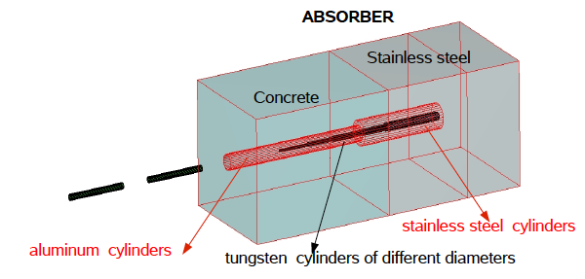
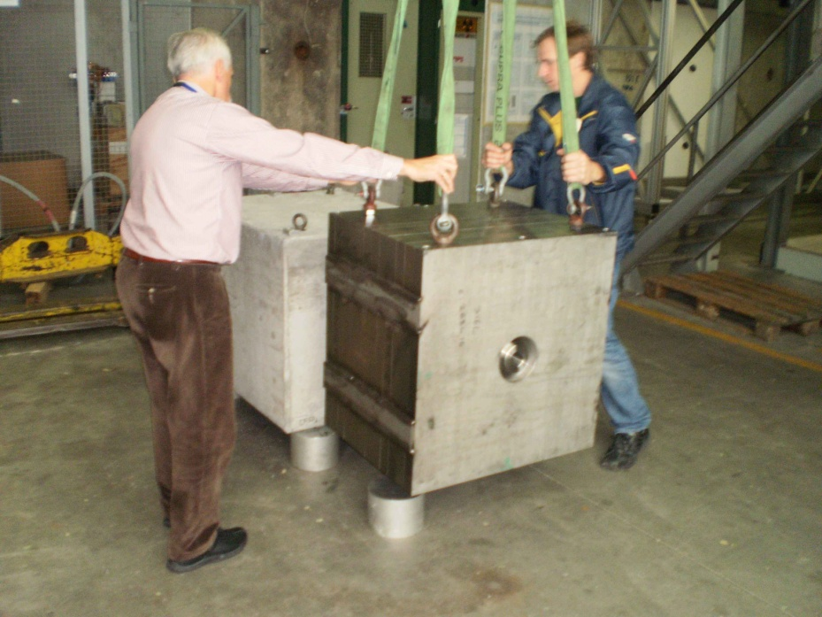
DY Feasibility@COMPASS: Beam Test 2009 – the most important in a row of three beam tests 2007-2009
The project.
Mounting and alignment.

Slide 23
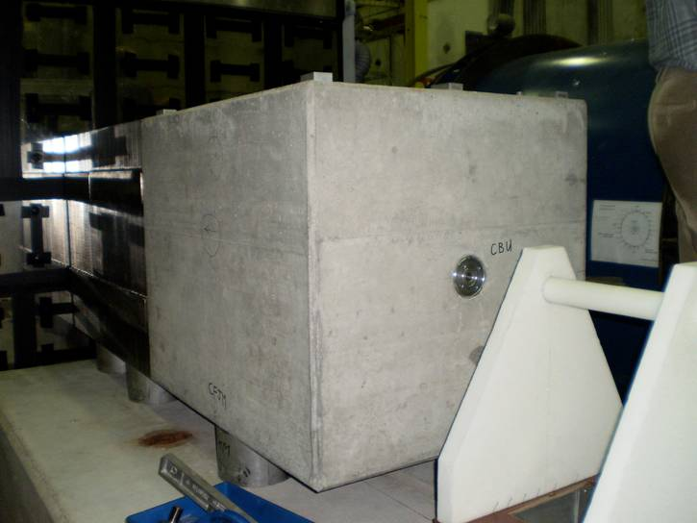
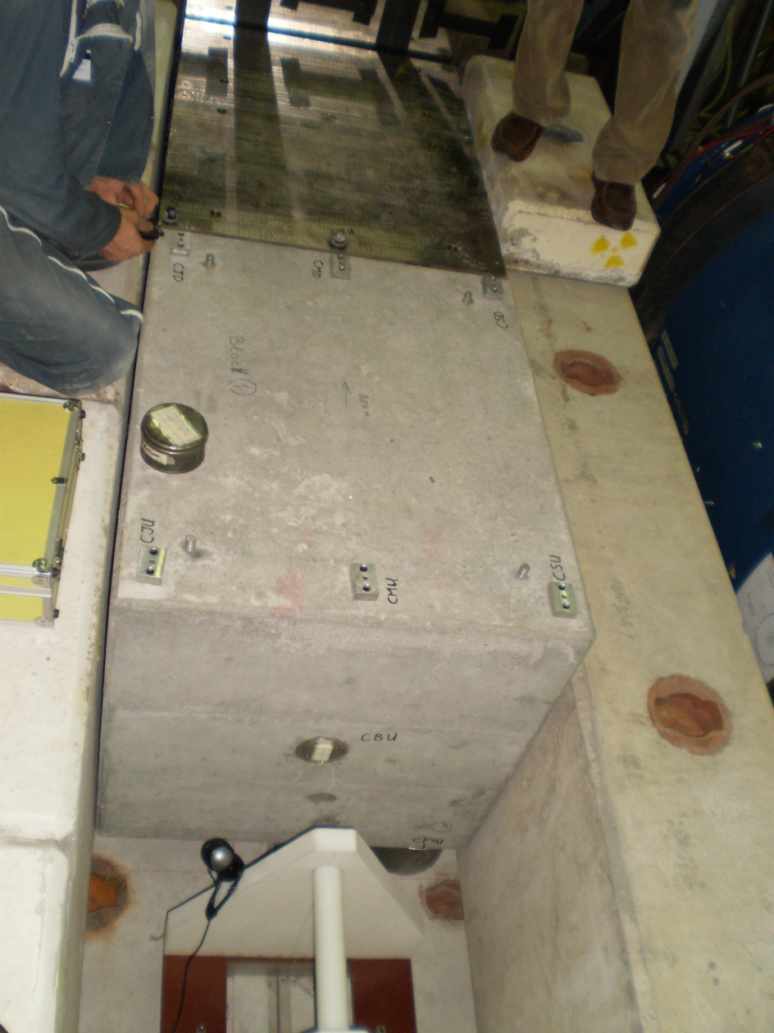
DY Feasibility@COMPASS : Beam Test 2009 (the hadron absorber)
Installation of the target and of the absorber in the experimental hall.

Slide 24
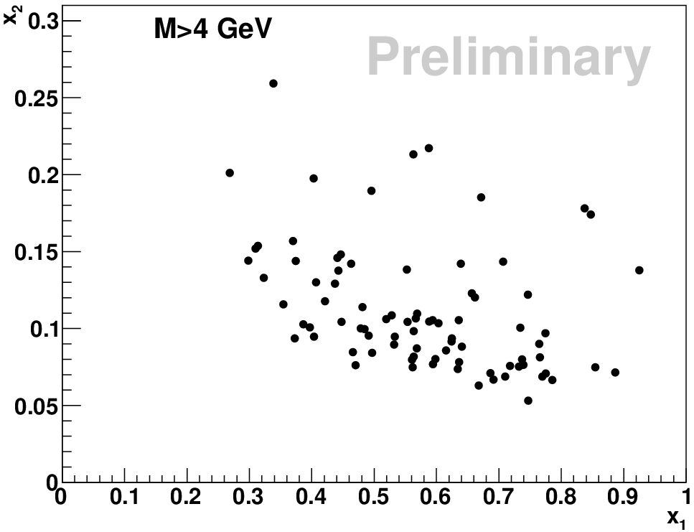
DY Feasibility@COMPASS :
Kinematic plots for x_{a} and x_{b}
COMPASS acceptance covers the range of valence quarks for both DY and J/ψ.

Slide 25
DY Feasibility@COMPASS :
Kinematic plots for p_{t} and x_{f}
Kinematic distributions for x_{f} and p_{t} of dimuons obtained during the Drell-Yan test run 2009.
They correspond to out expectations.

Slide 26
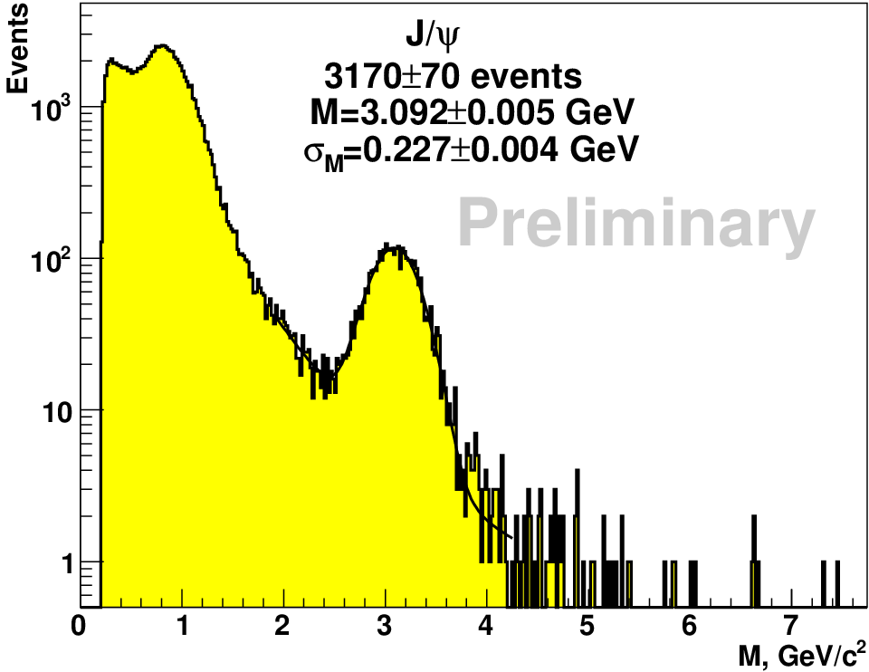
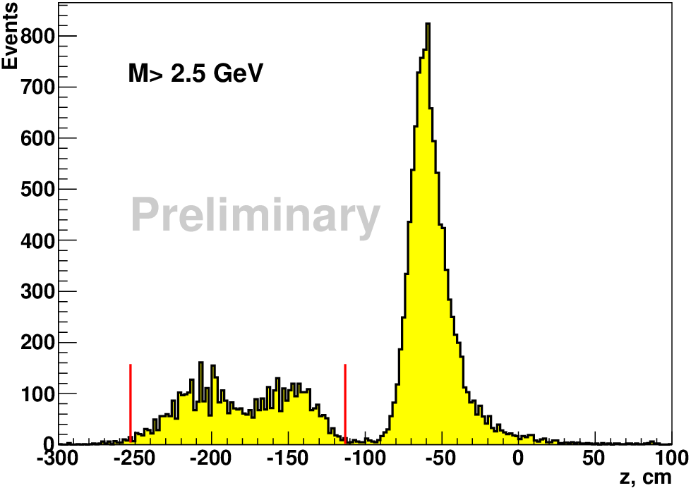
DY Feasibility@COMPASS : 2009 running
Beam intensity: per spill.
Two CH₂ target cells (40+40 cm).
Hadron absorber.
Mass spectrum of dimuons.
Reconstructed z-vertex position:
the two target cells and the absorber
are visible.

Slide 27
Absorber and beam plug (I)
A hadron absorber made of low Z material allows to minimize the
multiple scattering suffered by the muons. Additionally, we need to
maximize the stopping power for produced hadrons.
A tungsten beam plug allows to efficiently stop the beam which
does not interact in the target. Its shape is optimized to contain
the Molière cascades, reducing the probability of crossing by
Drell-Yan muons.
Different combinations of materials are being studied: Al₂O₃ with
borated polyethylene; Al₂O₃ with steel; graphite with copper
The present reference absorber we use in simulations is 236 cm
of Al₂O₃.

Slide 28
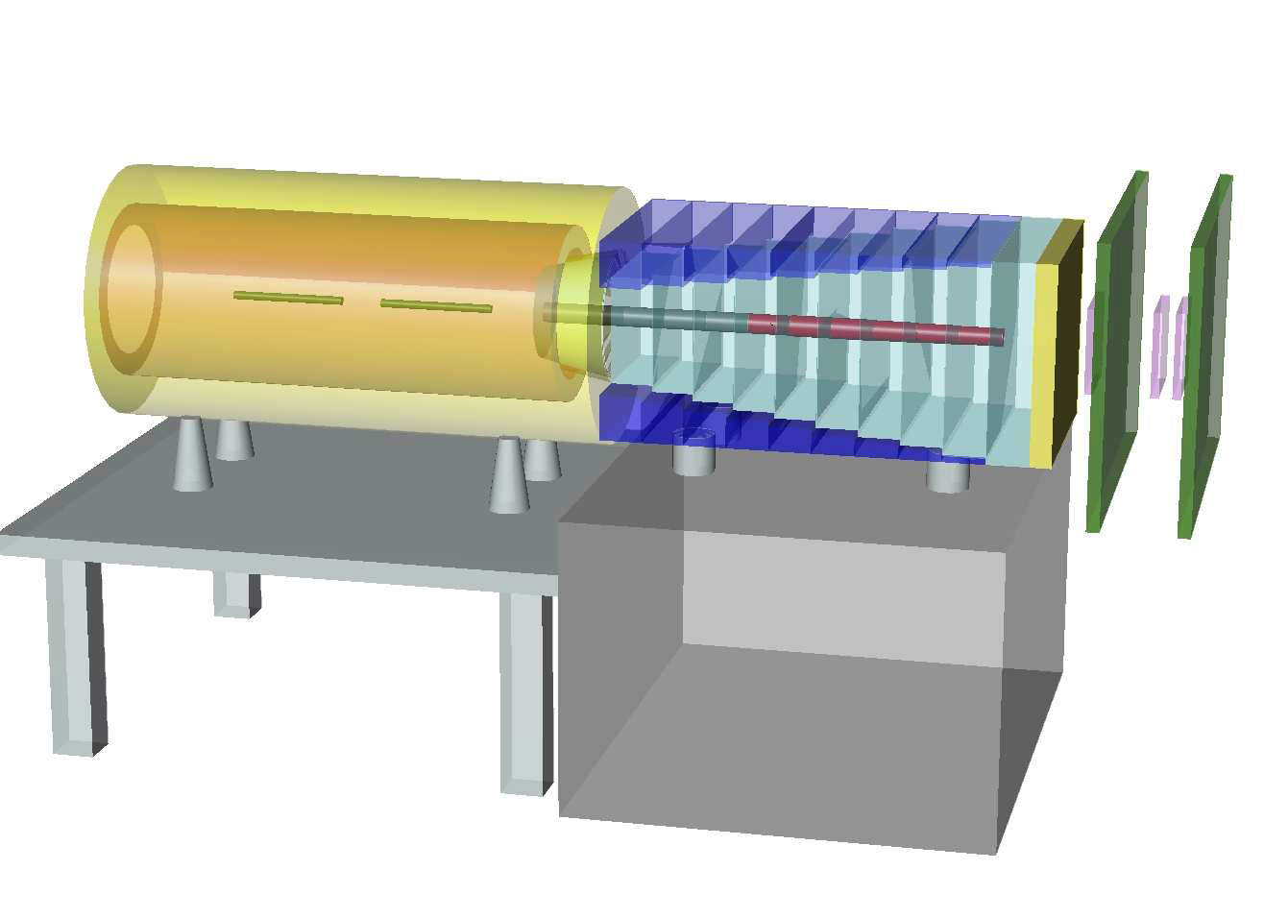
Absorber and beam plug (II)
Two target cells (NH₃) inside the dipole with 55 cm length and 4 cm diameter, spaced by
20 cm.
The absorber is 236 cm long, made of Al₂O₃.
The plug inside the absorber is made of 6 disks of W, 20 cm long each and 20 cm of Alumina in the most downstream part (total of 140 cm).
Present configuration
(still undergoing optimization):
 | Absorber | Beam plug
X/X₀ | 34 | 343
X/λ_{int} | 7.2 | 10.6

Slide 29
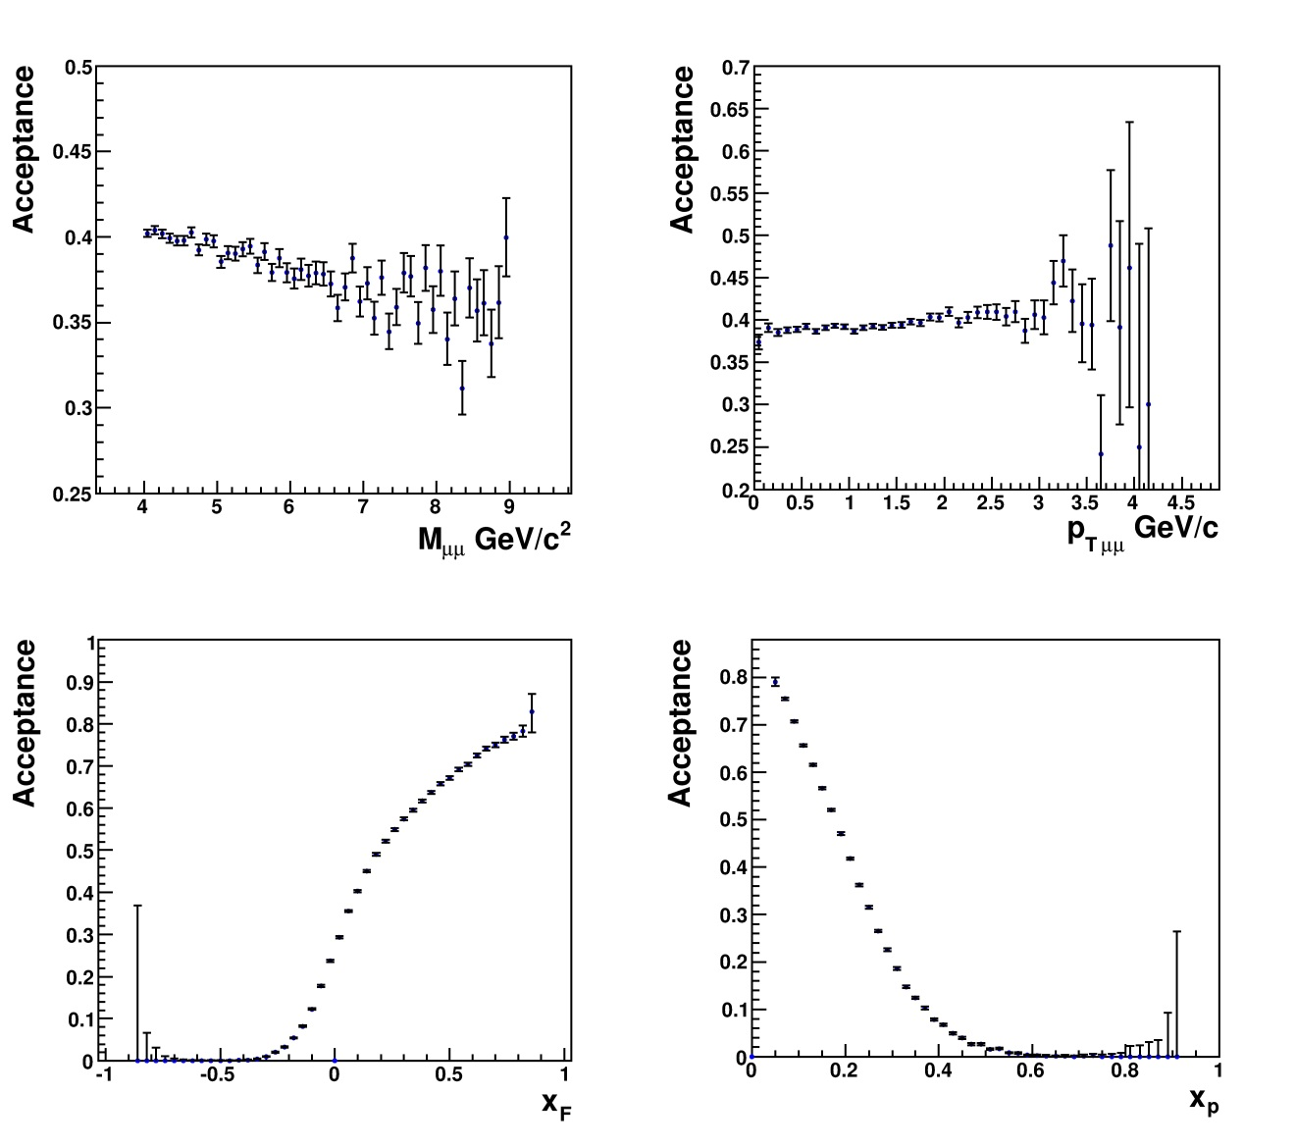
Acceptances
Global acceptance for high mass dimuons: 39% :
both muons in the LAS: 22%
one in LAS, one in SAS: 18%
4 ≤ M_{µµ} < 9 GeV/c²
both muons in the SAS: 2%
(no trigger)
(some superposition between LAS and SAS)

Slide 30
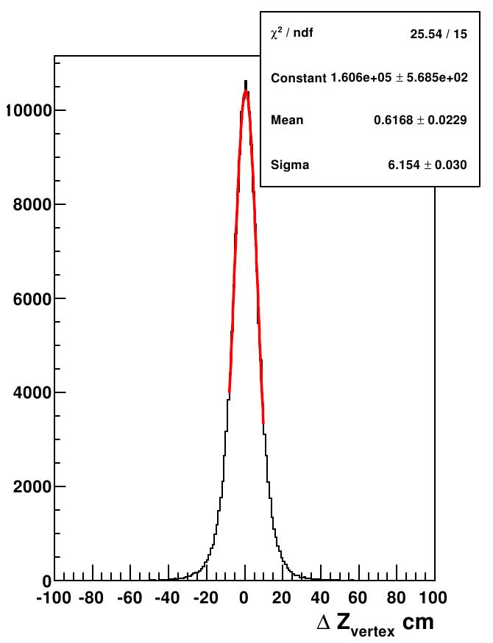
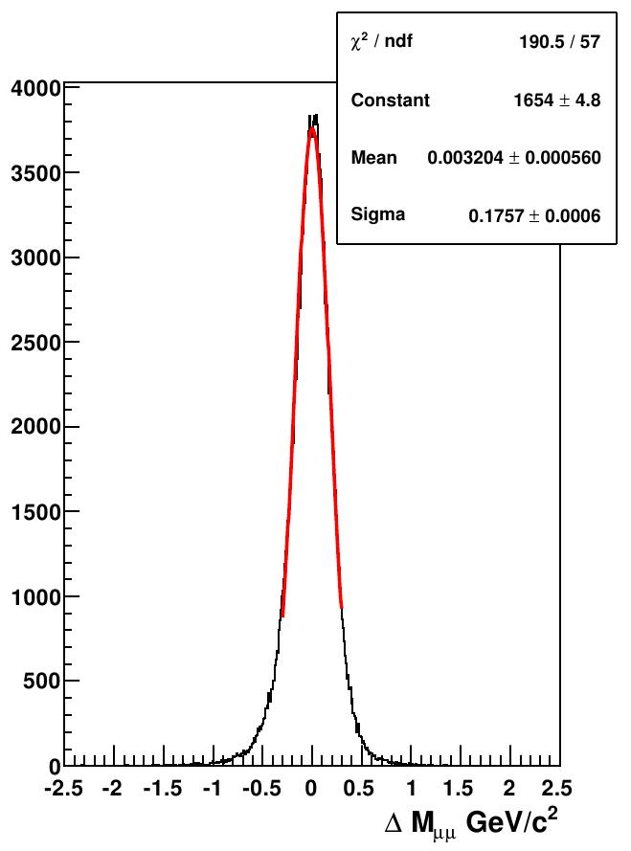
Resolutions
MC simulation of Drell-Yan events with 4 ≤ M_{µµ} < 9 GeV/c².
Z _{vertex} resolution is 6 cm: allows to distinguish the events from
each cell.
Dimuon mass resolution is 180 MeV/c²: as expected taking into
account the absorber.

Slide 31
Radiation conditions (I)
COMPASS is a ground level experiment => the whole target area including the absorber needs proper shielding.
Several options for shielding are being considered: concrete; concrete and borated polyethylene; concrete and steel.
Higher the beam intensity => increase of radiation dose -> modularity of the absorber, and a shielding with good margin.
The control room must be moved to a remote location.
The radiation conditions must be carefully monitored online.

Slide 32
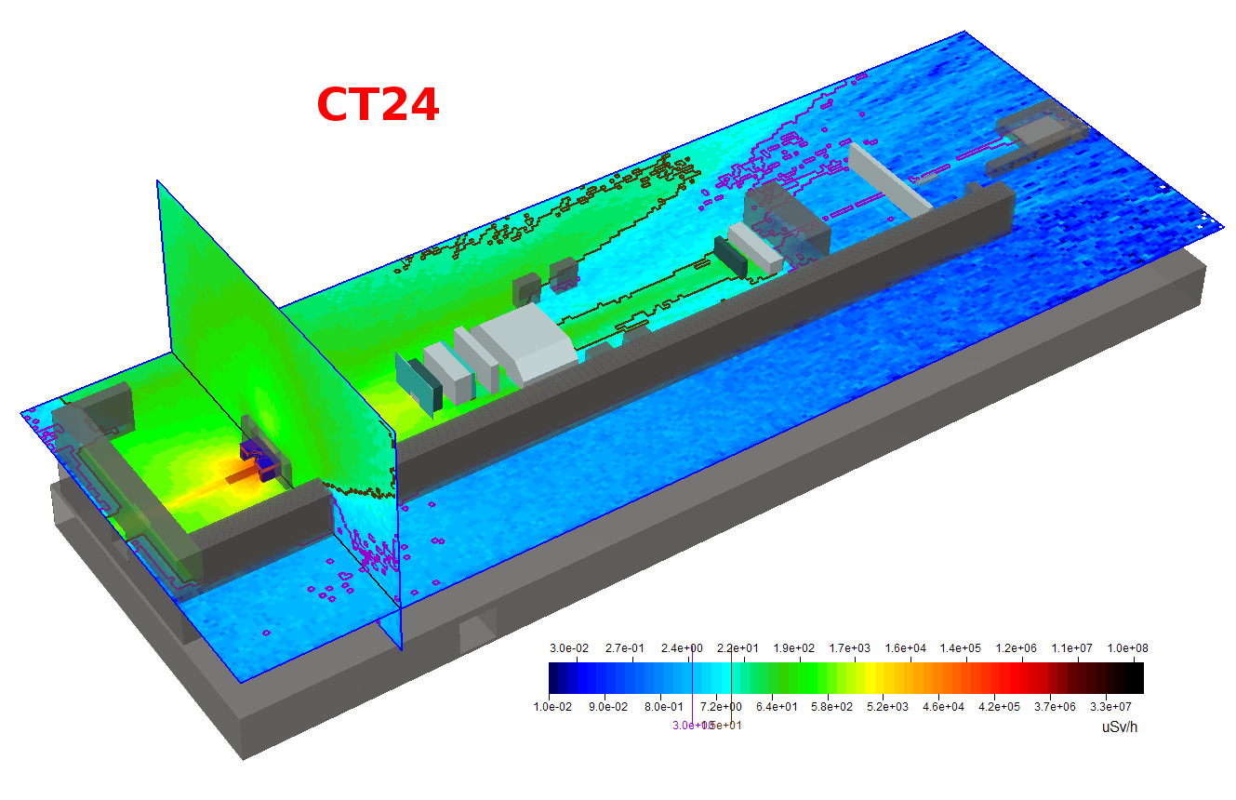
Radiation conditions (II)
With a radiation screen of steel, borated polyethylene (neutrons absorption) and concrete, also on top, to avoid important skyshine.
With a beam intensity up to 1 * 10⁸ π⁻/second, the radiation levels are within safety limits.

Slide 33
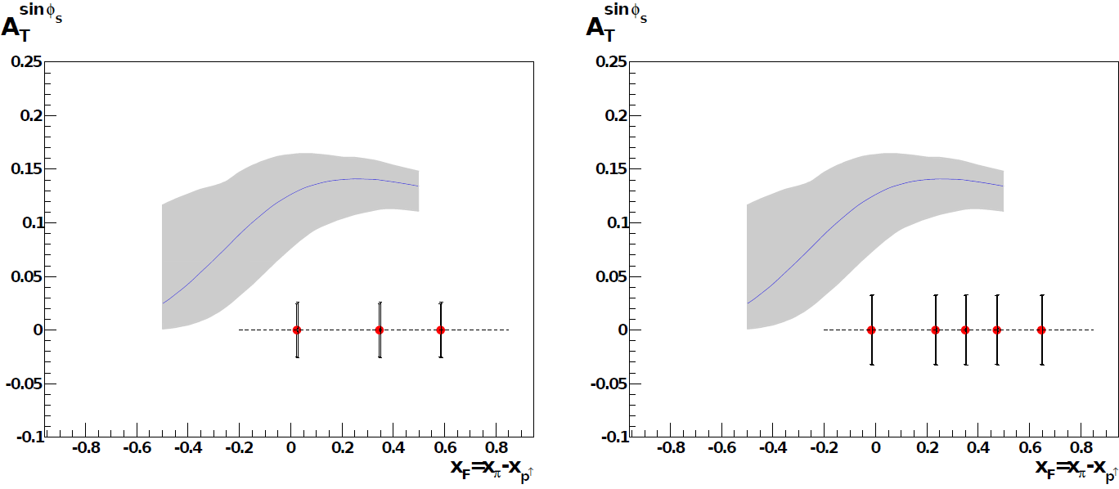
Expected event rates & Projections I
With a beam intensity I_{beam}=6x10⁷ particles/second, a luminosity of L=1.2x10³²cm⁻²s⁻¹ can be obtained:
→ expect 800/day DY events with
Assuming 2 years of data-taking (140 days/year), one can collect: ≈230000 events in HMR DY.
This will translate into a statistical error in the asymmetries:
Expected statistical error of the Sivers asymmetry in the dimuon mass range 4GeV/c² ≤ M_{μμ} ≤ 9GeV/c², assuming one year of data taking.
Expected statistical error of the Sivers asymmetry for a measurement in three (left) and five (right) bins in x_{F} . The smaller error bar is the statistical only, while the larger one corresponds to the quadratic sum of statistical and systematic errors. The theoretical prediction of the asymmetry from Anselmino et al. is also shown.
Possibility to study the asymmetries in several x_{F} bins.

Slide 34
Projections II (COMPASS II proposal )

Slide 35
Competition and complementarity
The Drell-Yan way of accessing TMDs has raised a lot of interest in
recent years.
Several experimental proposals appeared. Meanwhile, some are on
hold due to lack of funding, some waiting for R&D break-through, some
waiting for a time opportunity.

Slide 36
Summary
The polarized Drell-Yan measurement is part of the COMPASS-II new physics proposal.
The proposal for a first period of 3 years (2014 to 2016) including 1 year of Drell-Yan data tacking was recommended for approval by the SPSC/CERN and approved by the CERN research board.
The feasibility of the measurement was confirmed by the 3 beam tests performed in 2007-2009.
The expected statistical accuracy reached in 2 years (6∙10⁷ π⁻/sec) of data taking should allow to check the theory predictions and to extract TMD PDFs, namely Sivers and Boer-Mulders, as well as the transversity PDF.
Sivers and Boer-Mulders PDFs sign change when measured in Drell-Yan versus SIDIS will be checked.

