Slide 1


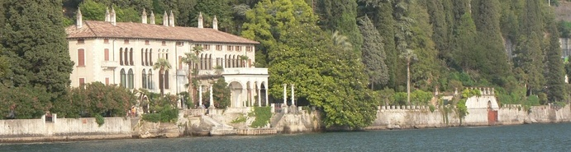
Spin physics at COMPASS: present and future
Gerhard K. Mallot
CERN/PH
On behalf of the COMPASS Collaboration
Enrico Fermi School (Course CLXXX), Varenna, 28 June - 11 July, 2011

Slide 2
Plan
COMPASS I
  Goals
  Experiment
  Results
    Helicity distributions
    Gluon polarization
    Transverse spin
    TMDs
COMPASS II
  Drell-Yan
  DVCS/GPDs
  Outlook

Slide 3
Global effort: Pol. DIS/pp
 | 1970 | 1980 | 1990 | 2000
SLAC
CERN
DESY
JLab
RHIC
E80
E130
E142/3 E154/5
EMC
SMC
COMPASS I
HERMES
CLAS/HALL-A
Phenix/Star
A worldwide effort since decades

Slide 4
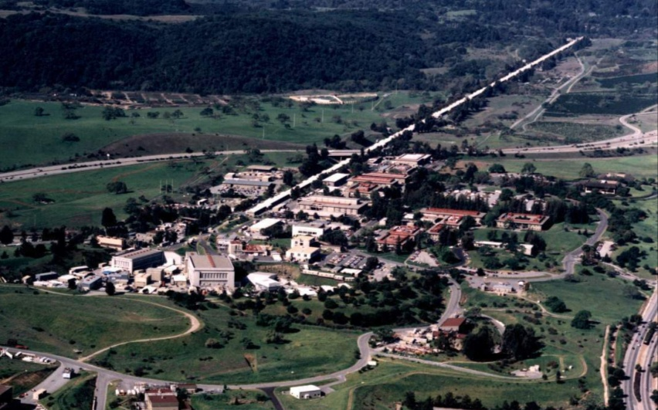
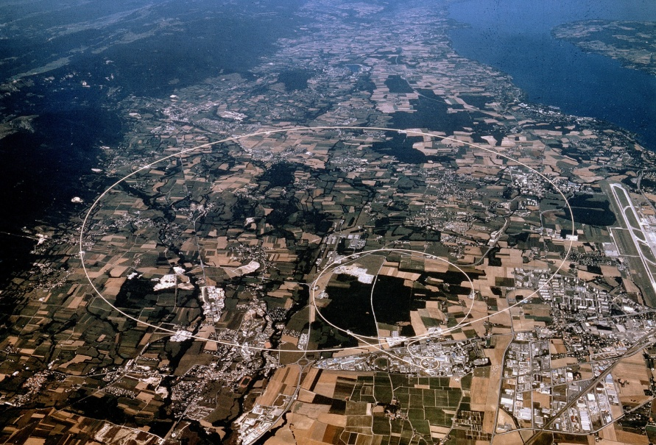
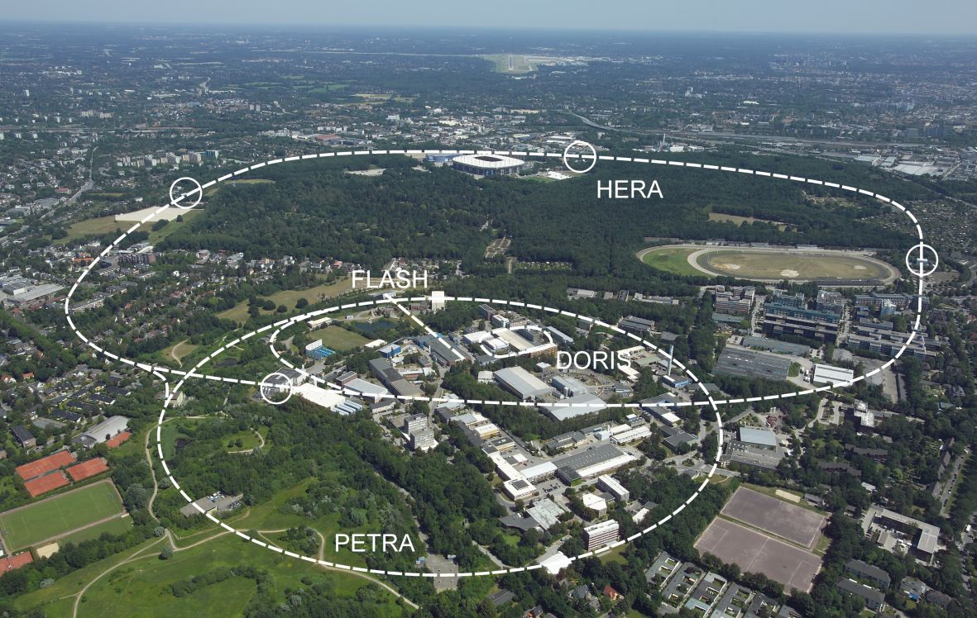
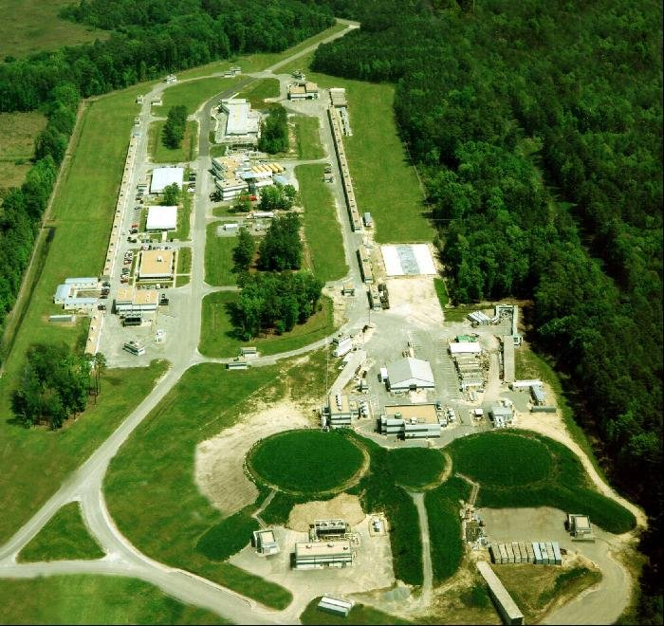
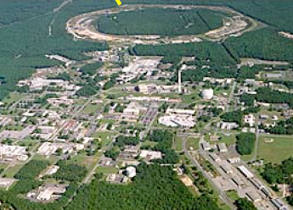
Laboratories
SLAC
CERN
49 GeV e–
160/280 GeV µ⁺
DESY
RHIC
JLab
27 GeV e±
6 GeV e –
250+250 GeV pp

Slide 5

COMPASS@CERN
LHC
COMPASS
SPS

Slide 6
COMPASS I: Goals
Founded 1996, approved 1998, first data 2002
Goals of the semi-inclusive measurements
  Helicity distributions
  Gluon polarization
  Transversity PDF
  Meson and baryon spectroscopy , π polarizability (not discussed here)

Slide 7
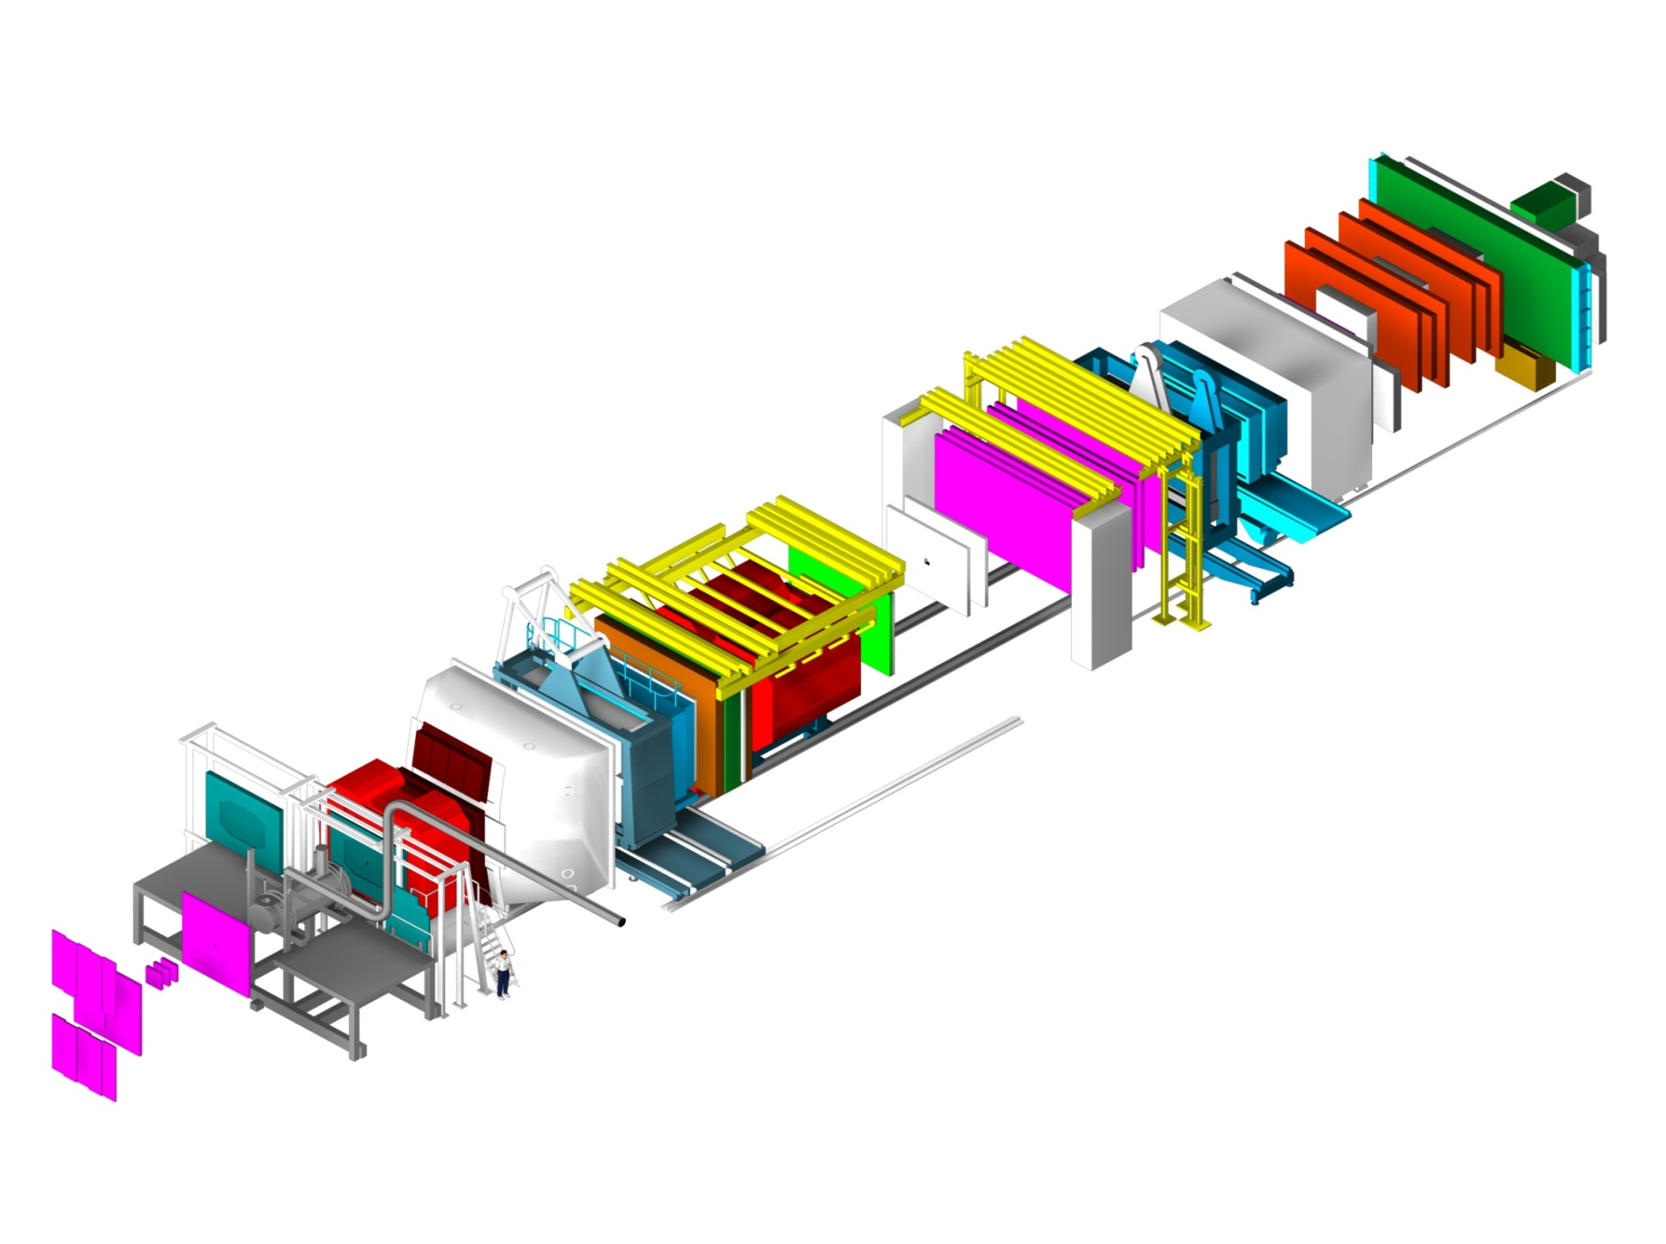
Experiment: Spectrometer
60m long
Hodoscopes
E/HCAL2
E/HCAL1
SM2
RICH1
Muon Wall 2,
MWPC
SM1
Polarised Target
MWPC, Gems, Scifi,
W45
Muon Wall 1
Straws, Gems
160/200 GeV
μ beam
Micromegas, DC, Scifi
Scifi, Silicon

Slide 8
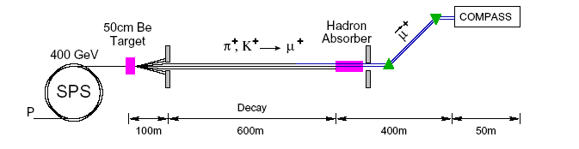
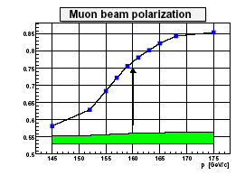
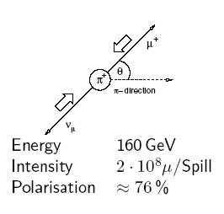
CERN muon beam
100−200 GeV/c
E_{π}=180 GeV

Slide 9
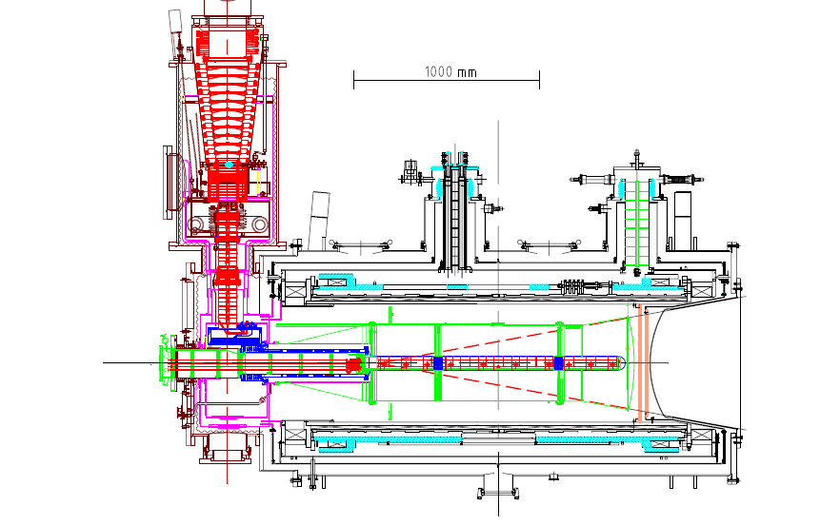
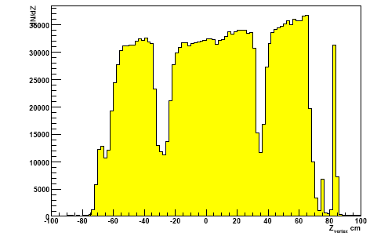
Polarized target system
solenoid 2.5T
dipole magnet 0.6T
acceptance ± 180 mrad
³He – ⁴He dilution
refrigerator (T~50mK)
⁶LiD/NH₃ (d/p)
50/90% pol.
40/16% dil. factor
μ
Recontructed interaction vertices

Slide 10
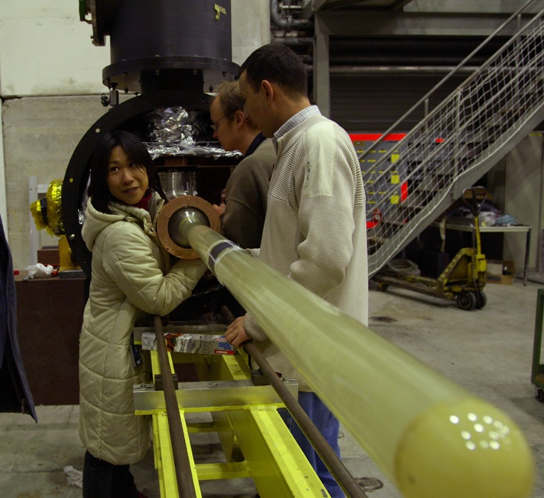
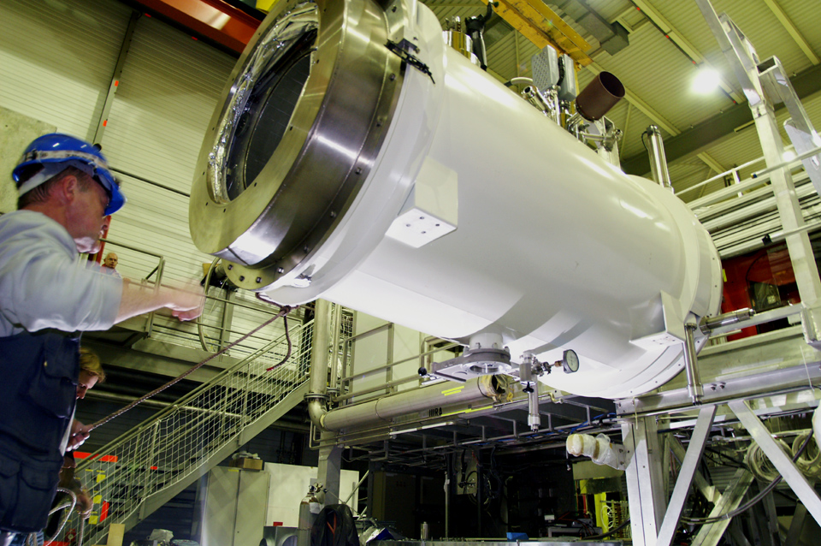
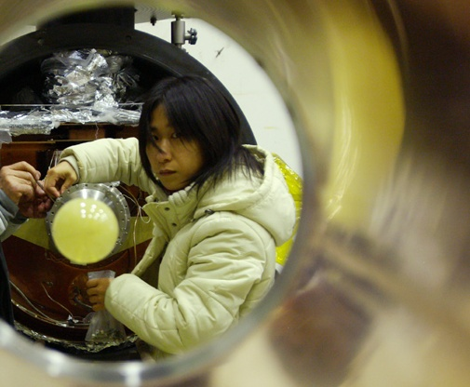
Polarized target
The coldest place @ CERN:
60mK, 1/30 of LHC magnets temperature

Slide 11
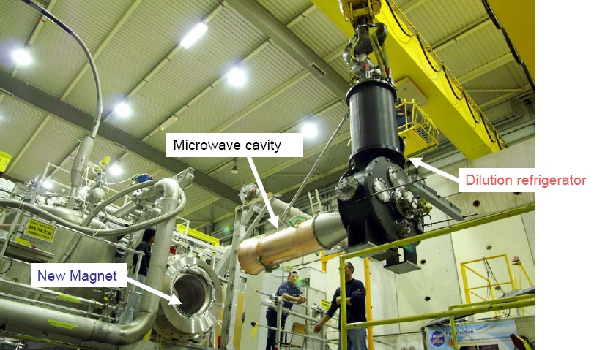
Polarized target installation

Slide 12
Polarized target performance
Polarization of ⁶LiD in 2006
+53.5% -52.0% +56.1%
days

Slide 13
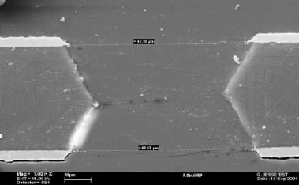
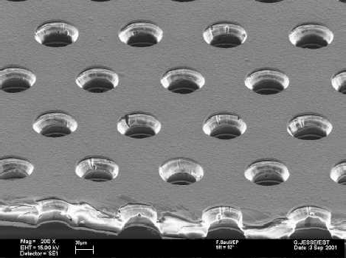
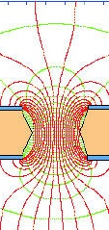
Tracking example: GEMs
Gaseous Electron Multiplier
Gem foil

Slide 14
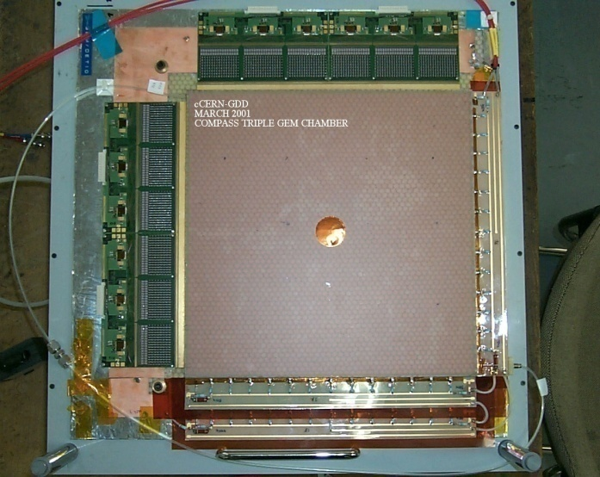
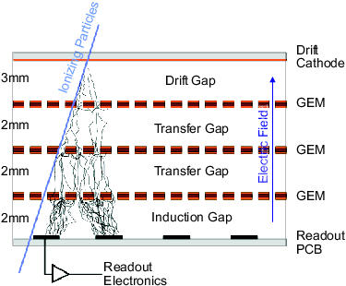
GEMs
-4100 V
20 triple Gems detectors
in 10 stations
40 coordinates
size 30×30 cm²
12 ns time resolution
50 μm space resolution
efficiency ≈97 %
Ar/CO₂ 70/30 %
0V

Slide 15

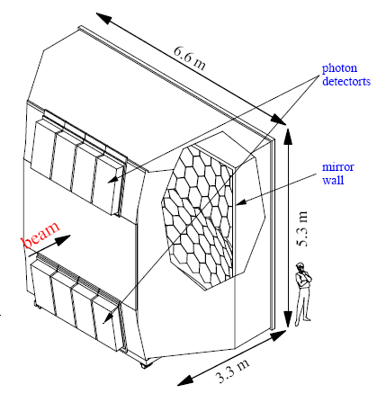
Particle identification: RICH
80 m³ (3 m C₄F₁₀ radiator)
116 UV mirrors
5.3 m² UV detectors
  MWPC CsI photo-sensitive cathodes
  8×8 mm² pads
84k analog r/o channels
2006: inner quarter with maPMTs

Slide 16
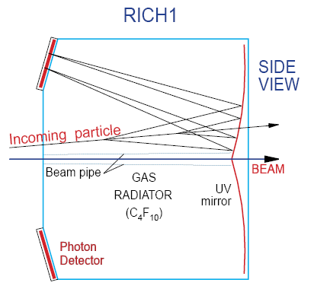
RICH
π/K separation up to 60 GeV/c
Large angular acceptance

Slide 17
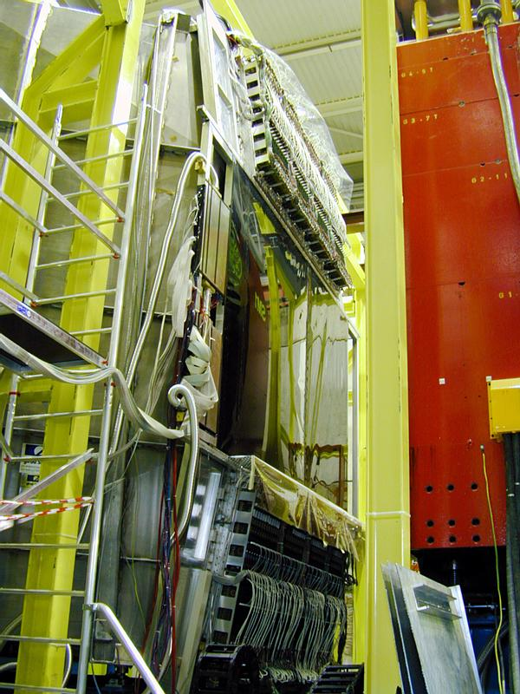
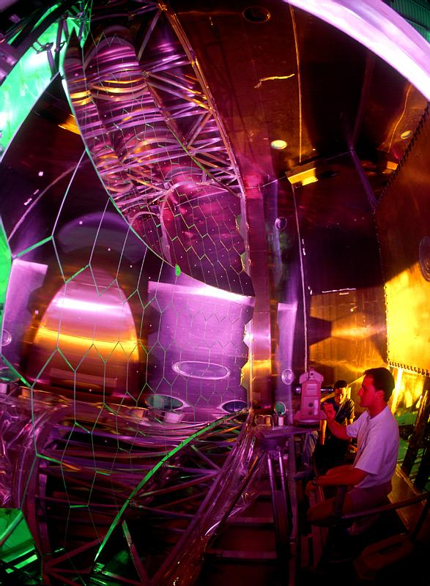
RICH

Slide 18
Results: Data taking
    Data taking:
    2002–2004: polarized deuteron target (⁶LiD),
    longitudinal & transverse polarization
    2005: CERN shutdown
    2006: polarized deuteron target (⁶LiD), long.
    2007: polarized proton target (NH₃),
    longitudinal & transverse polarization
    2008-2009: spectroscopy
    2010: polarized proton target (NH₃) , transv.
    2011: polarized proton target (NH₃) , long.

Slide 19
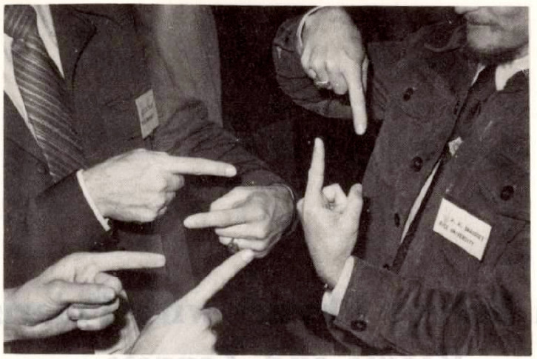
Results: helicity structure

Slide 20
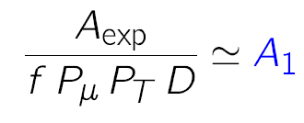
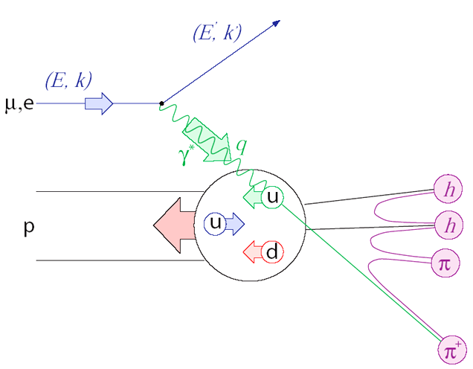
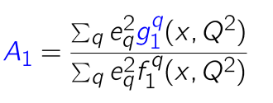
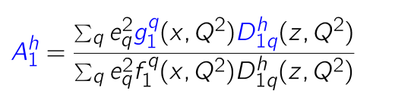

X-sect. asymmetries
Inclusive scattering
Semi-inclusive scattering

Slide 21
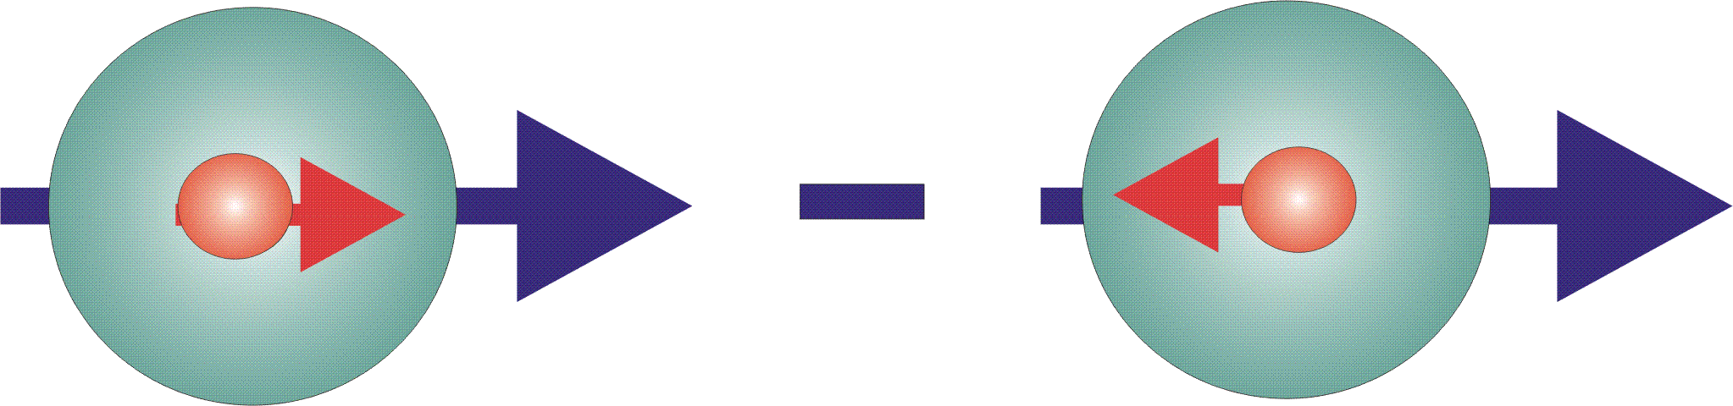
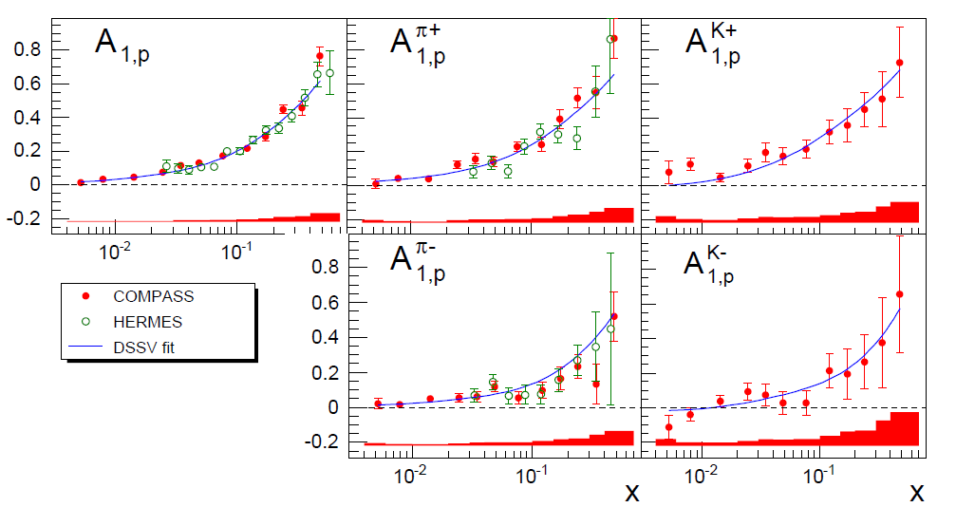
Proton A₁ asymmetries
incl. & semi-incl. asymmetries
for identified π’s and K’s
incl.
π⁺
K ⁺
π –
K ⁻
PLB 693 (2010) 227

Slide 22
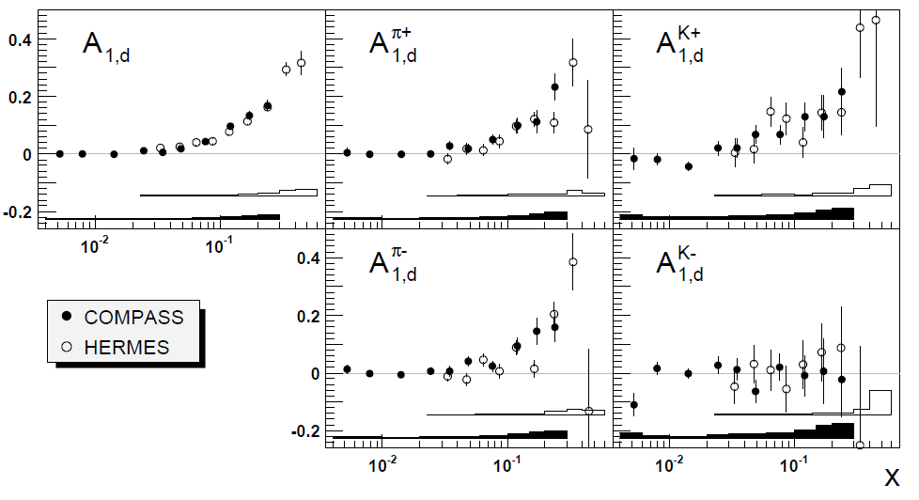
Deuteron A₁ asymmetries
Inclusive & semi-inclusive asymmetries
for identified π’s and K’s
incl.
π⁺
K ⁺
π –
K ⁻
PLB 680 (2009) 217–224

Slide 23
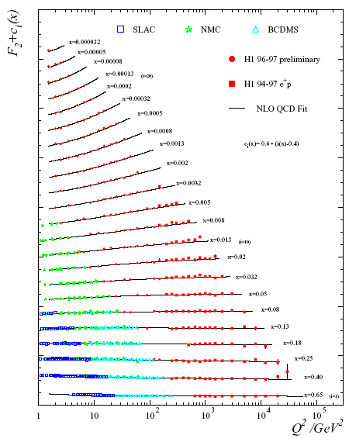
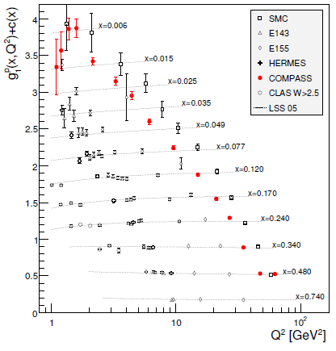
F₂(x,Q²)
g₁(x,Q²)
p

Slide 24
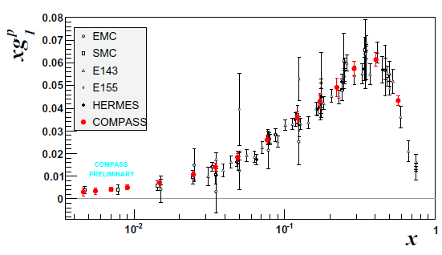
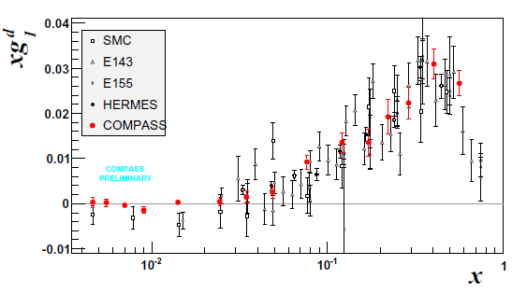
Structure function g₁(x,Q²)
p
very precise data
only COMPASS for
x < 0.01 (Q² > 1)
deuteron data:
ΔΣ= 0.33±0.03±0.05
Δs+Δs =−0.08±0.01±0.02
(ΔΣ = a₀, evol. to Q²=∞)
d

Slide 25


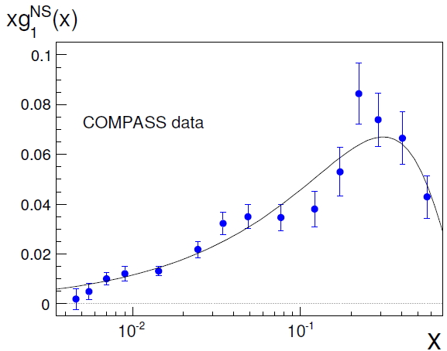
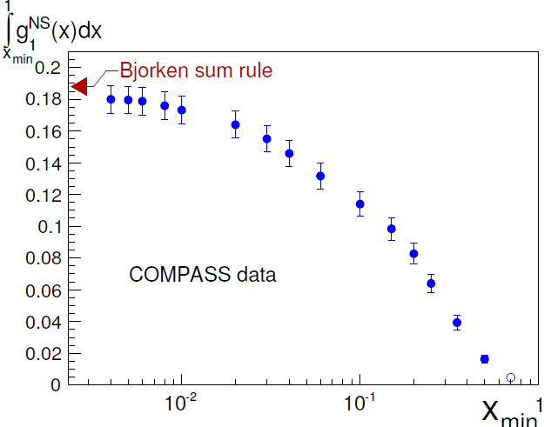

Bjorken sum rule
PLB 690 (2010) 466
from neutron β decay

Slide 26
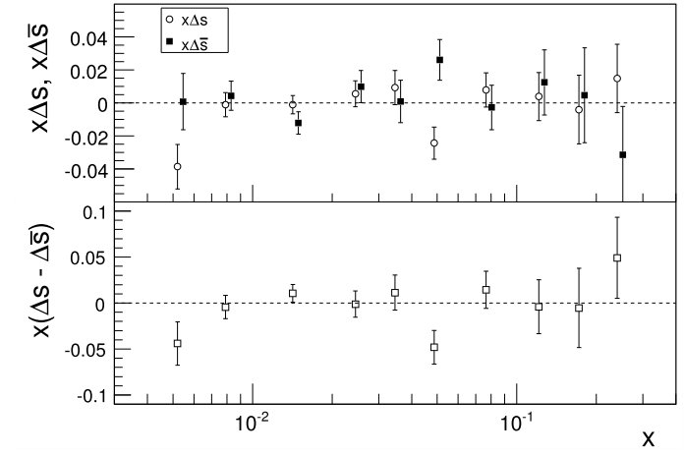
Flavour distributions: Δs = Δs ?
LO analysis of 5p+5d asymmetries, DSS FF
6 flavours: u, d, s, u, d, s
No significant difference! Go on assuming Δs = Δs
PLB693 (2010) 227

Slide 27
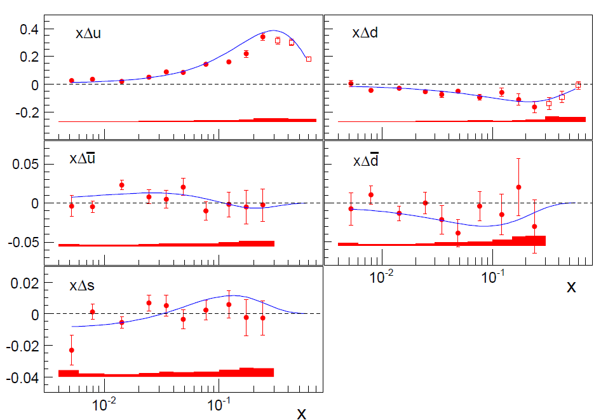
Flavour distributions
LO analysis of 5p+5d asymmetries, DSS FF
Line: NLO DSSV not including these data
PLB693 (2010) 227
PRD80 (2009) 034030
5-flavour fit, assuming Δs = Δs

Slide 28

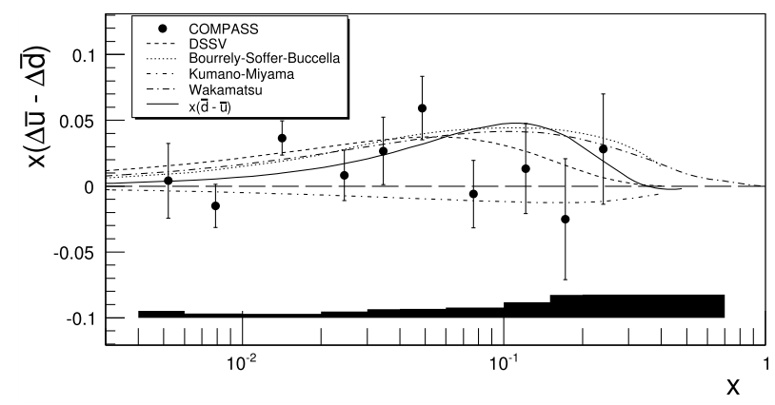
Flavour asymmetry?
PLB693 (2010) 227
Rather small effect, Δu > Δd

Slide 29
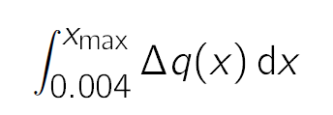
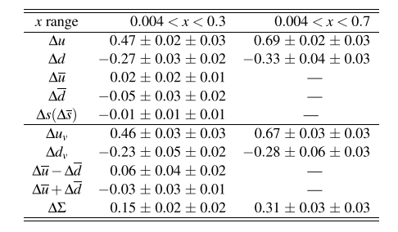
Truncated first moments
Δs small, compatible with zero

Slide 30
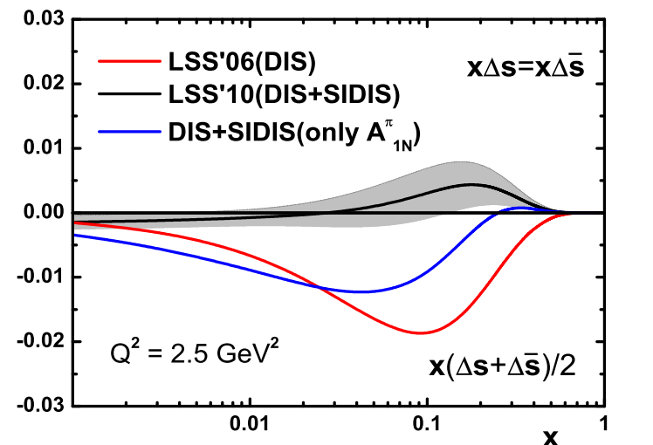
Inclusive data favour Δs < 0
J. Phys.: Conf. Ser. 295 012054
Inclusive data only
Δs ≈ −0.08± 0.01
Semi-inclusive point to
Δs ≈ 0
Shape of Δs(x) at small x unknown
Δs determination crucially depends on the fragm. functions used:
DSS, DNS, HKNS, EMC, …

Slide 31
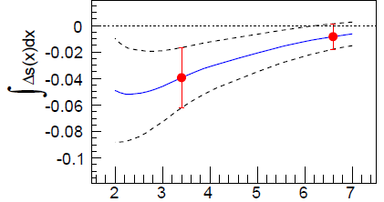
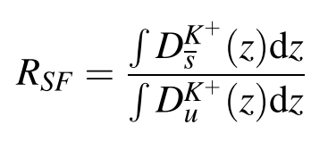
Strange quark FFs
DSS: PRD75 (2007)
EMC: NPB321 (1989)
DSS FF
EMC FF
PLB 693 (2010) 227
  Measurements of K and π multiplicities are mandatory!

Slide 32
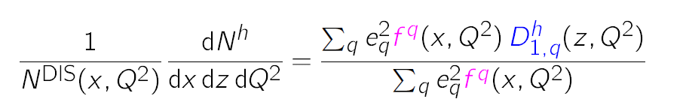
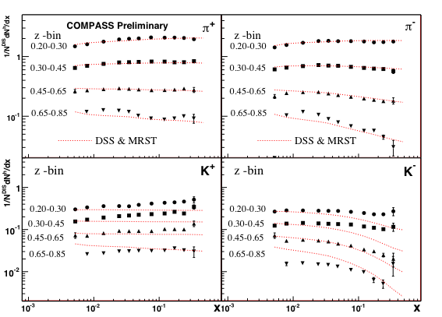
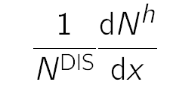
Multiplicities for K’s and π’s
LO:
π⁺
π –
Unpolarised data
For the z bins:
0.20 − 0.30
0.30 − 0.45
0.45 − 0.65
0.65 − 0.85
Lines: MRST04 PDF
+ DSS FF (LO)
K ⁺
K ⁻

Slide 33

K multiplicities, closer look
π multiplicities ± in agreement with LO calc.
Big deviations for K’s → consequences for FF!
Data to be in-
cluded in global
analyses
Only 4 weeks of
data, more to
come
Same bins as prev. page

Slide 34



Gluon polarization
EMC result 1987/88: quark spins contribute little to nucleon spin!
ΔΣ compatible with zero
Quark spin hidden by large gluon
polarization via axial anomaly?
small
poorly known
certainly not 6
unknown

Slide 35



Lepton-Photon Conf. 1989
G. Ross 1989
possible scenario:
∆G ≈ 6 (Q²=10 GeV²)
∆g/g(x) = 1 for x_{g} > 0.1
Let’s measure!

Slide 36







Photon–gluon fusion (PGF)
Gluon polarization is measurable in PGF
measure
calculate and
using Monte Carlo

Slide 37

Hadron production
Analysis of hadron-pair asymmetries:
  open charm: single D meson AROMA
    cleanest process wrt physics background
  high-p_{T} hadron pairs with Q² > 1 GeV² LEPTO
  high-p_{T} hadron pairs with Q² < 1 GeV² PYTHIA
  Single hadron production Q² < 0.1 GeV² NLO, Vogelsang et al.
D⁰ → K π
D⁰ → K π π⁰

Slide 38

Results for Δg
All results compatible with zero!
Confirmed by RHIC results in pp
NLO

Slide 39

Single hadron production
Calculations exist in NLO for small Q² large p_{T} Vogelsang et al.
Theory applicable at COMPASS? YES! Preferred scale μ=p_{T}/2
Next steps: asymmetries, inclusion into global analyses of Δg
Much more data on tape

Slide 40
Results: transverse spin structure

Slide 41



TMD parton distributions
8 intrinsic-transverse-momentum dependent PDFs at LO
Azimuthal asymmetries with different angular modulations in the hadron and spin azimuthal angles, Φ_{h} and Φ_{s}
aka
Sivers
Transversity
Boer–
Mulders

Slide 42






Transversity PDF h₁
Couple h₁ PDF to chiral-odd Collins FF
Azimuthal cross-section asymmetry:

Slide 43


Collins Asymmetries
large asymmetry for proton ~10%
zero deuteron result important ⇒ opposite sign of u and d
proton
h⁺
h⁻
deuteron
h⁺
h⁻

Slide 44
Collins proton: identified hadrons
π
x
z
P_{T}
positive
negative
K

Slide 45


Collins: Comparison to Hermes
Good agreement

Slide 46


Global Fit
Fit to COMPASS d, HERMES, BELLE (Collins FF, e⁺e⁻)
in good agreement with new proton data

Slide 47





Transversity PDF h₁ via 2-hadron
Alternative: couple h₁ to chiral-odd 2-hadron interference FF
cross-section
asymmetry:

Slide 48

two-hadron asymmetry
large asymmetries
interference FF and transversity sizable

Slide 49

Comparison to a recent Fit
Recent fit (dominated by HERMES, COMPASS p not yet in)

Slide 50




Sivers function
Sivers Asymmetry:
proposed (1990, Sivers)
thought to vanish (1993, Collins)
resurrected (2002, Brodsky,
Hwang, Schmitt)
different sign in DY and SIDIS

Slide 51


Proton Sivers Asymmetry
compatible with zero for the deuteron
non-zero asymmetry for pos. hadrons
h⁺
h⁻

Slide 52

Hermes data show somewhat larger asymmetry
for positive π’s

Slide 53


Sivers as function of W
Tendency for asymmetries to increase towards small W,
however some correlation with other kinematic variables
π
K

Slide 54

Spin-averaged asymmetries
Unpolarized target ⁶LiD (deuteron)
Kinematic factor devided out
sin φ modulation is small
cos φ
“Cahn”
cos 2φ
“ Boer-
Mulders”

Slide 55


COMPASS is more!
Rich physics programme with hadron beams (2008,2009,2012)
Proton, pion and kaon beams
Pion/kaon polarizability
Meson and baryon spectroscopy, PWA

Slide 56
What’s next?
Focus on transverse structure of the nucleon
Transverse size and orbital angular momentum (GPDs)
Restricted universality of T-odd TMDs (Sivers, Boer-Mulders), sign change from SIDIS to DY, additional TMDs (pretzelocity, worm-gear)
COMPASS-II Proposal
wwwcompass.cern.ch/compass/proposal/compass-II_proposal/compass-II_proposal.pdf
Other new facilitites/experiments
  JLAB, RHIC, JLAB 11 GeV, JPARC,
  ENC, eRHIC/ELIC, NICA/SPD

Slide 57

COMPASS-II
Generalized Parton Distributions (GPD)
Drell-Yan
Pion (and kaon) Polarizabilities
Approved December 2010

Slide 58


GPD’s
~
~
Novel concept, universal, H, H, E, E
H (E) nucleon helicity (non)conservation
Nucleon form factors and PDFs as limiting cases
Correlating transverse spatial and longitudinal momentum degrees of freedom (‘tomography’)
Total orbital momentum:
X.-D. Ji, PRL 78 (1997) 610
x is not x-Bjorken

Slide 59

Orbital angular momentum
A model-dependent case-study
JHEP06 (2008) 066

Slide 60


DVCS
DVCS is the cleanest process to determine GPDs
need a world-wide effort
Global analysis over large kinematic range mandatory
COMPASS-II: from HERA to JLAB 12 GeV kinematics

Slide 61


DVCS
DVCS can be separated from BH and the GPD H can constrained the cross section using different charge & spin (e_{μ}& P_{μ}) combinations of the μ beam
Deep VCS
Bethe-Heitler
Note: μ± have opposite polarization at COMPASS
Charge & Spin difference and sum:
Related to:
H (x= ξ,ξ,t)
P ∫dx H (x,ξ,t) /(x-ξ)

Slide 62



`Tomography’
Subtract BH from , intergrate over φ → unpol. DVCS x-sect
ξ=0 → t = −Δ_{T}² , no long. transfer
Transverse size as function of longitudinal momentum fraction
μ’
γ*
γ
μ
θ
φ
p
Independent of a GPD
parametrisation!

Slide 63





COMPASS-II projection
COMPASS-II projection, 2 years of data taking
Pilot run 2012
x_{B} region unique to COMPASS

Slide 64

BH vs DVCS simulation
Rapid variation of relative contributions with x_{B}
Normalisation of BH contributon at small x_{B}

Slide 65

BH vs DVCS data
Test runs in 2008/2009 – 40 cm long H₂ target
Clear DVCS signal, BH can be subtracted

Slide 66

COMPASS II proj. data set
Charge & spin asymmetry
Sensitive to GPD H models
Cancelation of several experimental
uncertainties
Easier to measure than absolute cross-sections
Asymmetries, sums and differences in
6x_{B} ×4 Q² bins as function of φ
Simulation for 2 years data taking, 160 GeV/c
and a 2.5 m long liquid H₂ target
Not shown: Deeply virtual vector meson production
μ’
γ*
γ
μ
θ
φ
p

Slide 67

Proj. charge & spin difference
α’=0.8
α’=0.05

Slide 68

Proj. charge & spin asymmetry

Slide 69

Semi-inclusive DIS
COMPASS I had ⁶LiD and NH₃ (i.e. deuterons for unpol.)
COMPASS II pure hydrogen target in parallel with DVCS
  A^{cosφ}, A^{cos2φ,} A^{sinφ} for proton
  Hadron multiplicities for FF, strange quark PDF
Proj. for 1 week

Slide 70


DVCS – main new equipment
ECAL1
ECAL2
50 m
New electromagnetic calorimeter, ECAL0
Liquid hydrogen target, 2.5 m long
Proton Time-Of-Flight detector, 4.0 m long

Slide 71



Experimental setup: Camera
2 barrels 4m long long scintillators
~ 300ps timing resolution
2.5 m long LH2 target
Gandalf Readout Project:
1 GHz digitalisation of the PMT signal to cope for high rate

Slide 72

Geometry target region
beam
LH2 target

Slide 73


ECAL0
new ECAL0 large angle calorimeter
Multipixel Avalanche Photodiode readout
ECAL0 248 modules (12 × 12 cm²)
of 9 cells read by 9 MAPDs
2.20 m

Slide 74


Drell−Yan Process
No fragmentation function involved
Convolution of two PDFs
Best: pol. antiproton−proton (long-term)
Simpler: negative pion on pol. proton (short-term)
Pion valence anti-u annihilates with proton u
‘

Slide 75




Restricted universality in SIDIS and DY
T-odd TMD
`gauge link changes sign
for T-odd TMD’, restricted
universality of T-odd TMDs
SIDIS: FSI
DY:ISI
J.C. Collins, PLB536 (2002) 43
Sivers
Boer-Mulders

Slide 76

Future DY experiments
2014
RHIC AnDY collider pp pol. 500² > 2013

Slide 77

Drell−Yan muon pair mass regions
4 < M_{μ+μ-} < 9 GeV
Safe region
2 < M_{μ+μ}- < 2.5 GeV
possible region
Combinatorial background < 1:1
J/ψ region

Slide 78


COMPASS-II Polarised Drell-Yan
COMPASS-II: 190 GeV/c π⁻ beam on transversely pol. proton target
π⁻ valence u-antiquark picks nucleon’s u quark
in valence region (u-quark dominance)
Access to transversity , the T-odd Sivers and Boer-Mulders TMDs

Slide 79

Major rearrangement of target region
Quench and Exhaust Lines
Cable trays
Transfer Line
Absorber
Control Racks
Pol. target
He-pipes
Micro Wave guides

Slide 80



COMPASS polarized DY
x_{p}
x_{π}
x_{F}=x_{π}−x_{p}
x_{F}

Slide 81








More projections
x_{F}=x_{π}-x_{p⇑}
x_{F}=x_{π}-x_{p⇑}
x_{F}=x_{π}-x_{p⇑}
x_{F}=x_{π}-x_{p⇑}

Slide 82
COMPASS-II schedule
  2012 Primakoff scattering: Polarizabilities of π and K
  DVCS pilot run: t-slope, transverse size
  2013 Accelerator shutdown
  2014 Drell-Yan : Universality of TMDs
  2015−2016 DVCS and DVMP: Study GPDs,
  “nucleon tomography”
  Unpolarized SIDIS: FF, strangeness PDF, TMDs
  Caveat: CERN Accelerator schedule not fixed beyond Nov 2012

Slide 83
Summary
Wealth of data from COMPASS, more to come, e.g
  COMPASS: 2010 p transverse, 2011 p longitudinal
  Single hadron production asymmetries (ΔG)
  Hadron spectroscopy
Focus shifting to 3D structure of the nucleon
COMPASS II will make major contributions
Exciting times ahead (also off-LHC)

Slide 84

(Nucleon) Spin is fun

Slide 86

Longitudinal spin transfer to Λ & Λ
2003/2004 data 69500 Λ
41600 Λ
Λ
Λ
Large (!) D_{LL} for Λ related to antistrange quark distribution

Slide 87


Slide 88
COMPASS-2: the near future
COMPASS-2 is a new experiment
  Recommended by the CERN SPSC: Sept. 29, 2010.
  Approved by the CERN Research Board: Dec. 1, 2010.
COMPASS-2 physics – 4 main topics
  DVCS and DVMP : Study GPDs, “nucleon tomography”
  Unpolarized SIDIS : Fragmentation Functions, s-PDFs, TMDs
  Drell-Yan : Universality of TMDs
  Primakoff scattering : Polarizabilities of π and K
Data taking
  2012, SPS/LHC shutdown, 2014, 2015, 2016

Slide 89


Polarized Drell-Yan measurements
COMPASS
  190 GeV pion beam
  Transversely polarized NH₃ target
  Spectrometer ready for muon detection
  SIDIS :
  DY:
    Dominated by u/u annihilation
Access to TMDs, complementary to SIDIS
  Universality of TMDs
  Test of factorization: opposite sign expected:

Slide 90

DY cross section expansion
Expansion in LO quark parton model
  polarized target nucleon
  Access 4 TMDs:
    Sivers, Boer-Mulders, Pretzelosity, Transversity
  Convolution with the pion f₁ or BM distributions
Access 4 TMDs – asymmetry modulation:
Arnold, Metz and Schlegel, Phys. Rev. D79:034005, 2009.
Siv
BM
Pr
Tr

Slide 91


Polarized Drell-Yan – expected results
2 x 5 months of data taking
6.10⁸ pions/spill
1.1 m NH₃ target
Mass: 4<M_{μμ}<9 GeV
Sivers
Boer-Mulders
DY beam test in 2008
Pretzelosity
Transversity

Slide 92
Drell-Yan preparation
Upgrade of the spectrometer
New beam telescope (Sci-Fi)
Thick hadron absorber/beam dump
Vertex detector
Displacement of the target

Slide 93

Sivers asymmetry: identified hadrons
Positive hadrons: slightly positive signal
Negative hadrons: the asymmetry is compatible with zero

Slide 94


Sivers: COMPASS data vs fit (Anselmino et al.)
Anselmino et al., Eur.Phys.J.A39 (2009)89
Update in S. Mellis, DIS 2011.
Updated fit with the latest HERMES and COMPASS data (Mellis, 2011)
Opposite transverse momentum for u and d quarks
Additional results in Arnold et al., arXiv: 0805.2137 (2008).

Slide 95


Accessing ΔG: QCD fits to world data (DIS, SIDIS)
From Leader, Spin-2008
From DSSV, PRL 101, 2008
      Shape of ΔG(x)?
      Needed are dedicated measurements of ΔG(x)
LSS-06 : Phys. Rev. D73, 2006
AAC’06 : Phys. Rev. D74, 2006
DSSV-08: Phys. Rev. Lett. 101, 2008
ΔG(x) may be: positive, negative, or sign-changing!

Slide 96

Accessing ΔG: Photon-Gluon Fusion (2 methods)
High-p_{T} hadron pairs (q=u, d, s)
  Physical background
  Rely on MC estimates
  2 cases: Q²>1 (GeV/c)² Q²<1 (GeV/c)²
Open Charm production (q=c)
  Detect D° → K⁻p⁺ and D*→D°π⁺
  Clean channels (no u, d, s quarks)
  Low statistics
COMPASS data:
  hi-p_{T}, Q²>1 : 3 points, data from 2002-2007
  Hi-p_{T}, Q²<1 : 1 point, data from 2002-2004
  Open charm: 1 point, data from 2002-2007
Photon-Gluon Fusion
5 ΔG/G points

Slide 99
DVCS – main new equipment
ECAL1
ECAL2
50 m
New electromagnetic calorimeter, ECAL0
Liquid hydrogen target, 2.5 m long
Proton Time-Of-Flight detector, 4.0 m long

Slide 101
COMPASS spectrometer

Slide 102

COMPASS spectrometer

Slide 103

Flavour asymmetry?
considerable asymmetry in the unpolarised case
model predicts naturally asymmetry for pol. case
Rather small effect, u-bar > d-bar

Slide 104


Inclusive data favour Δs < 0
Inclusive only, Δs ≈ −0.08±0.01
Inclusive + semi-incusive, Δs ≈ −0.08±0.01
J. Phys.: Conf. Ser. 295 012054

Slide 105

Δg/g from PGF → open charm
cleanest process
  little physics background (LO, QCDC)
observe asymmetry in
D meson production
  statistics limited
  only one D meson via D → πK (BR ~ 4%)
  combinatorial background large
  drastically reduced when looking to D* decay in coincidence with slow pion
c
c
g

Slide 106
Δg/g from open charm
D⁰ → K π
D⁰ → K π π⁰

Slide 107

p_{T} dependence of single hadrons
Good description of data by NLO pQCD
Considerable scale dependence
Validates determination of Δg from high-p_{T} hadron distributions at COMPASS energies

Slide 108

Accessing ΔG: summary of measurements
LSS ’10
DSSV ‘08
Measurements are compatible with 0 – large values of ΔG seem excluded
But: Sign of ΔG is yet ambiguous
The shape of ΔG(x) is still unknown, data constrain a limited region
The contribution of ΔG to the nucleon spin is not determined

Slide 109


High p_{T} hadron cross sections
Absolute cross-section measurement
quasi real photo production of hadron
μ⁺d → μ⁺h±X
2004 data, 4 weeks
Huge statistics: rapidity bins
COMPASS Q²<0.1
√s =17GeV
In agreement with NLO pQCD, within theory’s uncertainty
over 6 orders of magnitude
→ Settles the theory framework for ΔG high p_{T}
Next step: produce spin asymmetries A_{LL}(p_{T}) for same events

Slide 110
From inclusive reactions
to exclusive reactions
Deep Inelastic Scattering
Deeply Virtual Compton Scattering
μp → μ’X
μp→ μ’p’γ
μ’
μ
Q²x_{B}
γ*
Q²
γ
γ*
x
x+ξ
x-ξ
p
z
p
GPDs
P’
z
t
from Nicole D’Hose
x P
x P
b⊥
x boost
y
y
x boost
PDF q ( x )
GPD H( x,ξ,t )
P_{x}
( P_{x,} b⊥ )
in 1 dimension in 1+2 dimensions

Slide 111



PDF, GPD, TMD
PDF GPD TMD
For theory see:
Ji, PRL 2003, Belitsky, Ji, Yuan PRD 2004
Meissner, Metz, Schlegel, JHEP 0908:056 2009

Slide 112
Diffractive dissociation into 3π final states
2008 data, p target
Mass of outgoing 3π system
charged mode: π⁻ p −−> π⁻π⁺π⁻ p
neutral mode: π⁻ p −−> π⁻π⁰π⁰ p
PWA: ~ 24M events (acceptance corr.)
PWA: ~ 1M events

