Slide 1
XIV Workshop on High Energy Spin Physics, DSPIN-11
Nuclear Magneto-Mechanical Effect at Negative Spin Polarization
By
Yu. Kiselev, N. Doshita, F. Gautheron, C. Hess, T. Iwata, J. Koivuniemi,
W. Meyer, H. Matsuda, A. Srnka.
Polarized target group at COMPASS: University of Bochum, Yamagata University, JINR Dubna, ISI of ASCR Brno.

Slide 2
Introduction
In the solid polarized targets the nuclear spin lattice relaxation goes mainly via
the interaction with the electron impurities because the number of lattice
phonons with nuclear frequencies is extremely small at low temperatures.
In our study We observed the effect which provides a fast nuclear relaxation even at superlow temperatures and It enables an excitation of the lattice vibrations; the first nuclear magneto-mechanical spectrum was obtained.

Slide 3
CERN’s 3-cells polarized target
Dilution fridge
2.5 T Solenoid
& 0.6T dipole
3-cells cavity

Slide 4
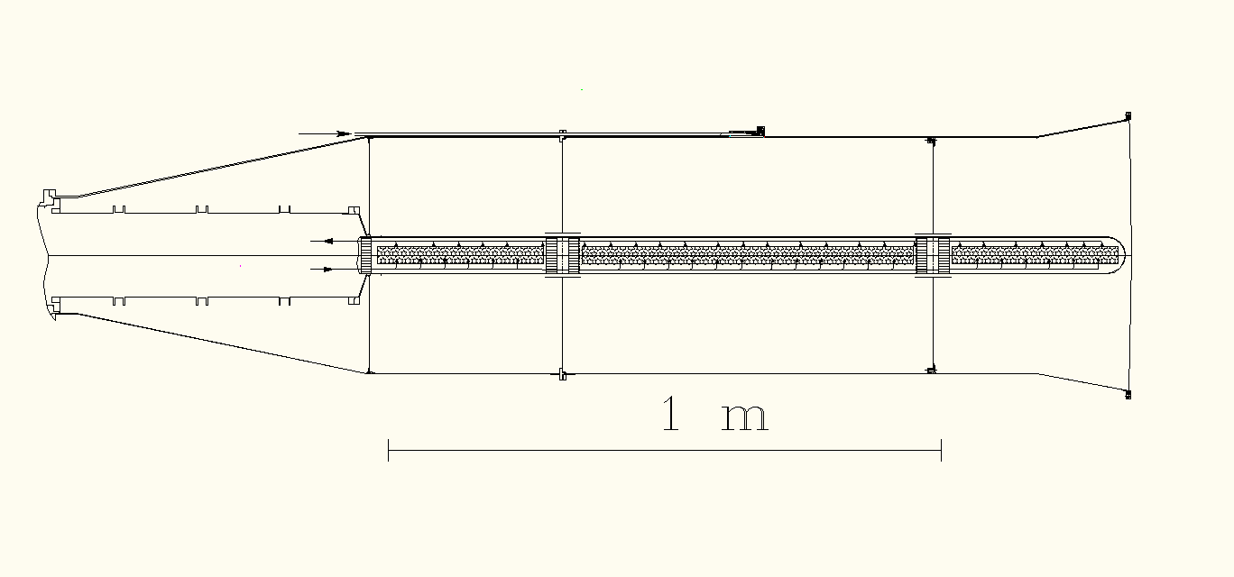
3-cellsNH3- polarized target at CERN
MW-stopper 1, 2
MW-stopper 3
MW-waveguide
3He Output
3He Input
Upstream
cell
Central cell
Downstream
cell
Target volume of bout: 400+800+400 cm^3, Surface1.5 m^2
H (solenoid) =2.5 T ±2·10^-5
H (dipole) 0.6 T ±5·10^-2
Microwave frequency 70 GHz
3He-inlet and 3He-Outlet
MW-stoppers make the electrical isolation of cavities

Slide 5
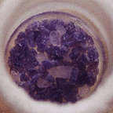
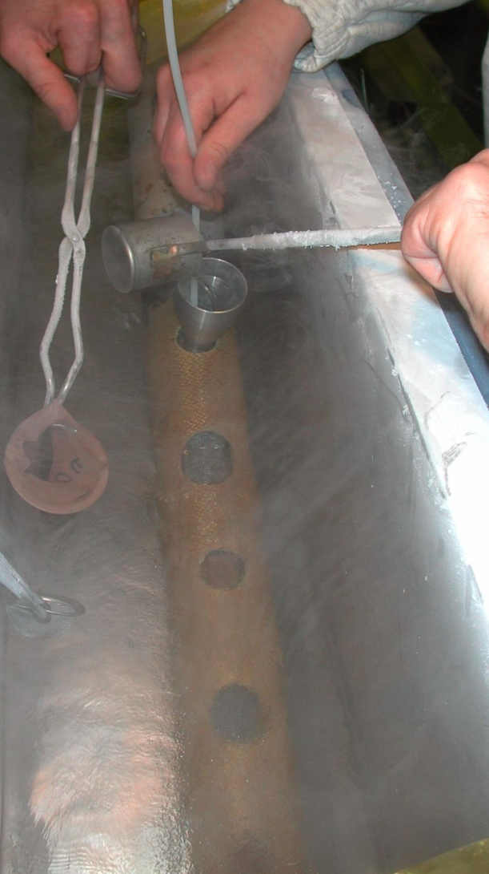
Up-cell, 30 cm
Middle-cell, 60 cm
Down-cell, 30 cm
3He ­ Out
3He ­ In
The target consists of granulated crystalline ammonia (NH3) loaded in three cylindrical cells .
The material is located in the mixing chamber of a 3He/4He dilution fridge and cools down at 100 mK.
3He atoms move under osmotic pressure inside the mixture. They go through the target material and are able to get contacts with polarized nuclei of ammonia.

Slide 6
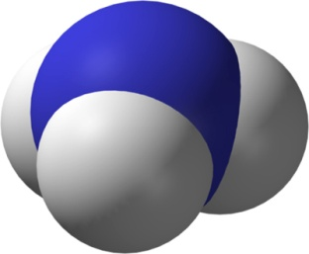
What are the ways and means for coupling between ammonia and
3He/4He mixture :
*Direct transport of angular moments from NH3 to 3He nuclei
b. By excitation of lattice vibrations and excitation of 3He/4He mixture:
**Translation ( from zero to some MHz),
***Torsion and Rotation degree of freedom (10¹³ Hz)
*** Inversion degree of freedom (3·10¹³ Hz)
* Proposed by C.J. Gorter and B. Kahn
** F.P. Reding and D.F. Horning, J. Chem.. Phys. V 22, p.1926 (1954)
*** Ref: see C.H. Townes, A.L. Shawlow, Microvave Spectroscopy 1955.

Slide 7
We estimate the relaxation times for the average spin energy due to magnetic and quadrupolar interactions during cross-relaxation between proton and nitrogen spins.
Ed-d - dipolar interaction energy between proton and nitrogen :
(c.g.s)
Wq-q - energy of quadrupolar interaction :
Assuming
we have :
R.V. Pound, Phys. Rev. 79, 685 (1950) ;
C.P. Slichter, Principles of Magnetic Resonance,
Ch.5, Springer-Verlag Berlin Heidelberg New-York 1980.
So, if the relaxation time of magnetic energy is of about 1 hour, its relaxation over the quadrupolar interactions will lead to of about the seconds!!!

Slide 8
At almost zero magnetic field the average quadrupole interaction energy <Hq> is proportional to the alignment A(N) of nitrogen spins:
Then, a change of alignment produces a transport of angular momentum from spin system to the lattice to conserve the total momentum.
This process could be realized in the proton-nitrogen cross-relaxation.
Let us go to the experiment!

Slide 9
At 0.2 K and 2.5 T homogeneous solenoid field the nuclear spins in ammonia were polarized by the DNP-method up to ±80 %.
Then our experiments were performed without use of external alternating fields.
At positive proton polarization:
Slowly sweeping up and down of the static field does not affect sensors
Observation:
At 0.03T
the proton –nitrogen cross-relaxation takes place
As a result :
Partial exchange of polarizations between
Proton and Nitrogen
spins
No any
visible thermal effects
coming
from
material
!
See SMC experiments by B.Adeva et al. NIM in Phys. Res. A 419 (1998) 60-82;
Review by D.Edmonds, Phys. Rep. (Sec. C of Phys. Let. 29,N4 (1977) 233-290)
At positive polarization the cross-relaxation goes by adiabatic way without visible thermal effects coming from ammonia.

Slide 10
The first magneto-mechanical spectra of 14N-lattice vibrations in homogeneous
field; H (solenoid) =0.03 T ± 2·10^-5.
Up-cell
Middle-cell
Down-cell
+82 %
+62%
-81 %
-45%
+84%
+65%
Temperature [mK]
Time [Min] (bottom scale); Dotted line shows the solenoid field in [G] (left scale)
Variation of nitrogen alignment nearby 0.03 T field excites the lattice vibrations.
Vibratory excitations spread up and down from the middle cell
Spectral resolution of magneto-mechanical vibrations consists of about 0.1 MHz.

Slide 11
“The physical fact underlined all gyromagnetic effects is that the
nuclear spin and the electronic spin, as well as their orbital angular
moments, generate a magnetic moment parallel to the angular
momentum.”
S. P. Heims and E. T. Jaines, Revs. Modern. Phys., 34, 136 (1962) .

Slide 12
Summary
The nuclear magneto-mechanical effect was observed in the irradiated ammonia at superlow temperatures and at negative spin polarizations.
Nitrogen spins produce the lattice vibrations when their alignment is being varied at the proton-nitrogen cross-relaxation.
Lattice vibrations are transmitted by 3He/4He mixture; they are detected by thermometers and made faster the relaxation of negatively polarized protons.
Evidence was produced, that a presence of quadruple nuclei in the polarized target materials makes shorter the relaxation time at negative polarization as compared with positive polarizations.
By the same reason, the negative polarization could be higher than the positive one due to its faster built-up at superlow temperature.

Slide 13
Thank you!

Slide 14
We wished to repeat the same tests at the negative nuclear polarizations.
Up-cell
Middle-cell
Down-cell
-0.3%
-67,5%
-1.0%
Temperature [mK]
a
b
Time [Min] (bottom scale); Dotted lines: the dipole field in [G] (left scale)
The change of nitrogen alignment nearby 0.03 T field excites the lattice vibratory spectra. The plot shows an nondegenerating (a) and degenerated (b) magneto-mechanical spectra of 14N; the effect is absent at static field.

Slide 15
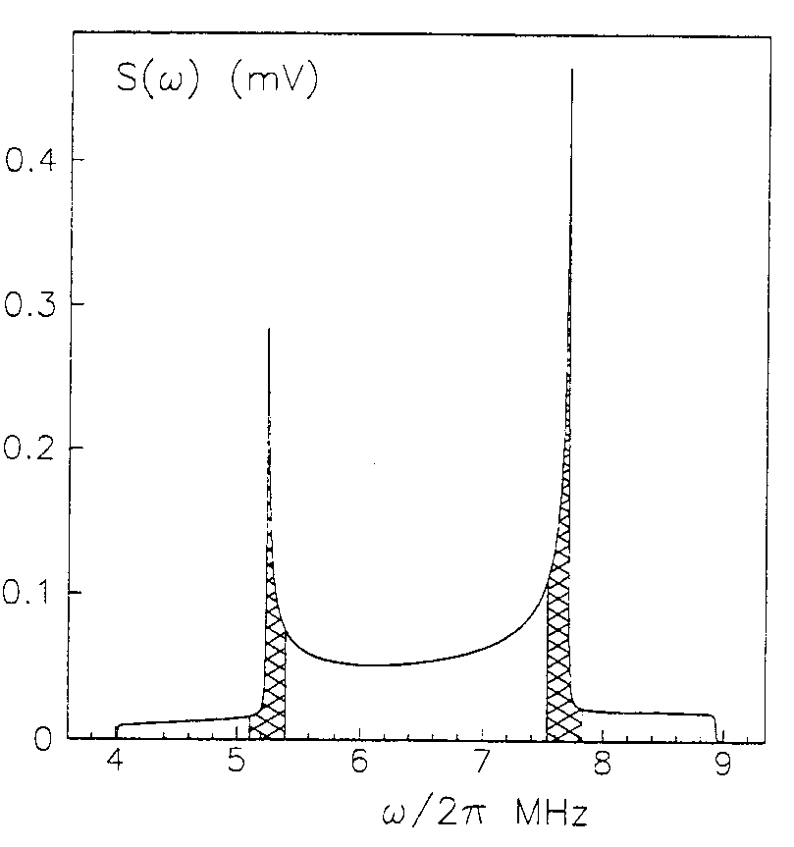
The vibratory spectra taken in the inhomogeneous field of dipole magnet
Up-cell
Middle-cell
Down-cell
-0.3%
+0.41%
-67,5%
-0.36%
-1.0%
+0.46%
Temperature [mK]
667 G
Time [Min] (bottom scale); Dotted line: the dipole field in [G] (left scale)
2. Vibratory excitations spread up and down from the middle sell arising the fast nuclear relaxation at the positively polarized Up and Down cells .

