Slide 1
Spin measurements in lepton scattering
G. K. Mallot
CERN/PH
Workshop on High-energy hadron physics with hadron beams
KEK, Tsukuba, January 2010

Slide 2
Plan
Introduction
DIS
Experiments
Helicity structure of the nucleon
Quarks
Gluons
Transverse spin-structure of the nucleon
Outlook

Slide 3
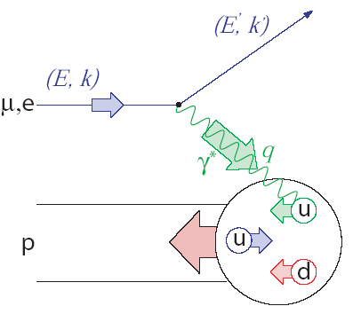
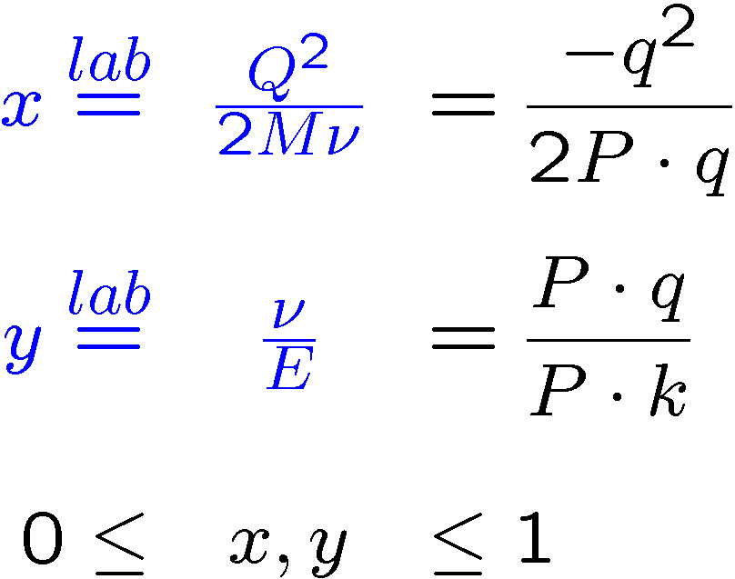
Deep Inelastic Scattering

Slide 4
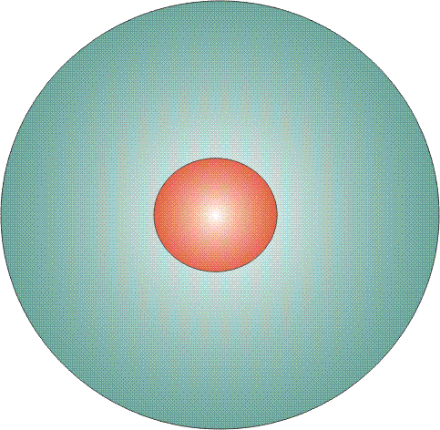
Parton Distribution Functions
Three twist-2 PDFs
q(x)
f₁^{q} (x)
unpolarised PDF
quark with momentum xP in a nucleon
well known – unpolarised DIS
Δq(x)
g₁^{q}(x)
helicity PDF
quark with spin parallel to the nucleon spin in a longitudinally polarised nucleon
known – polarised DIS
transversity PDF
quark with spin parallel to the nucleon spin in a transversely polarised nucleon
Δ_{T}q(x)
h₁^{q}(x)
chiral odd, poorly known

Slide 5
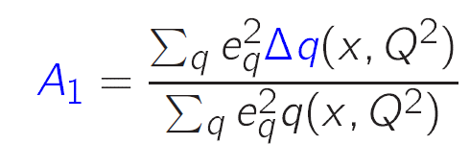
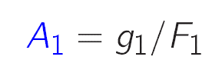
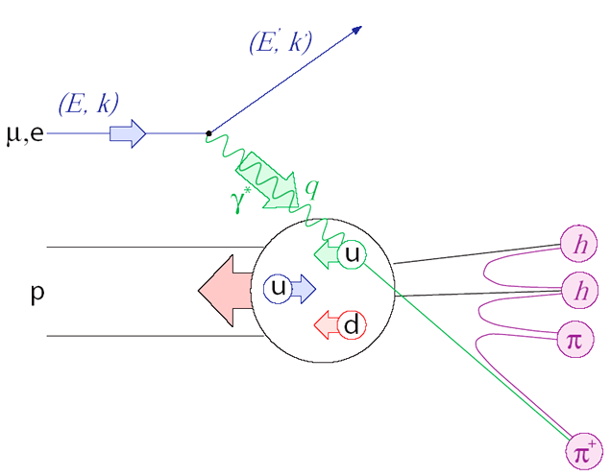
Longitudinal asymmetries
Inclusive scattering
with
Semi-inclusive scattering
with

Slide 6
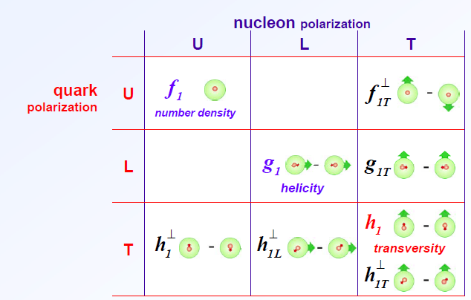
TMD parton distributions
8 intrinsic transverse momentum dependent PDFs at LO
Asymmetries with different angular dependences on hadron and spin azimuthal angles, Φ_{h} and Φ_{s}
Sivers
Transversity
Boer–
Mulders

Slide 7
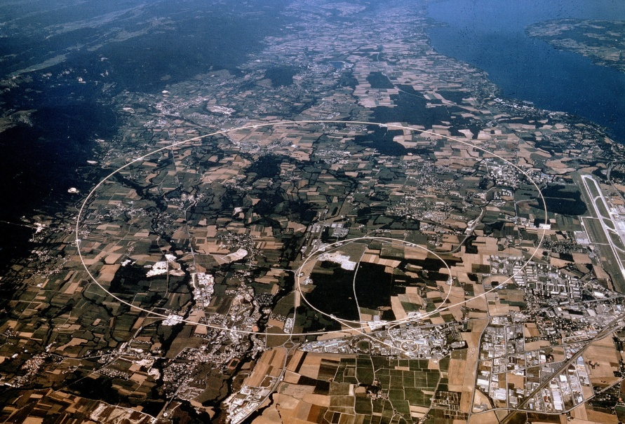
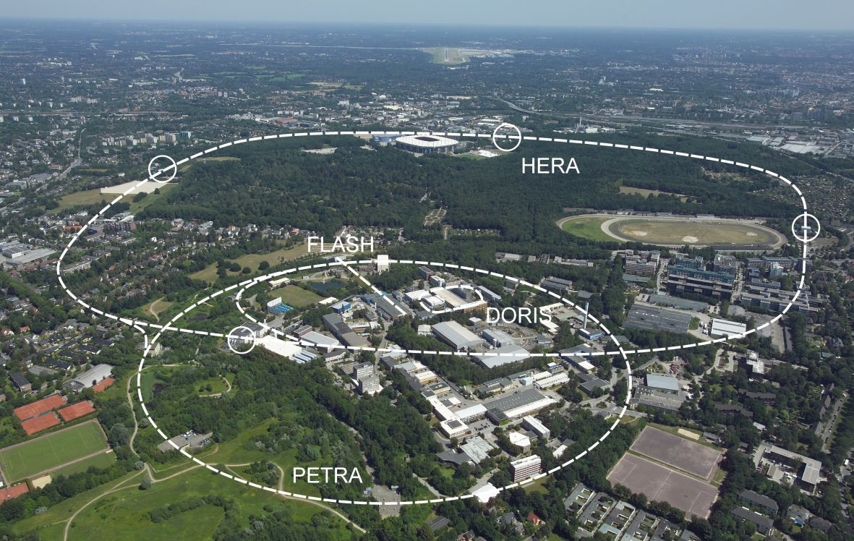
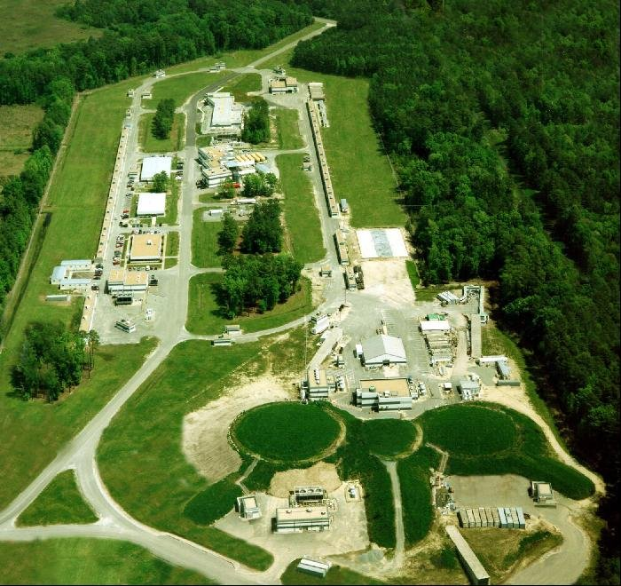
Laboratories
CERN
SLAC
49 GeV e–
160/280 GeV µ⁺
DESY
JLab
27 GeV e±
6 GeV e –

Slide 8
Experiments
 | 1970 | 1980 | 1990 | 2000
SLAC
CERN
DESY
JLab
E80
E130
E142/3 E154/5
EMC
SMC
COMPASS
HERMES
CLAS/HALL-A
A worldwide effort since decades

Slide 9
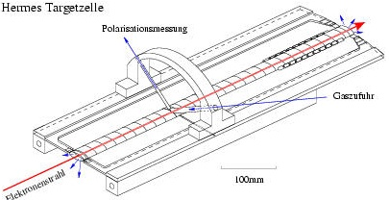
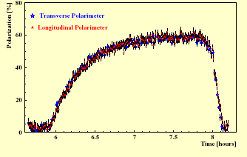
HERMES
Gas to polarisation measurement
Target: atomic beam source +
internal storage cell
10¹⁴ atoms/cm²
p, d, ³He (~90% pol.)
Gas inlet
beam
100 mm
Polarization built-up / 2h
Beam: 27 GeV, electrons,
polarized by the Sokolov-Ternov effect +
spin rotators
60%

Slide 10
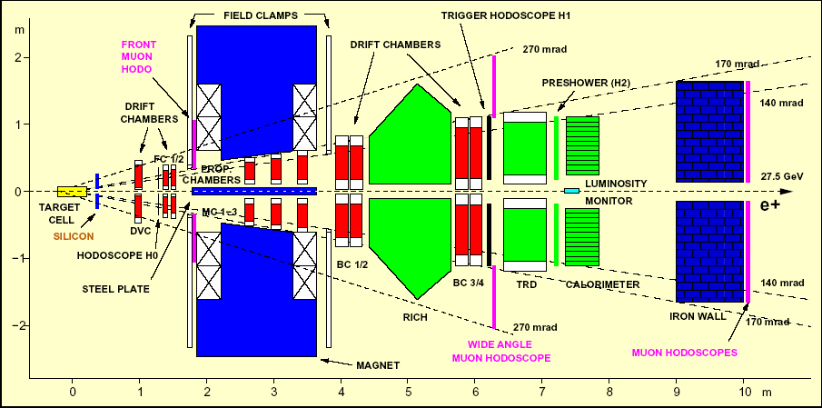
HERMES

Slide 11
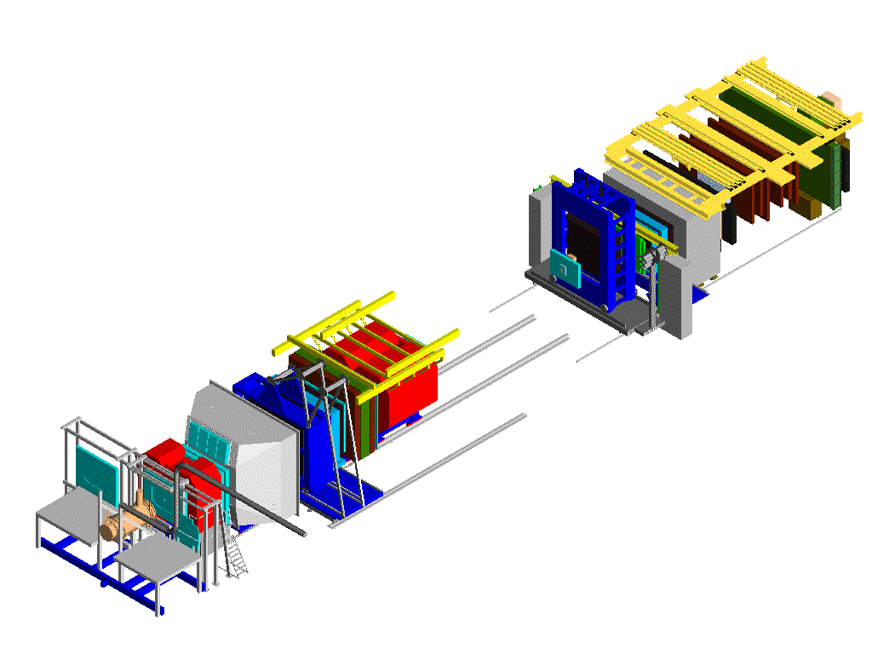
COMPASS
Beam: 160 GeV µ⁺, pol. 80%
from π decay
Two-stage spectrometer
60 m long
Hodoscopes
SM2
E/HCAL1
Muon Wall 2
MWPC
SM1
RICH1
E/HCAL2
Polarised Target
MWPC, Gems, Scifi,
W45 (not shown)
160 GeV
µ beam
Muon Wall 1
Straws, Gems
Scifi, Silicon
Micromegas, SDC, Scifi

Slide 12
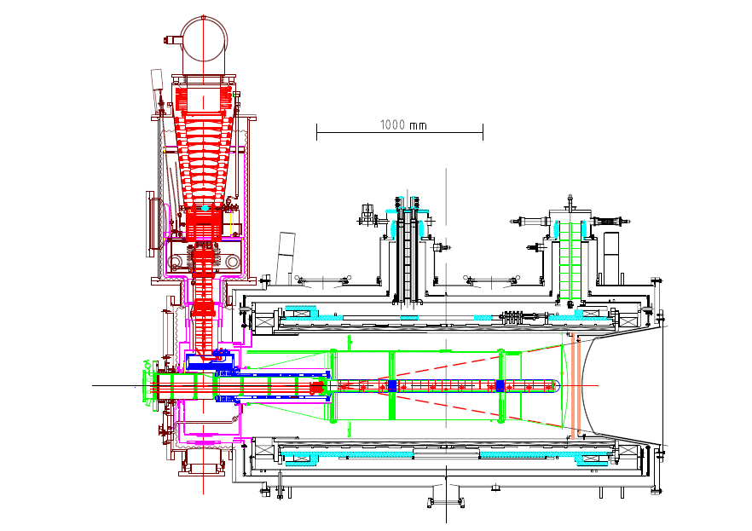
COMPASS Target system
solenoid 2.5T
dipole magnet 0.5T
acceptance ± 180 mrad
³He – ⁴He dilution
refrigerator (T~50mK)
⁶LiD/NH₃
50/90% pol.
40/16% dil. f.
μ

Slide 13
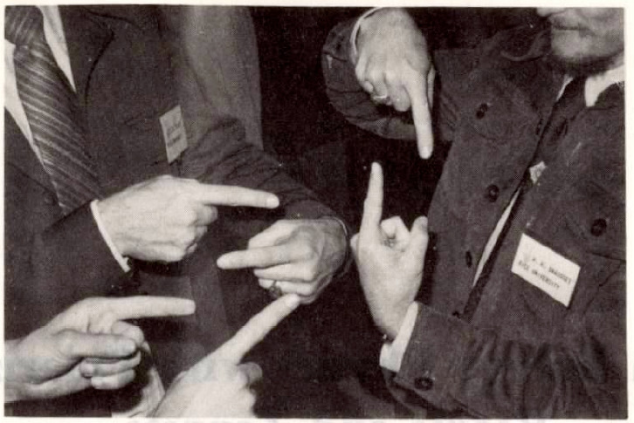
Helicity structure

Slide 14
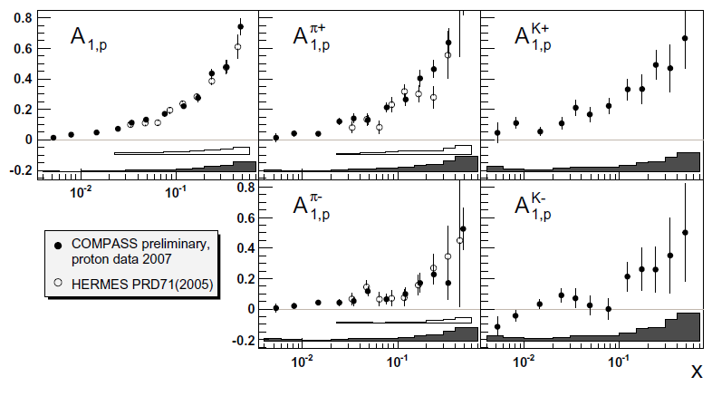
Proton helicity structure
incl. & semi-incl. asymmetries,
first measurement of A^{K}
incl.
π⁺
K⁺
π –
K⁻

Slide 15
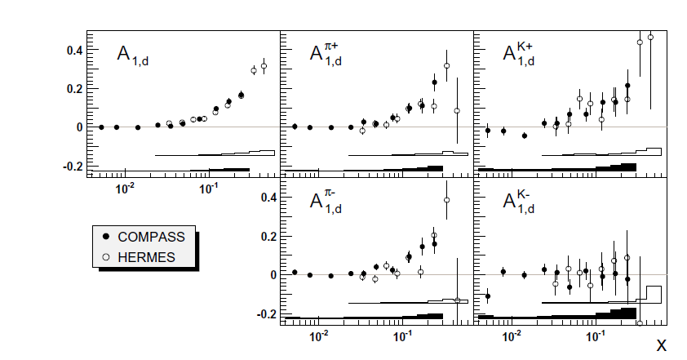
Deuteron helicity structure
incl. & semi-incl. asymmetries
incl.
π⁺
K⁺
π –
K⁻

Slide 16
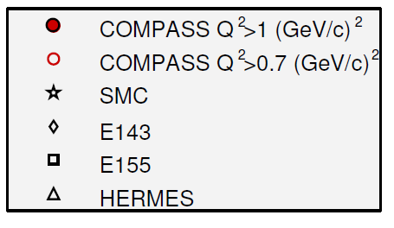
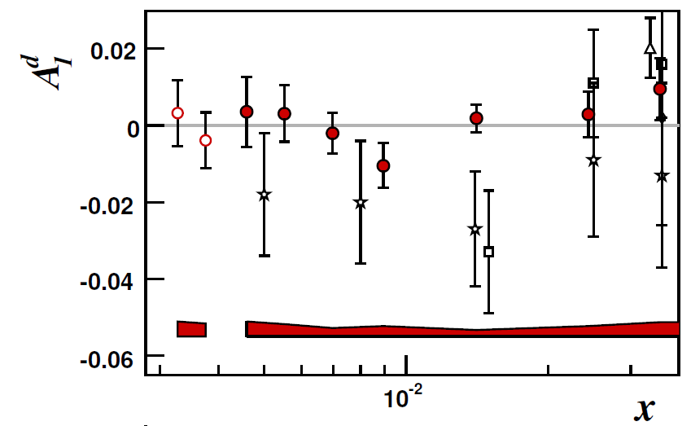
Incl. deuteron asymmetry
most precise measurement for x<0.03 and Q² > 1 GeV²

Slide 17
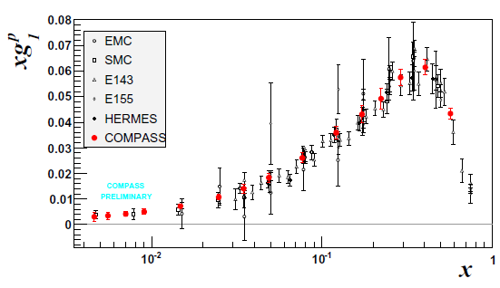
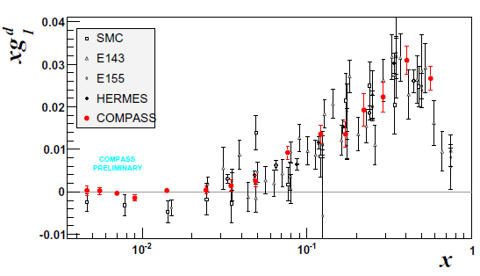
Structure function g₁(x,Q²)
new
p
very precise data
only data below x < 0.01 (Q² > 1)
deuteron data:
a₀ = 0.33±0.03±0.05
Δs+ Δs =−0.08±0.01±0.02
(evol. to Q²=∞)
d

Slide 18
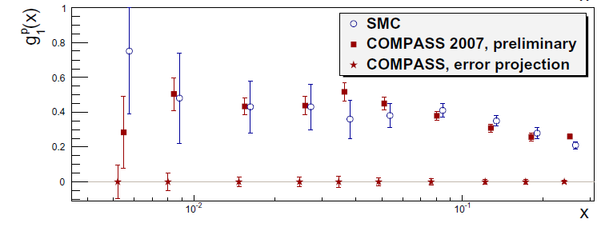
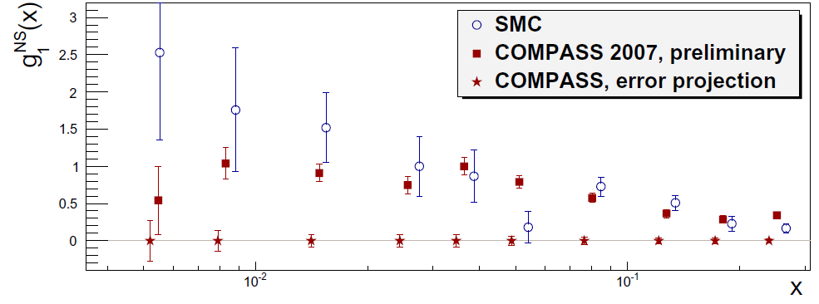
g₁ proton and g₁^{NS}
new

Slide 19
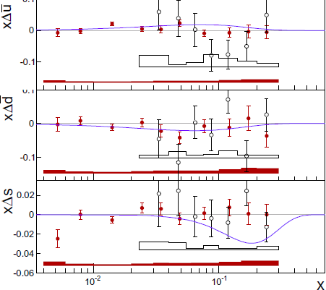
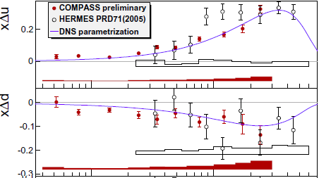
The role of quark flavours
LO semi-inclusive data analysis

Slide 20
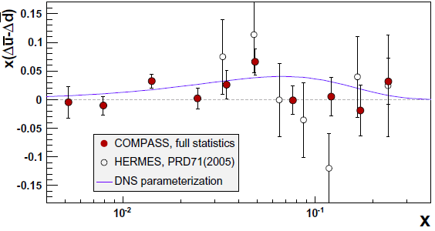
Flavour asymmetry?
considerable asymmetry in the unpolarised case
model predicts naturally asymmetry for pol. case
Rather small effect, u-bar > d-bar

Slide 21
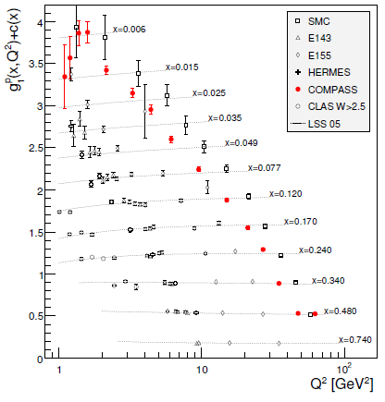
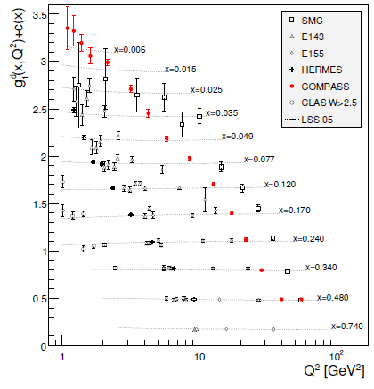
QCD analyses
Q² dependence g₁ or A₁ data described in QCD
Nice data, but limited kinematic rages (c.f. unpol. HERA)
p
d
CLAS
HERMES

Slide 22
Gobal NLO QCD analysis
DGLAP
choose scheme (MS, AB, jet) and Q₀²
optionally fix ns moments from hyperon decays (a₃, a₈)
fit PDFs for quark non-singlet and singlet and gluon to data
extra problems in polarized case no positivity condition, no momentum sum rule
Recent analyses include semi-inclusive and RHIC data
DSSV 2009 arXiv:0904.3821
Hirai, Kumano arXiv:0808.0413

Slide 23
Global NLO QCD analyses
Recent analyses of DIS and RHIC data
DSSV 2009 arXiv:0904.3821 DIS and SIDIS data, RHIC π⁰ and inclusive jets
Hirai, Kumano arXiv:0808.0413 DIS data, RHIC π⁰ data
Pol. gluon PDFs with node allowed
Detailed studies of systematic uncertainties
SIDIS data very sensitive to used fragmentation functions
“PGF” hadron data not yet included (s. below)

Slide 24
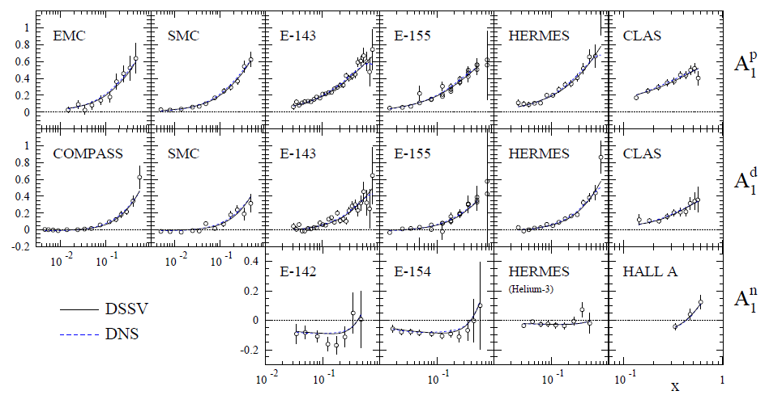
DSSV fit to inclusive asymmetries
p
d
n
CERN
SLAC
DESY
JLab

Slide 25
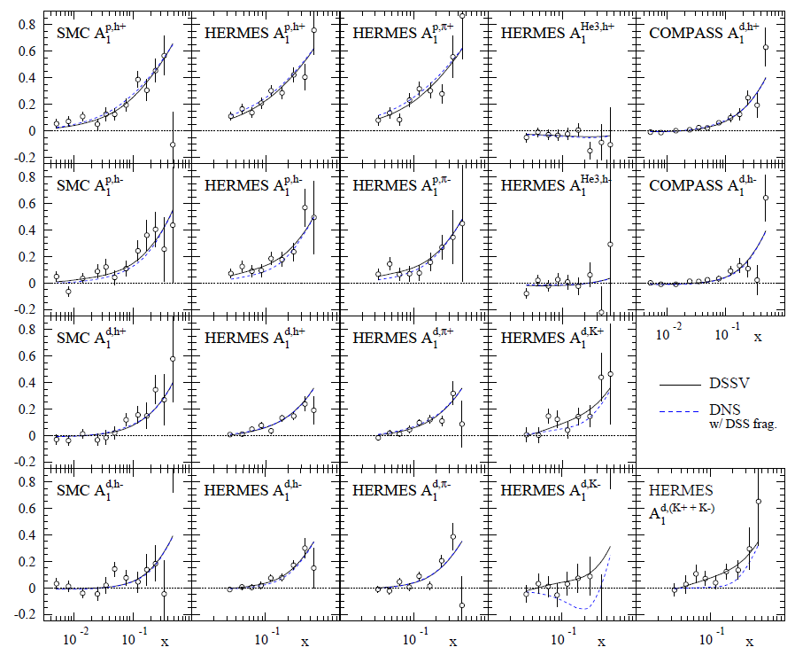
DSSV (semi-inclusive data)
Most data from HERMES
COMPASS proton data not yet in
DSS fragmentation functions PRD 75, 114010 PRD 76, 074033

Slide 26
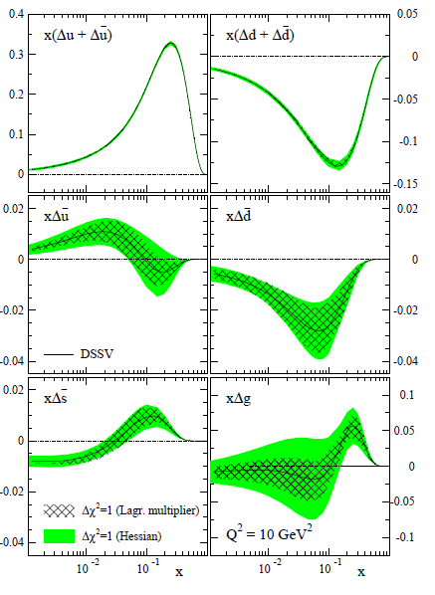
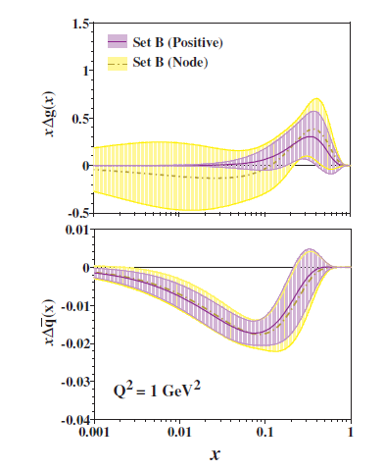
PDFs from global analyses
DSSV
Hirai, Kumano

Slide 27
Global analyses
Gluon polarization still poorly known but much smaller than expected in axial anomaly scenario for solving the spin puzzle.
Gluons can still make a major contribution to the nucleon spin.
Many analyses indicate the possibility of a node around x=0.1 in Δg(x)
Quark distributions well determined (apart from anti-quarks)
Strange quark distribution is indeed strange: SIDIS data prefer Δs>0 (x>0.01) while incl data require with SU3 the first moment to be ~ –0.1 => node in DSSV

Slide 28
Angular momentum of the nucleon
quarks gluons orbital
small ~0.15
unknown
Still poorly known

Slide 29
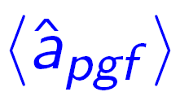
Gluon polarization from PGF
Principle: Gluon polarisation enters via photon-gluon fusion (PGF)
q
measure
calculate , and
background by Monte Carlo
q

Slide 30
Analysed channels
analysed data sets:
high-p_{T} hadron pairs (no ID, pions/kaons)
Q² > 1 GeV² Lepto
Q² < 1 GeV² / unmeasured Pythia
high-p_{T} single hadron
small Q² / unmeasured Pythia
single charmed meson
quasi-real photons Aroma, Rapgap
All analyses in LO till now (plus parton showers)

Slide 31
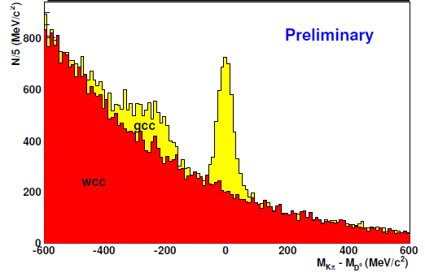
Δg/g from open charm
Little physics background (LO, QCDC)
Statistics limited, D→πK (BR ~ 4%)
Large combinatorial background, drastically reduced in D* channel with slow π_{s}
All deuteron data
new channels in D* sample
sub-threshold kaons
3-body decay with non-observed π⁰ (bump)
wrong charge
combination

Slide 32
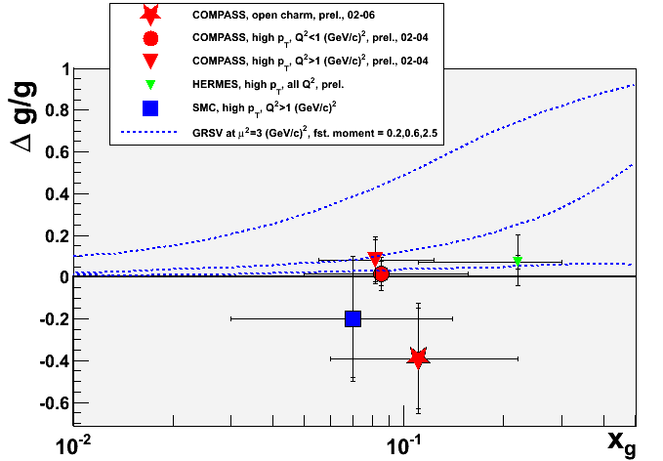
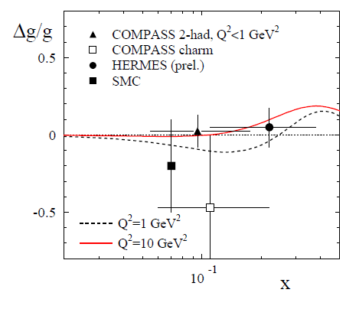
Gluon Polarization from LO PGF
GRSV
ΔG = 2.5
ΔG = 0.6
ΔG = 0.2
Comparison with NLO DSSV

Slide 33
Transverse spin structure

Slide 34
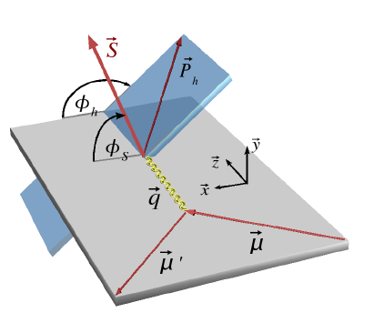
Transversity PDF
Couple to chiral odd Collins FF
Azimuthal cross-section asymmetry:

Slide 35
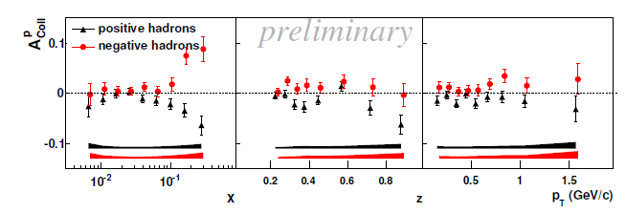
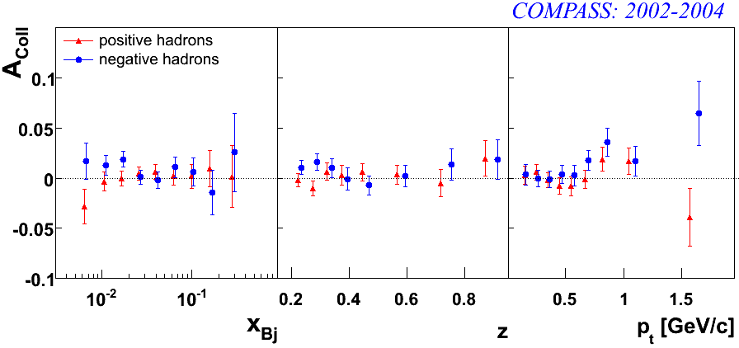
Collins Asymmetries
New from COMPASS: full 2007 proton data set (statistics tripled)
proton
new
h⁺
h⁻
h⁺
deuteron
h⁻

Slide 36
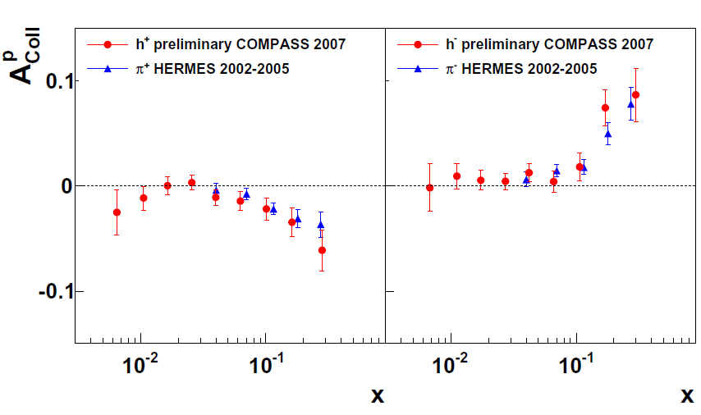
Comparison
proton
sign change and D_{nn} ≅ y applied for HERMES data
h⁺
h⁻
COMPASS HERMES
large asymmetry ~10%
good agreement in common x range
zero deuteron result important ⇒ opposite sign of u and d quark transversity PDF

Slide 37
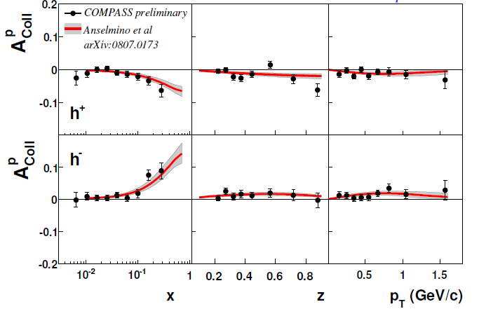
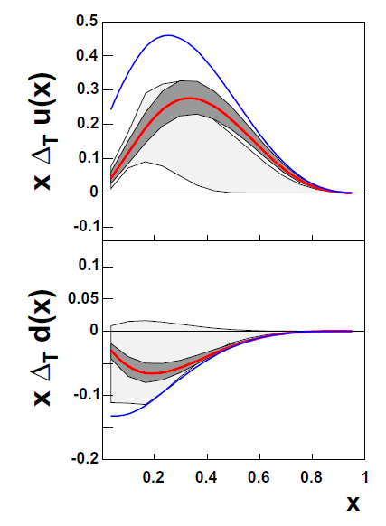
Global Fit
Fit to COMPASS d, HERMES, BELLE (FF, e⁺e⁻)
in good agreement with new proton data

Slide 38
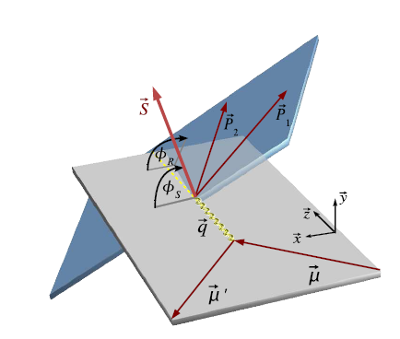
Transversity PDF
Alternative: couple to chiral odd 2-hadron interference FF
cross-section asymmetry:

Slide 39
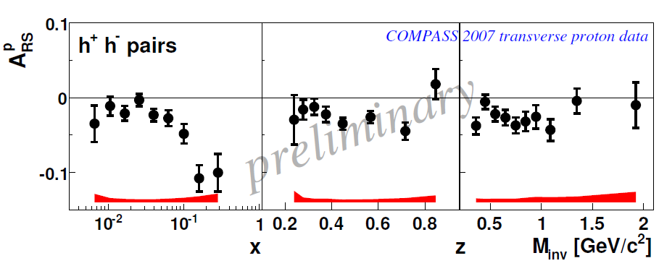
two-hadron asymmetry
large asymmetries
interference FF and transversity sizable

Slide 40
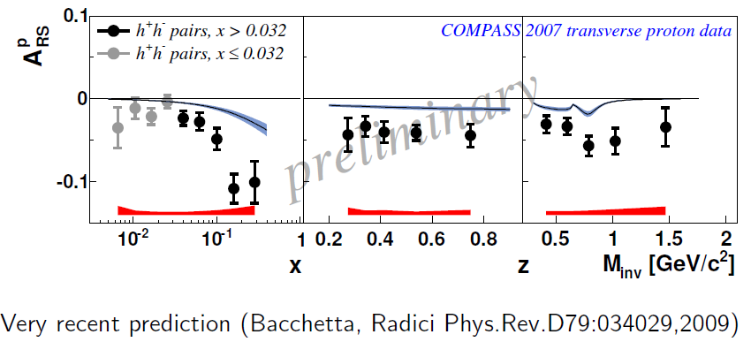
Comparison to a recent Fit
Recent fit (dominated by HERMES, COMPASS p not yet in)

Slide 41
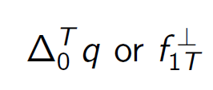
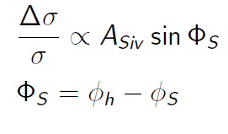
Sivers function
Sivers Asymmetry:
proposed (1990, Sivers)
though to vanish (1993, Collins)
resurrected (2002, Brodsky, Hwang, Schmitt)
different sign in DY and SIDIS

Slide 42
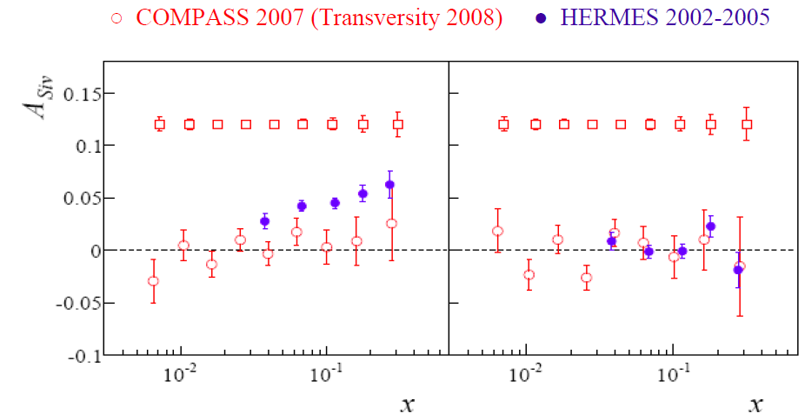
Proton Sivers Asymmetry
compatible with zero for the deuteron
large effect seen by HERMES, not confirmed by COMPASS
clarification needed
h⁺
h⁻

Slide 43
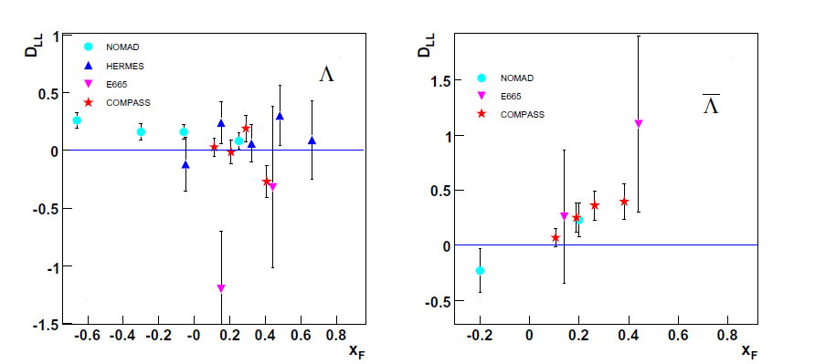
Longitudinal spin transfer to Λ & Λ
Λ
Λ
non-zero D_{LL} related to polarisation of strange (anti) quarks (?)

Slide 44
Outlook
Goals: Precise determination of Δg(x) Generalized parton distributions (GPD) Orbital angular momentum
Experimental prospects:
Short term: More lepton data from COMPASS & Jlab More hadron data from RHIC (500 GeV!)
Longer term: COMPASS GPD & DY programme RHIC upgrade JLab 12 GeV
Long term: Electron-Ion Colliders: eRHIC, ELIC, ENC

