Slide 1

Proposal for GPD studies at COMPASS
E. Burtin CEA-Saclay Irfu/SPhN
On behalf of the COMPASS Collaboration
MENU 2010 – College of William & Mary
Williamsburg - June 2nd, 2010
Proposal submitted to the SPS comittee (May 17,2010)
Physics topics:
Hard exclusive photon and meson production
Unpolarized PDFs and TMD effects in SIDIS
Pion induced Drell-Yan muon pair production (TMD)
Experimental studies of chiral perturbation theory
COMPASS II proposal available at : CERN-SPSC-2010-014 preprint
http://cdsweb.cern.ch/record/1265628/files/SPSC-P-340.pdf

Slide 2

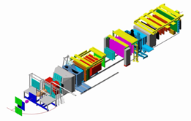

CERN.gif
Jura mountains
Lac Léman
COMPASS
SPS
LHC
N
2

Slide 3
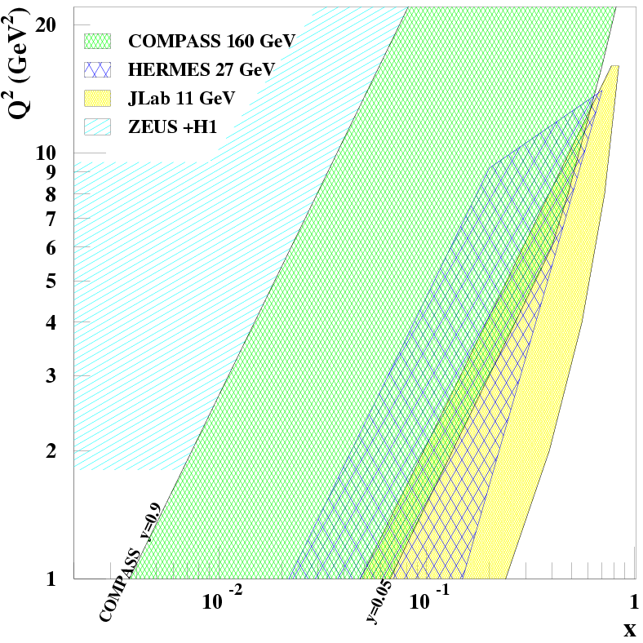
What makes Compass unique ?
CERN High energy muon beam
100 - 190 GeV
80% Polarisation
μ⁺ and μ⁻ available
  Opposite polarization
Luminosity limit
Foreseen program :
DVCS and meson production off
a liquid H2 target (unpolarized)
Will explore the intermediate
x_{Bj} region
Uncovered region between
ZEUS+H1 and HERMES+Jlab
x_{Bj}
Gluon, sea and valence quarks

Slide 4
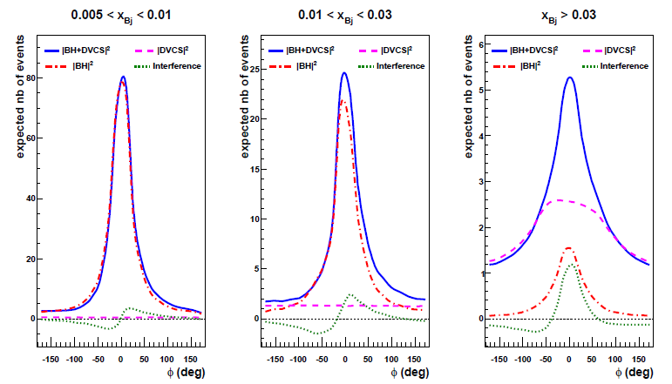
Comparison of BH and DVCS at 160 GeV
DVCS :
Bethe-Heitler :
γ
μ’
γ*
θ
μ
φ
p
φ
φ
BH dominates BH and DVCS at the same level DVCS dominates
excellent access DVCS amplitude study of dσ^{DVCS}/dt
reference yield through the interference

Slide 5
Azimuthal angular dependence analysis
μ’
γ*
γ
μ
θ
from Belitsky, Kirchner, Müller :
polarized beam off unpolarized target
φ
p
dσ_{(μp→μpγ)} = dσ^{BH} + dσ^{DVCS}_{unpol} + P_{μ} dσ^{DVCS}_{pol}
+ e_{μ} a^{BH} Re A^{DVCS} + e_{μ} P_{μ} a^{BH} Im A^{DVCS}
← Known expression
P_{μ} ×
e_{μ} ×
e_{μ}P_{μ} ×
Twist-2 M¹¹
>>
Twist-3 M⁰¹
Twist-2 gluon M⁻¹¹

Slide 6
Angular dependence analysis
μ’
γ*
γ
Case of COMPASS : μ+(P=-0.8) and μ-(P=+0.8)
unpolarized H₂ target
μ
θ
φ
p
S_{U,CS} : dσ_{μ+}+ dσ_{μ-}= 2(dσ^{BH}+dσ^{DVCS}_{unpol} ) + 2 e_{μ} P_{μ} a^{BH} Im A^{DVCS}
=> dσ/dt
=> Im (F₁H)
D_{U,CS} : dσ_{μ+}- dσ_{μ-}= 2 P_{μ} dσ^{DVCS}_{pol} + e_{μ} a^{BH} Re A^{DVCS}
=> Re (F₁H)

Slide 7
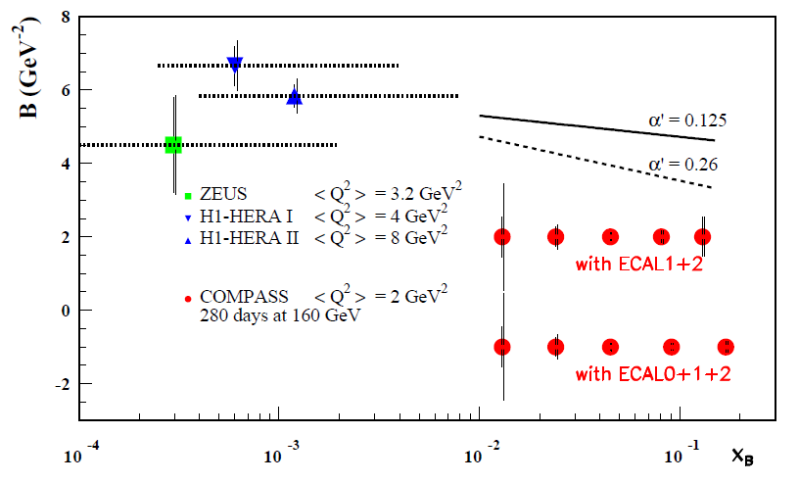
From S_{U,CS} : transverse imaging
Using S_{U,CS} :
dσ_{DVCS} / dt ~ exp(-Bt)
B ~ ½ <r²>
Ansatz at small x :
B(x) = b₀ + 2 α’ ln(x₀/x)
α’ =0.125 GeV⁻² (FFS)
160 GeV muon beam
2.5m LH₂ target
2 years
L = 1222 pb⁻¹
ε_{global} = 10 %
?
Assuming 3% syst. error
on BH subtraction
1.
0.5
0.65 ±0.02 fm
H1 PLB659(2008)
2.5 σ slope meas. for :
α’ > 0.26 (ECAL 1+2 )
α’ > 0.125 (ECAL 0+1+2)
COMPASS
x_{B}

Slide 8
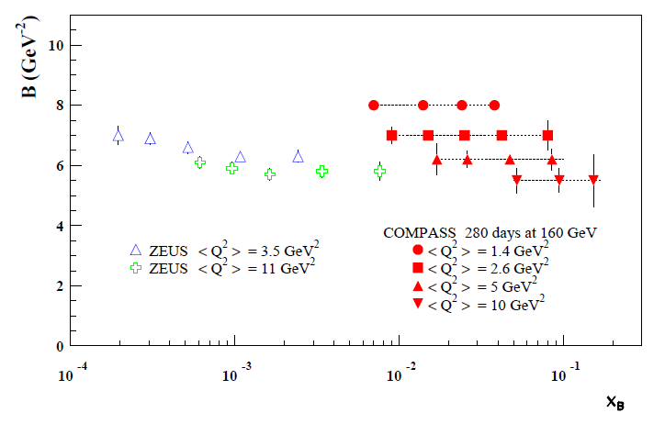
Exclusive production of rho mesons
dσ_{ρVMP} / dt ~ exp(-Bt)
Exclusive ρVMP
ρVMP model developed
by Sandacz
Normalised according
Goloskokov and Kroll
160 GeV muon beam
2.5m LH₂ target
2 years
L = 1222 pb⁻¹
ε_{global} = 10 %
Sensitive to the nucleon size
+ the transverse size of the meson
Q²=1 GeV² B ~ 8 GeV⁻²
Q²=10 GeV² B ~ 5.5 GeV⁻²

Slide 9
Angular dependence analysis
μ’
γ*
γ
Case of COMPASS : μ+(P=-0.8) and μ-(P=+0.8)
unpolarized H₂ target
μ
θ
φ
p
S_{U,CS} : dσ_{μ+}+ dσ_{μ-}= 2(dσ^{BH}+dσ^{DVCS}_{unpol} ) + 2 e_{μ} P_{μ} a^{BH} Im A^{DVCS}
=> dσ/dt
=> Im (F₁H)
D_{U,CS} : dσ_{μ+}- dσ_{μ-}= 2 P_{μ} dσ^{DVCS}_{pol} + e_{μ} a^{BH} Re A^{DVCS}
=> Re (F₁H)

Slide 10
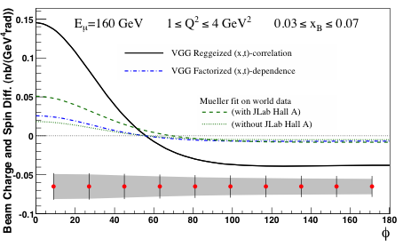
D_{U,CS} : Beam Charge & Spin Difference
μ’
γ*
γ
D_{U,CS} : dσ_{μ+}- dσ_{μ-}= 2 P_{μ} dσ^{DVCS}_{pol} + e_{μ} a^{BH} Re A^{DVCS}
μ
θ
φ
p
160 GeV muon beam
2.5m LH₂ target
2 years
L = 1222 pb⁻¹
ε_{global} = 10 %
=> Re (F₁H)
Systematic errors : 3% charge-dependent effect between μ+ and μ-

Slide 11
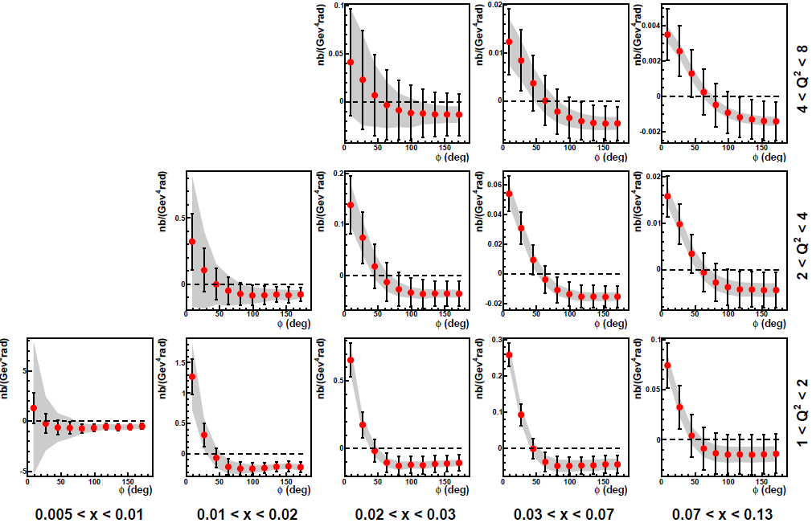
D_{U,CS} () over the kinematical domain
160 GeV muon beam
2.5m LH₂ target
2 years
L = 1222 pb⁻¹
ε_{global} = 10 %
Syst. : 3% μ⁺/μ⁻ norm.
φ (deg)
using the VGG model
Phys. Rev. D60:094017,1999

Slide 12
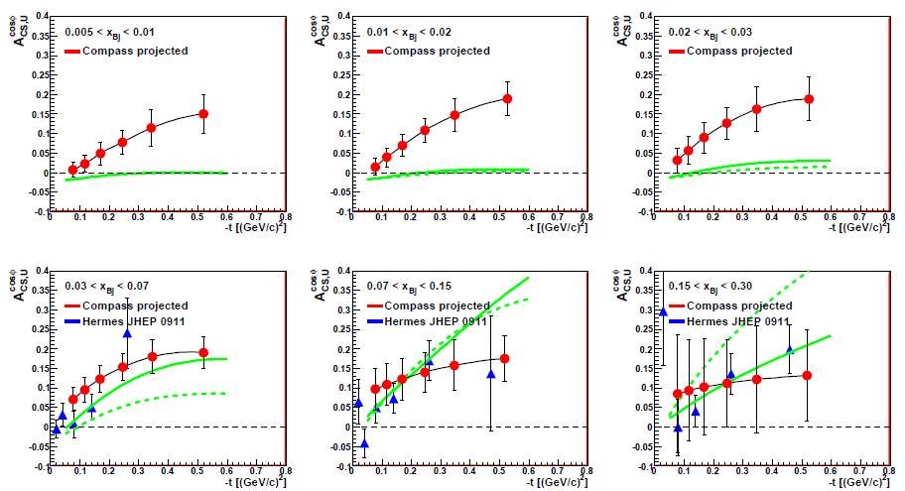
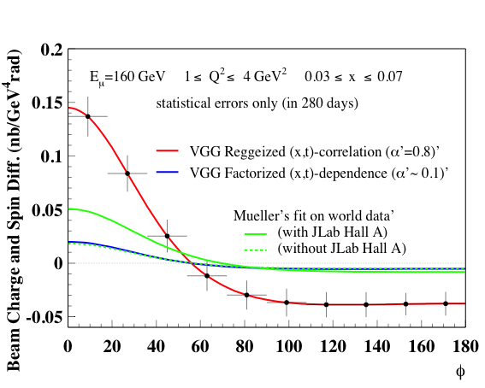
Sensitivity of COMPASS: cosϕ modulation
BCSA = D_{U,CS} /S_{U,CS} = A₀ + A_{CS,U} cos ϕ + A₂ cos2ϕ
_{B}
_{B}
_{B}
_{B}
_{B}
_{B}

Slide 13
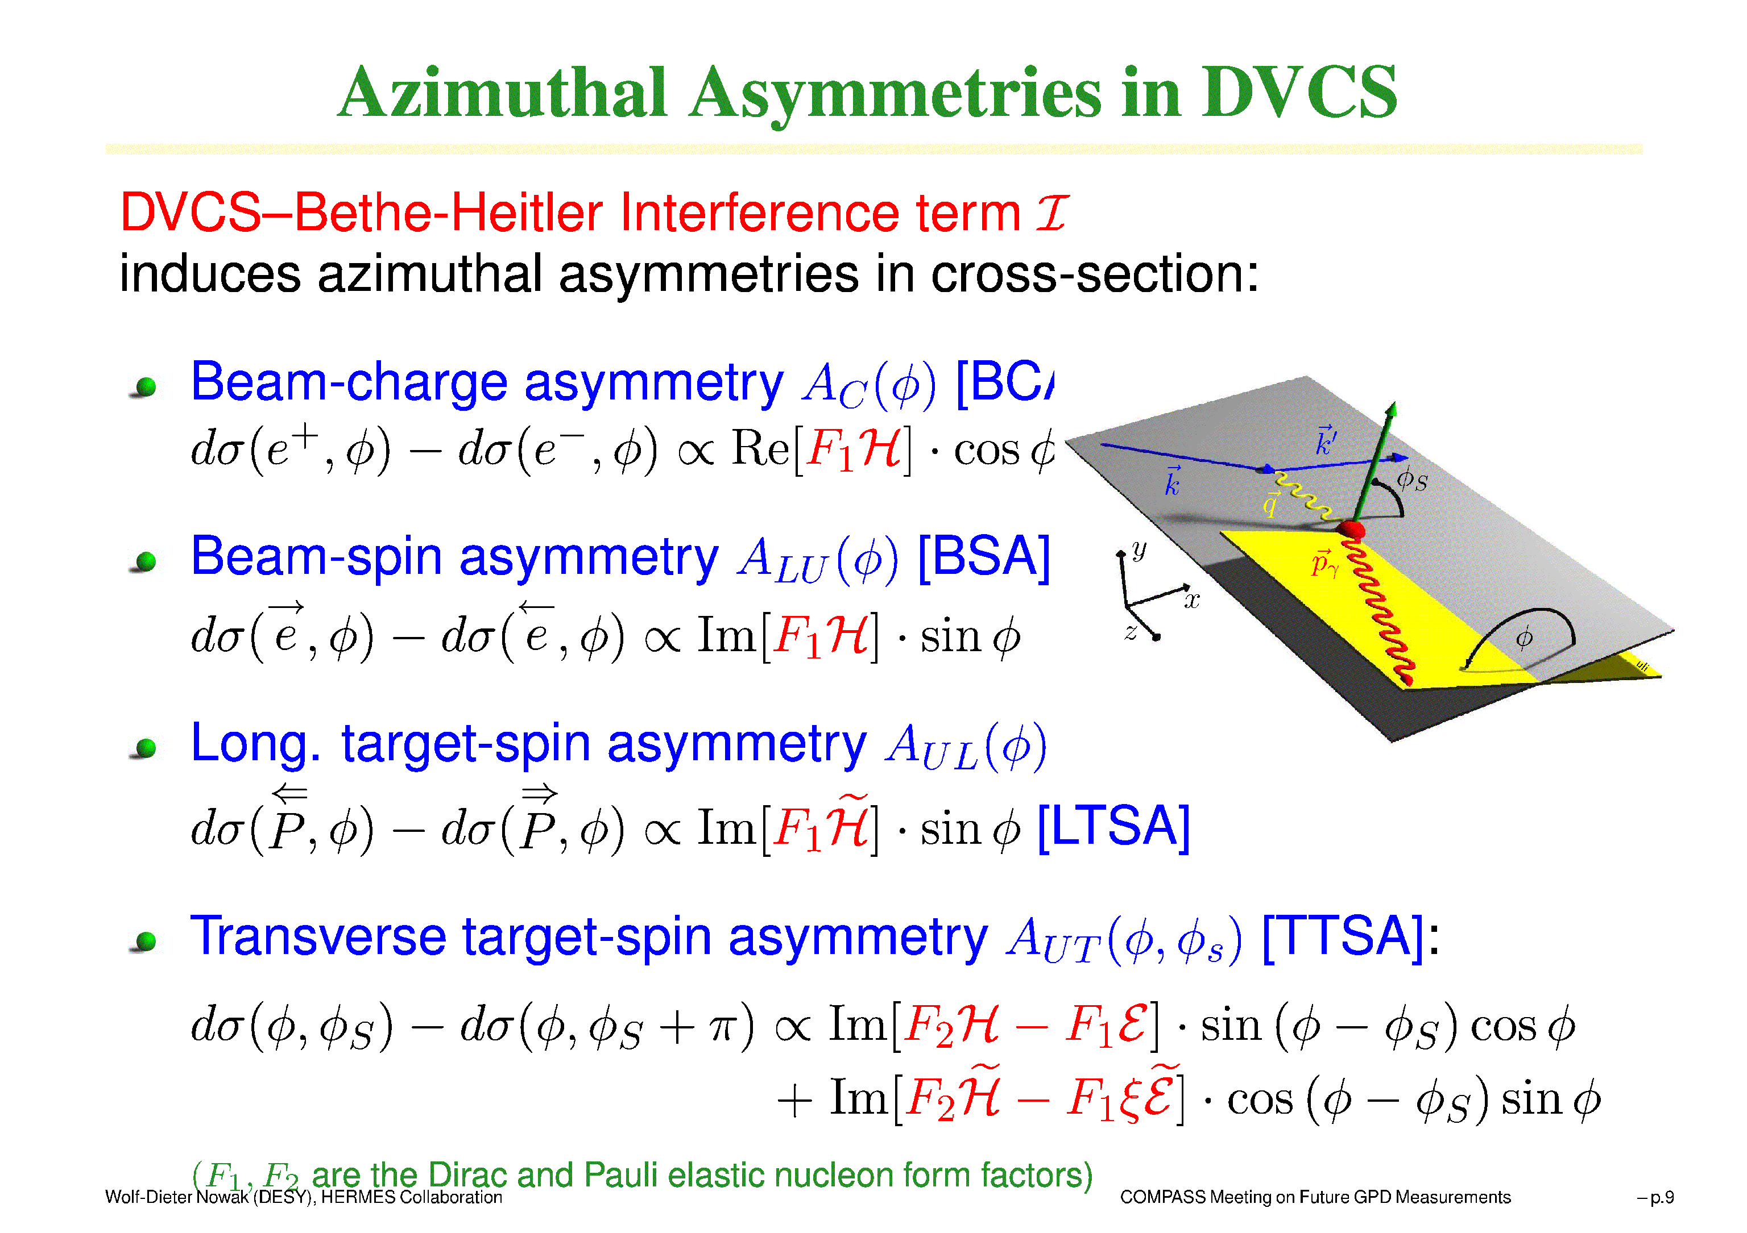
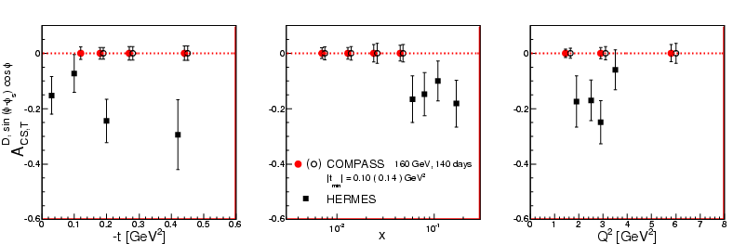
Continuation of the GPD program : constrain the GPD E
with μ^{+↓}, μ^{-↑} beam and transversely polarized NH3 (proton) target
D_{T,CS} ≡ dσ_{T} (μ ^{+↓}) - dσ_{T} (μ ^{-↑})
∝ Im(F₂ H – F₁ E) sin(φ- φ_{S}) cos φ
160 GeV muon beam
1.2 m polarized NH3 target (f=0.26)
2 years - ε_{global} = 10 %

Slide 14
2008 DVCS beam test
Experimental realisation
Compass hadron set-up
Talks of
F. Haas, S. Neubert
μ’
γ
proton
New « superRPD » and H₂ target
Hermetic calorimetry : Move ECALs upstream and/or complete ECAL2
New ECAL0 upstream of SM1

Slide 15
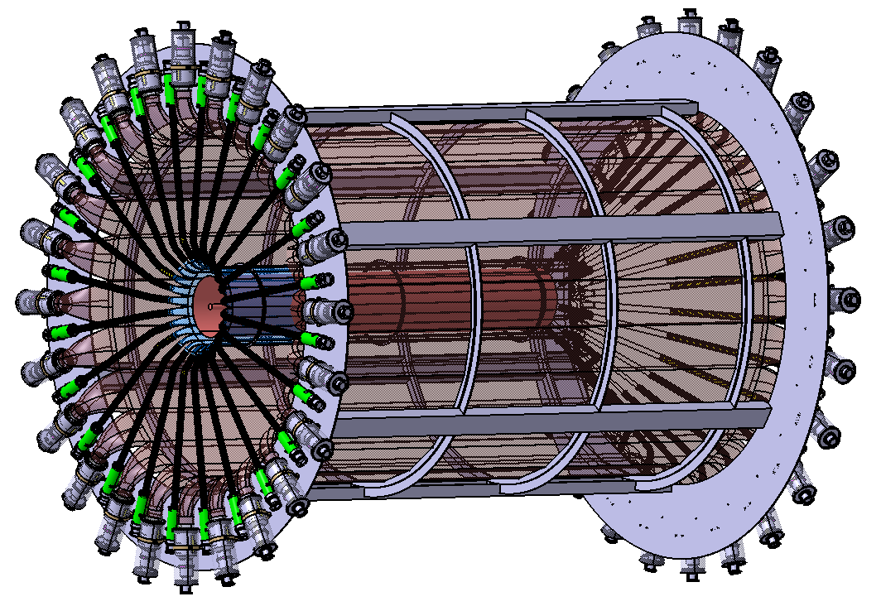
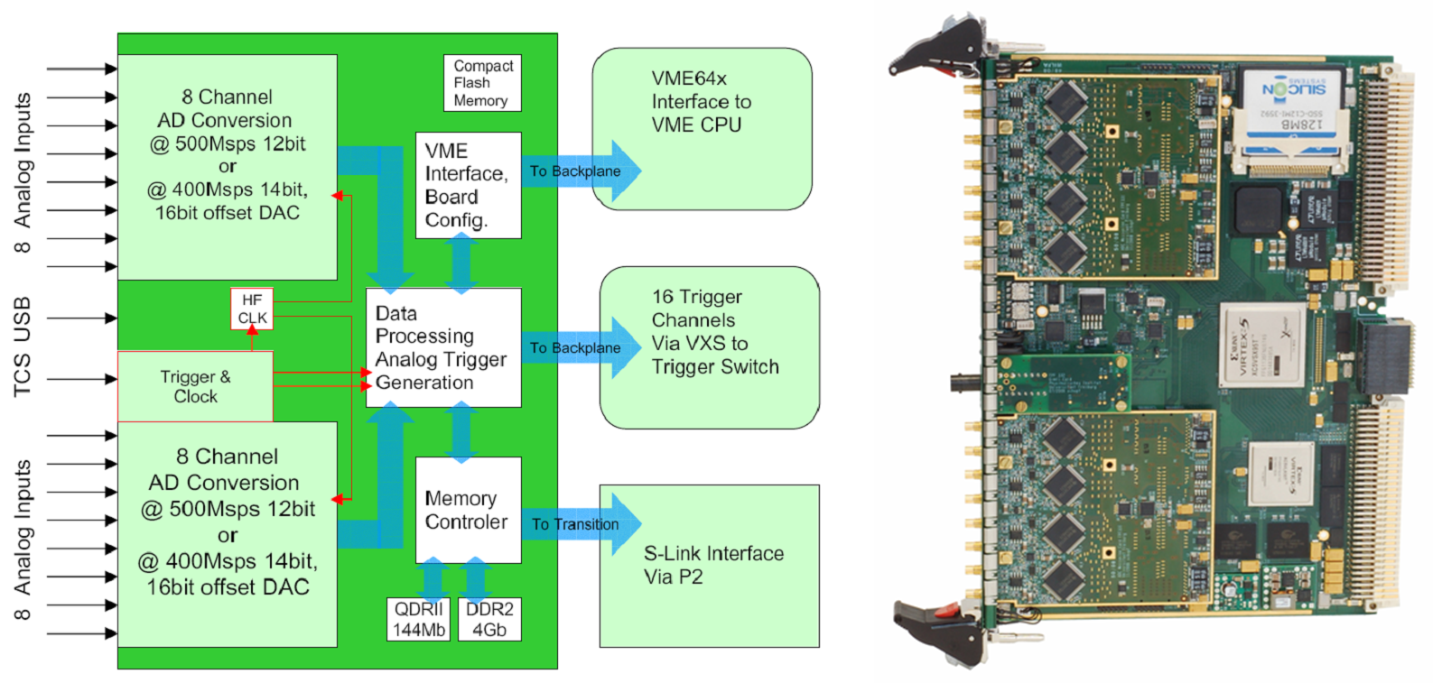
Recoil Proton Detector
4 m long scintillator slabs
~ 300ps timing resolution
Full scale prototype
tested successfully
Gandalf Project:
1 GHz digitalisation
of the PMT signal to
cope for high rate

Slide 16
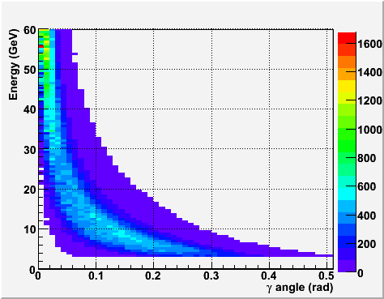
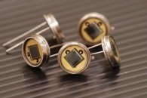
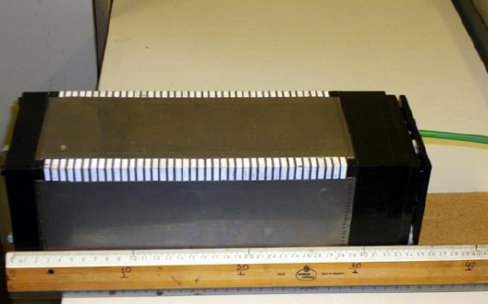
ECAL 0
Requirements
- Photon energy range 0.2- 30 GeV
- Size: 320cm x 320cm ;
- Granularity 4x4 – 6x6 cm²
- Energy resolution < 10.0%/√E (GeV)
- Thickness < 50 cm,
- Insensitive to the magnetic field.
Prototype under studies
Shaschlyk module with AMPD readout
Tested
ECAL1&2
DVCS+BH

Slide 17
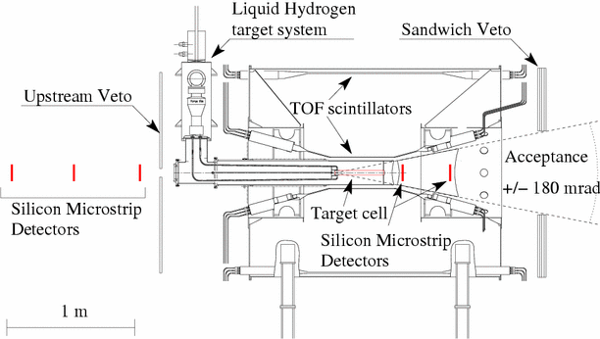
2008-2009 DVCS tests
Compass hadron run
Target region
Ring B
Ring A
Selection of events :
- one vertex with μ and μ’
- no other charged tracks
- only 1 high energy photon (Δt<5ns)
- 1 proton in RPD with p < 1. GeV/c
DVCS
Bethe-Heitler

Slide 18
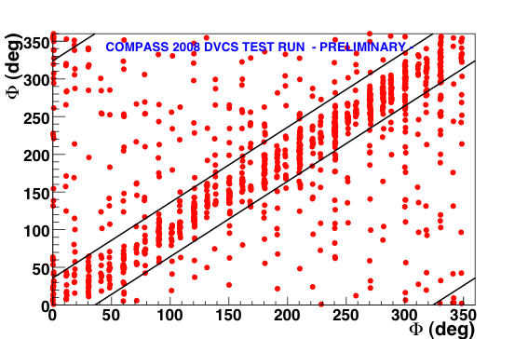
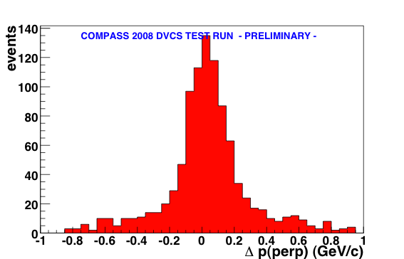
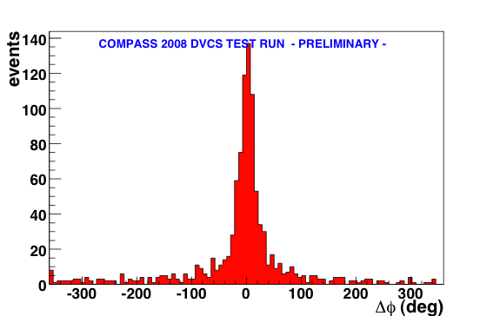
2008 beam test : exclusivity cuts
μ’+γ
Δp⊥ =|P⊥_{μ’+γ}|-|P⊥_{RPD}|
Δp_{perp} < 0.2 GeV
μ’
γ
miss
Δϕ
proton
Transverse plane
Δϕ=ϕ_{miss} - ϕ_{RPD}
Δϕ < 36 deg

Slide 19
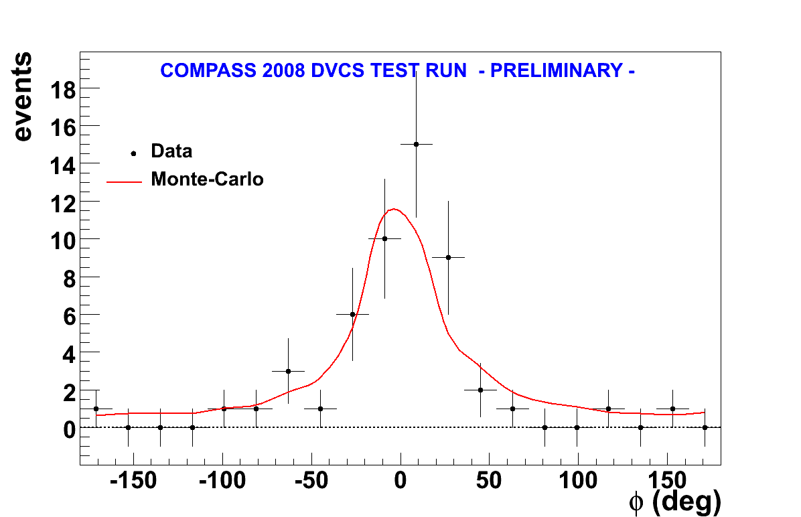
2008 beam test : Bethe-Heitler signal
Monte-Carlo simulation
of BH (dominant) and DVCS
Deep VCS
Bethe-Heitler
=> Bethe-Heitler observed
Detection efficiency :
ε _{μ+p->μ+p+γ} = 0.32 +/- 0.13
After all cuts,
Q²>1GeV²
Global efficiency :
- μ+p->μ+p+γ efficiency
SPS & COMPASS availability
Dead time
trigger efficiency
  ε_{global} = 0.13 +/- 0.05
Projections of errors
are realistic
~ 10 times more data taken in 2009

Slide 20
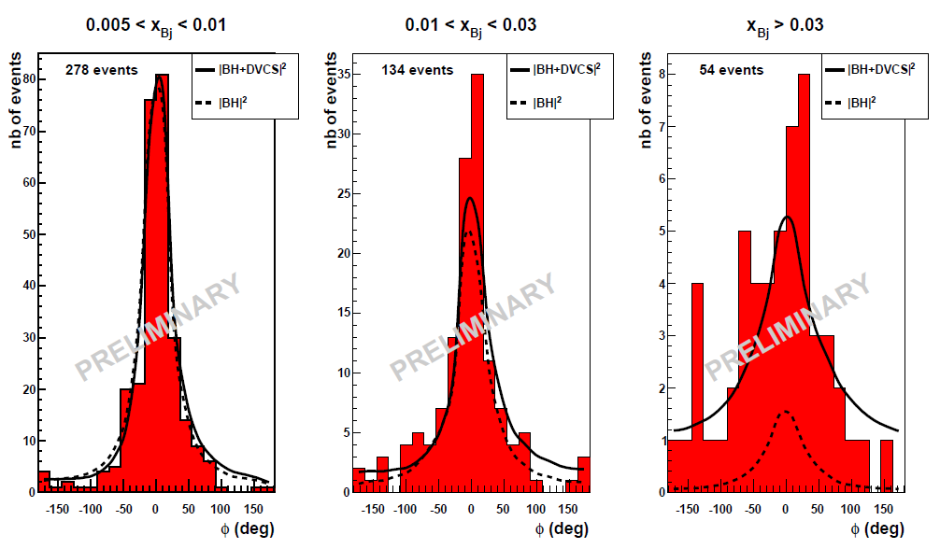
2009 beam test : DVCS signal
~ 10 times more data taken than in 2008
Excess of events for x_{bj}>0.03
is a sign for DVCS

Slide 21
Conclusions & perspectives
the COMPASS-II proposal has been submitted
  Wide physics case proposed :
  GPDs, TMDs, Chiral perturbation theory, unpolarized PDFs
  SPS Committee meets at the end June
COMPASS has a great potential in GPDs physics
  Study of the GPD H with a LH2 target: 2013-
  measurement ot t-slopes – transverse partonic structure of the nucleon
  measurement of Beam Charge and Spin differences & asymmetries
  Equipments needed :
4m long RPD, 2.5m LH2 target, Extended & improved calorimetry
  at a later stage :
  study of the GPD E with a transversely polarized target

Slide 23
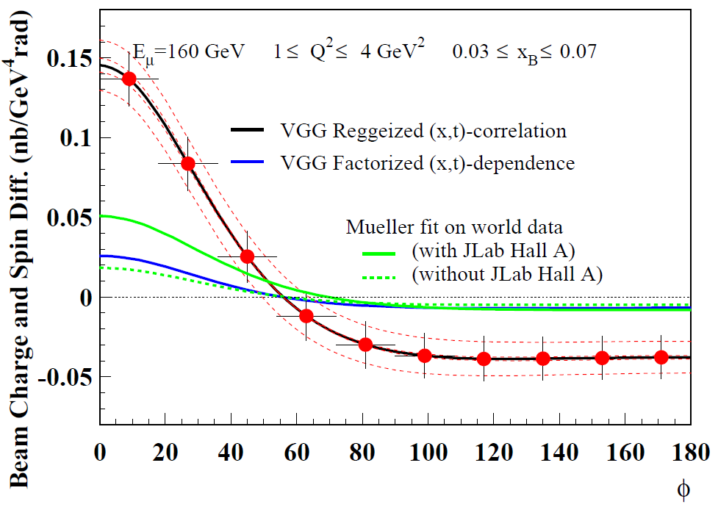
D_{U,CS} : Beam Charge & Spin Difference
μ’
γ*
γ
D_{U,CS} : dσ_{μ+}- dσ_{μ-}= 2 P_{μ} dσ^{DVCS}_{pol} + e_{μ} a^{BH} Re A^{DVCS}
μ
θ
φ
p
160 GeV muon beam
2.5m LH₂ target
2 years
L = 1222 pb⁻¹
ε_{global} = 10 %
=> Re (F₁H)
Systematic errors : 3% charge-dependent effect between μ+ and μ-

Slide 24
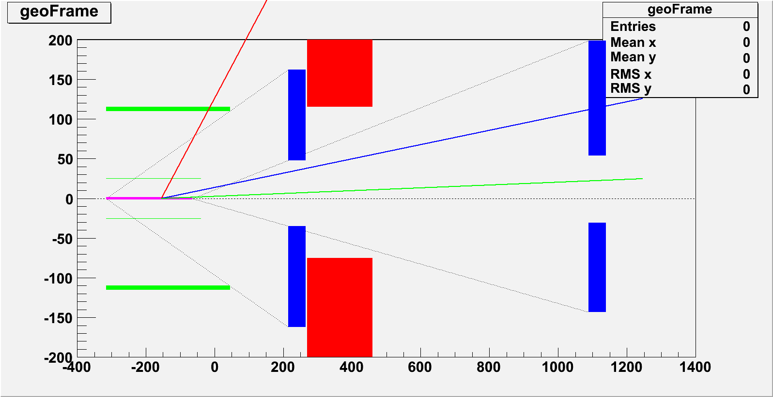
2008 DVCS beam test
ECAL0 and ECAL1
proton
Horizontal
γ
μ’
“superRPD”
SM1
Vertical
ECAL0
ECAL1
ECAL2

Slide 25
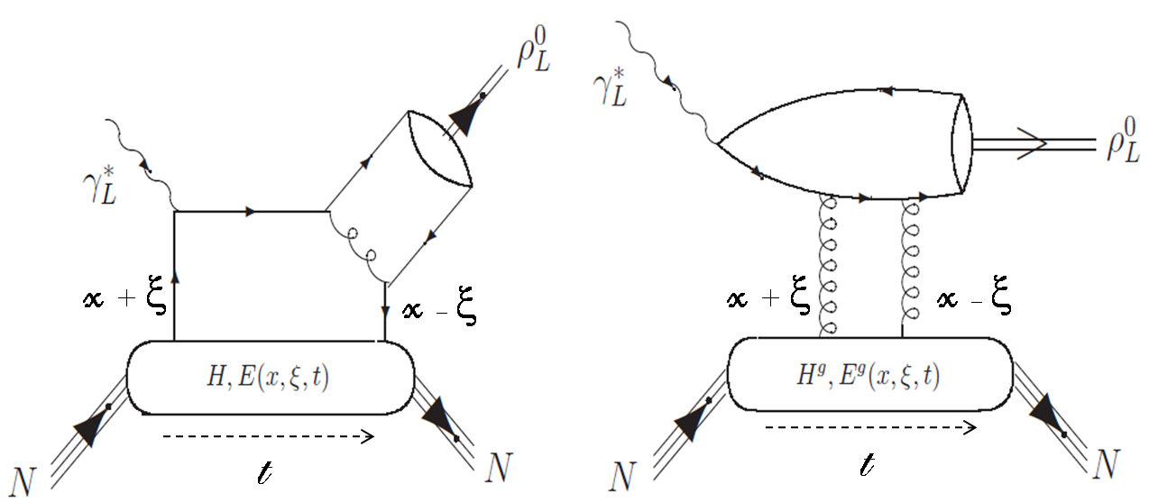
Meson production : filter of GPDs
Cross section measurement :
Vector meson : ρ,ω,φ… ⇒ H & E
Pseudo-scalar : π,η… ⇒ H & E
~
~
Would allow for flavor separation :
Hρ⁰ = 1/√2 (2/3 H^{u} + 1/3 H^{d} + 3/8 H^{g})
Hω = 1/√2 (2/3 H^{u} – 1/3 H^{d} + 1/8 H^{g})
Hφ = -1/3 H^{s} - 1/8 H^{g}
⇒ ρ : ω : φ ∼ 9 : 1 : 2 at large Q²
Transversely polarized target asymmetry on vector meson :
⇒ E/H ( studied at COMPASS without RPD )

Slide 26
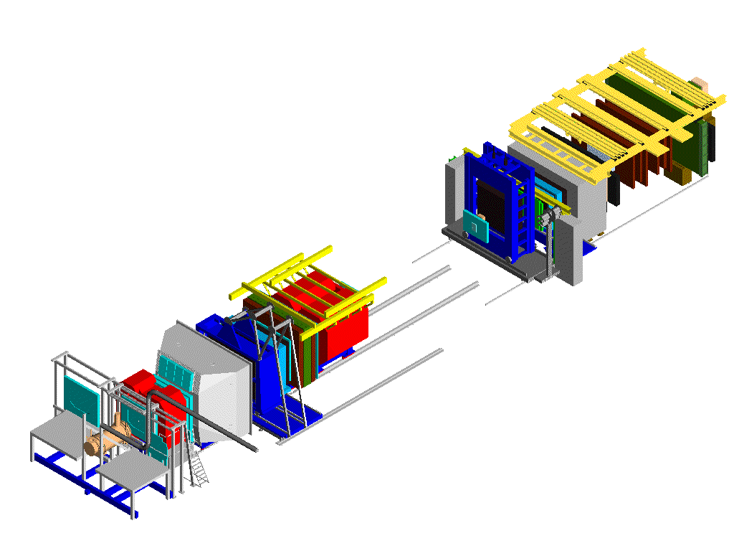
GPD program : new equipments
DVCS μp → μ’p’γ
μ’
γ ECal1 + ECal2
θ_{γ} ≤ 10°
2.5 m liquid H₂ target
μ
Hermetic calorimetry
new ECAL0
p’
4m long Recoil Proton Detector
Later stage…
Transversely polarized target
Associated RPD

Slide 27
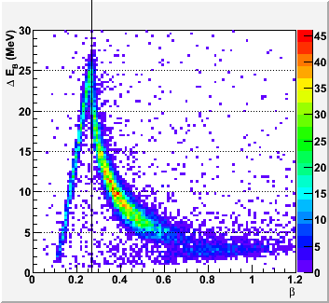
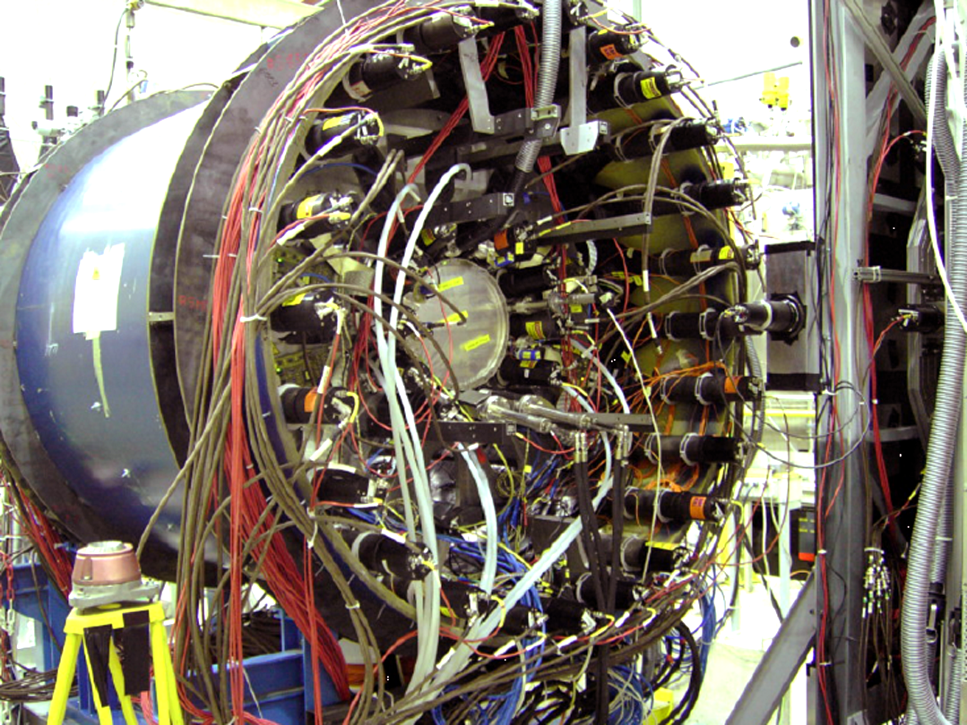
Hadron program RPD
Proton identification in RPD
Elastic scattering (hadron beam)

Slide 28
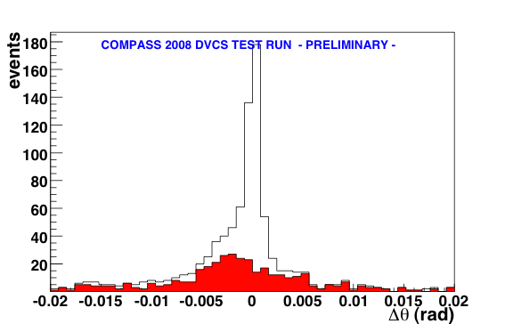
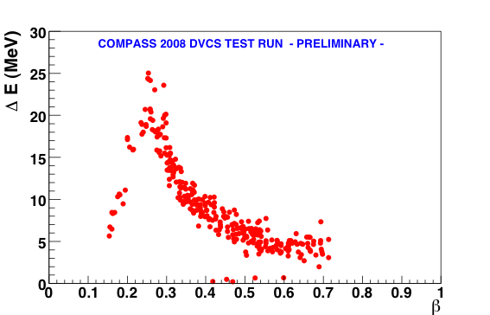
Kinematical consistency : ϑ_{γ*γ}
μ’
With μ, μ’ and γ :
μ
γ*
γ
With μ, μ’ and proton :
proton
μ+p->μ’+γ+p
Events rejected

Slide 29
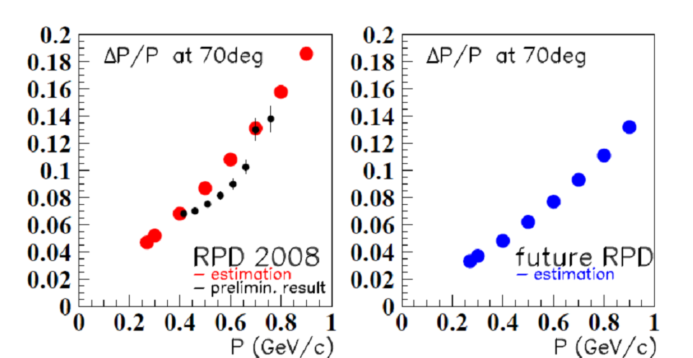
Measurements and Estimations for resolution
 | RPD(2008) | MuRex (2006)
B | L=1m; th=1cm Atten length = 0.7m σ_{B} = 300 ps | L=4m; th=5cm Atten length = 4m σ_{B} = 200 ps
A | L=50cm; th=5mm σ_{A} = 180 ps | L=2.83m; th=4mm σ_{A} = 270 ps
ToF | σ_{ToF} = 350 ps R_{B}-R_{A}= 85-12 = 63 cm | σ_{ToF} = 310 ps R_{B}-R_{A}= 110-25 = 85cm
t_{min}=-0.06 GeV²
Good resolution in t
Importance for the
the transverse imaging

Slide 30
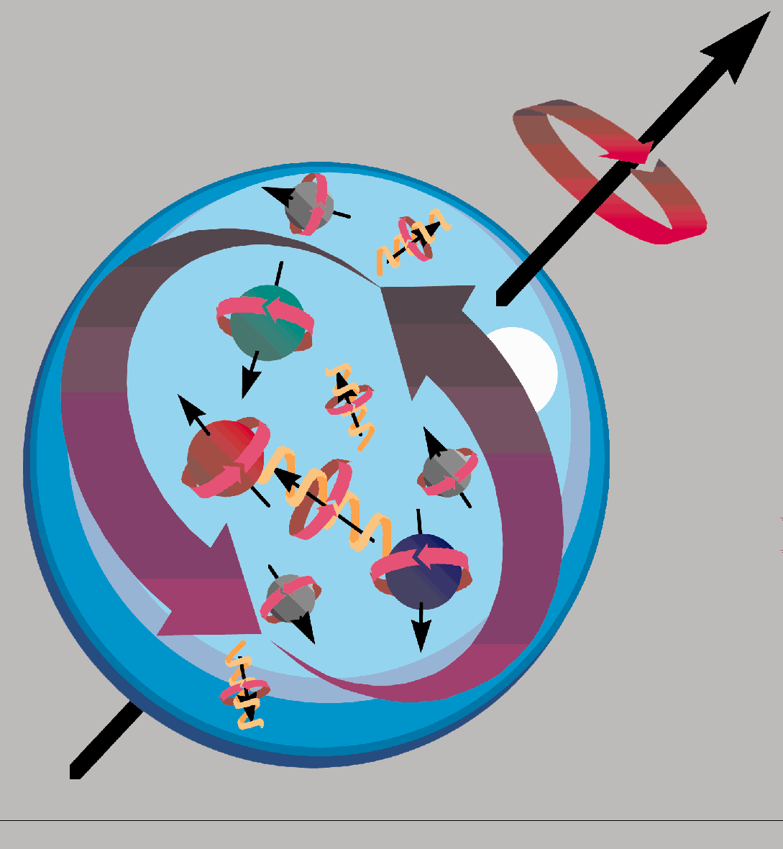
Generalized Parton Distributions
γ*
γ,π,ρ
hard
Factorisation:
Q² large, -t<1 GeV²
soft
x+ξ
x-ξ
GPDs
P
P’
contains pdf
H(x,0,0) = q(x)
measured in DIS
t
Generalized Parton Distributions
for quarks :
4 functions H,E,H,E(x,ξ,t)
∼ ∼
contains form factors
measured in elastic scattering
contains information on the nucleon spin :
Ji’s sum rule :

Slide 31
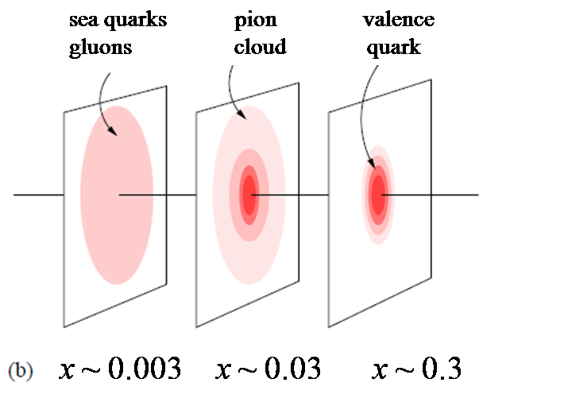
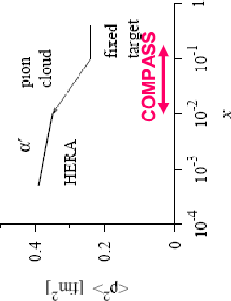
3-D partonic structure of the nucleon (P_{z},r_{y,z})
Hard Exclusive Scattering
Deeply Virtual Compton Scattering
ep→ epγ
γ*
Q²
γ
x+ξ
x-ξ
p
GPDs
p
t
z
x P
r⊥
y
x boost
GPDs : H( x,ξ,t )
Fourier (ξ=0)
access to correlations :
( P_{x,} r_{y,z} )
Burkardt,Belitsky,Müller,Ralston,Pire
Notes:
measure H(x,0,t) as function of t

