Slide 1

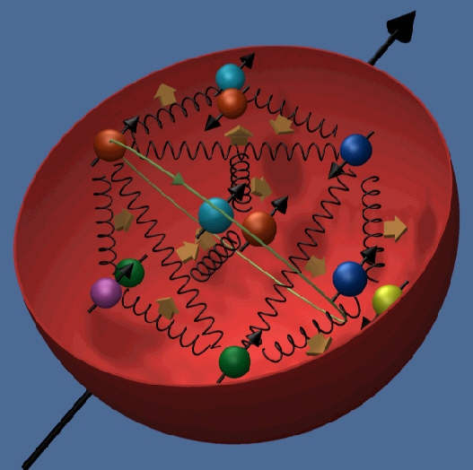


The Nucleon Spin Structure
Gerhard Mallot

Slide 2
Lecture 3
Experimental status
  RHIC pp data
  transverse asymmetries
Excursion: pion polarisability

Slide 3
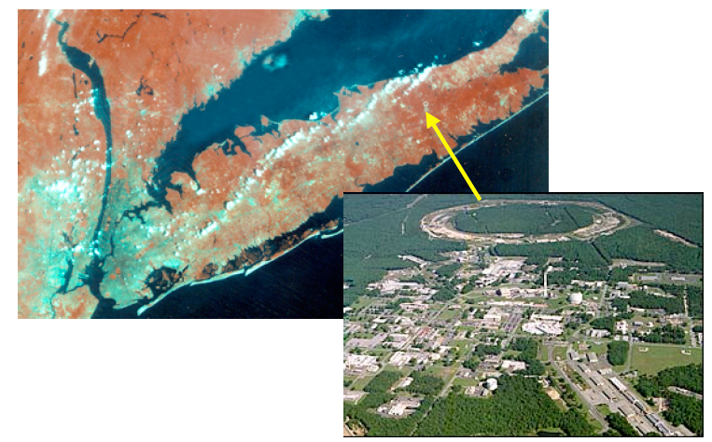
RHIC pp

Slide 4
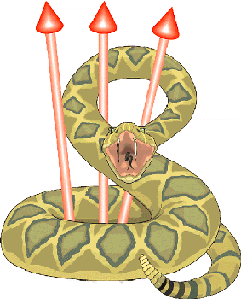
RHIC polarised pp Collider
absolute polarimeter (H↑ jet)
pC polarimeters
PHOBOS
BRAHMS & PP2PP
snakes
snakes
PHENIX
STAR
spin rotators
spin rotators
pol. H⁻ source
LINAC
BOOSTER
5% snake
200 MeV polarimeter
AGS
pC polarimeter
Siberian Snake
20 % snake
Notes:
Show layout & point of polarimeters and experimental locations
Emphasize bunch polarizations prepared at source going through AGS etc. to RHIC
Time spacing between them ~100 ns
Transverse polarization in ring, longitudinal at experiments (optional) using spin rotators
Emphasize none of these techniques existed just 4-5 years ago, all developed here at RHIC with international collaborations led by US and Japanese teams.

Slide 5
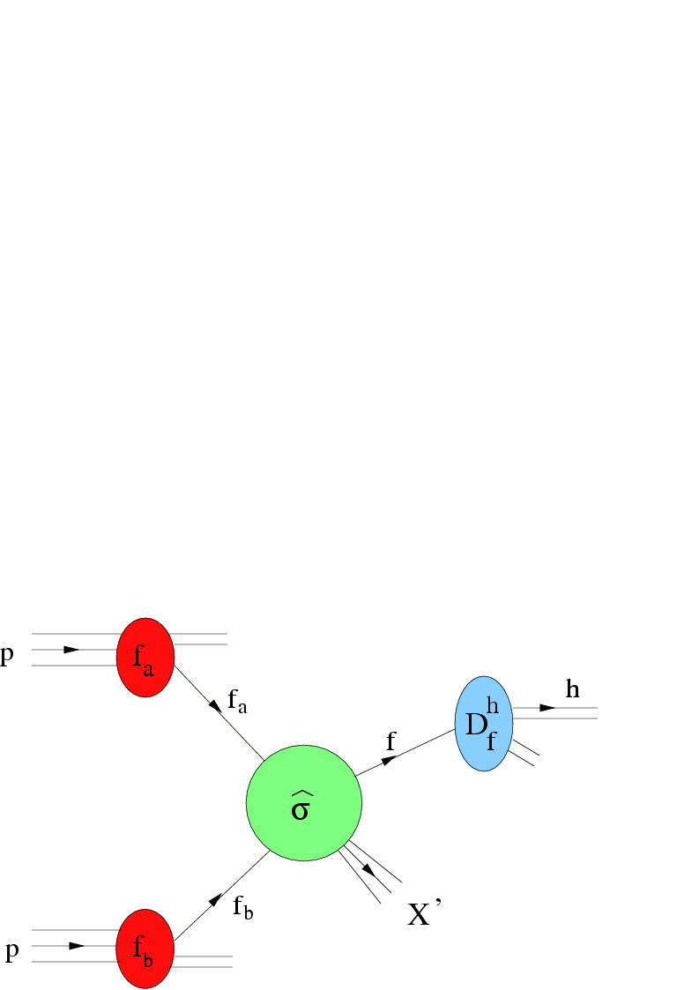
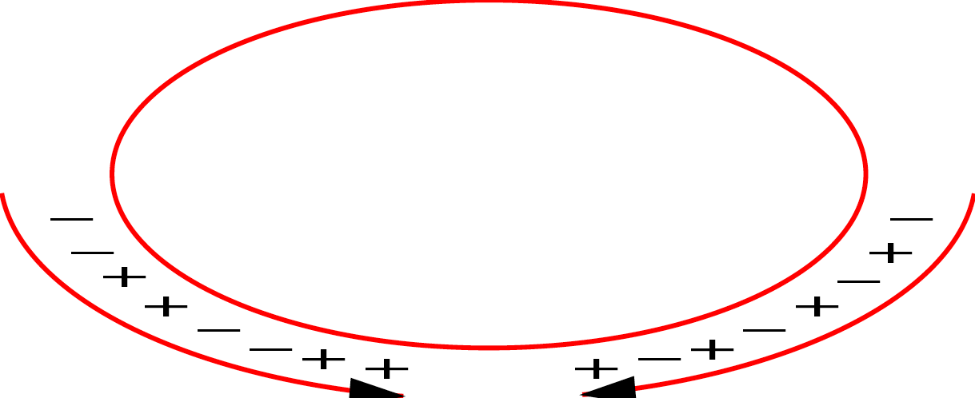
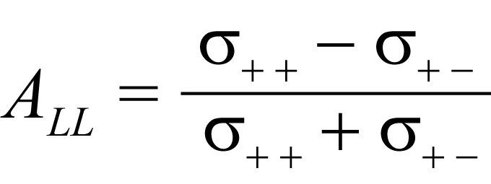
pp collisions
polarisation ~ 45 % in 2005
~ 60 % in 2006

Slide 6
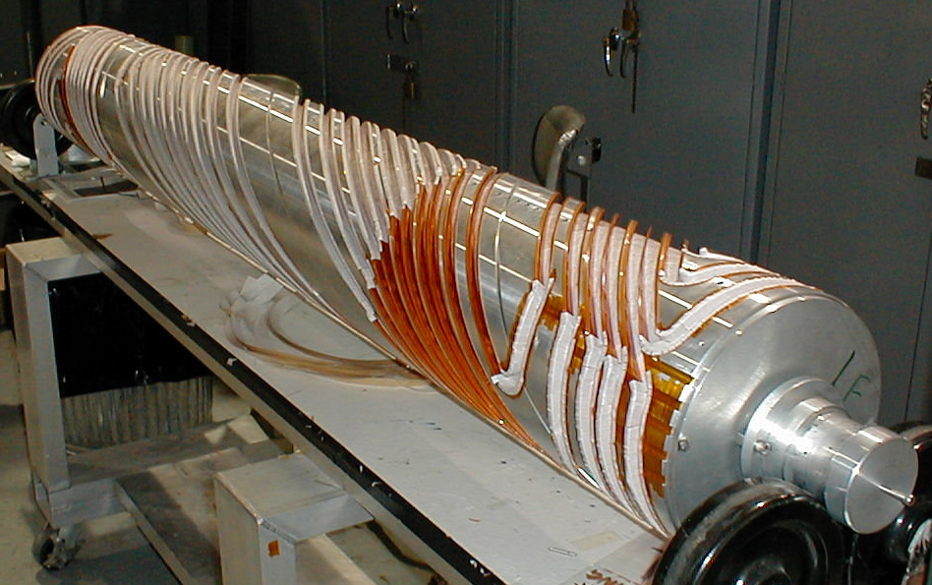
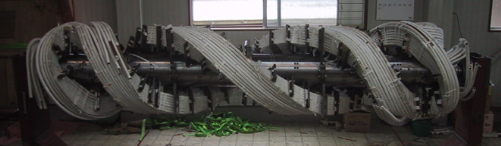
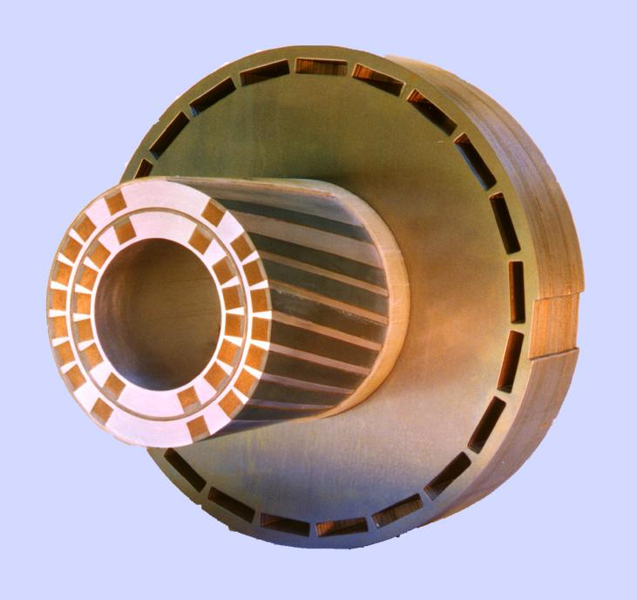
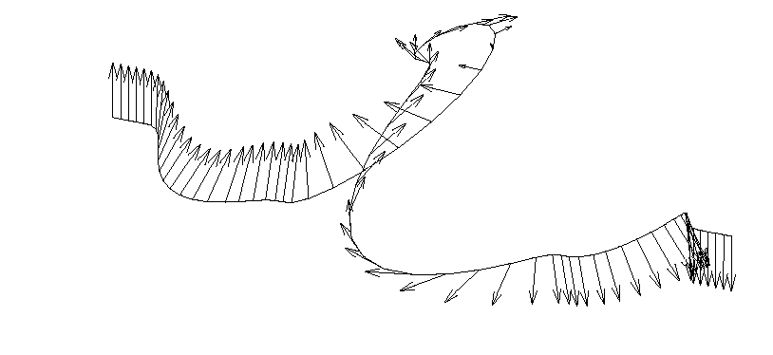
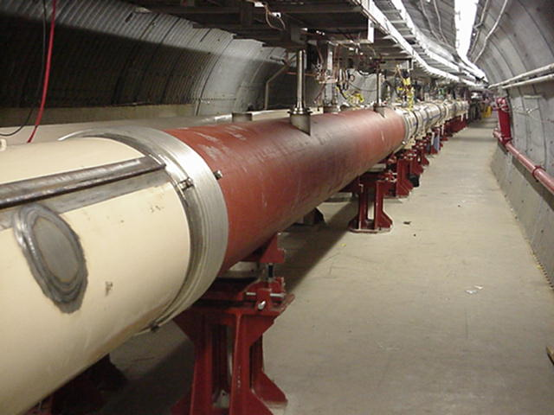
Siberian Snakes (helical dipoles)
from Th. Roser
AGS partial snakes, 1.5T (RT) & 3T(SC)
2.6 m
2.6 m
RHIC full Siberian Snakes: 4 x 4 T (SC), each 2.4
9.6 m
w/o: 1000 depolarising resonances
Notes:
first suggested in 1974 by Russian theorists Yaroslav S. Derbenev and Anatoly M. Kondratenko of the Novosibirsk Laboratory

Slide 7
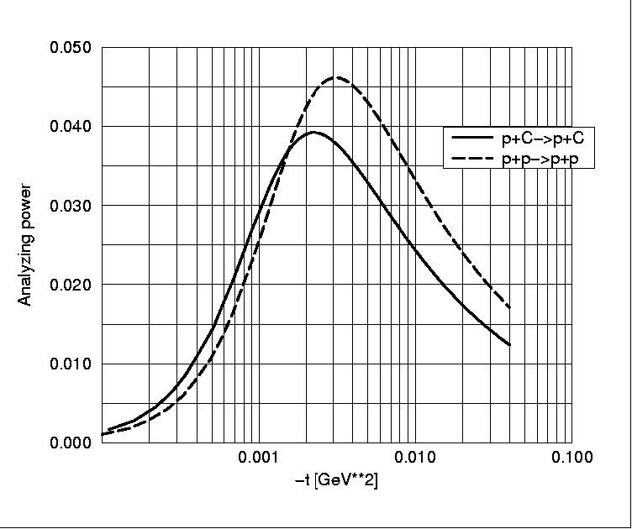
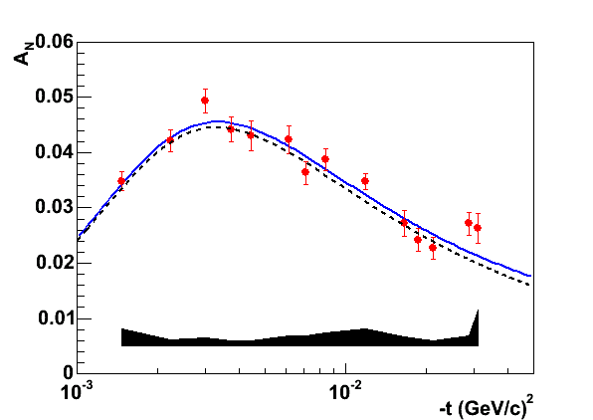
Polarimetry
left-right asymmetry A_{N} in elastic p↑p and p↑C scattering
interference of em and nuclear spin-flip amplitude,
Coulomb−Nuclear Interference (CNI), up to 4.5 %
self calibration with polarised H jet target
Calculation
pp measurement
A_{N} (t)
p+p
H. Okada et al., PLB 638 (2006), 450
p+C
-t (GeV/c) ²

Slide 8
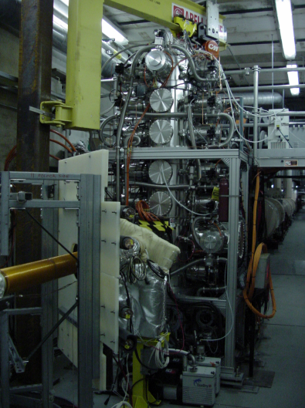
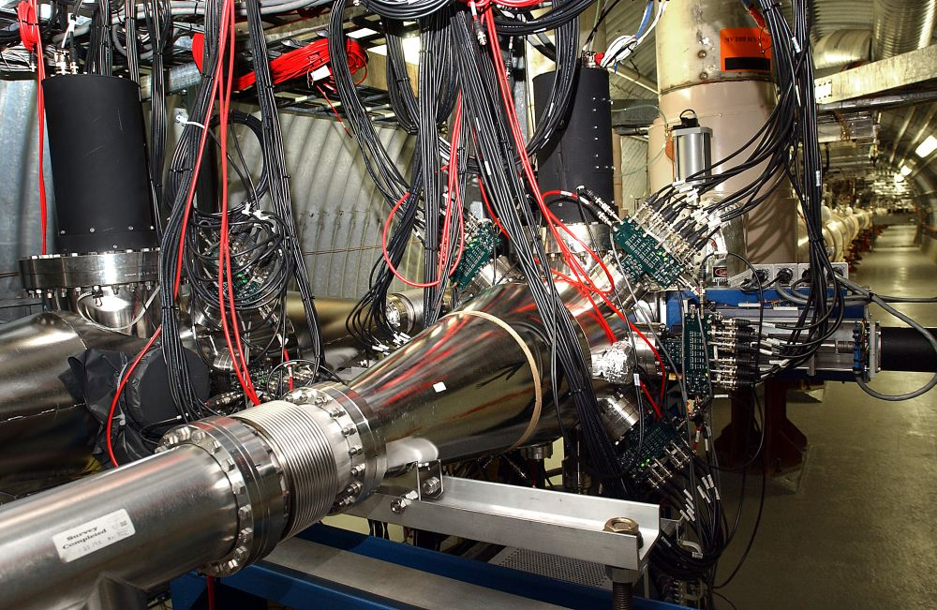
RHIC polarimeters
from G. Bunce
Carbon target polarimeters
3μm carbon ribbon
every 2h, Δp/p < 5%
calibration with H-jet target
Polarized H jet target

Slide 9
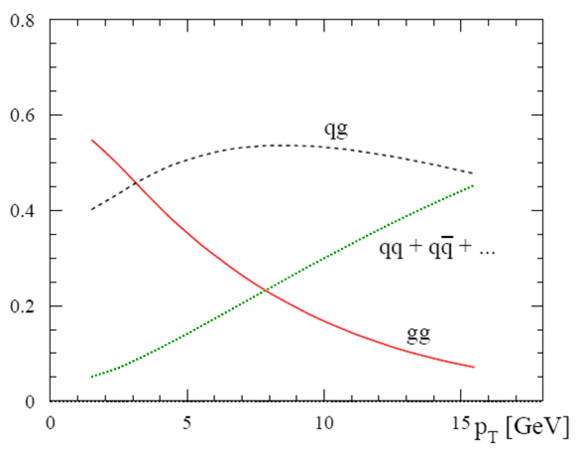
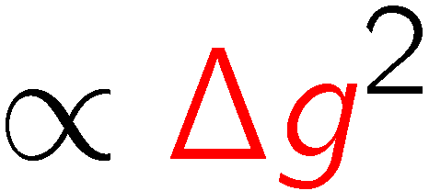
qg – qq – gg processes
100+100 GeV
250+250 GeV
upgrade
present energy:
100 on 100 GeV
gg processes dominate
sign ambiguity
fractions
5
10
p_{T}(GeV)

Slide 10
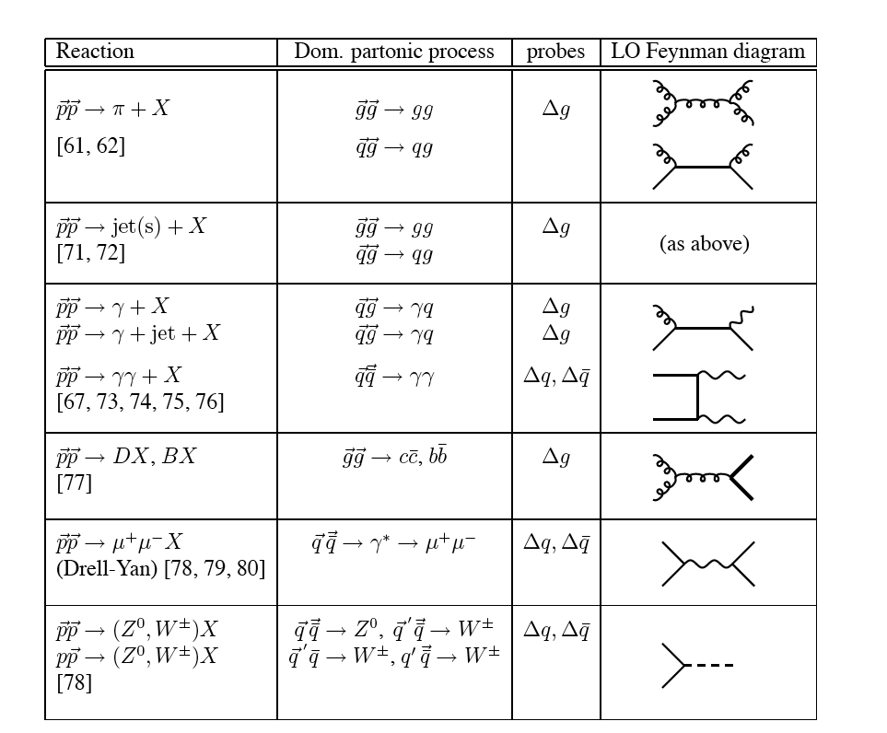
pp: NLO Calculations
In better shape than semi-inclusive DIS:
Jäger,Schäfer, Stratmann,
Vogelsang; de Florian
π
Jäger,Stratmann,
Vogelsang;
Signer et al.
jet
γ
Gordon,Vogelsang;
Contogouris et al.;
Gordon, Coriano
Bojak, Stratmann
Summary by Stratmann, DIS2006

Slide 11
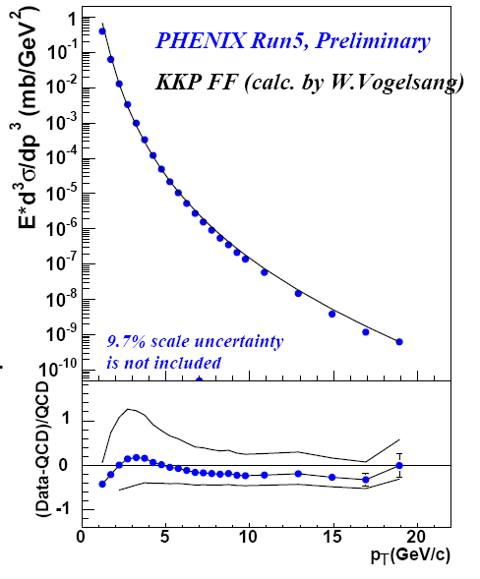
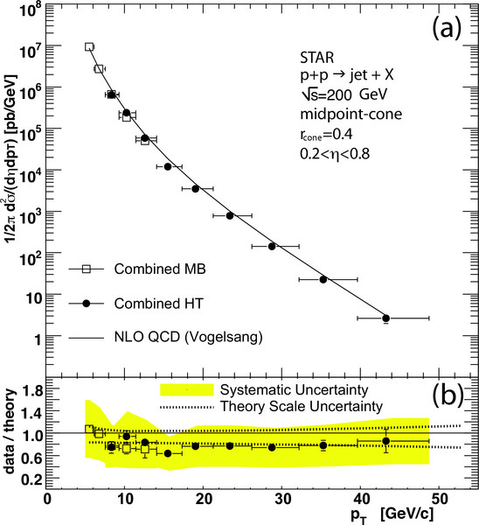


NLO vs data (unpol)
π⁰
jets
π⁰ production
PRL 97 (2006) 252001

Slide 12
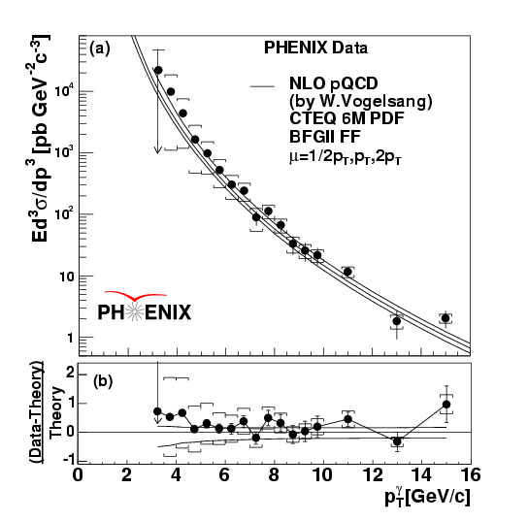
Direct photons
good agreement of
calc. and data at
collider energies
PRL 98 (2007) 012002

Slide 13
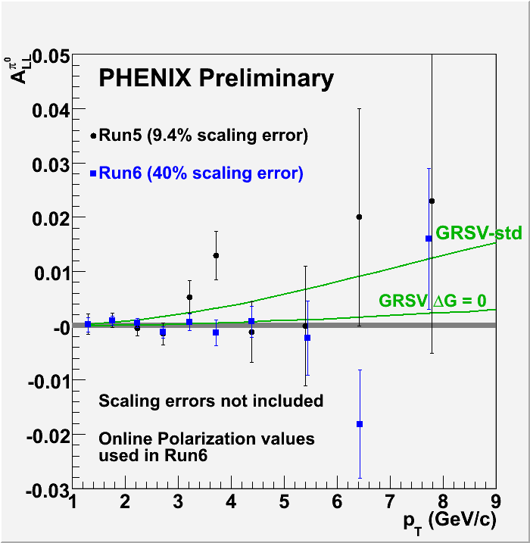
Phenix π⁰ asymmetries

Slide 14
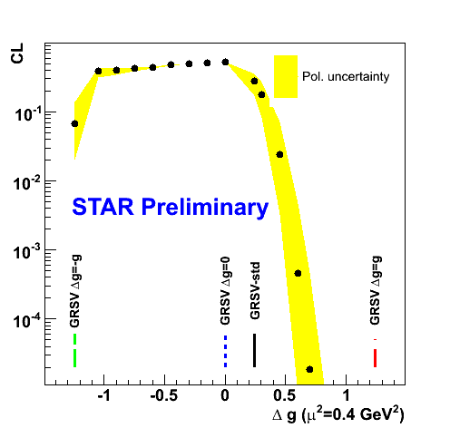
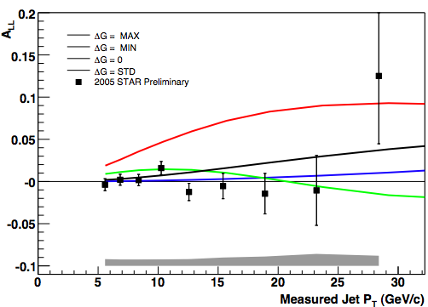
STAR jet asymmetries
GRSV Models:
ΔG = G: ΔG(Q²=1GeV²) = 1.9
ΔG = −G: ΔG(Q²=1GeV²) = −1.8
ΔG = 0: ΔG(Q²=1GeV²) = 0.1
ΔG = std: ΔG(Q²=1GeV²) = 0.4
GRSV DIS
Phenix/Star χ²-tests for fixed GRSV shape, not (yet)
conclusive for ∆G; no refit of the PDF parameters

Slide 15
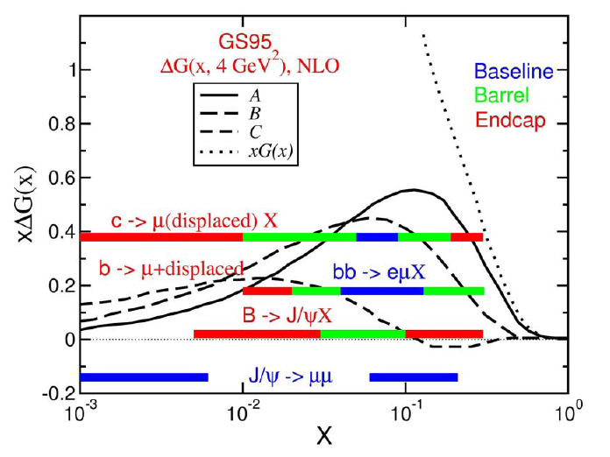
Probed x-Bjorken range
π⁰ production
detector upgrades (Phenix)
log₁₀(x_{gluon})

Slide 16
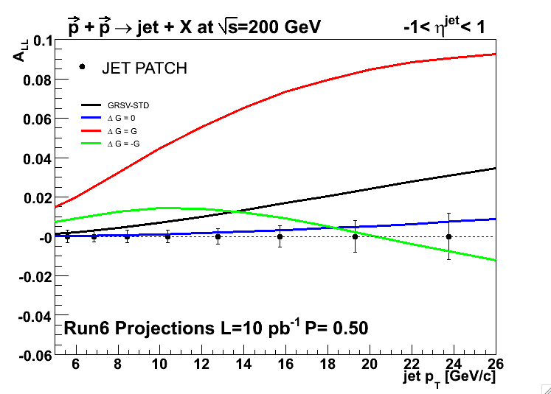
STAR jet asymmetries 2006
projected precision!
DG=G
GRSV-std
DG=-G
DG=0
2006
Projection
L = 6 pb⁻¹ P=0.6

Slide 17
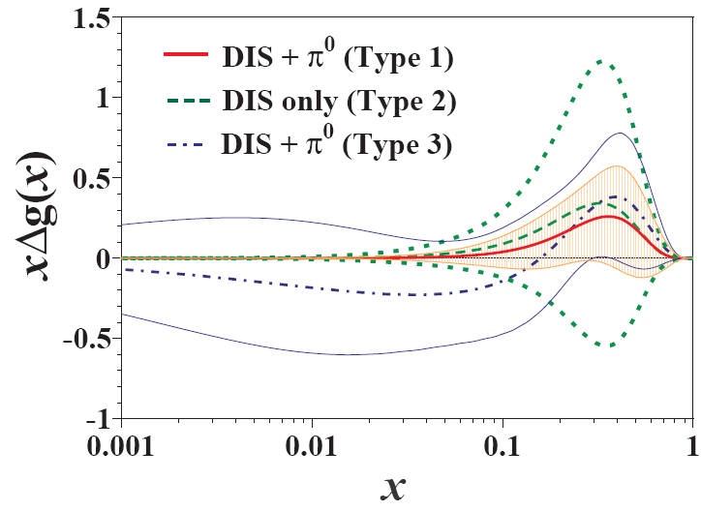
Global analysis
need global analysis of all data relevant for ∆g:
DIS, hadron pairs, charm, pp π and jets (direct γ, …)
first attempt AAC2006
ΔG > 0
ΔG < 0

Slide 18
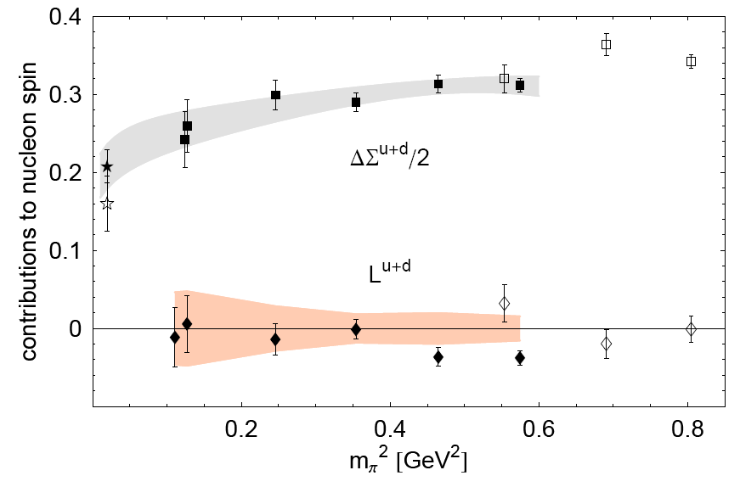
Lattice results
chiral extrapolation to physical pion mass m_{π}
Ph. Hägler et al., LHPC/MILC arXiv:0705.4295 [hep-lat]
HERMES

Slide 19
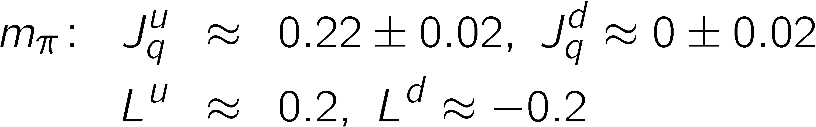
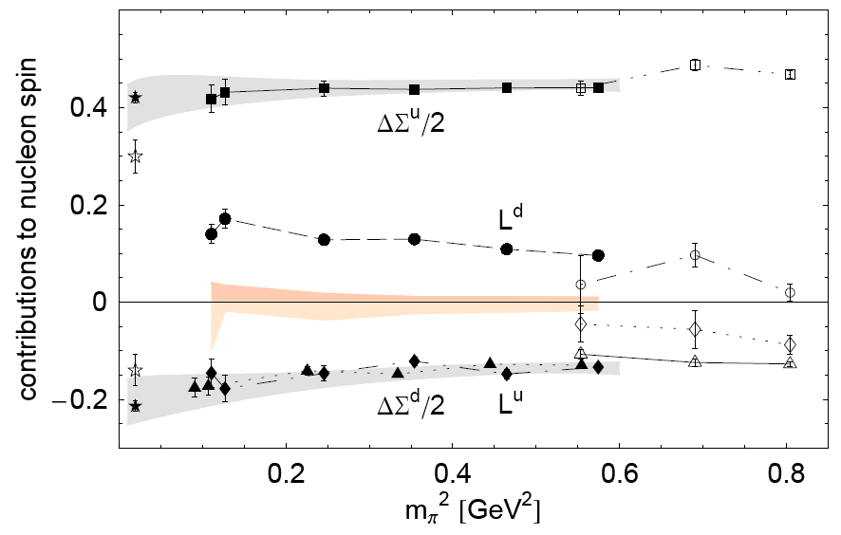
Lattice results
extrapolated to phys.
Ph. Hägler et al., LHPC/MILC arXiv:0705.4295 [hep-lat]
HERMES

Slide 20
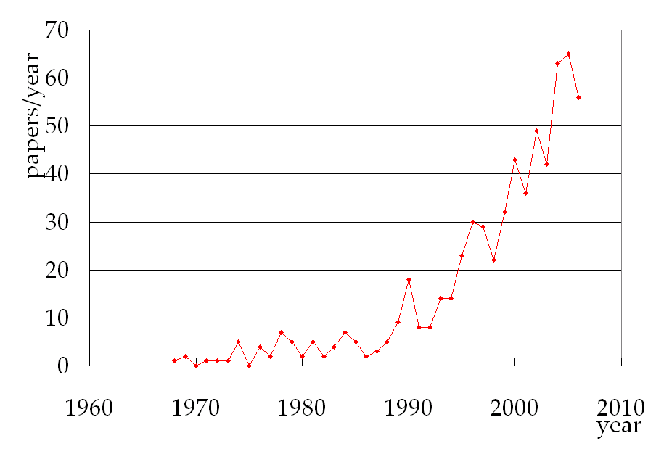
Transverse spin effects
SPIRES-HEP: search title including: “Transverse spin, Transversity, single spin”
from L. Bland
Total number: 625 (1968~2006)
Experimental results ~14%

Slide 21
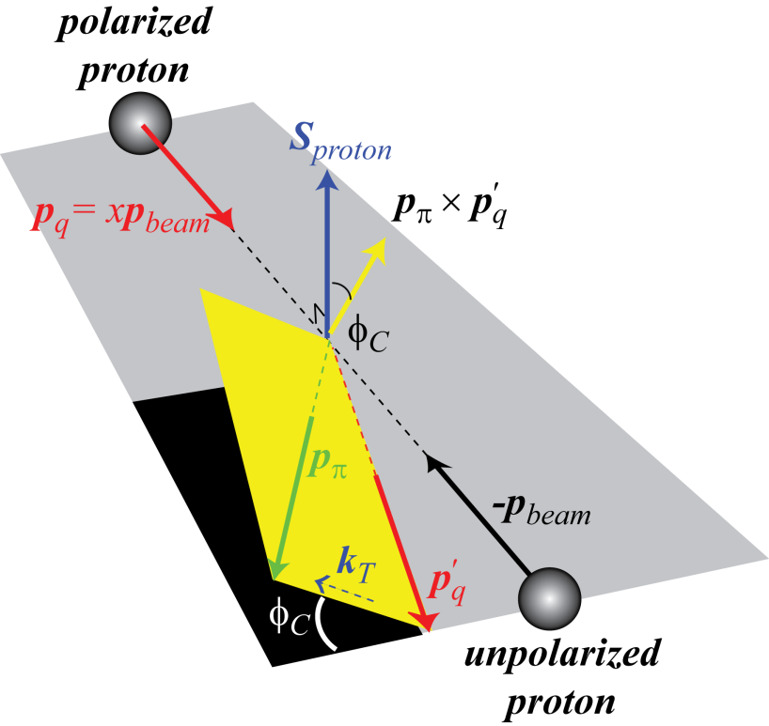
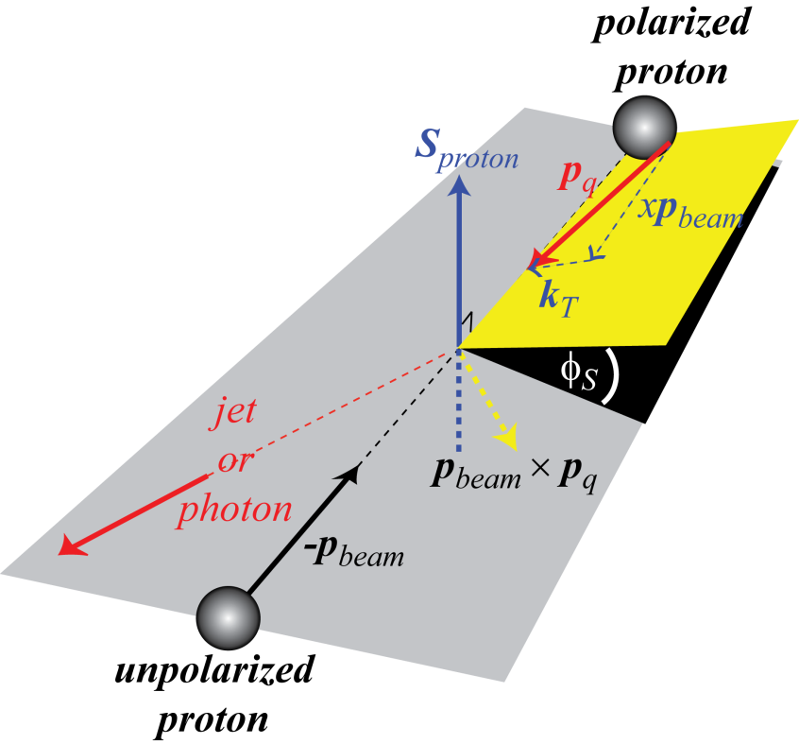
Origin of single-spin asymmetries
from L. Bland
Collins/Heppelmann mechanism requires transverse quark polarization and spin-dependent fragmentation
Sivers mechanism
requires spin-correlated transverse momentum k_{T} in the proton (orbital motion).
initial state
final state

Slide 22
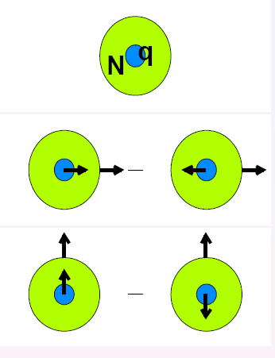
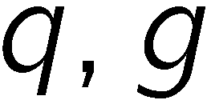
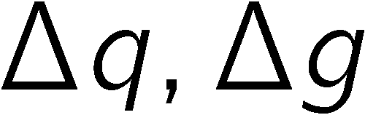


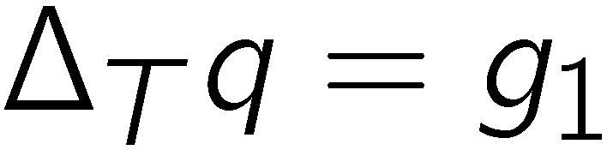
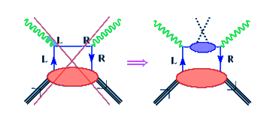
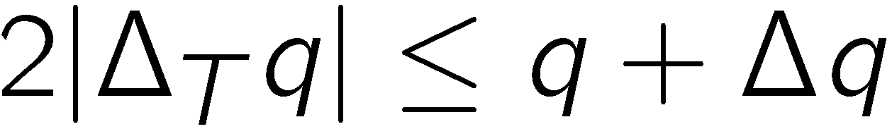
Transversity
momentum
helicity
transversity
(alias h₁)
3 fundamental twist-2 PDFs, new transversity
non-relativisic
chiral-odd PDF → not seen in DIS
semi-inclusive DIS allowed if
coupled to a chiral-odd FF
Soffer bound:

Slide 23

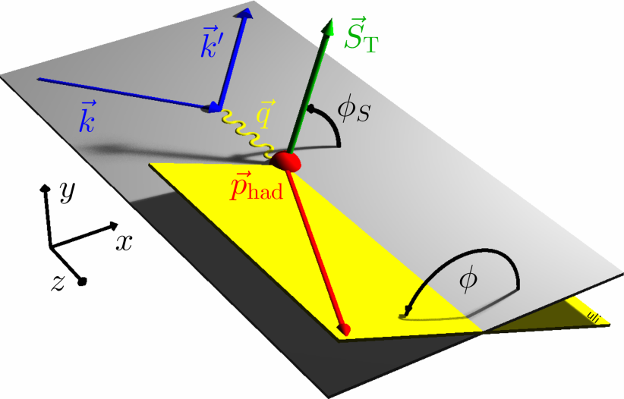
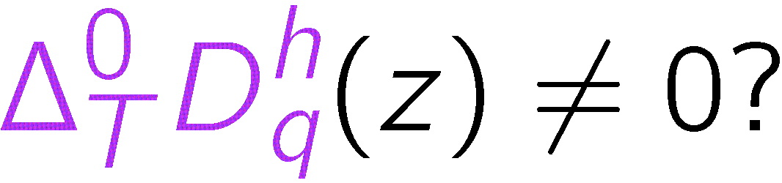
Transversity
single-spin asymmetry:
Chiral-odd Collins FF:

Slide 24

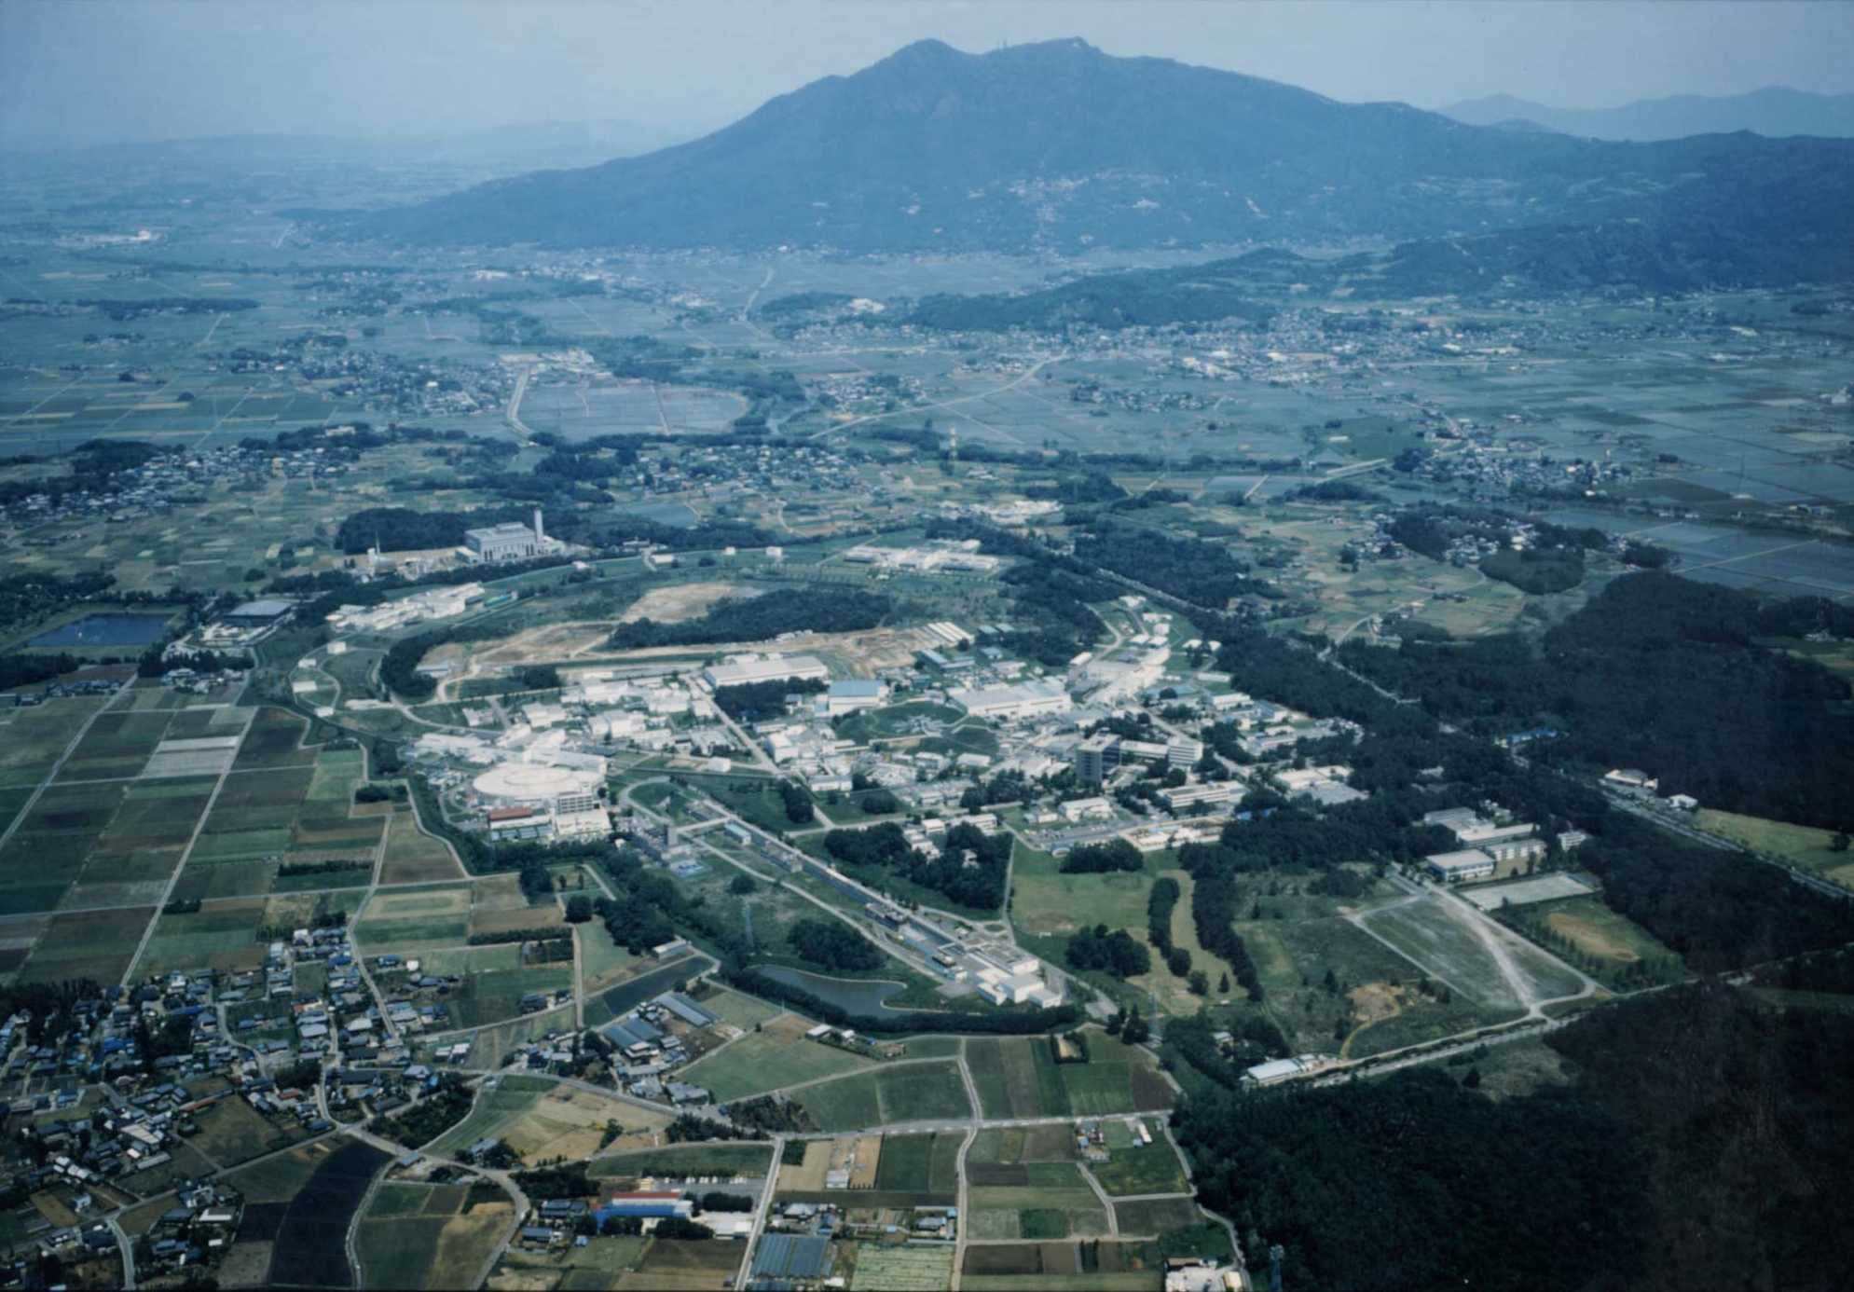
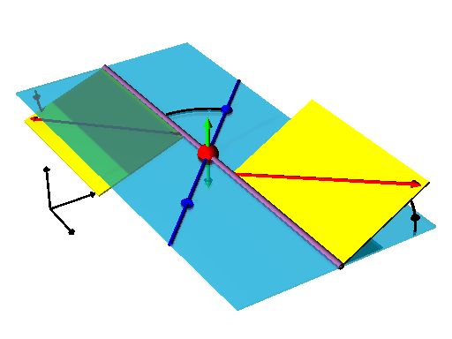
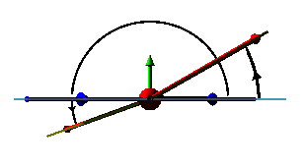
Fragmentation functions from
Belle detector
KEKB e⁺e⁻ coll. 3.5+8 GeV
L > 1.6 x 10³⁴cm⁻²s⁻¹ !
correlation of hadron
azimuthal angles
KEKB
ϕ₂−π
e⁻
Θ
ϕ₁
ϕ₁
e⁺
ϕ₂

Slide 25
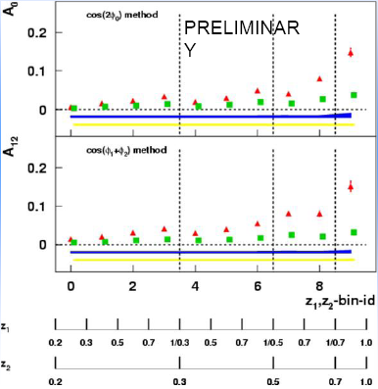
Collins asymmetries from e⁺e⁻
e⁺ e⁻→ ππ X (547 fb⁻¹)
Y
first direct measurement of the Collins function
rising with z
UC unlike sign/all
UL unlike sign/like sign
different mix of favoured and unfavoured FF
UC asymmetries about 40−50% of UL asymmetries
M. Grosse Perdekamp et al.

Slide 26

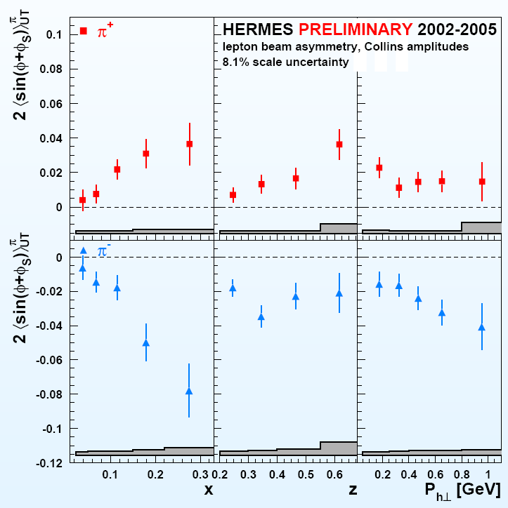
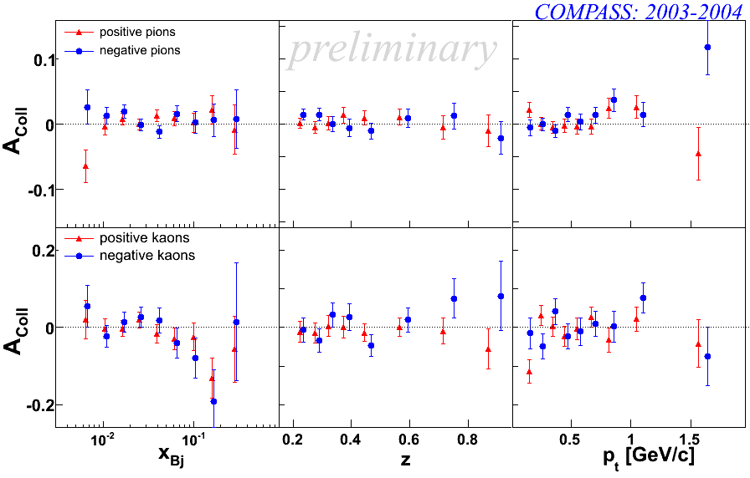
Collins asymmetries
Hermes: proton
COMPASS: deuteron
π^{+/−}
π⁺
Κ^{+/−}
π⁻

Slide 27
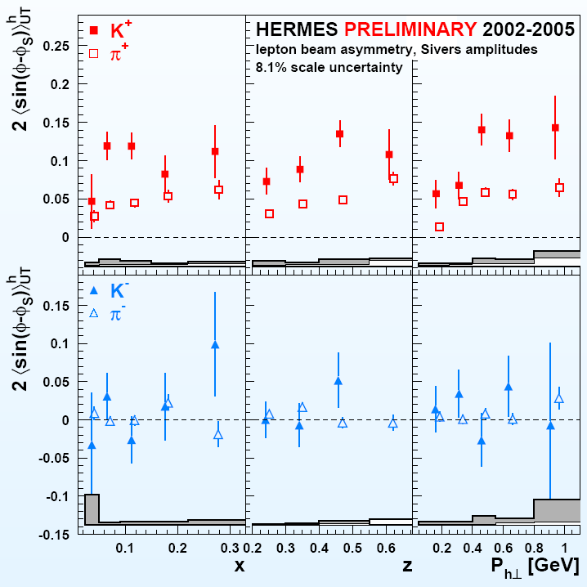
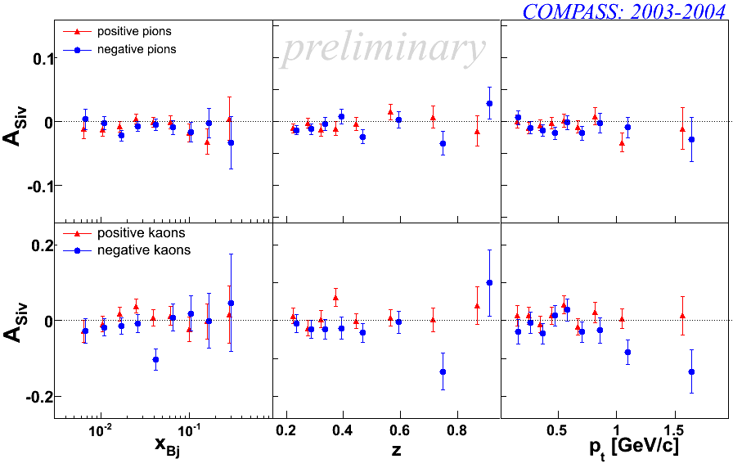
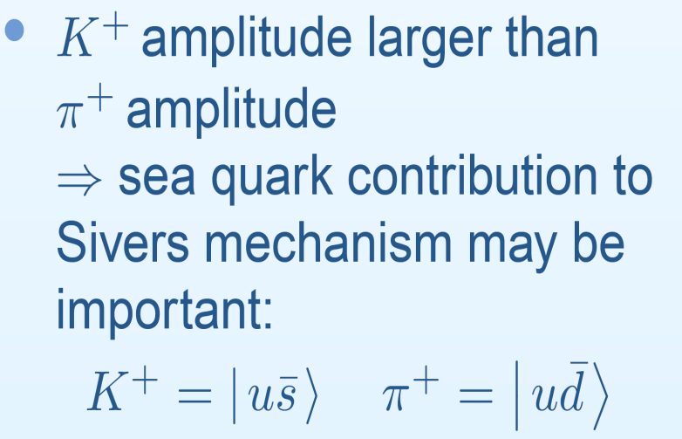
Sivers asymmetries
Hermes: proton
COMPASS: deuteron
π^{+/−}
Κ^{+/−}

Slide 28


towards transversity
global fit of data to BELLE (FF ),
HERMES, COMPASS (DFxFF )

Slide 29


A first glimpse of transversity
q+∆q
Anselmino et al., Phys. Rev. D75 (2007) 054032

Slide 30



Transverse spin effects @ RHIC
π⁰
huge effects up to 40%

Slide 31
Pion Polarisability

Slide 32

Polarizabilities
electric polarisability :
magnetic polarisability :
Charges oscillate ~ 0.1% π radius
From S. Paul

Slide 33





Polarisability: a test of χPT
electrical , magnetic polarisability
χPT:
Low Energy Constant (LEC)
χPT:
1 loop
2 loop
= 0 at 1 loop

Slide 34






Polarisability: Primakoff
measurable in Compton scatt.
γπ∀ γπ
Primakoff: inverse kinematics
with and
where , depends on analysis cuts

Slide 35

Polarisability: Primakoff
Finally compare the shape of the measured Primakoff cross-section to a Monte Carlo simulation for the point-like case.
Note COMPASS also measured the point-like muon

Slide 36

Pilot hadron-beam run 2004
Trigger
π
γ
190 GeV π beam, low intensity: 2 ·10⁶/spill
Beam time: 7 days
Trigger: beam, pion in hodoscope, and E_{γ} > 90 GeV
Trigger rate (40−50k/spill)
Different targets (Pb, C, Cu)

Slide 37
Event selection
Exclusivity
Diffractive background
Coulomb peaks of π and µ agree
Interference
Extrapolate diffr.active
background

Slide 38
Cross checks
Cross section ratios
Empty target background
σ/σ_{Pb}
before
after subtract.
Abs. Pb cross-section:
estimate ~ 100 µb
theory ~ 140 µb
Not needed in analysis
M_{πγ} (MeV)

Slide 39

Result for β_{π}
Ratio data/MC
R
Radiative corrections included
zero result for muon
Systematic error:
π
µ
0.5
0.7
0.9
ω

Slide 40
World data on α_{π}
preliminary
Precise preliminary result
Good agreement with χPT
Smaller than Serpukhov and Mainz result
χPT

Slide 41
Summary
We are starting to assess the gluon polarisation
The large ΔG scenario is basically excluded
Still the gluon can have a significant contribution to
the nucleon spin.
Need now precise measurements to actually
determine the various contributions exactly.
Transverse spin effects still puzzling
Work for a polarised ep collider!
Lots to come from:
  Hermes
  COMPASS
  RHIC

Slide 42

“You think you understand something…,
now add spin” R. Jaffe
It seems spin goes
pretty far down…

Slide 43

Thanks to the organisers
… and the audience

