Slide 1

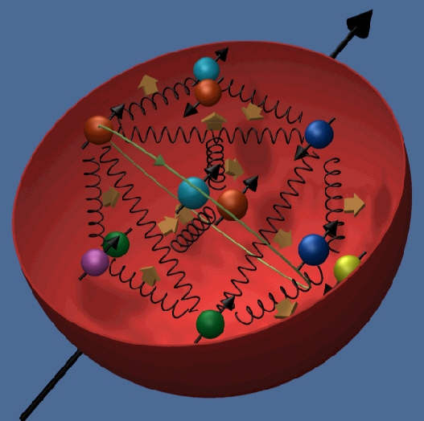


The Nucleon Spin Structure
Gerhard Mallot

Slide 2
Lecture 2
Experimental status
  Q² evolution, scaling violations, DGLAP
  status of g₁ and QCD analyses
  interplay: g₂
  semi-inclusive data
  ΔG from hadron pairs

Slide 3
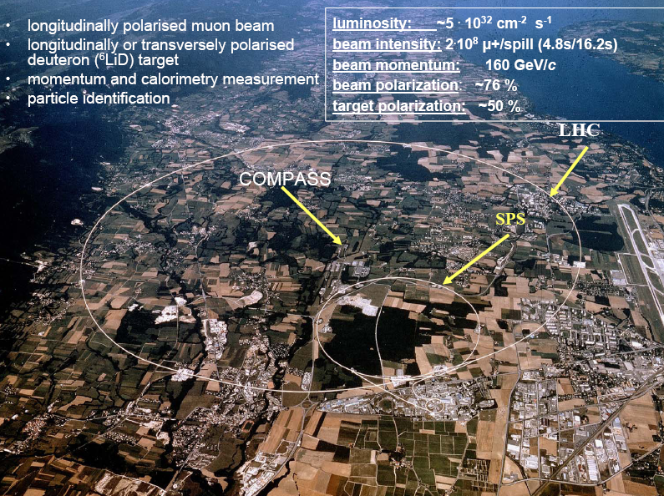

Slide 4



1. Q ² evolution of structure functions
with increasing Q² more details are resolved
quarks/gluons split and produce more partons
the ‘new’ partons have smaller x-Bjorken, since the new partons have to share the momentum
scaling violations in PDFs and SFs: P(x) → P(x,Q²)
the Q ² evolution is calculable in perturbative QCD, if the PDFs P(x,Q²₀) are known at some Q²₀
x dependence is non-perturbative and not described in pQCD

Slide 5
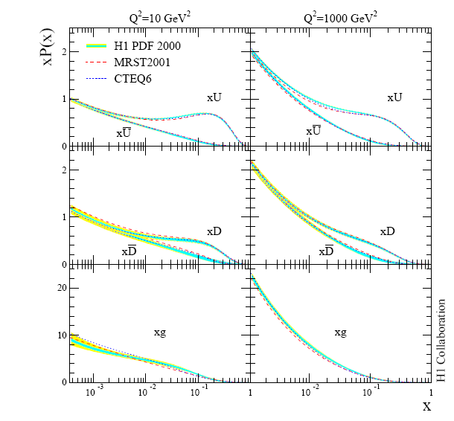
Parton Distribution Functions
Q²= 10 GeV²
Q²= 1000 GeV²
unpolarised
H1 analysis of
HERA ep data
strong increase at small x with Q²
the various fits agrees very well
fully constrained by data
u
d
g

Slide 6
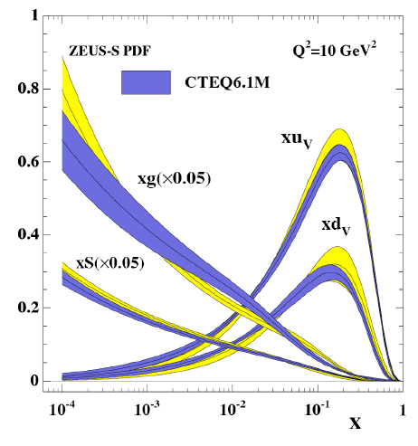

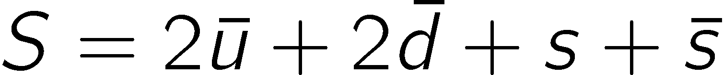
PDFs
Zeus analysis
valence quark distr.
sea quark distr.

Slide 7
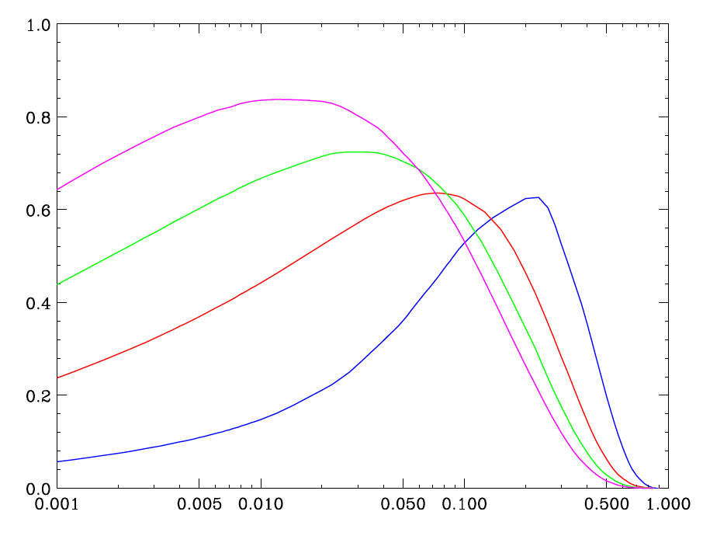
Polarised gluon evolution Δg (x,Q ²)
xΔg(x,Q²)
GRSV std.
Q² = 1000
Q² = 100
Q² = 10
Q² = 1 GeV²
x

Slide 8
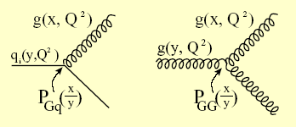
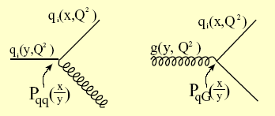
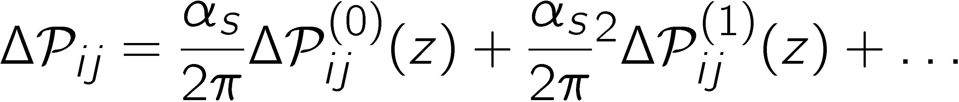
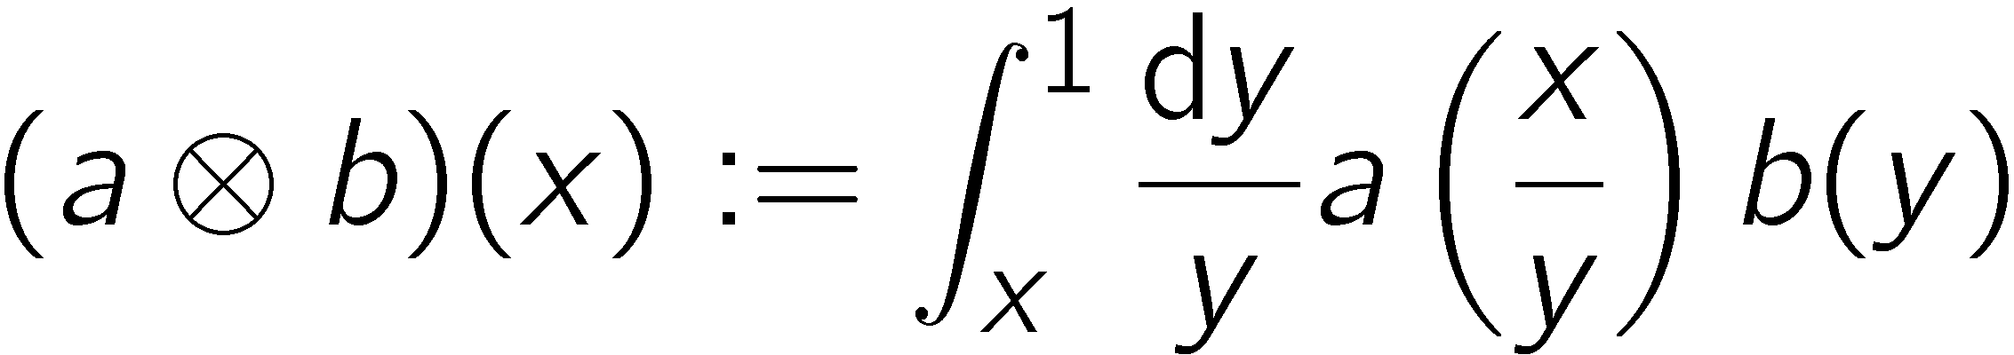
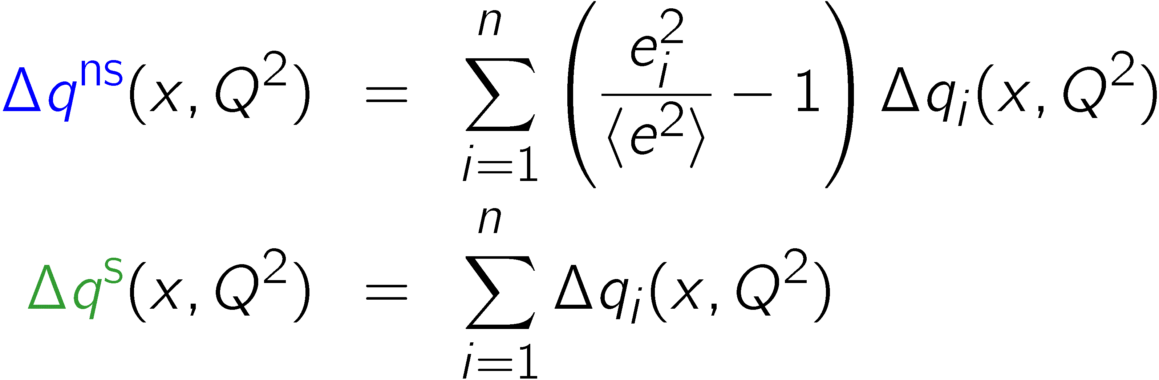
Splitting functions ΔP
LO
NLO
define:

Slide 9
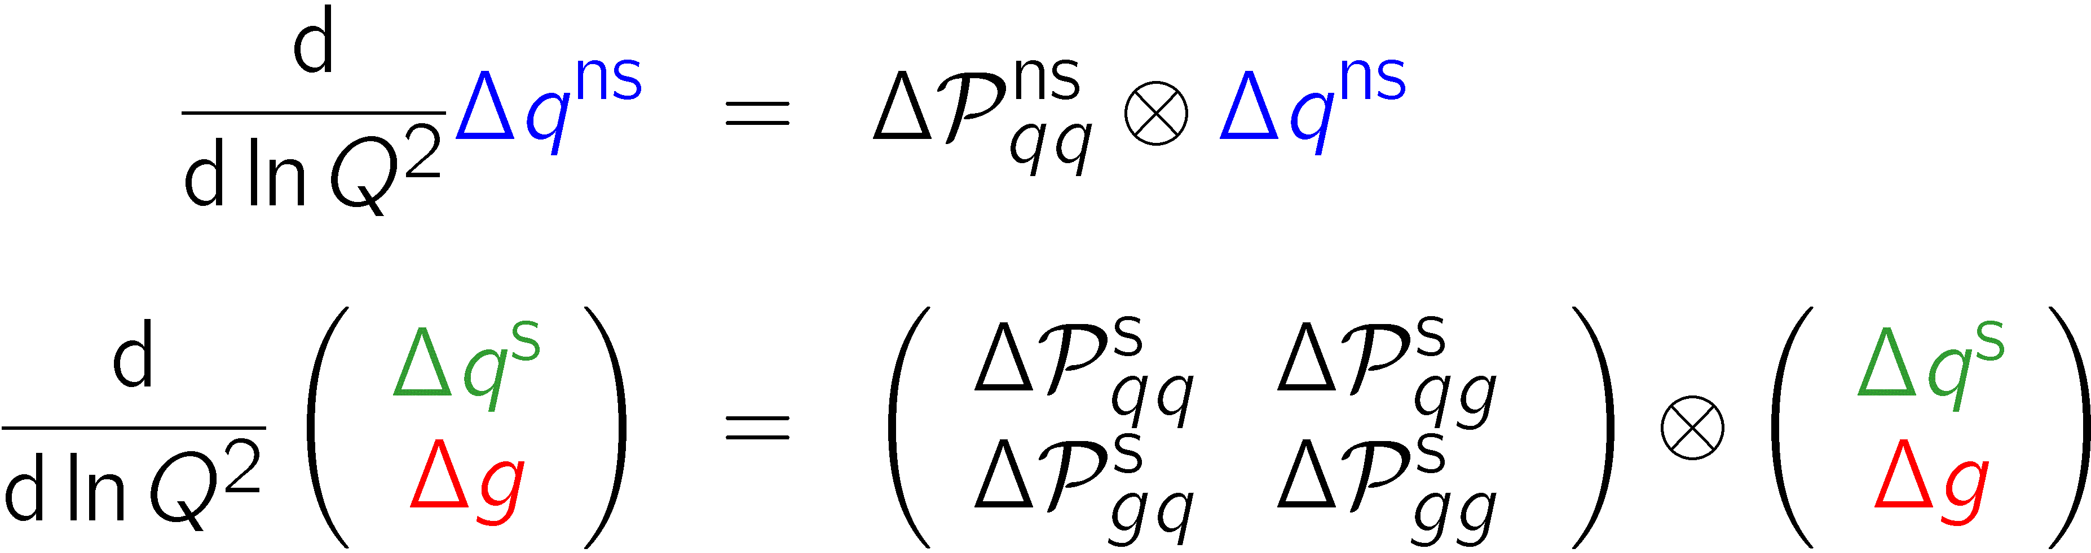
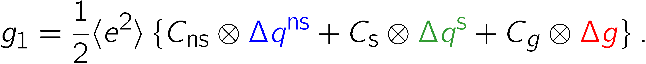
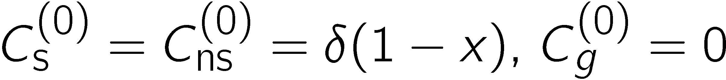
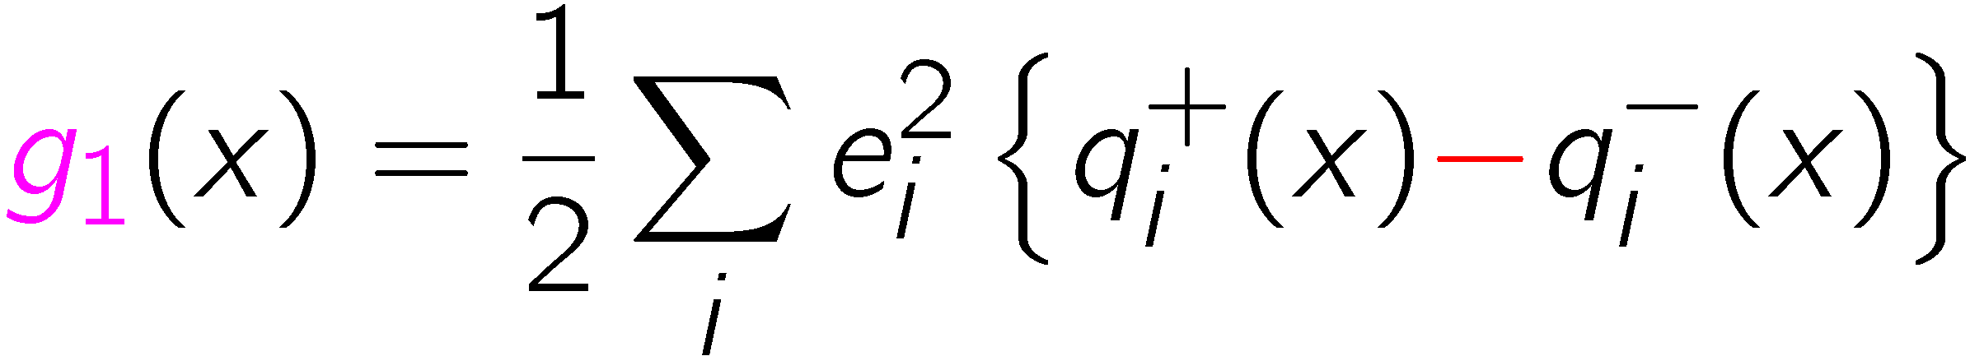
Q ² evolution & DGLAP equations
Dokshitzer ‘77; Gribov, Lipatov ‘75; Altarelli, Parisi ‘77
LO coefficient functions:
back to PM expression:

Slide 10
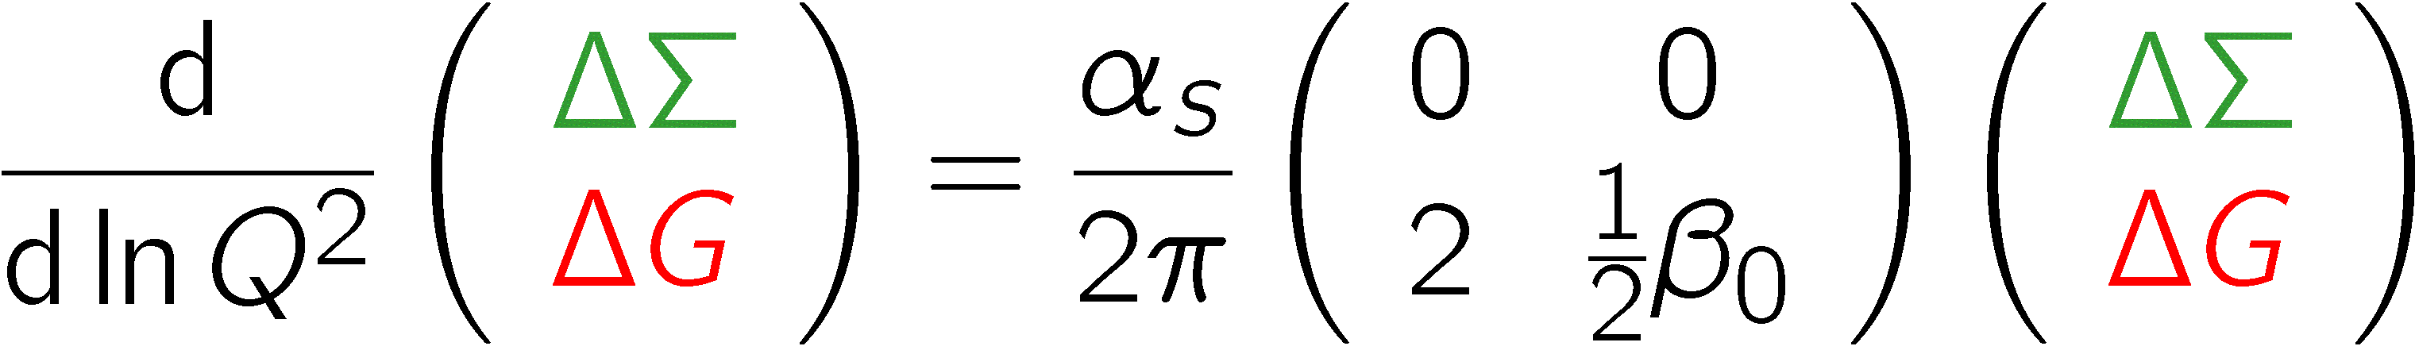
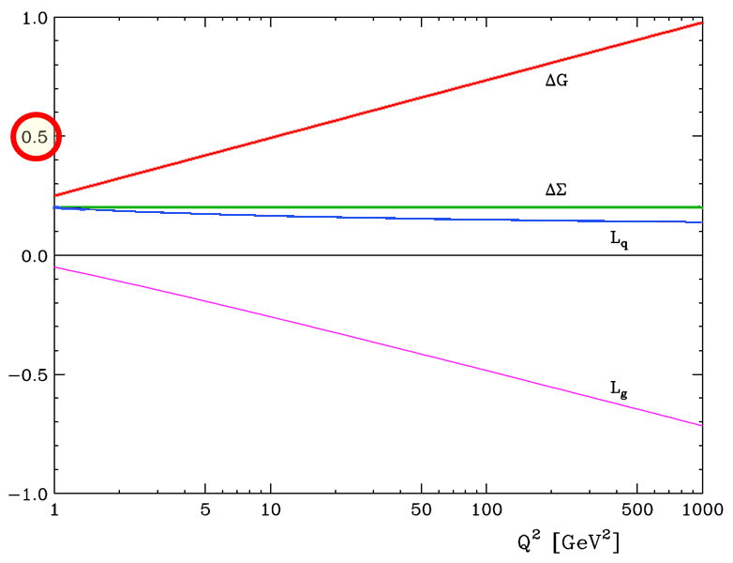

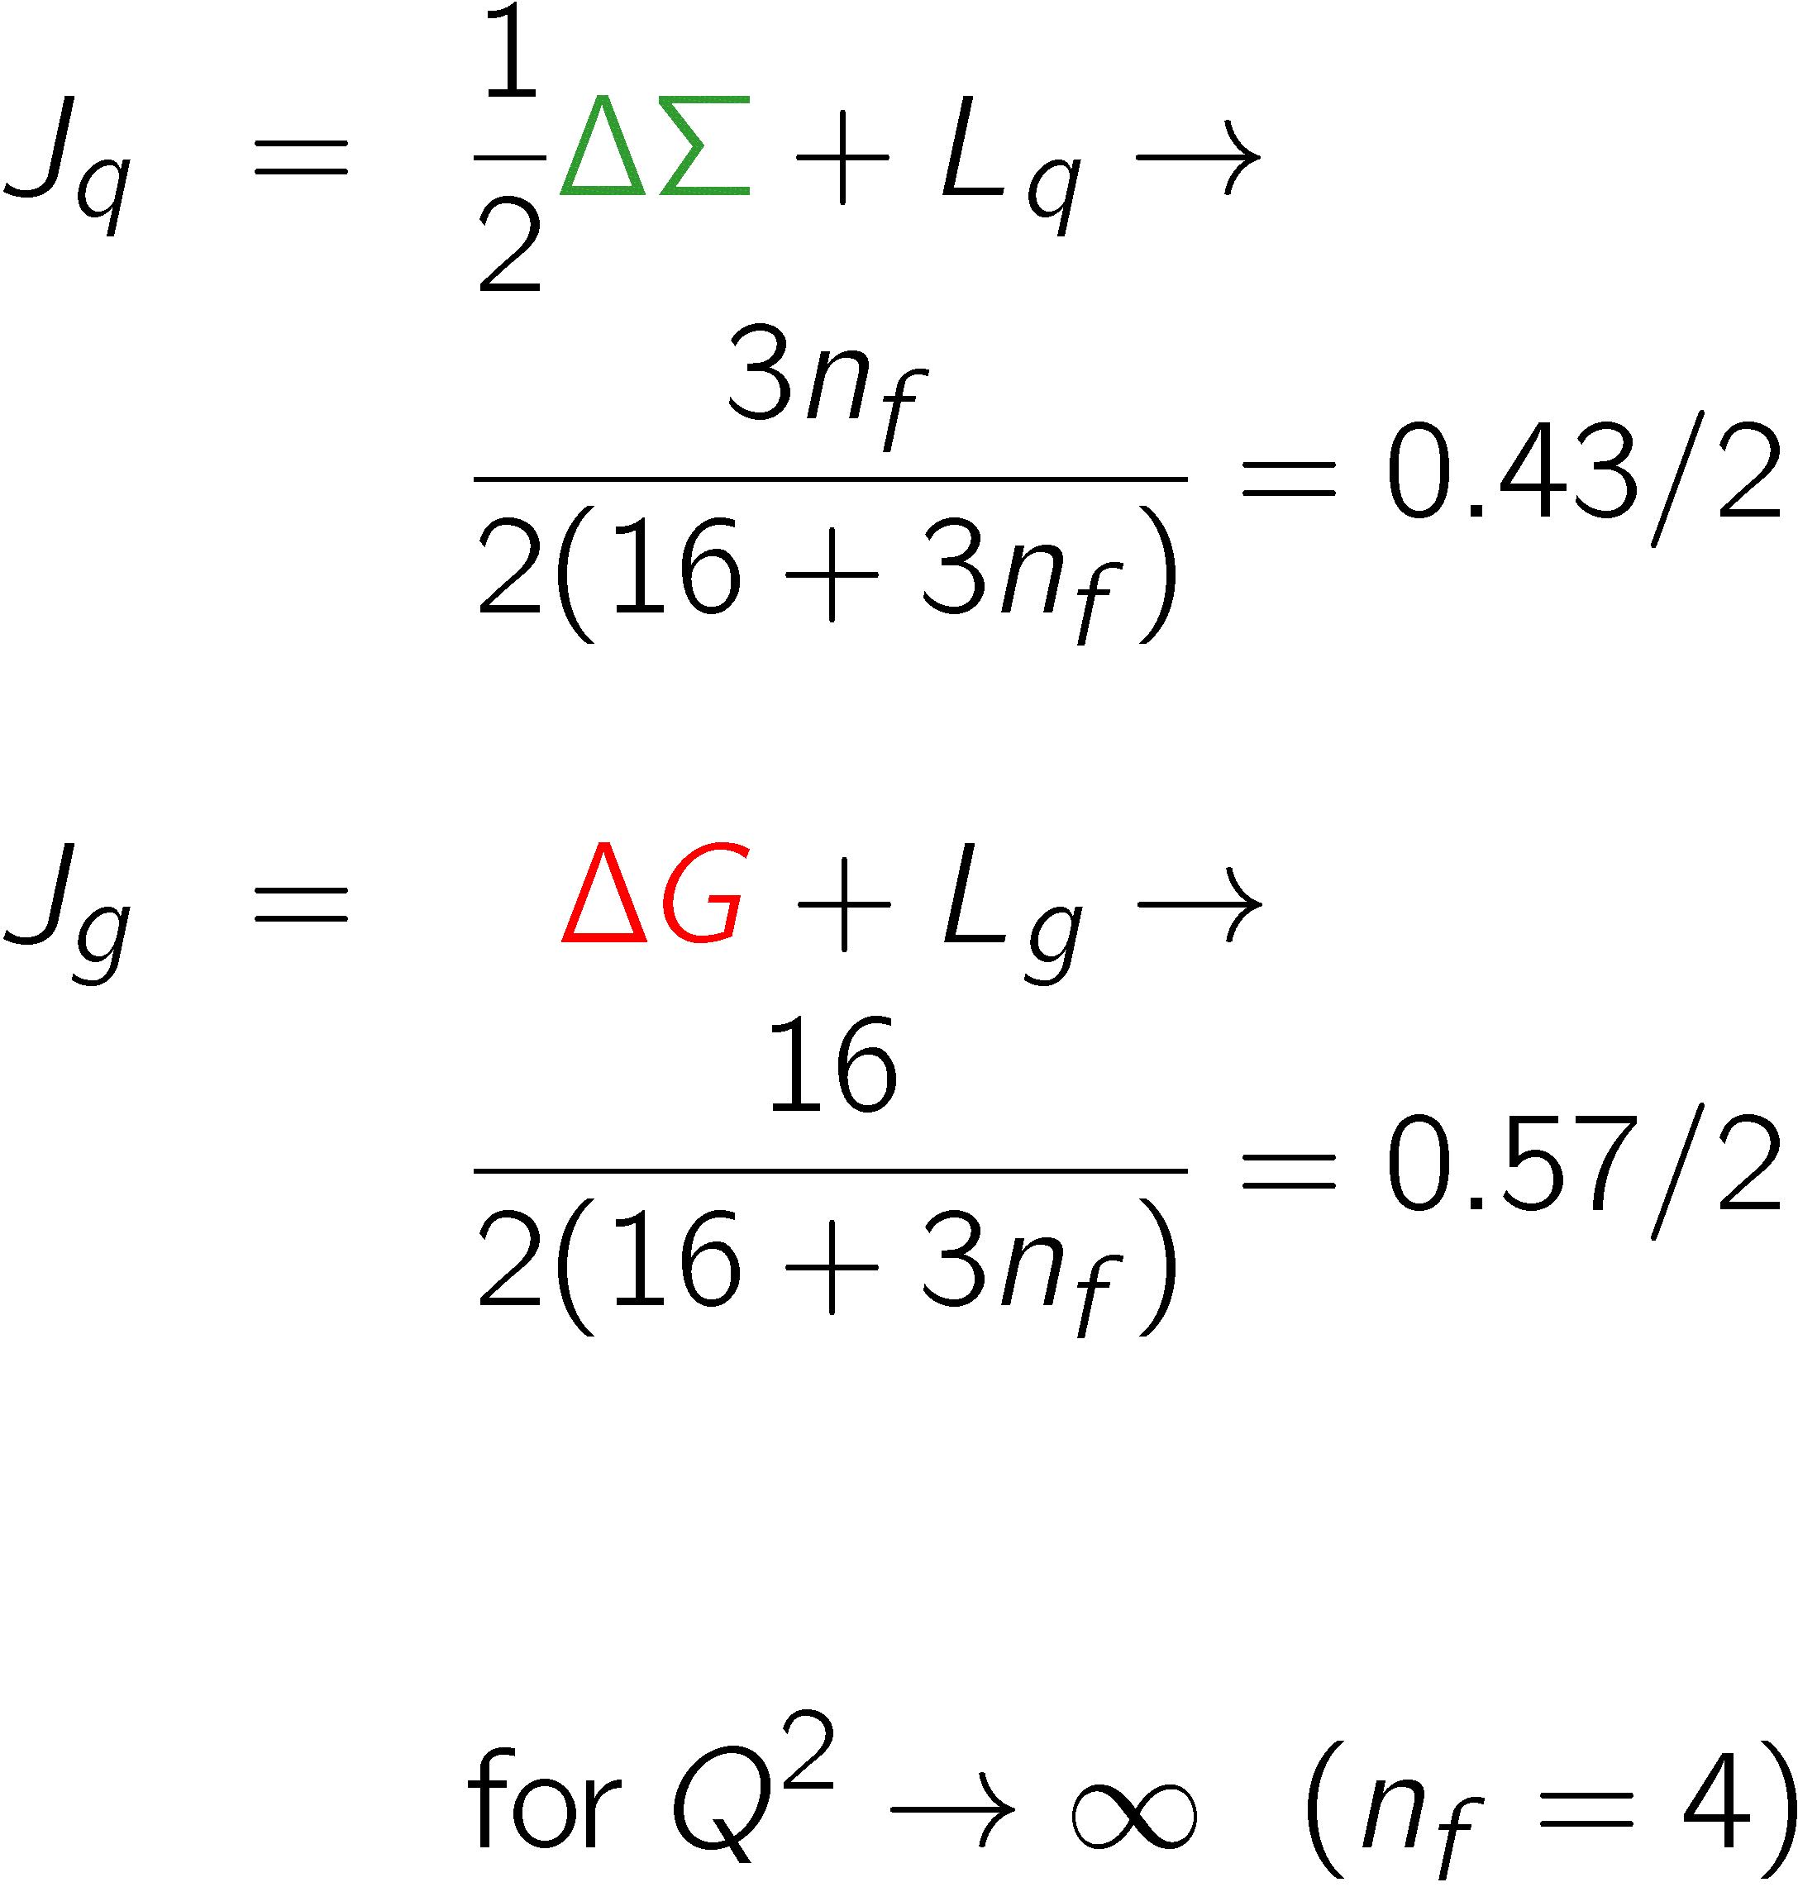



Evolution of first moments (LO)
Ji
Ratcliffe; Ji, Tang, Hoodbhoy; Hägler, Schäfer

Slide 11
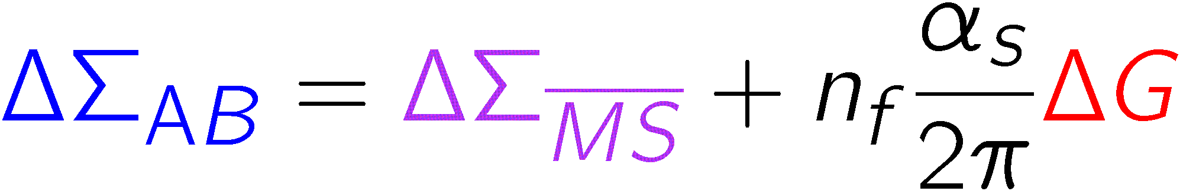
Q ² evolution
non-singlet distributions decouple from gluon evolution,
moments are Q²-independent , e.g. Δu − Δd = g_{a}
evolution of flavour singlet Δq^{s} and gluon are coupled
α_{s} Δ G constant in LO for Q² → ∞, α_{s} → 0 therefore scheme ambiguity large (MS ↔ AB)
(axial anomaly)
in principle Δg can be determined from the Q² evolution of g₁(x,Q²) like g in the unpolarised case (DGLAP fit)!
need reasonable range in Q² at fixed x
we lack a polarised ep collider

Slide 12
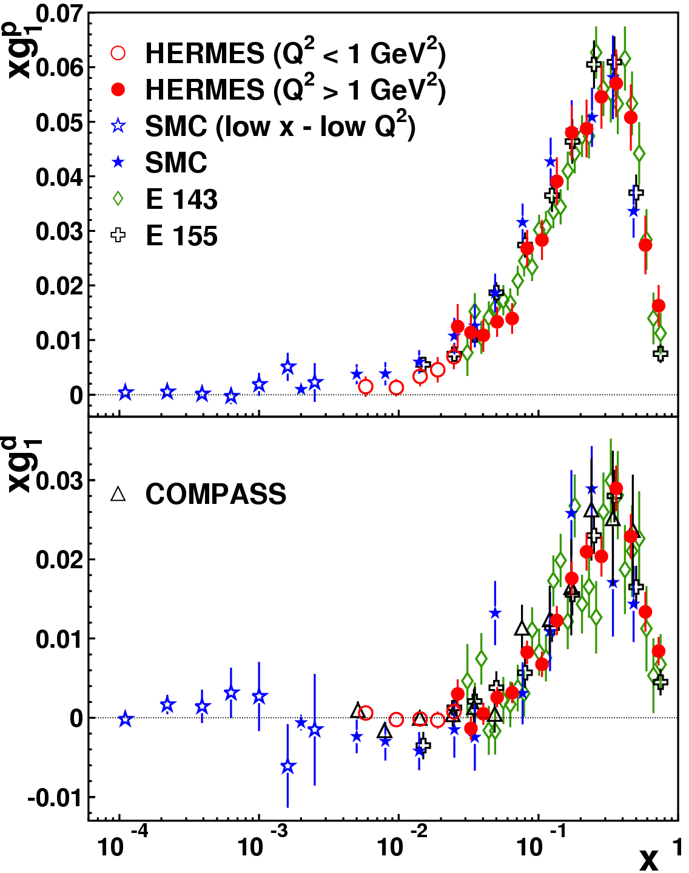
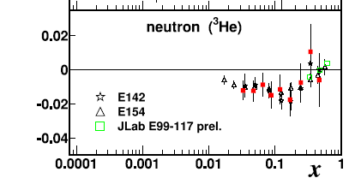
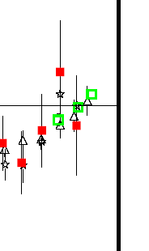
2. Status of g₁
Wealth of data g₁ data for p, n and d
Data taken at different Q²
Only weak Q²-dependence in overlap region
large x neutron data from JLAB for the neutron (³He): g₁^{n} > 0

Slide 13
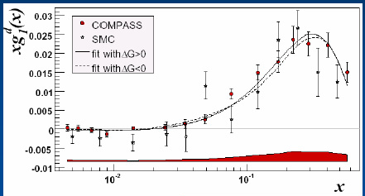
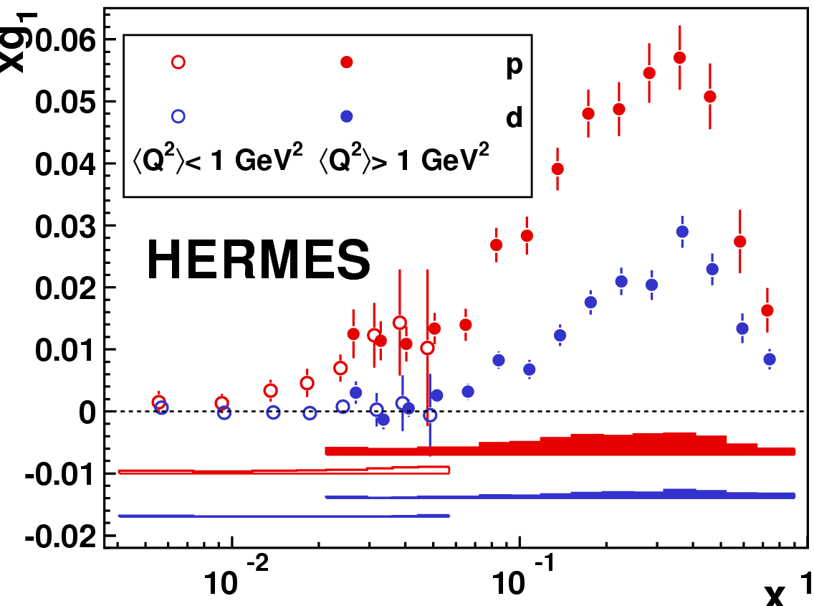
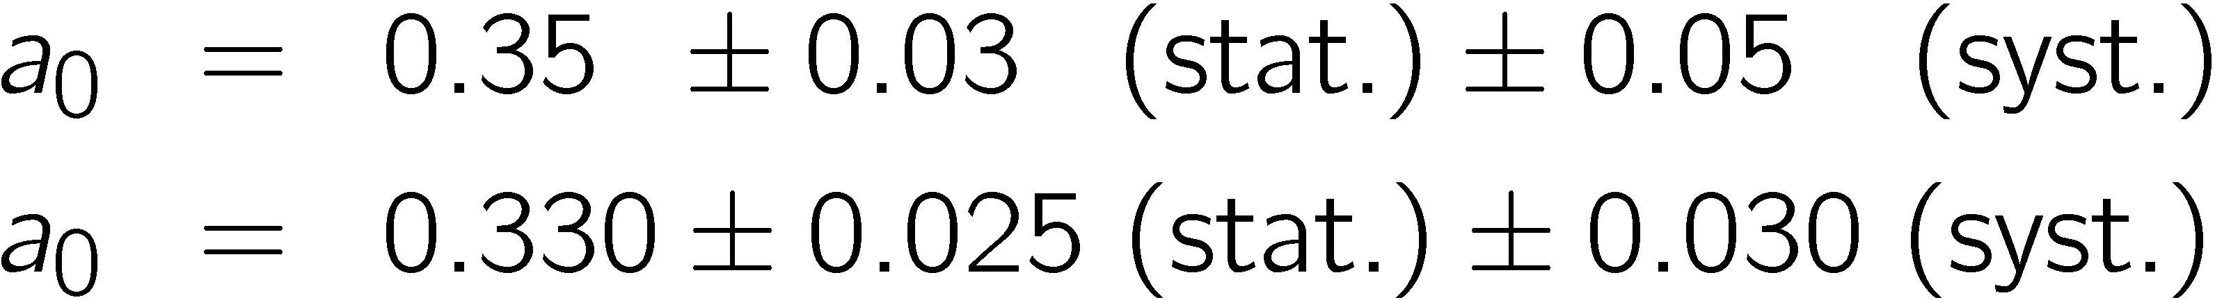

New g₁ data

Slide 14
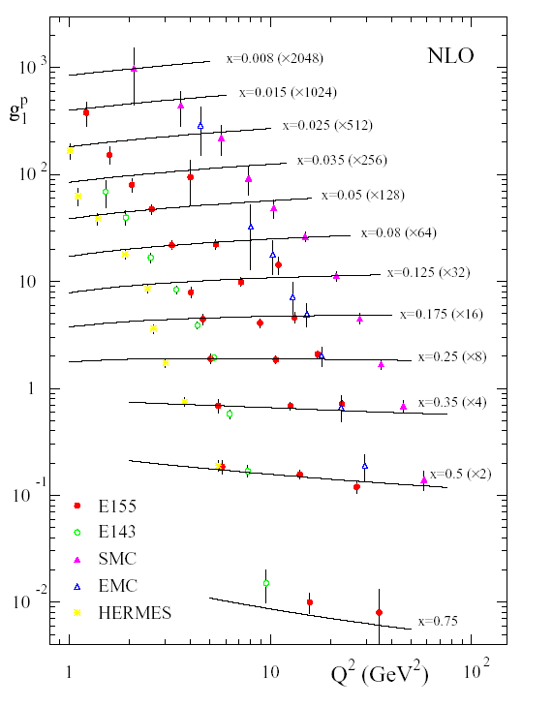
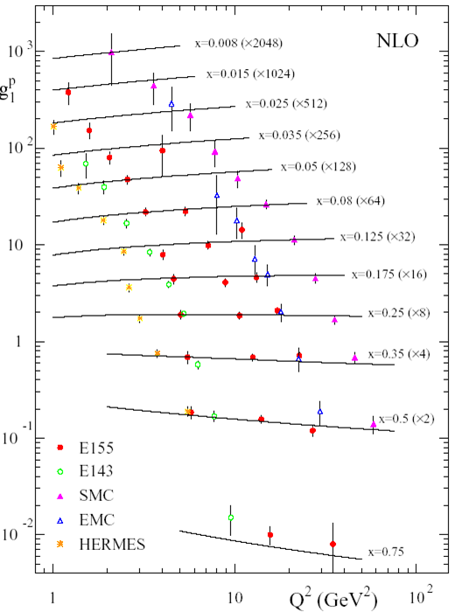
QCD fits to g₁(x,Q²)
Looks quite nice, but...

Slide 15
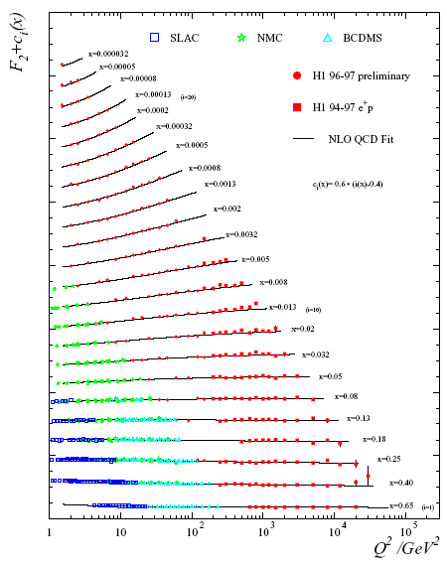
g₁(x,Q²) F₂(x,Q²)

Slide 16
NLO QCD Fits
choose scheme, usually MS
choose start value for evolution, Q²=Q²₀
choose parametrisations for
  Δ q^{s}, Δ q^{ns}, Δg (x,Q²₀)
fit parameters of these parametrisations using the DLGAP equations (NLO)
extra problems in polarised case
  no positivity condition
  no momentum sum rule

Slide 17
NLO QCD fits
Many groups, example AAC 2006
  AAC: Asymmetry analysis collaboration, Japan
  GRSV: Glück, Reya, Stratmann, Vogelsang
  BB: Blümlein, Böttcher
  LSS: Leader, Sidorov, Stamenov
  …
Still large uncertainty
in Δg, even sign not
determined

Slide 18
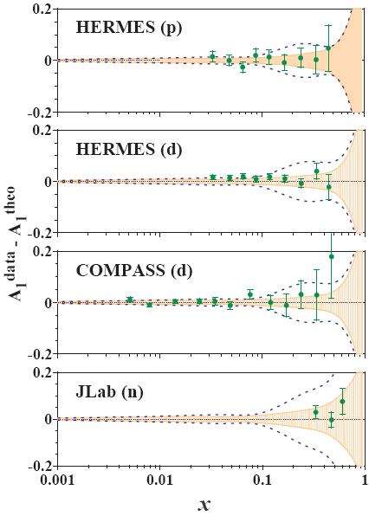
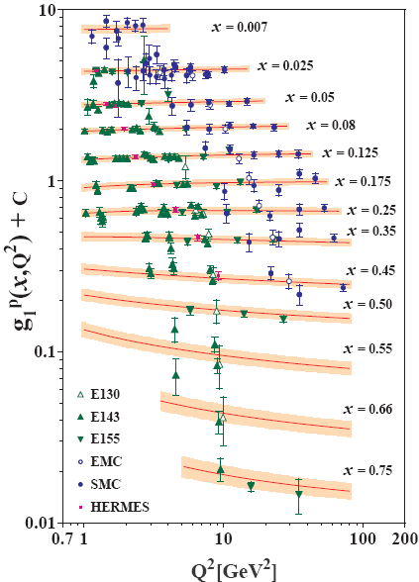
AAC06 analysis

Slide 19
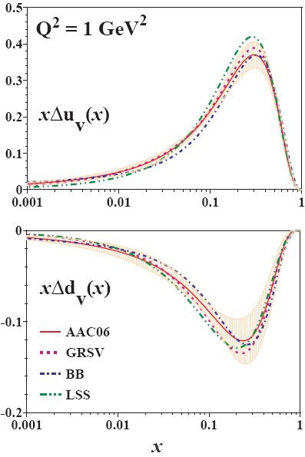
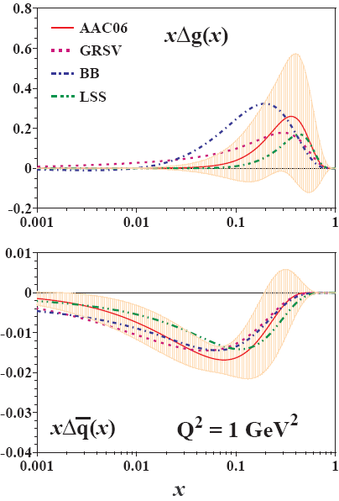
AAC 2006

Slide 20
First moments
 | ΔG | ΔΣ
AAC06 | 0.47 ± 1.08 | 0.25 ± 0.10
GRSV01 | 0.420 | 0.204
LSS | 0.680 | 0.210
BB | 1.026 | 0.138
only DIS
  AAC06 [Phys. Rev. D74 (2006) 014015]
  GRSV01 [ Phys. Rev. D63 (2001) 094005 ]
  LSS01 [ Eur.Phys.J. C23 (2002) 479 ]
  BB02 [ Nucl. Phys. B636 (2002) 225 ]

Slide 21
COMPASS QCD fit
parton distributions
New g₁^{d} data + world data
Δ G > 0 and Δ G < 0
Q² = 3 GeV²

Slide 22

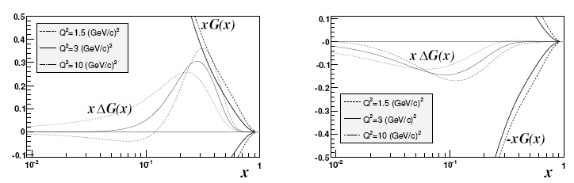
COMPASS QCD fit
two solutions: Δ G > 0 and Δ G < 0
|Δ G|' 0.2–0.3
Δ G > 0
Δ G < 0

Slide 23

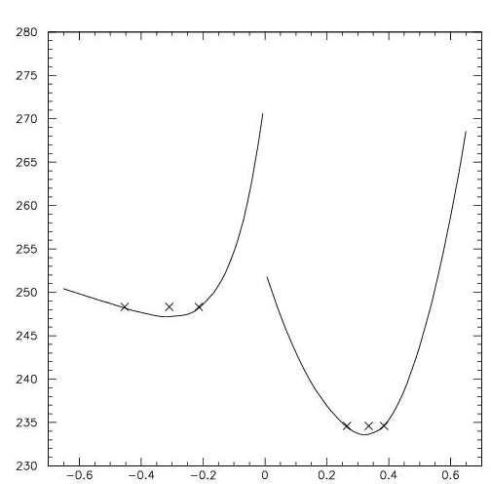
as Function ofΔG
Two distinct solutions
ΔG > 0 preferred
ΔG < 0 preferred by small-x points
ΔG = - 0.309
ΔG = 0.336
Δ G

Slide 24
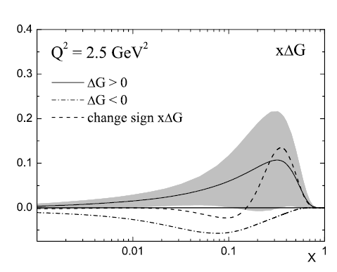
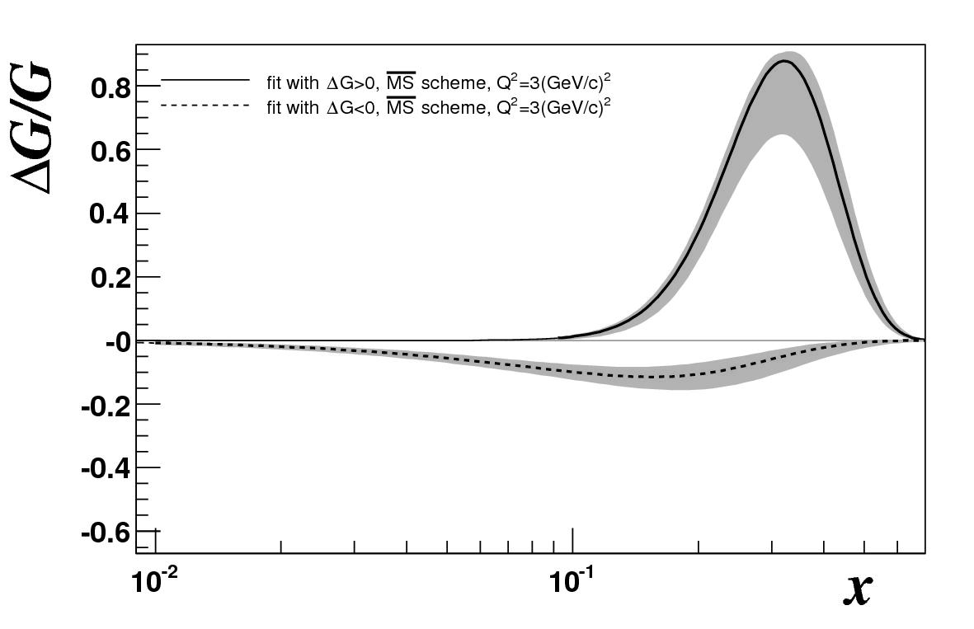
COMPASS QCD fit
COMPASS
LSS 2006
ΔG=0.34
ΔG=−0.34
Not yet included in fits: final Hermes g₁^{d}
Uncertainty due to parametrisation not included

Slide 25
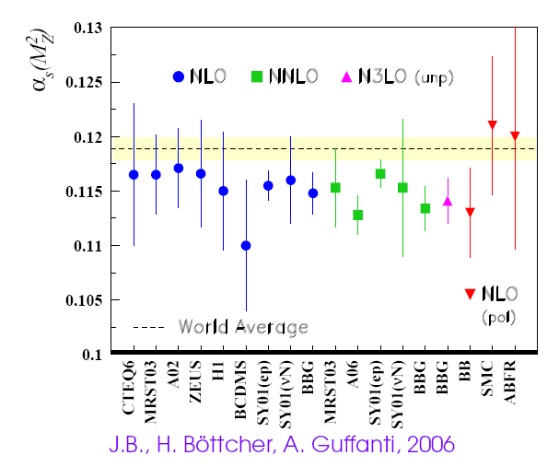
α_{s} from pol. DIS

Slide 26
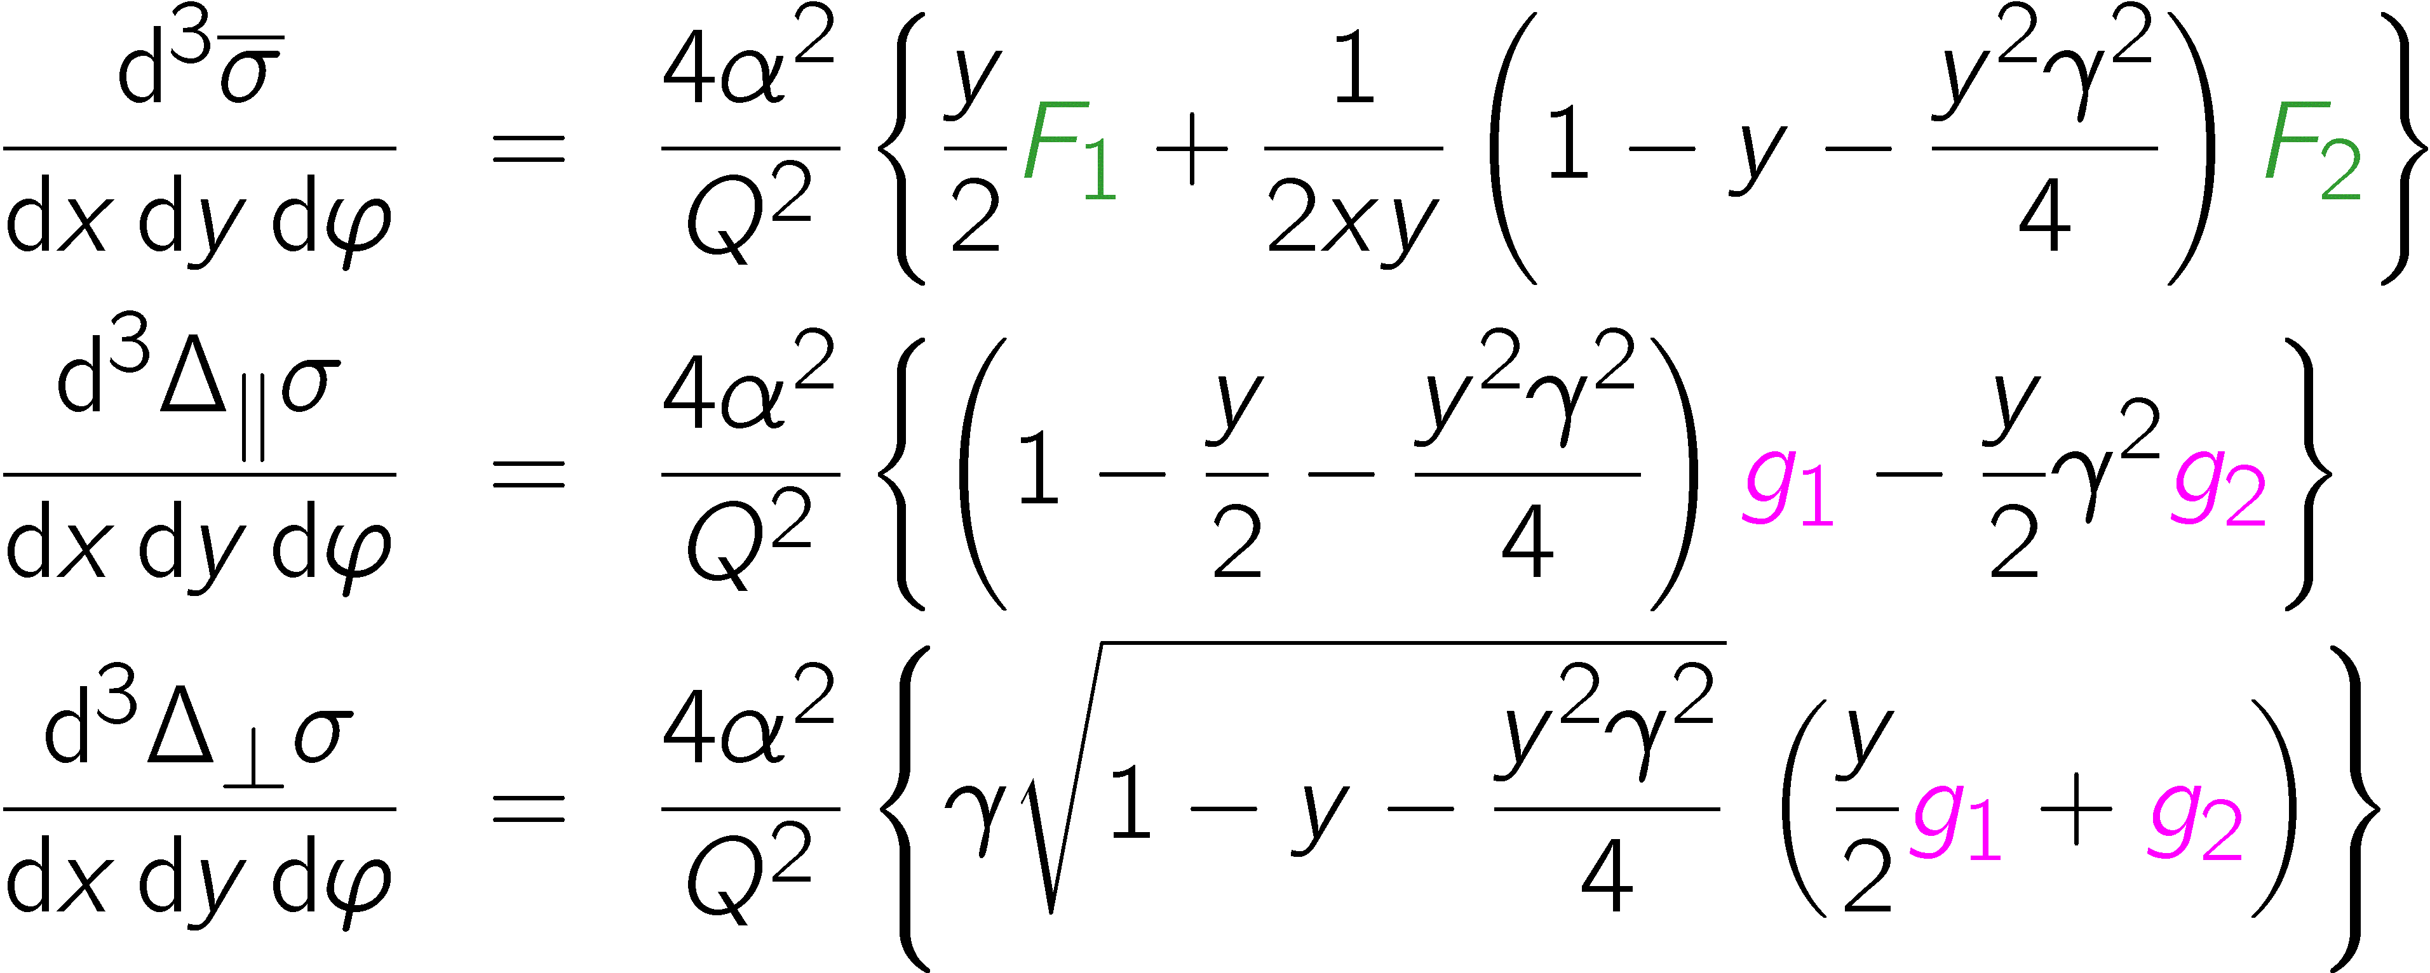
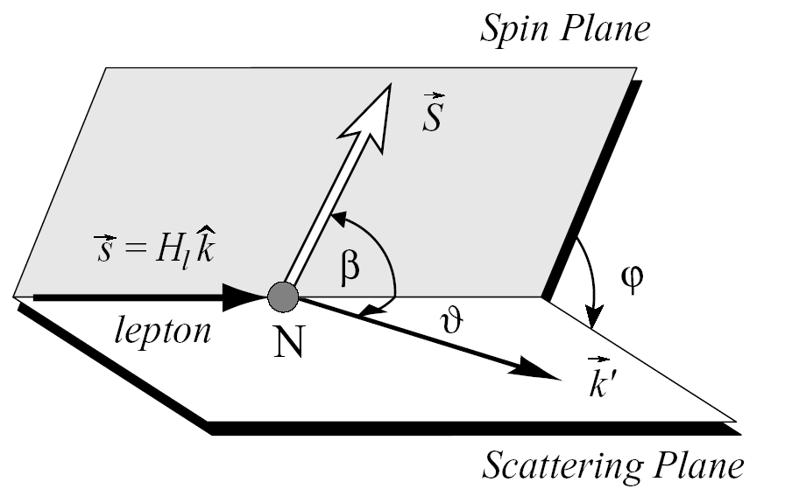
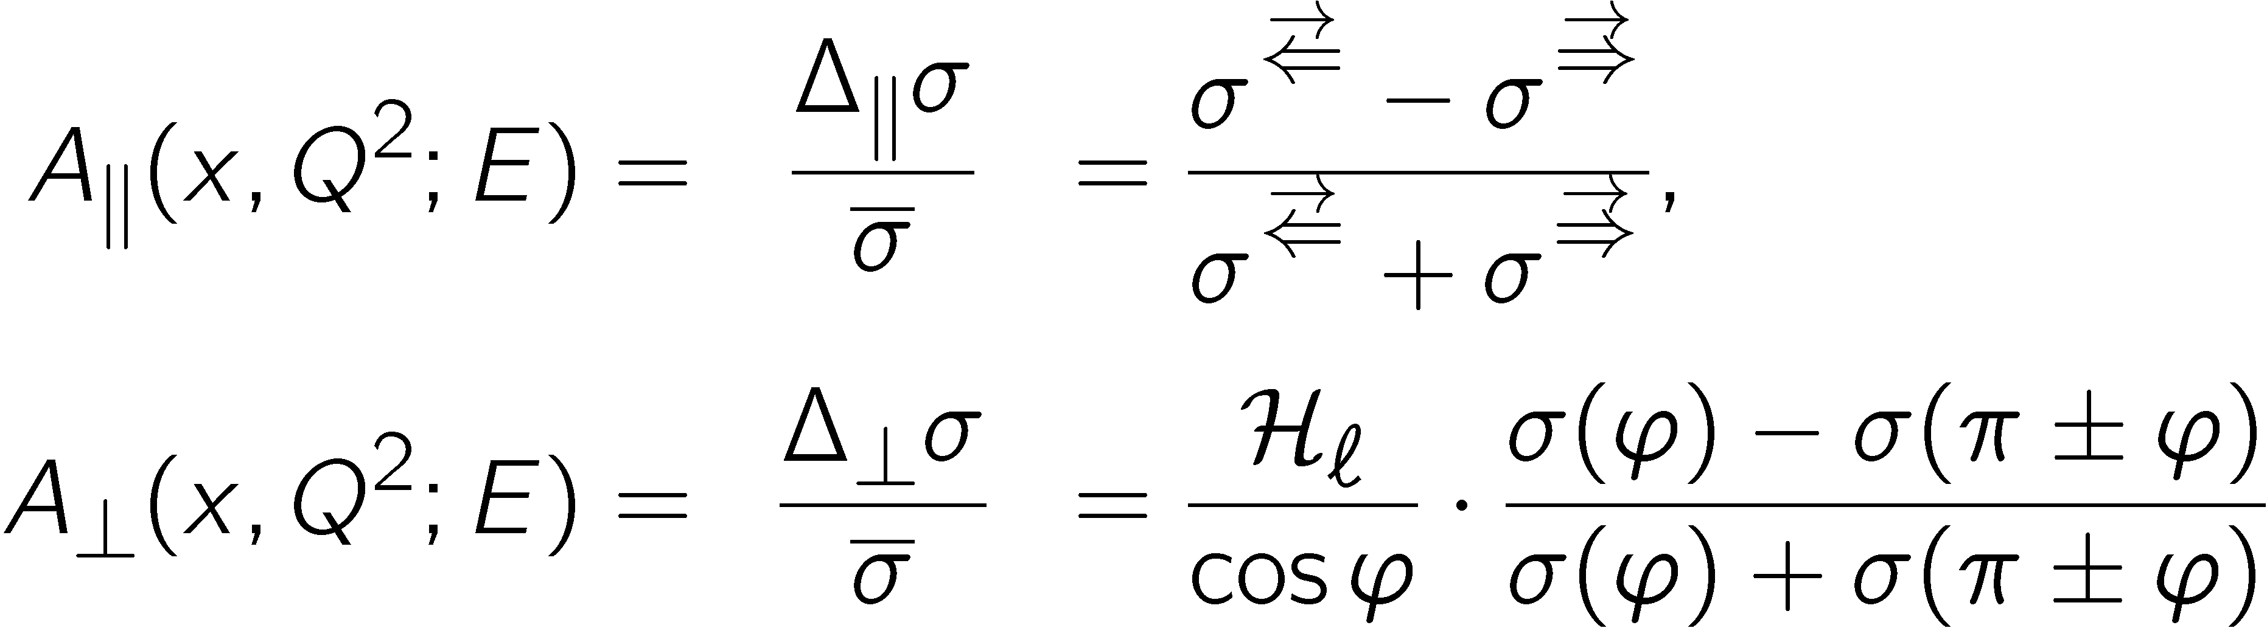
3. Interplay: g₂
unpolarised:
longitudinally polarised nucleon: β=0,π
transversely polarised nucleon: β=±π/2
Measure asymmetries:

Slide 27
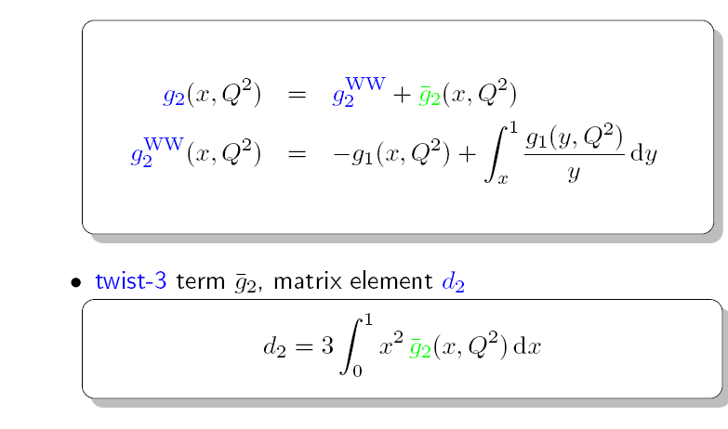
Wandzura-Wilczek
Twist 3 g2 (quark-gluon corr.)
Wandzura-Wilczek :

Slide 28
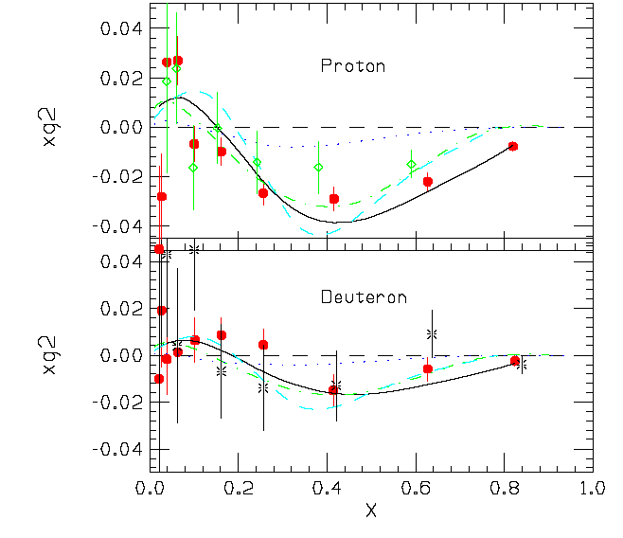
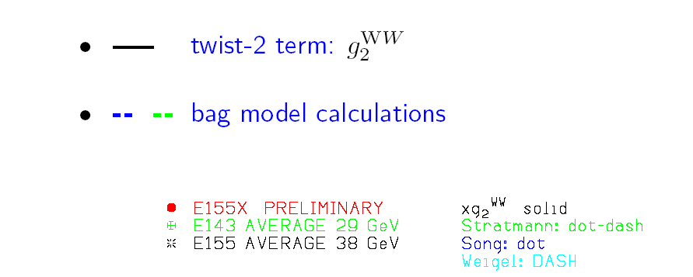
g₂ from SLAC

Slide 29
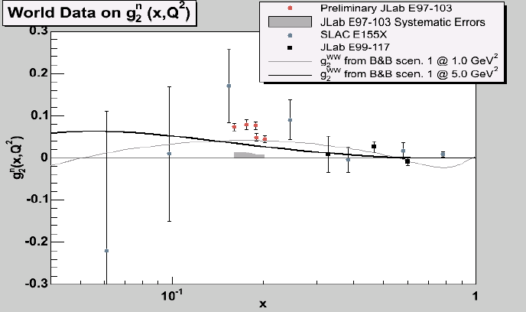
Neutron g₂ from JLAB
maybe first hint of a pure twist-3 effect
K. Kramer DIS 2004

Slide 30
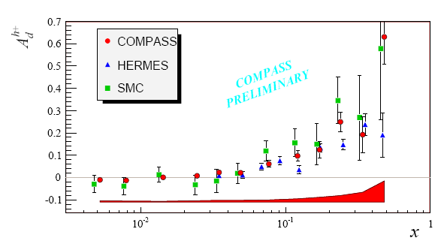
4. Semi-inclusive DIS
additional hadron observed in final state

Slide 31
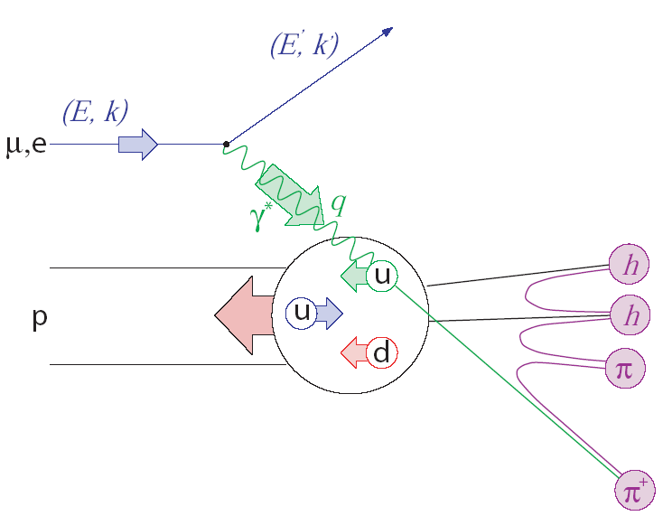
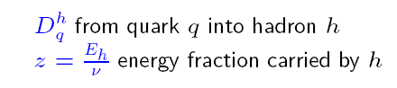
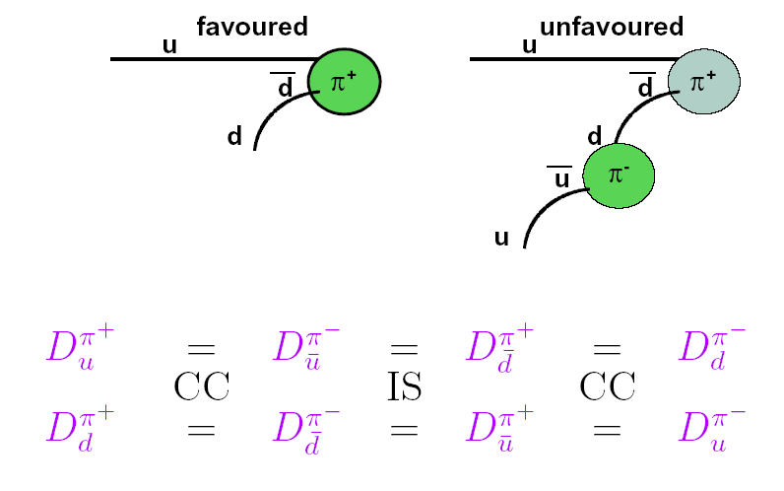

Fragmentation Function
Factorisation!
1
dσ^{h}
σ₀
d z
=

Slide 32
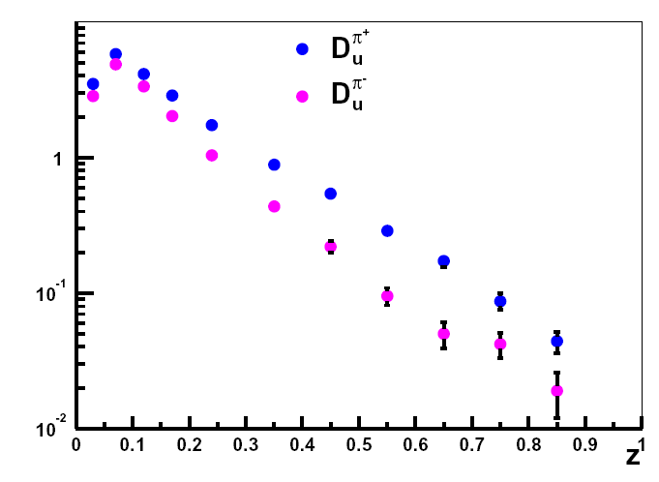
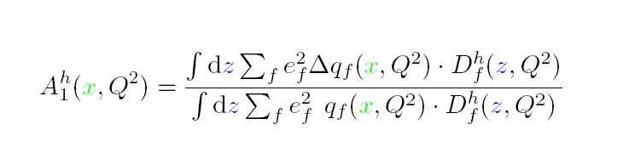
Semi-inclusive DIS
final hadron “remembers”
flavour of initially struck!
poorly known
better: one-particle exclusive

Slide 33





Flavour separated polarisation
Asymmetries can in LO be related
to Δq by
where

Slide 34

Alternative: difference asymmetries
Valence quark polarisation without
fragmentations function

Slide 35


Slide 36



Valence quark polarisation

Slide 37

5. Δ G from high-p_{T} hadron pairs

Slide 38







Photon–gluon fusion (PGF)
Gluon polarisation is measurable in PGF
measure
calculate and
using Monte Carlo

Slide 39
Hadron production
LO analysis of hadron-pair asymmetries:
  open charm: single D meson AROMA, RAPGAP
    cleanest process wrt physics background
  high-p_{T} hadron pairs with Q² > 1 GeV² LEPTO
  high-p_{T} hadron pairs with Q² < 1 GeV² PYTHIA
NLO (photo production)
  open charm Bojak, Stratmann
  single incl. high-p_{T} hadron Jaeger. Stratmann, Vogelsang
  hadron pairs: LO done, Hendlmeier, Stratmann, Schäfer
  NLO underway
All analyses up to now in LO (plus parton showers)

Slide 40

Open charm at COMPASS
Photon-gluon fusion: 1.2 D⁰ per PGF cc event
c
BR 4 %
c
g
or:
D⁰ from D* about 20 %

Slide 41

Kπ separation
kaon identification by RICH
cleaner D* → D π_{s}→ K π π_{s}
additional slow pion π_{s}
no D decay vertex due to multiple
scattering in solid target
define
sharp peak for D* in ΔM _{K π πs}

Slide 42



tagging
Choose:
3.1 < ΔM_{Kππ} < 9.1 MeV

Slide 43

Open Charm: D’s from D*’s
D* → D π_{s}→ K π π_{s} slow pion required
2002–2004
D⁰ → K π π⁰
D⁰ → K π

Slide 44


Analysing power A_{LL}
a_{LL}
a_{LL}

Slide 45

Open charm: MC
analysis uses event a_{LL} weighting for statistical precision
a_{LL} estimated with NN from event kinematics
indispensable due to large variation of a_{LL}
good correlation of 0.82 between generated and reconstructed a_{LL}
a_{LL} generated
a_{LL} reconstructed (NN)

Slide 46

Light hadron production
Ratios for processes for Q² < 1
Resolved photons

Slide 47


Example: k_{T} tuning
nucleon
photon
systematic error:
  determined using 15 independent MC simulations
  exploring the parameter space
    in k_{T} of nucleon and photon
    fragmentation functions
    parton shower on/off,
    renormalisation scale

Slide 48

Resolved photons
More than 50%, however assuming a min and max
scenario, shows little difference.
Probing photon at
large x, where photon
PDF rather well
determined
Δ u/u
Glück, Reya, Sieg

Slide 49


Data versus MC
excellent to good agreement for all kinematics variables
p_{T}

Slide 50


Gluon polarisation
high-pT pairs; Q²>1GeV² :
2002–2003
high-pT pairs; Q²< 1GeV² :
2002–2004
Open charm:

Slide 51

Δ G/G from high-p_{T} pairs
ΔG = 2.5
ΔG = 0.6
ΔG = 0.2
GRSV-max strongy disfavoured

Slide 52

COMPASS QCD fit
Note NLO fits, LO data

Slide 53

New Hermes analysis
Single inclusive hadrons
P. Liebing at spin 2006

Slide 54


Can we learn more about x?
here Lepto and Q2>1
All processes
PGF events (MC)

Slide 55

Splitting in x_{g} bins?
Compass
Splitting of high-p_{T}, Q²<1 data in 3 x_{g} bins under study
Optimizing correlation of rec. and `true’ x_{g} (NN)
More significant with 2006 data

Slide 56
Lecture 3
Experimental status
  RHIC pp data
  transverse asymmetries
Excursion: pion polarisability

