Slide 1

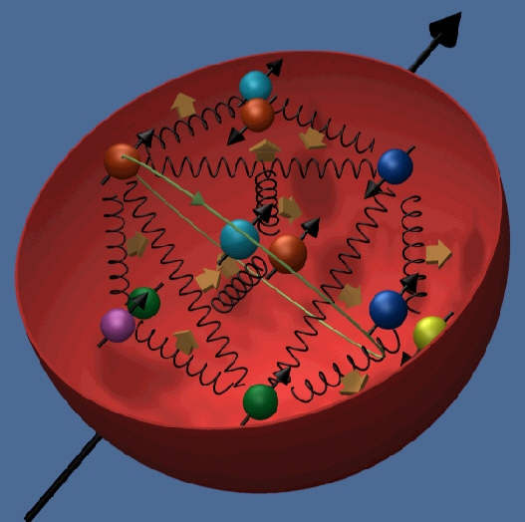


The Nucleon Spin Structure
Gerhard Mallot

Slide 2
Plan
Lecture I
  Introduction
  DIS and structure functions, sum rules
  Why contribute the quark spin so little?
  Principle of measurements, experiments

Slide 3
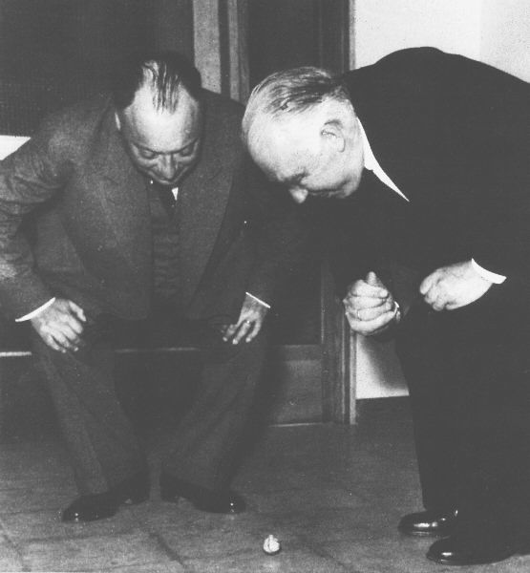
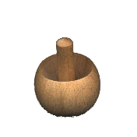
Spin Experiments are Puzzling
Wolfgang Pauli and Niels Bohr, 1954
wondering about a tippe top toy
A theory of the nucleon needs to describe the dynamics of quarks and gluons including spin.
Imagine the theory of the atom without spin!

Slide 4
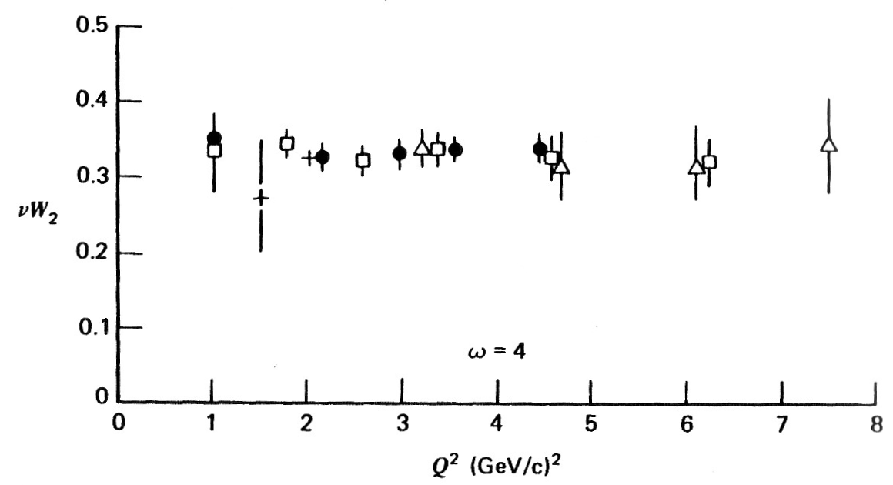
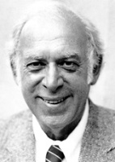
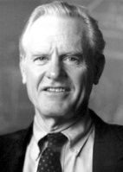
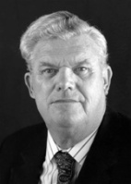
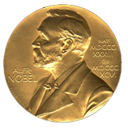
1. Introduction
electron scattering at SLAC in the late 1960ies revealed point-like partons in the nucleon → quarks
structure function is Q² independent (scaling)
Friedman, Kendall, Taylor
1990

Slide 5
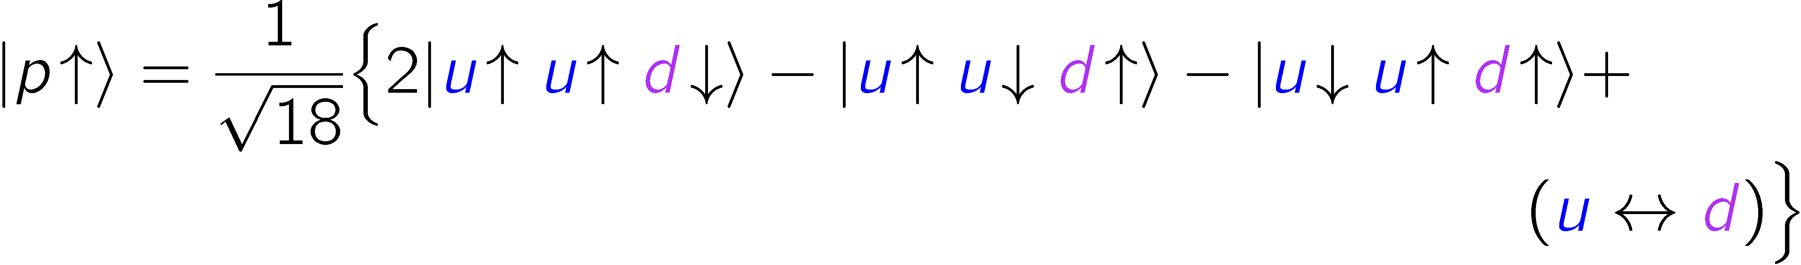
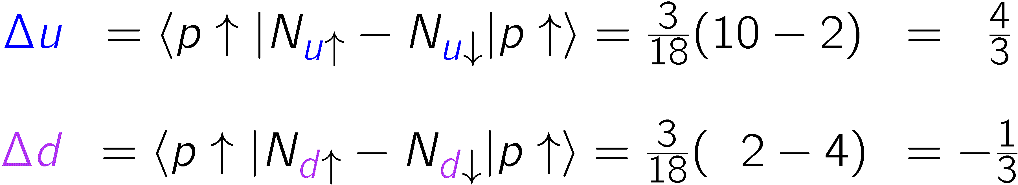
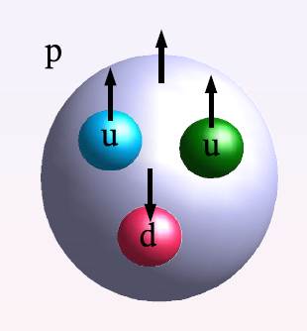
Quark model wave function
→ up and down quarks carry the nucleon spin!

Slide 6
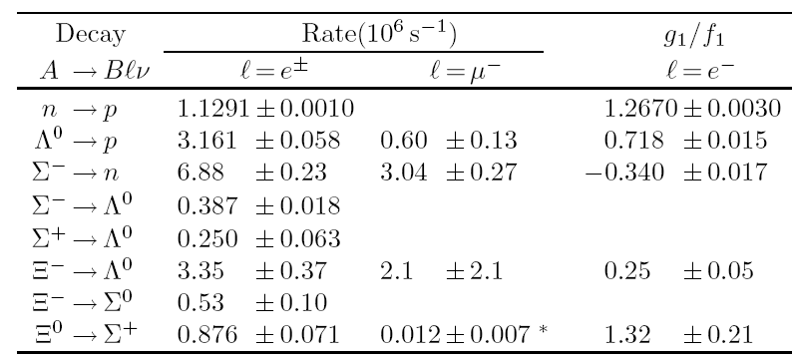
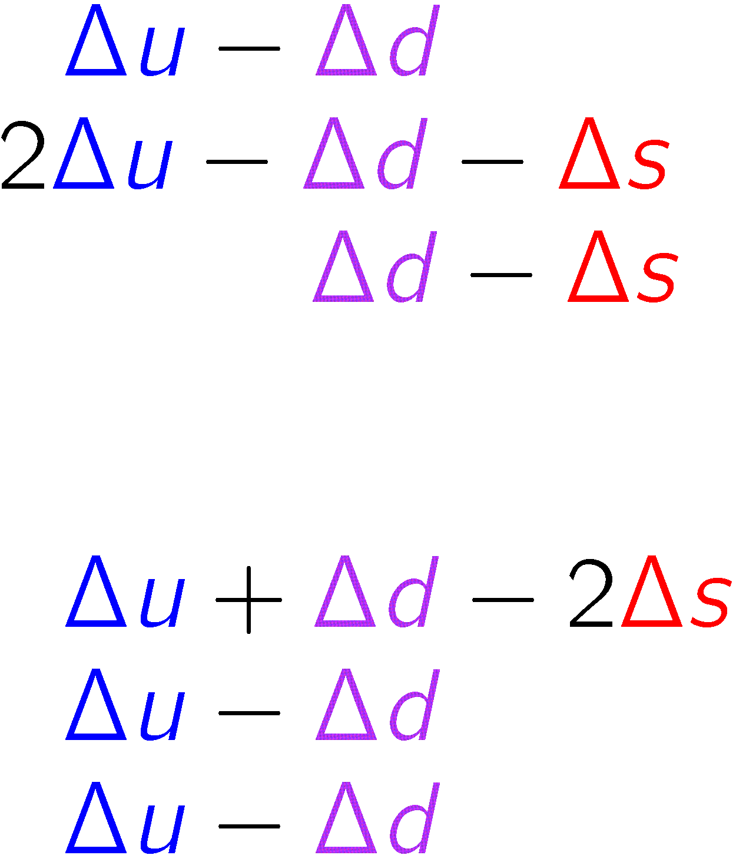
Weak baryon decays
weak decay constants are linked to quark polarisations via the axial vector currents matrix elements
SU(3) flavour symmetry assumed
P. Ratcliffe, Czech. J. Phys. 54 (2004)

Slide 7

From weak baryon decays
Fit to decay data:
assuming
→ up and down quarks carry 58% of the nucleon spin!
deviation from 100% due to relativistic motion

Slide 8
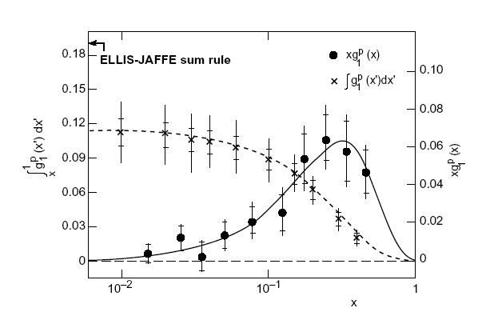
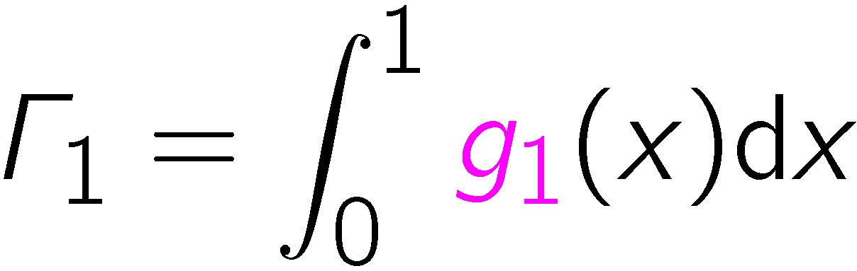

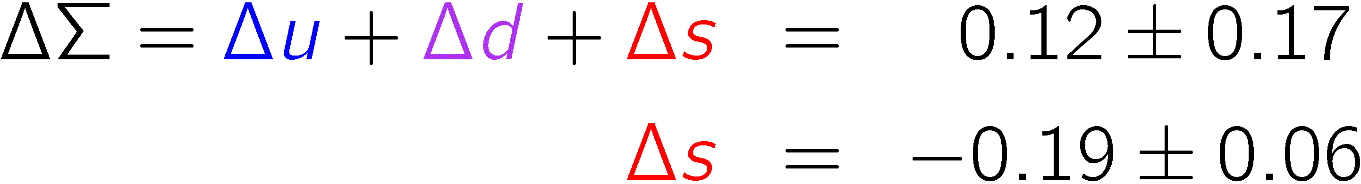
Spin puzzle: EMC 1987
20th anniversary
→ quark spin contribution to nucleon spin is consistent
with zero! Strange quark polarisation negative.

Slide 9
2. DIS and structure functions
What did the EMC actually measure?
How severe is the spin puzzle?
Can the Quark Model expectation
ΔΣ = 0.6
be restored?

Slide 10
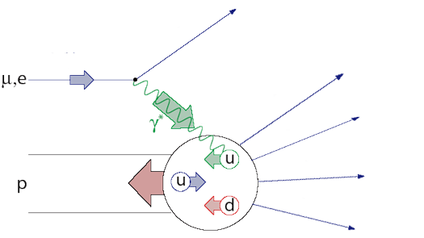
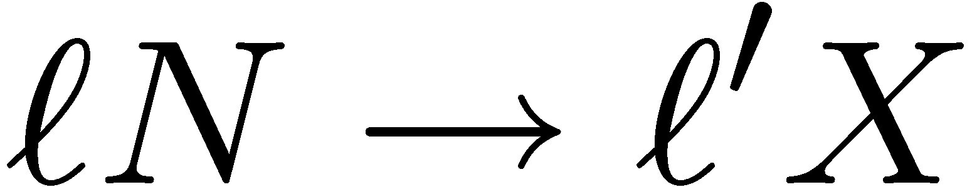
Deep inelastic scattering
probing partons
  inclusive lepton − nucleon scattering
  large momentum and energy transfer Q ² and ν
  finite ratio Q ² / ν
  large c.m. energy of the hadronic final state W > 2 GeV

Slide 11
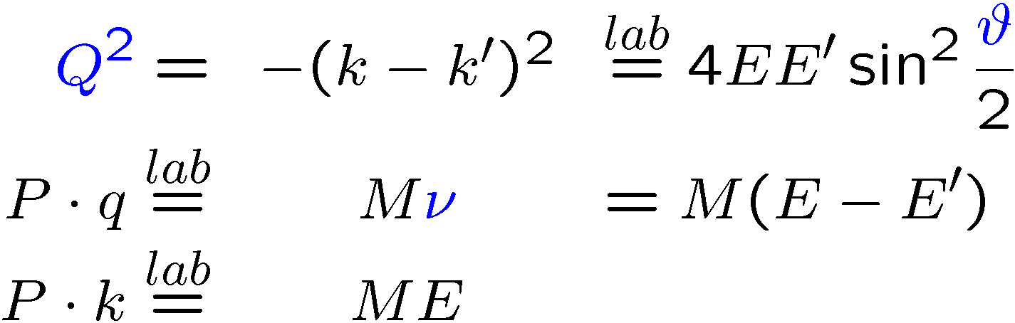
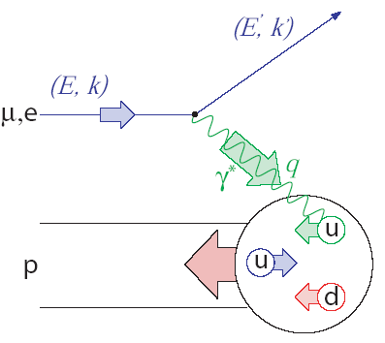
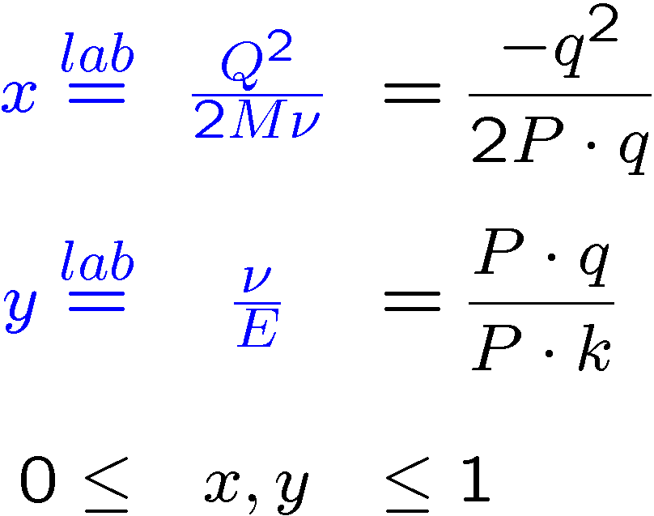
Deep Inelastic Scattering
Bjorken-x: fraction of longitudinal momentum carried by the struck quark in infinite- momentum frame (Breit)

Slide 12
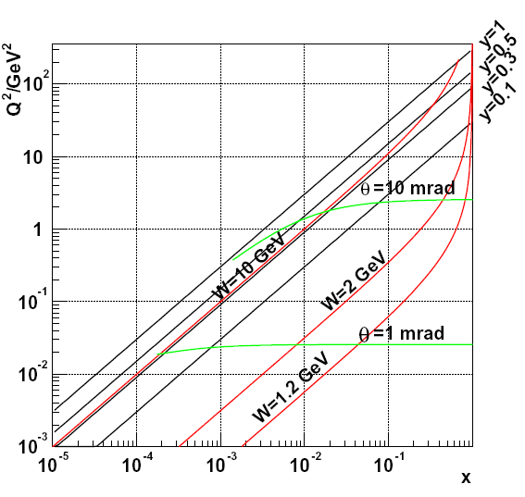
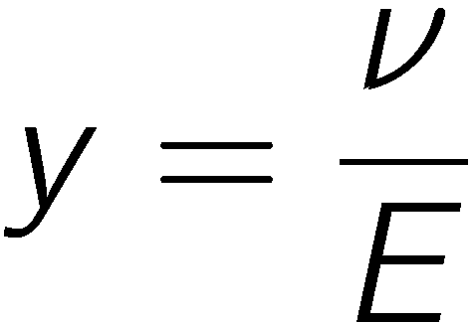
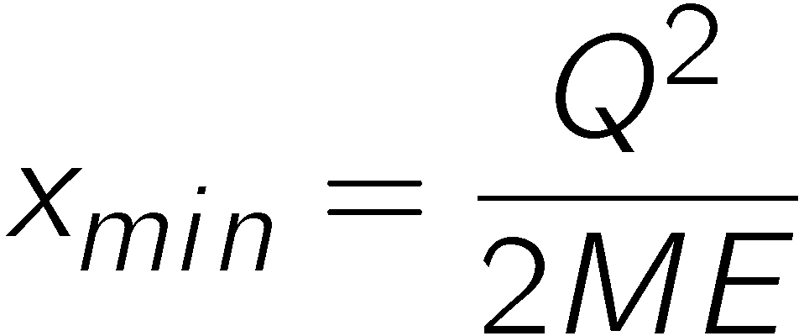
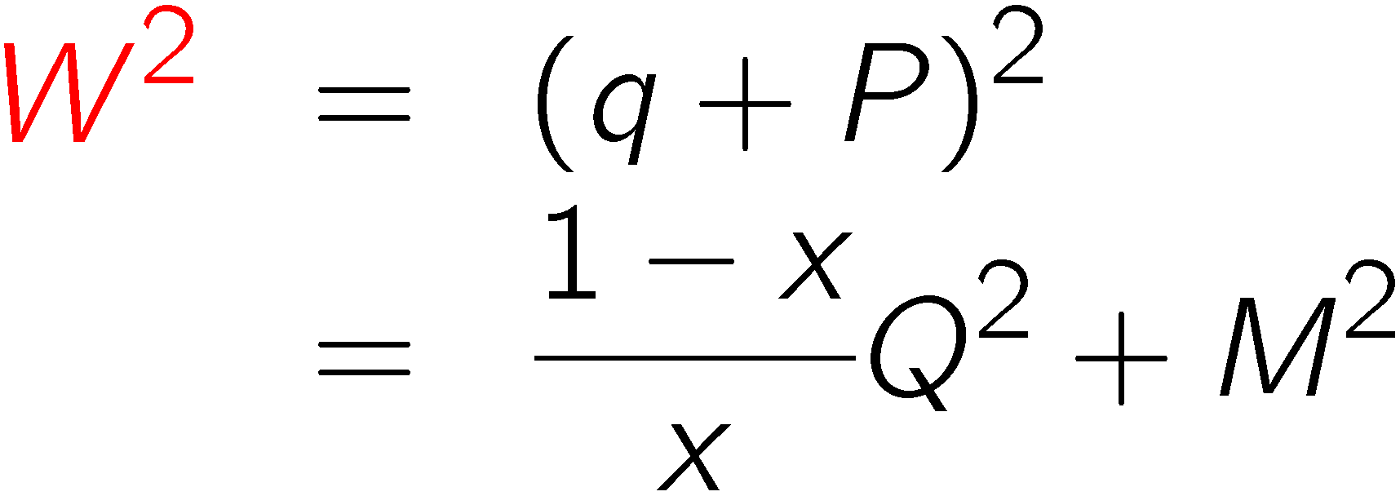
Kinematics
160 GeV μ
beam energy
c.m. energy of hadronic
final state, W:
DIS: Q ², W ² ! 1, x fix

Slide 13
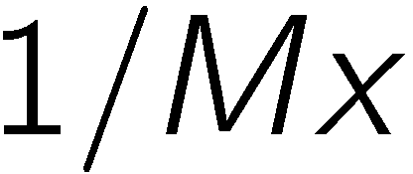
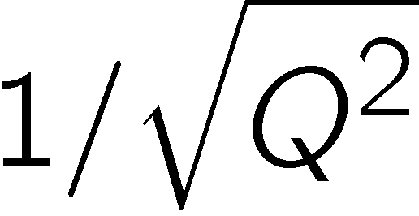
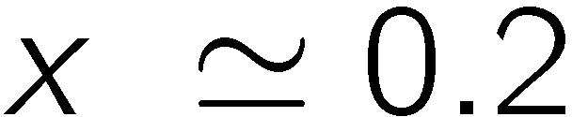
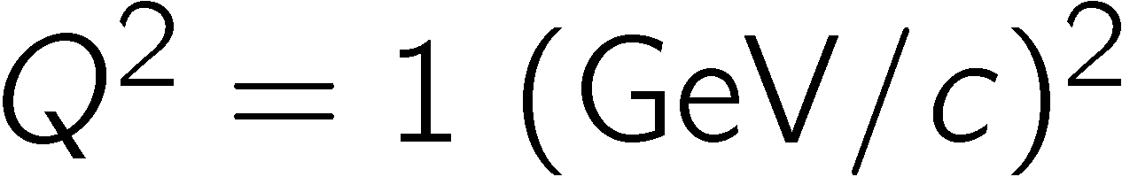
Distance scales
longitudial
transverse
for the longitudinal scale is 1 fm
for the transverse scale is 0.2 fm

Slide 14
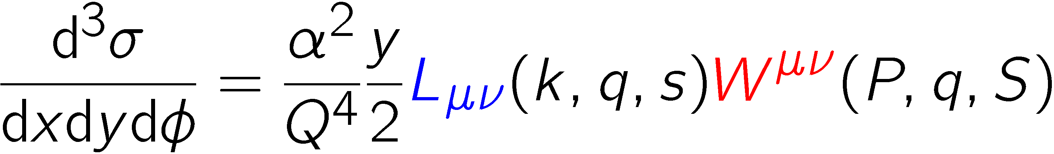
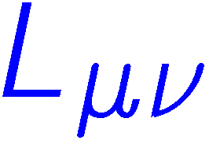

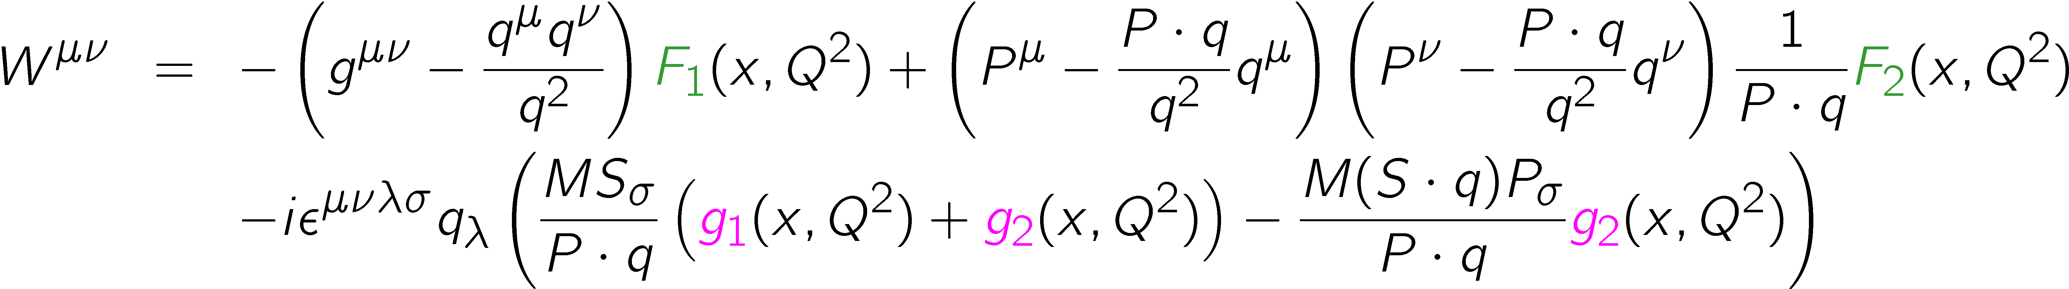
DIS cross section
lepton
spin
nucleon
cross section:
leptonic tensor : kinematics (QED)
hadronic tensor : nucleon structure
factorise

Slide 15
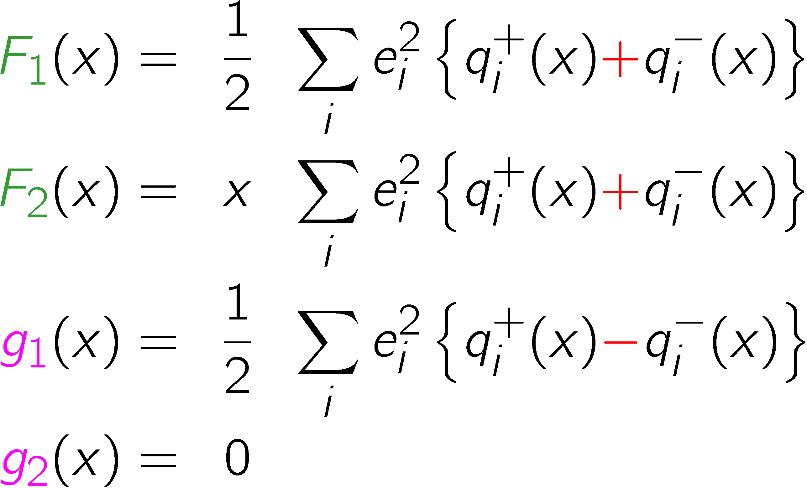
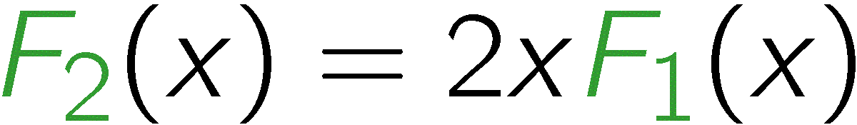
Quark−Parton Model
in the QPM: for massless spin-½ partons
unpolarised SF,
momentum distributions
polarised SF,
spin distributions
no Q² dependence (scaling)
Calan−Gross relation
g₂ twist-3 quark−gluon correlations

Slide 16
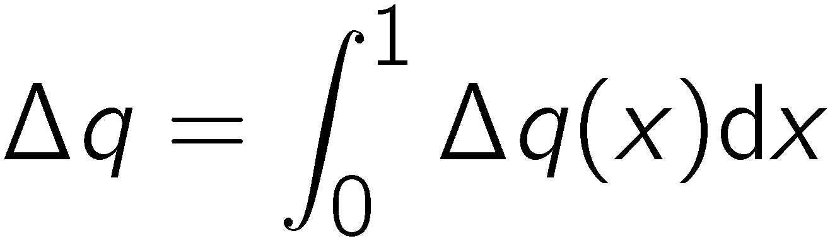
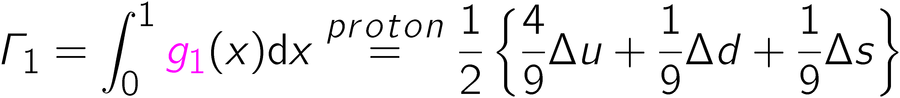
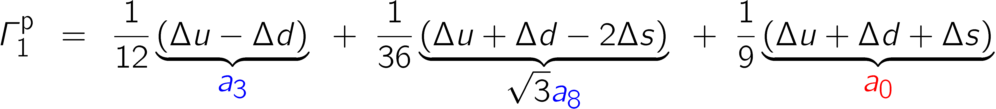
Sum rules for g₁
first moment Γ₁ of g₁ with
Neutron decay
a₃ = g_{a}
Hyperon decay
(3F-D)/3
∆Σ
From Γ₁, a₃ and a₈ we obtain ∆Σ without assuming ∆s = 0

Slide 17
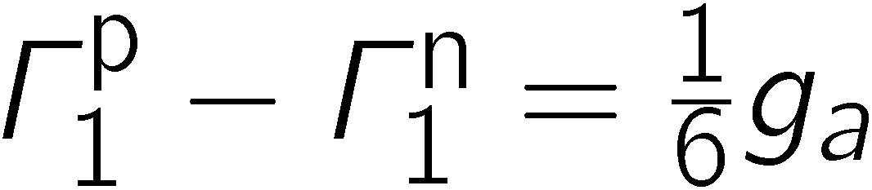
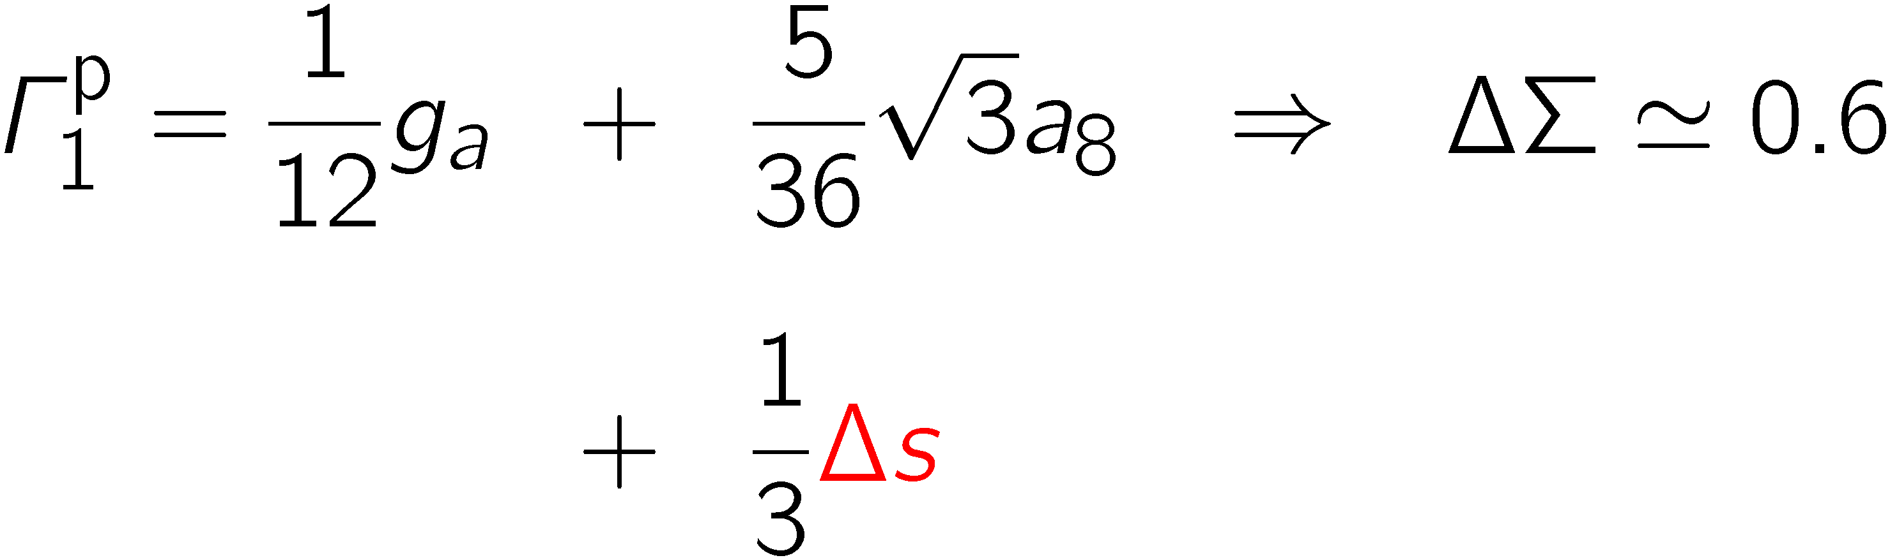
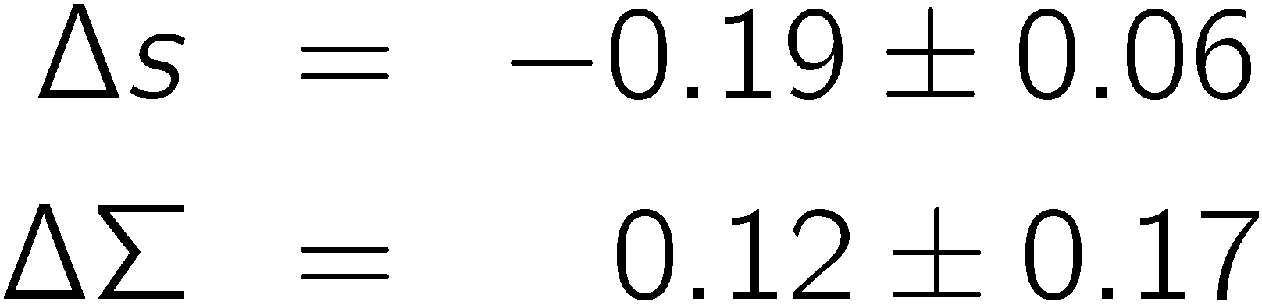
Sum Rules
Bjorken
sum rule
if wrong ⇒ QCD wrong,
“worthless equation”, needs neutron measurement
PR 148 (1966) 1467
Ellis-Jaffe
sum rule
PR D9 (1974) 1444
formulated for ∆s=0,
unpolarised strange quarks
Consequences of violation:
EMC 1987

Slide 18
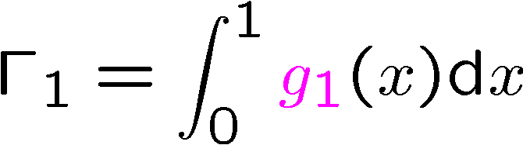
The First Moment of g₁
first moment of g₁
“Spin crisis”
EMC 1987

Slide 19
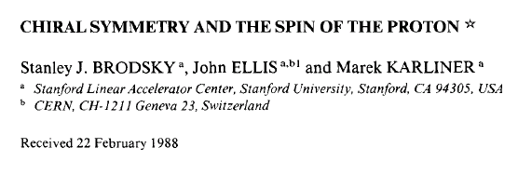
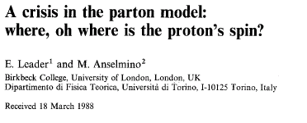
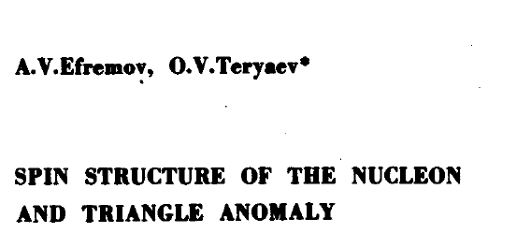
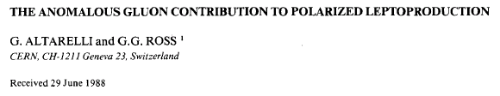
3. Why is ΔΣ so small
(1988)
PLB 206 (1988) 309
ZPC 41 (1988) 239
PLB 212 (1988) 391

Slide 20
Considered Options
Skyrmions: model,
all orbital angl. mom. ( BEK) maybe
Bjorken sum rule broken?
Measurement wrong? (LA) no!
Large ΔG ~ 2-3-6 at EMC Q² could mask measure
quark spin via axial anomaly (ET, AR) gluon!
requires fine tuning of cancelation of ΔG and orbital angular momentum (orb. ang. mom. is generated at gluon emision)

Slide 21
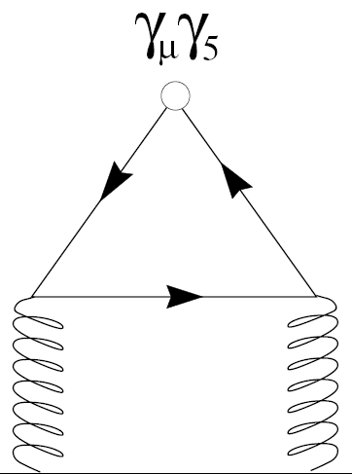
Axial anomaly contribution
The contribution of the quark spins ∆Σ is NOT an observable. The observable is a₀ , the flavour-singlet axial vector ME.
The singlet axial vector current is not conserved and receives a
gluon contribution via the axial anomaly ( à la π⁰ → 2γ). The contribution vanishes for the triplet and octet currents.
A conserved current can be constructed in
next-to-leading order QCD by subtracting
the anomalous gluon contribution, however ,
not in a gauge invariant way.
The corresponding ME is then independent of Q².

Slide 22

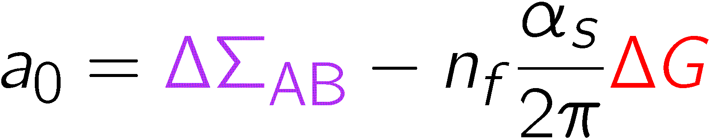

Axial anomaly (continued)
in the MS renormalisation scheme
in the so-called Alder−Bardeen and the jet scheme:
thus a large gluon polarisation could mask the quark spin contribution to the nucleon spin and the parton model value of 0.6 could be restored by

Slide 23
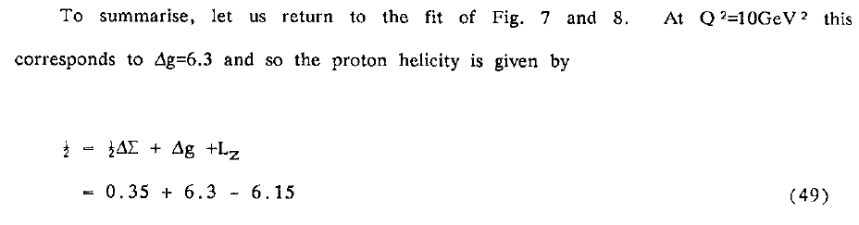
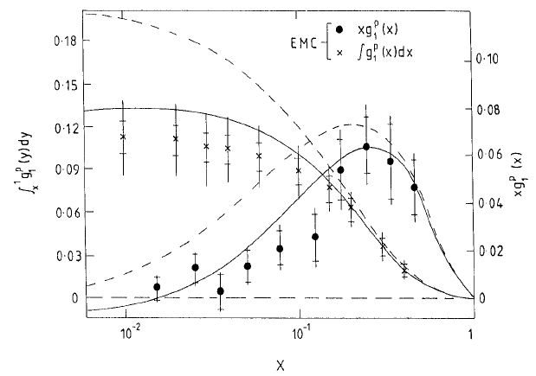
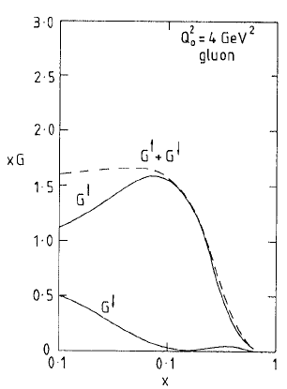
Lepton-Photon 1989
R.G. Ross 1989
Need ∆G ≈ 6 at
Q² = 10 GeV²
for ∆Σ = 0.7,
to be compared to ½
=> measure ∆G

Slide 24




∆G and ∆Σ in AB/jet scheme
α_{s} strong coupling constant
Now:
Need:

Slide 25







Spin sum rule
naive QPM: only valence quarks
QCD: sea quarks and gluons
gluons carry 50% of momentum!
orbital angular momentum:

Slide 26

Where is the proton spin?
small
poorly known
certainly not 6
unknown

Slide 27


Riddle
What is similar and what is different between the following two sets?:
The first set consists of a farmer, his pig and the truffles:
The second set consists of the theorist, the experimentalist and
the big discoveries
A. De Rújula
not an experimentalist!

Slide 28
Answer
The farmer takes his pig to the woods. The pig snifs around looking for a truffle. When the pig gets it and is about to eat it, the farmer kicks the pig on the head with his club and steals the truffle. Those are the similarities…
The difference is that the farmer always takes the pig to woods where there are truffles, while more often than not, the suggestions by the theorists take the experimentalists to "woods'' where there are no “truffles”…
… often while looking for the theorists' “truffles” the experimentalists find “gold”…
http://public.web.cern.ch/Public/Content/Chapters/AboutCERN/WhoWorksThere/ThinkersMakers/Theorists/Theorists-en.html

Slide 29


4. Principle of measurements
(flavours ignored)
Photoabsorption:
only quarks with opposite helicity can
absorb the polarised photon via spin-flip
# quarks in direction
of nucleon
need polarised photons & nucleons
J_{z:}
3/2
1/2

Slide 30



Cross Section Asymmetries
unpolarised:
longitudinally polarised nucleon: β=0,π
transversely polarised nucleon: β=±π/2
Measure asymmetries:

Slide 31
Experimental essentials
up to now only fixed-target pol. DIS experiments
need polarised targets and beams
need detection of scattered lepton, energy, direction, identification
need to know energy and direction of incoming lepton
  detection or given by machine
  measurable asymmetries very small
  need excellent control of fake asymmetries, e.g. time variations of detector efficiency

Slide 32

Experiment essentials
Beams & targets:
target beam pol
SLAC 48 GeV, solid/gas e, pol. source 0.01
DESY 28 GeV, gas internal e, Sokolov-Ternov 0.02
CERN 200 GeV, solid μ, pion decay 0.0025
( RHIC 100 – 100 GeV pp collider )
fake asymmetries:
rapid variation of beam polarisation (SLAC)
rapid variation of target polarisation (HERMES)
simultaneous measurement of two oppositely polarised targets (CERN)
bunch trains of different polarisation (RHIC)

Slide 33


Measurable asymmetries
P_{b}, P_{t} beam and target polarisations,
f target dilution factor = polarisable N/total N
note: linear in error: f=1/2 => requires 4 times statistics
huge rise of F₂ / 2x at small x
D depolarisation factor, kinematics, polarisation transfer from
polarised lepton to photon, D ≈ y
Even big g₁ at small x means small asymmetries

Slide 34

Pol. DIS experiments
Spin Crisis
/D
running

Slide 35




SLAC E155 Spectrometer
beam

Slide 36

E155 Target
cryogenic target
⁶LiD, NH₃
1K evaporator fridge
5 T magnetic field
beam

Slide 37


HERMES

Slide 38



HERMES
Target cell
Gas to polarisation measurement
Gas inlet
beam
100 mm
beam polarisation
built-up by
Sokolov-Ternov
effect

Slide 39

The COMPASS Spectrometer
Hodoscopes
E/HCAL2
E/HCAL1
SM2
RICH1
Muon Wall 2,
MWPC
SM1
Polarised Target
MWPC, Gems, Scifi,
W45 (not shown)
SPS 160 GeV
μ beam
Muon Wall 1
Straws, Gems
Micromegas, SDC, Scifi
Scifi, Silicon

Slide 40
Spectrometer

Slide 41

The CERN Muon Beam

Slide 42

COMPASS Spectrometer

Slide 43

Polarised target
⁶LiD/NH₃
50/90% polarisation
50/16% dilution fact.
2.5 T
50 mK
μ

Slide 44


Slide 45


Target system
solenoid 2.5T
dipole magnet 0.5T
³He – ⁴He dilution
refrigerator (T~50mK)
new magnet
acceptance
± 180 mrad
μ
Reconstructed
interaction vertices

Slide 46
Polarized target performances
Polarization of ⁶LiD in 2006
+53.5% -52.0% +56.1%
days

Slide 47


Gems
20 triple Gems detectors
in 10 stations
40 coordinates
size 30x30 cm²
12 ns time resolution
50 μm space resolution
efficiency ~ 97 %
Ar/CO₂ 70/30 %
-4100 V
0V

Slide 48



Gems
Gem foil

Slide 49

RICH
80 m³ (3 m C₄F₁₀ radiator)
116 VUV mirrors
5.3 m² VUV detectors
  MWPC CsI photo-sensitive cathodes
  8x8 mm² pads
84k analog r/o channels
2006 inner quarter with maPMTs

Slide 50


RICH

Slide 51


RICH

Slide 52
Lecture 2
Experimental status
  Q² evolution, scaling violations, DGLAP
  status of g₁ and QCD analyses
  interplay: g₂
  semi-inclusive data
  ΔG from hadron pairs

