Slide 1
experiment NA58 at CERN
The spin physics results from COMPASS
Oleg Kouznetsov JINR, Dubna
On behalf of the COMPASS Collaboration

Slide 2
COmmon Muon and Proton Apparatus
for Structure and Spectroscopy
~220 physicists
13 countries 23 Institutes
COMPASS I 2002-2011
Hadron beam
Muon beam
Unpolarised
physics
Polarised
physics
Coulomb
production
Central production
Diffractive
scattering
Trans
polar. .
Long.
polar.
Polarizabilities
Exc. V meson production
Glueballs
Spectroscopy
Λ hyperon polarization
Quark den- sities Δq
Hybrids
Multiquarks
Heavy hyperons
Quark den- sities Δ_{T}q
Gluon den- sities Δg

Slide 3

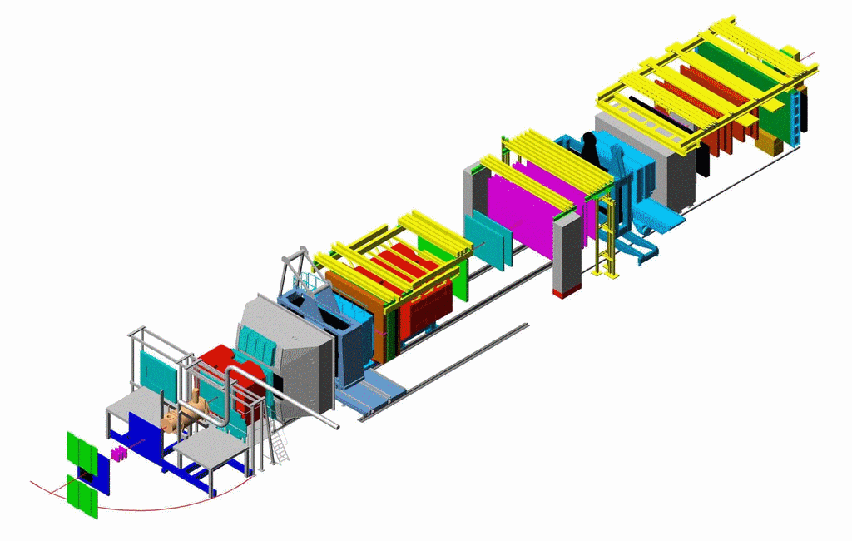
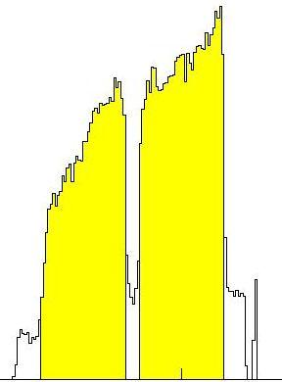
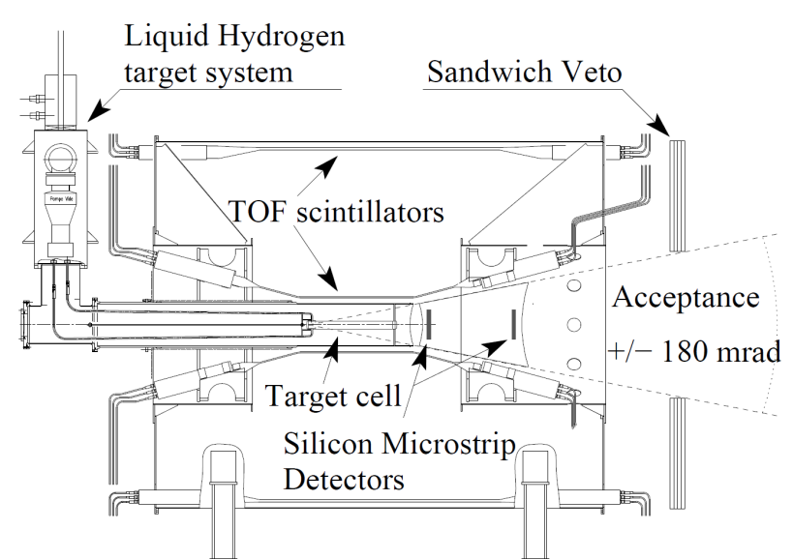
COMPASS in μ run
NIM A 577(2007) 455
⁶LiD target μ run
Trigger Hodoscopes
ECALs
& HCALs
MWPCs
50 m
SM2
RICH
μ Filters/Walls
SM1
LH₂ target π run
Drift
Chambers
Straws
GEMs
160 GeV μ
190 GeV π
Si
Micromegas
SciFi
veto

Slide 4
Outline
Data taken
1.Longitudinal spin structure of the nucleon
2002-2004 160 GeV μ on ⁶LiD L,T
2006 160 GeV μ on ⁶LiD L
2007 160 GeV μ on NH₃T
2010 160 GeV μ on NH₃ T
200 GeV μ on NH₃ L
2012 160 GeV μ on LH₂ (GPD test)
2. Transverse spin and momentum structure of the nucleon
190 GeV π⁻, μ on Pb (2 weeks)
2008 190 GeV π⁻ on LH₂
190 GeV p,π⁺ on LH₂,Pb,Ni,W
2012 190 GeV π⁻, μ on Ni (DY test)
Data for hadron spectroscopy
  SPS/LHC shutdown, 2015 (Polarized DY), 2016-2017 (GPD program)
  3. COMPASS-II

Slide 5
1.Longitudinal spin structure of the nucleon

Slide 6
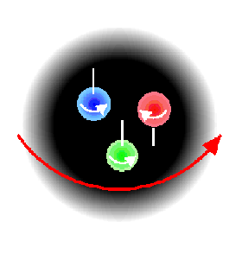
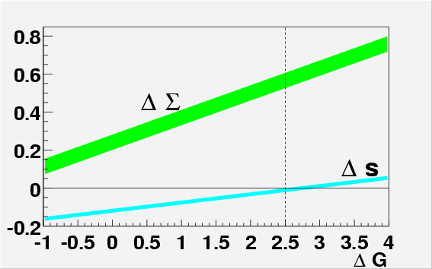
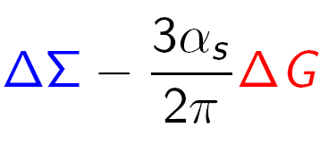
Nucleon spin puzzle since 1988
½= ½ΔΣ + ΔG + <L_{z}>
quarks gluons orb. mom.
“past” “present” “future” experiments
Measurement of ΔG is important for two reasons:
- as an element of nucleon spin puzzle - possible role of axial anomaly in the a₀ interpretation (a₀ ≠ ΔΣ)
a₀ (= ΔΣ) is measured to be
~0.30-0.35 instead of expected 0.6
a₀ =

Slide 7
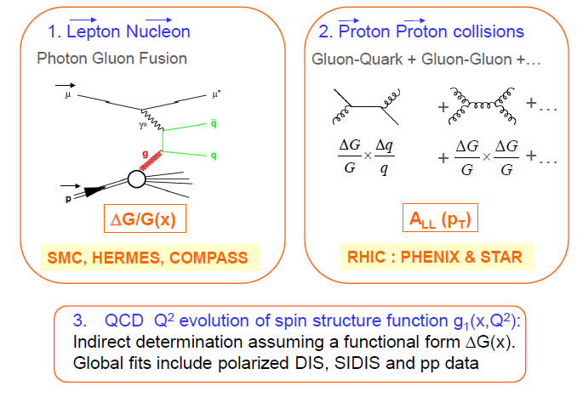
Three ways to study gluon spin contribution ΔG
1. Lepton Nucleon
Photon Gluon Fusion

Slide 8
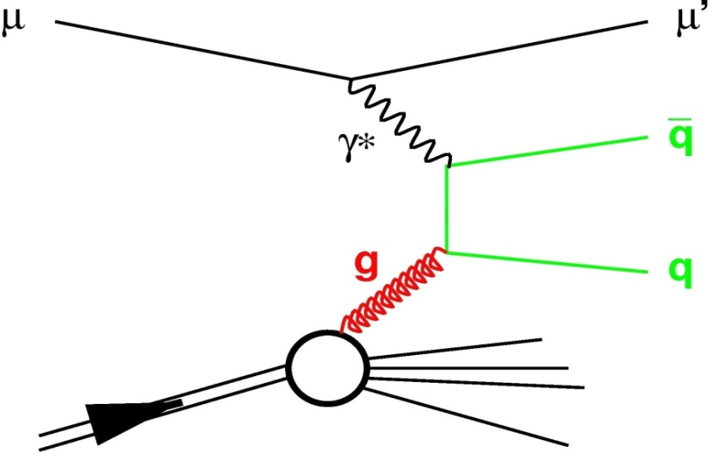
Direct gluon polarization Δg/g from μ N scattering COMPASS flagship measurement
Photon Gluon Fusion (PGF)
Open Charm
→ clean channel
→ but experimentally difficult
σ ≈ 100 nb… limited statistics
High-pT Hadron Pairs
→ easy to get a statistics
→ but physical background
2 cases Q² <1 GeV² (90% stat) & Q² > 1 GeV² (10% stat)
N
A|| = R_{PGF} <a_{LL}> <Δg/g> + A_{bkg}
Spin asymmetry of cross sections for longitudinal polarizations of beam and target, parallel and antiparallel

Slide 9

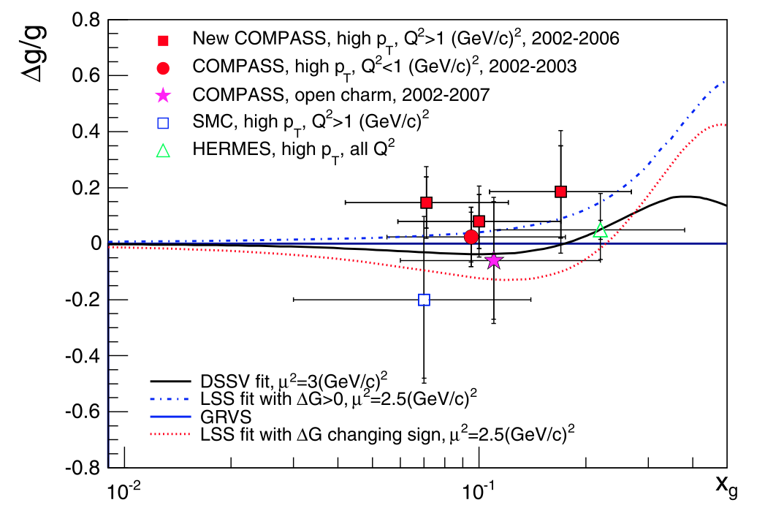
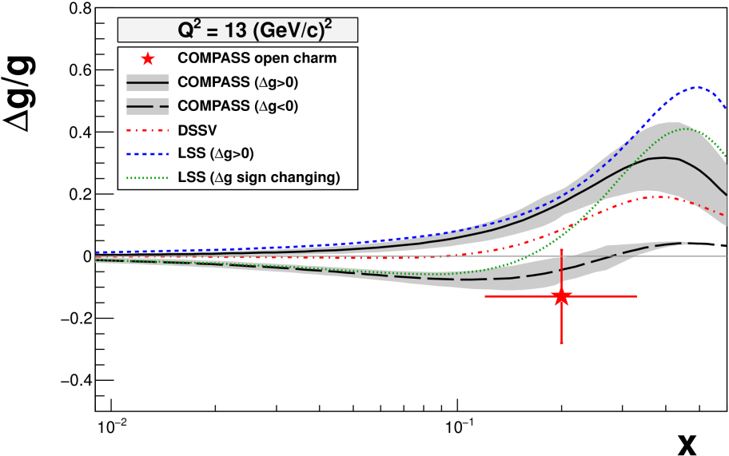
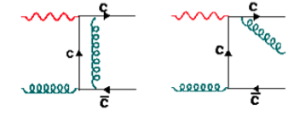
5 points from COMPASS
World direct measurements on Δg/g in LO
Phys. Lett. B 718 (2013) 922
Δg/g(x=0.09) = 0.125 ± 0.060 ± 0.063
All measurements compatible with 0
confirmed by polarised pp at RHIC
Open charm NLO (first time)
PRD 87 (2013) 052018
Δg/g(x=0.2) = -0.13 ± 0.15 ± 0.15

Slide 10
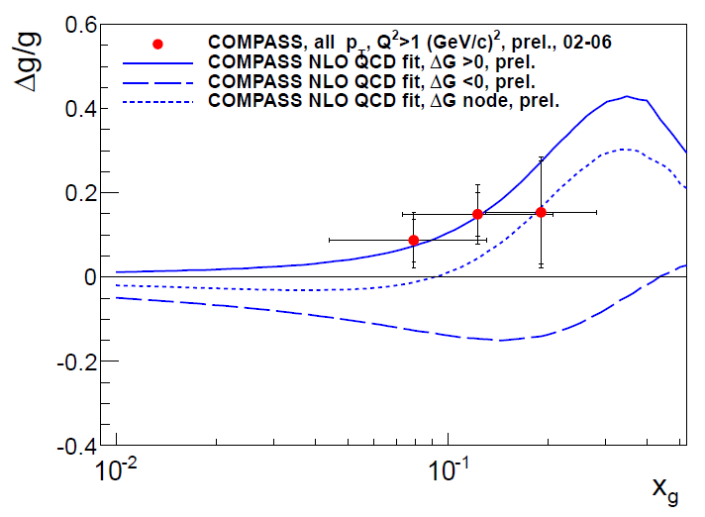
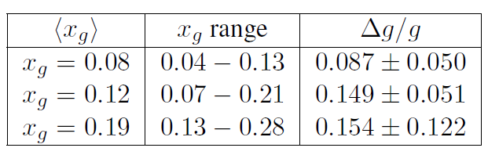
A new LO extraction of gluon polarization from COMPASS DIS data
The events in DIS region were re-analyzed and gluon polarization was extracted using the so called all-pT method. In this new method gluon polarization and leading process asymmetry are extracted simultaneously from the same data set using Neural Network approach. A reduction of both systematic and statistical uncertainties by more than 50% is achieved comparing to the published result PLB 718 (2013) 922.
Δg/g(x=0.09) = 0.125 ± 0.060 ± 0.063
Presented at DIS2014 Warsaw
Δg/g(x=0.1) = 0.113 ± 0.038 ± 0.035

Slide 11
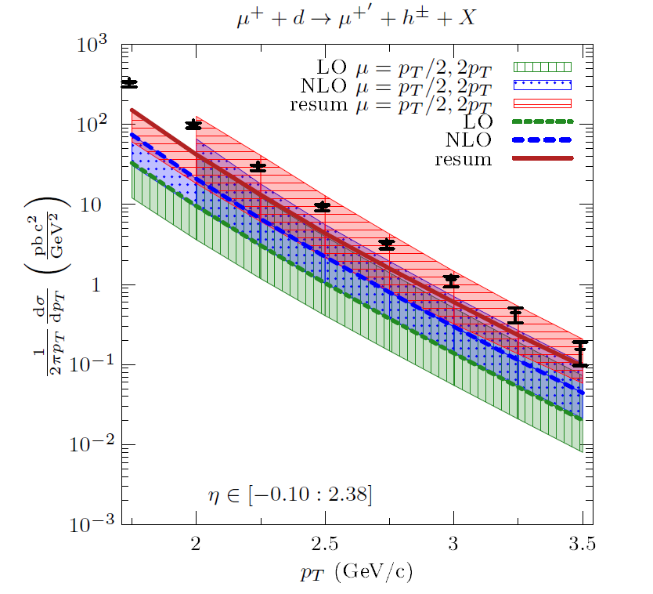
High p_{T} hadron photo production cross-section
1 COMPASS absolute cross-section measurement
μ d → μ’ h^{+/-} X
2 pQCD calculation with resummation ‘all orders’ (soft gluons, leading logs)
1
COMPASS, PRD 88 (2013) 091101
De Florian, Pfeuffer; Schaeffer, Vogelsang, PRD 88 (2013) 014024
2
--- Resummation
--- NLO
--- LO
Bands= scale uncertainty
3. Data /theory in agreement over 4 orders of magnitude
4. This gave an idea: to measure the spin asymmetries A_{LL}(p_{T}) for same events and compare to the calculations with ΔG hypotheses
5. Resummation for the polarized case needed (underway)

Slide 12
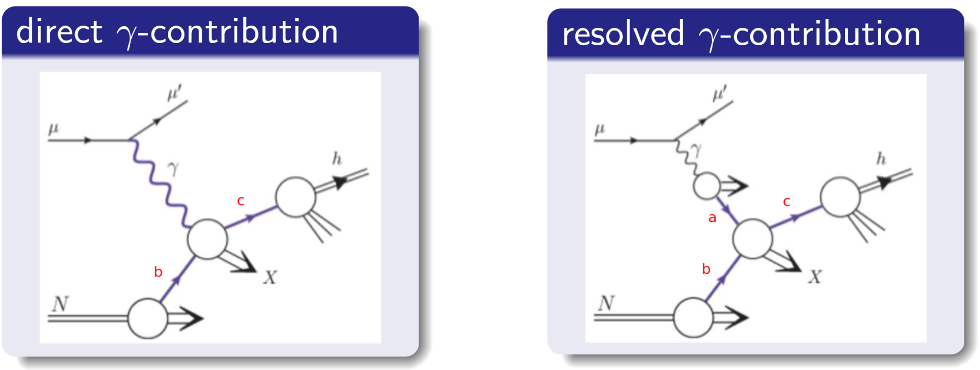
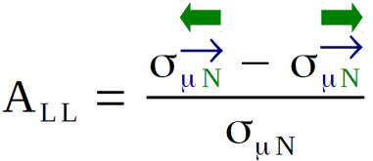
ΔG from high p_{T} hadron photo production « a la RHIC »
To measure spin asymmetry A_{LL}(p_{T}) and compare to the theoretical calculations with various assumptions for ΔG(x),
Method ‘à la RHIC’: No direct extraction of ΔG → no model needed
All processes taken into account: γg (PGF) γq (QCD Compton) and all resolved γ.
Spin asymmetries should be measured ….

Slide 13
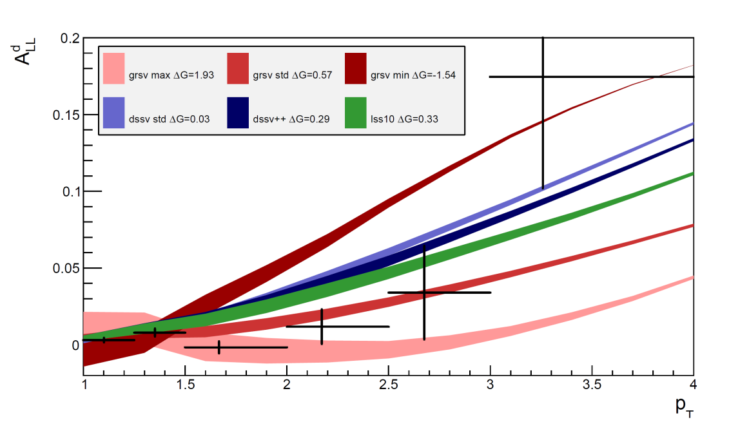
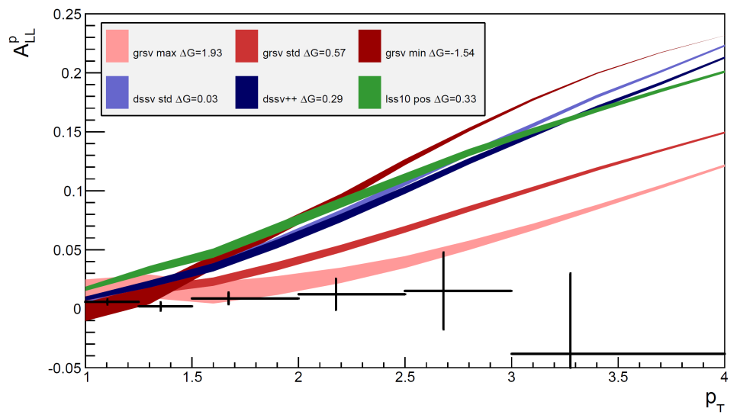
ΔG from high p_{T} hadron photo production « a la RHIC »
DEUTERON
PROTON
COMPASS A_{LL} measurements
Comparison with calculations (V. Vogelsang, M. Stratmann and B. Jager) of A_{LL} at NLO
No conclusion can be drawn before including the gluon resummation calculations

Slide 14
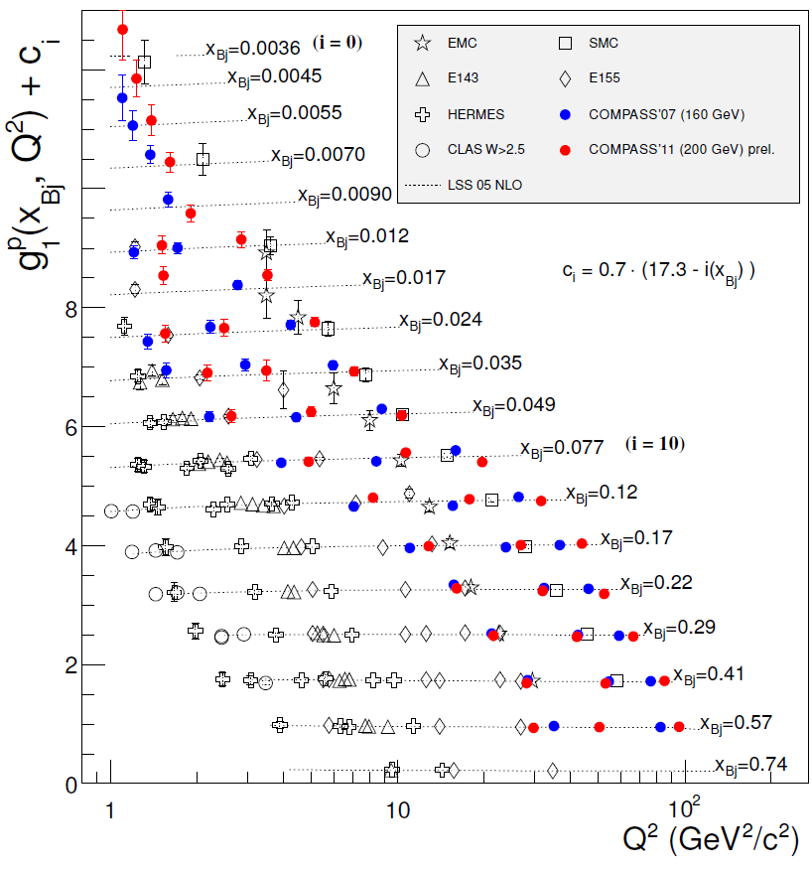
g₁^{p} world data
COMPASS 200 GeV
COMPASS 160 GeV
--- LSS QCD fit
Large set of data, extending to lower x and higher Q² region
New data were included in the QCD global analyses

Slide 15
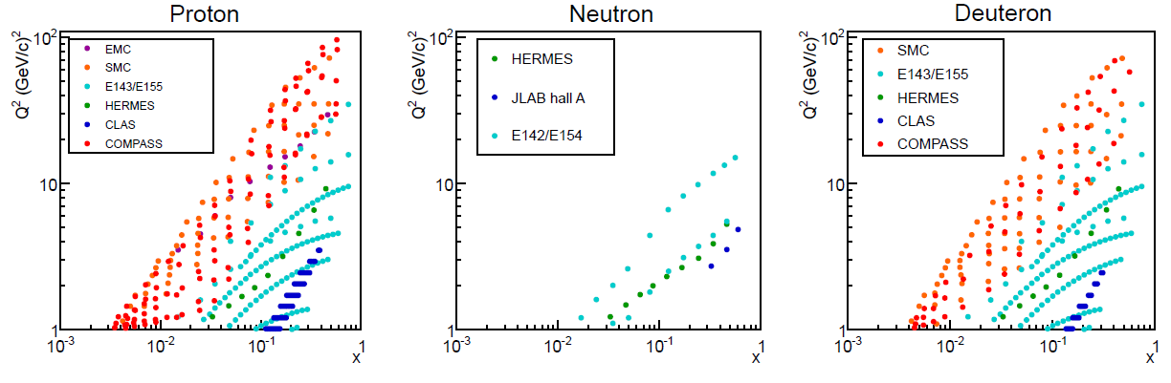
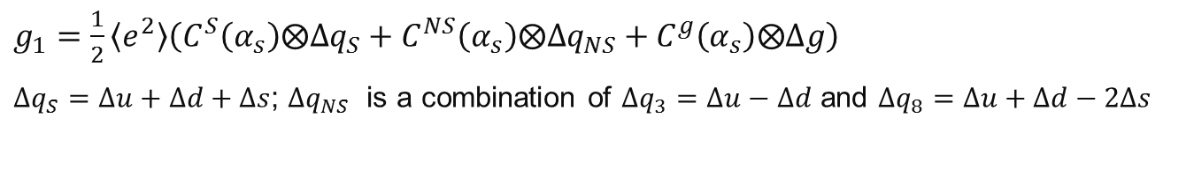
Global NLO QCD fits to world data on g₁
138 out of 679 points are from COMPASS
$g_{1}=\frac{1}{2}\left\langle e^{2}\right\rangle \left(C^{S}\left(α_{s}\right)⨂Δq_{S}+C^{NS}\left(α_{s}\right)⨂Δq_{NS}+C^{g}\left(α_{s}\right)⨂Δg\right)$
$Δq_{S}=Δu+Δd+Δs$; $Δq_{NS}$ is a combination of $Δq_{3}=Δu−Δd$ and $Δq_{8}=Δu+Δd−2Δs$
DEUTERON
PROTON

Slide 16
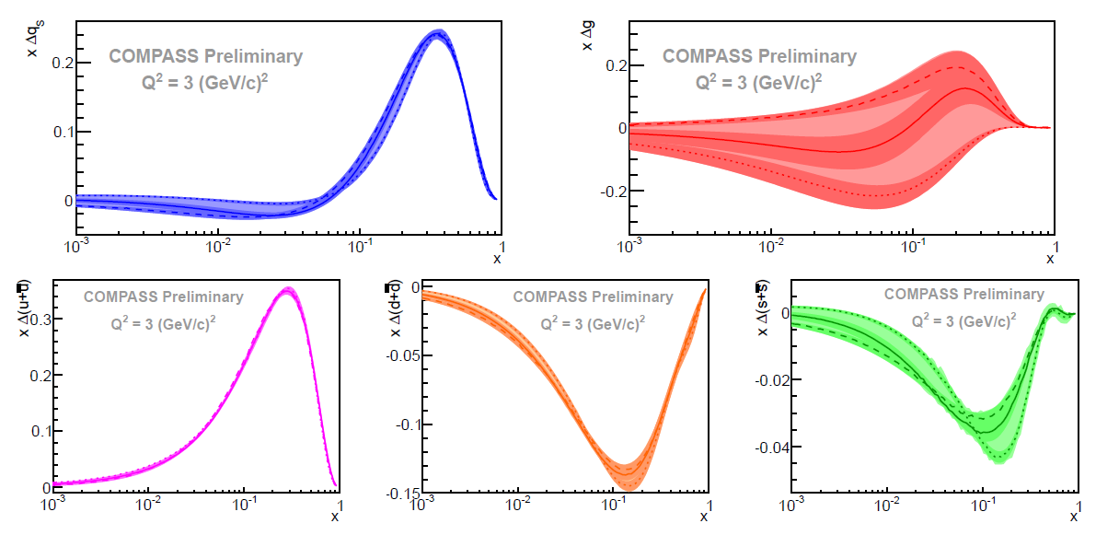
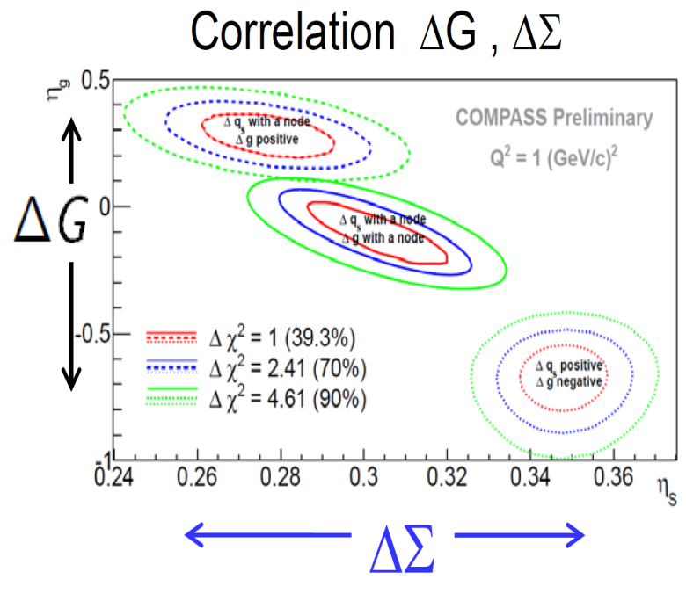
Polarized PDFs from the NLO-QCD fits to the g₁d and g₁p data
Three scenarios, ΔG < 0, ΔG~ 0 and ΔG > 0, cover all possible results on the polarized PDFs (the largest uncertainty arises from the choice of the functional forms):
Result in fair agreement with other global fits, and with Lattice QCD
● Small sensitivity to light sea and gluon helicities
● Quark helicity: ΔΣ = ∫ Δq_{s}(x)dx ϵ [0.256, 0.335]
● Gluon helicity: ΔG = ∫ Δg(x)dx → Not well constrained

Slide 17
2.Transverse spin and momentum structure of the nucleon

Slide 18
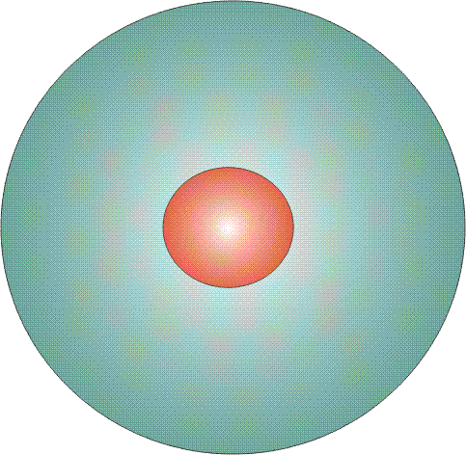
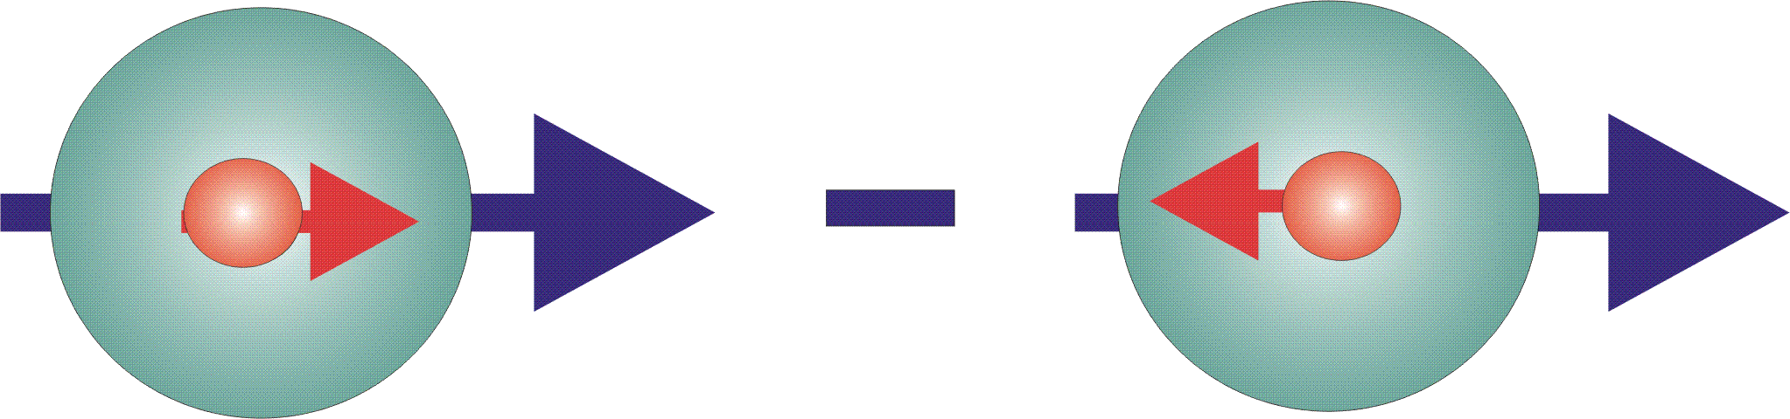

Parton Distribution Functions
three distribution functions are necessary to describe the
spin structure of the nucleon at LO in the collinear case
q(x)
f₁^{q} (x)
unpolarised PDF
quark/gluon with momentum x_{P} in a nucleon
well known – unpolarized DIS
Δq(x)
g₁^{q}(x)
helicity PDF
quark/gluon with spin parallel to the nucleon spin in a longitudinally polarized nucleon
known – polarized DIS
transversity PDF
quark with spin parallel to the nucleon spin in a transversely polarized nucleon
Δ_{T}q(x)
h₁^{q}(x)
poorly known – polarized SIDIS

Slide 19
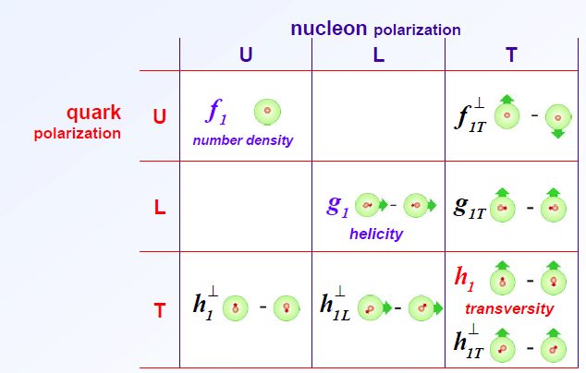


Basic twist-2 PDFs of the nucleon
8 intrinsic-transverse-momentum k_{T} dependent PDFs at leading twist
Azimuthal asymmetries with different angular modulations in the hadron and spin azimuthal angles, Φ_{h} and Φ_{s}
Vanish upon integration over k_{T} except f₁ , g₁ , and h₁
Sivers
Worm-gear-T g┴_{1T}
Boer–
Mulders
Transversity
chiral -odd
T -odd
Pretzelosity
Worm-gear-L h┴_{1L}

Slide 20
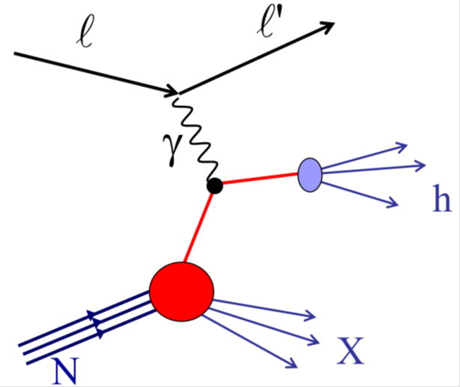
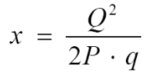

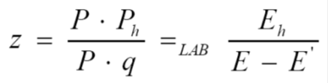
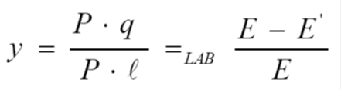

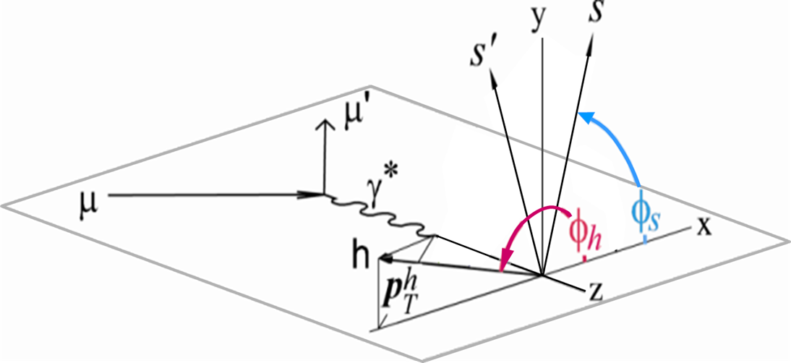



Semi-Inclusive Deep Inelastic Scattering (SIDIS)
$$p{}_{T}^{h}$$
$$φ_{h}$$
azimuthal angle of hadron momentum
$$φ_{S}$$
azimuthal angle of spin vector of initial quark

Slide 21
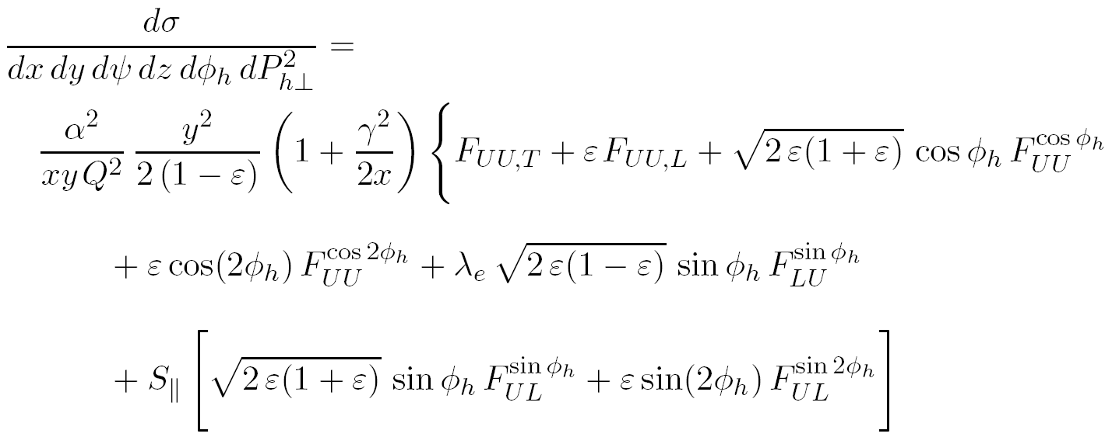
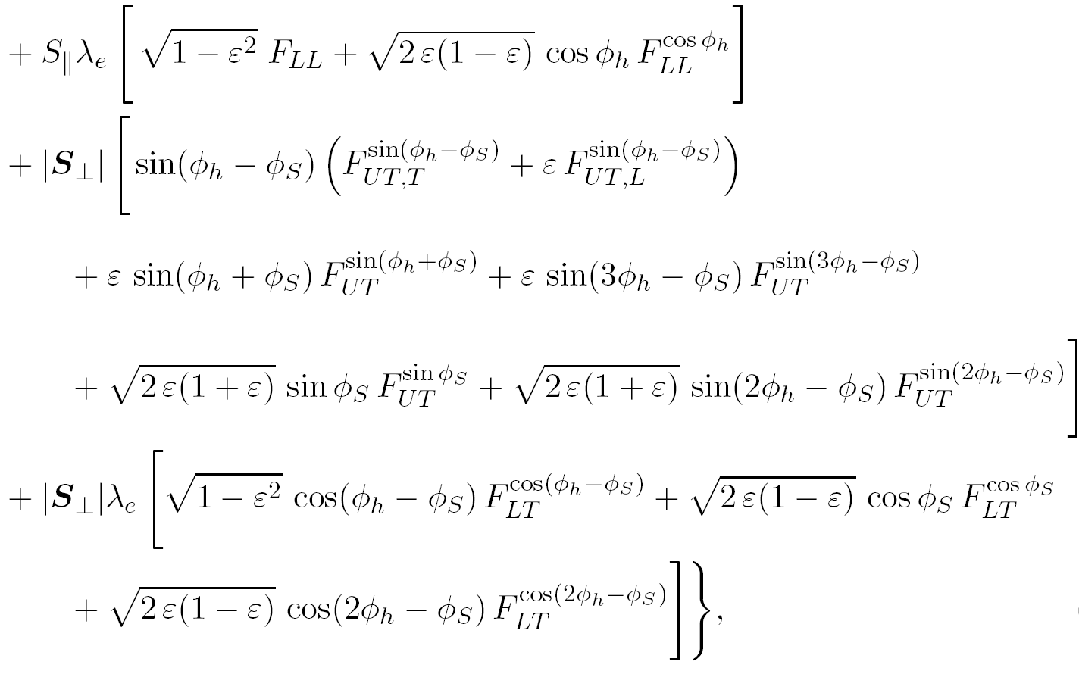
SIDIS cross section ( from A.Bacchetta at all., hep-ph/0611265)
Sivers asymmetry
18 structure functions
14 independent
azimuthal modulations
Collins asymmetry
all the 14 amplitudes are been measured
in COMPASS

Slide 22
An azimuthal distribution of the inclusively produced hadrons
polarization direction
nucleon transverse polarization
Collins angle
Sivers angle
spin transfer coefficient
and and the other 6 transverse spin asymmetries
are measured by fitting the distributions
in the different x, z, p_{T}^{h} bins

Slide 23
Transversity and Sivers
transversity PDF
correlation between the transverse polarisation of the nucleon and the transverse polarisation of the quark (non-zero because of Collins FF)
Collins FF
Sivers PDF
correlation between the transverse spin of the nucleon and the transverse momentum of the quark (sensitive to orbital angular momentum)
N.B.
No data : Pretzelosity PDF h┴_{1T}
Worm-gear-L h┴_{1L}
Worm-gear-T g┴_{1T}
Boer-Mulders h┴ ₁

Slide 24
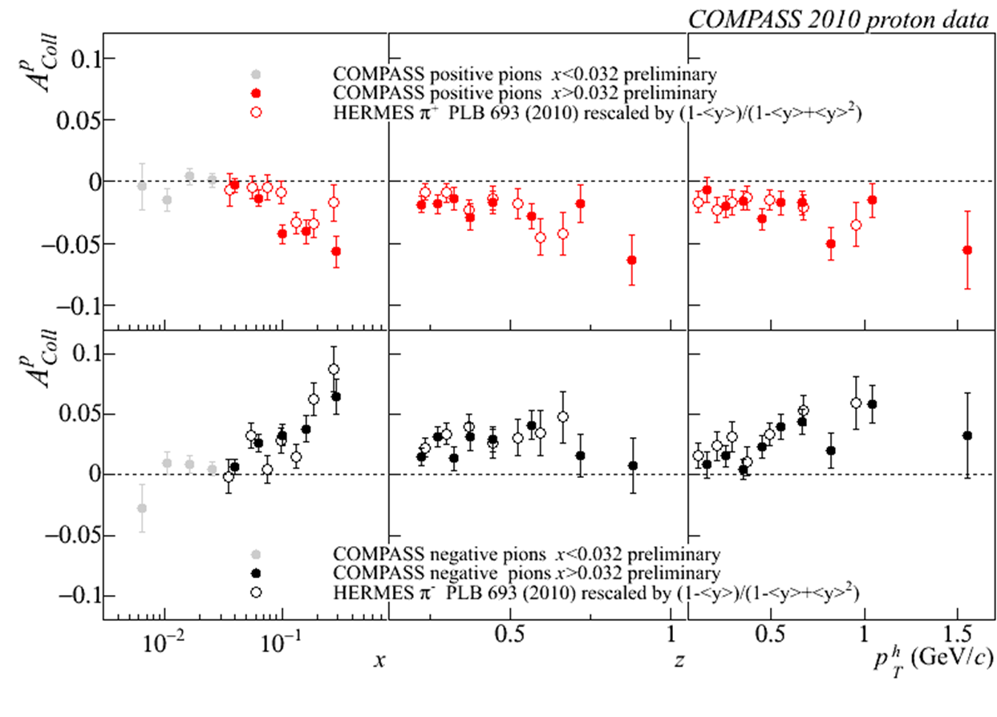
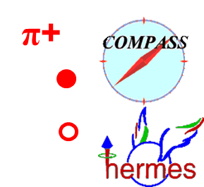
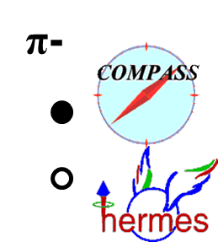
Collins asymmetry
charged pions (and kaons), 2010 data
x > 0.032 region
COMPASS & HERMES results
Notes:
24

Slide 25
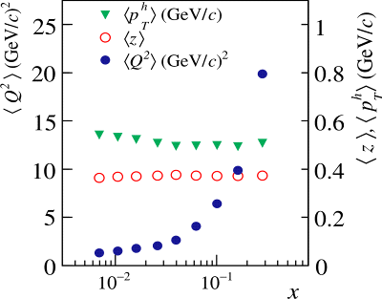

Collins asymmetry
same strength:
a very important, not obvious result!
~12
~ 4
no strong Q² dependence
Notes:
25
\

Slide 26
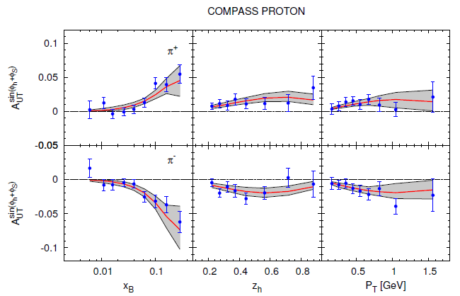
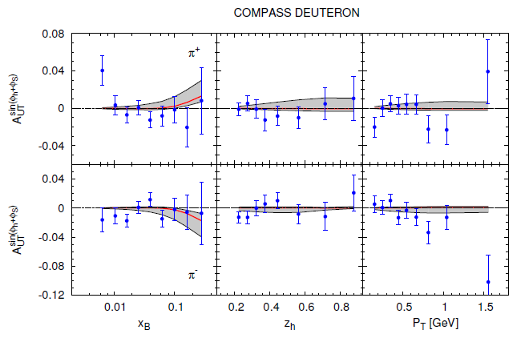

Collins asymmetry on proton
M. Anselmino et al., arXiv:1303.3822 (2013)
fit to HERMES p, COMPASS p and d, Belle e+e- data
2010 p data
d data
Notes:
26

Slide 27
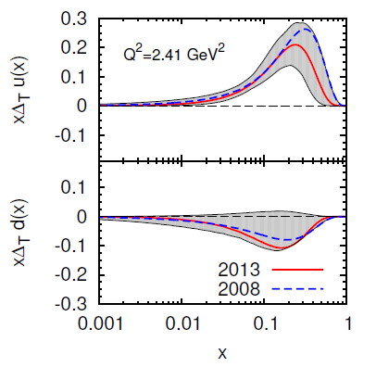
Transversity from Collins
Combined analyses of HERMES, COMPASS and BELLE fragm.fct. data
Anselmino et al. arXiv: 1303.3822 (2013)

Slide 28
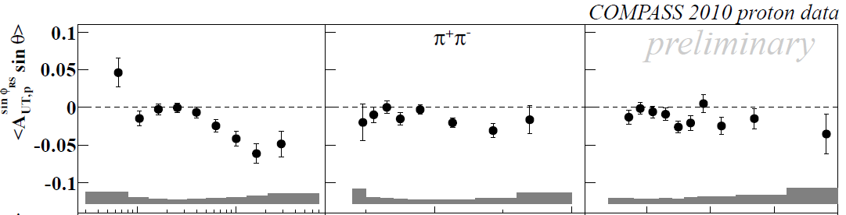
Di-hadron asymmetries
Another access to transversity h₁
h₁^{u} & h₁^{d} extraction
Also measured for the first time for K⁺K⁻ , p⁺K⁻ and K⁺p⁻ pairs

Slide 29
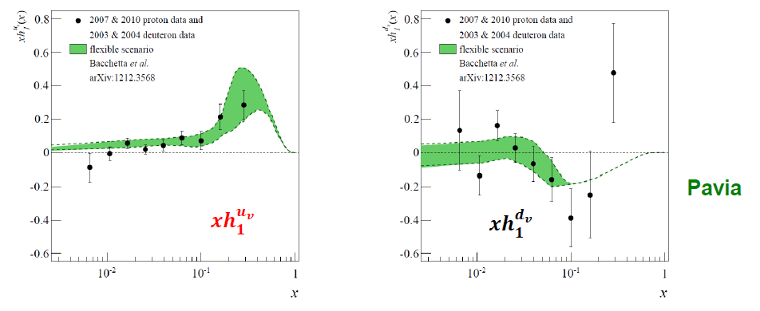
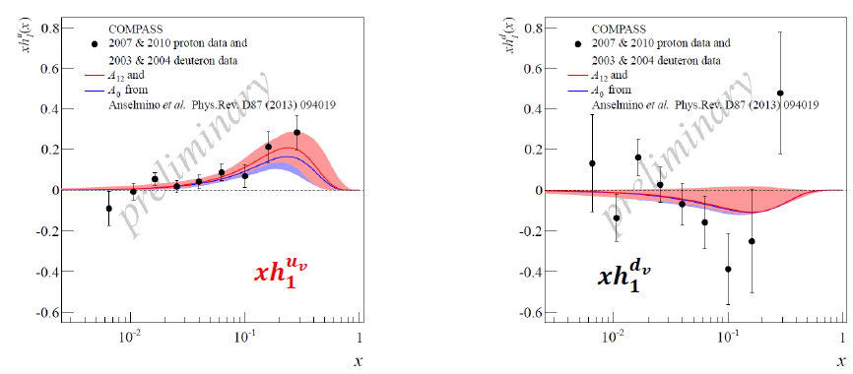

Transversity from 2h p and d results

Slide 30
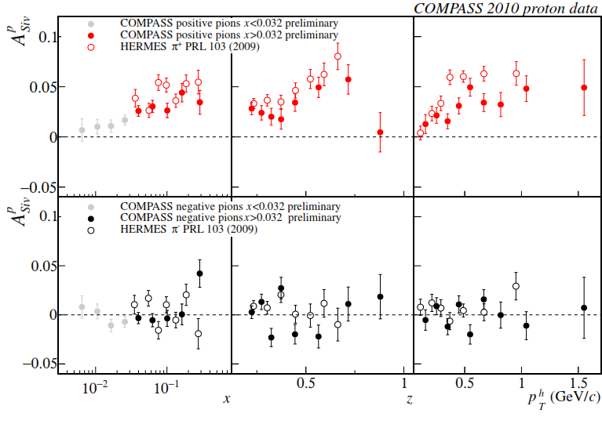
Sivers asymmetry
charged pions (and kaons), 2010 data
x > 0.032 region
COMPAS &HERMES results
as for h+, smaller values measured by COMPASS;
same indication for K+

Slide 31
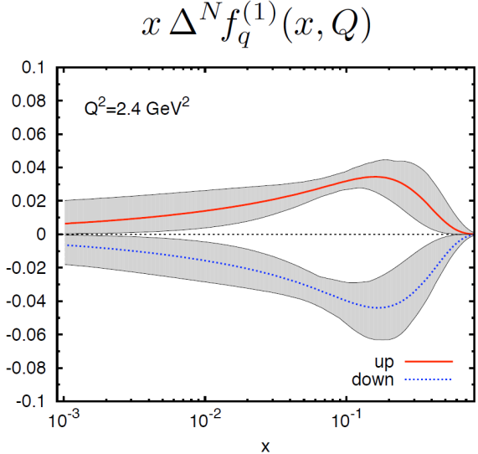
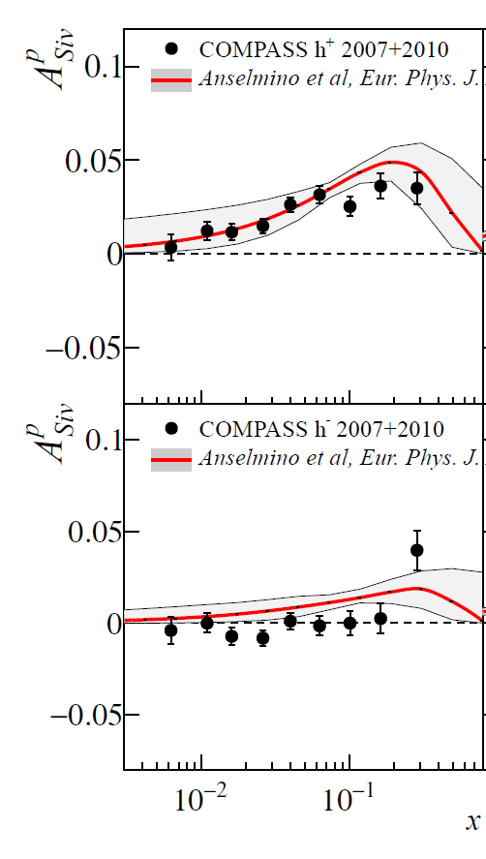
From Sivers asymmetry to Sivers function
COMPASS data
with Anselmino
et al. global analysis
u and d quark Sivers function opposite

Slide 32
By product result

Slide 33
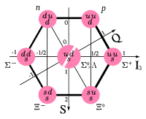
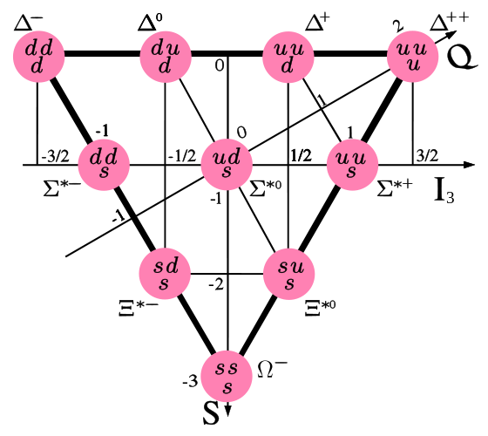
Heavy hyperon production rates in DIS
Measurement of the Longitudinal Spin Transfer to Λ and Λ-bar Hyperons in Polarized Muon DIS EPJC 64 (2009) 171–179 (COMPASS paper)
If you study Λ baryon it’s reasonable to have a look at hyperons also. (Λ is a lightest hyperon itself)

Slide 34
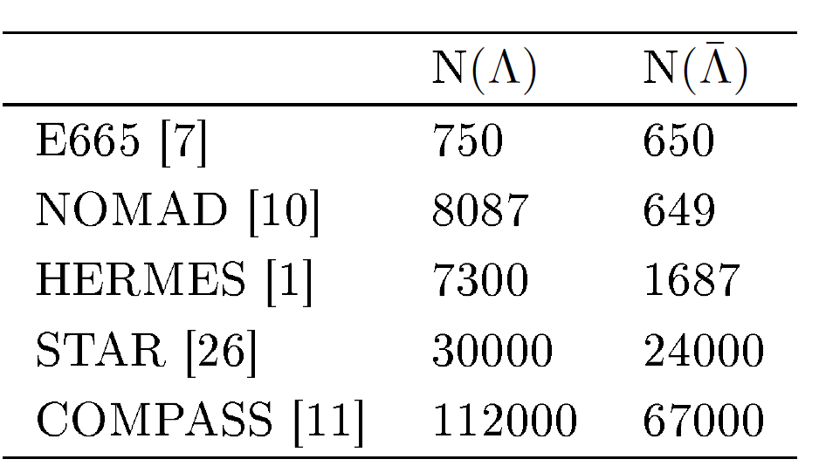
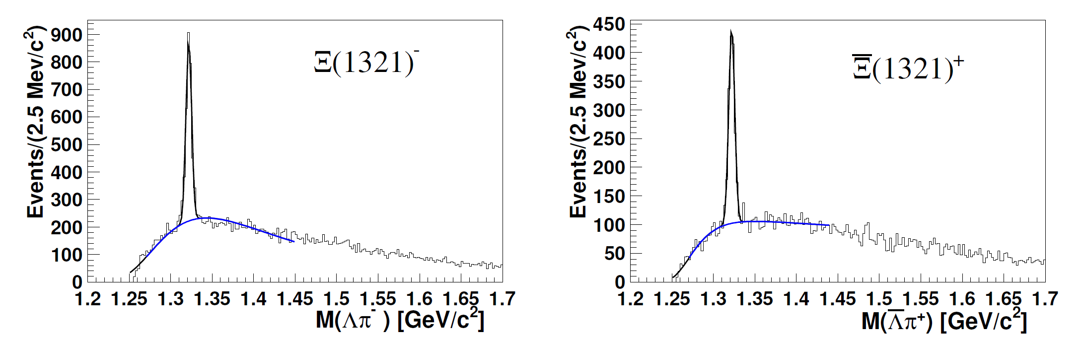
Σ(1385) and Ξ(1321) hyperon and antihyperon production in DIS
Decay channel Σ(1385), Ξ(1321) ➔ Λπ
EPJC 73 (2013) 2581
Best Λ hyperon statistics
Example ➔ Ξ(1321) signal
2320 ± 68
1147 ± 49.

Slide 35


Σ(1385) and Ξ(1321) hyperon and antihyperon production in DIS
First time the yields of antihyperons were measured in DIS
Measured ratios
Tuning of LEPTO/JETSET parameters related to the strange baryon productions was done
fraction of indirectly produced Λ(anti-Λ) was found to be 37(32)%

Slide 36
3. COMPASS-II in 2015-2017 years

Slide 37
COMPASS-II was approved by the CERN Research Board: Dec. 1, 2010.
2014
  Preparation for DY run
    Refurbished PT magnet, PT installation, hadron absorber
    2 months of data taking (October-December)
2015
  Drell - Yan data taking (1 “year” ≈ 140 days)
End 2015, beg. 2016
  Removal of PT, Installation of LH target, CAMERA, ECAL0
2016/2017
  DVCS data taking (2 “years” ≈ 2x140 days)
2018 and beyond Long Shutdown 2
  Extensions of DY and DVCS programs (definition underway)

Slide 38




Polarized Drell-Yan measurements
→pion valence anti-u annihilates with proton u
→access to 4 azimuthal modulations: Boer-Mulders, Sivers, pretzelosity and transversity PDFs
gauge link changes sign for T-odd TMD’, restricted universality of T-odd TMDs
J.C. Collins, PLB536 (2002) 43

Slide 39

Expected event rates & projections
With a beam intensity I_{beam}=6x10⁷ particles/second, a luminosity of L=1.2x10³²cm⁻²s⁻¹ can be obtained:
→ expect 800/day DY events with
Assuming 2 years of data-taking (140 days/year), one can collect: ≈230000 events
Expected statistical error of the Sivers asymmetry for a measurement in three (left) and five (right) bins in x_{F} . The smaller error bar is the statistical only, while the larger one corresponds to the quadratic sum of statistical and systematic errors. The theoretical prediction of the asymmetry from Anselmino et al. is also shown.

Slide 40




18
Why DY πp↑ is very favourable at COMPASS?
σ^{DY} dominated by the annihilation of a valence anti-quark from the pion and a valence quark from the polarised proton
COMPASS has large acceptance in the valence quark region for p and π where SSA are expected to be larger and we will start next year
Competitive experiments at
RHIC (STAR, PHENIX) collider
Fermilab fixed target
J-PARC fixed target
FAIR (PAX) collider
NICA collider
COMPASS has the chance to be the first experiment to collect single polarized DY

Slide 41
Conclusion
  COMPASS is one of the major players in spin physics
  - essential contributions to clarify the spin structure of the nucleon both longitudinal and transverse
  - direct measurements of the gluon polarization Δg/g
FUTURE
  COMPASS II 2015 (Polarized Drell-Yan) 2016-2017 (GPD program)
  The feasibility of the Drell-Yan measurements was confirmed by
  4 tests runs performed in 2007-2012.
The feasibility of the DVCS measurements was confirmed by
3 tests runs performed in 2008-2012.

Slide 42

Beyond 2017……. COMPASS III (?)
In the nucleon spin structure studies can be done more from 2018 ……First ideas were already submitted to European Strategy Preparatory Group

Slide 43
Backup slides

Slide 44
Twist-2 PDFs of nucleons
f₁ - density of partons in non-polarized nucleon, (x, Q²);
g₁ - helicity , longitudinal polarization of quarks in longitudinally
polarized nucleon;
h₁ ₋- transversity, transverse polarization of quarks in transversely
polarized nucleon ;
f┴_{1T} - Sivers, correlation between the transverse polarization of nucleon
(transverse spin) and the transverse momentum of non-polarized quarks;
g┴_{1T} - worm-gear-T, correlation between the transverse spin and
the longitudinal quark polarization ;
h┴ ₁ - Boer-Mulders, distribution of the quark transverse momentum
in the non-polarized nucleon ;
h┴_{1L} - worm-gear-L, correlation between the longitudinal polarization
of the nucleon (longitudinal spin) and the transverse momentum
of quarks ;
h┴_{1T} - pretzelosity, distribution of the transverse momentum of quarks
in the transversely polarized nucleon

Slide 45

Key COMPASS apparatus: polarized target
³He – ⁴He dilution
refrigerator (T~50mK)
solenoid 2.5T
dipole magnet 0.6T
acceptance ± 180 mrad
Deuterated lithium
ammonia
⁶LiD/NH₃ (d/p)
50/90% pol.
40/16% dil. factor
μ
biggest /fabricated for SMC coll.
Special shift during the data taking

