Slide 1
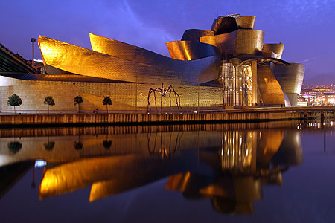
GPD program at COMPASS-II
New results for excl. ρ prod (NPB 865 1- July 2012)
with polarized target (p and d) without recoil detection
Preparation of the first DVCS run (oct- 3 dec 2012)
with LH2 target and with recoil detection
Outlook for the complete program
Nicole d’Hose (CEA-Saclay)
On behalf of the COMPASS Collaboration
QCD-N'12
3rd Workshop on the QCD
Structure of the Nucleon
October 22-26, 2012
Bilbao, Spain

Slide 2
The COMPASS-II program
DVCS & HEMP measurements
Transverse Imaging of the proton
Beam charge & spin
sum, difference and asymmetry
GPD H, later GPD E
Data taking (2012), 2015 & 16
Drell-Yan measurements
Sivers PDF
Boer Mulders PDF
Test of factorization approach
Data taking 2014
SIDIS expts
PDFs and Frag.F
s(x), Kaon FF
Data taking
parasitically
Upgrade existing
COMPASS Spectro
@ CERN/SPS
Primakoff expts
π and K Polarizability
Chiral Dynamics
Data taking 2012
Proposal submitted to CERN: 05/2010
Approval 12/2010

Slide 3












COMPASS: Versatile facility to study QCD
with hadron (π±, K±, p …) and lepton (polarized μ±) beams
for hadron spectroscopy and hadron structure studies
LHC
COMPASS
SPS

Slide 4
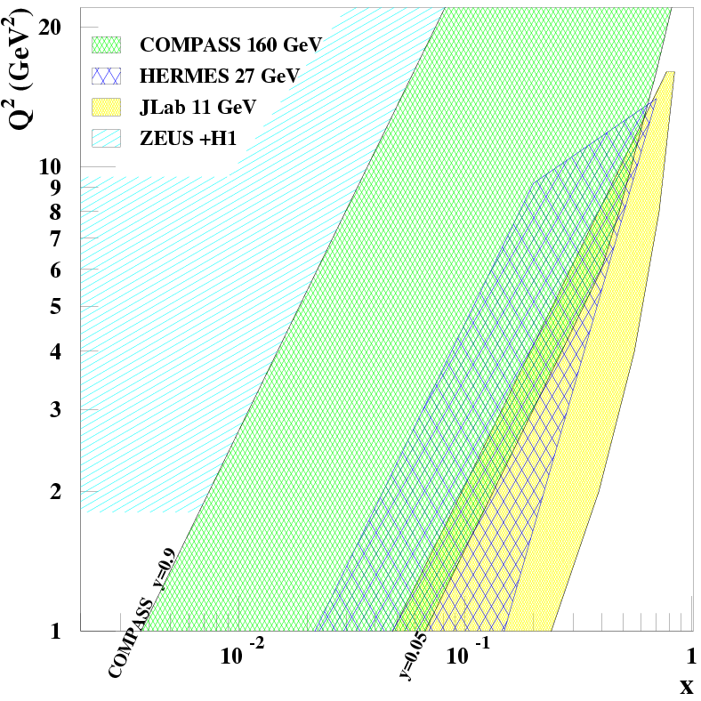
Kinematic domain (Q², x_{B}) for GPDs
COMPASS unique for GPDs
}
CERN High energy muon beam
  100 - 190 GeV
fixed target
collider
Explore the intermediate x_{Bj} region
Uncovered region between
ZEUS+H1 & HERMES + JLab
before new colliders may be available
Transverse structure at x~10⁻²
essential input for phenemenology
of high-energy pp collision (LHC)
E=160 GeV
E=27 GeV
E=11 GeV
Proton₁
x₁
Higgs?
x₂
W > 2GeV
Proton₂
x_{1,2} = M _{Higgs} / √s ∼ 10⁻²
M _{Higgs} = 140 GeV and √s =14 TeV
 126 GeV
B

Slide 5
Kinematic domain (Q², x_{B}) for GPDs
COMPASS unique for GPDs
}
CERN High energy muon beam
  100 - 190 GeV
  μ^{+↓} and μ^{-↑} available
  80% Polarisation
  with opposite polarization
fixed target
collider
4.6 10⁸ μ⁺
for 2.7 10¹³ protons / SPS spill
(9.6s each 48 s)
Lumi= 10³² cm⁻² s⁻¹
with 2.5m LH2 target
E=160 GeV
E=27 GeV
E=11 GeV
W > 2GeV
B

Slide 6
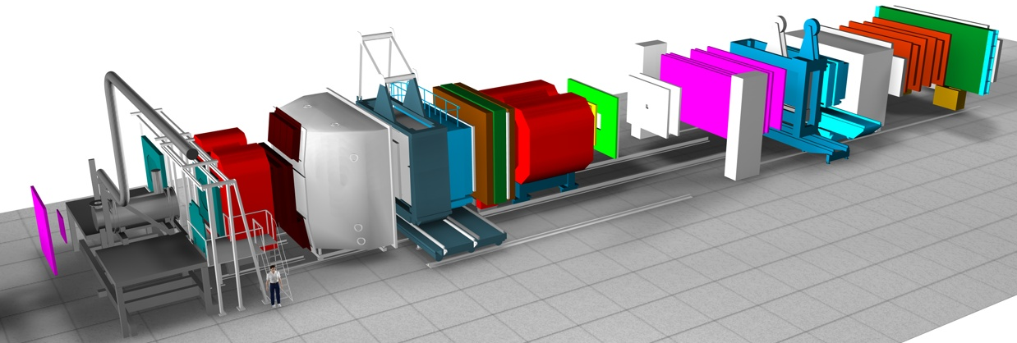
The COMPASS experiment at CERN
NIM A 577 (2007) 455
SM2
SM1
ECAL2
ECAL1
50m
Two stage magnetic spectrometer for large angular & momentum acceptance
Particle identification with:
- Ring Imaging Cerenkov Counter
- Electromagnetic calorimeters (ECAL1 and ECAL2)
- Hadronic calorimeters
- Hadron absorbers

Slide 7
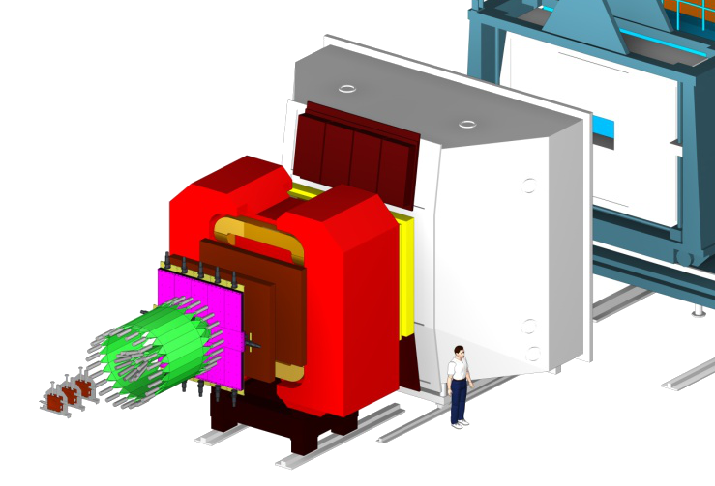
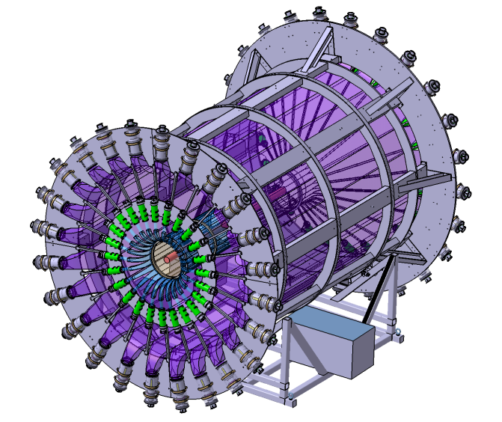
Upgrades of COMPASS spectrometer
DVCS : μ p → μ’ p γ
μ
μ’
p
γ
New equipements:
2.5m LH2 target
4m ToF Barrel CAMERA
ECAL0
ECAL0
CAMERA

Slide 8
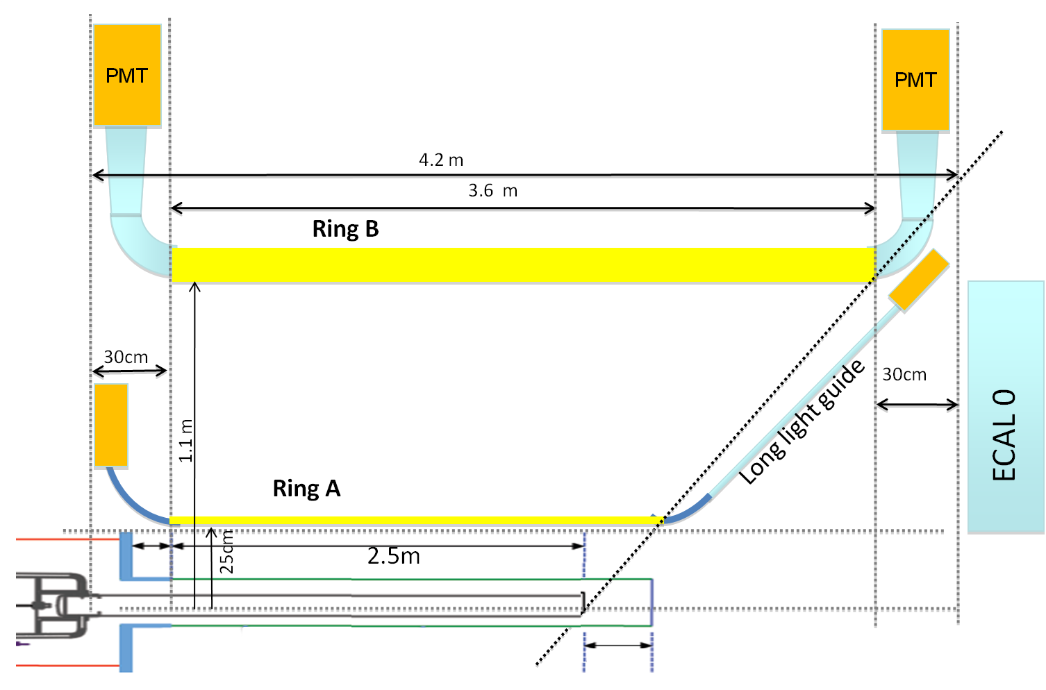
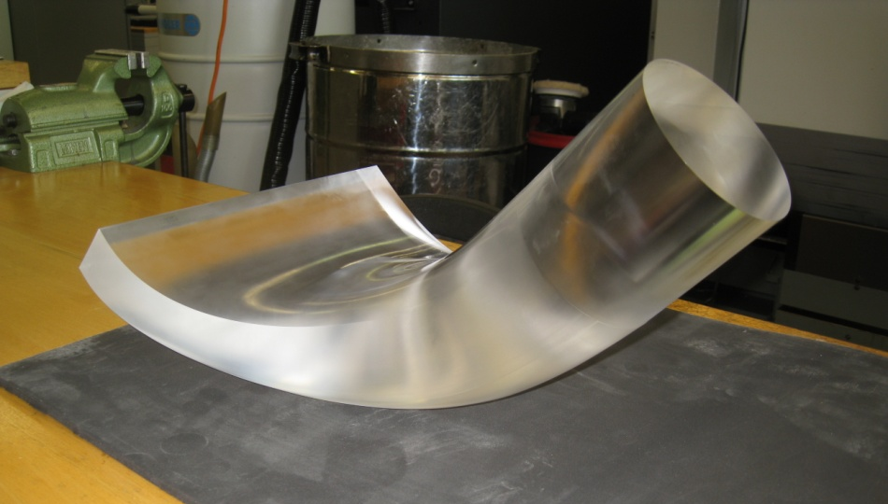
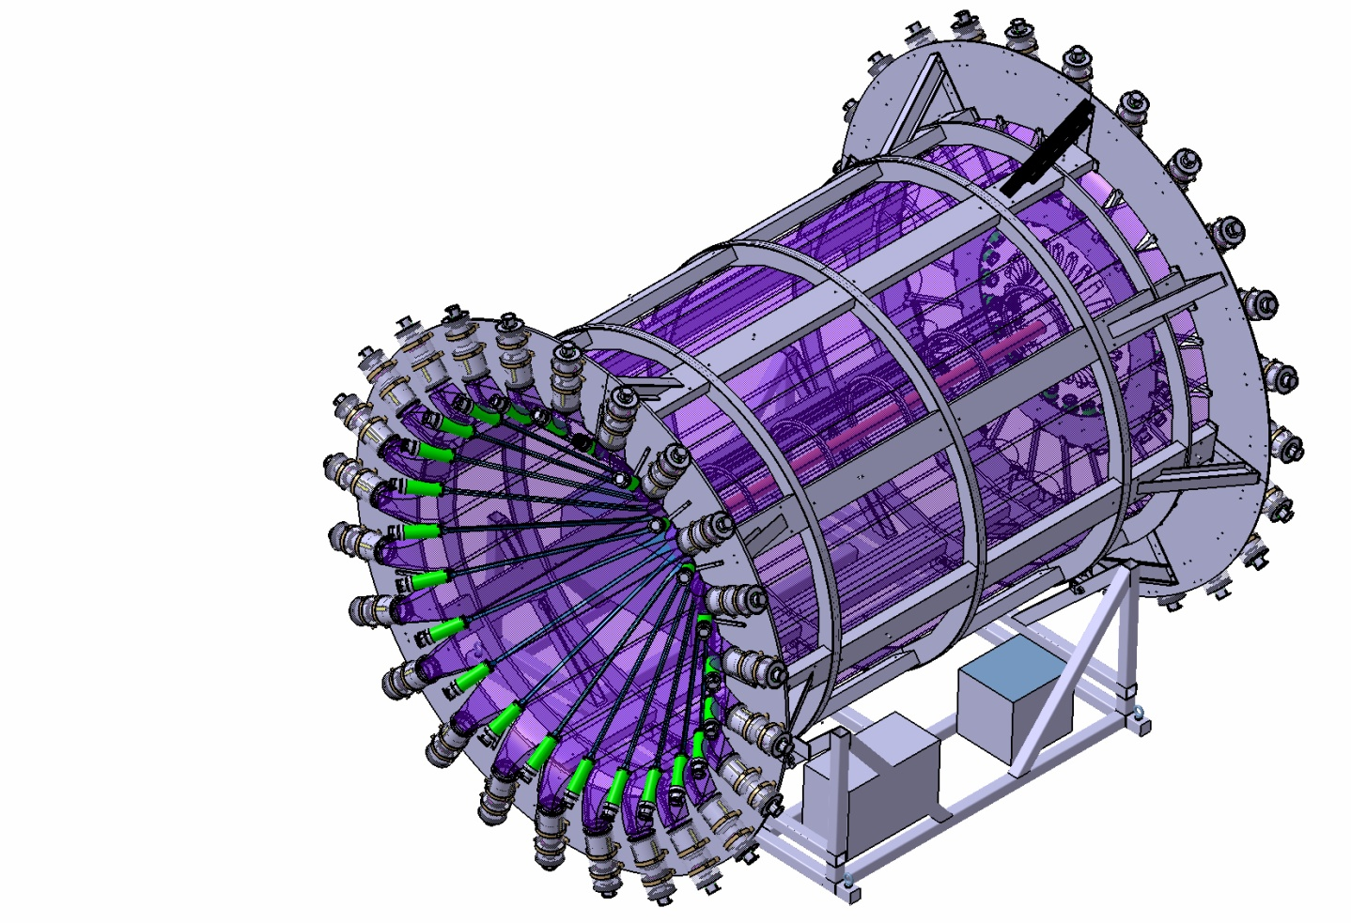
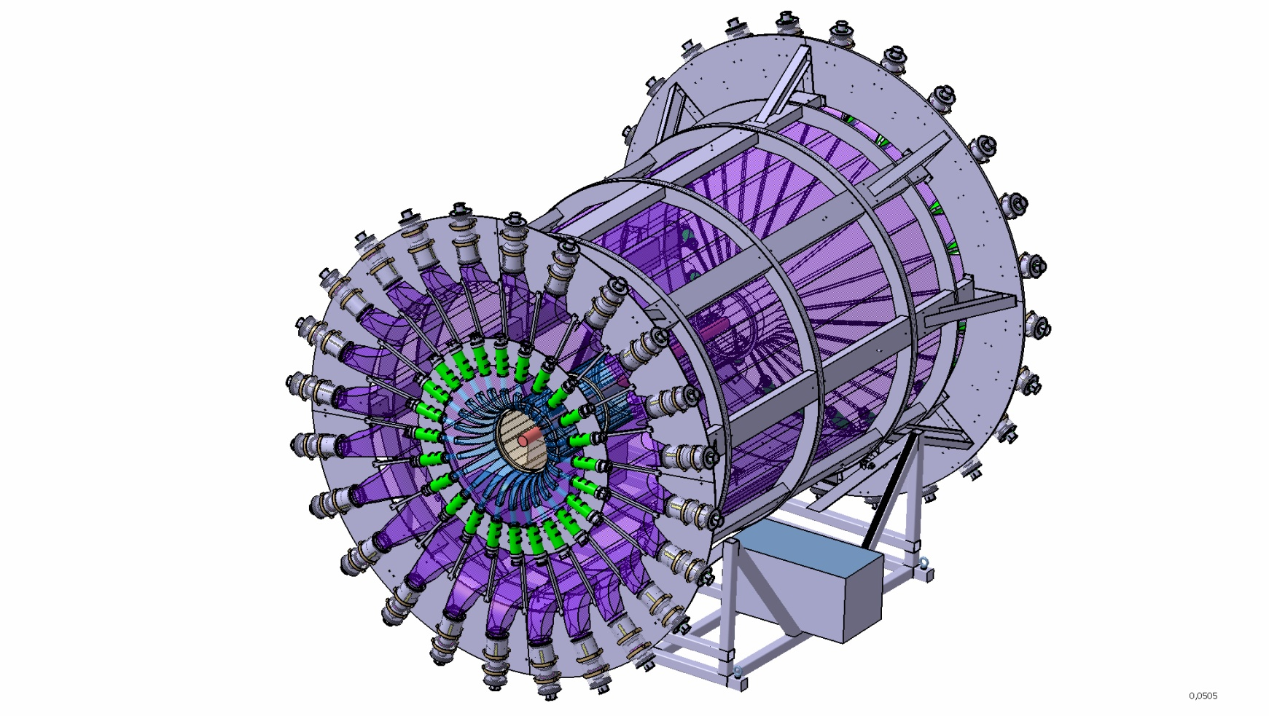
Recoil Proton Detector CAMERA
ToF between 2 rings of scintillators σ(ToF) < 300ps
0.06 < t < 0.8 GeV/c²
light guide
downstream side
upstream side
3.90m

Slide 9
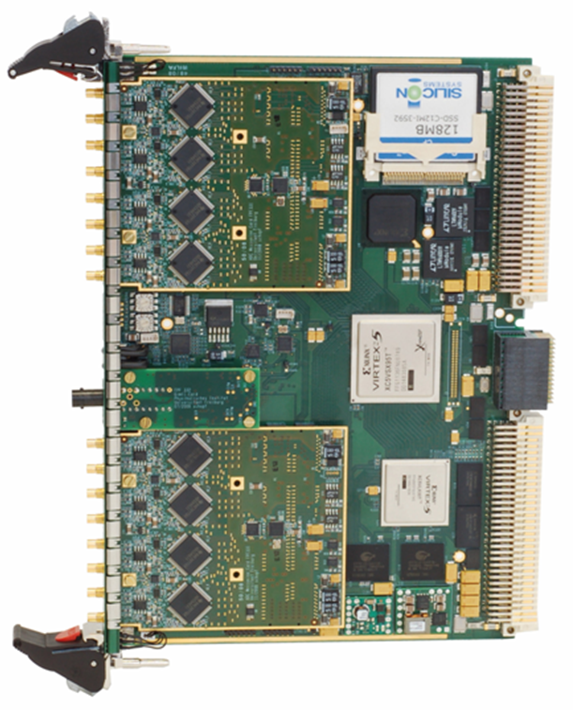
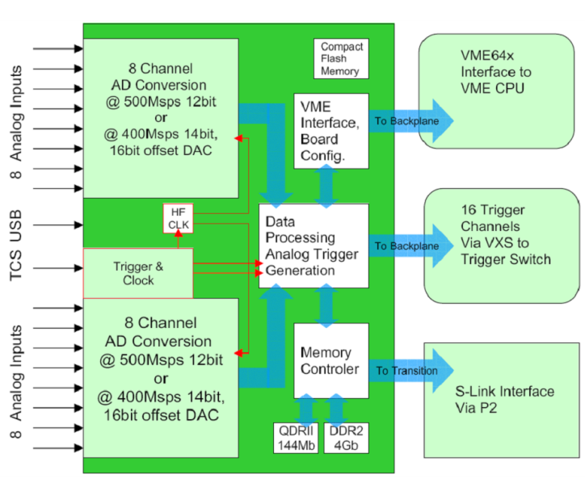
CAMERA read out with GANDALF boards
1 GHz digitization of the PMT signal to cope with high rate
GANDALF boards ➔ First level trigger

Slide 10
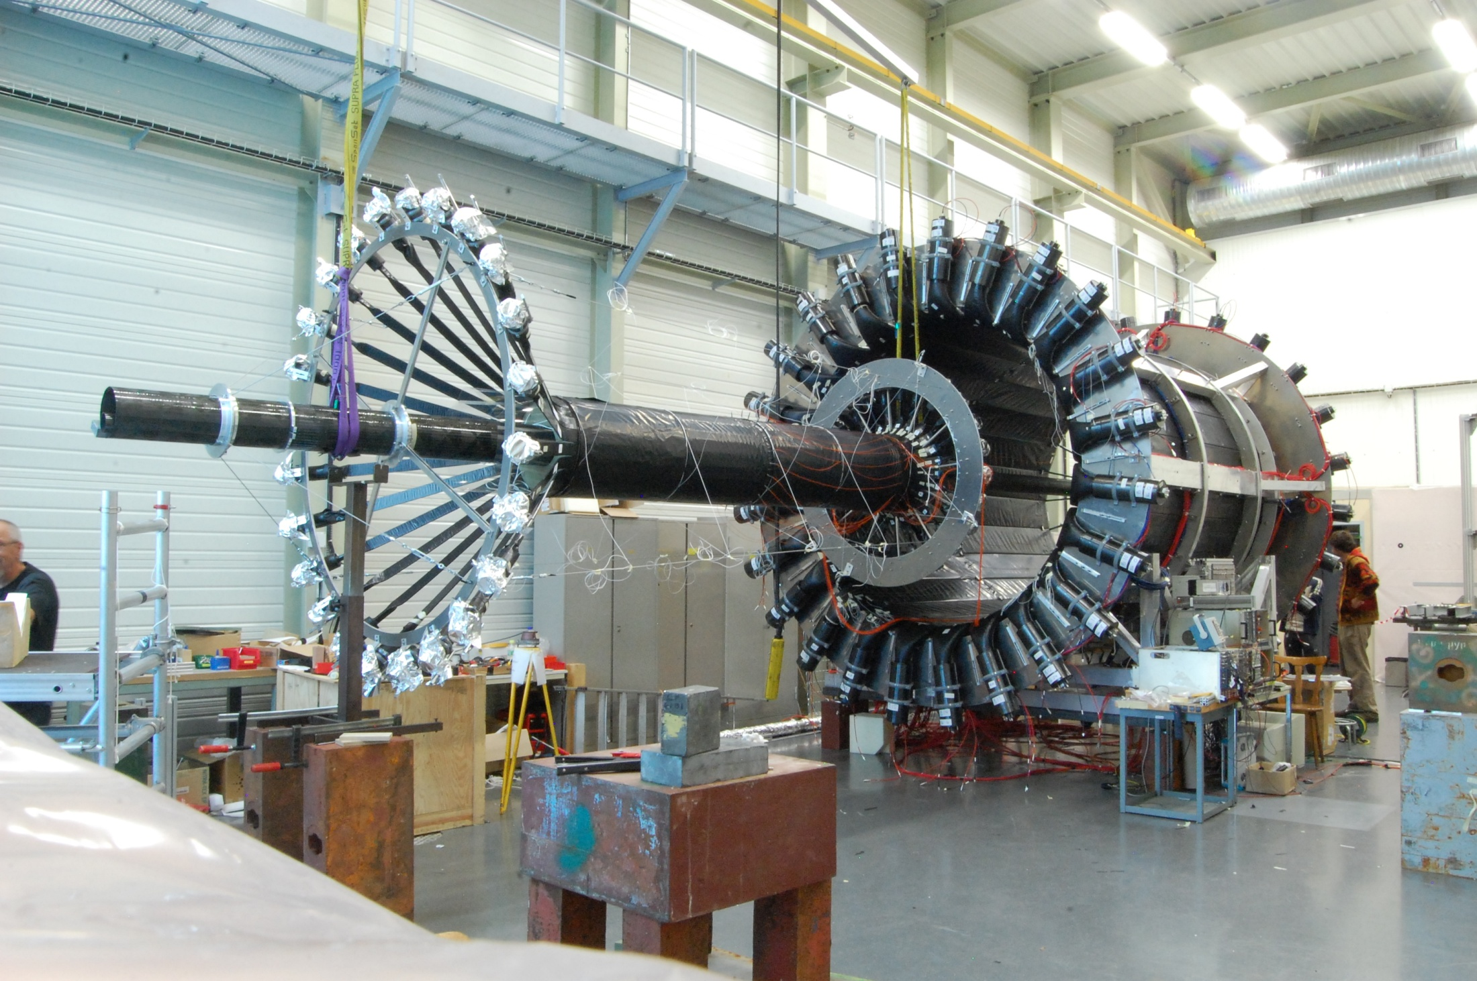
Mounting in clean room at CERN
Ring B
Ring A
14/09/2012

Slide 11
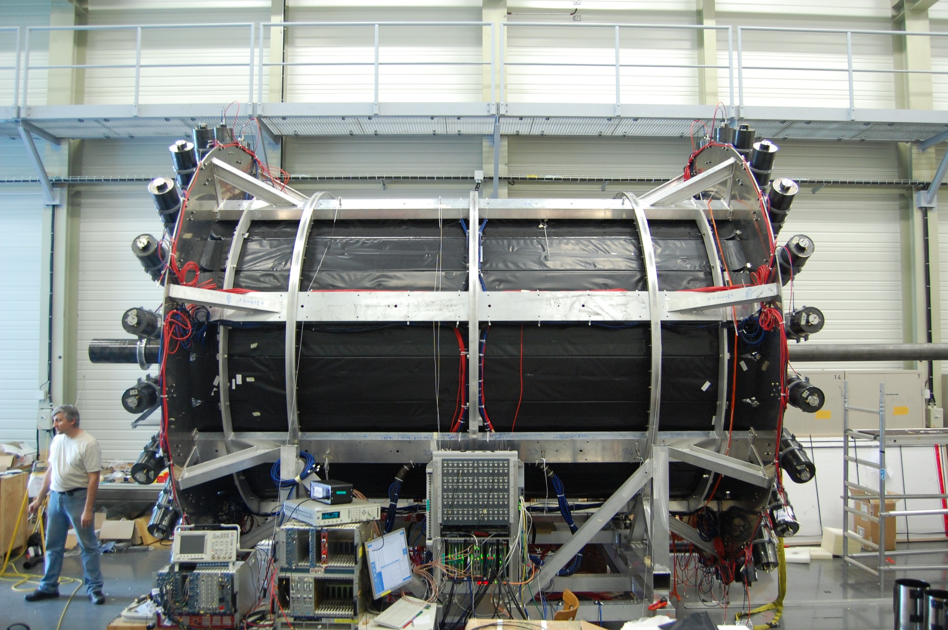
Mounting in clean room at CERN
14/09/2012

Slide 12
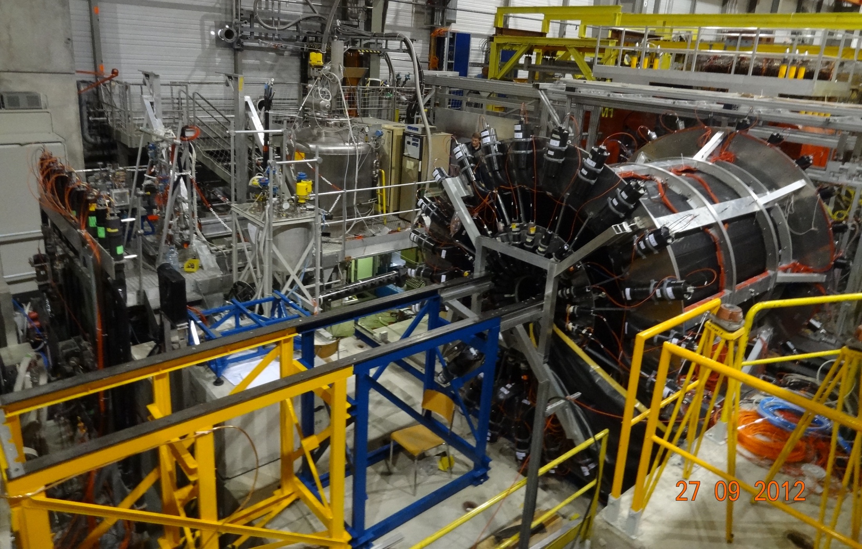
Installation in the Compass hall
27/09/2012

Slide 13
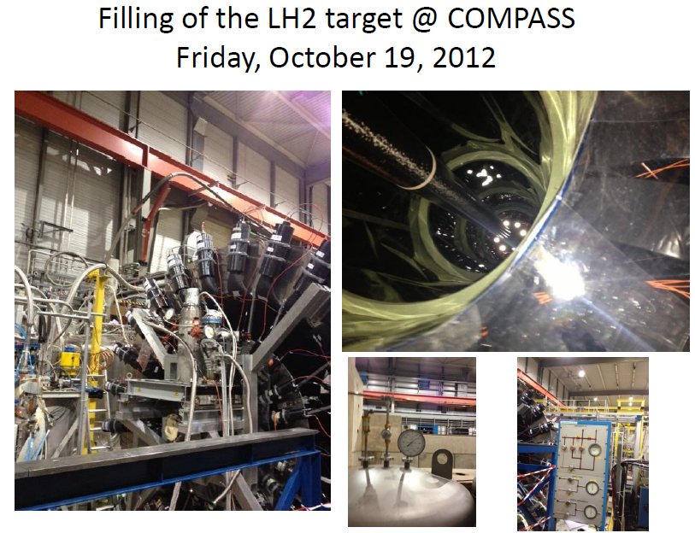
Cryo cooler
Heat exchanger

Slide 14
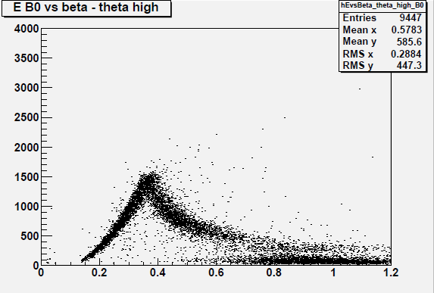
CAMERA calibration
Energy lost in Ring B
preliminary
Protons
stopped
in Ring B
β
25/09/2012
Calibration with the pion beam with elastic events (π p → π p)
➔ To face the high rates using the high muon beam intensity

Slide 15
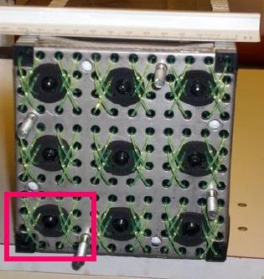
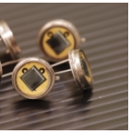
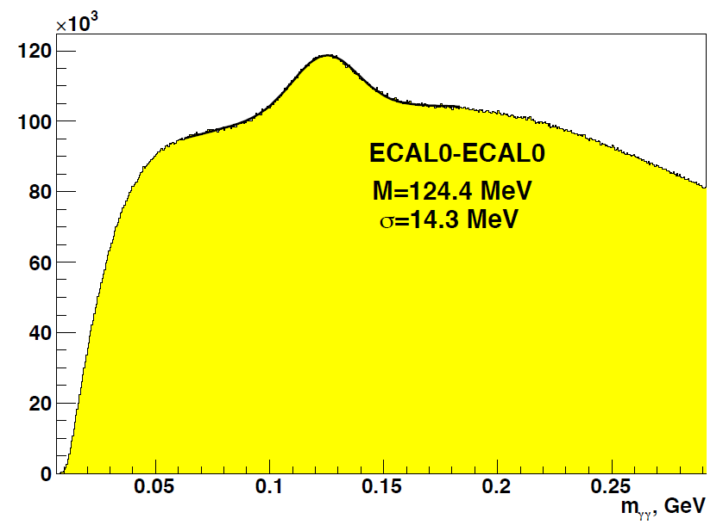
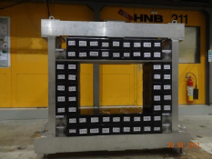
ECAL0 to enlarge the angular coverage
ECAL0 made of 200 modules (12 × 12 cm²) of 9 cells read by 9 MAPDs
Modules are available for the 2012 setup
They are already calibrated (24 Oct 2012)
30/08/2012
Eγ > 0.5 GeV
preliminary
24/09/2012

Slide 16
  Constraints on the GPD H
  and Transverse Imaging : dσ/dt
with recoil proton detection and hydrogen target
      Very first tests in 2008-9
      1 month in autumn 2012
    2 years 2015-16
NOW

Slide 17
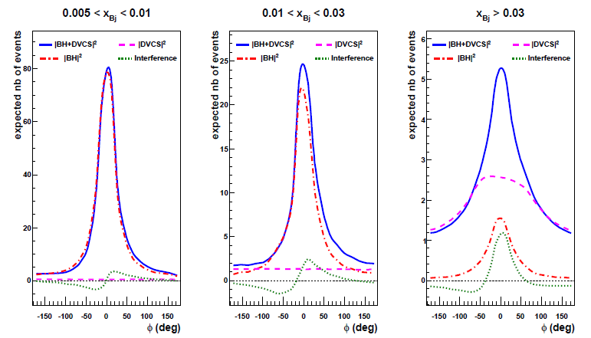
Contributions of DVCS and BH at E_{μ}=160 GeV
μ’
γ*
γ
μ
θ
φ
p
Deep VCS
Bethe-Heitler
dσ α |T^{DVCS}|² + |T^{BH}|² + Interference Term
Monte-Carlo
Simulation
for COMPASS
set-up with
only ECAL1+2
Missing
DVCS acceptance
without ECAL0
BH dominates study of Interference DVCS dominates
excellent → Re T^{DVCS} study of dσ^{DVCS}/dt
reference yield or Im T^{DVCS} → Transverse Imaging

Slide 18
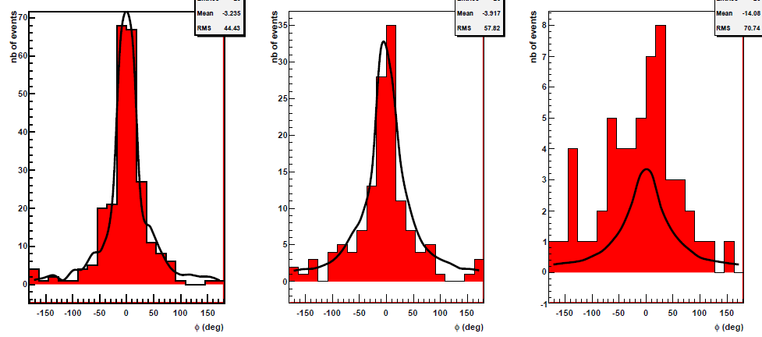
2009 DVCS test run (10 days, short RPD+target)
251 evts
135 evts
54 evts
|BH|²
|BH|²
|BH|²
PRELIMINARY
PRELIMINARY
PRELIMINARY
BH
0.005 < x_{B} < 0.01 0.01 < x_{B} < 0.03 0.03 < x_{B}
Є _{μp → μ’γ p} ≈ 35%
  × (0.8)⁴ for SPS + COMPASS avail. + trigger eff + dead time
  ε_{global} ≈ 0.14 confirmed ε_{global} = 0.1
  as assumed for COMPASS II predictions
54 evts ≈ 20 BH
+ 22 DVCS
+ about 12 γ from π⁰

Slide 19
Deeply Virtual Compton Scattering
dσ_{(μp→μpγ)} = dσ^{BH} + dσ^{DVCS}_{unpol} + P_{μ} dσ^{DVCS}_{pol}
+ e_{μ} a^{BH} Re A^{DVCS} + e_{μ} P_{μ} a^{BH} Im A^{DVCS}
Phase 1: DVCS experiment
with μ^{+↓}, μ^{-↑} beam + unpolarized 2.5m long LH2 (proton) target
to study the transverse imaging
S_{CS,U}
≡ dσ(μ ^{+↓}) + dσ(μ ^{-↑}) ∝

Using S_{CS,U} and BH subtraction
dσ ^{DVCS} /dt ~ exp(-B|t|)
and integration over φ
μ’
γ*
γ
μ
θ
φ
p

Slide 20
Transverse imaging at COMPASS
dσ ^{DVCS} /dt ~ exp(-B|t|)
mainly dominated by H(x, ξ=x, t)
B(x_{B}) = ½ < r⊥² (x_{B}) > related to ½ < b⊥² (x_{B}) >
distance between the active quark distance between the active quark
and the center of momentum of spectators and the center of momentum of the nucleon
Transverse size of the nucleon
Impact Parameter Representation
q(x, b⊥ ) <-> H(x, ξ=0, t)
< r⊥ > ~ <b⊥ > / (1-x)
?
1.
0.5
0.65 ±0.02 fm
H1 PLB659(2008)
COMPASS
x_{B}
Note 0.65 fm = √2/3 × 0.8 fm

Slide 21
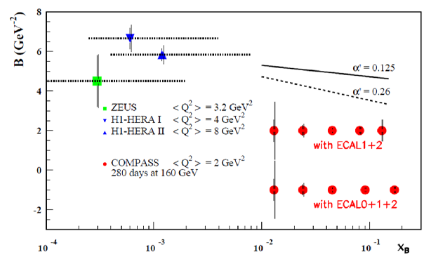
Transverse imaging at COMPASS
dσ ^{DVCS} /dt ~ exp(-B|t|)
2 years of data
160 GeV muon beam
2.5m LH₂ target
ε_{global} = 10%
as soft Pomeron
ansatz at small x_{B}
inspired by
Regge Phenomenology:
in 2 weeks in 2012
with 40 weeks in 2015-16
1rst bar= stat. error; 2nd = stat + syst. errors
B(x_{B}) = b₀ + 2 α’ ln(x₀/x_{B})
α’ slope of Regge traject
for valence quark α’ ~ 1 GeV⁻² to reproduce FF ≅ meson Regge traj.
for gluon α’ ~ 0.164 GeV⁻² (J/Ψ at Q²=0)
α’ ~ 0.02 GeV⁻² (J/Ψ at Q²=2-80 GeV²)
<< α’ ~ 0.25 GeV⁻²
for soft Pomeron

Slide 22
Transverse imaging at COMPASS
dσ ^{DVCS} /dt ~ exp(-B|t|)
2 years of data
160 GeV muon beam
2.5m LH₂ target
ε_{global} = 10%
as soft Pomeron
ansatz at small x_{B}
inspired by
Regge Phenomenology:
in 2 weeks in 2012
with 40 weeks in 2015-16
1rst bar= stat. error; 2nd = stat + syst. errors
B(x_{B}) = b₀ + 2 α’ ln(x₀/x_{B})
α’ slope of Regge traject
without any model we can extract B(x_{B})
B(x_{B}) = ½ < r⊥² (x_{B}) >
r⊥ is the transverse size of the nucleon
Accuracy > 2.5 σ if α’ = 0.125 and full ECALS

Slide 23
Transverse imaging at COMPASS
dσ ^{DVCS} /dt ~ exp(-B|t|)
DVCS test in 2012
With 2 weeks
Using the 4m long RPD
+ the 2.5m long LH2 target
1/20 of the complete
statistics
as soft Pomeron
in 2 weeks in 2012
with 40 weeks in 2015-16
1rst bar= stat. error; 2nd = stat + syst. errors
2012: we can determine one mean value of B
in the COMPASS kinematic range

Slide 24
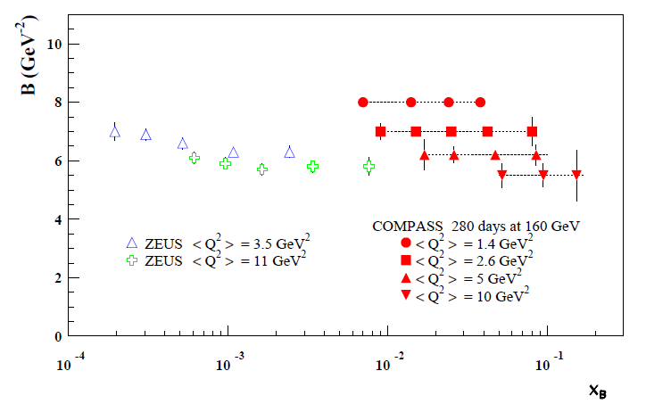
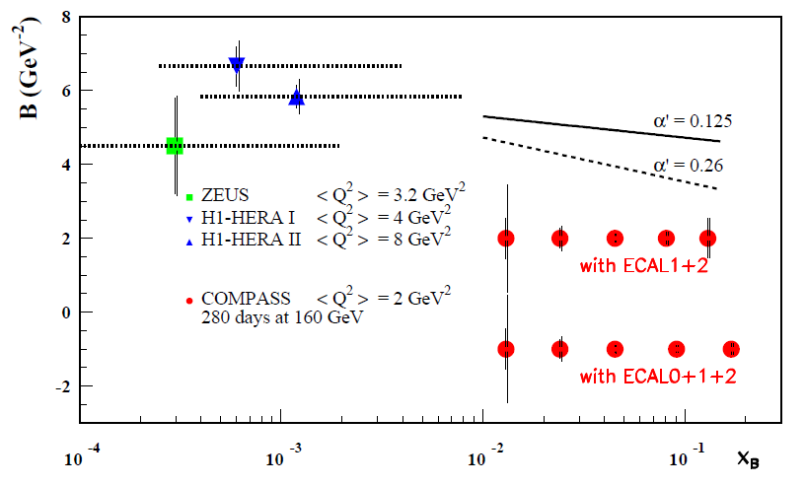
Transverse imaging at COMPASS
dσ ^{excl.ρ} /dt ~ exp(-B|t|)
Exclusive ρ production
2 years of data
160 GeV muon beam
2.5m LH₂ target
ε_{global} = 10%
model developed by Sandacz renormalised according
Goloskokov and Kroll prediction

Slide 25
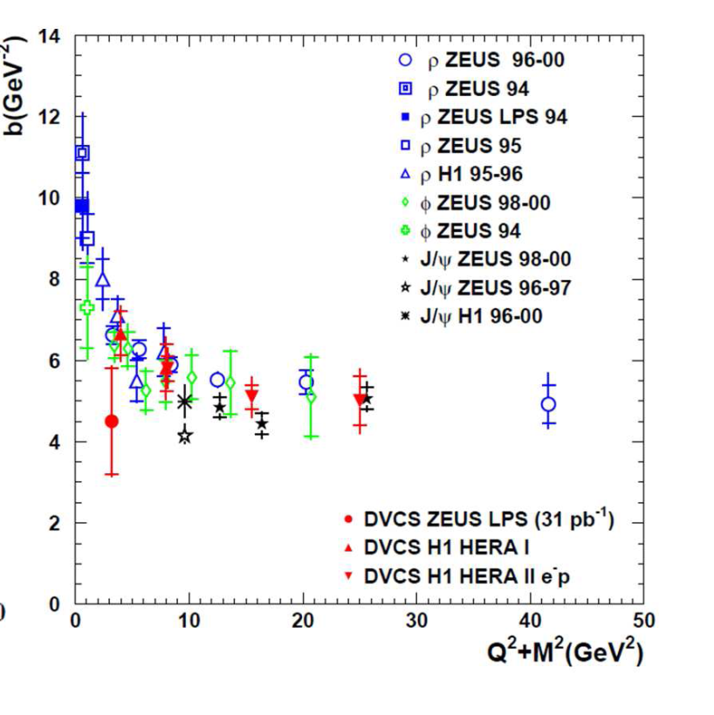
Transverse imaging at COMPASS
dσ ^{excl.ρ} /dt ~ exp(-B|t|)
Exclusive ρ production
2 years of data
160 GeV muon beam
2.5m LH₂ target
ε_{global} = 10%
B~8 @ Q²=2
B~5.5 after Q²=10
We are sensitive
to the nucleon transverse size
+ to the meson transverse size

Slide 26
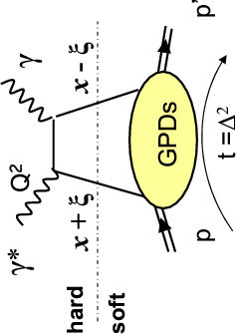
Deeply Virtual Compton Scattering
dσ_{(μp→μpγ)} = dσ^{BH} + dσ^{DVCS}_{unpol} + P_{μ} dσ^{DVCS}_{pol}
+ e_{μ} a^{BH} Re A^{DVCS} + e_{μ} P_{μ} a^{BH} Im A^{DVCS}
Phase 1: DVCS experiment to constrain GPD H
with μ^{+↓}, μ^{-↑} beam + unpolarized 2.5m long LH2 (proton) target
D_{CS,U}
≡ dσ(μ ^{+↓}) - dσ(μ ^{-↑}) ∝
and ∼ Re(F₁ H)
S_{CS,U}
and ∼Im(F₁ H)
≡ dσ(μ ^{+↓}) + dσ(μ ^{-↑}) ∝
Im H (ξ,t)= H(x= ξ,ξ,t)
Re H (ξ,t)= P ∫dx H(x,ξ,t) /(x-ξ)
Note: dominance of H at COMPASS kinematics
ξ ∼ x_{B} / (2-x_{B})

Slide 27
Deeply Virtual Compton Scattering
dσ_{(μp→μpγ)} = dσ^{BH} + dσ^{DVCS}_{unpol} + P_{μ} dσ^{DVCS}_{pol}
+ e_{μ} a^{BH} Re A^{DVCS} + e_{μ} P_{μ} a^{BH} Im A^{DVCS}
Phase 1: DVCS experiment to constrain GPD H
with μ^{+↓}, μ^{-↑} beam + unpolarized 2.5m long LH2 (proton) target
D_{CS,U}
≡ dσ(μ ^{+↓}) - dσ(μ ^{-↑}) ∝
and ∼ Re(F₁ H)
S_{CS,U}
and ∼Im(F₁ H)
≡ dσ(μ ^{+↓}) + dσ(μ ^{-↑}) ∝
Angular decomposition of sum and diff of the DVCS cross section
will provide umambiguous way to separate
the Re and Im of the Compton Form Factors
from higher twist contributions

Slide 28
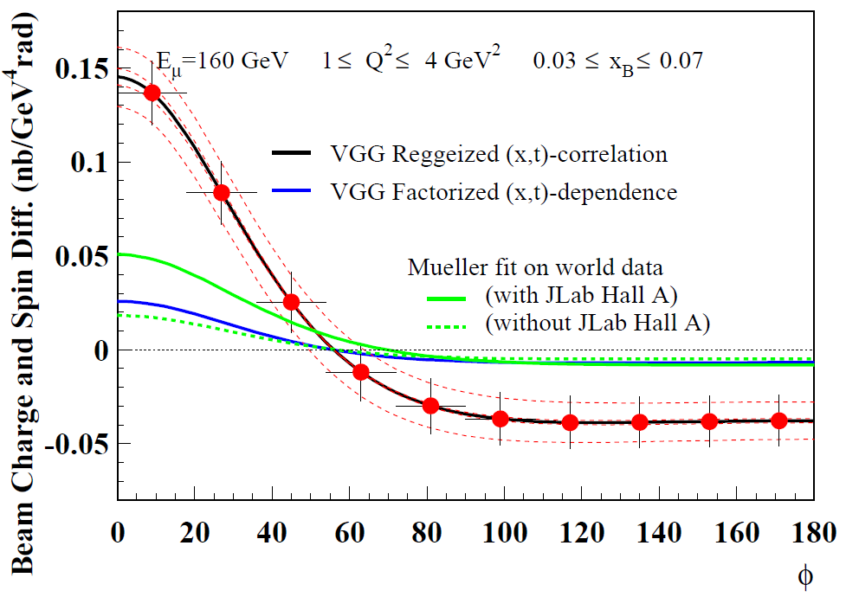
Beam Charge and Spin Difference (using D_{CS ,U})
Comparison to different models
μ’
γ*
γ
μ
θ
φ
p
0.06 < |t| < 0.64 GeV²
α’=0.8
2 years of data
160 GeV muon beam
2.5m LH₂ target
ε_{global} = 10%
α’=0.05
(asymmetries +cross section)
(only asymmetries)
Note: Kroll, Moutarde, Sabatié
predictions are of the same
order of magnitude than
Mueller predictions
High precision beam flux and acceptance determination
Systematic error bands assuming a 3% charge-dependent effect
between μ+ and μ- (control with inclusive evts, BH…)

Slide 29
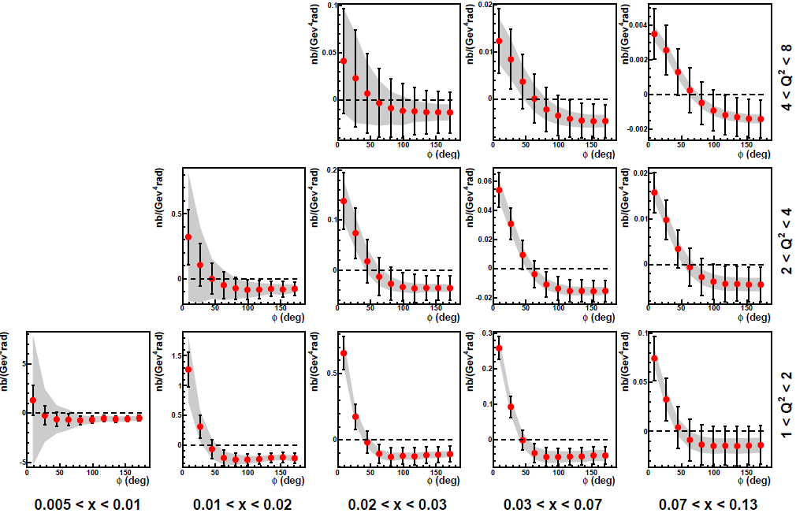
Beam Charge and Spin Difference over the kinematic domain
Statistics and Systematics
Diff = (N_{BH}+N_{DVCS})⁺ /a⁺ - ( N_{BH}+N_{DVCS})⁻/a⁻
a= lumi×acceptance
ΔDiff _{Syst} = Δa/a_{charge dependent} × Sum
∼3% (hypothesis)
ΔDiff _{Stat}= 1/√(N_{BH}+N_{DVCS}) × Sum
Eμ= 160 GeV 0.06 < |t| < 0.64 GeV²

Slide 30
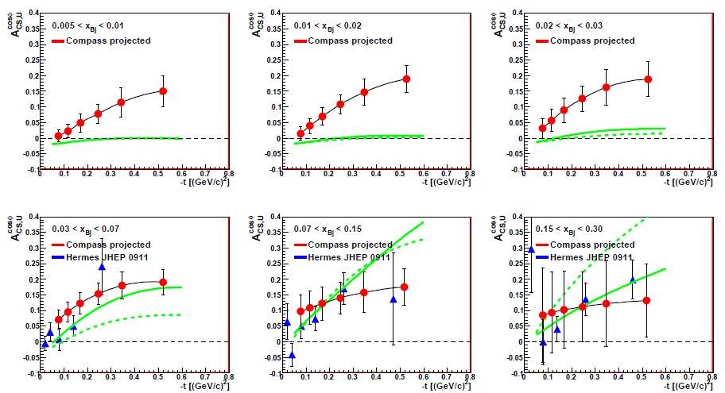
D_{CS,U}
≡ dσ(μ ^{+↓}) - dσ(μ ^{-↑}) ∝
and ∼ Re(F₁ H )
Re(F₁ H ) > 0 at H1
< 0 at HERMES/JLab
Value of x_{B} for the node?
Predictions with
VGG and D.Mueller
2 years of data
Eμ= 160 GeV 1 < Q² < 8 GeV²
With ECAL2 + ECAL1 + ECAL0

Slide 31
Constraints on the GPD E
on transversely (and long.)
polarized protons (NH3 target)
1) without recoil detection (2007 & 10)
2) with recoil detection Phase 2 (in a future addendum)
3 target cells
μ Beam
upstream central downstream
the GPD E allows nucleon helicity flip
so it is related to the angular momentum
Ji sum rule: 2J^{q} = ∫ x (H^{q} (x,ξ,0) +E^{q} (x,ξ,0) ) dx
q
q
p
E
p
t
The GPD E is the ‘Holy-Grail’ of the GPD quest

Slide 32
Constraints on the GPD E
on transversely (and long.)
polarized protons (NH3 target)
1) without recoil detection (2007 & 10)
2) with recoil detection Phase 2 (in a future addendum)
3 target cells
μ Beam
upstream central downstream
the GPD E allows nucleon helicity flip
so it is related to the angular momentum
Ji sum rule: 2J^{q} = ∫ x (H^{q} (x,ξ,0) +E^{q} (x,ξ,0) ) dx
q
q
p
E
p
t
The GPD E is the ‘Holy-Grail’ of the GPD quest

Slide 33
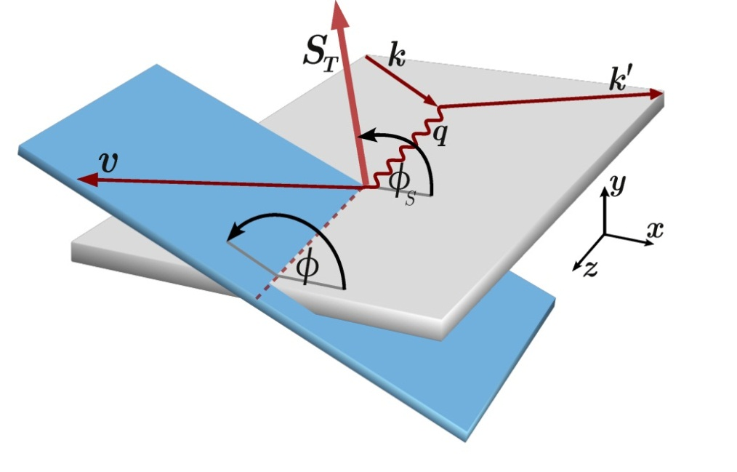
Hard Exclusive Vector Meson Production
A_{UT}(ρ⁰_{L}) ∝ √|-t’| Im( E* H ) / |H|²
× sin(φ - φ_{S})
S_{T} target spin vector / γ* direction
P_{T} target transverse polarization / the μ beam direction
Diehl, Sapeta, EPJC41 (2005)
Diehl, JHEP09 (2007)
θγ* mainly smaller than 60mrad at COMPASS

Slide 34
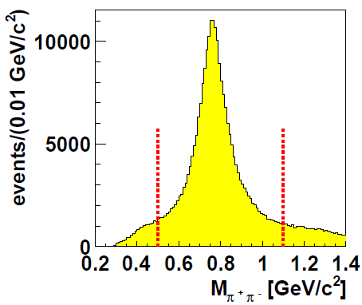
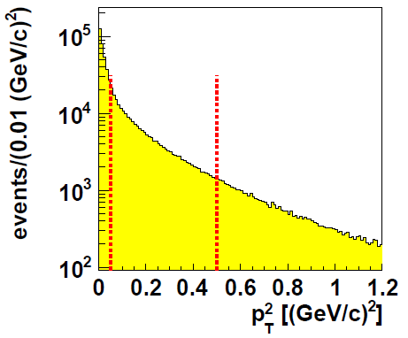

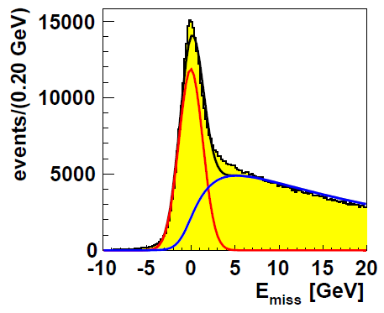
Selection of Exclusive ρ° Production: μ p → μ’ ρ° p
without RPD
1< Q² < 10 GeV² 0.1 < y < 0.9 W>4 GeV E_{ρ}> 15 GeV
1- Assuming both hadrons are π
0.5 < M_{ππ}< 1.1 GeV
To maximize the purity of the sample of ρ° /
non resonant π⁺π⁻
2- Suppression of incoherent production on quasi-free
protons in NH₃ polarized target
+ Suppression of SIDIS background
0.05 < p_{t}²< 0.5 GeV²
Contamination of about a 5% coherent production
3- Exclusivity of the reaction
-2.5 < E_{miss} < 2.5 GeV
Diffractive dissociation contamination ~14%
No attempt to remove it(motivated by HERA)
correction for SIDIS background (5 to 40%)
in each bin (x_{Bj}, Q², p_{T}², Φ - Φ_{S} , cell and polar. state

Slide 35
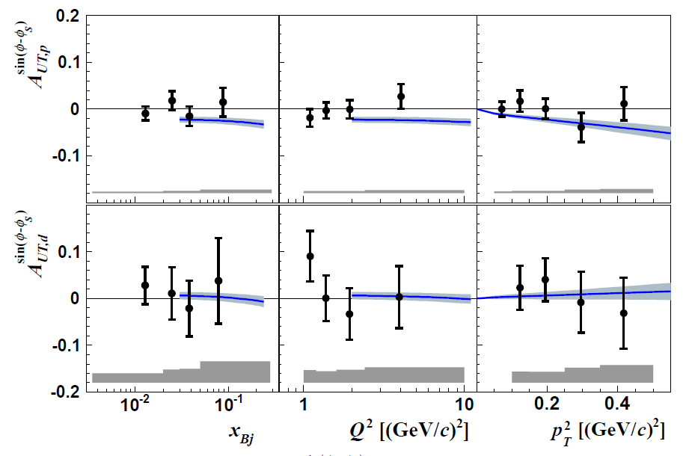
Exclusive ρ° production on transerve polar. target
without Recoil Detection
Proton (NH₃ target – 2007-2010 data)
Deuton (⁶LiD target – 2003-2004 data)
COMPASS (NPB 865 1- July 2012) and predictions by
Goloskokov & Kroll, EPJ C59 (2009)

Slide 36
Exclusive ρ° production on transerve polar. target
without Recoil Detection
Proton (NH₃ target – 2007-2010 data)
E^{u} and E^{d} cancel
Deuton (⁶LiD target – 2003-2004 data)
COMPASS (NPB 865 1- July 2012) and predictions by
Goloskokov & Kroll, EPJ C59 (2009)

Slide 37
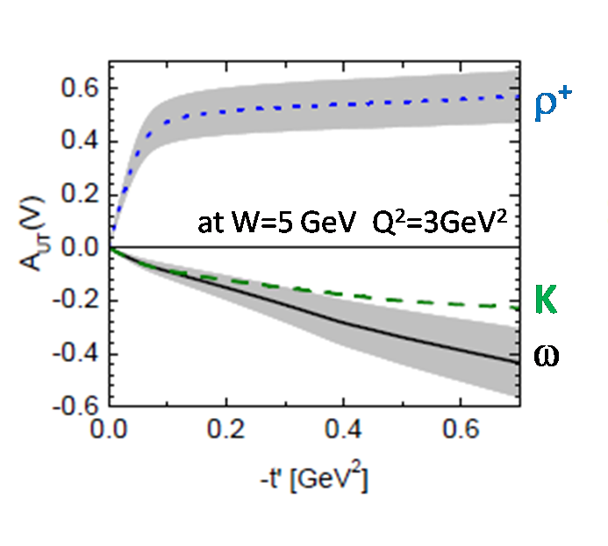
Hard Exclusive Vector Meson Production
A_{UT}(ρ⁰_{L}) ∝ √|-t’| Im( E* H ) / |H|²
Goloskokov & Kroll, EPJ C59 (2009)
κ^{q} = ∫ e^{q} (x) dx
➔ E^{u} ~ -E^{d}
Eρ⁰ ∝ 2/3 E^{u} + 1/3 E^{d} + 3/8 E^{g}
Eω ∝ 2/3 E^{u} – 1/3 E^{d} + 1/8 E^{g}
Eρ⁺∝ E^{u} – E^{d} - 3/8 H^{g}
ρ⁰
A_{UT}(ρ⁰) very small
A_{UT}(ω) and A_{UT}(ρ⁺) should be more promising
analysis on going for ω, ρ⁺, φ and γ

Slide 38
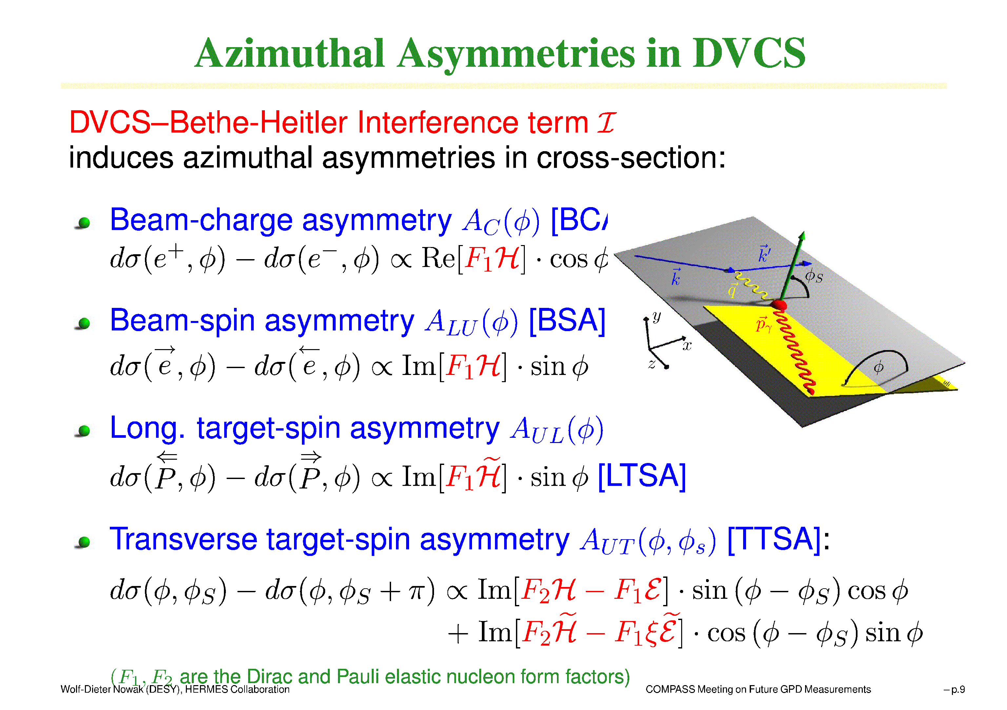
Deeply Virtual Compton Scattering
Phase 2 (in future): DVCS experiment to constrain GPD E
with μ^{+↓}, μ^{-↑} beam and transversely polarized NH3 (proton) target
μ’
γ*
γ
μ
θ
φ
p
∝ Im(F₂ H – F₁ E) sin(φ- φ_{S}) cos φ
D_{CS,T}
≡ dσ_{T} (μ ^{+↓}) – dσ_{T} (μ ^{-↑})

Slide 39

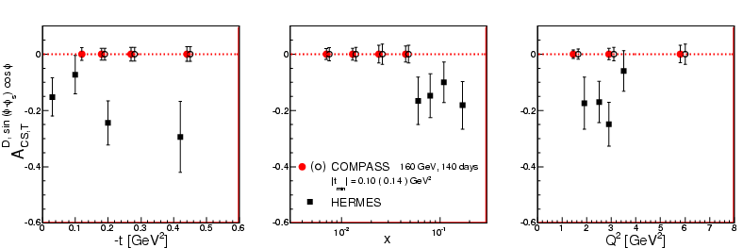
D_{CS,T}
and Transverse Target Asymmetry
Prediction for phase 2 (in future)
With a transversely polarized NH3 (proton) target:
2 years of data
160 GeV muon beam
1.2 m polarised NH₃ target
ε_{global} = 10%
CS,T
related to H and E
With ECAL2 + ECAL1

Slide 40
Summary for GPD @ COMPASS
GPDs investigated with Hard Exclusive Photon and Meson Production
μ^{+↓}, μ^{-↑} 160 GeV
COMPASS-II 2012-16: with LH₂ target + RPD (phase 1)
the t-slope of the DVCS and HEMP cross section
  → transverse distribution of partons
the Beam Charge and Spin Sum and Difference
  Re T^{DVCS} and Im T^{DVCS} for the GPD H determination
Longitudinal contribution of Vector Meson ρ⁰,ρ⁺,ω, Φ → GPD H
Total contribution of π⁰ → GPDs E and E_{T}
Using the 2007-10 data: transv. polarized NH₃ target without RPD
In a future addendum > 2016: transv. polarised NH₃ target with RPD (phase 2)
the Transverse Target Spin Asymm
→ GPD E and angular momentum of partons
~

Slide 42
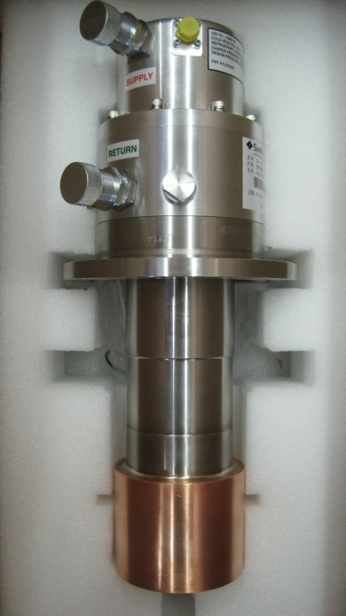
Vacuum pump connection
Cryo cooler
Heat exchanger
buffer volume
Target support
Vacuum flange

Slide 43
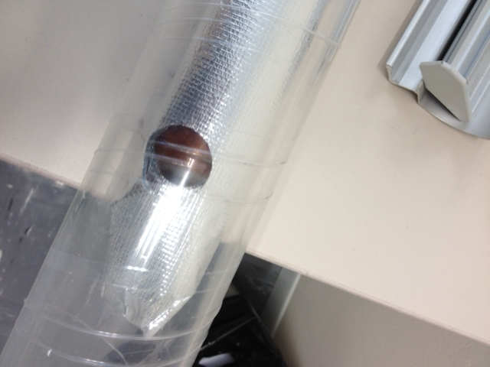
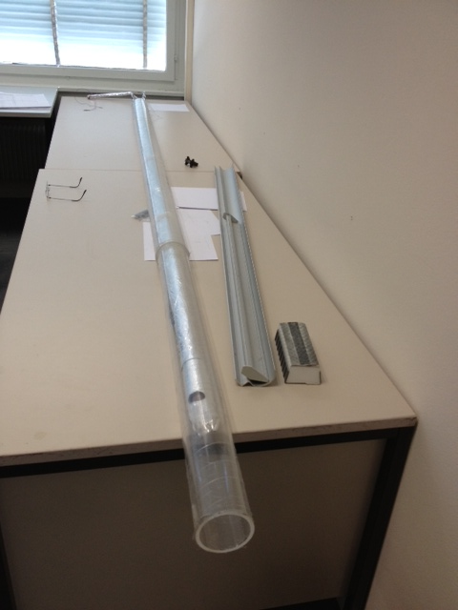
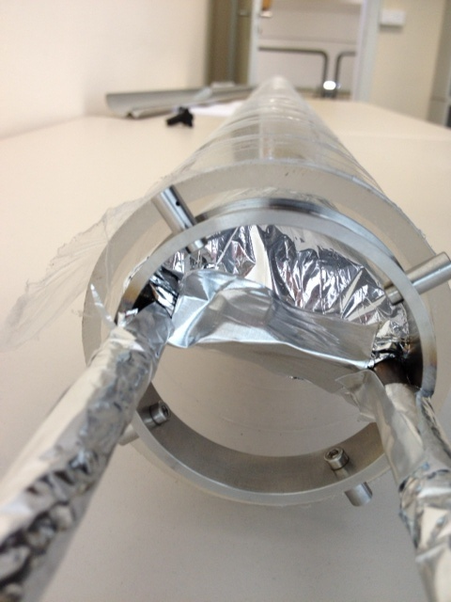
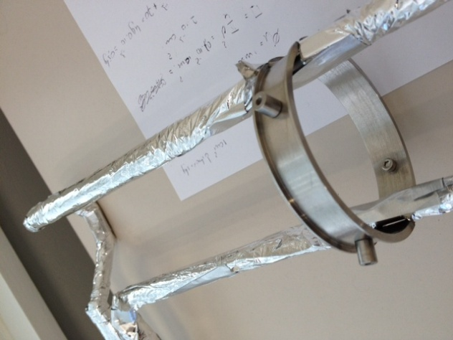
LH2 cell

Slide 44
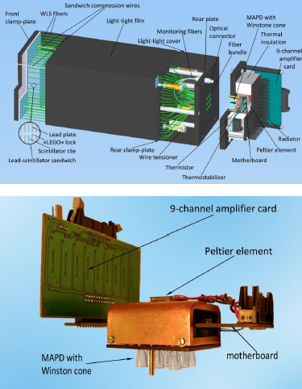
ECAL0 to enlarge the angular coverage

Slide 45
as soft Pomeron
α’= 0.8
in 2 weeks in 2012
with 40 weeks en 2015-16
1rst bar= stat. error; 2nd = stat + syst. errors

