Slide 1
International Committee for Spin Physics Symposia XIII WORKSHOP ON HIGH ENERGY SPIN PHYSICS
Dubna, Russia September 1 - 5, 2009
AZIMUTHAL ASYMMETRIES IN SEMI-INCLUSIVE PRODUCTION OF HADRONS ON THE LONGITUDINALLY POLARIZED DEUTERIUM TARGET
I.Savin, JINR,Dubna,on behalf of the COMPASS Collaboration
OUTLINE
Introduction: theoretical summary & motivations.
Methods of the analysis: single & double ratios.
Data selection.
Results.
Conclusions and prospects.
Back up slides.
Supported by the RFFI-CERN grant 08-02-91013

Slide 2
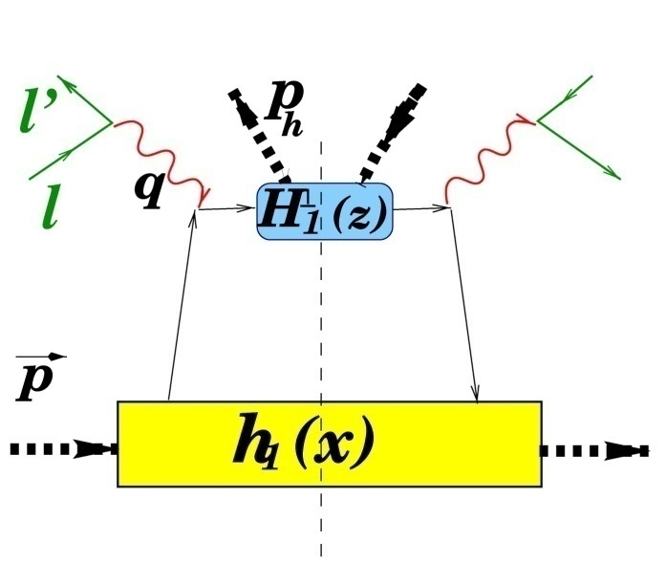
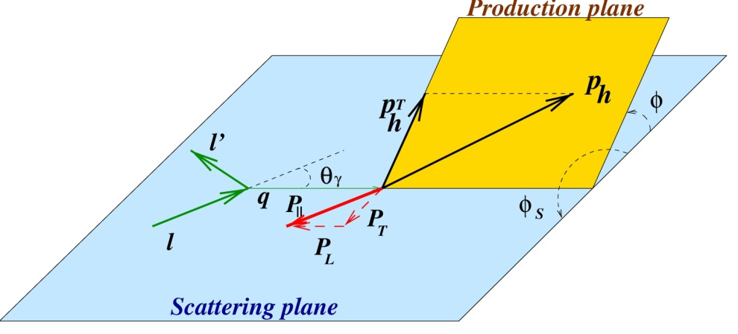
INTRODUCTION (1)
The azimuthal distributions of hadrons in SIDIS of leptons on T-and L-targets are sources of information on the PDF and PFF, characterizing the transverse spin structure of nucleons, e.g.:
A number of PDF’s and PFF’s enter in SIDIS cross section

Slide 3
INTRODUCTION (2)
The cross section and asymmetry of the h production in SIDIS:
,
where contributions to σ_{ij} (i=beam, j= target polarizations) from each quark and antiquark (up to the order of (M/Q)) have forms:
Twist 3
helicity
Twist 3
transversity
Mulders&Tangerman
Boer&Mulders
Bucchetta et al.
Sivers
,
⊗=convolution in k_{T}
, φ_{S} = 0 for L-target

Slide 4
INTRODUCTION (3)
Summary:
Quark transverse spin effects contribute to the asymmetries A_{L}(φ) in hadron production from longitudinally polarized target.
Asymmetries modulations should be seen in A_{L}(φ).
Aims: search for A_{L}(φ), its possible sin(φ) (Sivers + Transversity), sin(2φ) , sin(3φ) (Pretzelosity) and cos(φ) (Twist 3) modulations and -dependence of corresponding amplitudes.
A_{L}(φ) expected to be small, ≤1%.
Methods of analysis should be adequate.

Slide 5
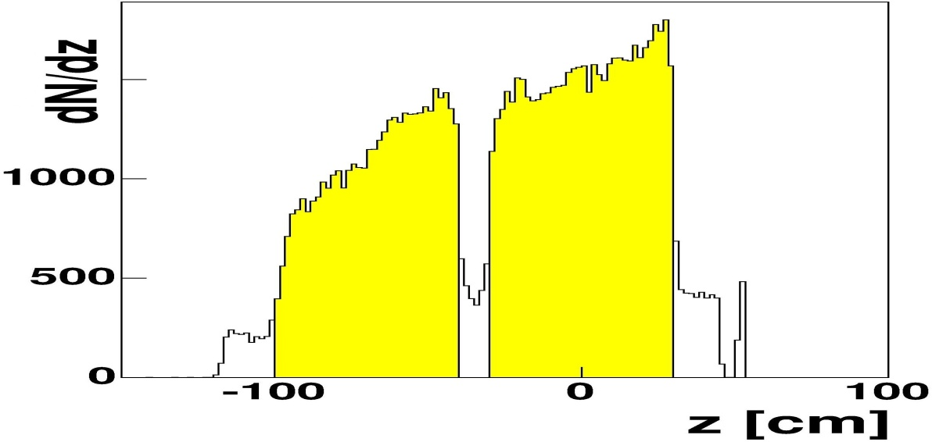
The polarized ⁶LiD-Target
The single ratio method, SRM (1)
4 possible spin combinations:
1
³He – ⁴He Dilution
refrigerator (T~50mK)
superconductive
2
Solenoid (2.5 T)
Dipole (0.5 T)
reversed every 8
hours
or:
two 60 cm long Target-Containers
with opposite polarization
3
4
reversed once a week
Polarization: ~ 50%

Slide 6
SRM (2)
Usually the φ- asymmetry is defined as
± - are the target polarizations
where
C is an acceptance (assumed to be φ-independent) ,L± is a luminosity and <P±> are average products of target polarization and dilution factors.
For COMPASS two cells target:

Slide 7
SRM (3)
The SRM method has been tested using a part of the COMPASS data of 2002, standard COMPASS selection cuts.
Results on asymmetries: A_{f}(φ), f is a direction of the target solenoid magnetic field, f=+ or -:
different for f₊ and f₋, i.e. A(φ) distributions depend on the initial f
different for U and D cells:
⇓
Large false asymmetries,
larger than physics ones
SRM can not be used for searches of small asymmetries

Slide 8
METHODS OF ANALYSIS: THE MODIFIED DOUBLE RATIO METHOD, (MDR) (1)
where
is a number of events,
t = U or D for Upper or Down cell,
p = + or – polarization (along or opposite to the beam),
f = + or – solenoid field direction (along or opposite to beam),
target acceptance factor (source of false asymmetries),
product of beam flux and target density,
σ_{p} spin dependent cross sections.
and cancel if beam crosses both cells and if one combines periods with the same f.

Slide 9
MDR (2)
Configuration 1 Configuration 2
Up Down Up Down
H(ƒ)
Beam
S(p)
free of false (multiplicative) asymmetries connected with the field.

Slide 10
MDR (3)
Summary:
the MDR method has been tested using a part of data,
possible φ-dependent false asymmetries, connected with the target solenoid magnetic field, are canceled,
the MDR method can be used for studies of small modulations of φ- asymmetries, of order 0.2% or smaller,
the analysis of the full set of COMPASS L-data is in progress, first the data of 2002-2004 from deuterium, presented in this talk.

Slide 11
DATA SELECTION (1)
AIM: TO HAVE A CLEAN SAMPLE OF IDENTITYED HADRONS
(1) Selection of “GOOD EVENTS” out of preselected sample of events with Q²>1 GeV² and y>0.1 (=167.5 M from 2002, 2003, 2004 data taking)
EXCLUDED EVENTS:
originated from bad spills,
with a number of rec.prim.vertex >1,
χ²/NDF>2,
Z vertex outside the fiducial volume U or D- cell,
140 GeV >E(muon)> 180 GeV,
invariant mass W < 5 GeV,
y > 0.9.
= 58% of initial sample

Slide 12
DATA SELECTION (2)
(2) Selection of “GOOD TRACKS” from “GOOD EVENTS”.
Total number of tracks from “GOOD EVENTS” = 290 M
Excluded tracks:
identified as muons,
with z-variable >1,
with <0.1 GeV -----------→ “GOOD TRACKS” = 157 M
(3) Selection of “GOOD HADRONS” from “GOOD TRACKS”.
Each track should:
hit one of the hadron calorimeters HCAL1 or HCAL2,
have an associated energy cluster E_{hcal1}>5 GeV or E_{hcal2} > 7 GeV,
energy cluster coordinates compatible with the track coordinates,
energy cluster compatible with the momentum of the track → “GOOD HADRONS” = 53 M (25 M h⁻ + 28 M h⁺)
(4) Each “GOOD HADRON” enters in considerations of asymmetries

Slide 13
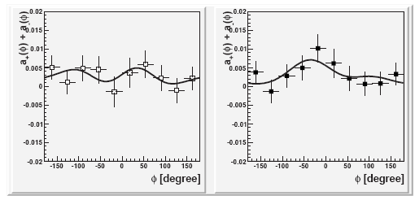
RESULTS (1)
The weighted sum of azimuthal asymmetries (AA) a₊(φ) and a₋(φ) for h⁻(left) and h⁺(right) averaged over all kinematical variables :
h⁻
h⁺
Preliminary
COMPASS 2002-2004
Preliminary
COMPASS 2002-2004
where solid lines are fit functions a₊+a₋=a₀+a₁sin(φ)+a₂sin(2φ)+a₃sin(3φ)+a₄cos(φ).
Within a stat. precision of about 0.15%, parameters a₁-a₄ are compatible with zero; fits by constants: Chsq/DF=4.8/9(h⁻) and 8.0/9(h⁺),
parameters a₀ are different from zero and about equal for h⁺ and h⁻.
REMIND: a₀ ∝dσ_{LL} ∝xg_{1L}(x) ⊕D₁(z) , where g_{1L} is a helicity PDF of L-polarized quarks in L-polarized target

Slide 14
RESULTS (2)
Dependence of the AA parameter a₀ for h⁺ and h⁻ on kinematical variables:
COMPASS 2002-2004
COMPASS 2002-2004
COMPASS 2002-2004
(D₀ is a virtual photon depolarization factor) is in
agreement with COMPASS published data (PLB660(2008)458),
a₀(z, ) for h⁻ and for h⁺: small and flat.
Statistical errors are shown, systematic ones are estimated to be smaller.

Slide 15
RESULTS (3)
Dependence of the AA parameter a₁ for h⁺ and h⁻ on kinematic variables:
2002-2004
2002-2004
2002-2004
a₁(x) are less pronounced than the HERMES ones,
is flat and do not confirm the HERMES trends.
REMIND: ,
where h_{L}(x) and are pure twis-3 PDF.
NOTE: HERMES data are for identified π⁺ and π⁻ and smaller <Q²>.

Slide 16
RESULTS (4)
Dependence of the AA parameter a₂ for h⁺ and h- on kinematic variables:
2002-2004
COMPASS 2002-2004
COMPASS 2002-2004
a₂(x) are small and in general agree with HERMES and theoretical predictions by H.Avakian et al., Phys.Rev. D77 (2008),
- no other data.
REMIND: where is a PDF not seen yet.

Slide 17
RESULTS (5)
Dependence of the AA parameter a₃ for h⁺ and h⁻ on kinematic variables:
COMPASS 2002-2004
COMPASS 2002-2004
COMPASS 2002-2004
a₃ are small, compatible with zero.
REMIND: , where is pretzelosity PDF ,additionally suppressed by

Slide 18
RESULTS (6)
Dependence of the AA parameter a₄ for h⁺ and h⁻ on kinematic variables:
COMPASS 2002-2004
COMPASS 2002-2004
COMPASS 2002-2004
a₄(x) increasing with x in absolute value,
a₄(z) and small, flat and consistent with zero,
a₄(x, z, p_{h}) are studied for the first time.
REMIND: , where is a pure twist-3
PDF (analog to the Cahn effect in unpolarized SIDIS).
RESULTS (1)-(6) DO NOT DEPEND ON Z-CUT (0.05 or 0.2).

Slide 19
CONCLUSIONS & PROSPECTS (1)
The azimuthal asymmetries (AA) in the h⁻ and h⁺ production on L-polarized target are observed and parameterized with sin (φ), sin (2φ), sin (3φ) and cos(φ). For the AA integrated over-all-kinematical-variables , these amplitudes are consistent with zero within errors.
The behaviour of the AA parameters are studied in the available region of kinematical variables which have shown that:
the constant term of the AA parameterization, A₀(x), is in good agreement with the COMPASS data on ;
the values of the sin (φ) parameter are small and in general do not contradict to the HERMES data, if one takes into account the difference in Q² between the two experiments;
the values of the sin (2φ) parameter , sin (3φ) parameter and cos(φ ) parameter are consistent with zero.
THE REPORTED DATA ARE PRELIMINARY.
NEW DATA of 2006 on D and
NEW DATA of 2007 on H ,
obtained with 3-cells target (smaller systematics) will be added

Slide 20
BACK UP SLIDES (1)
PDF & FF APPEARING IN SIDIS:
ƒ₁(x)≡q(x) is the PDF of non-polarized quarks in a non-polarized target,
g_{1L}(x)≡g₁(x) ≡ Δq(x) is the PDF of the longitudinally polarized quarks in the longitudinally polarized target (helicity PDF),
g_{1T}(x) is the same as g₁(x) but in the transversely polarized target,
h₁(x) is the PDF of the transversely polarized quark with polarization parallel to that one of a transversely polarized target (so-called transversity PDF),
is the PDF of the transversely polarized quark in direction of transverse momentum in longitudinally (transversely) polarized target (so-called pretzelosity PDF),
is the PDF of the transversely polarized quark (perpendicular to transverse momentum) in the non-polairzed target (so-called Boer-Mulders PDF),
is the PDF responsible for a left-right asymmetry in the distibution of the non-polarized quarks in the transversely (longitudinally) polarized target (so-called Sivers PDF),
D₁(z) is the PFF of the non-polarized quark in the non-polarized or spinless produced hadron,
is the PFF responsible for a left-right asymmetry in the fragmentation of a transversely polarized quark into a non-polarized or spinless produced hadron (so-called Collins PFF),
and are pure twist-3 trms entering the cross section with a factor M/Q and having no clear physical interpretation.

Slide 21
BACK UP SLIDES (2)
Sources of false asymmetries are identified using a simplified expression for A(φ):
Remind, that
Sin(φ) appears from the vector product which is pseudo-vector.
But it could appear only being multiplied by another pseudo-vector:
spin of the target
spin of the muon
with a fraction
physics asym.
target magnetic field
product
product
false asym., due to incomplete
knowledge of and/or misalignments
So, p₁~p_{s}+p_{μ}+p_{H μ}+p_{HS}+p_{H} ,where false asim depend on:
- directions of the field,
- track extrapolations,
- sign of particles.
different for U and D cells.

Slide 22
BACK UP SLIDES (3)
Q²
y
z

Slide 23
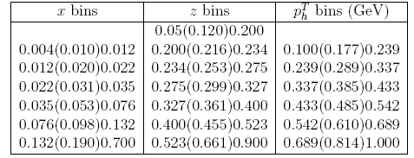
BACK UP SLIDES (4)
The size of each bin is optimized to have ≥ 1 M of events

