Slide 1
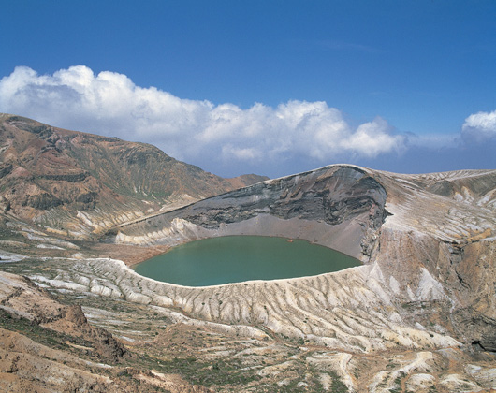




Spin structure of the nucleon studied with muon and electron beams
G. K. Mallot
CERN/PH
JPS Autumn Meeting,
Yamagata, Japan, September 23 , 2008
Zao Okama Crater Lake

Slide 2
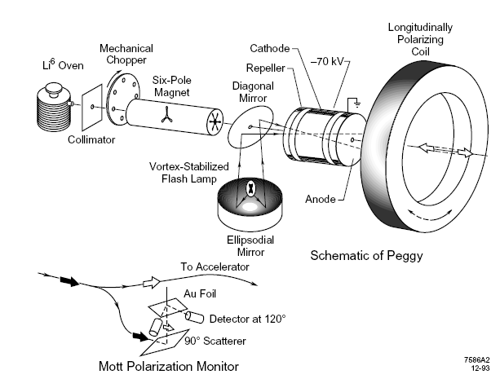
The early days
SLAC-Yale E80 (1975):
beam:
10-16 GeV e⁻ ,
85% pol from pol. ⁶Li
target:
butanol 60% pol
Peggy

Slide 3
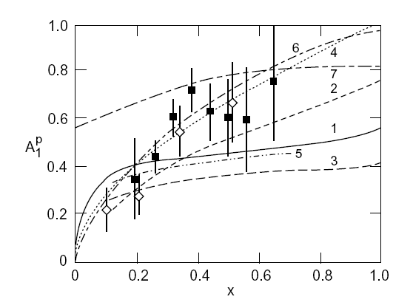
Support for the QPM
large longitudinal double spin asymmetries at large x_{Bj}
predicted by Bjorken from the Quark Parton Model
E80 (◊)
E130 (▪)

Slide 4
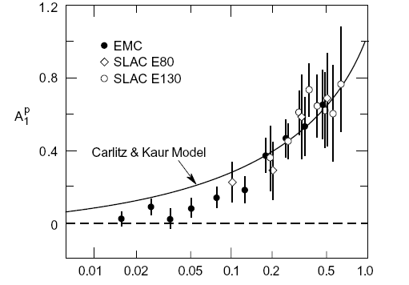
The shock 1987/88
European Muon Collaboration (EMC) at CERN
beam: 100 – 280 GeV, muons, pol. 80%
target: ammonia,
80% pol.
models wrong
below x < 0.1
unmeasured by
E80 & E130
x

Slide 5

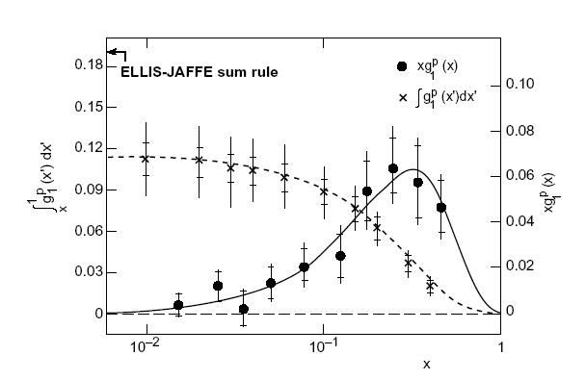
EMC 1987/88
20th anniversary

Slide 6
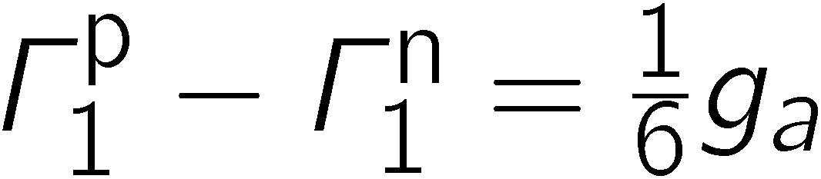
Implications of the EMC result
The Ellis-Jaffe sum rule for the proton is violated
The fundamental Bjorken sum rule can only be valid, if the EJ sum rule for the neutron is violated by the same amount
“if wrong, QCD is wrong”
The strange quark polarization Δs does not vanish
The quark spins contribute little to the proton spin

Slide 7
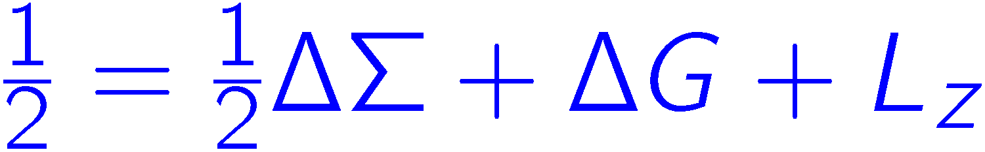
Where, oh where is the proton spin?
Elliot Leader
small
poorly known
certainly not 6
unknown

Slide 8
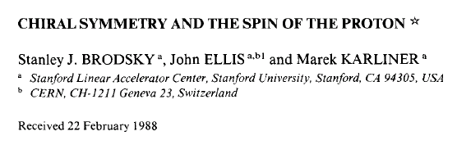
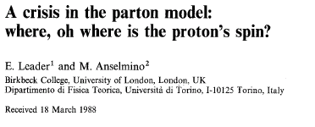
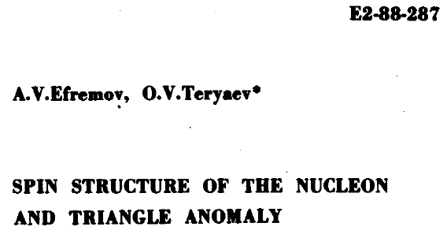
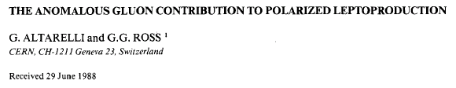
Theory Input 1988
PLB 206 (1988) 309
ZPC 41 (1988) 239
PLB 212 (1988) 391

Slide 9
Considered Options
Skyrmions: model,
all orbital angl. mom. ( BEK) maybe
Bjorken sum rule broken?
Measurement wrong? (LA) no!
Large ΔG ~ 2-3-6 at EMC Q² could mask measure
quark spin via axial anomaly (ET, AR) gluon pol!
requires fine tuning of cancelation of ΔG and orbital angular momentum (orb. ang. mom. is generated at gluon emission)

Slide 10
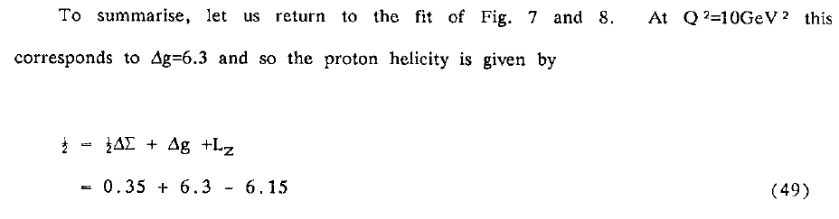
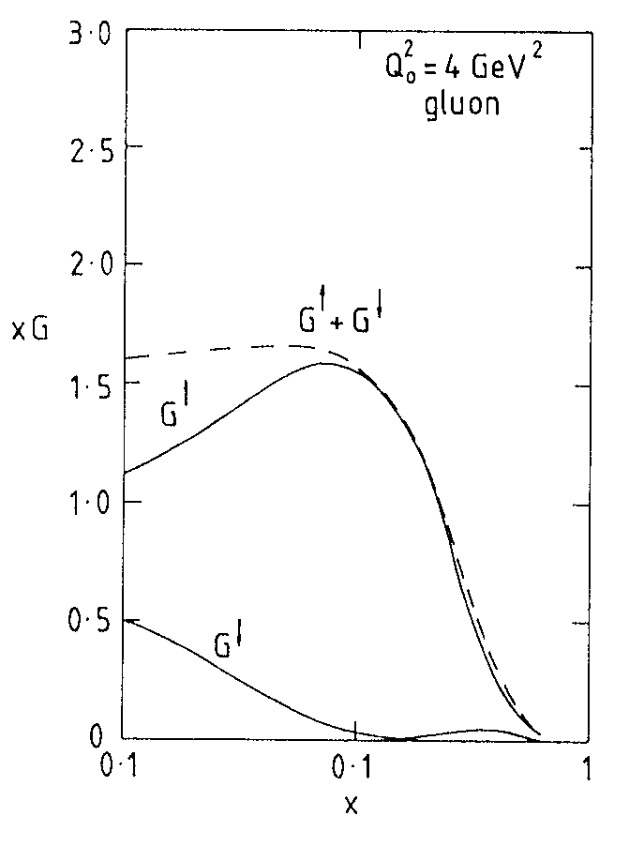
Lepton-Photon 1989
G. Ross 1989
possible scenario:
∆G ≈ 6 (Q²=10 GeV²)
∆g/g(x) = 1 for x_{g} > 0.1

Slide 11
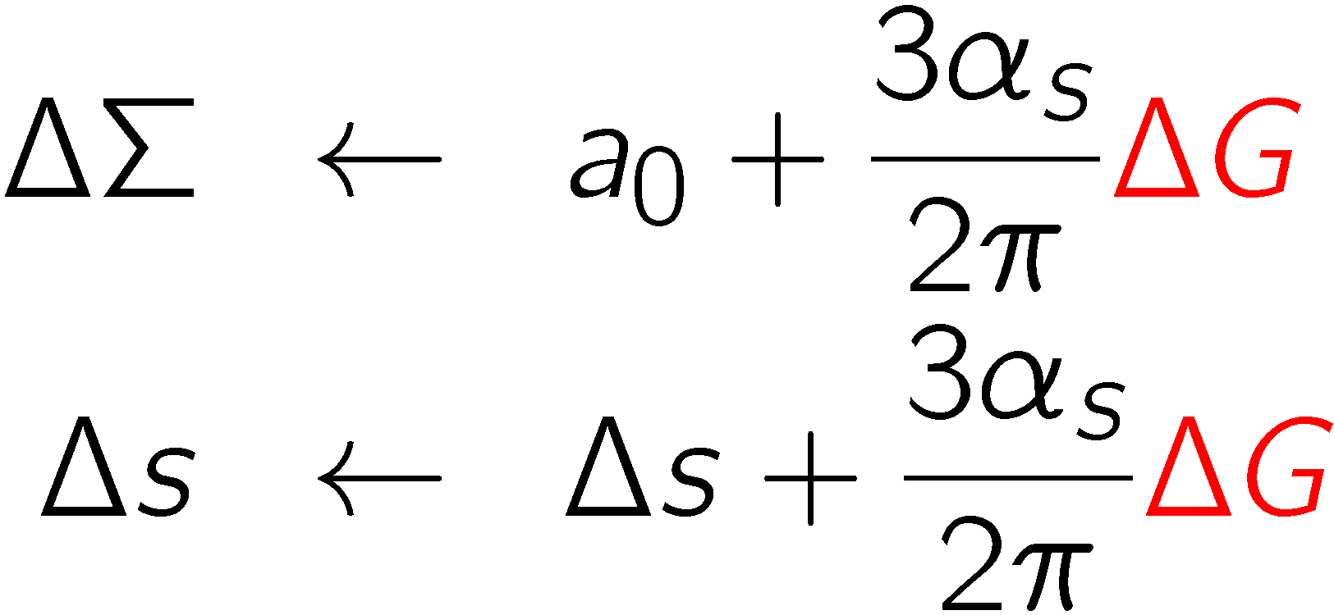
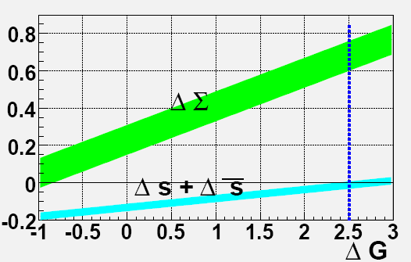
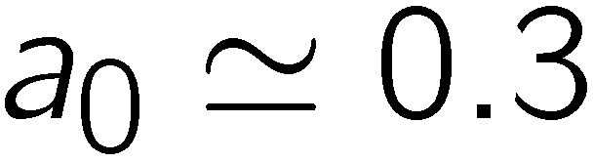

∆G and ∆Σ in AB/jet scheme
α_{s} strong coupling constant
Now:
Need:

Slide 12
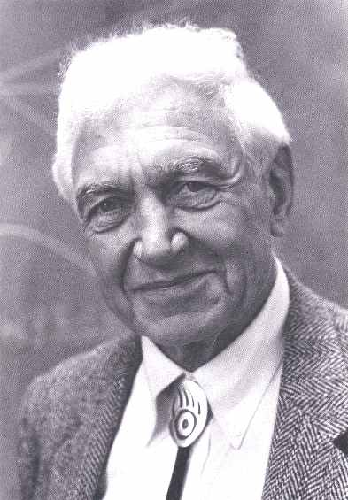





Priorities in 1988
repeat EMC meas. with higher precision and
measure BJ sum rule (neutron experiment)
gluon polarization (longer term)
Vernon W Hughes,
1921 – 2003,
E80, E130,
EMC, SMC
Third generation experiments:
SMC @CERN
Hermes @ DESY (delayed)
E142/43, E154/155, E155x at SLAC
Forth generation experiments:
COMPASS @CERN
E99-117,… Jefferson Lab
PHENIX & STAR @ RHIC

Slide 13
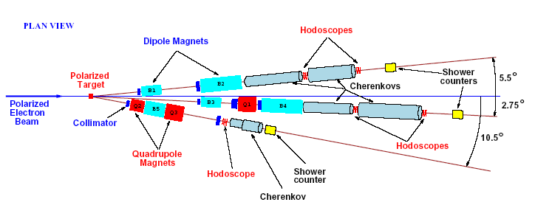
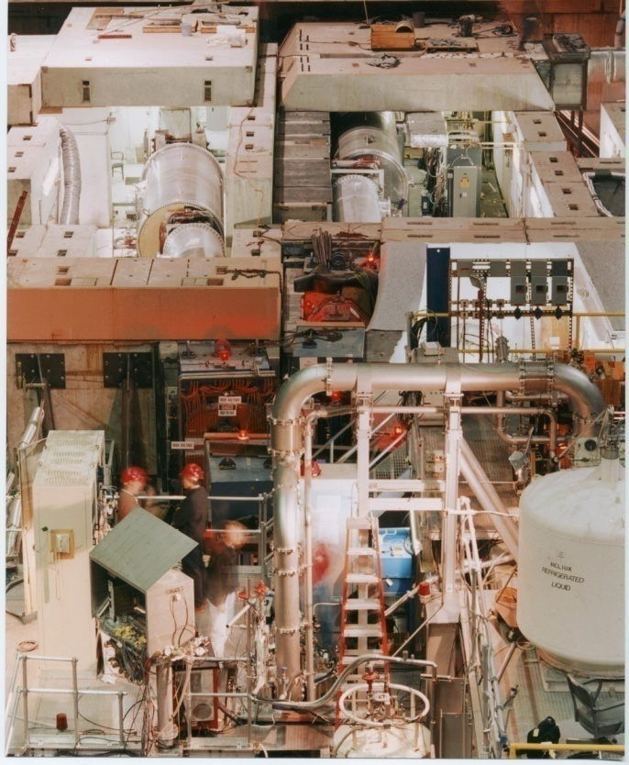
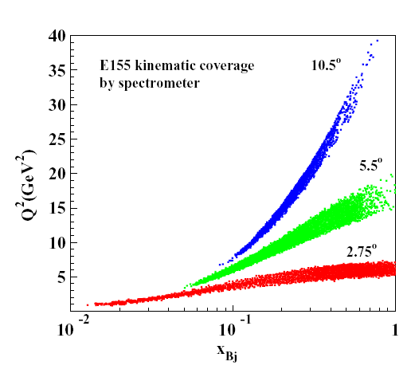
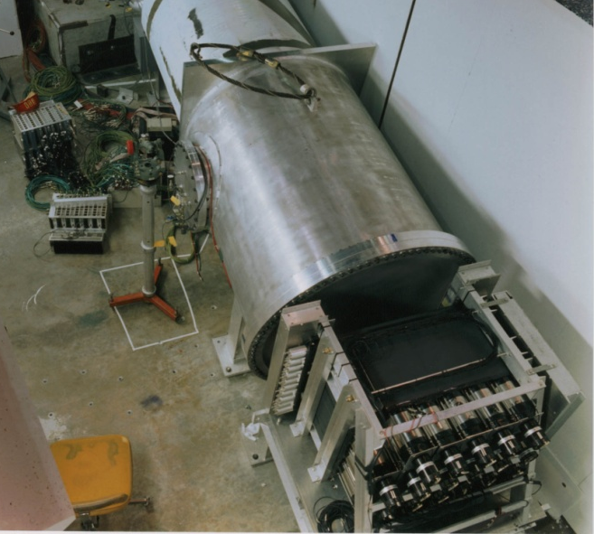
SLAC E155 Spectrometer
beam

Slide 14
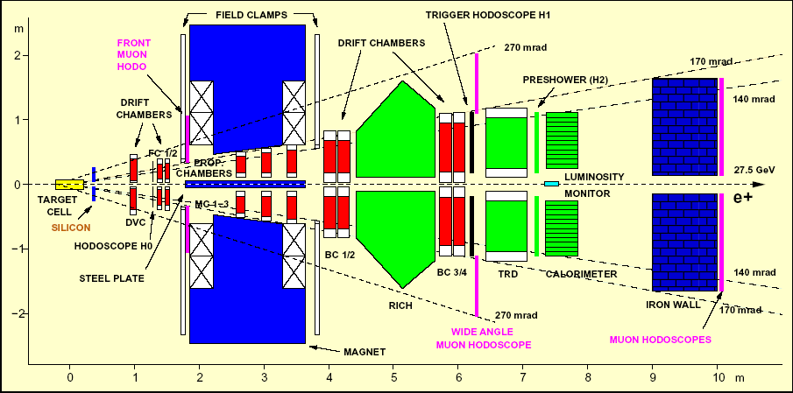
HERMES

Slide 15
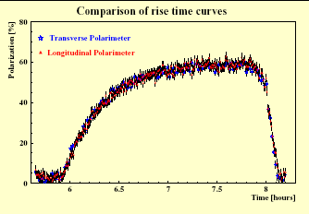
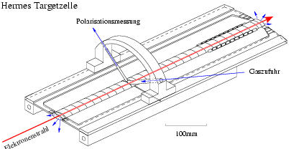
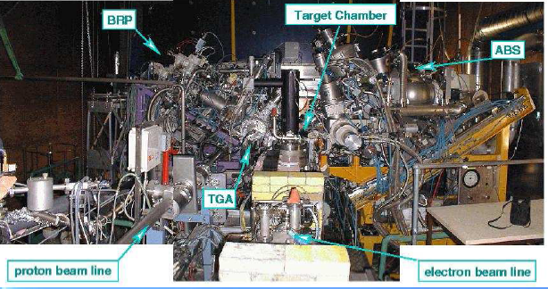
HERMES
Target cell
Gas to polarisation measurement
Gas inlet
beam
100 mm
beam polarisation
built-up

Slide 16
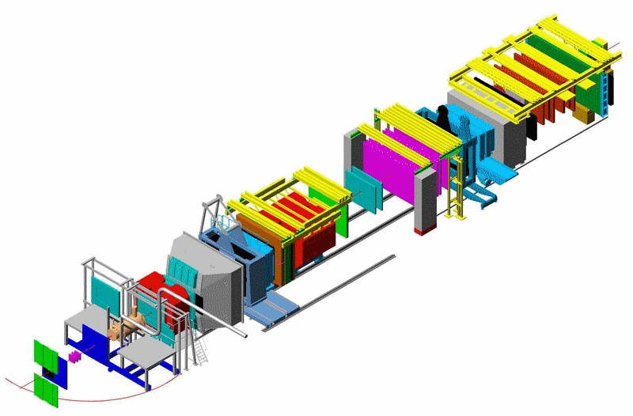
The COMPASS Spectrometer
Hodoscopes
E/HCAL2
E/HCAL1
SM2
RICH1
Muon Wall 2,
MWPC
SM1
Polarised Target
MWPC, Gems, Scifi,
W45
SPS 160 GeV
μ beam
Muon Wall 1
Straws, Gems
Micromegas, SDC, Scifi
Scifi, Silicon

Slide 17
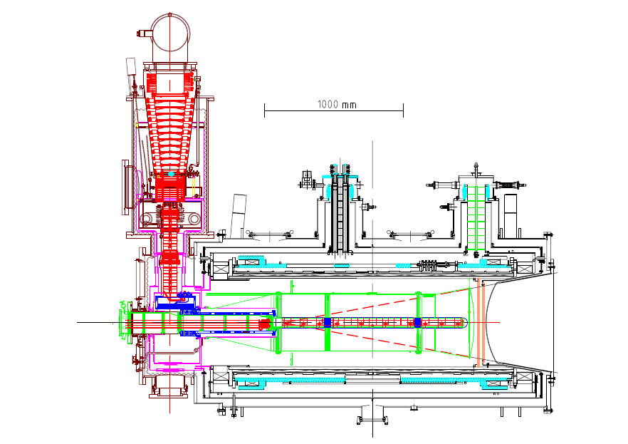
Polarized target
⁶LiD/NH₃
50/90% pol.
40/16% dil. f.
2.5 T
50 mK
beam
μ, 160 GeV

Slide 18
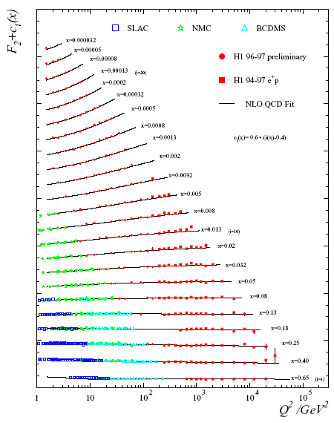
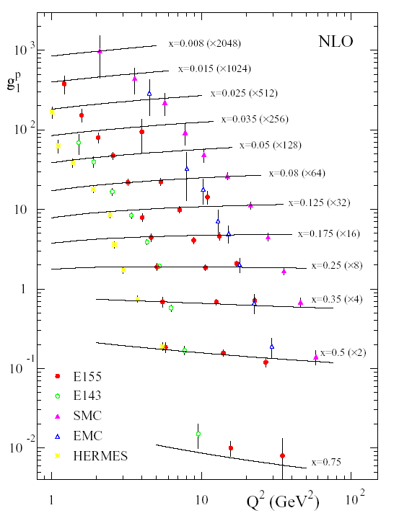
Structure Functions
F₂(x,Q²) g₁(x,Q²)
proton

Slide 19
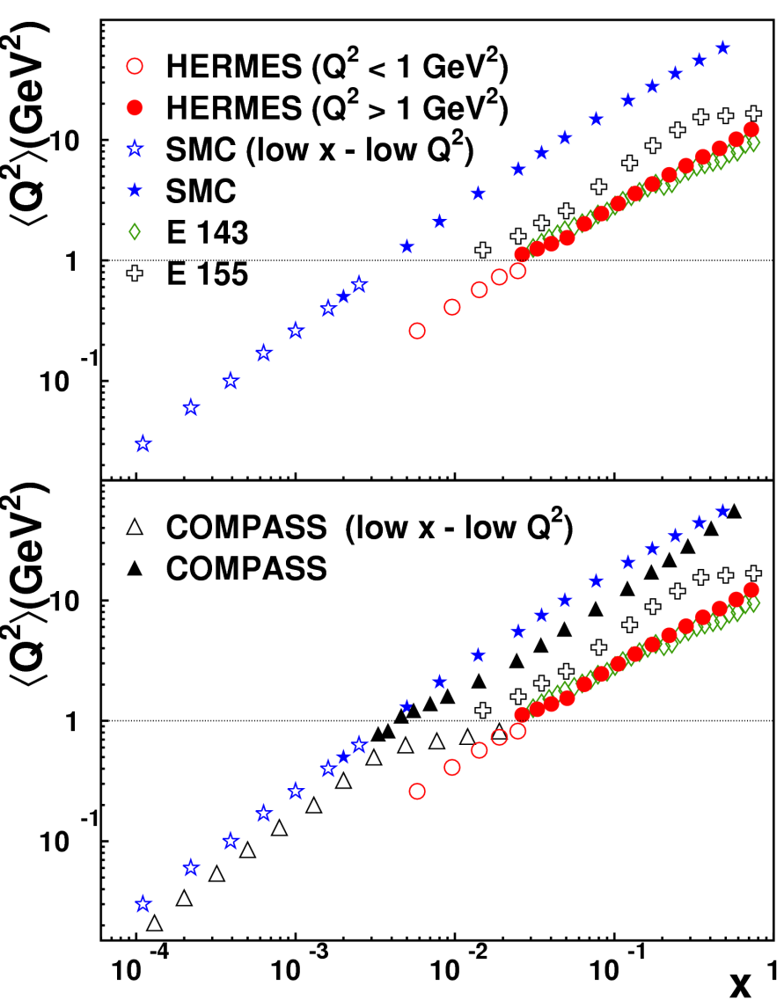
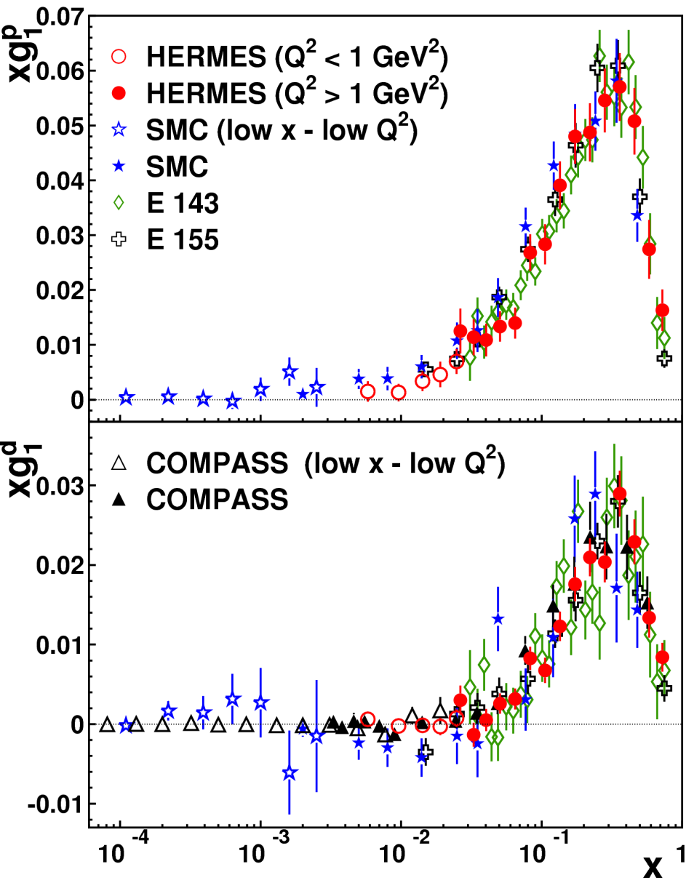
World data on xg₁ (x,Q²)
p
d

Slide 20
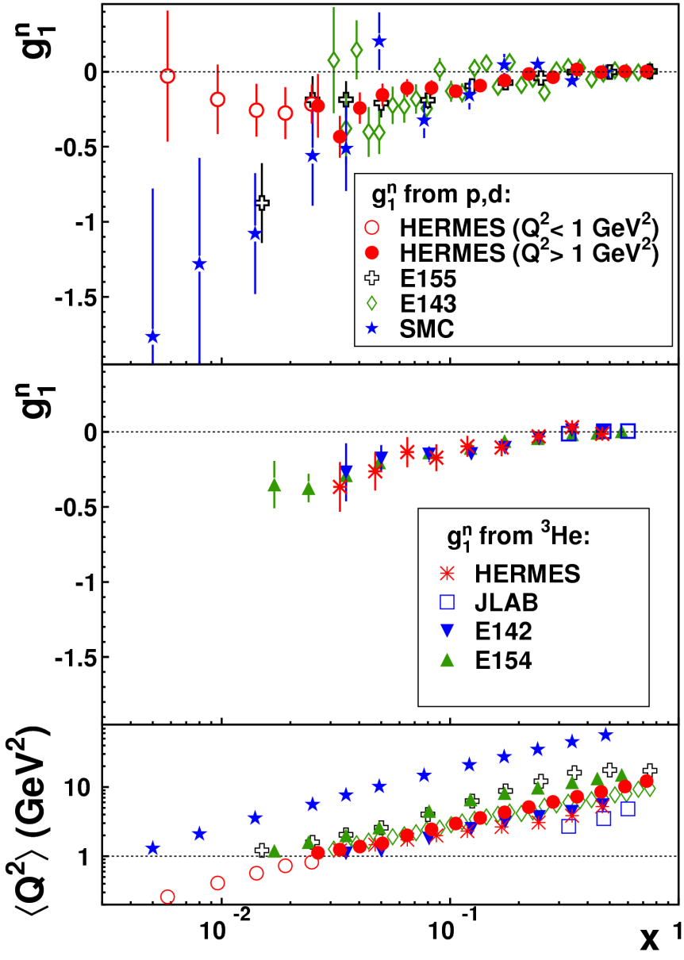
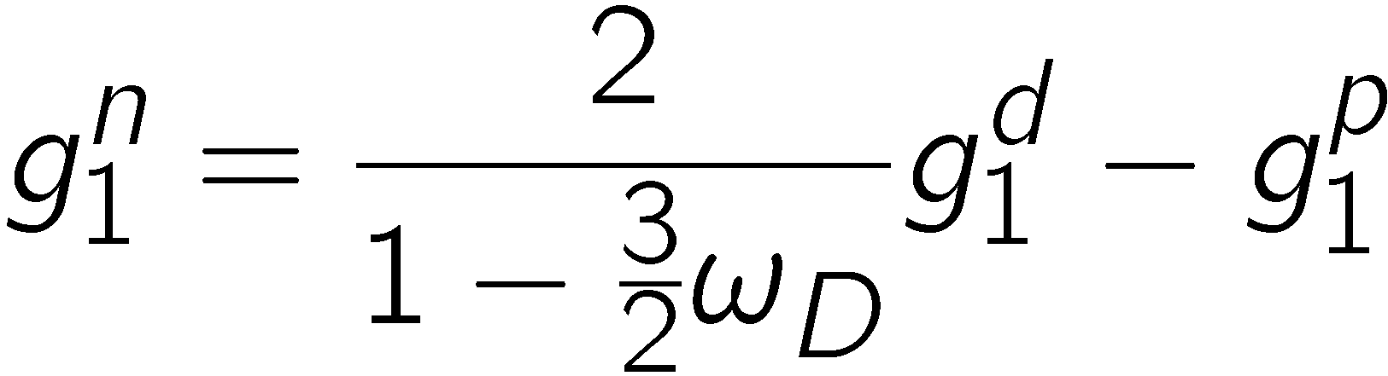
World data on neutron g₁
from p and d
n
from ³He

Slide 21
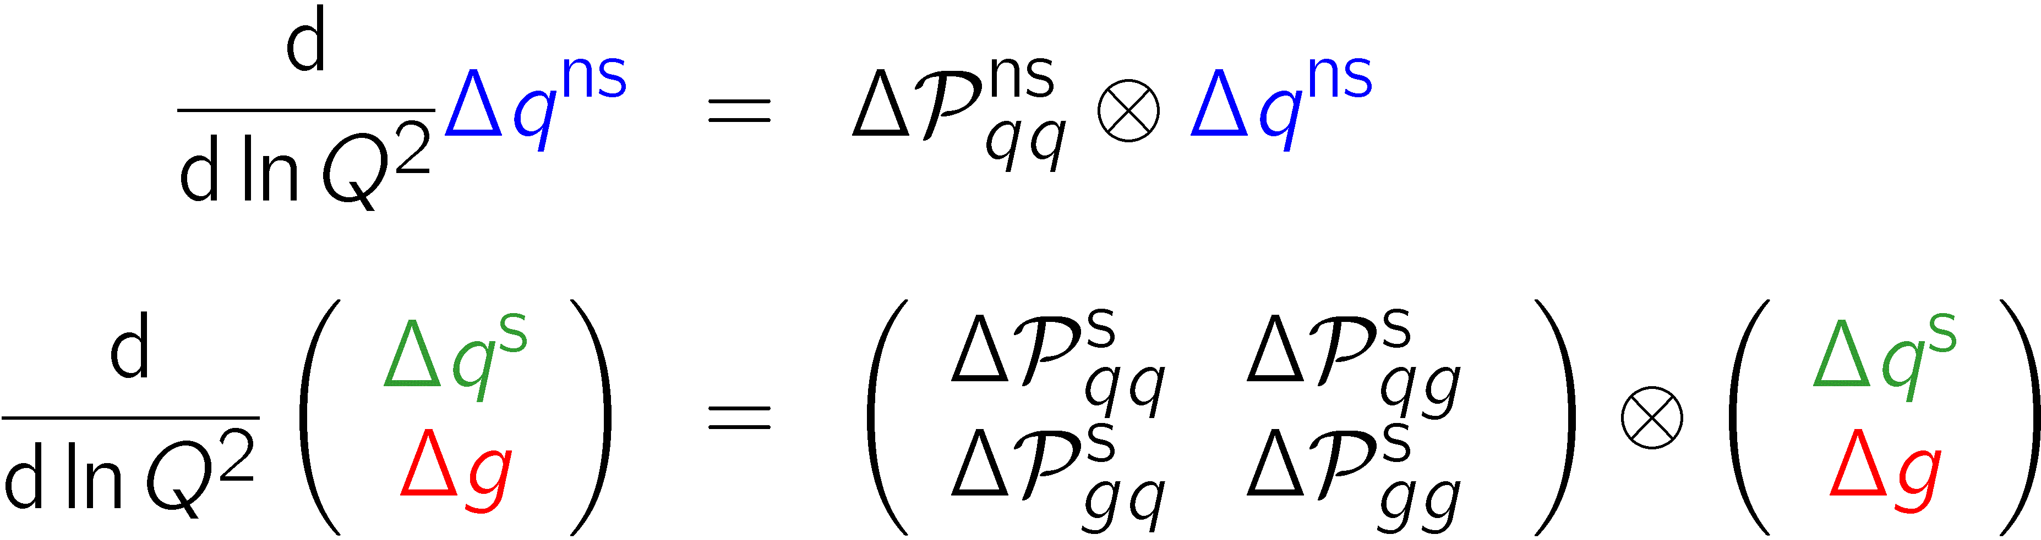
Scaling violations: QCD fits
NLO DGLAP:
choose scheme (MS, AB, jet) and Q₀²
optionally fix ns moments from hyperon decays (a₃, a₈)
fit PDFs for quark non-singlet and singlet and gluon to g₁ data
functional form of PDFs biases error band
extra problems in polarized case:
  no positivity condition, no momentum sum rule
higher twist, …

Slide 22
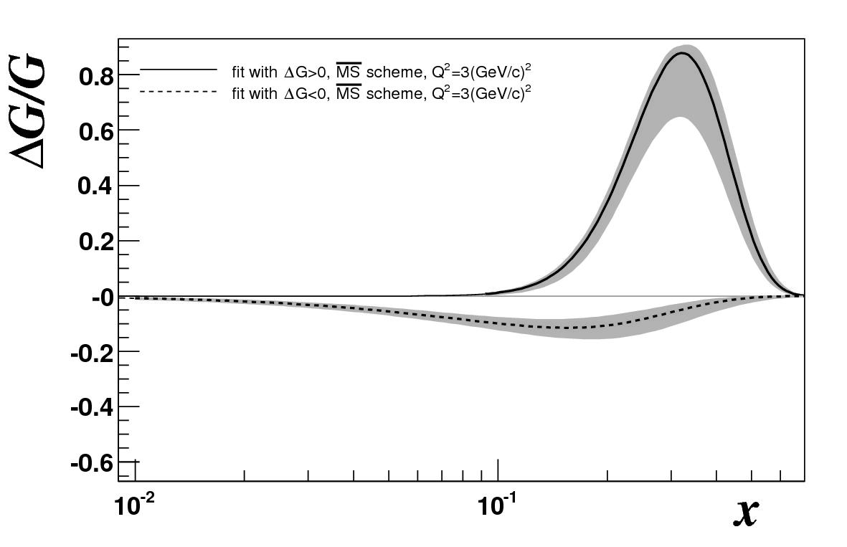
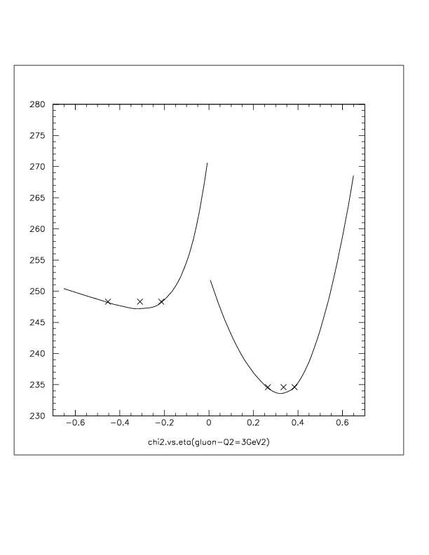

COMPASS QCD Fit
two solutions with ∆G > 0 and ∆G < 0
uncertainty due to parametrization not included
MS Q₀²=3 GeV²
∆G > 0
ΔG = - 0.309
ΔG = 0.336
∆G < 0
Δ G
PLB 647 (2007) 8-17

Slide 23
COMPASS deuteron g₁
Q² = 3 GeV²

Slide 24
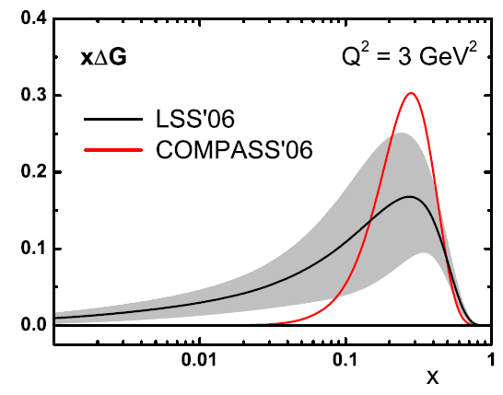
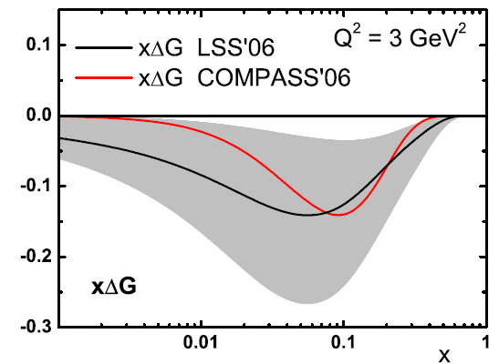
QCD Fit: LSS06 / COMPASS06
∆G > 0
LSS06 also finds two solutions with small
∆G > 0 and ∆G < 0
includes HT and Clas data
How to tell sign of ∆G?
∆G < 0

Slide 25
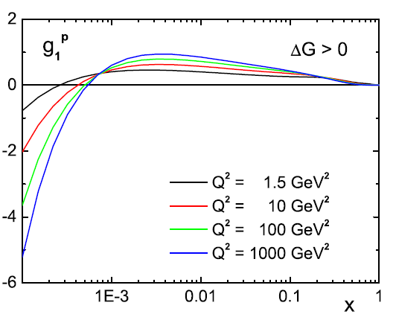
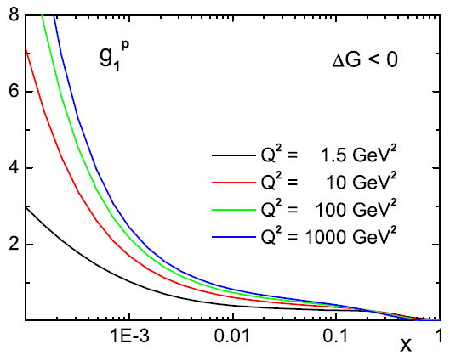
Sign of ∆G and low g₁ at small x
∆G > 0
∆G < 0
LSS06
g₁
p
Leader, DIS2008
x
x
measurable at a polarized ep collider (EIC)

Slide 26
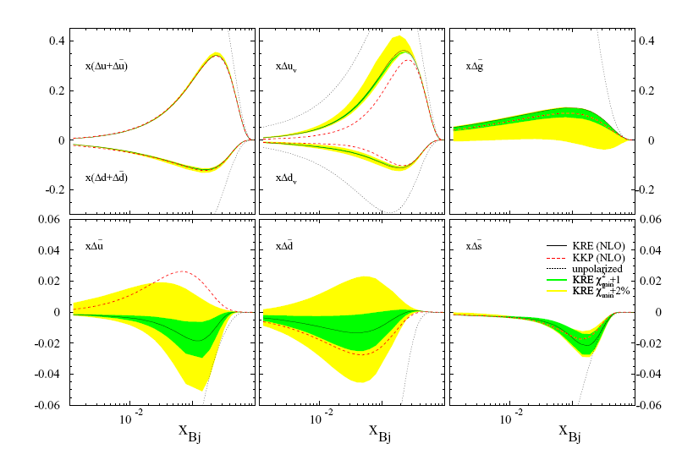
QCD Fit: DNS05/DSSV08
x(Δu+Δu)
x(Δu_{v})
de Florian,Navarro, Sassot
PRD71:094018
x(Δd+Δd)
x(Δd_{v})
Q²=10 GeV²

Slide 27
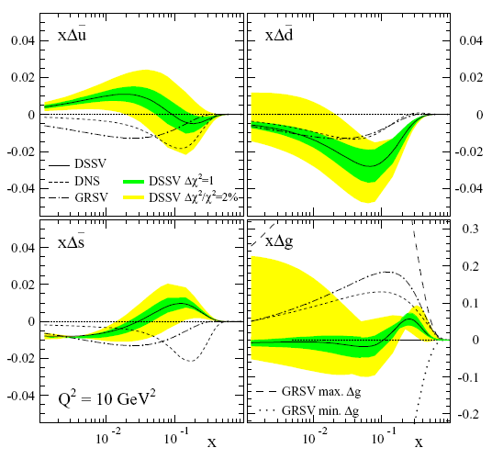
QCD Fit: DSSV08
include semi-inclusive data
includes pp data from Phenix and Star
Δg might have a node
Δs < 0 for x < 0.02
Δs > 0 for x < 0.02
forced by HERMES semi-inclusive data
de Florian, Sassot, Stratmann, Vogelsang
PRL101:072001

Slide 28
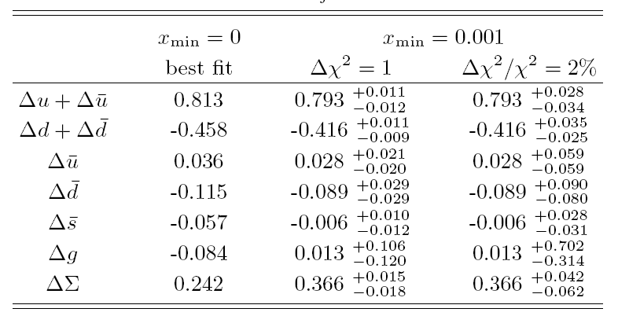
DSSV08
de Florian, Sassot, Stratmann, Vogelsang
PRL101:07200.
at Q² = 10 GeV²

Slide 29
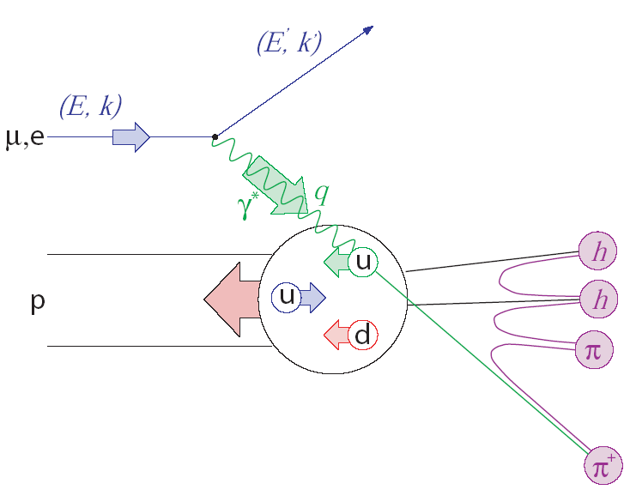
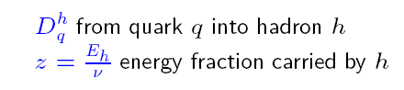
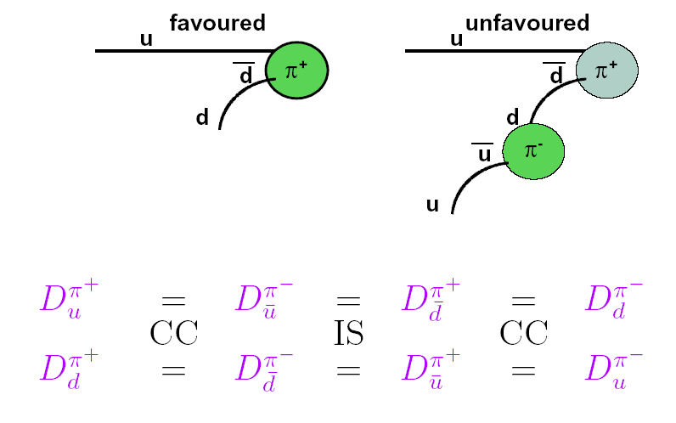

Semi-inclusive DIS
Factorisation!
1
dσ^{h}
σ₀
d z
=

Slide 30
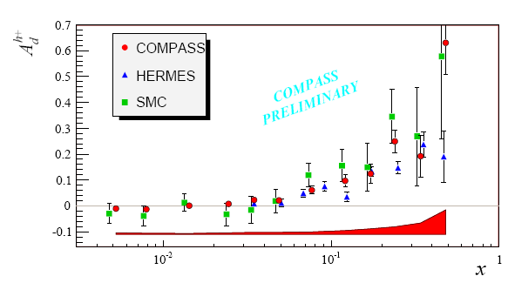
Semi-inclusive asymmetries

Slide 31
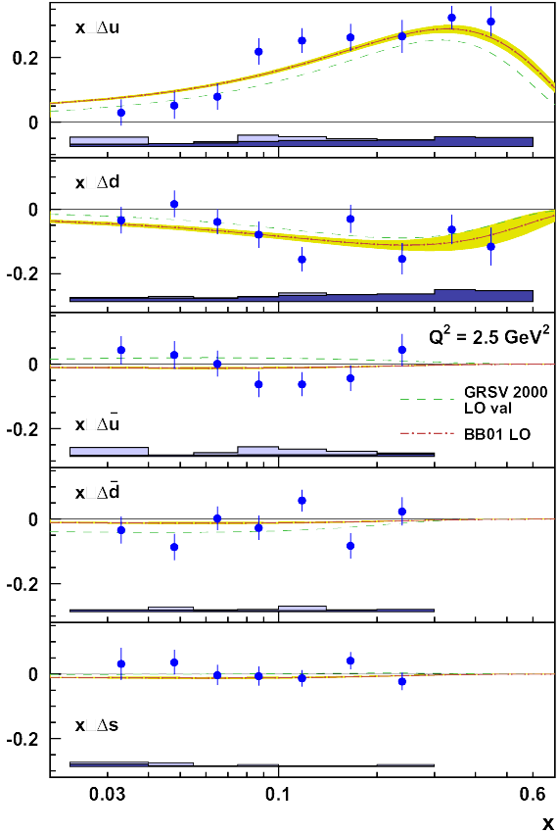
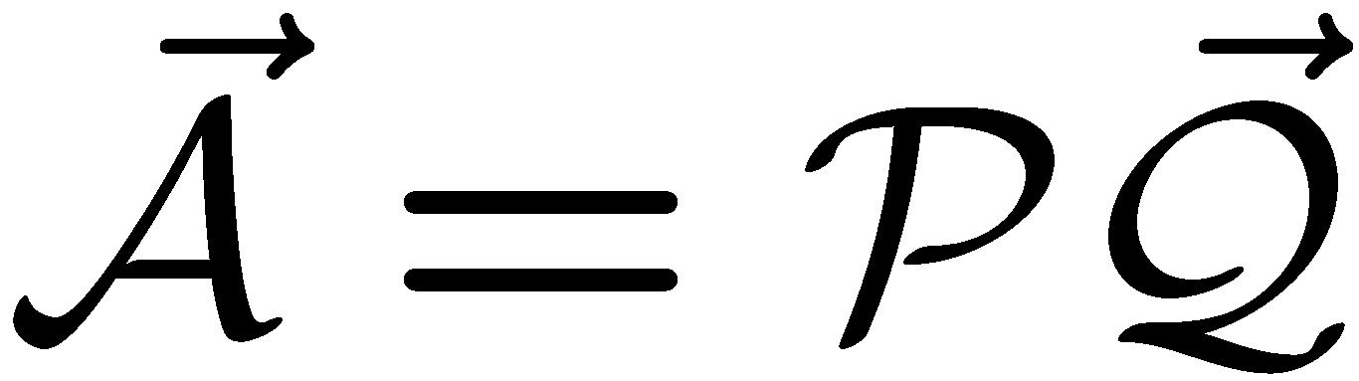
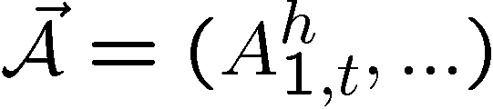


Flavour separated polarization
Asymmetries can in LO be related to Δq by
where

Slide 32

Alternative: difference asymmetries
Valence quark polarisation without
fragmentations function

Slide 33

Valence polarization

Slide 34



Valence quark polarisation

Slide 35



Strange quark sea
semi-inclusive data incl. kaon
ΔQ = Δq+Δq
ΔS = 0.037± 0.019 ± 0.027
ΔS < 0 expected
from incl. data
results from
COMPASS at
Spin 2008
Q²= 2.5 GeV²

Slide 36



Δg/g from hadron production
Photon-gluon fusion

Slide 37






Hadron production in DIS via PGF
Principle: Gluon polarization enters via photon-gluon fusion (PGF)
q
measure
calculate , and
background by Monte Carlo
q

Slide 38

Analyzed channels for Δg/g
analysed data sets:
  high-p_{T} hadron pairs (no ID, pions/kaons)
    Q² > 1 GeV² Lepto
    Q² < 1 GeV² or unmeasured Pythia
  high-p_{T} single hadron
    small Q² or unmeasured Pythia
  single charmed meson
    quasi-real photons Aroma, Rapgap
All analyses in LO till now (plus parton showers)
“untagged”
“untagged”

Slide 39
A_{LL} for single hadrons
h⁺
tagged
h⁻
h⁺
untagged
h⁻
A_{LL}
p
d
p_{T}
p_{T (beam)}
Q²>0.1 GeV², W²>4 GeV²
MC plus asymmetry model with Δg/g(x) = -1, 0, 1 for upper, middle and lower curve

Slide 40


Direct Method (I)
from Monte Carlo
statistical errors only
▲ pairs:

Slide 41


Indirect Method (II)
Fit parameters of polynomial function to A║ using MC
h⁺+h⁻
data

Slide 42




ΔG/G from high-p_{T} pairs
all Q²
Q² < 1 GeV²
+
q^{γ},g^{γ}
g
q
q
q,g
Photon Gluon Fusion ~ 30%
Resolved γ ∼50%
Leading Order
QCD Compton
use also inclusive A_{LL}

Slide 43

High-p_{T} pairs, low Q²
Ratios for hadron pairs with for Q² < 1
Resolved photons
signal

Slide 44
High-p_{T} pairs, Q² >1 GeV ²
tune MC (Lepto) to reproduce data
estimate relative fractions R on event-by-event basis using NN trained with MC events (kin. variables)
use in NN output as event weight
looser cuts possible
  Q² > 1 GeV²
  p_{T1,2} > 0.7 GeV
  x_{F} > 0, inv. mass 2h > 1.5 GeV²

Slide 45
Δg/g from open charm
cleanest process (“golden channel”)
  no or little physics background (LO, QCDC)
observe asymmetry in D meson production
  strongly statistics limited
  only one D meson via D→πK (BR ~ 4%)
  combinatorial background large
  drastically reduced when looking to D* decay in coincidence with slow pion

Slide 46


D mass spectra
D⁰ → K π
nD⁰ = 37398
nD* = 8675
D⁰ → K π π⁰

Slide 47


a_{LL} variation

Slide 48

Summary of results on Δg/g
charm point

Slide 49








Transversity
momentum
helicity
transversity
(alias h₁)
3 fundamental twist-2 PDFs, new transversity
non-relativisic
chiral-odd PDF → not seen in DIS
semi-inclusive DIS allowed if
coupled to a chiral-odd FF
Soffer bound:

Slide 50


Origin of single-spin asymmetries
from L. Bland
Collins/Heppelmann mechanism requires transverse quark polarization and spin-dependent fragmentation
Sivers mechanism
requires spin-correlated transverse momentum k_{T} in the proton (orbital motion).
initial state
final state

Slide 51

Collins asymmetry (proton)
at large x:
large and positive for π⁺
large and negtive for π–

Slide 52

Sivers asymmetry (proton)
large and positive for π⁺
small for π–

Slide 53


Collins & Sivers asymmetries (deut.)

Slide 54


Collins & Sivers asym (proton)
A.Magnon
CERN 15 July 2008
54
Notes:
54

Slide 55

Towards a global fit
Data
  Hermes p
  COMPASS p,d
  Belle fragm.
Prokudin et al., DIS2008

Slide 56

A glimpse of transversity
towards a global analysis
Anselmino et al., DIS2008

Slide 57
Summary & Outlook
Exiciting times behind AND ahead of us:
Bjorken sum rule confirmed at 10%
quark polarization are well measured
anti-quark still need improvement
first handles on Δg/g, axial anomaly
will not restore quark spin contribution of 0.6
GPD will be the topic of the next decade

