Slide 1
First results on pion polarizabilities @ COMPASS
Marialaura Colantoni
Univ. Piemonte Orientale – INFN Torino
For COMPASS collaboration
MENU 2007 - Jülich

Slide 2

MUON program
  ΔG/G
  Structure functions
  Exclusive production of vector meson
  Λ-physics
  Transversity & TMDs
HADRON program
  Pion polarizabilities
  Chiral anomaly
  Charm Barions
  Glueballs and exotic search
LHC
SPS
N
For a COMPASS review S. Platchkov `s talk

Slide 3
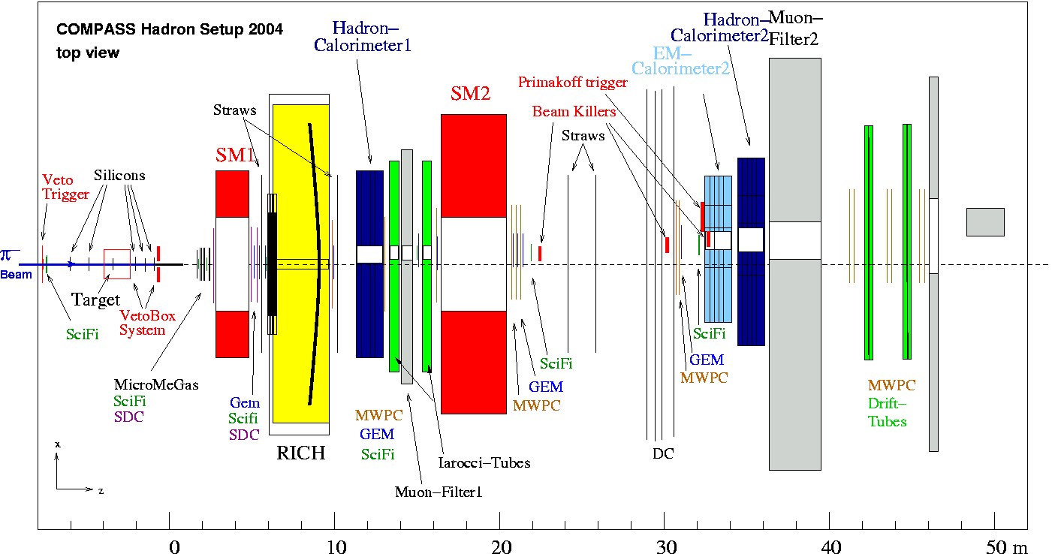
Hadron beam run 2004
First Spectrometer: LAS
Gap: 172 × 229 cm²
Integral field: 1 Tm
Analyzed momentum: p<60 GeV/c
Second Spectrometer: SAS
Gap: 200× 100 cm²
Integral field: 4.4 Tm
Analyzed momentum: p>10 GeV/c

Slide 4
The polarizabilities [in 10⁻⁴ fm³]
The polarizability (electric α and magnetic β) relates the average dipole (electric p and magnetic μ ) moment to an external electromagnetic field, characterizing the rigidity of the quark-antiquark system
The pion polarizabilities can be described in the framework of the Chiral Perturbation Theory (χPT) based on the chiral symmetry of QCD and Goldstone theorem using the effective chiral lagrangian
The numerical values are: (α_{π}+β_{π})= 0.16; (α_{π}-β_{π})=(5.7±1.0) [1]
Other models (dispersion sum rules^{[2]}, QCD sum rule^{[3]}, lattice calculations^{[4]},…) predict quite different value for the pion polarizabilities :
0<(α_{π}+β_{π})<0.39; 3.2<(α_{π}-β_{π})<11.2 [5]
[1] J. Gasser et al., Nucl.Phys B 745 (2006) 84-108
[2] L.V. Fil’kov et al., Eur. Phys. J. A5 (1999) 285
[3] M.J. Lavelle et al., Phys. Lett. B 335 (1994) 211
[4] W. Wilcox., Phys. Rev D 57 (1998) 6731
[5] A. Wilmot et al., Phys. Rev. C 65 (2002) 035206

Slide 5
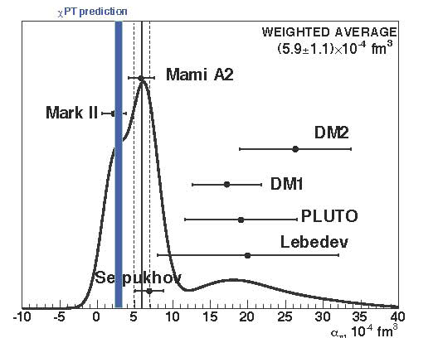
Experimental values
Experiment | Reaction | α [10⁻⁴ fm³]
Lebedev | γp→γπ⁺n | 20±12
PLUTO | γγ→π⁺π⁻ | 19.1±4.8±5.7
DM1 | γγ→π⁺π | 17.2±4.6
DM2 | γγ→π⁺π | 26.3±7.4
MARK II | γγ→π⁺π | 2.2±1.6
Serpukhov | πZ→πZγ | 6.8 ± 1.4± 1.2
Experiment | Reaction | (α+β)[10⁻⁴ fm³]
Serpukhov | πZ→πZγ | 1.4± 3.1±2.8
Experiment | Reaction | (α-β) [10⁻⁴ fm³]
Serpukhov | πZ→πZγ | 13.6 ± 2.8
MAMI-A2 | γp→γπ⁺n | 11.6±1.5±3.0±0.5
The experiments are affected by too large statistical and/or systematic errors

Slide 6
The Primakoff reaction π + Z → π’ + Z + γ
π
π’
γ*
γ
Inverse kinematics for the Compton scattering: γ*π→γπ’
In the incoming pion rest frame (Anti-laboratory system)
θ
Z,A
α_{π}, β_{π} independently
ω is the energy of the virtual photon in the anti-laboratory sys.
Assuming (α_{π}+β_{π})= 0 in the Laboratory system:
β_{π}
Q²_{max} depends on analysis cut
E_{γ} is the energy of the real photon

Slide 7
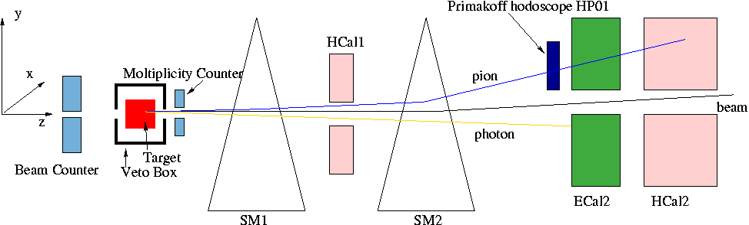
Trigger
Experimental conditions during the 2004 hadron run (7 days)
Beam: 190 GeV/c; ~10⁶ π/s, 4.8 s / 16 s spill structure
  190 GeV/c; ~10⁸ μ/s
Targets: 1.6 – (2+1) - 3 mm Pb , 7 mm Cu, 23 mm C
Triggers:
  Primakoff 1 = Hodoscope hit x ECal2 (E>50 GeV) x HCal2 (E>18 GeV)
  Primakoff 2 = ECal2 (E>100 GeV)
  Saturated trigger rate (40-50k/spill)

Slide 8
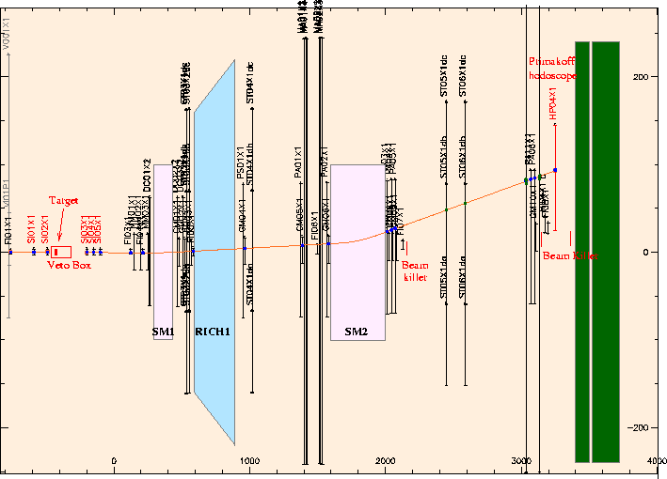
Typical reconstructed event:
γ
ECal2

Slide 9
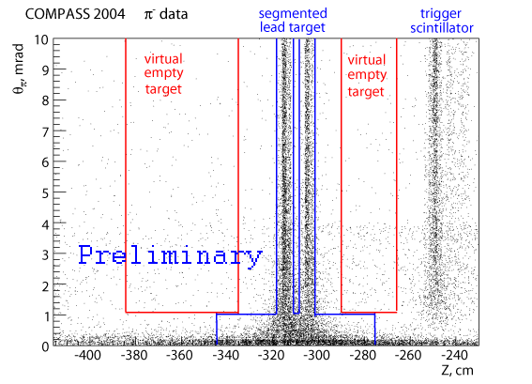
Event selections:
Data set :
  Pb (2+1)mm target (3 days of data taking)
  Primakoff2 trigger
π + γ in the final state
primary vertex near the target nominal position
invariant mass cut M_{π γ} <3.75 m_{π}
|E _{γ}+E_{π}-E_{beam}|<25 GeV
P_{T} > 45 MeV/c
0.5<E_{γ}/E_{beam}<0.9
Q²<7.5·10⁻³ (GeV/c)²
total energy

Slide 10
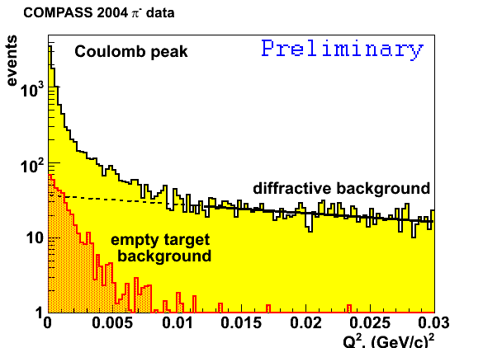
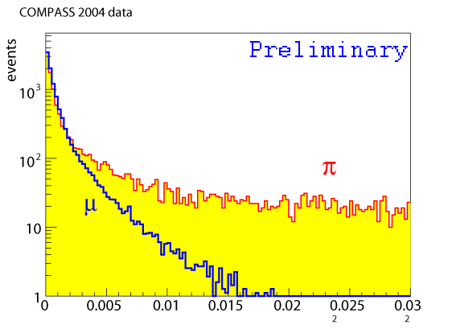
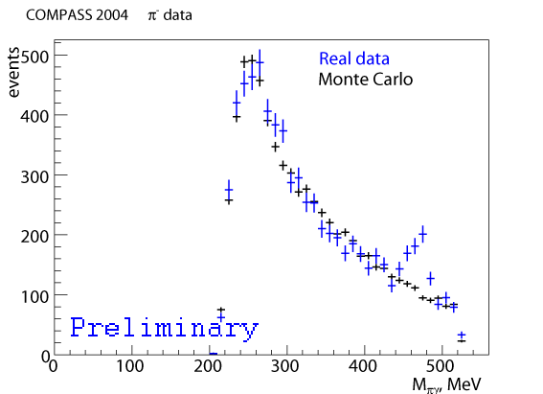
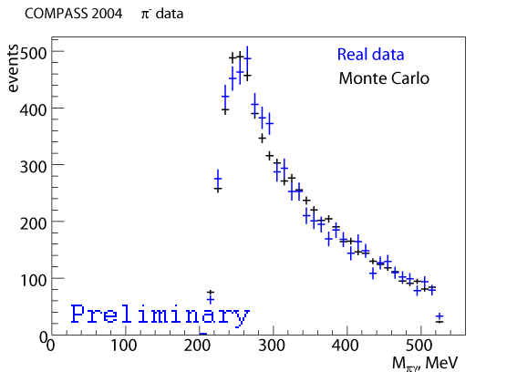
Analysis procedure:
Use point like particle (muon) as reference within the same setup
Corrections for background:
  ρ production: π⁻+Z→ρ⁻+Z→π⁻+Z+γ+γ suppressed by M_{πγ} cut
  e⁻→e⁻+γ (0.1% of e⁻ in hadron beam) suppressed by P_{T} cut
  µ⁻→µ⁻+γ (0.1% of µ⁻ in hadron beam) →σ_{syst}
  Diffractive process subtracted
  Kaon decay: k⁻→π⁻π⁰→π⁻+γ +γ subtracted with empty target
  (~4% of K⁻ in hadron beam)
Kaon peak before the subtraction
Q² (GeV/c)²

Slide 11
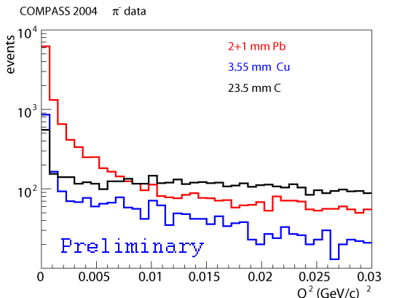
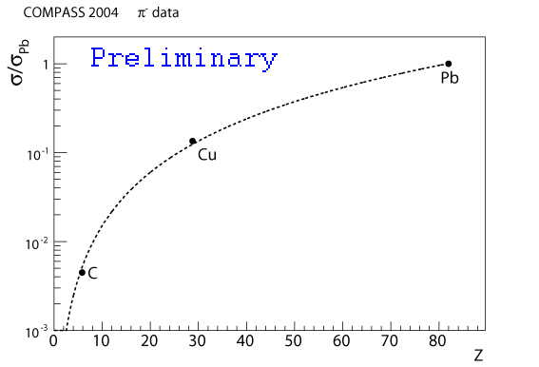
Comparison with different target:
Z²-dependence of the
Primakoff cross section
Q² distribution for different target material
Primakoff region
Good Z² dependence
between different target
Diffractive region

Slide 12
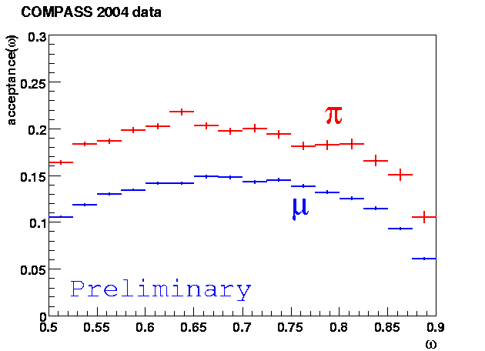
Monte Carlo simulation
POLARIS generator for Primakoff πγ and µγ events.
COMPASS simulation based on GEANT3
ω=E_{γ}/E_{beam}
Same acceptance behavior between the π and µ

Slide 13
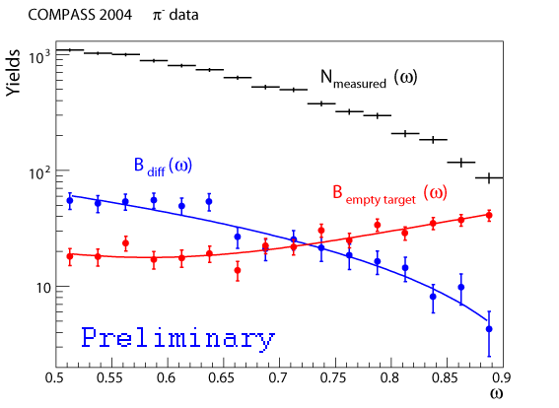
Analysis of the data (2+1)mm Pb
PION
MUON

Slide 14
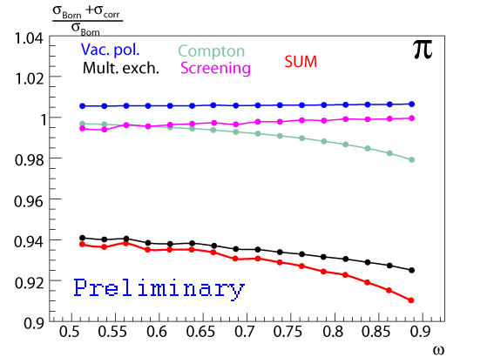
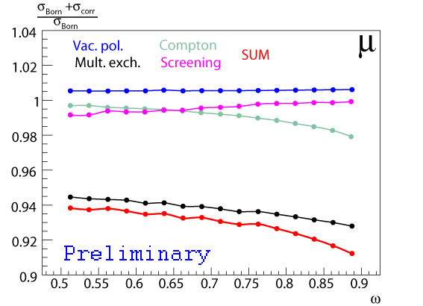
Radiative corrections
PION
MUON
Effects taken into account:
Vacuum polarization
Compton vertex
Multiple photon exchange
Screening by atomic electrons
The preliminary evaluation of the radiative corrections for the polarizability is
~0.6·10⁻⁴ fm³

Slide 15
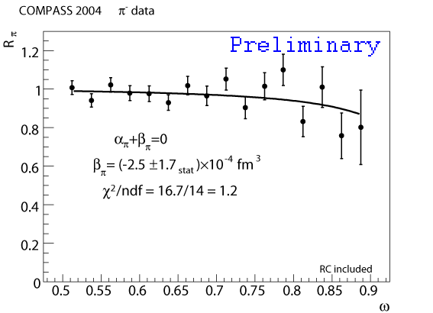
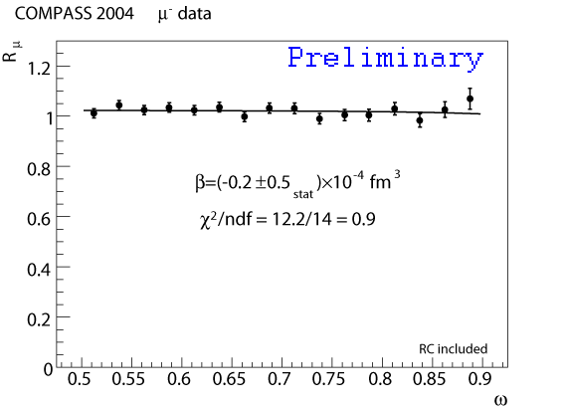
Preliminary results
PION
MUON
^{β}_{π}=(-2.5±1.7_{stat})·10⁻⁴ fm³
^{β}_{µ}=(-0.2±0.5_{stat})·10⁻⁴ fm³

Slide 16
Preliminary results
Systematic uncertainties
Origin | Syst. Error 10⁻⁴ fm³
Setup description in MC | ±0.5
Background subtraction | ±0.3
Beam muons | <0.2
Beam electron | <0.1
Total | ±0.6
α_{π} = -β_{π} = (2.5±1.7_{stat}±0.6_{syst})·10⁻⁴ fm³
With improved setup:
muon ID coverage
electron rejection
beam kaon ID
target arrangement
Improve accuracy by factor 4-5 in 30 days.

Slide 17
Summary:
α_{π} = - β_{π} = (2.5 ± 1.7_{stat} ± 0.6_{syst} ) · 10⁻⁴ fm³
is the preliminary result of pion polarizability measurement at COMPASS, under the approximation α_{π}+β_{π} = 0, in agreement with the χPT prediction.
Present analysis is based on only 3 days of data taking and is at the level of the most previous measurements;
Systematic uncertainties are understood and could be further improved with a better statistic with muon beam;
Next step is extract separately α_{π} and β_{π}

